Slide 1
Modelling Scope 3 GHG Emissions
Justin Parsons
MSDS 692 S8W1 2025
3/6/2025

Slide 2
TABLE OF CONTENTS
01
02
03
Research Case
Scope
Data
04
05
Benchmark
Models
Future Work
Background and case for modeling scope 3 GHG emissions
Project tasks contributing to the GHG emissions research group
Collection and analysis of data
Benchmark models using new data
Tasks for the next 8 weeks.

Slide 3
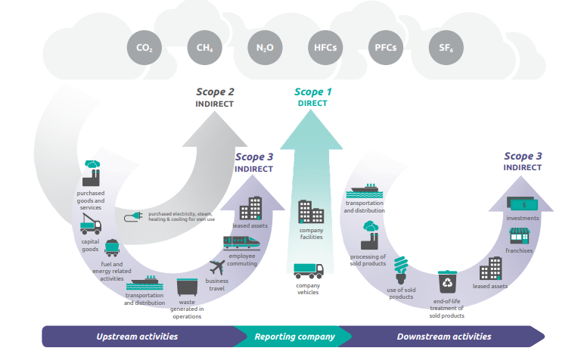
Scope 3 GHG - Research Case
Requirement
EPA - 40 CFR Part 98
California Global Warming Solutions Act of 2006
(Oregon, California, Colorado, …)
SEC
(March 6, 2024: https://www.sec.gov/newsroom/press-releases/2024-31)
UN
Global Citizenship
Identify overproducers
Self audit
Environmental Impact
Reporting Categories
Scope 1 – Power generation, transportation
Scope 2 – Power/Gas bills
Scope 3 – Upstream, downstream, and generally intractable
Source: https://ghgprotocol.org/sites/default/files/standards/Corporate-Value-Chain-Accounting-Reporing-Standard_041613_2.pdf
Scope 3
Machine Learning
Notes:
CO₂ – Metric tons CO₂e is the standard metric
Primary Emissions from Direct Burning of Fossil Fuels
Secondary Emissions from the purchase of electricity, steam, heat, and cooling.
Everything else (e.g. Upstream, Downstream, Travel, Commuting, Purchased goods and services)

Slide 4



Project Scope
XGBoost & Sequential Neural Network Baseline
Acquire new data via API
Merge data with “Mega Merged” dataset
Feature Engineering & Selection
Evaluation & EDA
Notes:
Outlier treatment was being handled by other team members…
Much of the feature engineering having to do with place names was completed prior to this course starting

Slide 5

Data
Primary Idustry-12
e.g. Retail
Primary Sector-64
e.g. Convenience Retail
Primary Activity-194
e.g. Coffee
2013-2023
180,000+ samples
36 Features
Account ID
Account Name
Scope 3 Emission Type
Scope 3 Emission Amount
6 additional features by symbol: normal, uniform, env, gov, soc, average, employee count(s)
300 call per minute limit
Versioning and other changes
API
Notes:
ESG Sc

Slide 6

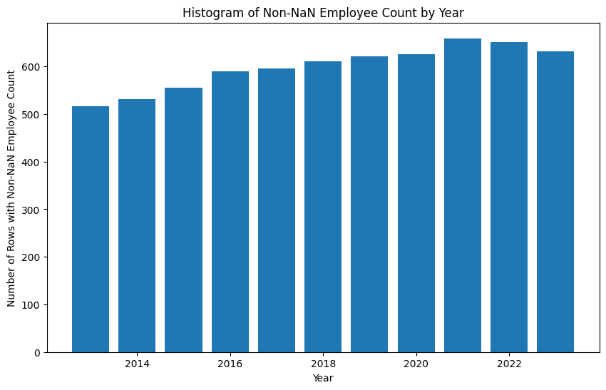
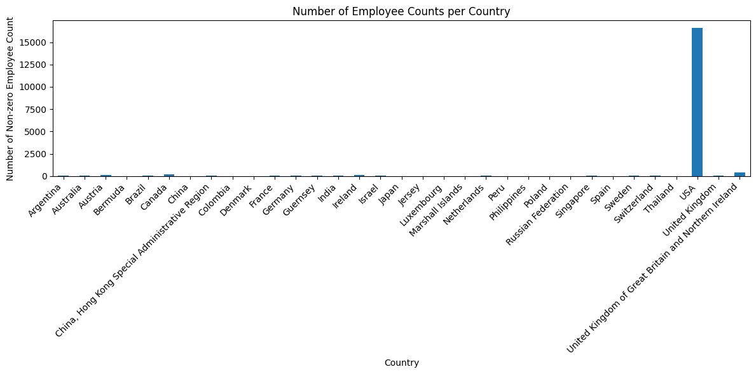

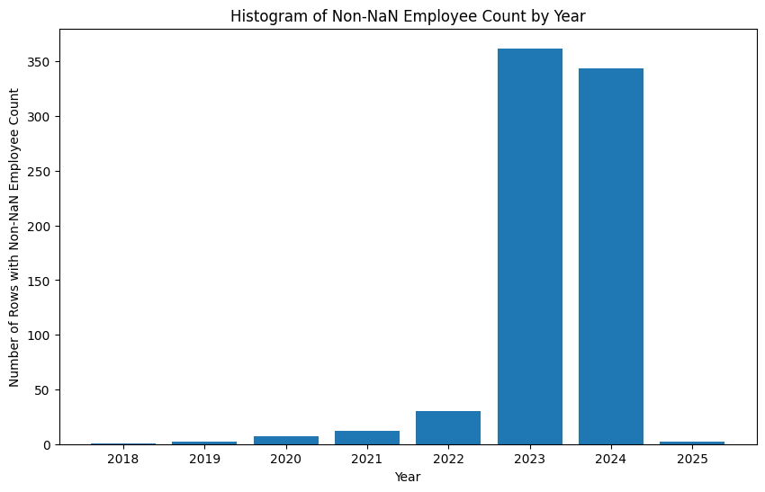
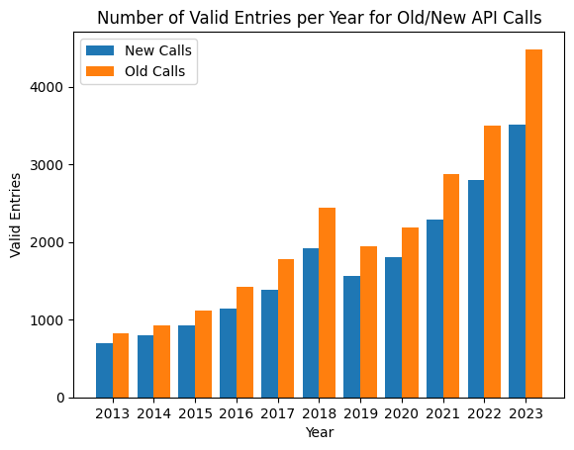

EDA
Historic
Non-historic
Notes:
Variation between calls
Old vs new employee count
Country representation
Outliers
Number of unique Symbol_1 with non-zero and non-NaN employee counts: 656
Number of unique Symbol_1 with non-zero and non-NaN (OG) employee counts: 669
Number of unique Symbol_1 with non-zero and non-NaN ESG scores: 885

Slide 7
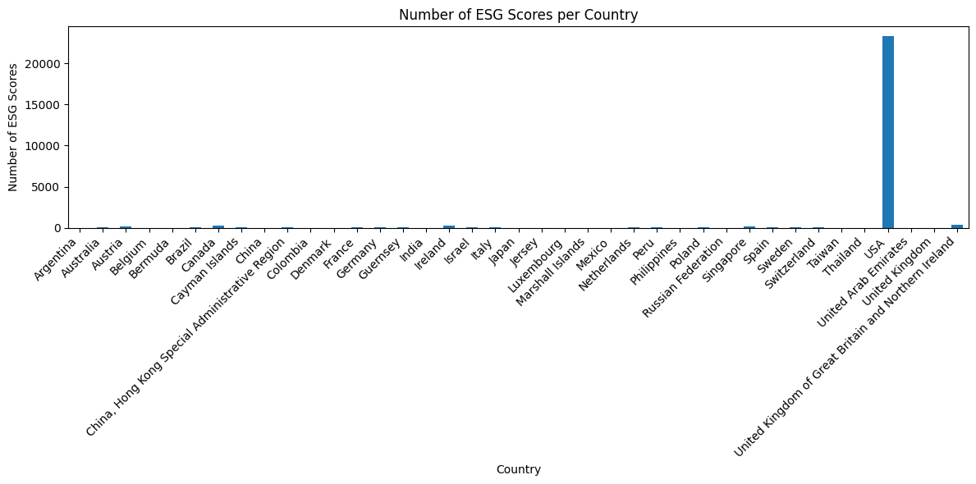
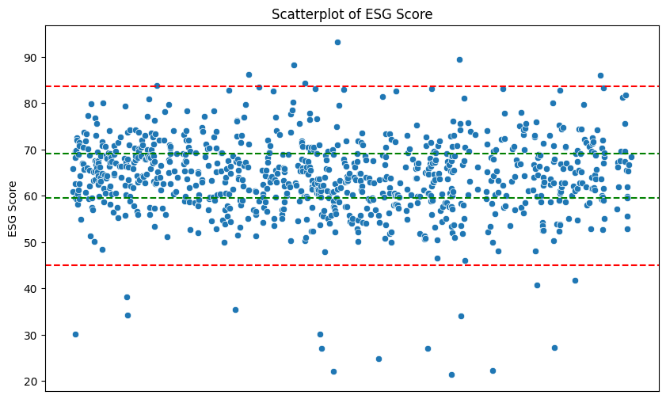
EDA
Pre logp1() normalization
Skewness of ESGScore (PG&S): -0.52
Kurtosis of ESGScore: 3.64
Skewness of employeeCount: 9.24
Kurtosis of employeeCount: 101.03
Post logp1() normalization
Skewness of ESGScore: -2.09
Kurtosis of ESGScore: 14.27
Skewness of employeeCount: -2.02
Kurtosis of employeeCount: 5.83
Notes:
Number of unique Symbol_1 with non-zero and non-NaN ESG scores: 885

Slide 8
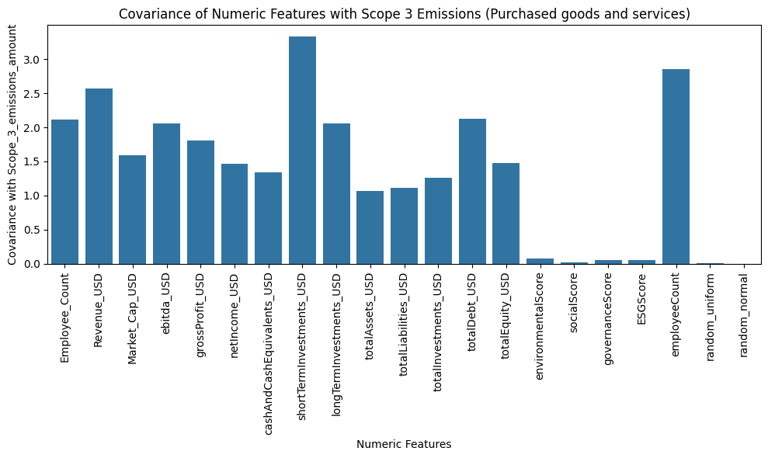
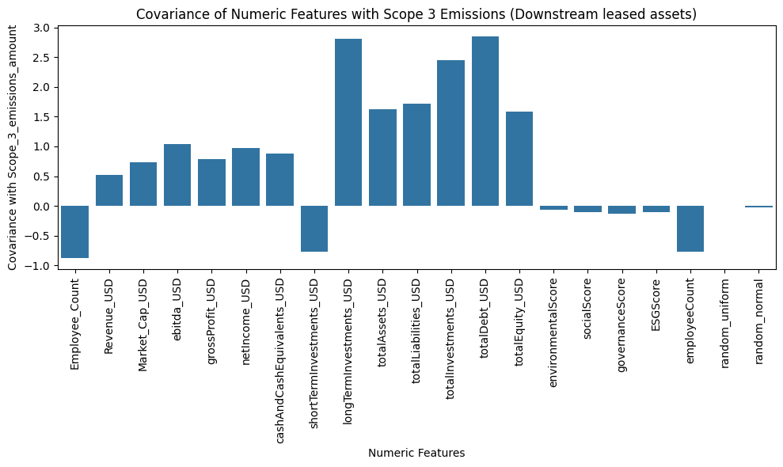
Features
Notes:
-ran for all 15
-approx. 6 of 15 show cov (visual) more significant than random variables
-Z=2.5, dummies for all categorical features

Slide 9
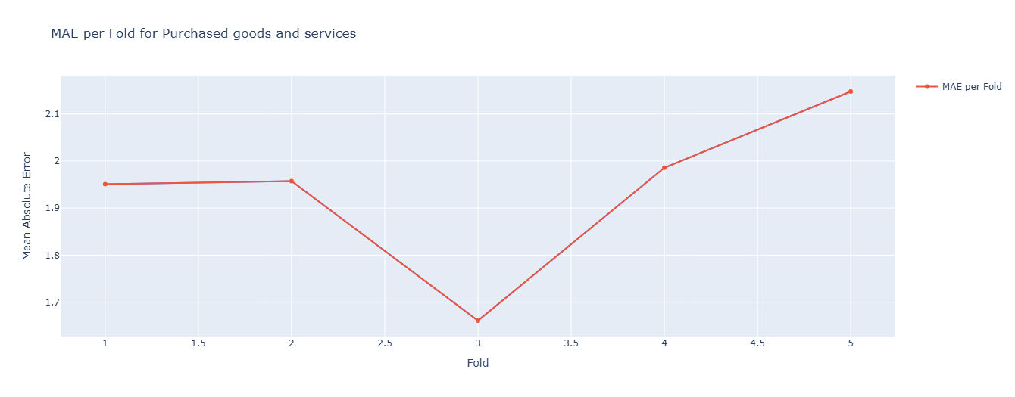

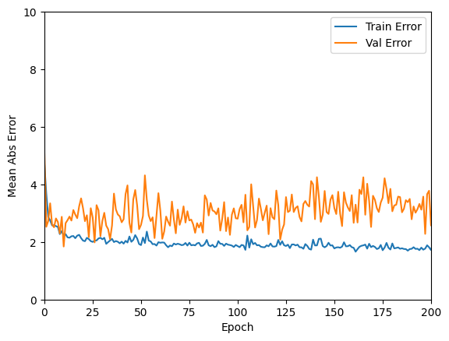

Model Analysis
Sequential Neural Network
Notes:
Xgboost – gradient boosted trees with “Extreme” tree forming algorithm based on residuals and gain (plus pruning parameters and learning rate for scaling)
“Big fancy squiggle fitting machine” -StatQuest
Run only on mm data for baseline with no ESG data yet
256 input nodes
Outlier considerations, scaling, and simple NN
4 hidden layers 256 256 128 64
Relu activation, adam optimizer, mae loss, T/T Split 0.2

Slide 10


Future Work
…surprise there is a lot
Merge account names to account id (invariant)
Feature engineering with ESG/EC per emission type
Investigate discrepancies b/t original EC calls and new
Determine treatment of reporting date of ESG data
Inputs to outlier work
NN development and evaluation (regularization, structure, weight limiting, activation, optimizers …)
Scaling/normalization
Run final model against all emissions types using 2023 as test and compare to XGBoost & other work

Slide 11
Thank you for your time.
jparsons005@regis.edu

