Slide 1
Modelling Scope 3 GHG Emissions, Part Two
Justin Parsons
Regis University
MSDS 696 S8W2 2025
jussn.parsons@gmail.com
jparsons005@regis.edu
LinkedIn
GitHub
5/1/2025

Slide 2
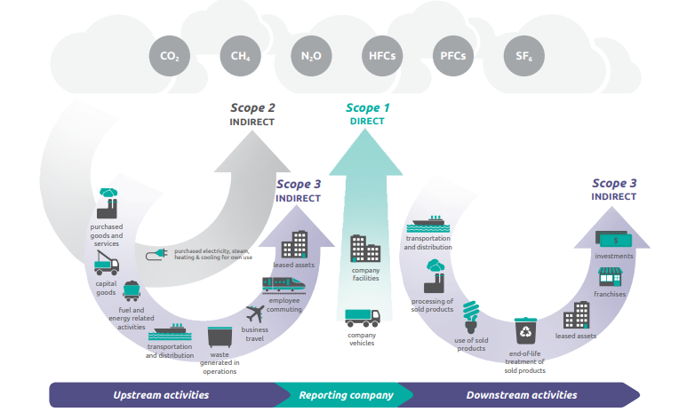
Scope 3 GHG - Research Case
Requirement
EPA - 40 CFR Part 98
California Global Warming Solutions Act of 2006
(Oregon, California, Colorado, …)
SEC
(March 6, 2024: https://www.sec.gov/newsroom/press-releases/2024-31)
UN
Global Citizenship
Identify overproducers
Self audit
Environmental Impact
Reporting Categories
Scope 1 – Power generation, transportation
Scope 2 – Power/Gas bills
Scope 3 – Upstream, downstream, and generally intractable
Source: https://ghgprotocol.org/sites/default/files/standards/Corporate-Value-Chain-Accounting-Reporing-Standard_041613_2.pdf
Scope 3
Machine Learning
Notes:
CO₂ – Metric tons CO₂e is the standard metric
Primary Emissions from Direct Burning of Fossil Fuels
Secondary Emissions from the purchase of electricity, steam, heat, and cooling.
Everything else (e.g. Upstream, Downstream, Travel, Commuting, Purchased goods and services)

Slide 3
Project Scope
NN research and planning
Compare models and evaluate results
EDA and viability
Train Neural Networks
ESG Data

Slide 4
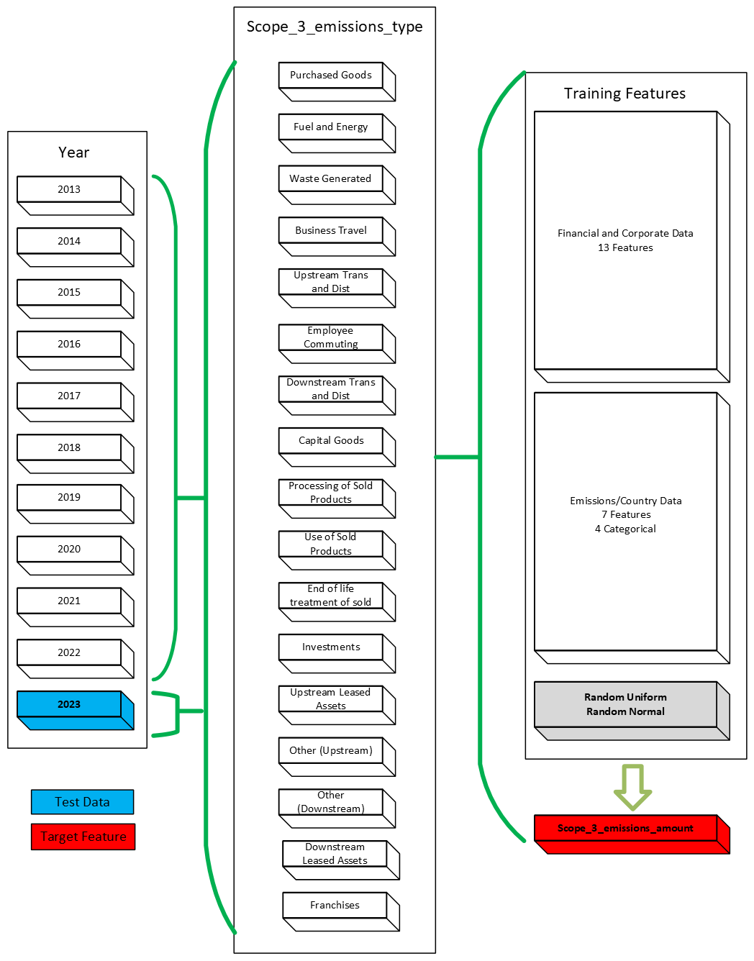
Data
2013-2023
40,000+samples
25 Features
Primary Sector-64
e.g. Convenience Retail
Primary Activity-194
e.g. Coffee

Slide 5
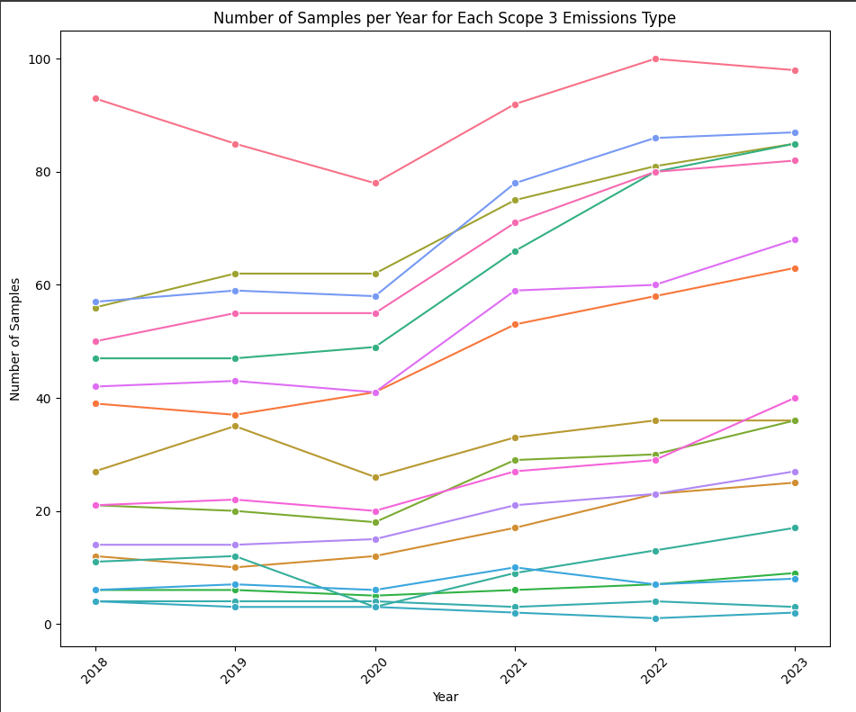
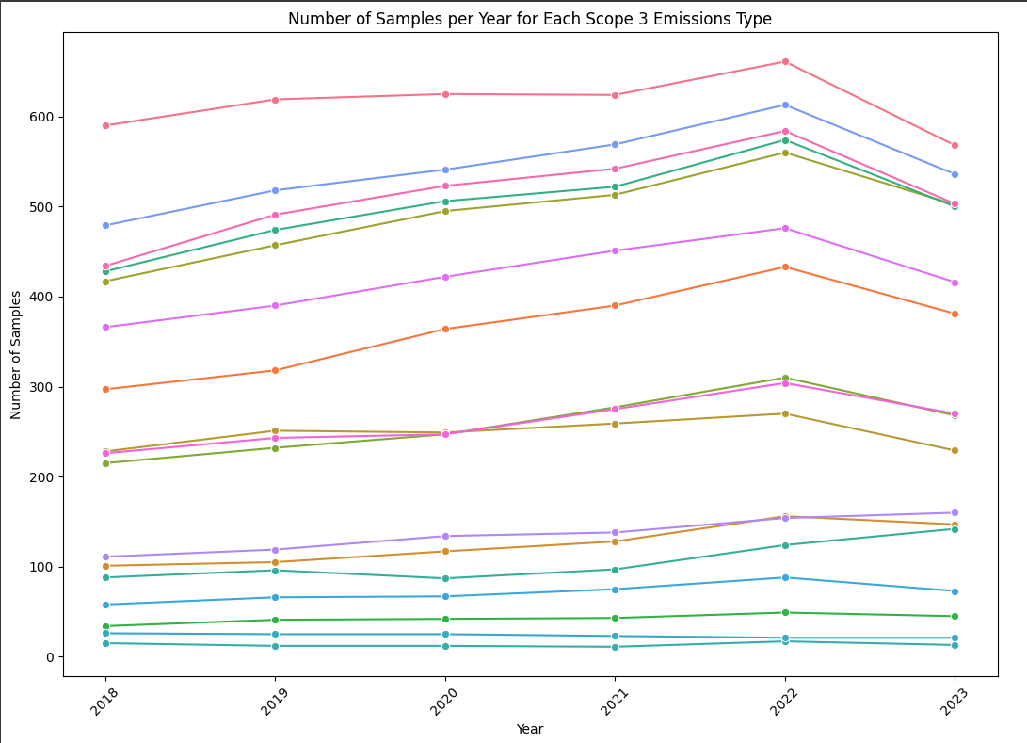
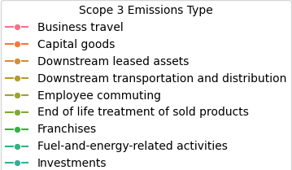
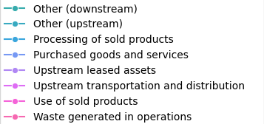
EDA – FMP Data
With ESG Data
No ESG Data

Slide 6
Data Prep
NaN/0s
Drop Features
Feature Names
Organize by Emission Type
Standard Scaler on Training Features
Dummy Categorical Features
2013-2023
28,378 samples
245 Features*
0-34%
36% reduction in samples
880% increase in features

Slide 7


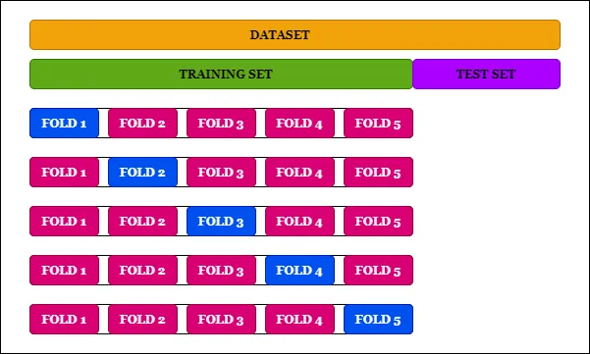
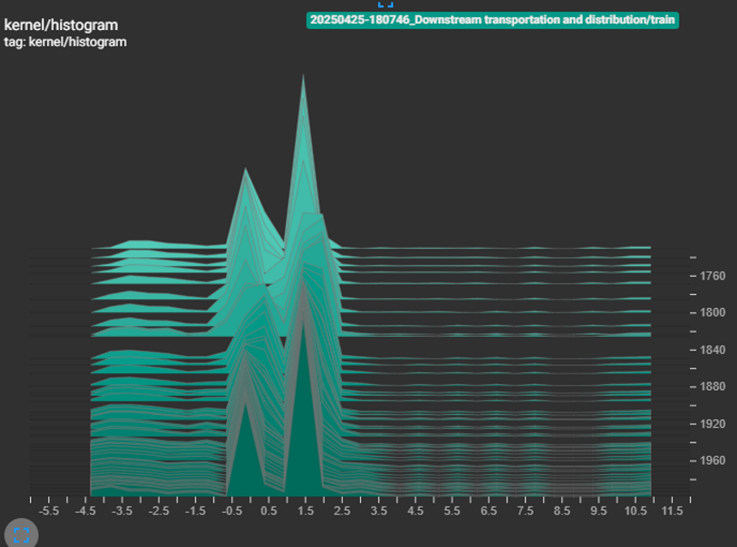
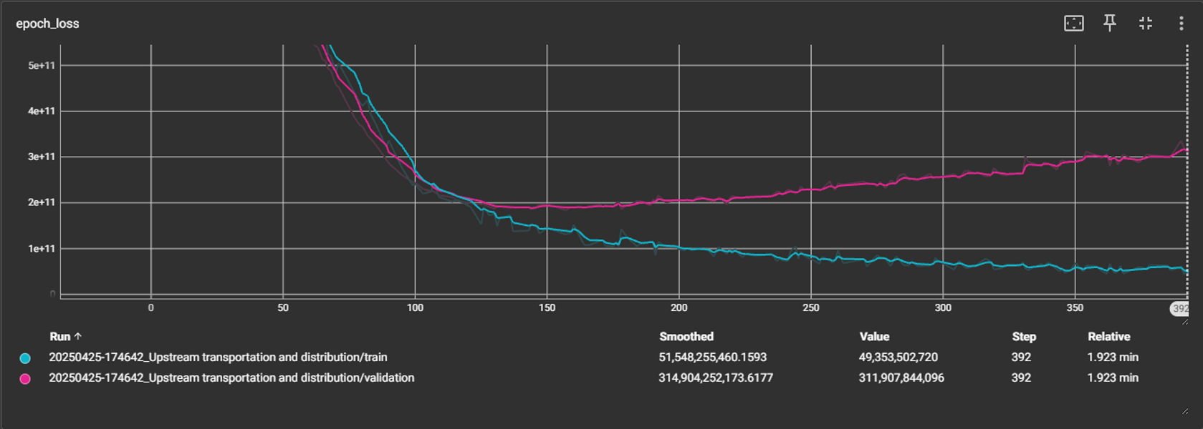
Network Architecture
* Early stopping on folds
† 80/20 train/validation and test on entire dataset
†† Final model with average K-Fold weights
Manna, Siladittya “K-Fold Cross Validation for Deep Learning Models using Keras”
https://medium.com/the-owl/k-fold-cross-validation-in-keras-3ec4a3a00538
Notes:
K-Folds
Why Use Softplus in Neural Networks?
The Softplus activation function is particularly useful for the following reasons:
Smooth Approximation of ReLU: The Softplus function is often seen as a smoother version of the ReLU function. While ReLU is simple and effective, it can have issues, such as causing neurons to "die" if they always output zero for negative inputs. Softplus avoids this issue by providing a smooth, continuous output for both positive and negative inputs.
Differentiability: Softplus is a differentiable function, unlike ReLU, which has a discontinuity at zero. The continuous and differentiable nature of Softplus makes it easier for gradient-based optimization algorithms to work effectively, ensuring smooth learning during training.
Preventing Dying Neurons: In the case of ReLU, when the input is negative, the output is exactly zero, which can lead to dead neurons that do not contribute to learning. Softplus gradually approaches zero for negative values, ensuring that neurons always produce some non-zero output and continue contributing to the learning process.
Numerical Stability: The Softplus function has better numerical stability than some other activation functions because it avoids the issues that arise from very large or very small values. It has a smooth output, and for very large or very small inputs, the function behaves predictably, reducing the risk of overflow or underflow in computations.

Slide 8
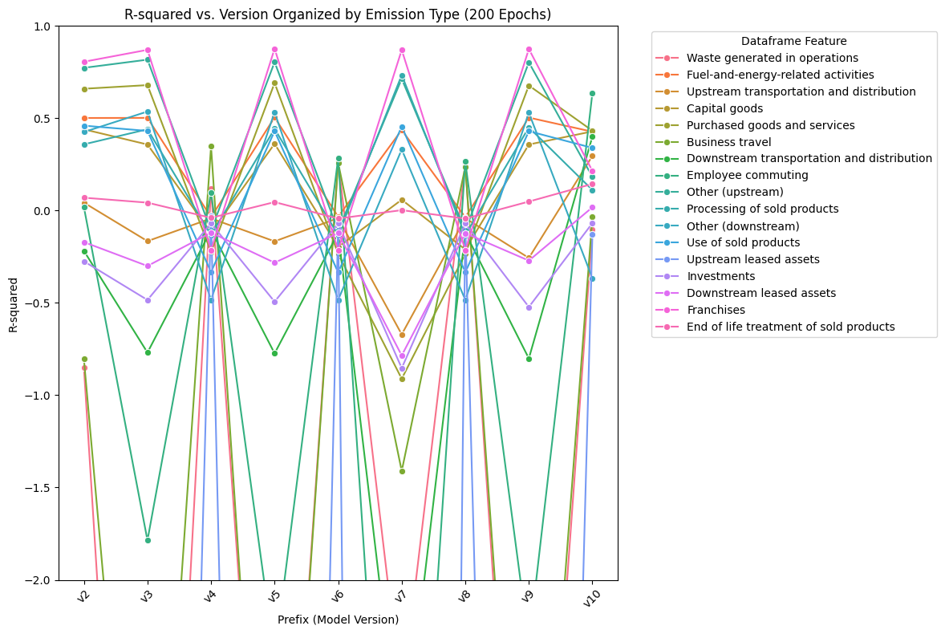
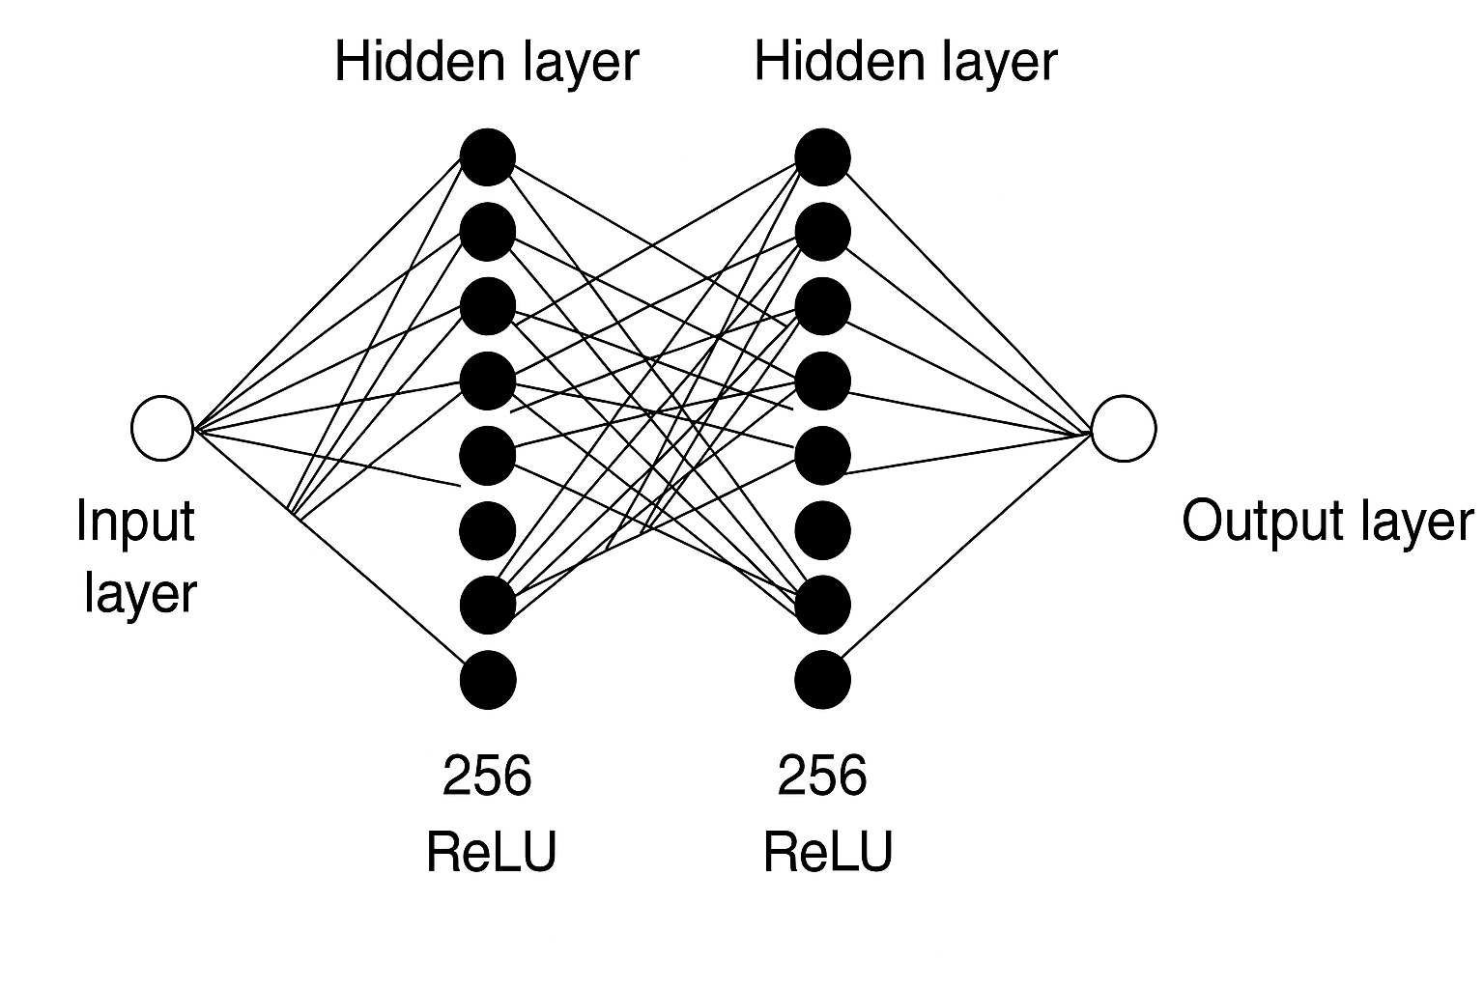
Network Architecture
Folds = 5
Stopping Patience = 10
L1 = 0.005
L2 = 0.001
Dropout = 2 x 0.2
Optimizer = Adam
Output Act = SoftPlus
V12

Slide 9
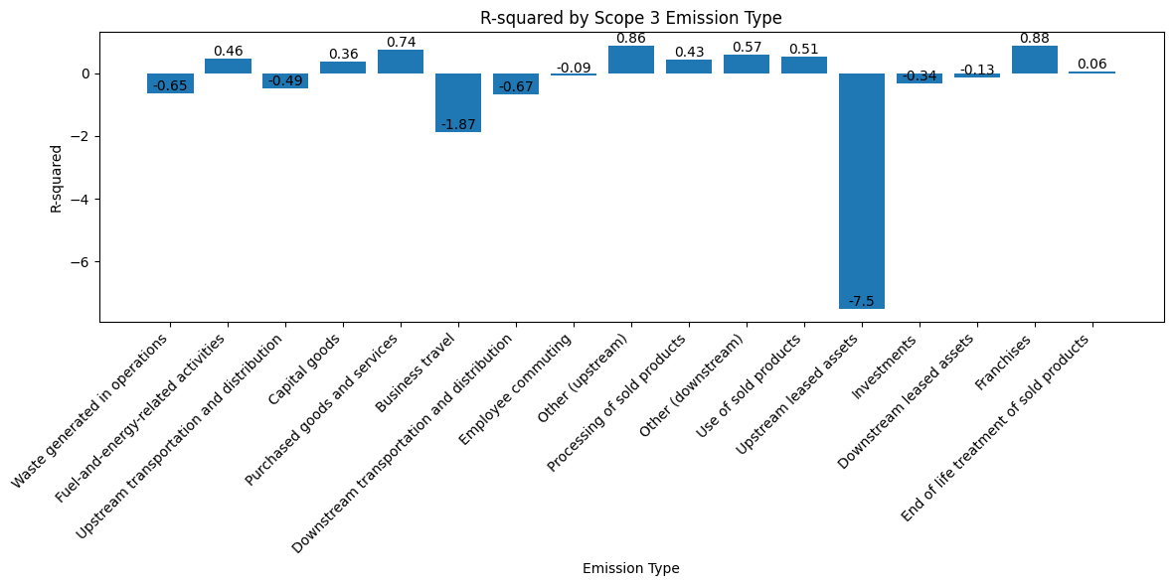
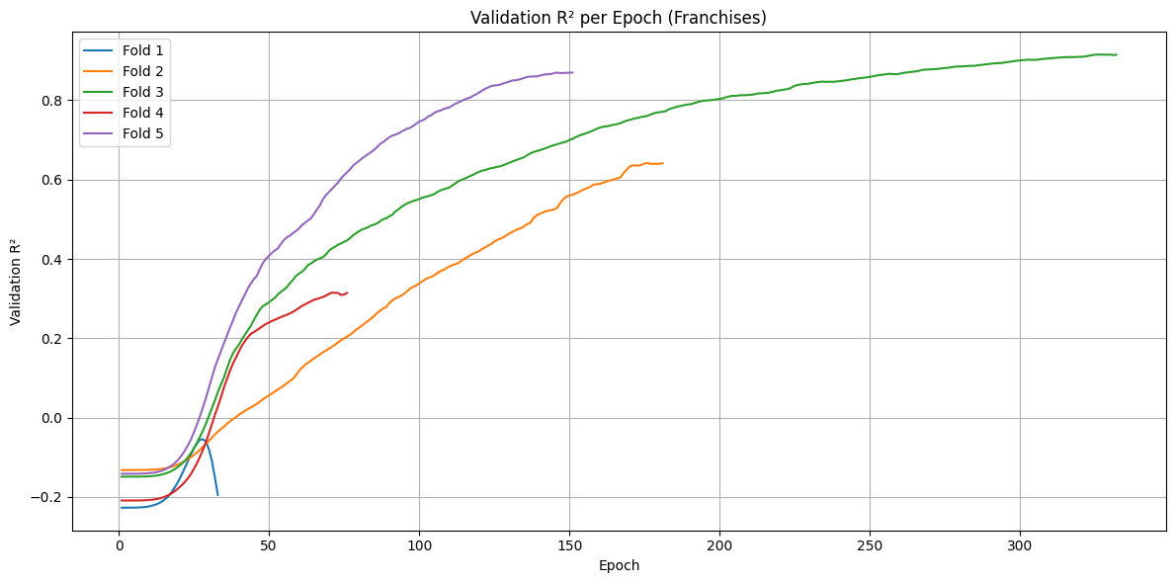
Model Analysis
Folds variance indicates potential issues with data.
V12: 2-layer with 5-Folds
“Best” results compared to previous runs based on v10 with no folds

Slide 10
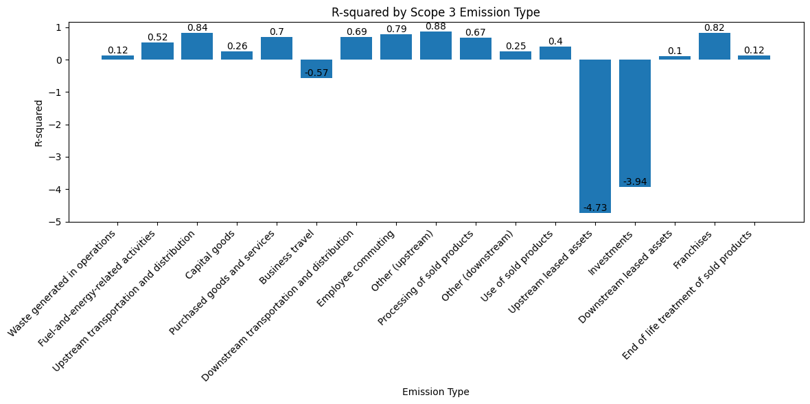
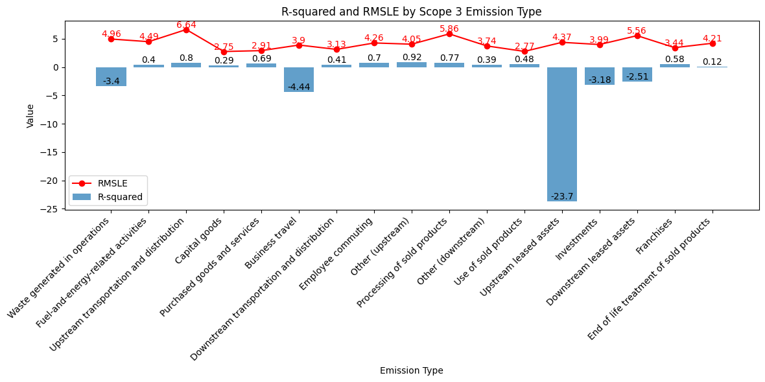
Model Analysis
V14: Fixed average folds weighting and leakage.
One metric is not enough.
v14
V13: Full-dataset split, 5-Folds
R² improvement or negligible decrease in all types but investments.
Notes:
Data leakage
Not using average k-folds weights on final model

Slide 11
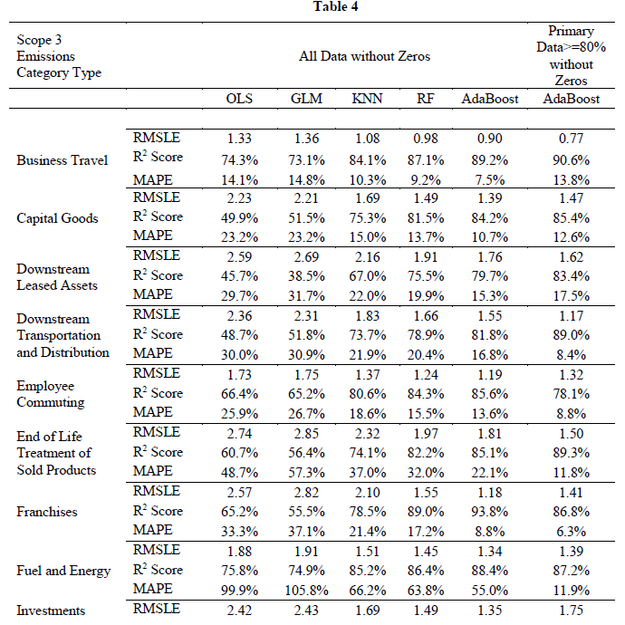
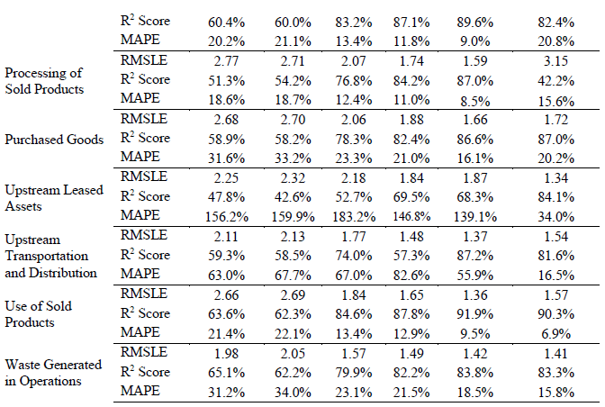
Model Analysis
Emission Type | MSE | MAE | R² | MAPE | RMSLE
Upstream transportation and distribution | 4.0375e+11 | 229872.3 | 0.802986 | 5646.68 | 6.635303
Business travel | 1.7064e+10 | 37247.9 | -4.440395 | 7247.08 | 3.898192
Downstream transportation and distribution | 8.0304e+11 | 331500.4 | 0.411558 | 12798.44 | 3.126480
Upstream transportation and distribution |  |  | 0.872 | 55.9 | 1.37
Business travel |  |  | 0.89 | 7.5 | 0.90
Downstream transportation and distribution |  |  | 0.818 | 16.8 | 1.55
George Serafeim & Gladys Vélez Caicedo. Machine Learning Models for Prediction of Scope 3 Carbon Emissions , Working Paper 22-080. https://www.hbs.edu/faculty/Pages/item.aspx?num=62566
Comparison of select emissions types vs Serafeim & Caicedo, 2022
Serafeihm’s AdaBoost algorithm was trained on data agnostic of “primary data” qualifications and contained no zeros
While focusing on single metrics, our models may appear comparable at times, but the bigger picture tells otherwise.
AdaBoost allows for the simultaneous individual treatment of emission types
Notes:
Single vs By type – Here by type for ours and Serafeim
AdaBoost
RMSLE
R2
MAPE

Slide 12


Future Work
…surprise there is a lot…again
Outliers, data scaling, and normalization
Grid search over hyperparameters
Type-dependent architecture and model hyperparameters
Pipeline
RNNs and other topologies

Slide 13
Thank you!
Dr. Mike Busch
Mr. Nasheb Ismaily
Mrs. Christy Pearson
Dr. Ksenia Polson
Mr. Khalid Rosa
Dr. Siripun Sanguansintukul
Dr. Kellen Sorauf
MSDS Cohort
Scope 3 GHG Group Members

