Slide 1
Open Source FINAL Project 22-BotDuo

Slide 2
최재영
(chlwodud77)
2016003972
-Presenter ,Developer
BOTDUO PROJECT
장주섭
(wntjq68)
2016003881
-Designer, Developer

Slide 3
List
Android Studio.
Icon.
Intro.
Main.
Planner.
Weather.
Search.
Demo Clip.
Github.
BOTDUO PROJECT

Slide 4
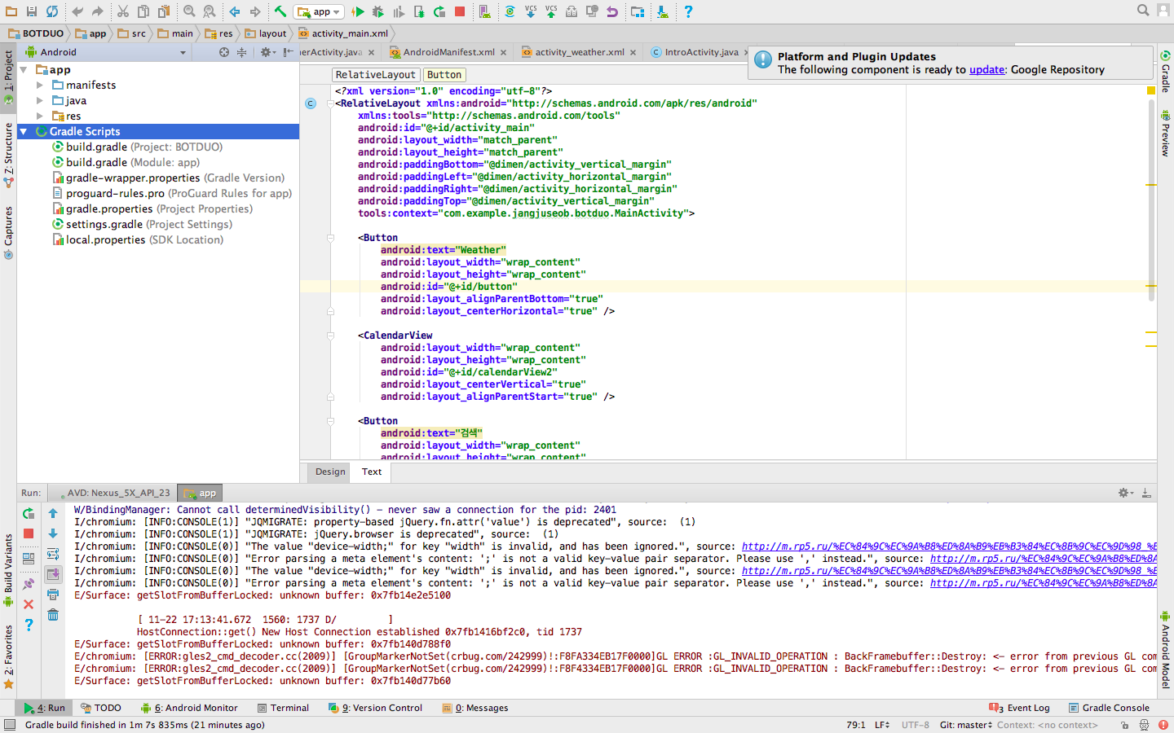
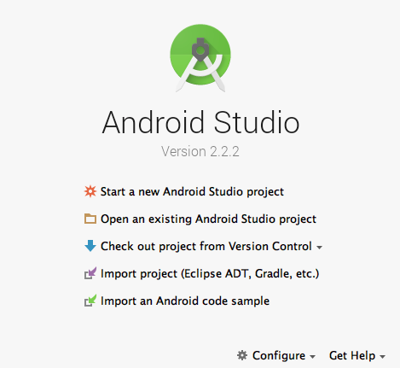
Android Studio

Slide 5
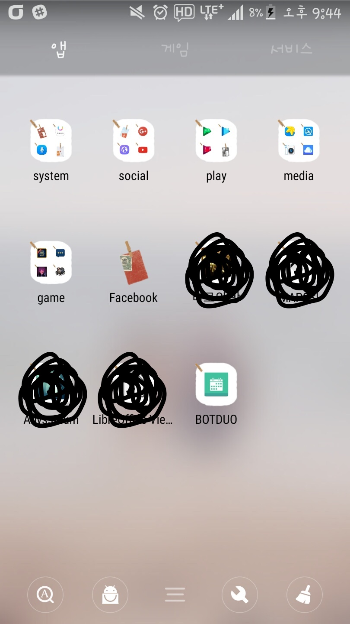


Icon
CLICK THIS!
BOTDUO PROJECT

Slide 6
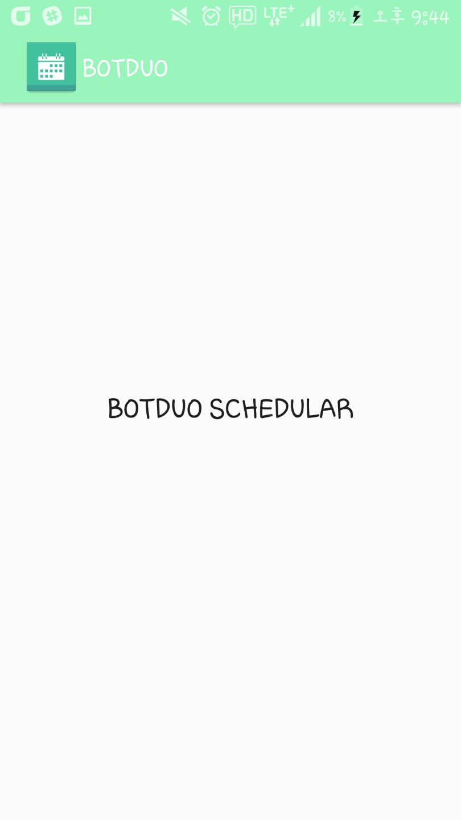

Intro
BOTDUO PROJECT
Loading

Slide 7
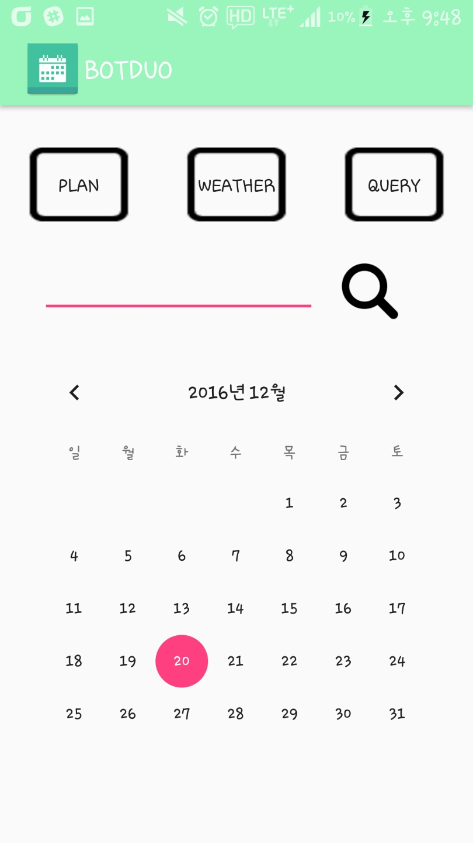

Main
Plan
Weather
Search
Query
BOTDUO PROJECT

Slide 8
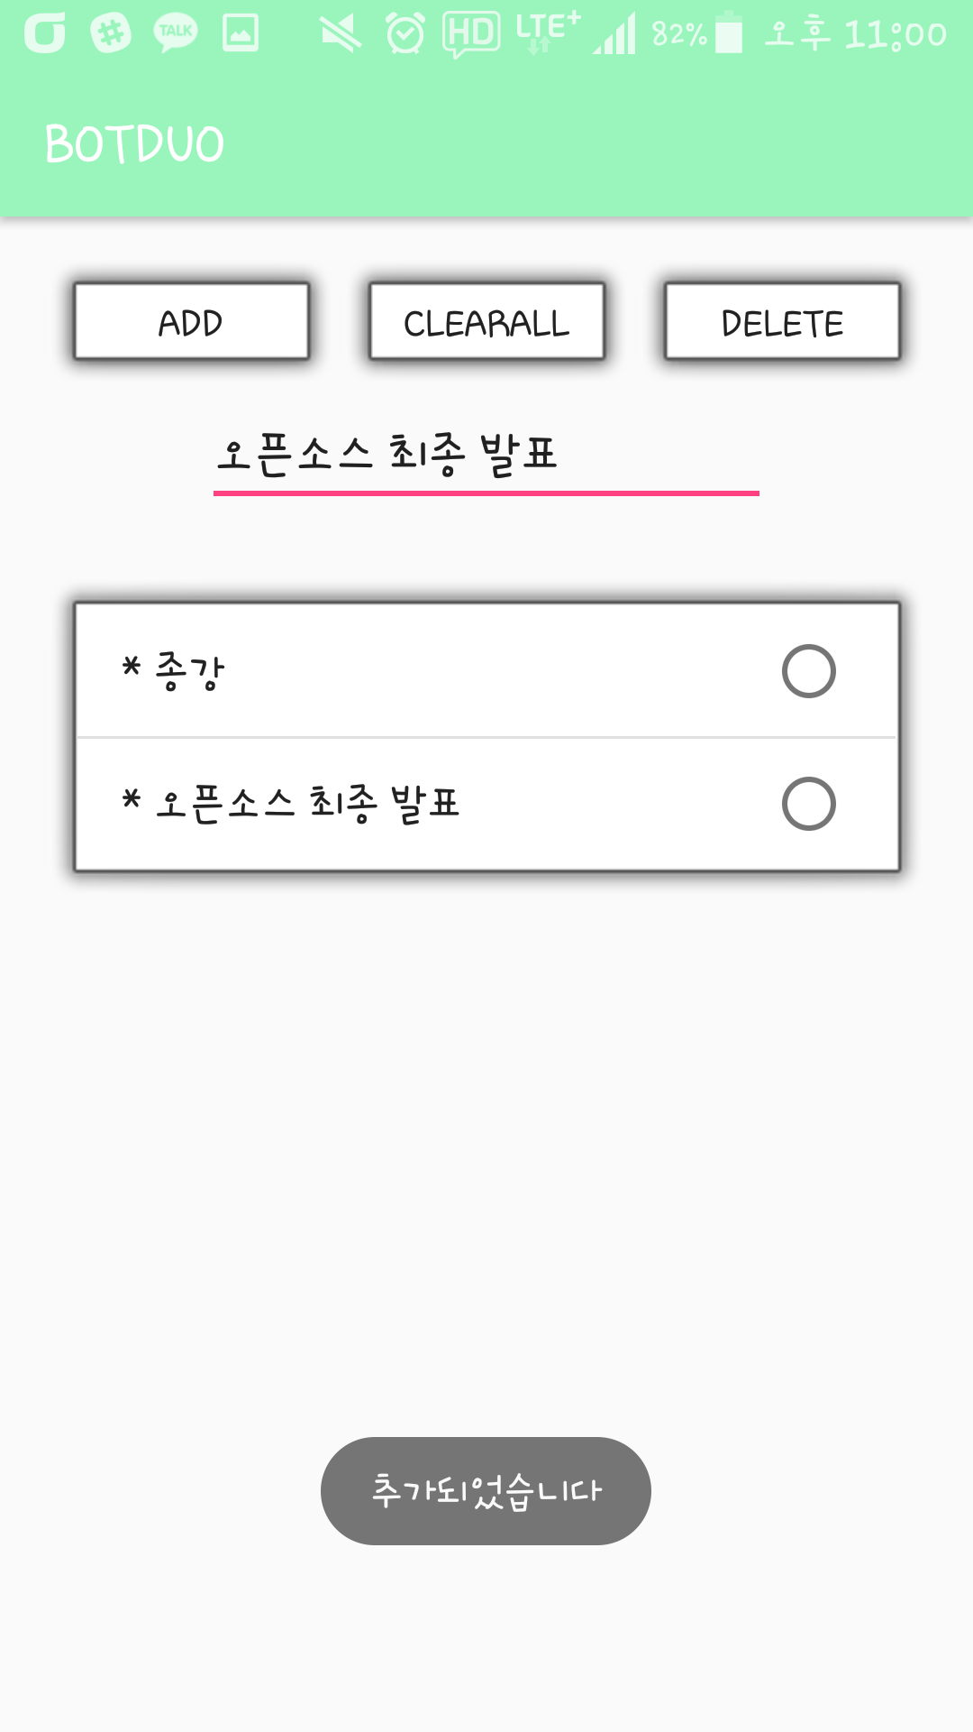
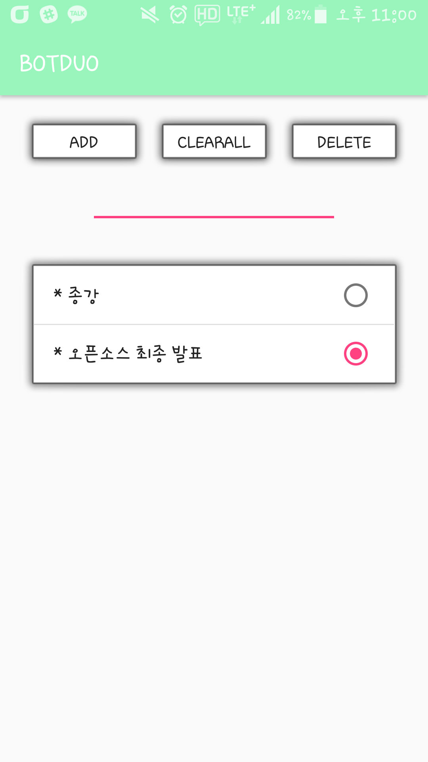
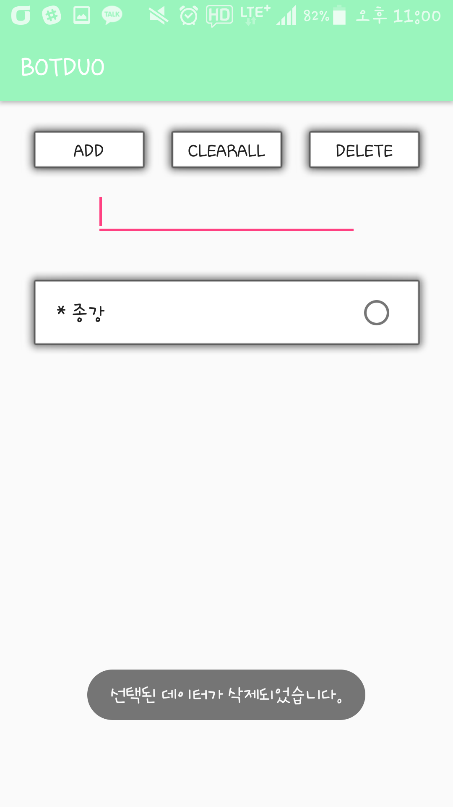
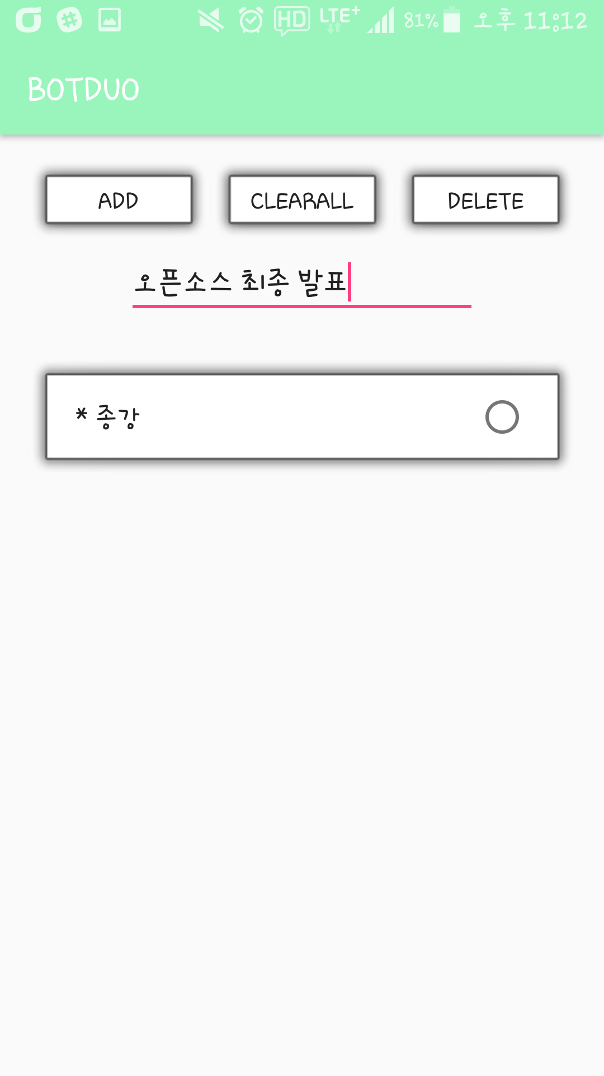
Planner

Slide 9
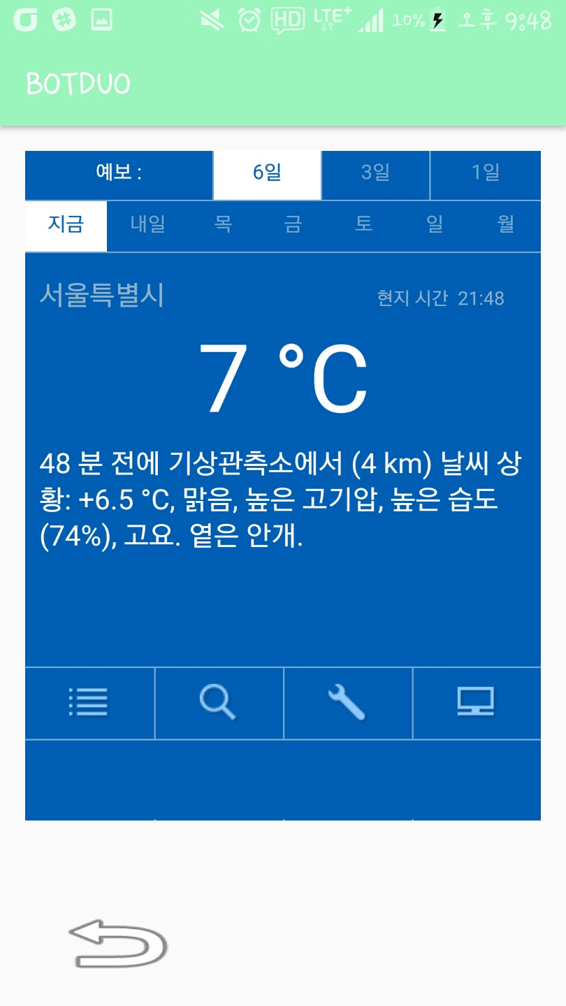




Weather
BOTDUO PROJECT

Slide 10
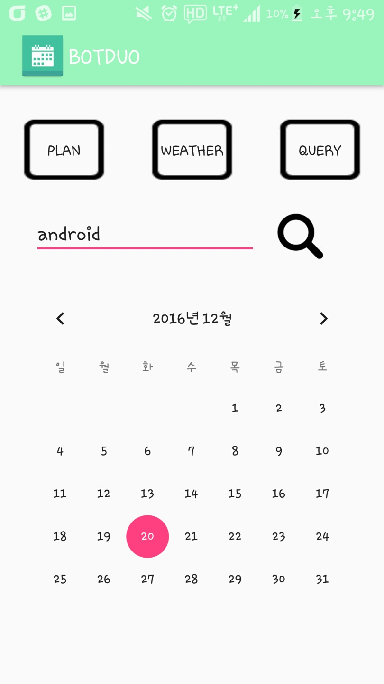
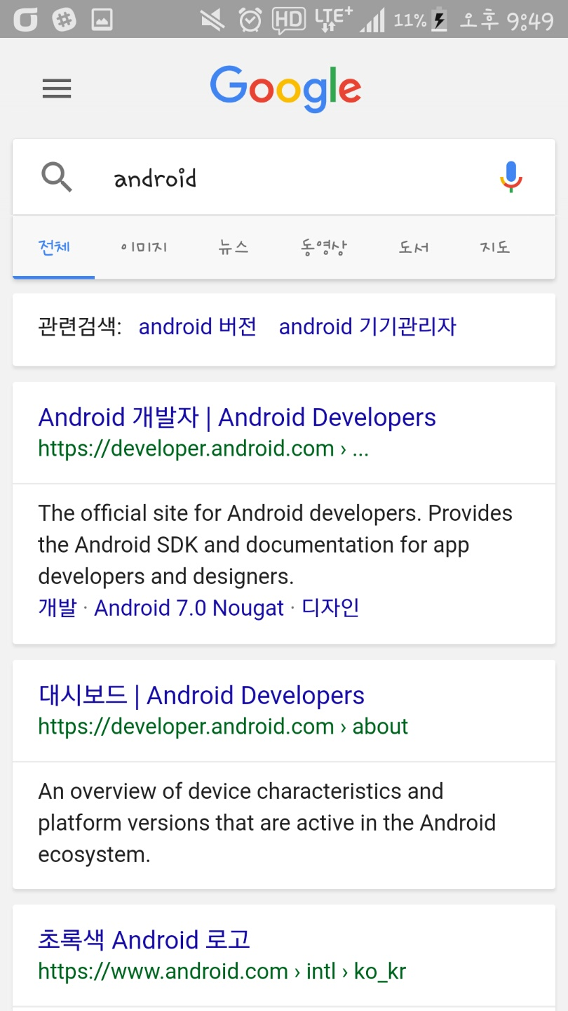

Search
android

Slide 11
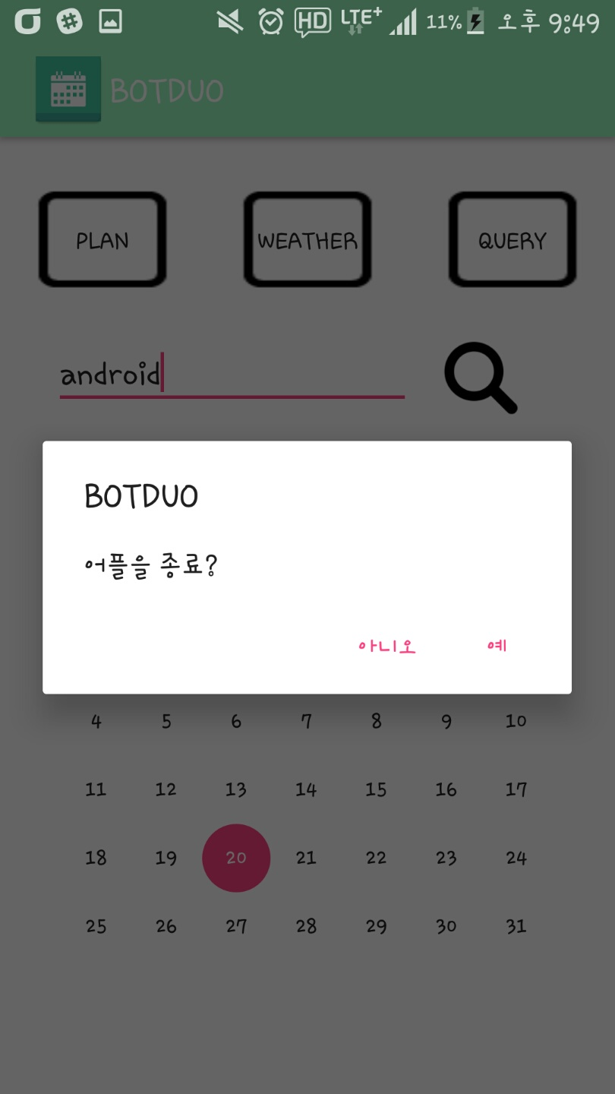
Quit Message

Slide 12
Demo Clip

Slide 13
Github
BOTDUO Github

Slide 14
Thanks for watching!
BOTDUO PROJECT
BOTDUO PROJECT

