Slide 1
Open Source Midterm Project 22-BotDuo

Slide 2
최재영
(chlwodud77)
2016003972
-Presenter ,Developer
BOTDUO PROJECT
장주섭
(wntjq68)
2016003881
-Designer, Developer

Slide 3
List
Android Studio.
Icon.
Intro.
Main.
Weather.
To do.
BOTDUO PROJECT

Slide 4
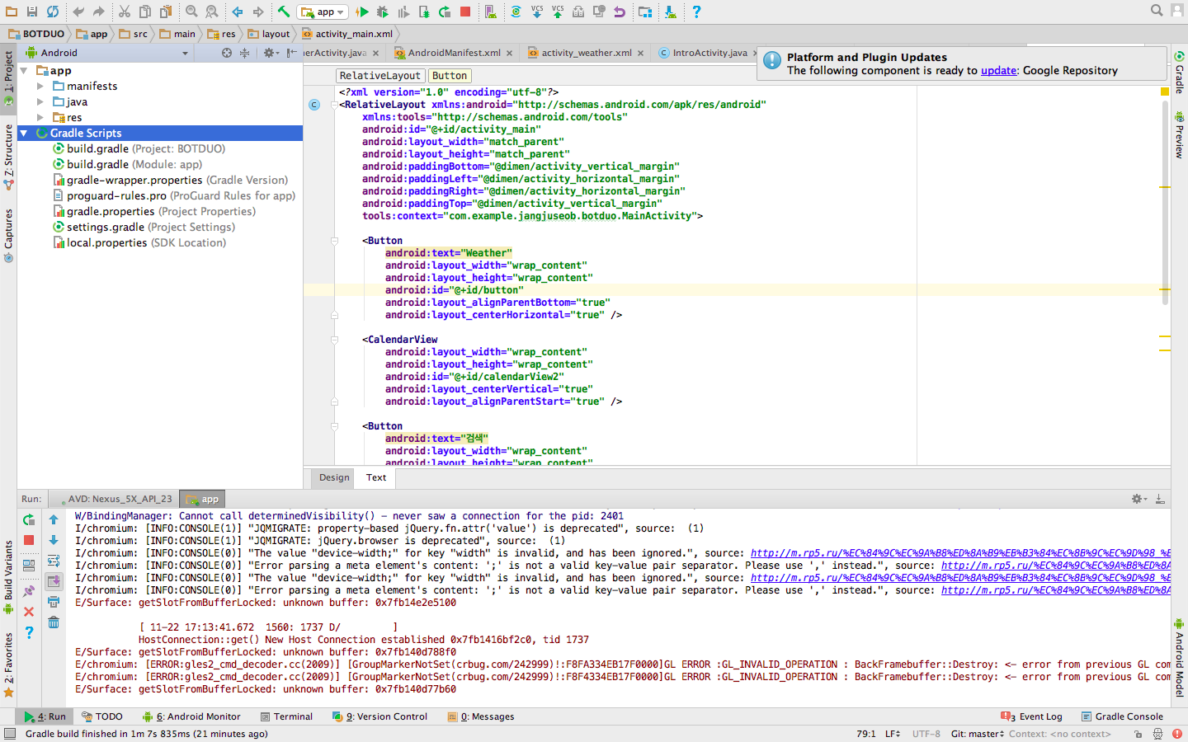
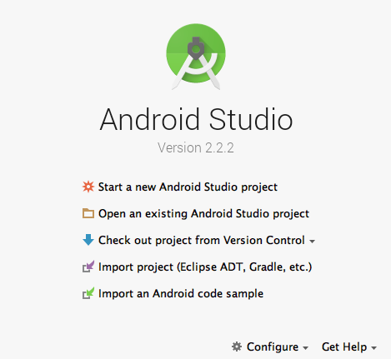
Android Studio

Slide 5
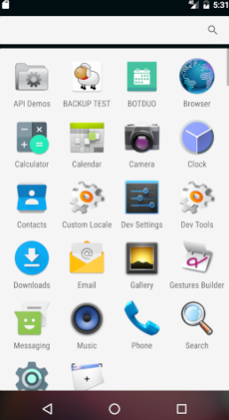


Icon
CLICK THIS!
BOTDUO PROJECT
BOTDUO

Slide 6
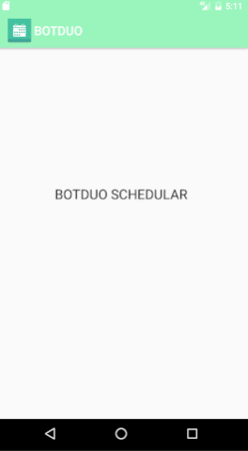

Intro
BOTDUO PROJECT
Loading

Slide 7
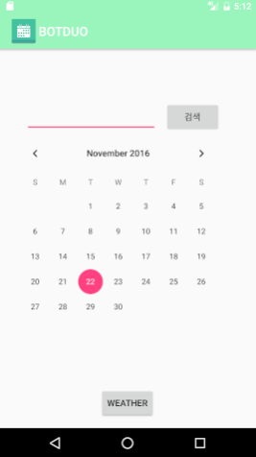

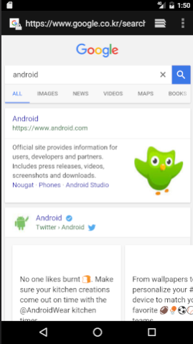
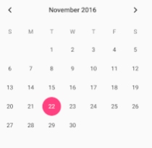
Main
android
BOTDUO PROJECT

Slide 8
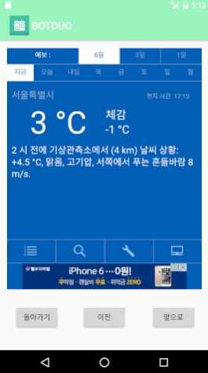




Weather
BOTDUO PROJECT

Slide 9




To do
BOTDUO PROJECT
Planner
Real Time Query
Design
Alarm

Slide 10
Thanks for watching!
BOTDUO PROJECT
BOTDUO PROJECT

