Slide 1

The unicorn search

Slide 2
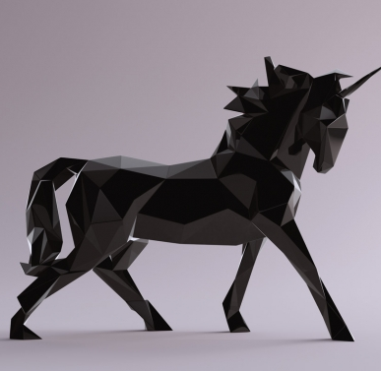
What is a unicorn company
1 Billion $ Valuation
Companies are getting richer by the day

Slide 3
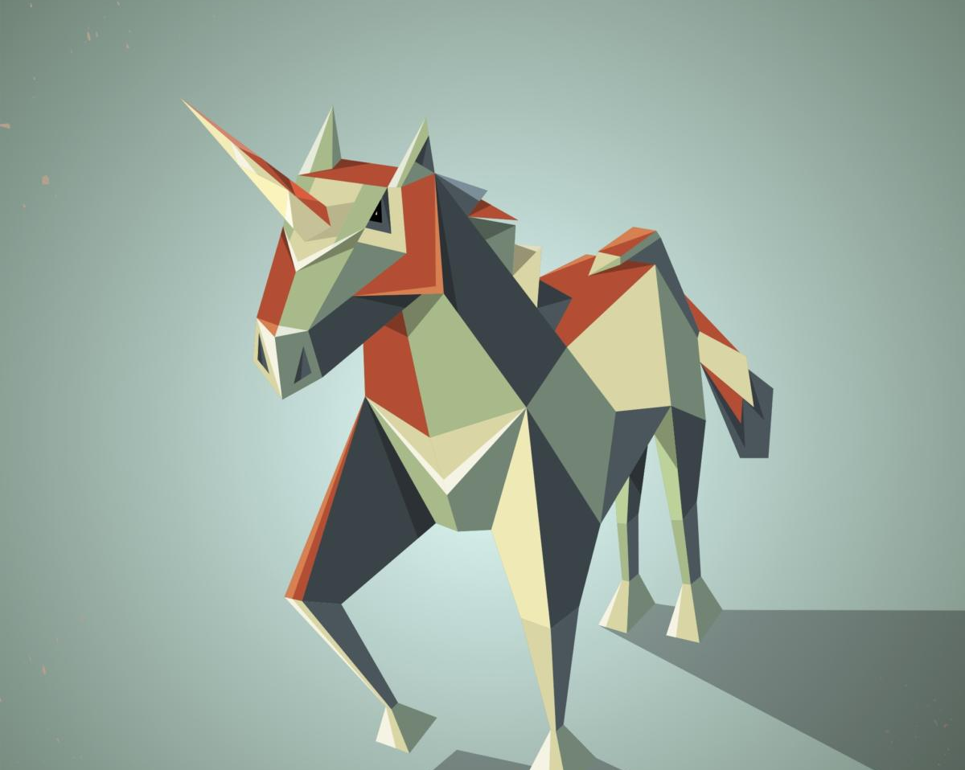

The data
Sourced from Kaggle, we decided on the Unicorn Dataset

Slide 4
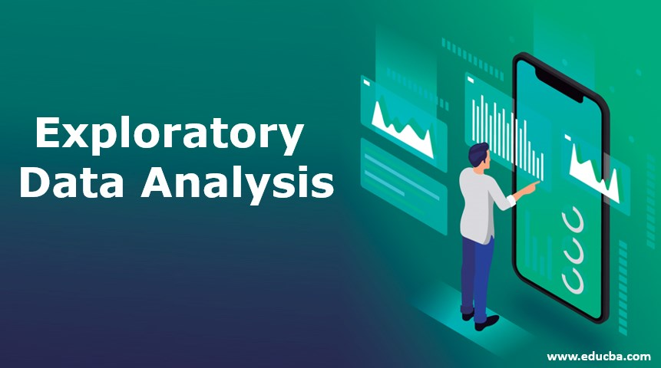
EDA
Unsupervised VS Supervised

Slide 5
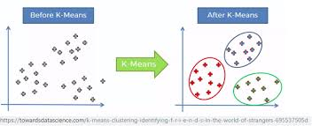
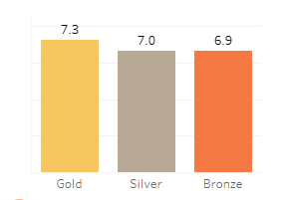
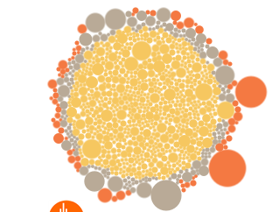
Analysis
The model and our clusters
PCA check

Slide 6
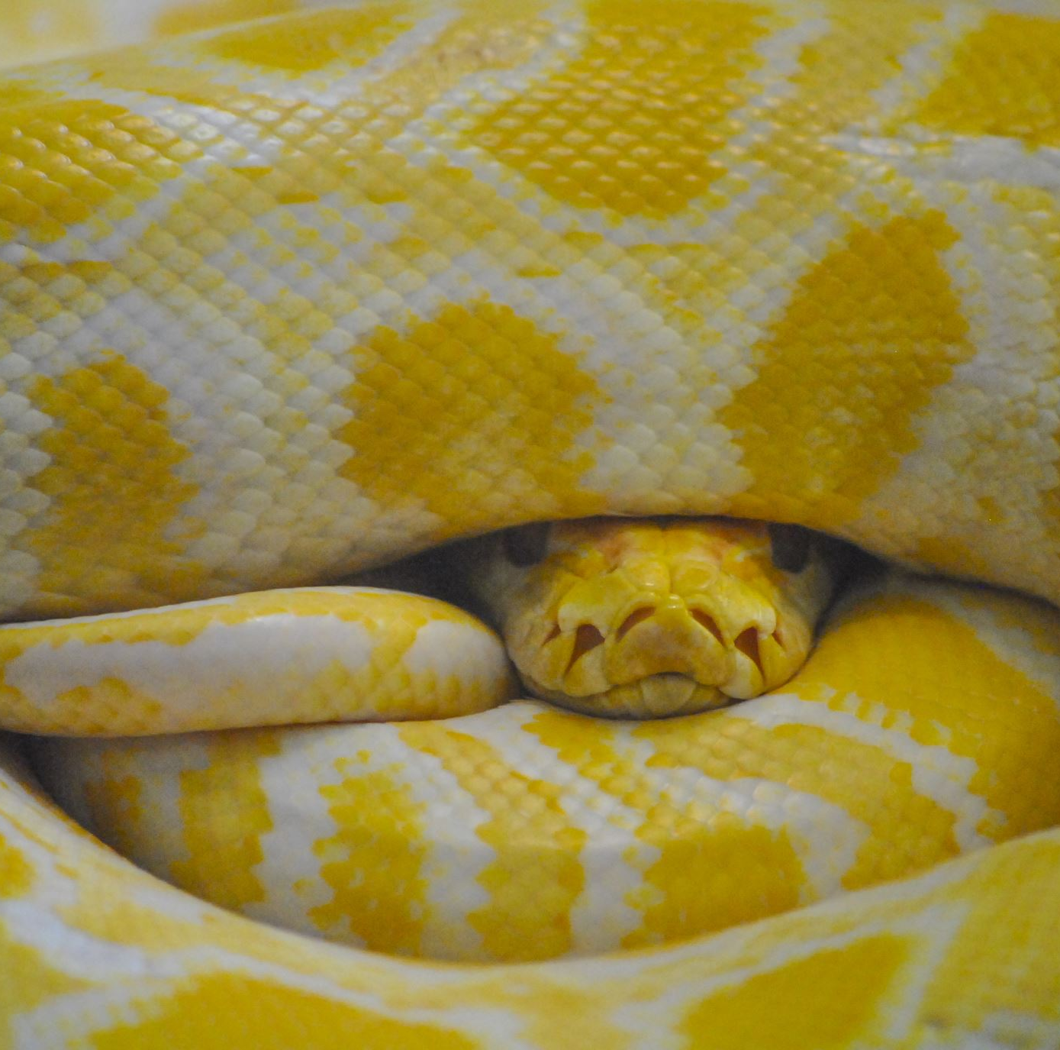
Tools Used
PGAdmin4 for the databases
Python, Pandas, KMeans(algo)
Heroku
Tableau(visuals)

Slide 7

conclusion
Onto Zeinab for a demo of our work
Final Regards

