Slide 1
# 数据科学介绍1.1： 课程简介
## Introduction to Data Science Part1.1: Intro
Zheng Wei

Slide 2
Goals & Limitations
Goals：
Basic data science methods
Using matlab to do data science
Be a data scientist apprentice
Limitations：
Only 2 lectures
Then what？：
You have to spend more time if you are interested.

Slide 3
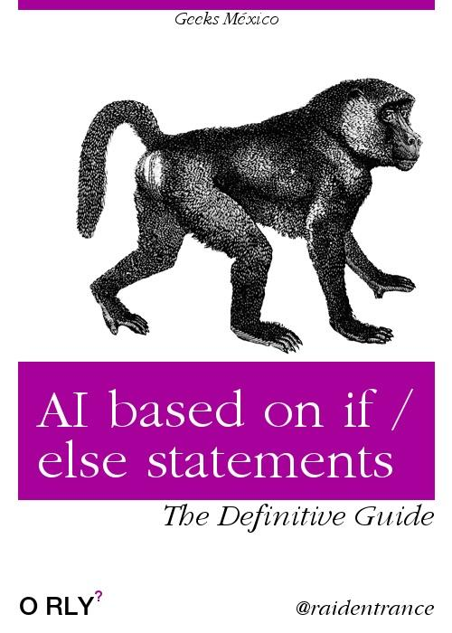
What is data science, AI,
What is data science ？
Science that studies data
Data collection, storage, processing, statistics, and of course machine learning
What is AI？
Make machine do intelligent stuff.
Relations：
Some data science methods is used to achieve AI.

Slide 4
machine learning
ML is a way of achieve AI
artificial neural network is a way of achieve ML
Deep Learning is mostly deep artificial neural network
人工智能
机器学习
神经网络

Slide 5
How do we learn?
Problem based
Using Matlab, hands on

Slide 6
You will learn
Simple linear regression model
Simple linear time series model
Basic classification
Basic clustering
Basic neural network.

Slide 7
Target of this class
Visualize you data and get a basic idea of it
Build a model to predict something or into the future
All in Matlab

Slide 8
# 数据科学介绍，探索性数据分析
## Introduction to Data Science Part1.1.1: Exploratory Data Analysis
Zheng Wei

Slide 9
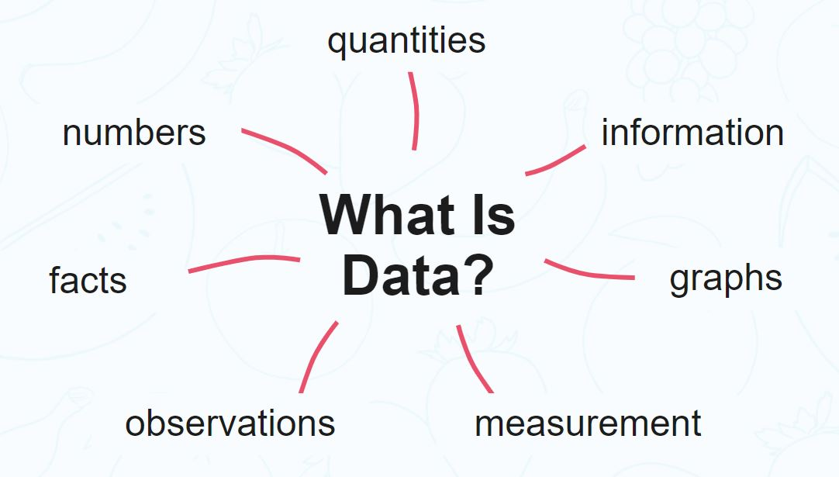
What is data
Data is a formal representation of information
Data is obtained by observation, and often numeric, qualitative or quantitative.

Slide 10
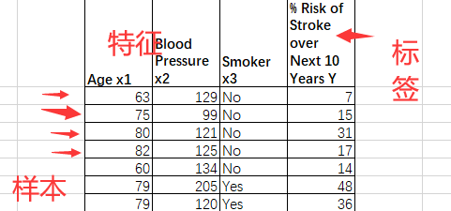
What is sample
Data is collected via observation
Observation is also knowns as sampling
The result of each sampling process is a sample

Slide 11
The routine of data science

Slide 12
Types of data
Categorical
Nominal
Ordinal
Continuous
Interval
Ration

Slide 13
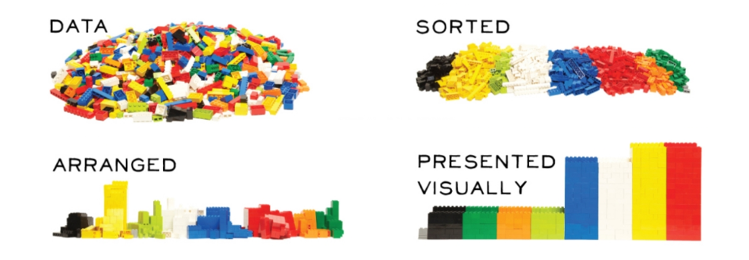
Exploratory Data Analysis
Know you data without building any model
Extremely helpful to model building
Mostly done via data visualization

Slide 14
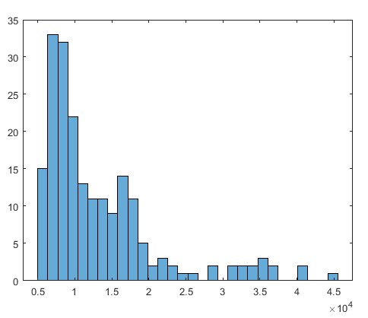
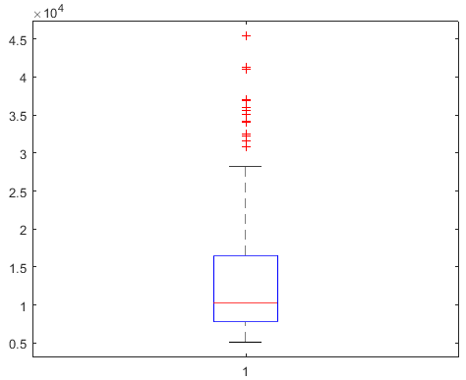
Descriptive statistics
Mean, median, range, variability

Slide 15
Relations between multiple variables
Continuous vs. Continuous
correlation
Categorical vs. Categorical
Contingency table
Continuous vs. Categorical
boxplot

Slide 16
# 数据科学入门1.2：回归的基本概念
## Introduction to Data Science Part1.2: Basic definitions
Zheng Wei

Slide 17
What is Regression models
A statistical procedure used to develop an equation showing how two or more variables are related.
Regression Analysis does not prove a cause and effect relationship, but rather it helps us to create a model (equation) that can help us to estimate or make predictions.

Slide 18
An Example
例1 测16名成年女子的身高与腿长所得数据如下：
身高 | 143 | 145 | 146 | 147 | 149 | 150 | 153 | 154 | 155 | 156 | 157 | 158 | 159 | 160 | 162 | 164
腿长 | 88 | 85 | 88 | 91 | 92 | 93 | 93 | 95 | 96 | 98 | 97 | 96 | 98 | 99 | 100 | 102
以身高x为横坐标，以腿长y为纵坐标将这些数据点（xi，yi）在平面直角坐标系上标出.
散点图 Scatter Plot

Slide 19

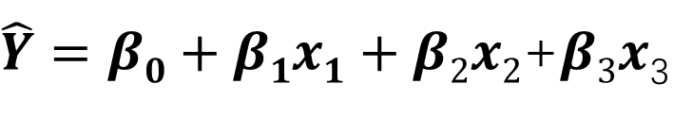
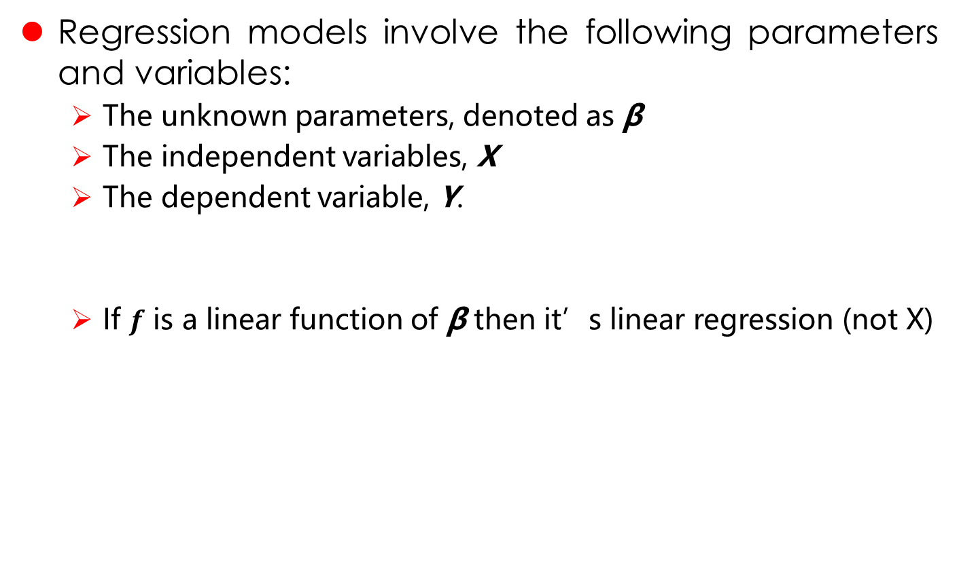
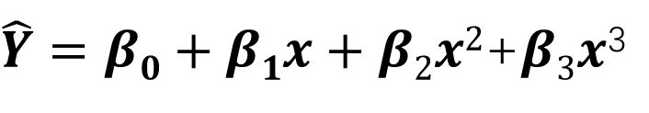


Regression models
Regression models involve the following parameters and variables:
The unknown parameters, denoted as β
The independent variables, X
The dependent variable, Y.
If $f$ is a linear function of β then it’s linear regression (not X)
$$E\left(Y | X\right)=f(X,β)$$
$$\hat{Y}=f(X,β)$$
$$\hat{Y}=β0+β1x$$
$\hat{Y}=β0+β1x+β2x2$+$β3x$³
$\hat{Y}=β0+β1x1+β2x2$+$β3x$₃

Slide 20
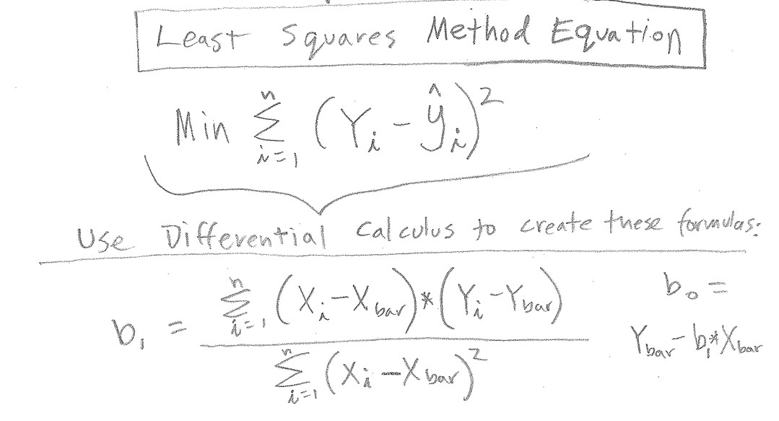

Simple Linear Regression
$\hat{Y}=β0+β1x$

Slide 21
# 数据科学入门1.3：简单线性回归
## Introduction to Data Science Part1.3: Basic Regression
Zheng Wei

Slide 22
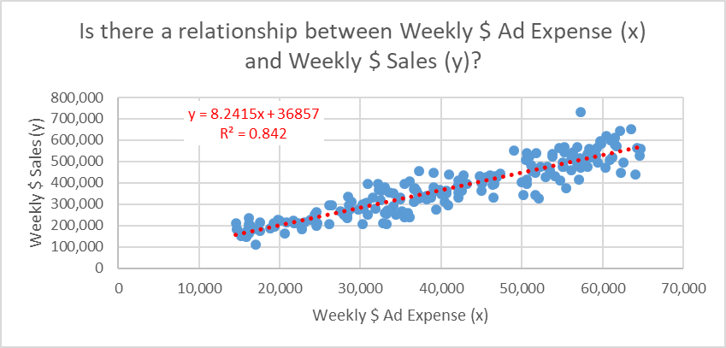
Simple Linear Regression
Do it in excel Matlab
Weekly $ Ad Expense (x) | Weekly $ Sales (y)
63,566 | 651,334
50,762 | 527,670
50,941 | 523,751
17,597 | 175,467
33,029 | 377,978
58,543 | 520,100
60,492 | 620,856
59,686 | 593,739
16,432 | 181,949
17,262 | 184,644
39,118 | 379,374
36,078 | 238,688
42,113 | 410,066
50,562 | 413,541
38,240 | 340,242
59,870 | 582,843

Slide 23
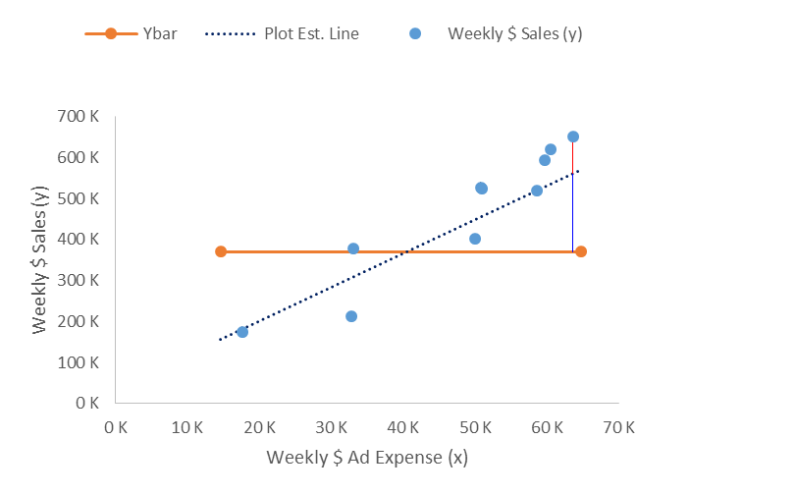
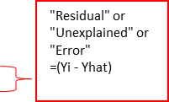
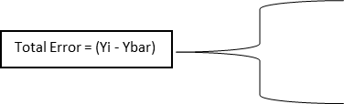
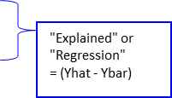

Evaluation of the regression result
Coefficient of determination
$R2=\frac{SSR}{SST}, SSR=\sum{\left(\hat{yi}−\overline{y}\right)2} SST=\sum{\left(yi−\overline{y}\right)2}$
The closer is Adjusted-R-Squared to 1 the better

Slide 24
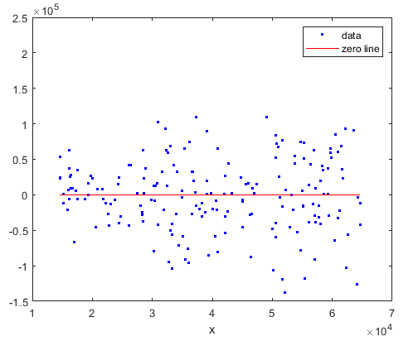
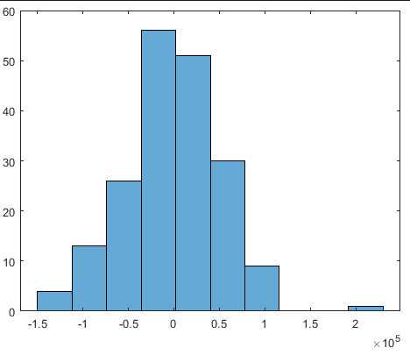
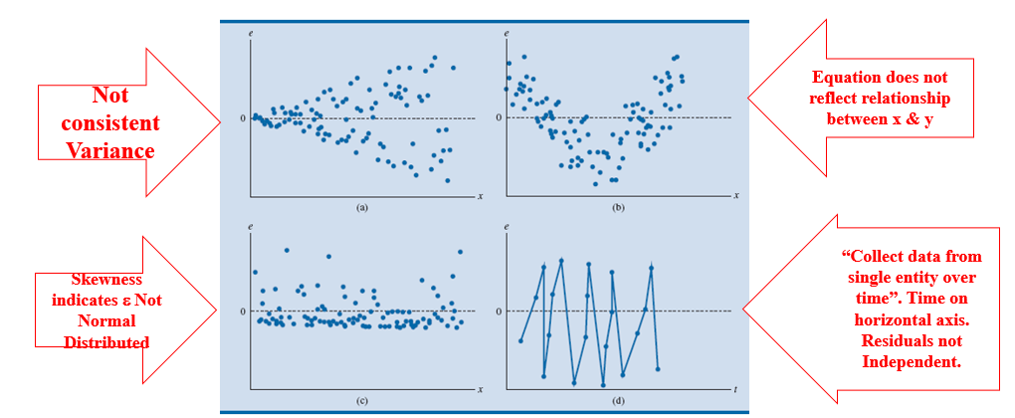
Evaluation of the regression result
A good regression should give normally distributed residual with mean of 0 across all independent variable values.
OK
OK
NOT OK

Slide 25
Polynomial Linear Regression
Date | Temperature X | Energy Expense Y
2015/1/12 | 46 | $236
2015/1/13 | 52 | $304
2015/1/14 | 55 | $164
2015/1/15 | 46 | $214
2015/1/16 | 47 | $210
2015/1/17 | 50 | $508
2015/1/18 | 36 | $295
2015/1/19 | 47 | $250
2015/1/20 | 40 | $372
2015/1/21 | 46 | $478
2015/1/22 | 55 | $258
2015/1/23 | 40 | $559
2015/1/24 | 53 | $536
2015/1/25 | 44 | $576

Slide 26
# 数据科学入门1.4：多变量回归
## Introduction to Data Science Part1.4: Multi variable Regression
Zheng Wei

Slide 27
Continuous variables
Categorical variables

Slide 28
# 数据科学介绍1.5：非线性回归和logistic 回归
## Introduction to Data Science Part1.5: Non-linear regression and logistic regression
Zheng Wei

Slide 29
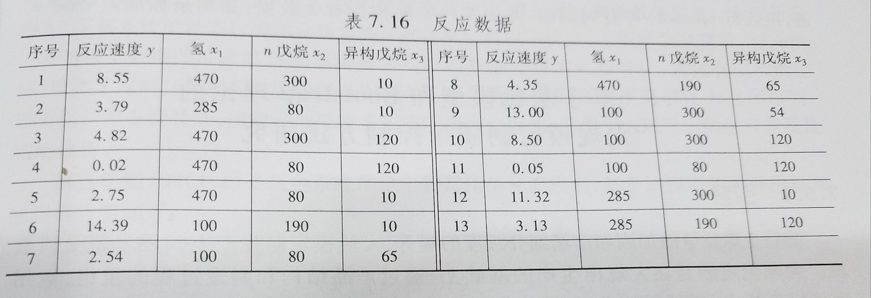
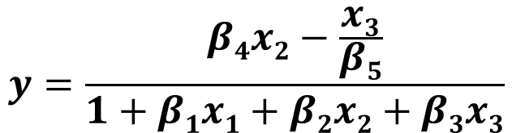

Non-linear regression
在化学动力学反应过程中，建立了一个反应速度和反应物含量的数学模型，形式为：
今测得一组参考数据，求$β1$~$β5$
$$y=\frac{β4x2−\frac{x3}{β5}}{1+β1x1+β2x2+β3x3}$$

Slide 30
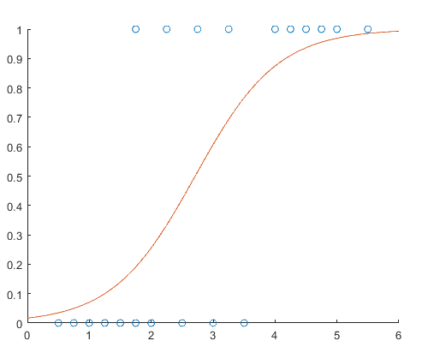
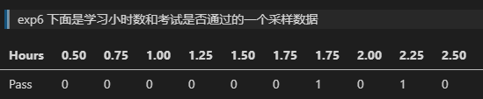
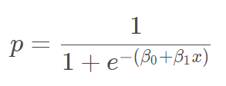
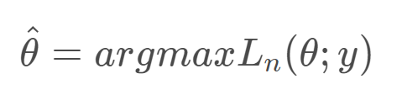
Logistics Regression

Slide 31
# 数据科学入门1.6：简单时间序列预测与总结
## Introduction to Data Science Part1.6: Time Series and Sumary
Zheng Wei

Slide 32
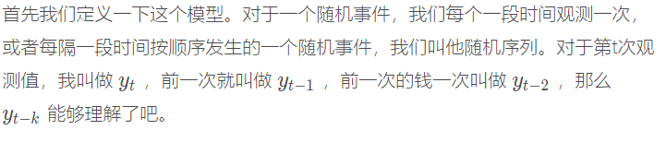
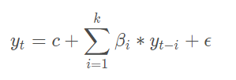
Time series and ARIMA model
What is a “time series”
Auto-regressive model

Slide 33
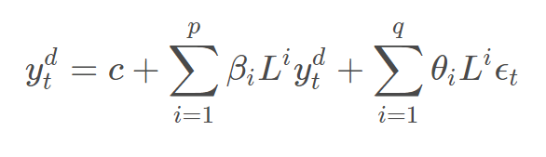
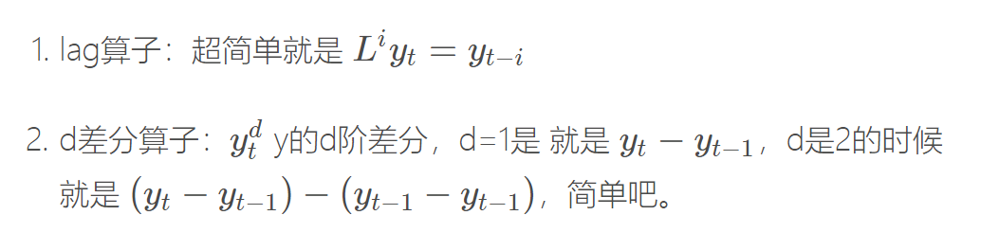
ARIMA（auto-regeressive integrated moving average）

Slide 34
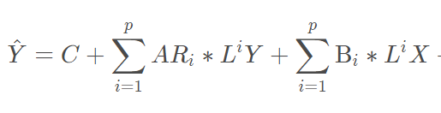
Vector Autoregression Models
Just like AR model
But with a Vector for Y

Slide 35
# Summary

Slide 36
How to do regression analysis?
Do EDA and get a basic idea of your data
Decide what is the features (independent variables) and what is the target (dependent variables)
Decide which type of model you are going to make (use linear model if you are not sure)
Fit (train, estimate) the model
Check adjusted-r-square and plot the residual
Use the model to do prediction or focasting.

Slide 37
Assignments
Try the examples in class
Choose from the 3 problems below
Predict car price from no more then 4 features can compare you model performance (auto_clean.csv)
Using logistic regression to predict the chance of survival for the Titanic passengers (exp-6-1.train/test.csv)
Predict the wind speed using the historical data (exp8.csv)

