Slide 1
IBM HACKATHON PROJECT
TRAVEL PLANNER AGENT
Presented By:JUSNEVIX A
Student name: JUSNEVIX A
College Name & Department:UNIVERSITY COLLEGE OF ENGINEERING,VILLUPURAM.
COMPUTER SCIENCE AND ENGINEERING.

Slide 2
OUTLINE
Problem Statement
Technology used
Wow factor
End users
Result
Conclusion
Git-hub Link
Future scope
IBM Certifications

Slide 3
Problem Statement
Travel planning is complex and time-consuming, requiring research across multiple platforms.
An AI-powered Travel Planner Agent using IBM Granite and IBM Cloud Lite Services.
It offers personalized itineraries, travel suggestions, real-time updates, and intelligent planning based on user needs and preferences.

Slide 4
Technology Used
IBM Cloud Lite Services
Retrieval-Augmented Generation (RAG)
IBM Granite Foundation Models
Natural Language Processing
Real-time data APIs (maps, weather, booking)

Slide 5
IBM cloud services used
IBM Cloud Watsonx AI Studio
IBM Cloud Watsonx AI runtime
IBM Cloud Agent Lab
IBM Granite foundation model

Slide 6
Wow Factor
Instant, smart travel suggestions
Personalized itineraries based on budget and interest
Integrated weather forecasts and local guides
Transport and accommodation recommendations
Real-time alerts and schedule updates
Smooth travel management experience

Slide 7
End Users
Travel enthusiasts and vacationers
Students planning educational tours
Families and group travelers
Travel agencies and agents
Business travelers

Slide 8
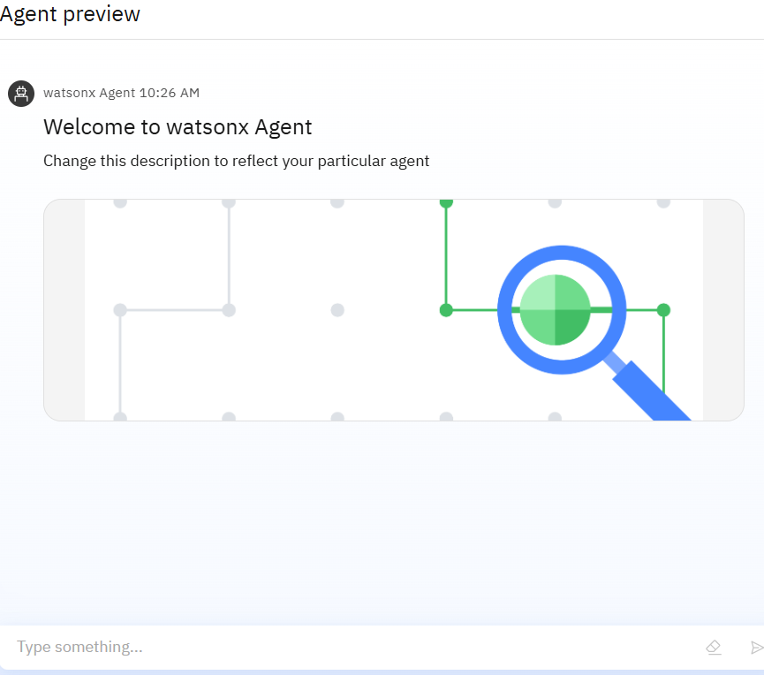
Result
Simplified travel planning process
Saved time with personalized, automated suggestions
Reduced planning errors and mismanagement

Slide 9
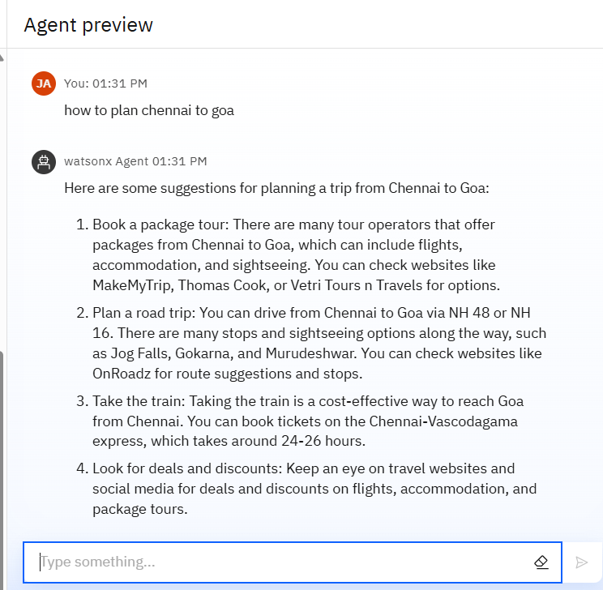
Results
Successfully built an AI-powered Travel planner Agent using Retrieval-Augmented Generation (RAG).

Slide 10
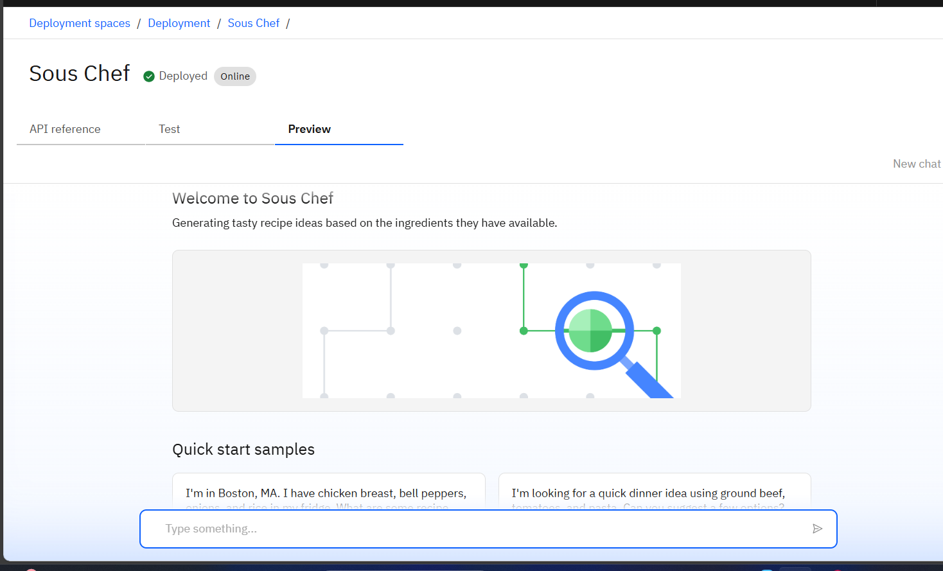
Results

Slide 11
Conclusion
The Travel Planner Agent:
Empowers travelers with AI-driven planning
Minimizes stress and confusion
Enhances the travel experience
Can be integrated into travel websites, apps, or personal assistants
.

Slide 12
GitHub Link

Slide 13
Future scope
Voice-based interaction
Multilingual support
Integration with major travel portals (e.g., MakeMyTrip, IRCTC)
In-app travel wallet & bookings
Trip sharing and social itinerary planning

Slide 14
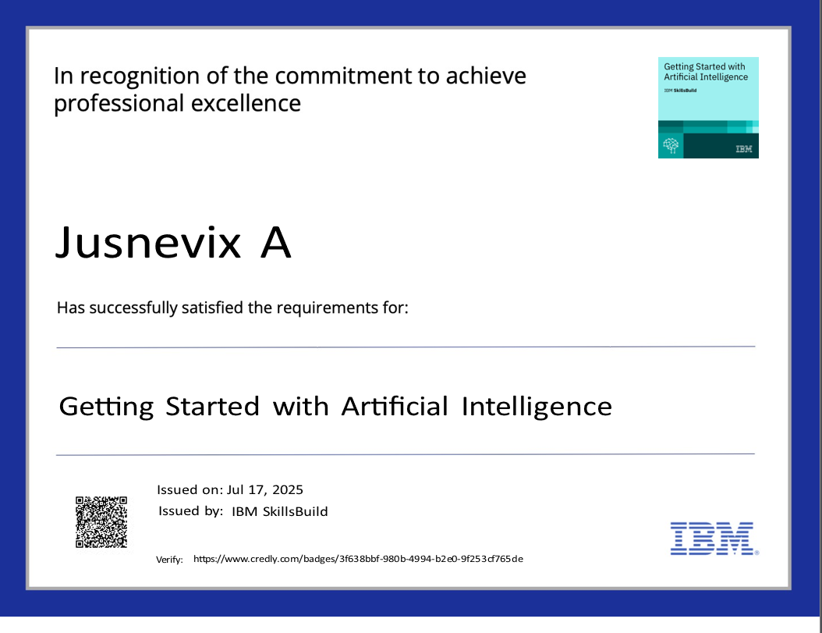
IBM Certifications

Slide 15
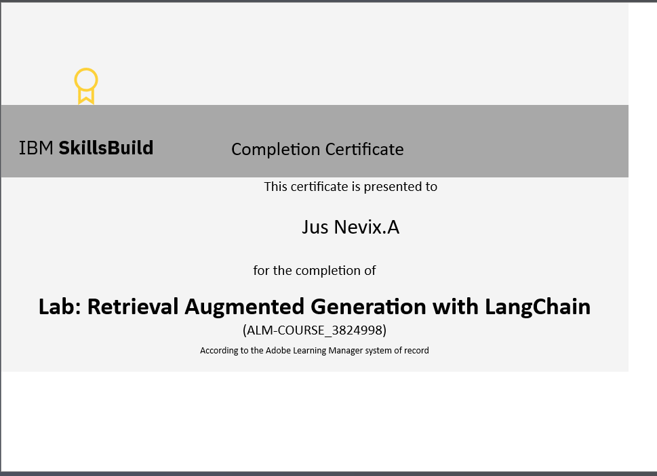
IBM Certifications

Slide 16


