Slide 1
IBM HACKATHON PROJECT
College admission
Presented By:JUSNEVIX A
Student name: JUSNEVIX A
College Name & Department:UNIVERSITY COLLEGE OF ENGINEERING,VILLUPURAM.
COMPUTER SCIENCE AND ENGINEERING.

Slide 2
OUTLINE
Problem Statement
Technology used
Wow factor
End users
Result
Conclusion
Git-hub Link
Future scope
IBM Certifications

Slide 3
Problem Statement
Many students and parents struggle to find the right college based on preferences, eligibility, and current academic trends. Manually researching college admissions, cutoffs, and application procedures is time-consuming and confusing.
An AI-powered College Admission Agent using Retrieval-Augmented Generation (RAG) that can answer queries about colleges, eligibility, fees, scholarships, deadlines, and application procedures.

Slide 4
Technology Used
IBM Cloud Watsonx AI Studio
Retrieval Augmented Generation (RAG)
IBM Granite Foundation Model
Natural Language Processing (NLP)
Custom college database or scraped data

Slide 5
IBM cloud services used
IBM Cloud Watsonx AI Studio
IBM Cloud Watsonx AI runtime
IBM Cloud Agent Lab
IBM Granite foundation model

Slide 6
Wow Factor
Personalized college recommendations
Natural language Q&A (e.g., “Which colleges accept NEET scores above 500?”)
Real-time admission deadline reminders
Course and stream comparison based on user profile
Scholarship suggestion based on financial background

Slide 7
End Users
School Students & Parents
Career Counselors
College Admission Consultants
Educational Institutes

Slide 8
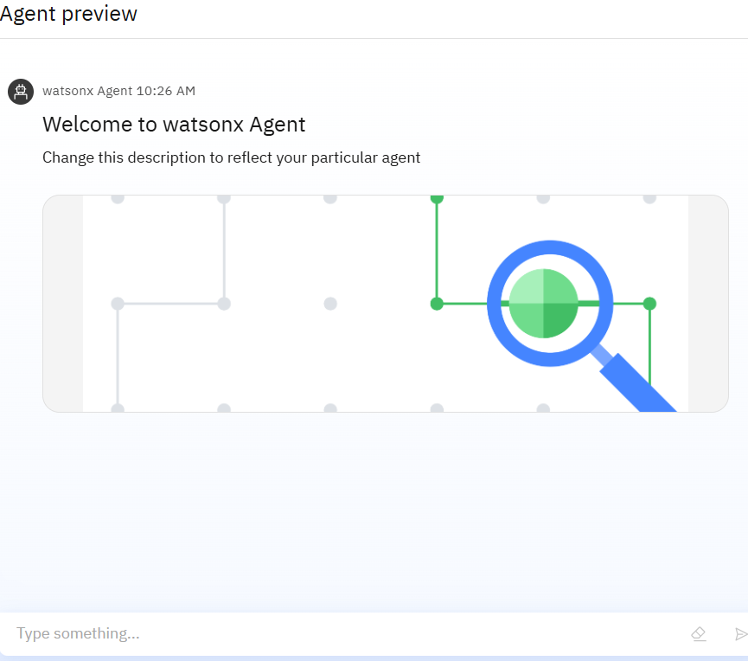
Result
Eligibility, fees, scholarships, and deadlines
Personalized college recommendations
Stream and course comparisons based on user profiles

Slide 9
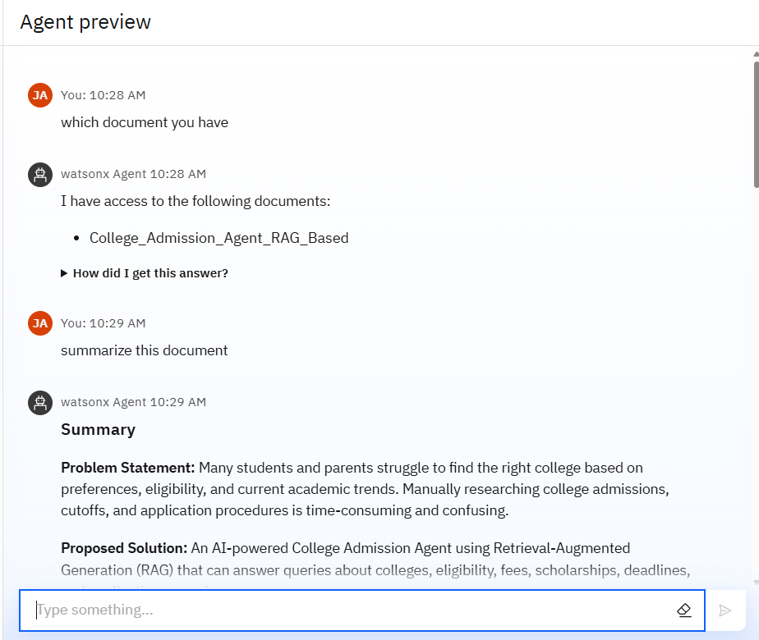
Results
Successfully built an AI-powered College Admission Agent using Retrieval-Augmented Generation (RAG).

Slide 10
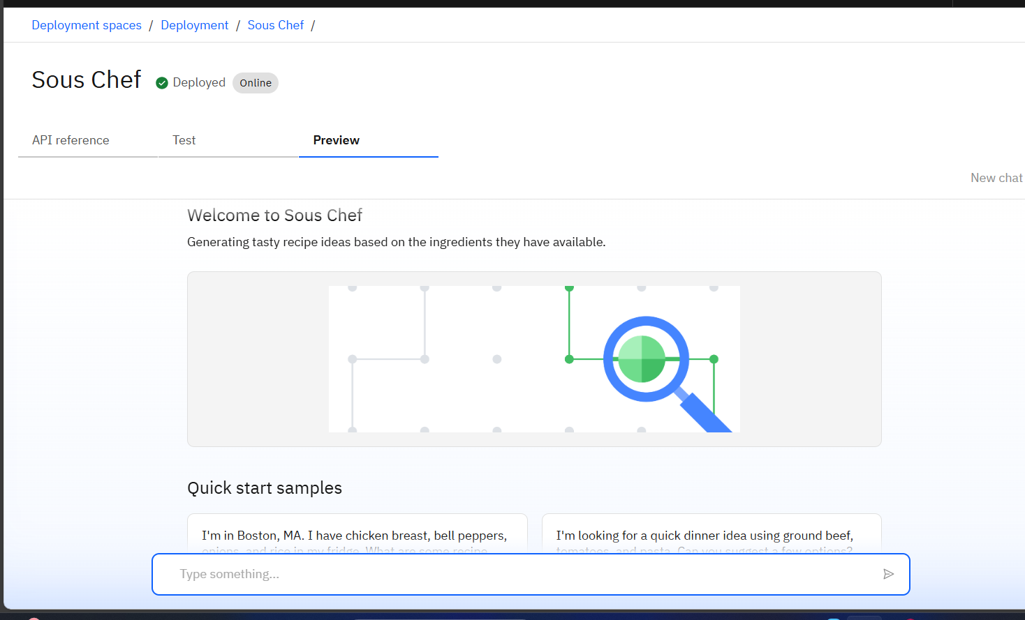
Results

Slide 11
Conclusion
The College Admission Agent empowers students with accurate, accessible, and personalized admission guidance using AI. It bridges the gap between students and the vast, scattered admission data from multiple sources.

Slide 12
GitHub Link

Slide 13
Future scope
Multilingual Research Support
Voice-Activated Research Assistant
Real-Time Collaboration Features
Research Gap and Novel Topic Identification
Integration with Publishing Platforms

Slide 14
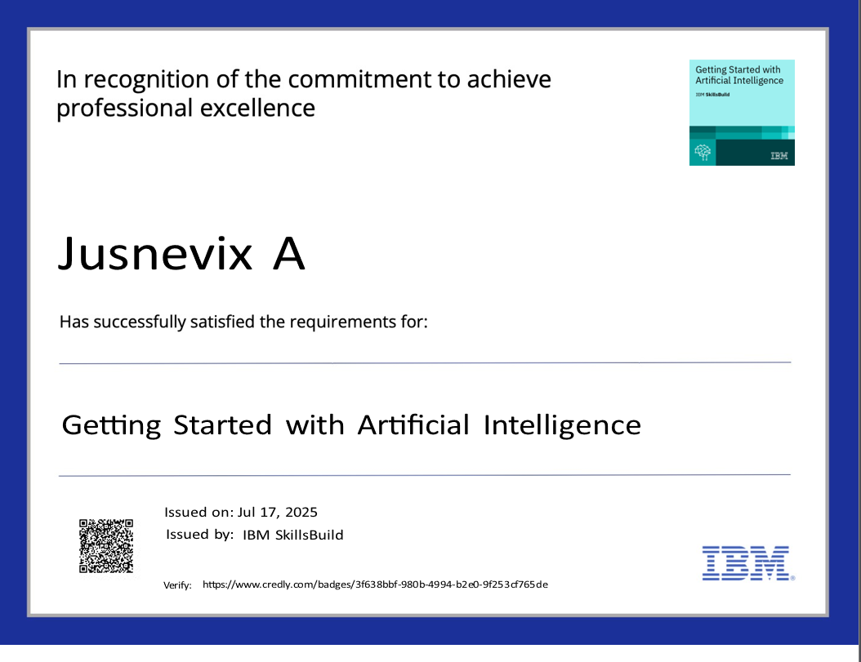
IBM Certifications

Slide 15
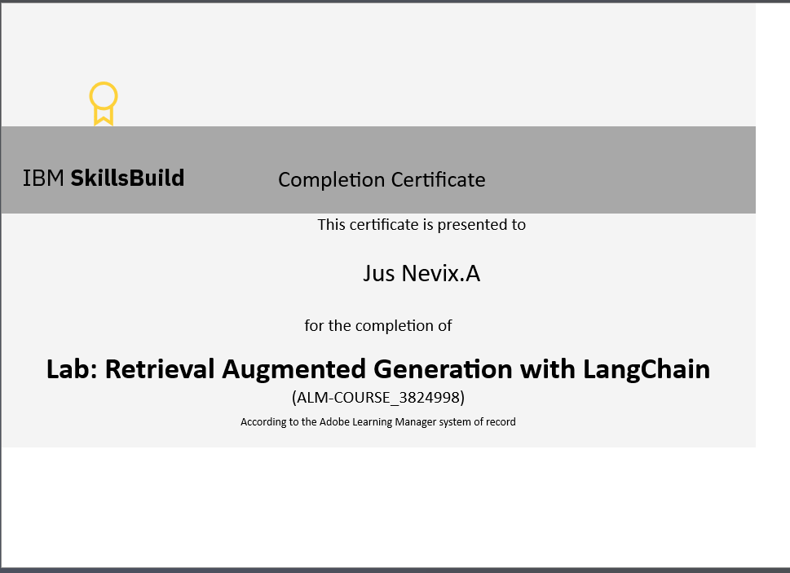
IBM Certifications

Slide 16


