Slide 1
Sri Shanmugha College of Engineering and Technology
Department of Electronics and Communication Engineering
Analytics for Electrical Vehicle
Presented by:
Kirankumar. G (732716106012)
Manu. K (732716106014)
Manu. D (732716106013)
Prakashraj. A (732716106030)
Guided by:
Mr. Saravanan. R , AP/ECE

Slide 2
ABSTRACT:
We have noticed that Electrical vehicle is emerging field in India. We noticed that some of the companies providing advance AI based intelligence features but it is high in cost which cannot be afforded by middle class Indian. So our team came forward to get an idea by Brainstorming. We had a solution that to offer an intelligence embedded system to both the consumer and manufacturer in less cost. it increase the efficiency of the vehicle and extend life time

Slide 3
Existing Solutions
At present there is no any companies are there in market to give such a Analytical portal as a service.
Companies like Revolt provides AI Based portal but it too cost and they are not sharing technology.
Number of companies are under developing Analytical portal and not yet came in market.

Slide 4
COMPONENTS USED:
List of Hardware components:
Tiva C Series tm4c123gh6pm - Controller
Temperature Sensor LM35
Ublox NEO-6m GPS Module
BLE hm-10
LED Display 800 (RGB) x 480
GSM / GPRS SIM 800
Customized Potentiometer
Metal Proximity sensors
Light Detector (LDR)
Software Used:
Code Composer Studio

Slide 5
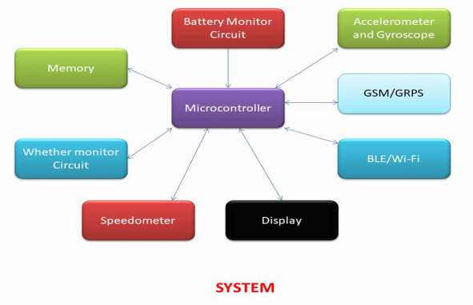
BLOCK DIAGRAM:

Slide 6
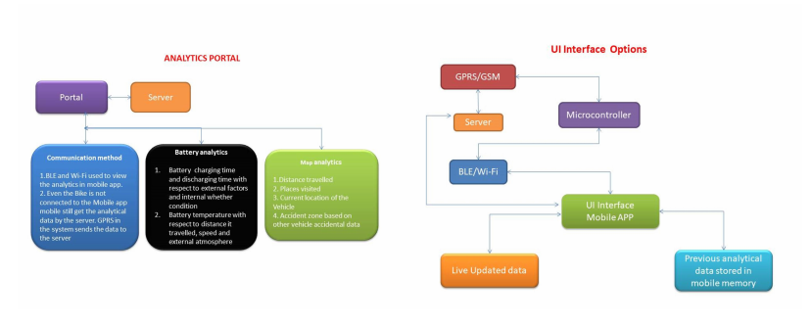
OVERVIEW FLOW

Slide 7
Working:
The system gets the power from the bike battery itself but it has backup which is used to send the data of GPS to the user even bike has no charge in battery. The data processing is being recorded in the device and it also sends to cloud and stored in user private portal. In case the vehicle met an accident even system has issue of data connection for a period of time, recorded data being stored in the memory of the system in bike. It can be extract later for analyzing the cause of the accident and it is like a kind of black box. Number of sensors placed in different location in the bike and controller is placed in safe place of the bike. It occupies fewer places. Bike display used to show the real time data to the user. Same data will send to the server.

Slide 8
Outcome of the Product
Data which we collect can be used as following in long term
1. Accident zones and cause of the accident. By using this data we can avoid accident.
2. Battery efficiency with respect to external atmospheric factors
3. Places they visit over a time and other details. o It encourage manufacturer to try more methods to increase efficiency

Slide 9
THANK YOU

