Slide 1

I can’t believe it’s not butter… A churning conundrum
By
George Gee

Slide 2
The Data
Features
N = Numeric : O = Object | Online Backup (O)
Customer ID (O) | Device Protection (O)
Gender (O) | Tech Support (O)
Senior Citizen (N) | Streaming TV (O)
Partner (O) | Streaming Movies (O)
Dependents (O) | Contract (O)
Tenure (N) | Paperless Billing (O)
Phone Service (O) | Payment Method (O)
Multiple Lines (O) | Monthly Charges (N)
Internet Service (O) | Total Charges (O)
Online Security (O) | Churn (O) ((Target))
An IBM Sample Data Set of customer churn for a telecommunications company.
The goal is to cluster the customers to find which characteristics (features) lead to higher churn rates.

Slide 3
Processing the data
Reassigning Column Data Types
Same data: two versions
Senior Citizen is an integer column containing 1’s or 0’s. Changed to ‘Yes’ and ‘No’ accordingly.
Total Charges is an object data type. The data contains ‘ ‘ values for some rows. Change ‘ ‘ to ‘nan’, drop nulls (11 rows), reassign column from object to numeric.
No other null or mislabeled data exists.
All numeric | All categorical
All “objects” one hot encoded | Numeric columns are 4-tiered
All features scaled (0,1) using MinMaxScaler | Tier 1 (low) < 25% : Tier 2 (medium) < mean
 | Tier 3 (high) < 75%: Tier 4 (very high) > 75%
Feature Count: 46 | Feature Count: 19 or 55

Slide 4
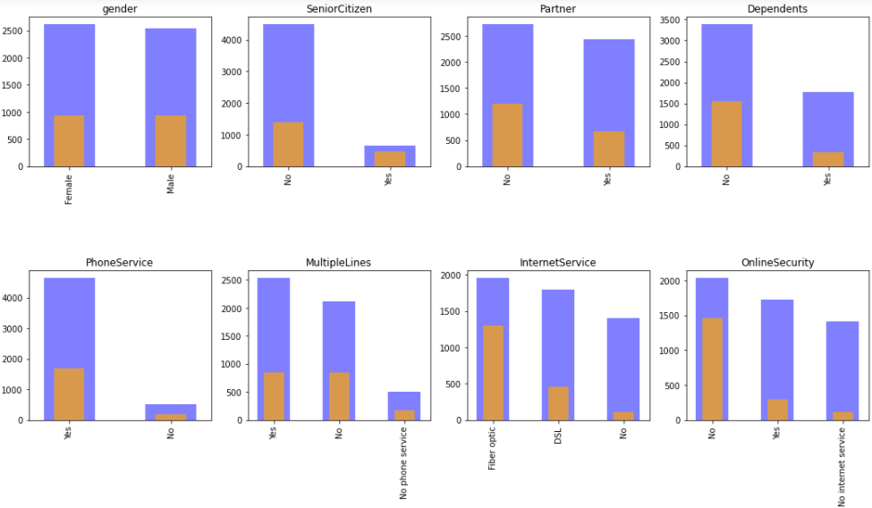
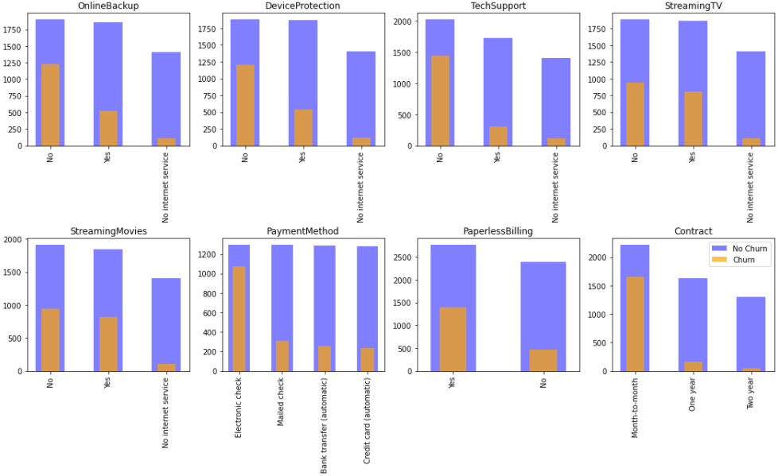
Visualizing features

Slide 5
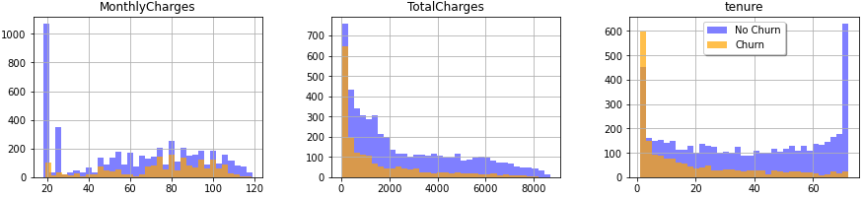
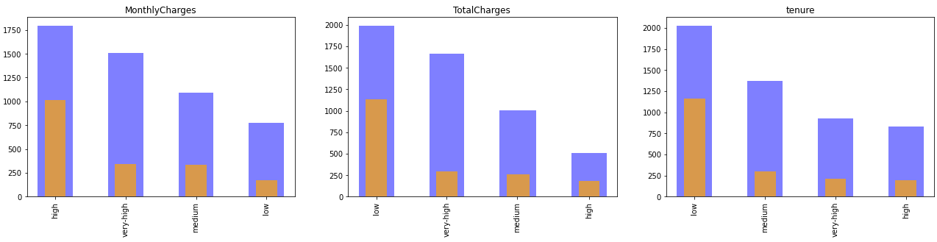
Visualizing features part 2
Tenure, Monthly Charges, Total Charges as Numeric
Tenure, Monthly Charges, Total Charges as Tiers

Slide 6
Feature dimensionality reduction

Slide 7
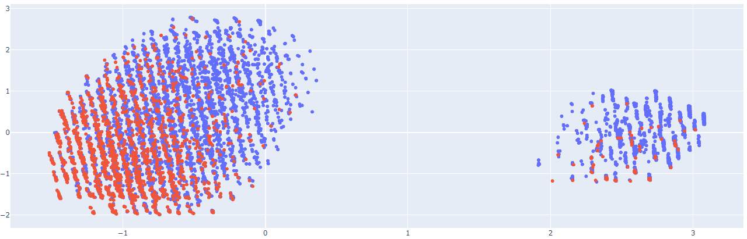
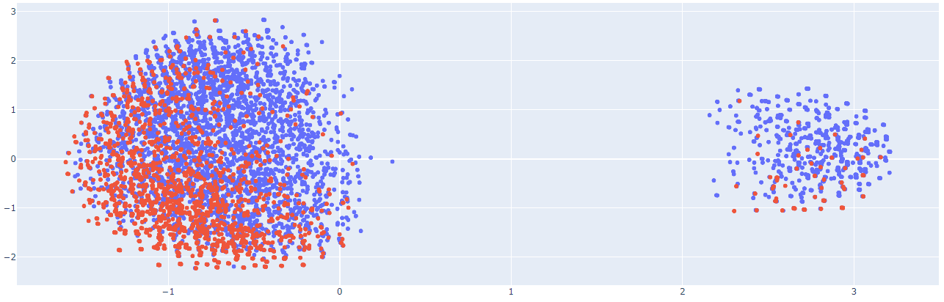
Dimensionality reduction (PCA)
Data 1
Data 2

Slide 8
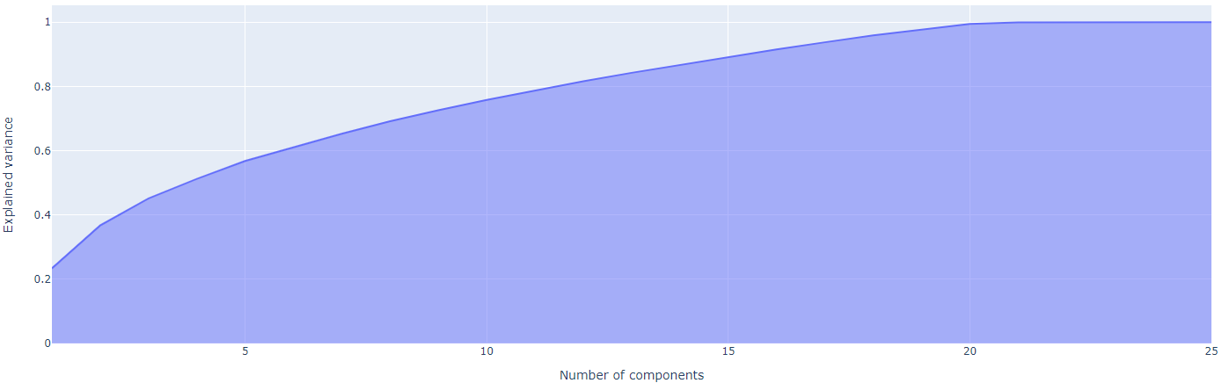
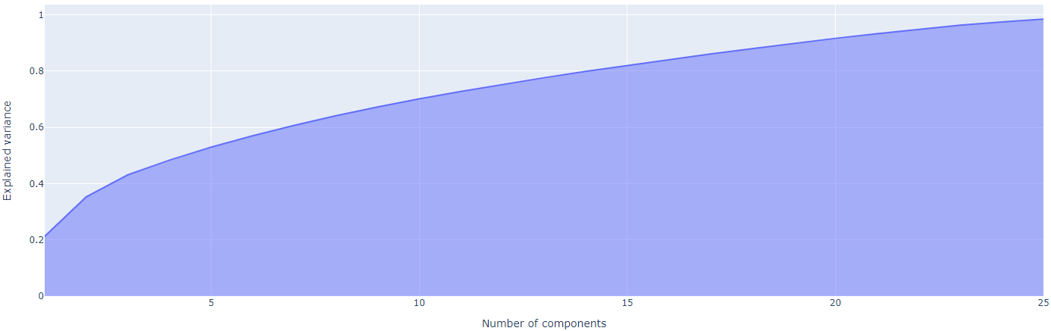
Dimensionality reduction (PCA)
Data : 90% 16 components
Data 2 : 90% 20 components

Slide 9
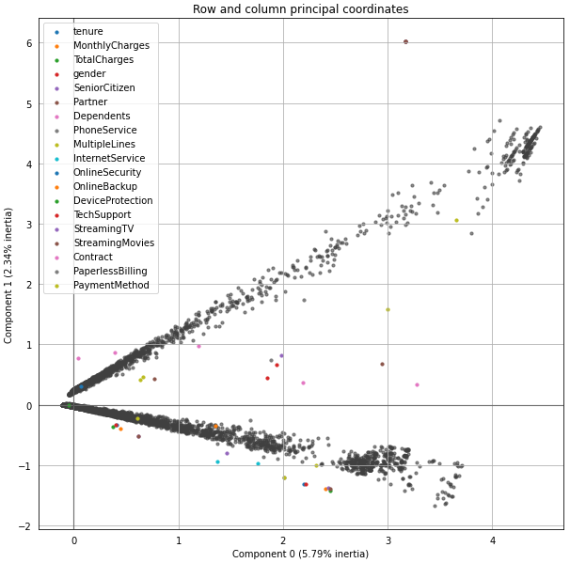
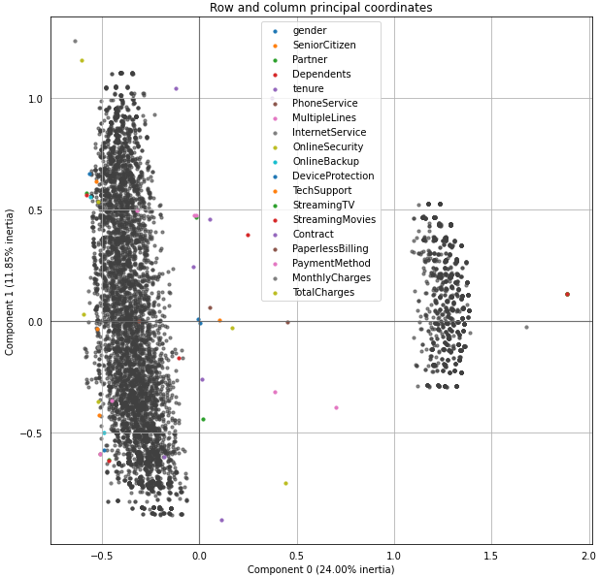
Dimensionality reduction (MCA)
Data 1
Data 2

Slide 10
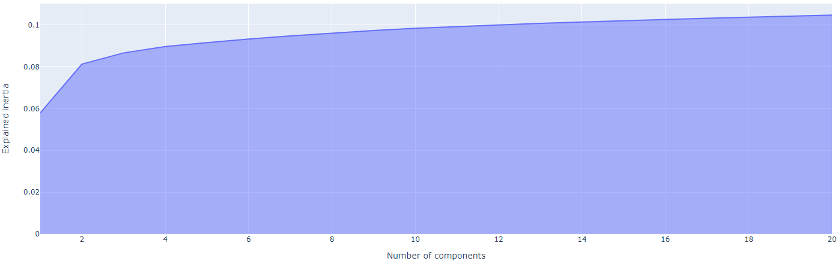
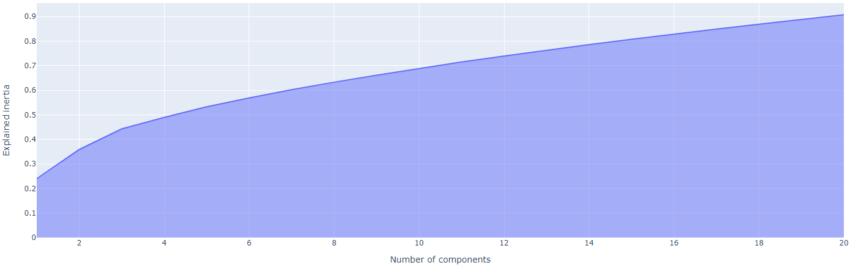
Dimensionality reduction (MCA)
Data 1
Data 2 : 90% 20 components

Slide 11
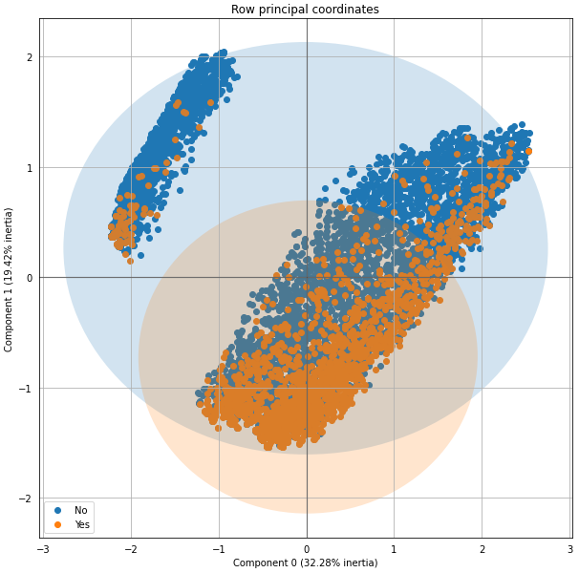
Dimensionality reduction (FAMD)
Data 1
Data 2
FAMD calls for both categorical and numeric data. The second set consist of only categorical data because I tiered the numeric columns.

Slide 12
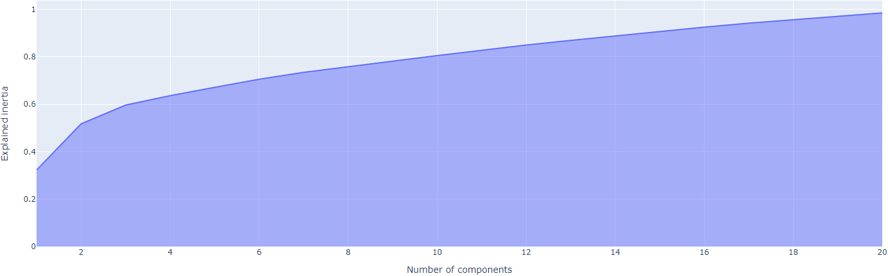
Dimensionality reduction (FAMD)
Data 1: 90% 15 Components
Data 2
FAMD calls for both categorical and numeric data. The second set consist of only categorical data because I tiered the numeric columns.

Slide 13
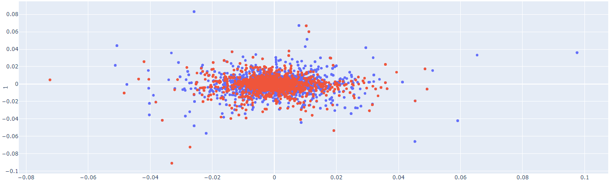
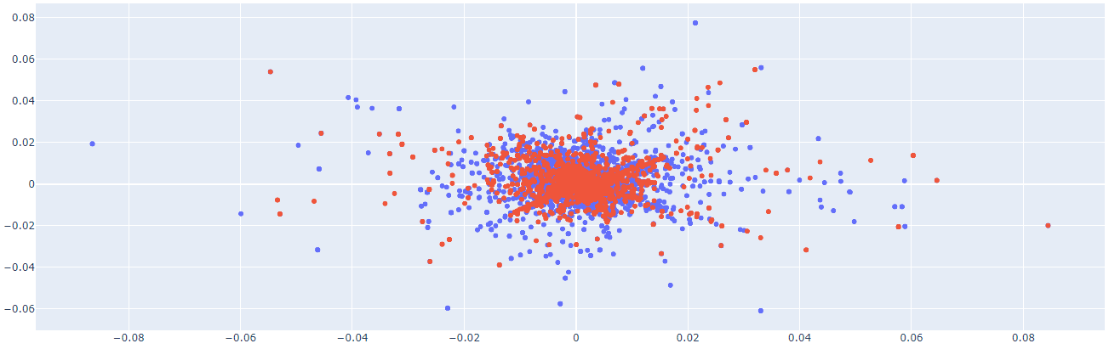
Dimensionality reduction (LLE)
Data 1
Data 2

Slide 14
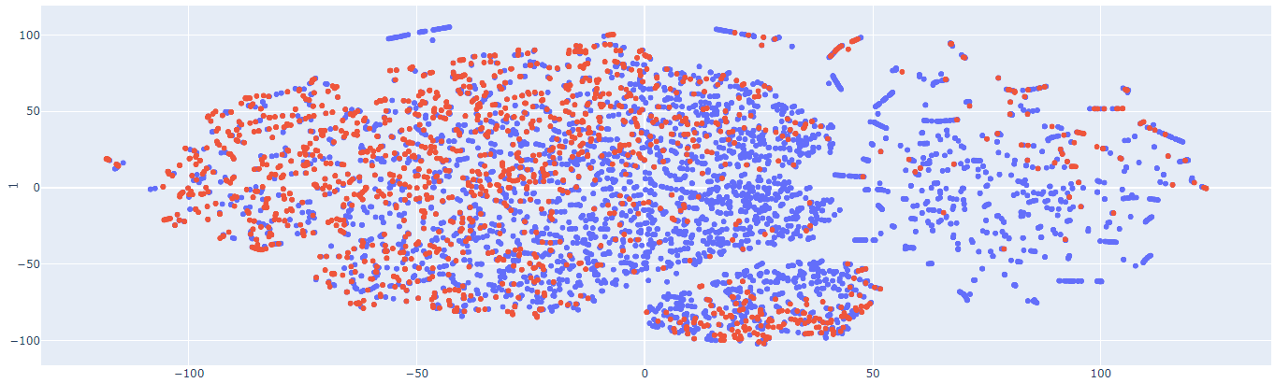
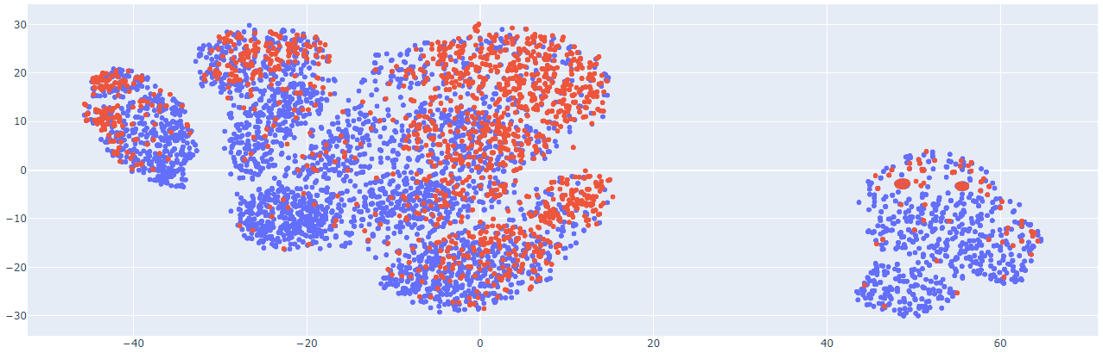
Dimensionality reduction (t-SNE)
Data 1
Data 2

Slide 15
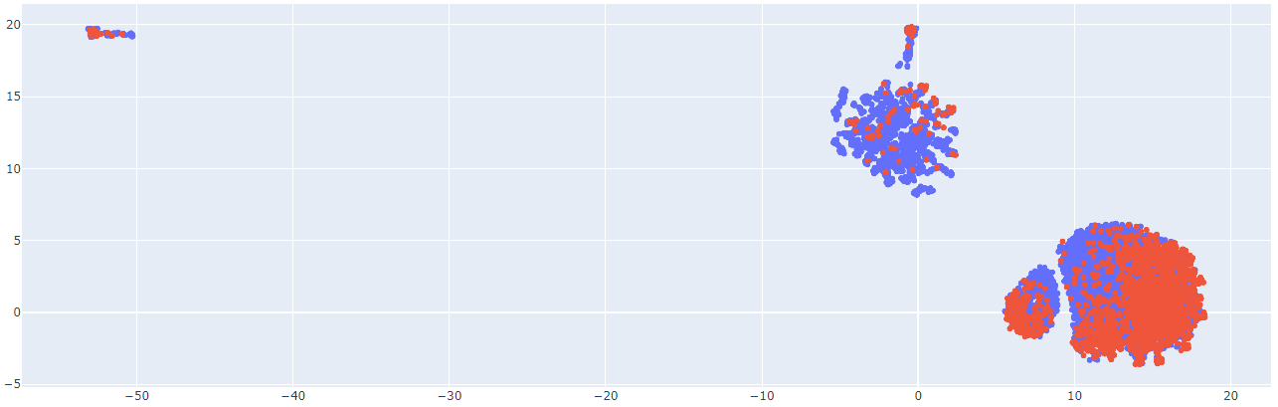
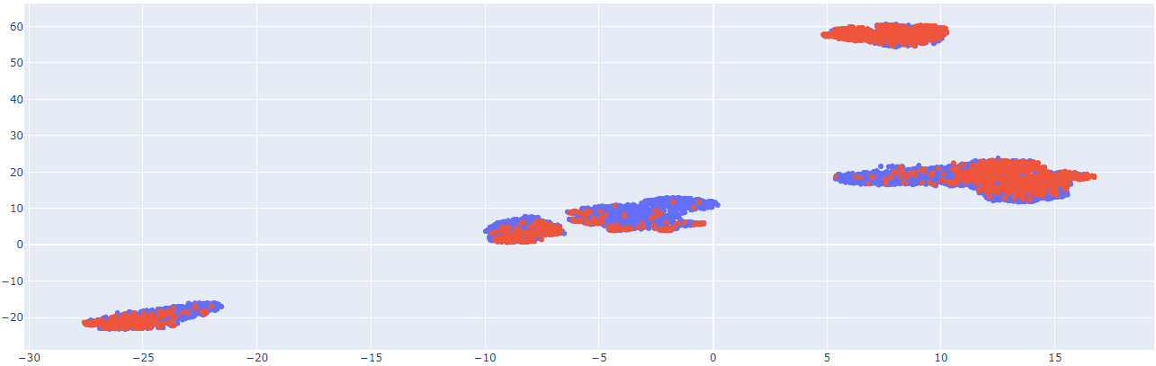
Dimensionality reduction (UMAP)
Data 1
Data 2

Slide 16
Deciding which reduction for clustering
Data 1
Data 2
FAMD reduction showed two distinct clusters. ‘Yes’ churned targets were bunched together within their larger clusters.
t-SNE reduction had distinct regions that gradually shifted from no to yes and vice versa.
MCA reduction mapped two distinct clusters.
t-SNE reduction had more overall clusters mapped but also had more homogenous clusters.

Slide 17
Dive on in… the clusters fine

Slide 18
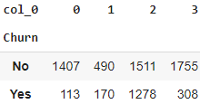
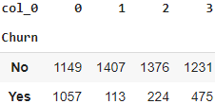
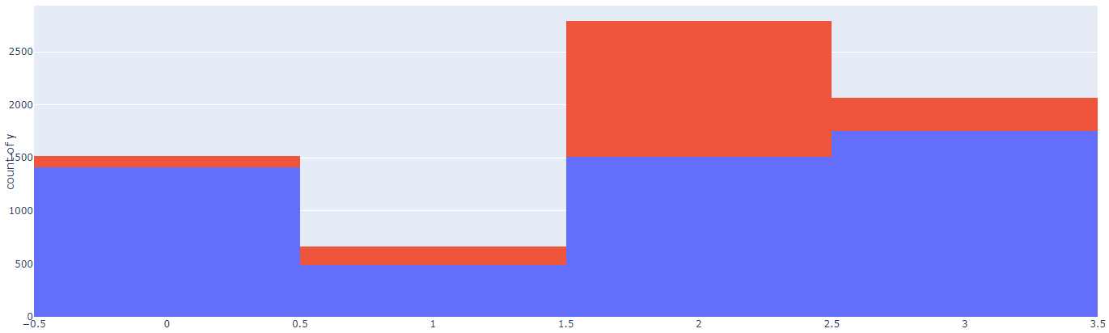
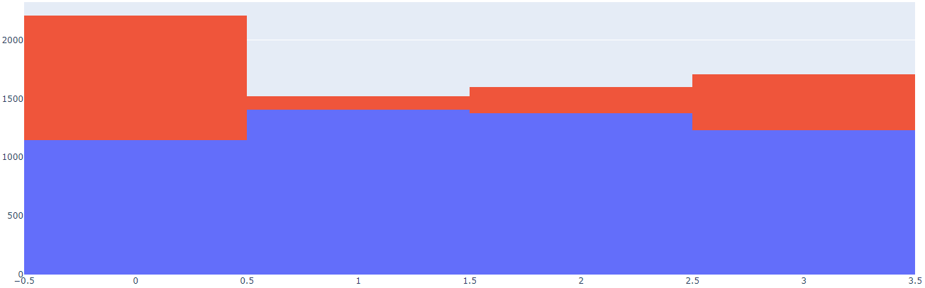
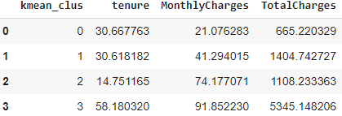
Clustering (Kmeans)
Data 1: FAMD
Data 2: MCA

Slide 19
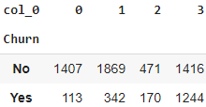
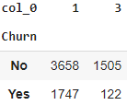
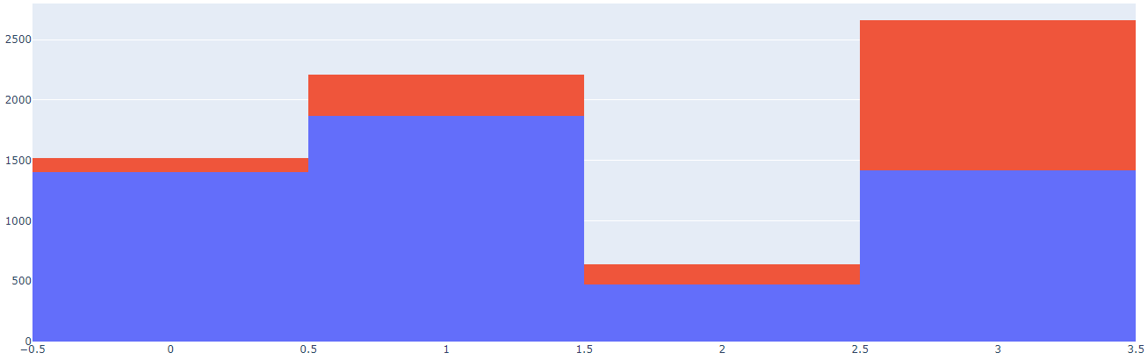
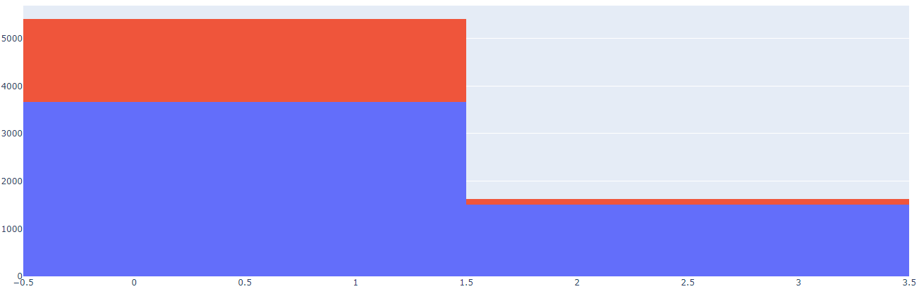
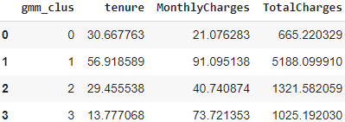
Clustering (Gaussian Mixture)
Data 1: FAMD
Data 2: MCA

Slide 20
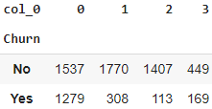
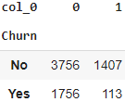
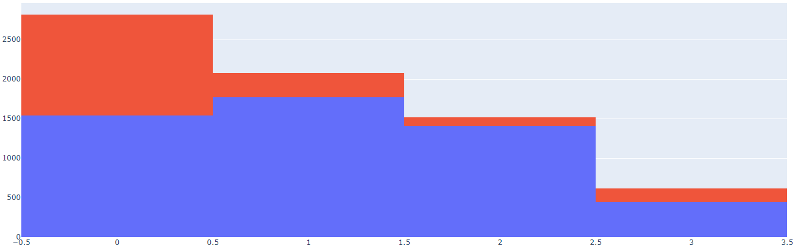
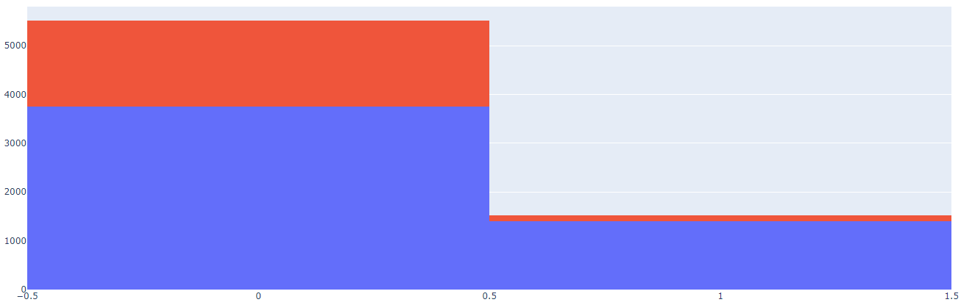
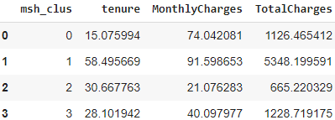
Clustering (mean shift)
Data 1: FAMD
Data 2: MCA

Slide 21
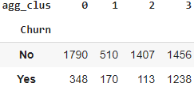
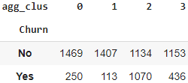
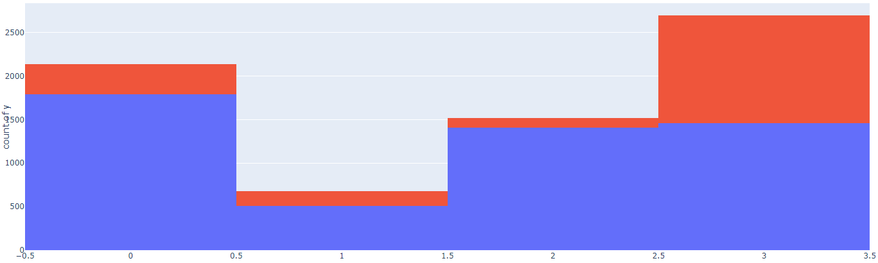
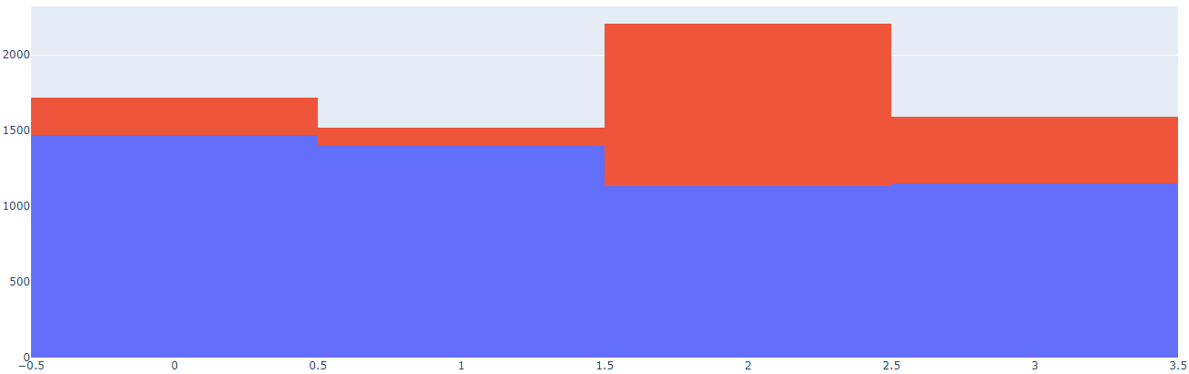
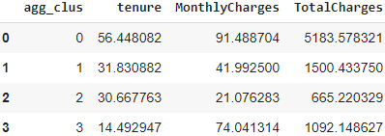
Clustering (agglomerative)
Data 1: FAMD
Data 2: MCA

Slide 22
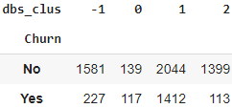
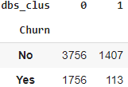
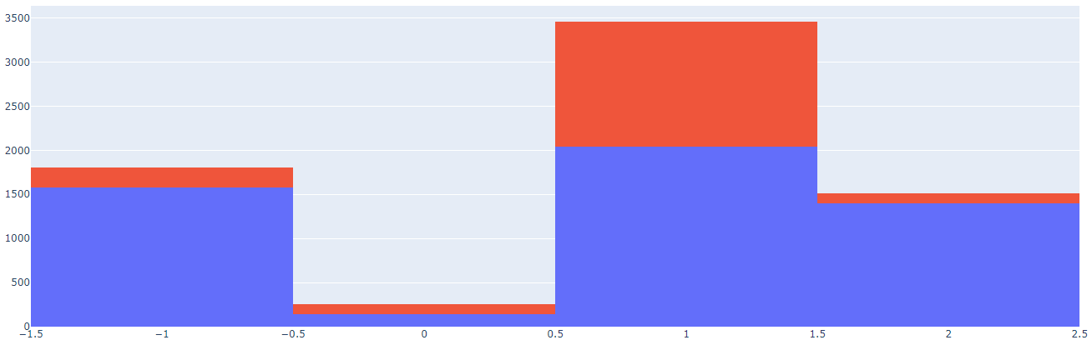
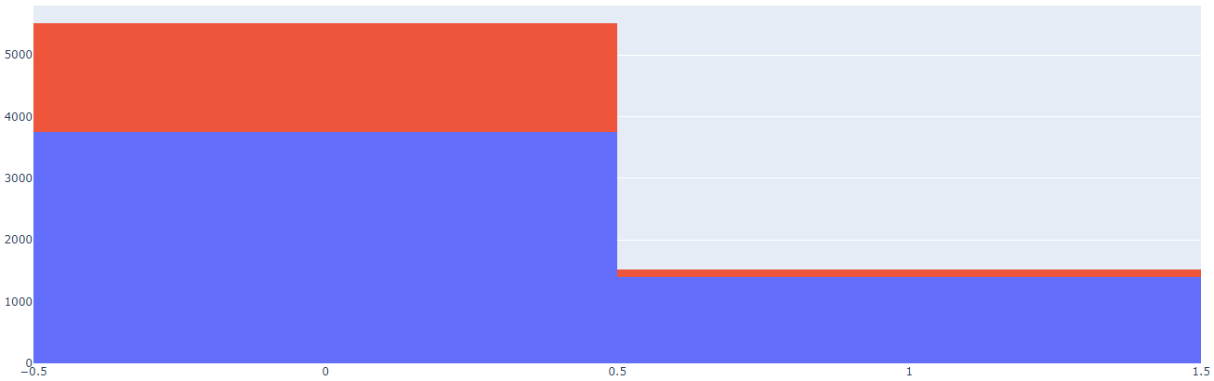
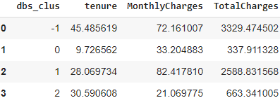
Clustering (dbscan)
Data 1: FAMD
Data 2: MCA

Slide 23
T-sne comparisons

Slide 24
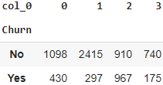
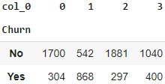
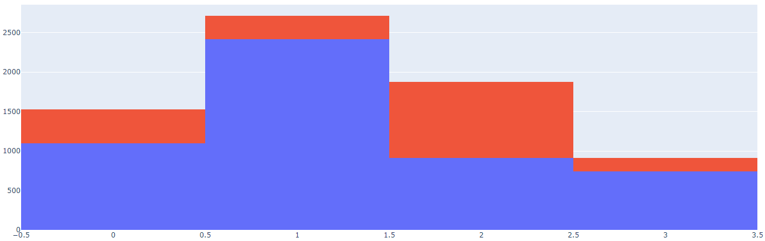
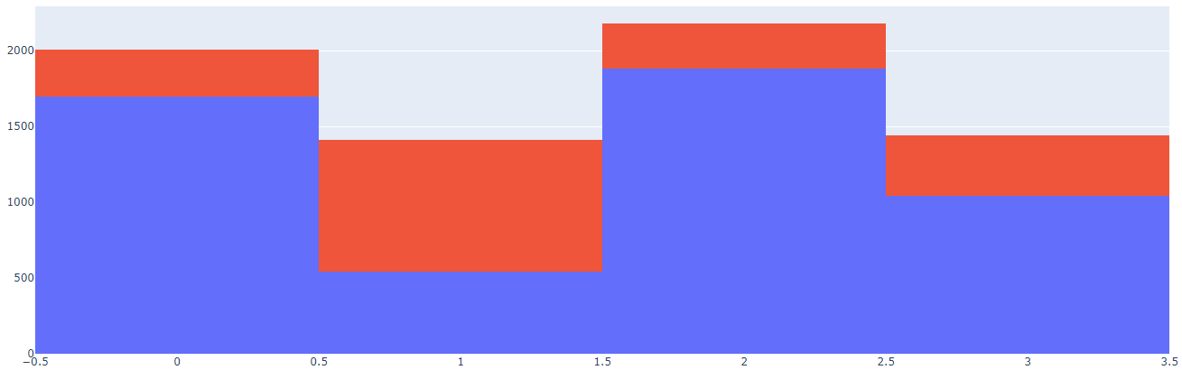
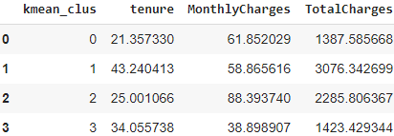
Clustering (Kmeans)
Data 1: t-SNE
Data 2: t-SNE

Slide 25





Clustering (Gaussian Mixture)
Data 1: t-SNE
Data 2: t-SNE

Slide 26





Clustering (mean shift)
Data 1: t-SNE
Data 2: t-SNE

Slide 27





Clustering (agglomerative)
Data 1: t-SNE
Data 2: t-SNE

Slide 28





Clustering (dbscan)
Data 1: t-SNE
Data 2: t-SNE

Slide 29

So you think you can churn???
Data: Version 1
When comparing silhouette scores Kmeans and GMM performed best respectively with FAMD.
When comparing adjusted rand scores GMM and Kmeans performed best respectively with t-SNE.

Slide 30

So you think you can churn??? Data version 2
Data: Version 2
When comparing silhouette scores Mean Shift and DBScan performed best respectively with MCA.
When comparing adjusted rand scores Kmeans and Agglomerative performed best respectively with t-SNE.
Version 2 produced far superior silhouette scores than version 1, however version 1 had superior AR scores.

Slide 31
Best reduction and cluster combo
Data: Version 1
Data: Version 2
A combination of Kmeans and GMM with either FAMD or t-SNE will produce the best clustering results based on silhouette scores or AR scores.
If leaving the “Tenure”, “Monthly Charges’, and “Total Charges” columns as numeric.
If using version 2 with the bucketed numeric features. It will depend on what kind of metric to define model “goodness”. Silhouette score vs Adjusted rand score. Given the data I would recommend minimizing the randomness of the clusters and go with AR Score.

Slide 32
Churn baby churn… …wait. No!!
Winners and Losers: Data 1
Winner and Losers: Data 2
The various clustering techniques all picked up on similar trends within the numeric columns. Tenure obviously played a role. Someone who has been with the company for a long time obviously hasn’t churned. When combined with a high monthly cost, newer customers are turned off by high initial bills.
Although no numerical aggregations could be ascertained. There is still value in the clustering chunks. Additional resources are available for a deeper breakdown of the chunks. The chunks within data 2 did an overall better job of segmenting where additional resources should be focused.

Slide 33
In conclusion
Bucketing the numeric to have all categorical features is ideal. T-SNE coupled with clustering techniques and evaluating based on adjusted rand will minimize the randomness within the clusters. Version 2, t-SNE reduction, and Kmeans as a clustering technique are ideal.

Slide 34
Improvements??
Processing:
Clustering:
Feature engineering.
Dropping correlated features.
Fine tuning the dimensionality reductions.
Fine tuning hyperparameters of the clustering algorithms.
Grid searching and cross validating results.

Slide 35
Thank you
Shout Out….
… to Kaggle for providing a space to share the data.
… to IBM for building the sample dataset.
… to Thinkful for providing an opportunity to excel.
Have a great day!!

