Slide 1
How to guarantee: They run that track back!!
What makes a hit song a hit?
By: George Gee

Slide 2
The Data
Over 40k observations.
Songs from the 60’s – 10’s.
Predetermined target variable:
1: Hit
0: Not-Hit
Equal number of each
Both categorical and numeric features.
Categorical:
Time Signature (beats per measure)
Mode (Major or Minor)
Key (C/D/E/F/etc.)
Numeric
Danceability
Loudness
Acousticness
Instumentalness
Valence
Tempo
Duration (ms)
Notes:
Mode: The modality aka scale of the song.
Key: The overall pitch/key of the song.
Loudness: Measured in decibels dB.

Slide 3
Data Processing
Categorical variables turned into dummy variables.
Numeric variables scaled with standard scaler.
Complete data no nulls!
Target variable in perfect balance so all outliers are (initially) approved.
Columns that were dropped:
Track (song name)
Artist
uri (unique Spotify identifier)
Chorus hit
Sections
Speechiness
Liveness
Energy
Notes:
-Track name isn't important when considering if people are going to like it.
-Who the artist is doesn't determine if a track will be a hit or not.
-URI the spotify identifier surely can't predict a hit song.
-Chorus_hit is the authors best guess at when a chorus begins. Subject to extreme bias.
-Sections should be correlated with duration. The more sections a song has the longer the duration of said song.
-Speechiness has a correlation with instrumentalness. As one rises the other falls.
-Liveness is a measure how whether a crowd could be detected within the track. Liveness should play no role in whether a track is a hit or not. In addition any song that adds crowd noise or applause in post production will trigger a false reading.
-Energy had high correlations of .77 and -.71 with loudness and acousticness respectively.

Slide 4
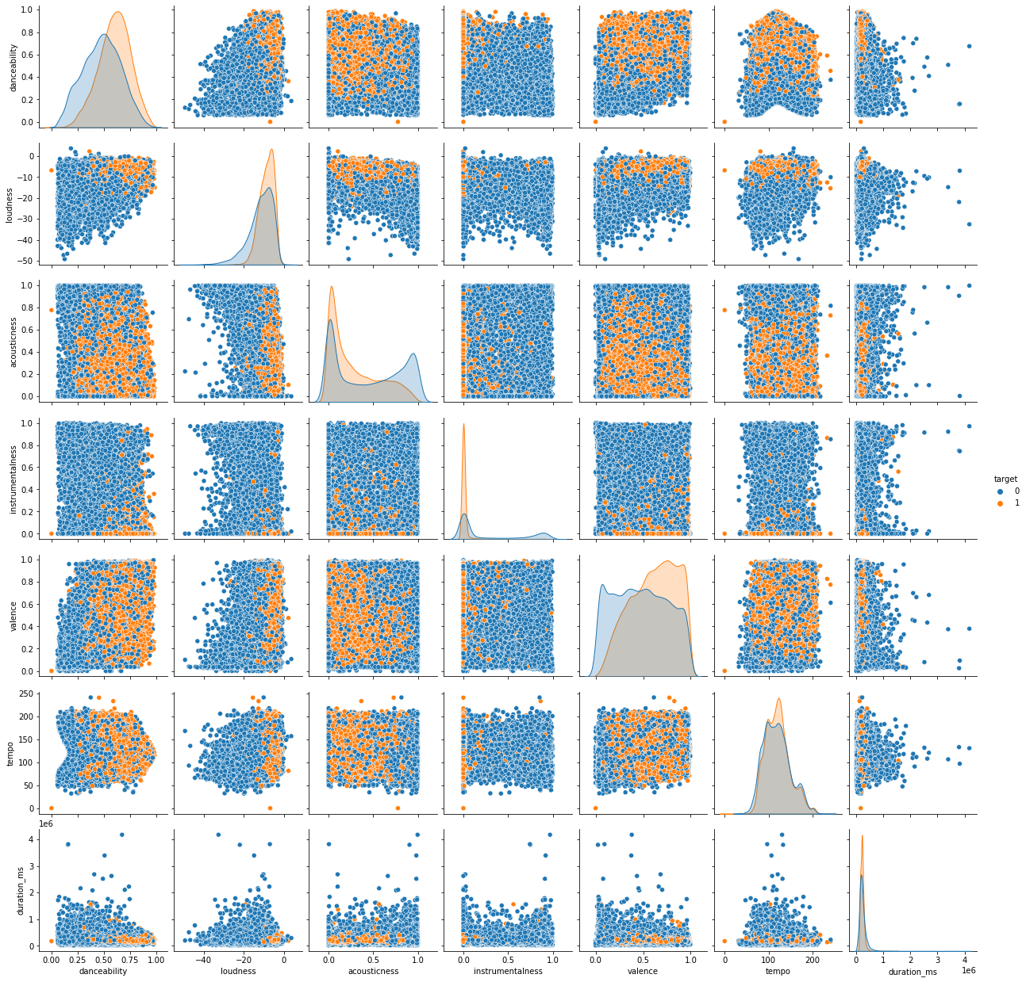

Slide 5
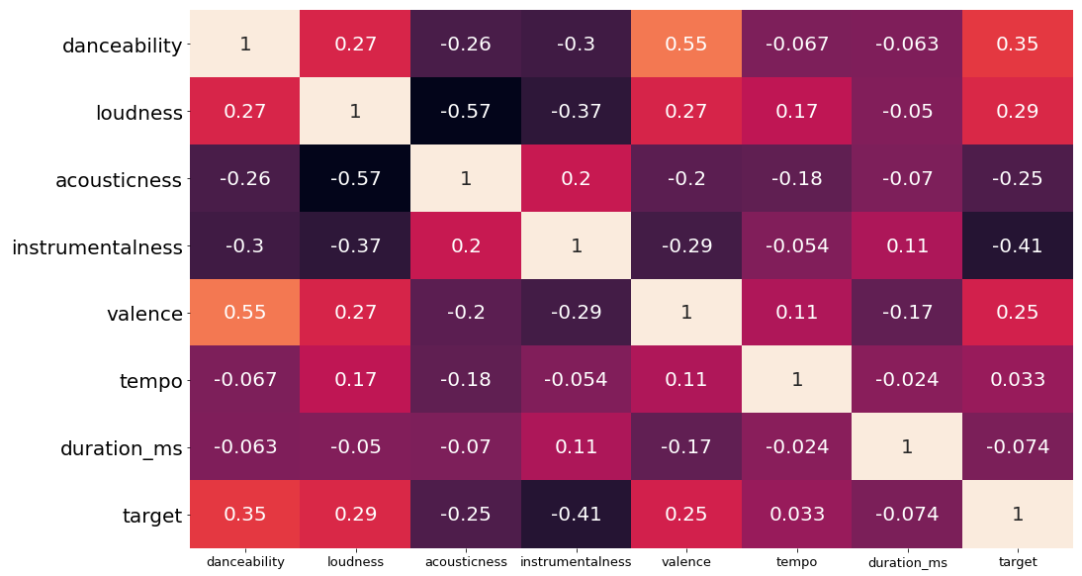
Correlations
Danceability has the highest positive correlation with the target variable.
Instrumentalness has the highest negative correlation with the target variable.
Notes:
-danceability has the highest positive correlation with the target value. Not surprising as Men Without Hats once stated
"We can dance if we want to. We can leave your friends behind. Cause your friends don't dance and if they don't dance. Well they're no friends of mine."
Getting people to move and groove makes sense as a potential predictor towards hit status.
-instrumentalness has the highest negative correlation which makes sense as most hit songs tend to feature someone singing, rapping, or some kind of spoken word over the music. Although I personally find it best to listen to instrumental music while working/studying.
Instrumentalness will likely play the biggest factor in determining hit-status.

Slide 6
Model Prep
Data split 60/40 (train/test)
Logistic Regression
Support Vectors
KNearest Neighbors
Decision Tree
Random Forest
Gradient Boost
XGBoost
All models were chosen for their strengths with classifying discrete variables.
Models needed to perform well on a two key metrics for consideration. F1-score (balance of recall and precision) and overall accuracy.

Slide 7
…and then there were two.
Random Forest
XGBoost
First Round Scores
Average f1-score: 75%
Accuracy score: 76%
Second Round Score
Average f1-score: 78%
Accuracy score: 78%
First Round Scores
Average f1-score: 76%
Accuracy score: 76%
Second Round Score
Average f1-score: 78%
Accuracy score: 78%
Tie Breaker:
Best Grid Search F1:
78.63% VS 78.67%

Slide 8
WINNER: XGBoost
After final adjustments:
Training: Accuracy 80% and F1 79%
Testing: Accuracy 77% and F1 77%
Although not great it is 27% better than a dummy model splitting the hit v non-hit equally at 50% as there is an equal representation of both outcomes.

Slide 9

So… what makes a hit?
Instrumentalness explained 30.15% variance
Acousticness explained 9.88% variance
Danceability explained 9.06% variance
Mode(Major scale) explained 6.16% variance
Time Sig explained 5.77% variance
17 features explained between 1%-5.5%
1 features explained < 1%

Slide 10
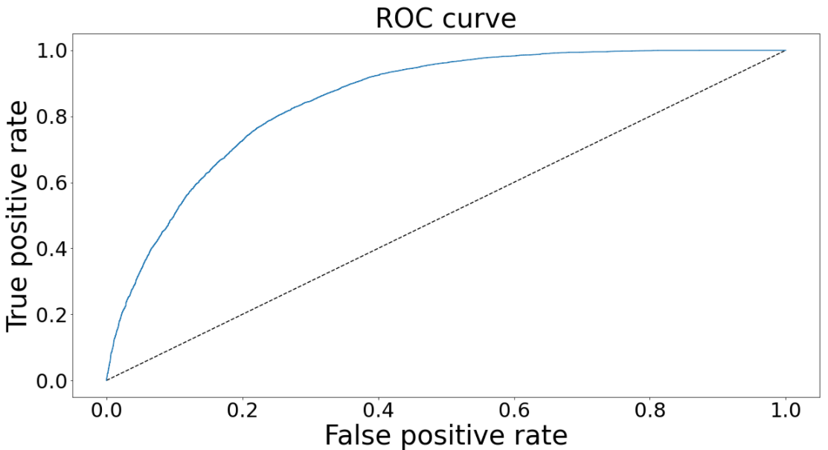
Growth??
The ROC Curve shows some room for improvement.
Additional tuning of the hyperparameters could yield better results.
Eliminating outliers could help focus the data and eliminate noise.

Slide 11

THANK YOU!

