Slide 1

Worldwide Suicides and the Socio-Economic Indicators.
1985-2015
Presenter:
George Gee

Slide 2

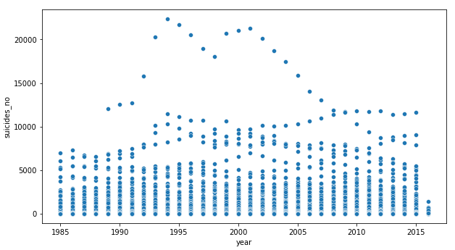
Suicides by year
For many countries, suicide rates remain unchanged.
We will be exploring a few socio-economic factors
GDP/year
GDP/capita
HDI Human Development

Slide 3

Hypothesis
As a countries GDP/year rises their suicide totals will fall.
As a countries GDP/capita rises their suicide totals will fall.
As a countries Human Development Score (HDI) increases their suicide totals will fall.

Slide 4

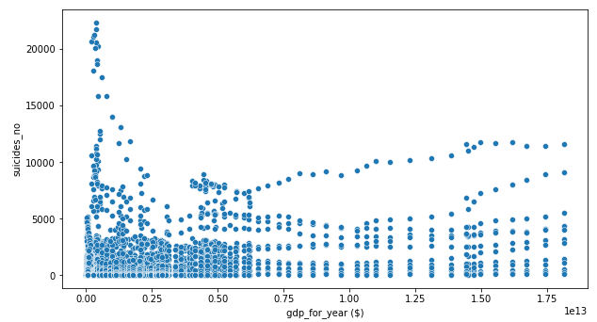
Suicides by GDP/year
The GDP range $46,919,625(Kiribati) to $18,120,714,000,000 (US).

Slide 5
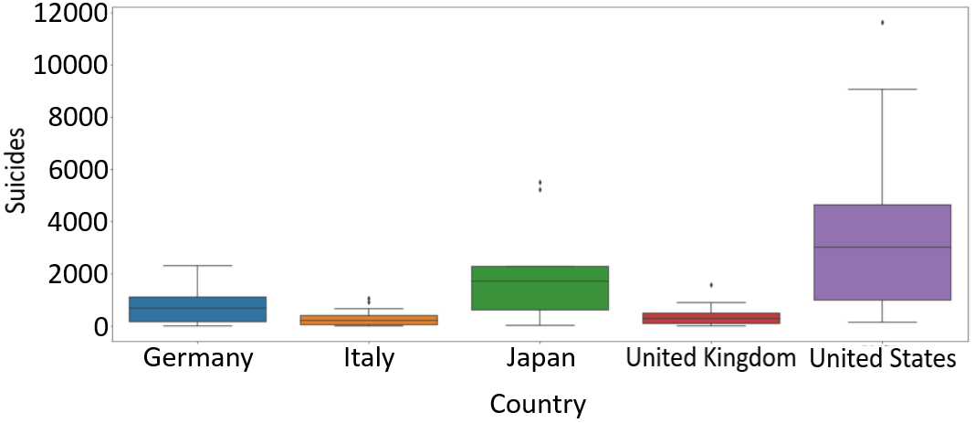
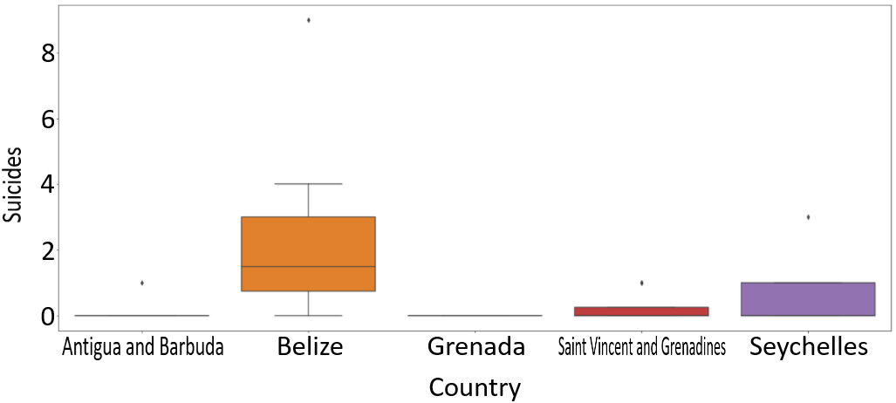
Suicides by GDP/year 2015
TOP
United States, Japan, Germany, United Kingdom, Italy
Total Suicides: 86,267
BOTTOM
Saint Vincent and Grenadines, Grenada, Antigua and Barbuda, Seychelles, Belize
Total Suicides: 37

Slide 6
Suicides by GDP/year 2015
Mann-Whitney results
Statistic = 5.5, p-value = 3.028692260654975e-22
Kruskal-Wallis results
Statistic = 92.76080296335026, p-value = 5.901242304078644e-22
The 95% confidence interval ranges from -1992.988 to -881.345.

Slide 7
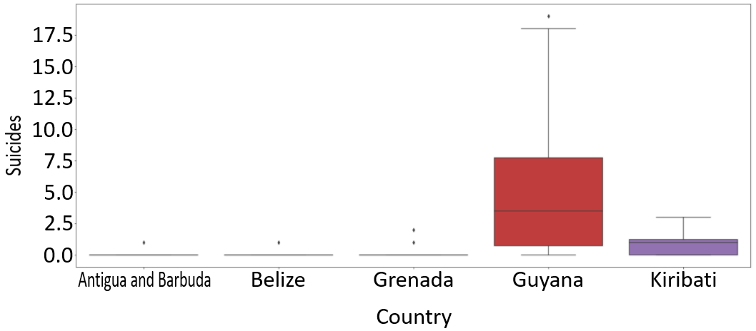
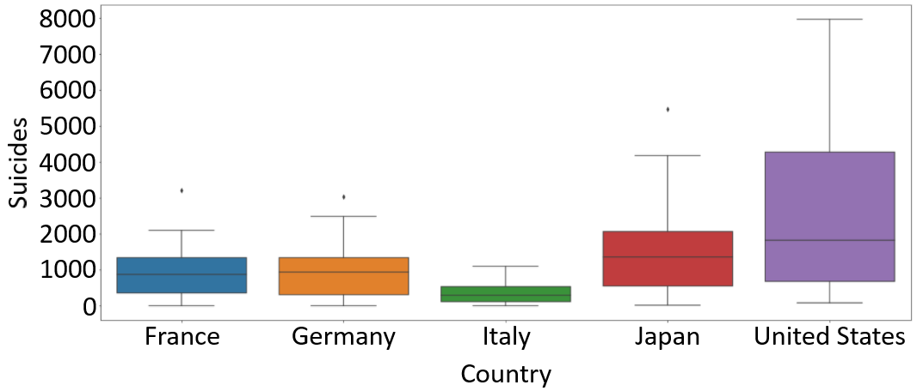
Suicides by GDP/year 1993
BOTTOM
Kiribati, Grenada, Guyana, Antigua and Barbuda, Belize
Total Suicides: 89
TOP
United States, Japan, Germany, France, Italy .
Total Suicides: 81,075

Slide 8
Suicides by GDP/year 1993
Mood’s Median results
93.63333333333334, p-value = 3.797382535195607e-22, 14.5
Kruskal-Wallis results
Statistic = 91.58947253244064, p-value = 1.0665893043970622e-21
The 95% confidence interval ranges from 945.036 to 1754.498.

Slide 9
Suicides by GDP/year SUMMARY
2015 rejected null hypothesis p-values and contained valid confidence intervals
1993 rejected null hypothesis p-values and contained valid confidence intervals
It would appear that the number of suicides were more numerous in both instances of top five vs bottom five GDP/year values.

Slide 10
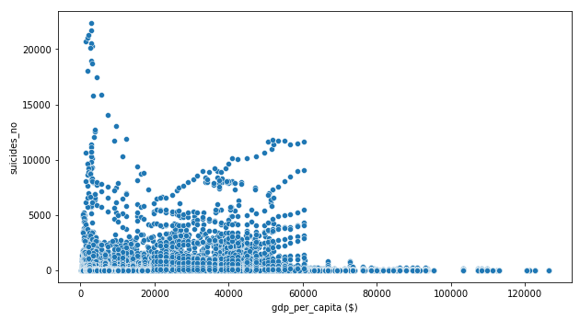
Suicides by GDP/capita
The GDP/capita range is from $251 (Albania) to $126,352 (Luxembourg).
Norway and Luxembourg are the only two countries that have GDP/capita above $100,000.

Slide 11
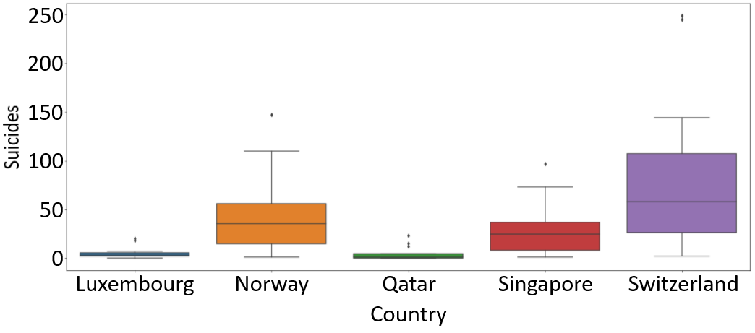
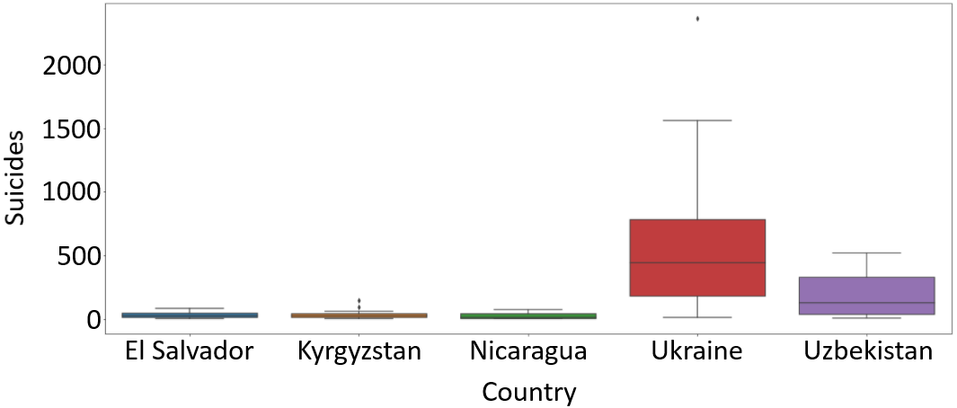
Suicides by GDP/capita 2014
TOP
Luxembourg, Norway, Qatar, Switzerland, Singapore
Total Suicides: 2,057
BOTTOM
Kyrgyzstan, Nicaragua, Uzbekistan, Ukraine, El Salvador
Total Suicides: 11,221

Slide 12
Suicides by GDP/capita 2014
Mood’s Median results
5.633333333333334, p-value = 0.017622090962324415, 22.5
Mann-Whitney results
Statistic=1048.0, p-value = 3.970252226239632e-05
The 95% confidence interval ranges from 49.746 to 225.720.

Slide 13
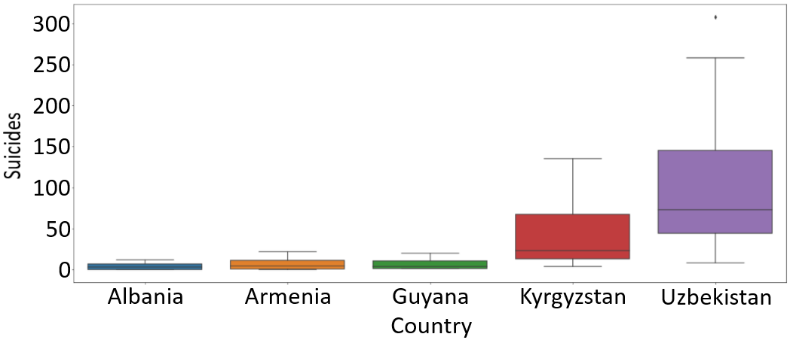
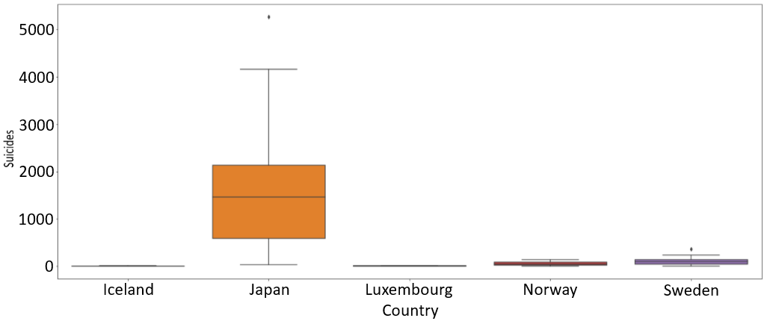
Suicides by GDP/capita 1992
BOTTOM
Albania, Armenia, Guyana, Kyrgyzstan, Uzbekistan
Total Suicides: 2,043
TOP
Luxembourg, Sweden, Japan, Norway, Iceland
Total Suicides: 22,814

Slide 14
Suicides by GDP/capita 1992
Kruskal-Wallis results
Statistic = 3.3556499172279617, p-value = 0.06697476837120041
Mood’s Median results
0.3, p-value = 0.583882420770365, 10.5
95% confidence interval ranges from 99.225 to 593.142.

Slide 15
Suicides by GDP/capita SUMMARY
2014 rejected null hypothesis p-values and contained valid confidence intervals
1992 accepted null hypothesis p-values and contained valid confidence intervals
The general trend suggests that a higher GDP/capita equates to a lower suicide count. With one null rejected and the other accepted, additional years should be tested.

Slide 16
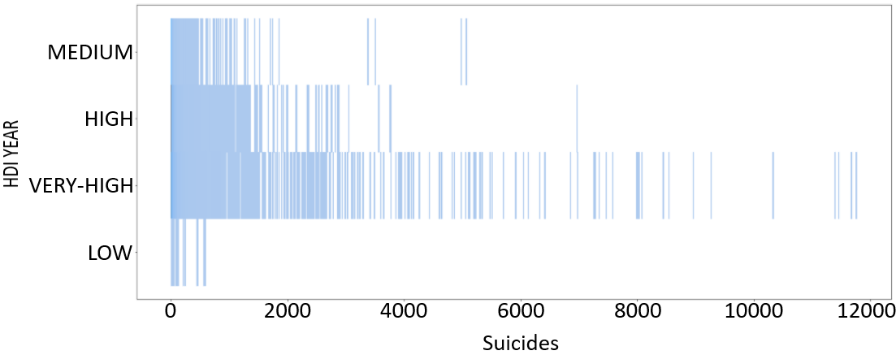
Suicide by HDI (Human Development Index) (1985-2015)
Low = .350 - .549
Med = .550 - .699
High = .700 - .799
Very-High = .800 - 1.00

Slide 17
Suicide by HDI (Human Development Index) (1985-2015)
Kruskal-Wallis results
Statistic = 251.6242518942161, p-value = 2.9142046438335437e-54
Mood’s Median results
176.8078136740204, p-value = 4.3131808849473355e-38, 27.0

Slide 18
Suicides by HDI Score SUMMARY
As nations elevate their HDI Scores the rates of suicide also elevate.
Healthier, wealthier, and smarter citizens are potentially more vulnerable to succumbing to suicide.

Slide 19
Hypothesis results
As a countries GDP/year rises their suicide totals will fall.
FALSE
As a countries GDP/capita rises their suicide totals will fall.
UNDETERMINED
As a countries Human Development Score (HDI) increases their suicide totals will fall.
FALSE

Slide 20
In (depressing) Conclusion
It would appear that as nations become wealthier and the citizens become wealthier, healthier, and smarter the rate of suicide begins to creep upward. World leaders should be looking for ways to maximize the main economic drivers, their citizens. A deceased citizen can no longer help to increase the economic potential of the country.

Slide 21


Slide 22

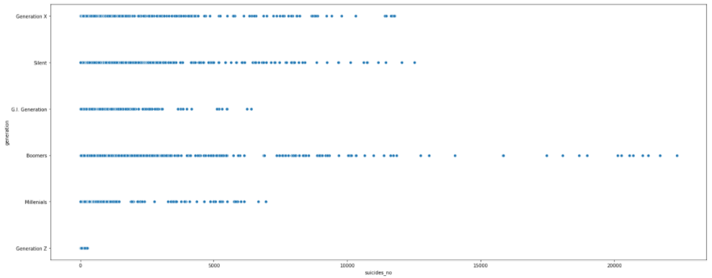
Suicide by Generation (1985-2015)
1901-1927 -- G.I.
1928-1945 – Silent
1946-1964 – Boomers
1965-1979 – Generation X
1980-1994 – Generation Y (Millennials)
1995-2009 – Generation Z

Slide 23
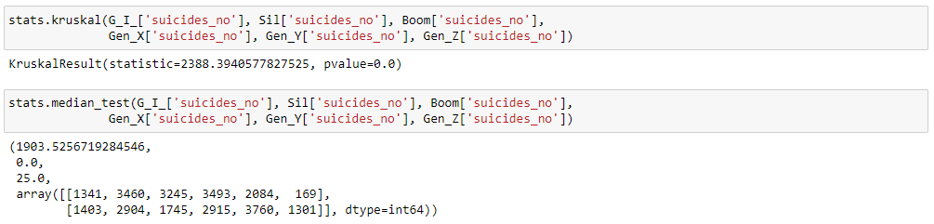
Suicide by Generation (1985-2015)
GI: Skew = 5.756 / Kurt = 44.076
Silent: Skew = 6.999 / Kurt = 61.936
Boom: Skew = 8.201 / Kurt = 86.77
Gen-X: Skew = 8.103 / Kurt = 82.389
Gen-Y: Skew = 9.484 / Kurt = 108.938
Gen-Z: Skew = 4.958 / Kurt = 32.029
Kruskal-Wallis test and a Mood’s Median test yield p-values of 0.0.

Slide 24

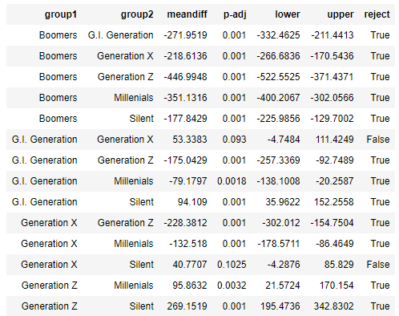
Suicide by Generation (1985-2015)
The TukeyHSD test yielded results almost across the board that reject the null hypothesis. Two instances within Generation X failed to reject the null.

Slide 25
Suicides by Generation SUMMARY
Each generation has statistically different medians.
Each generation experiences suicide at different instances but occasionally overlap, likely due to specific age groups shared between generations.

Slide 26
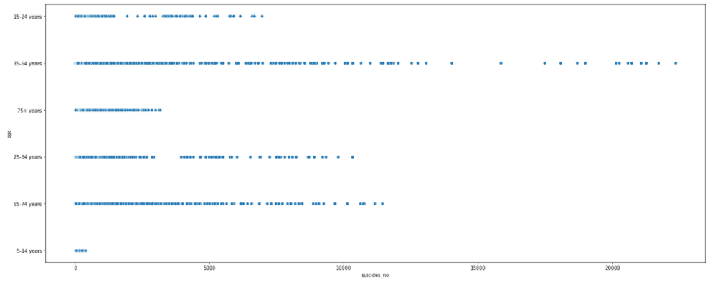
Suicide by Age Group (1985-2015)
5-14 years old
15-24 years old
25-34 years old
35-54 years old
55-74 years old
75+ years old

Slide 27

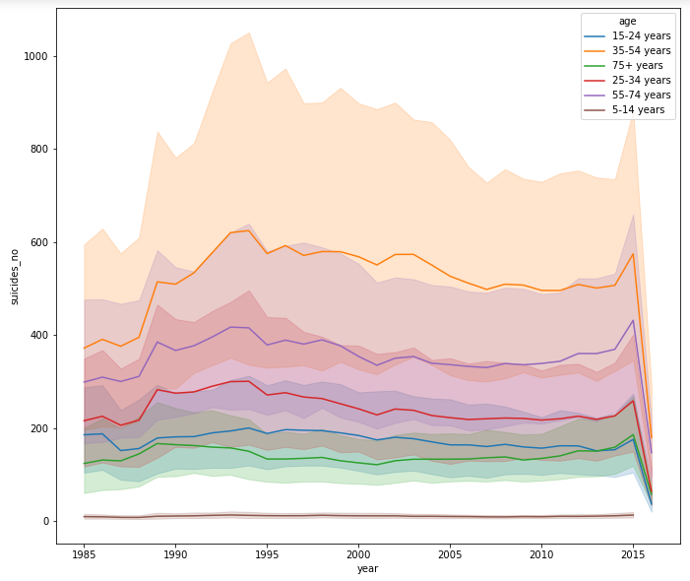
Suicide by Age Group (1985-2015)
Individuals within the age range of 35-54 historically have the highest suicide count.
The data shows that as we age from childhood the likelihood of suicide increases. However, we reach a certain age and the likelihood then begins to fall.
The stressors of life mount up and mount up until potentially retirement and then smooth sailing till your timely dirt nap from sickness or old age.

Slide 28
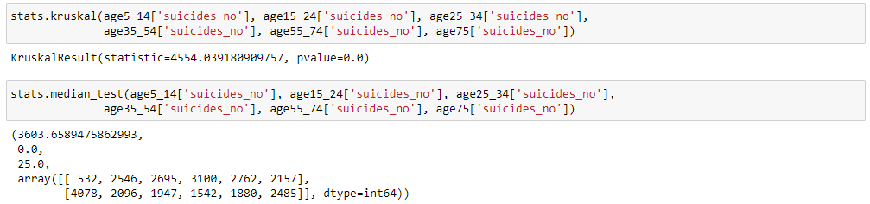
Suicide by Age Group (1985-2015)
5-14 years: Skew = 6.630 / Kurt = 56.921
15-24 years : Skew = 7.428 / Kurt = 66.452
25-34 years : Skew = 7.438 / Kurt = 66.979
35-54 years : Skew = 7.318 / Kurt = 68.585
55-74 years : Skew = 5.771 / Kurt = 40.304
75+ years : Skew = 4.303 / Kurt = 20.689
Kruskal-Wallis test and a Mood’s Median test yield p-values of 0.0.

Slide 29
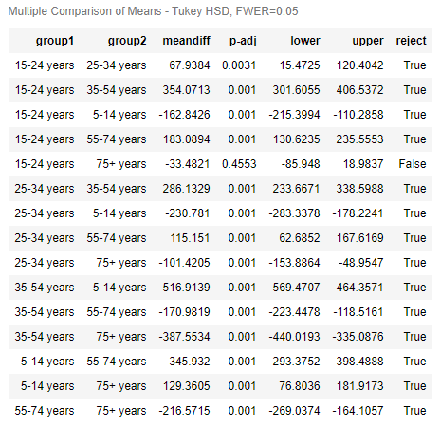
Suicide by Age Group (1985-2015)
The TukeyHSD test yielded results almost across the board that reject the null hypothesis. One instance of 15-24 – 75+ failed to reject the null hypothesis. Can’t win them all…

Slide 30
Suicides by Age Group SUMMARY
Each age group has statistically different medians.
Year over year age groups experiences suicides at different rates.
Occasionally in a single year two very distinct age groups can simultaneous shift their trends to produce an accepted null hypothesis.

