Slide 1
NLP(tween) Da Sheets
By George Gee

Slide 2

Sexy nlp?! No way!! yeah, baby yeah!!
The what?
Background: 50% of all beautiful… and ugly marriages end in divorce.
Leading cause of divorce is a lack of intimacy which can lead to infidelity.
Mission: Train NLP to help re-ignite intimacy spark.
BONUS: Happy sexually satiated couples are less likely to be involved in abusive behavior. Domestic violence cases are on the rise.

Slide 3

Scientific process…
Phase 1: Identify problem (rising divorce rates)
Phase 2: Brainstorm novel ideas to combat problem.
Phase 3: Gather resources…
Alf is ready for combat… leggo!!

Slide 4
The Source
For Efficiency's Sake (Easy Part)
Free romantic sexually suggestive stories are in no short supply on the internet. There are a number of sites dedicated to hosting repositories of stories from authors of both professional and amateur acclaim.
Special shoutout to textfiles.com for this adventure.
Over 4000 stories readily available. Ranging from a few hundred lines to 26,000+ lines of text.
Built custom web-scraper that went letter by letter and copied the text to file.
Woes of ROUGH DATA (Hard Part)
Had to go file by file and remove custom metadata REGEX can’t handle.

Slide 5
sexy Nostalgia… because it’s there
The Data
Corpus (Nostalgia)
Small handful of stories incorporating popular tv-show, movie, and political figures dating from 1988-1994.
Alf
Aliens
Smurfs
Brady Bunch
Star Trek
Hillary Clinton
…and more!!
20 documents
30291 Sentences
13217 Unique Vocab Words
Corpus (SexyBot)
420 Documents
139149 Sentences
30623 Unique Vocab Words

Slide 6
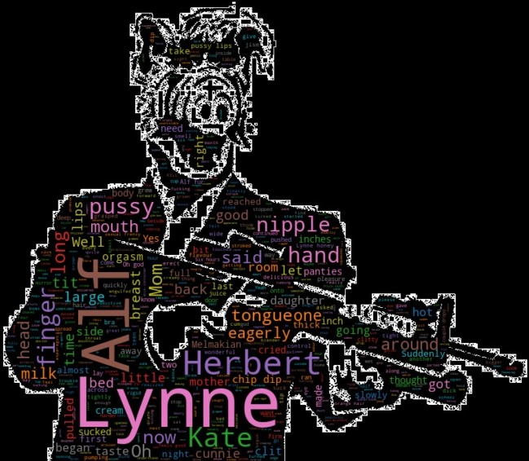
The process continues…
Phase 1: Identify problem (rising divorce rates)
Phase 2: Brainstorm novel ideas to combat problem.
Phase 3: Gather resources…
Phase 4: Play with resources to find solutions.
Phase 5: Stir pot…
Phase 6: Stir some more…
Alf is really getting into it…

Slide 7
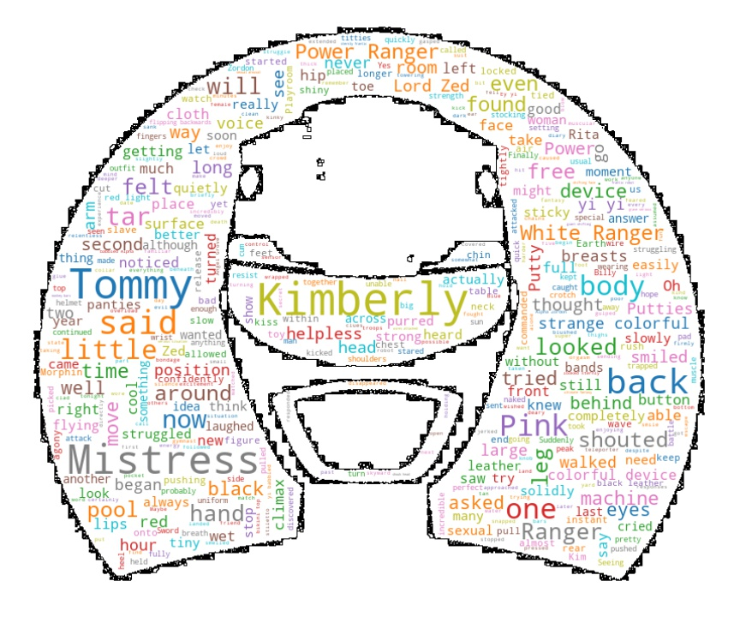
I’m just not seeing it…
Example: Power Rangers
Scenario Seeds:
She had a date tonight with Tommy, the White Ranger.
full red lips widened to a broad, evil smile.
Tommy's eyes grew thoughtful.
Summary Seeds:
"All right, you asked for it!" Tommy said as he
"Tommy!" gasped The Pink Mistress, as they heard
Tommy and Kimberly felt a familiar vibrating

Slide 8
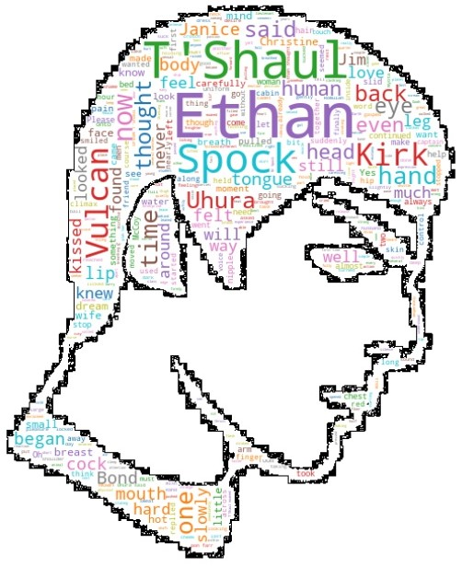
Teen years nostalgia… check!
Example: Star Trek (Spock)
Live long and prosper… in bed!
Scenario Seeds:
There is nothing they can do but poke and prod, hoping to.
First her neck, then her shoulders
Uhura said, moving over to
Summary Seeds:
isn't it Spock?" Kirks only reply was a nod from the Vulcan, eyes
Ethan was carefully exploring T'Shauls body, caressing and kissing and
"I want you to suck me off," Dream-Ethan said, rubbing the vulcans breasts

Slide 9
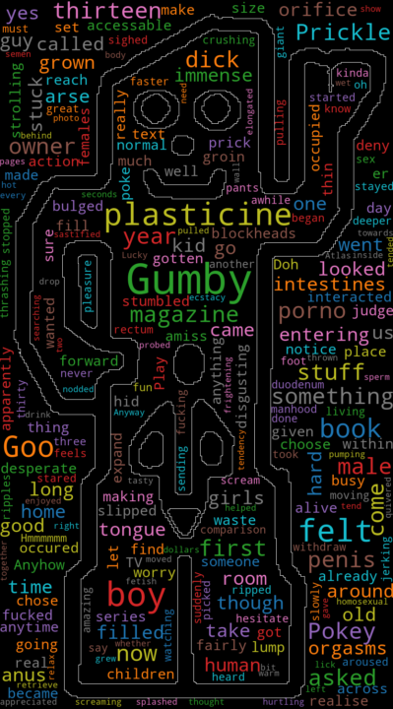
Too mainstream…
Example: Gumby
Scenario Seeds:
I had three orgasms, and boy did I scream with pleasure!
ecstacy as his tongue probed.
He stared down at us a while
Summary Seeds:
Gumby's groin bulged forward and his plasticine
Then I felt Gumby come, pumping hot plasticine sperm into me for a few
I had a guy (a Gumby) pulling his thirty foot dick out my

Slide 10
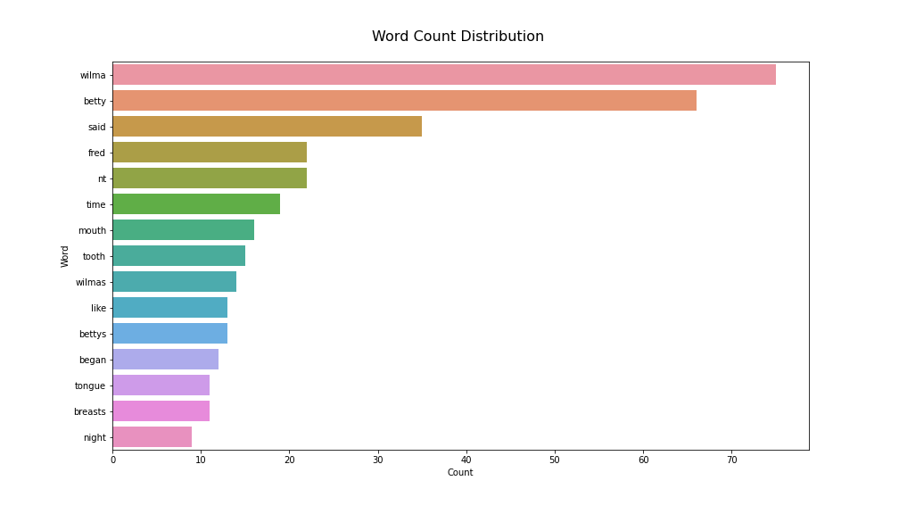
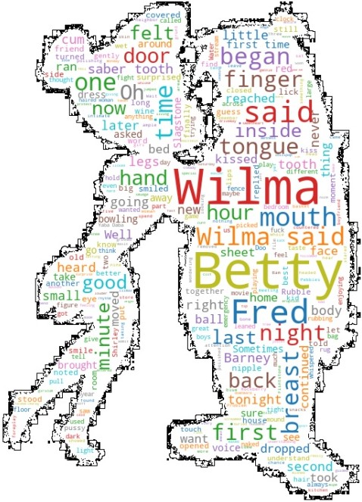
Pineapple is delicious… pineapples is safety!
Trigger (safe…) words

Slide 11
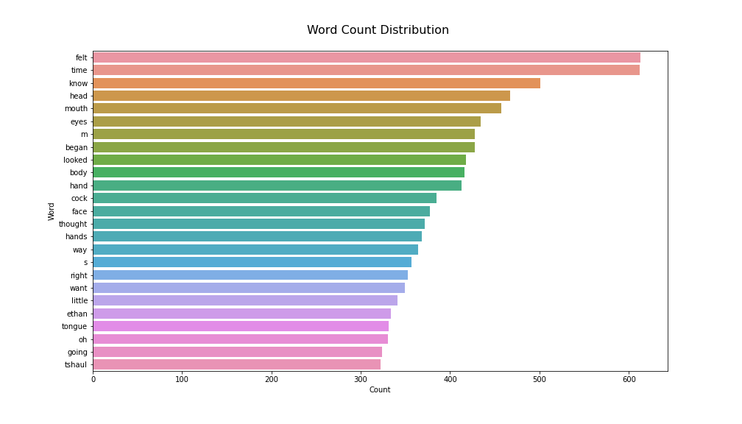

All together now… but not an orgy… a wordgy

Slide 12
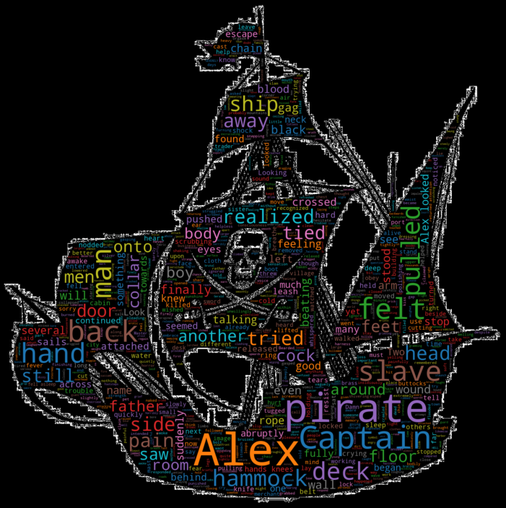
A ronin samurai in the struggle alone…?
Single people struggle with intimacy the most… no one to practice with.
Introducing: SexyBot
SextBot: Let's have a lil fun... If you want to exit, type bye.
User: Hey
SextBot: I missed you!
User: How are you?
SextBot: how are you?
User: I'm good.
SextBot: good
User: Are you horny?
SextBot: you are so horny now!
User: You know me boo
SextBot: you know..
User: Play with yourself.
SextBot: honey play with yourself....
User: We can play together
SextBot: so we can come together.
User: Now you're thinking like a champion!
SextBot: youre...
User: Now youre thinking like a champion.
SextBot: Are you thinking what I think youre thinking?
User: That depends on what you think I'm thinking.
SextBot: depends on what you want replied Rick.
User: Who's Rick?
SextBot: who
User: Hmm suspicious
SextBot: hmm
User: Bye
SextBot: Bye! Please cum again, I'll miss you!!
Trained on 30k+ sentences and growing. With over 200K more to go.
Utilizes Tfidf Vectorization to generate cosign similarities for best responses.
Bonus: SexyBot definitely won’t catfish you and sell your organs.

Slide 13
Use case (a very unconventional sex toy)
The Future:
The Target:
The Scenario Generator will hopefully evolve from a few sentences and summaries to providing full custom stories for couples to act out or just read together.
SexyBot will continue to ingest more sentences to become a better communicator for the lonely souls of the world.
Functionality could be built and launched into a fun and easy to use app.
Any struggling couple seeking a smidgen of additional excitement and wonder.
Marriage counselors seeking to boost their repertoire while embracing the future of ML and NLP.

Slide 14
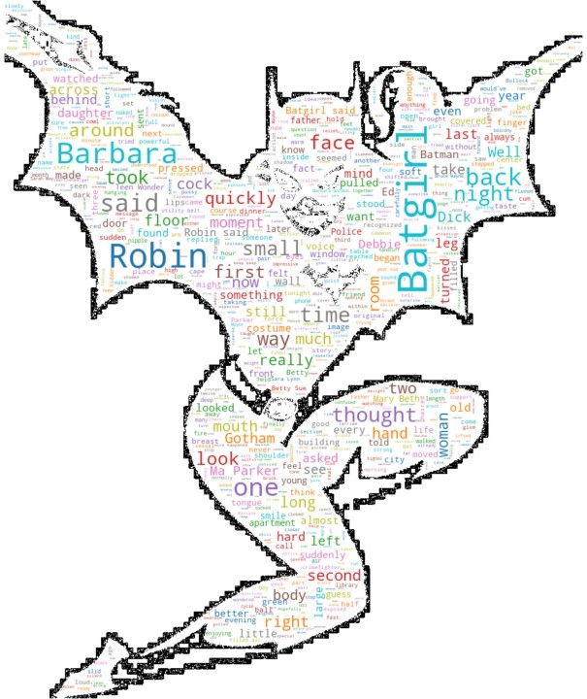
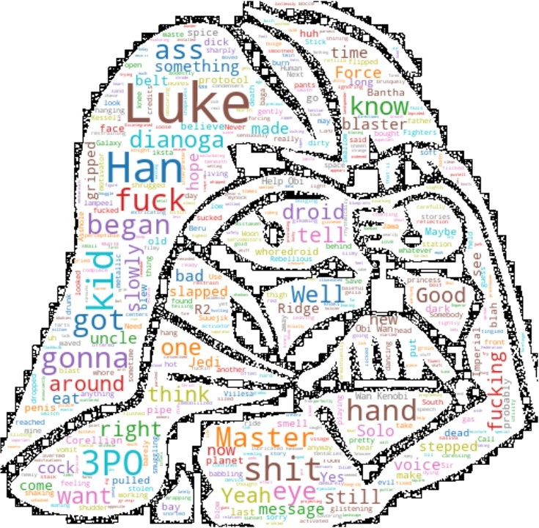
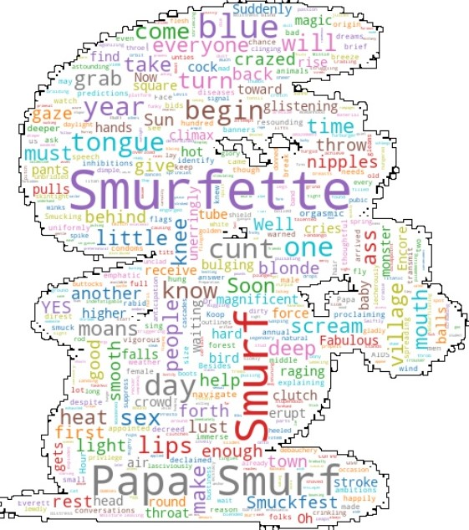
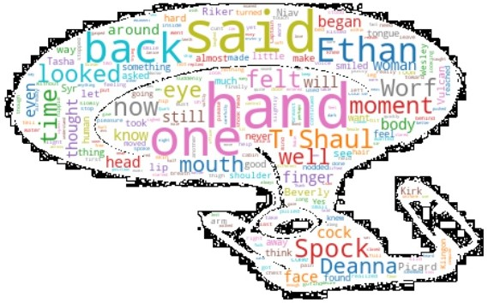
Acknowledgements…
The Brawns
The Brains
Shout out to textfiles.com for hosting such simple HTML code to scrape.
Shout out to the authors from the 80’s and 90’s. Pretty sure none of them wrote their stories for this purpose.
The pet projects of NLP enthusiasts are scaled on the backs on the greats.
Markovify
Gensim
SpaCy
NLTK
Word Cloud

Slide 15
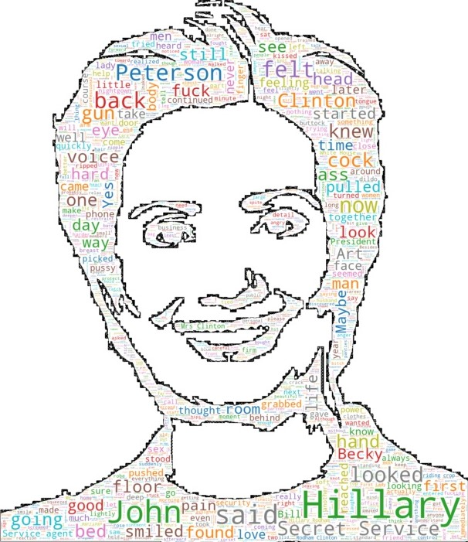
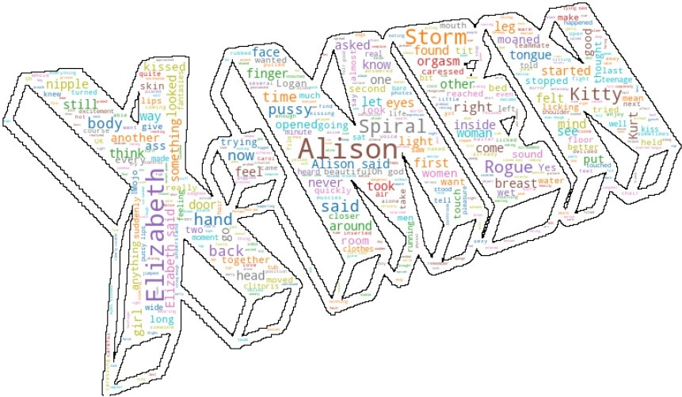


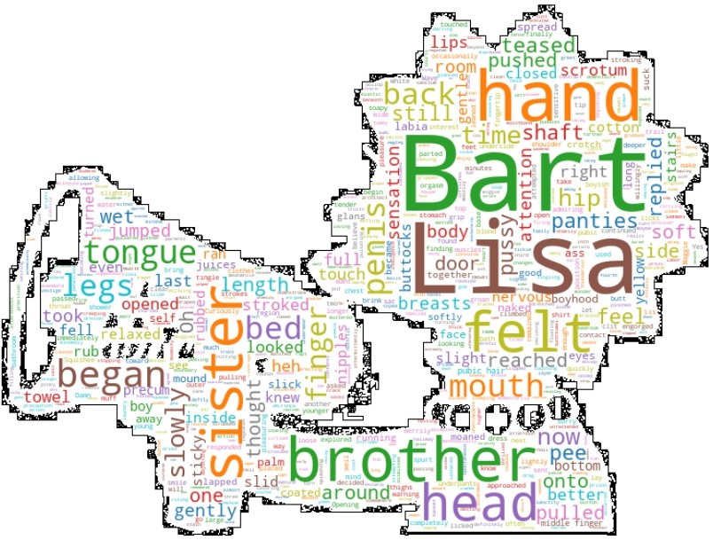

Slide 16
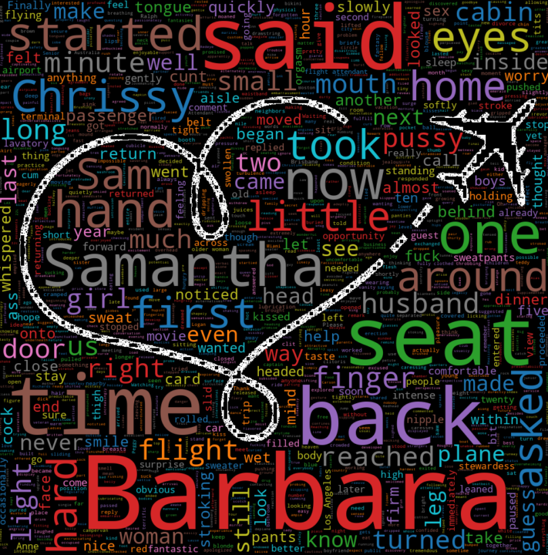
Thank you!! Let’s take care of each other ☺ ☺

Slide 17
Ooooooohhhh yes ohhh yes I’m finishing… … … … … … … … … …

