Slide 1
Cost of living analysis on food , transport and health
Made on 17/03/2023

Slide 2



Which expenses are we looking at today?
Food
Transport
Health

Slide 3




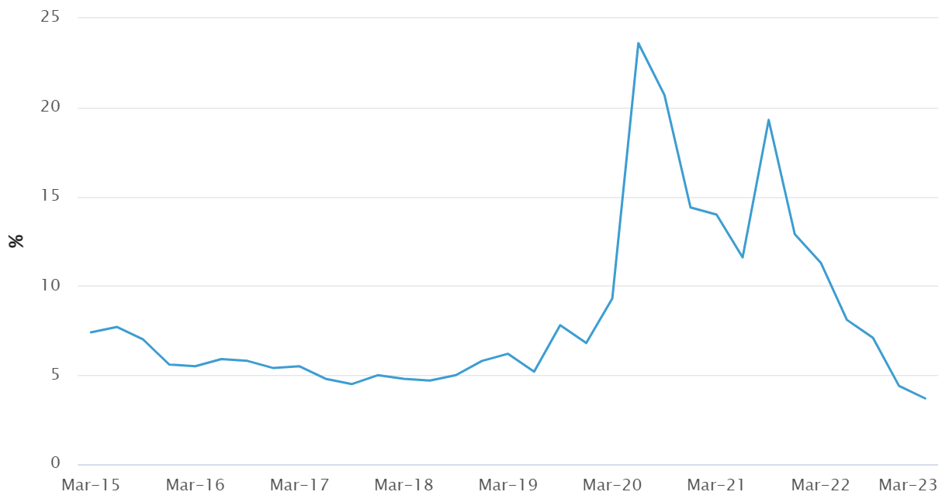
Cost of living is a widespread issue
1 in 4 people in people are struggling to get by on their current income according to an analysis by ANU.
About 1 in 5 households are considered severely food insecure and skip meals due to lack of income according to food bank.
According to the ABS, household saving rates are the lowest since 2008.
Inflation is highest it has been since 1990, at about 7%.
Household saving percent over time

Slide 4
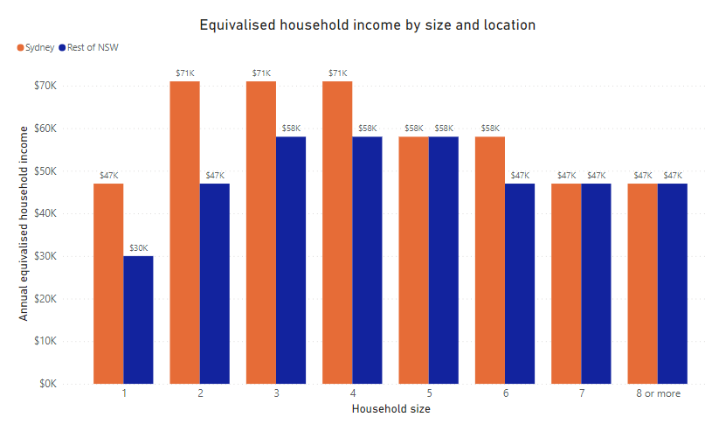
One-person households and large households are more vulnerable due to lower per person income
Equivalised income is the income a one-person household would need for the same quality of life according to the ABS
On average Sydney households earn more than their counterparts in the rest of NSW. This is due to more high paying jobs in city areas.
Equivalised income initially increases quickly with household size but then declines. This is because larger households often have a lot of children which do not contribute significantly to income.
ABS household income is grouped in ranges i.e. (52k - 65k.). Therefore, one household can earn more and still be in the same range.
Source: ABS Table builder 2021 census of population and housing.

Slide 5
Grocery costs are linearly proportional to the amount of food consumed
Grocery costs by household type
Food costs tend to scale linearly. If you purchase twice as much food, you will pay approximately twice as much in most cases. This is unlike some expenses like rent or energy bills which tends to decrease on a per person basis for larger households.
With linear costs like food, households with lower per person income are more vulnerable such as large households.
Food costs in NSW were on average $161 per person.
Between March 2022 and March 2023, vegetables saw an inflation rate of 12.7% and beef 12.1% according to the ABS consumer price index.
Household type | Household size example | Average cost of groceries per week
Single person | 1 person | $155
Couple only | 2 people | $331
Single parent with children | 2-3 people | $293
Couple with children | 4 people | $478
Source: Average cost of groceries per month - 2022 | Finder

Slide 6
Grocery costs are directly proportional to the amount of food consumed
Grocery costs based on location
Grocery costs based on healthy food basket costs at different locations. Healthy food basket is made using the number of calories and nutrients a family type would need. The research was done in SA, it wasn't available for NSW.
Typically, the same healthy food basket costed about 6% more in rural places.
Age is a major factor in predicting food costs. Children and elderly people tend to eat less.
Family Type | Metro | Rural
Typical | $425 | $450
Single parent | $292 | $307
Single pensioners | $102 | $108
Single adults | $133 | $142
'Typical family' (44-year-old male and female, 18-year-old female, 8-year-old male)
Source: Rural and remote health research

Slide 7
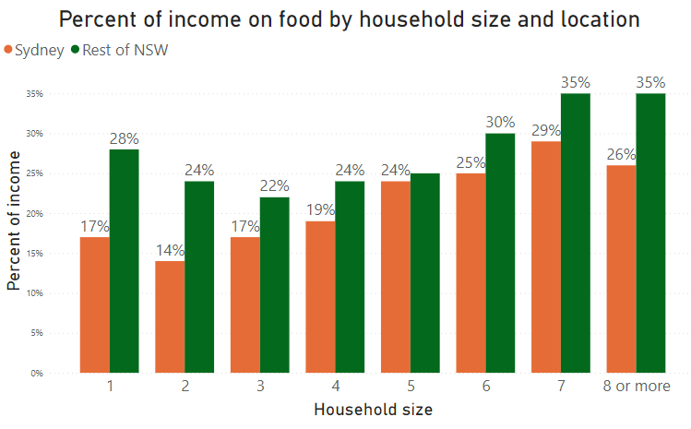
Rural and larger households more impacted by food costs
People in rest of NSW spend a greater percentage of income on food. This is due to Sydney having higher income and cheaper food.
Assumed every person spent $161 per week on groceries.
The most vulnerable households are large household and one person households. This is due to large households consuming more food. Whereas one person households tend to be low-income households.
Households that spend bigger portions of their income on food are more at risk.
Source: ABS Table builder 2021 census of population and housing
Source: Average cost of groceries per month - 2022 | Finder

Slide 8
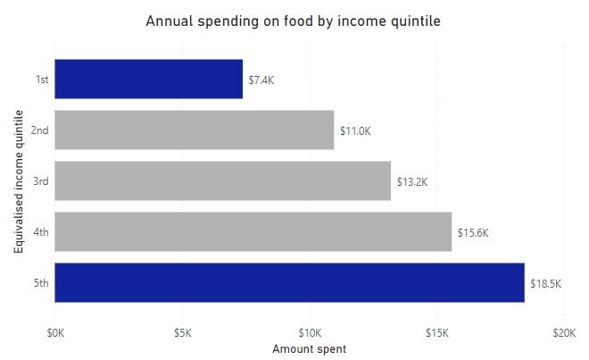
Households spend more on food if their income allows it
Equivalized income is income adjusted by household size by the ABS. It is the equivalent income, that a one person household would need for the same standard of living.
There is strong correlation between income and amount spent on food. The top quintile spends 2.5 times the amount of the bottom quintile.
Compromises in spending less on food can reduce quality of living. In more extreme cases, less nutritious food are purchased, or meals are skipped.
Source: ABS Household Expenditure Survey (2015 -2016)

Slide 9
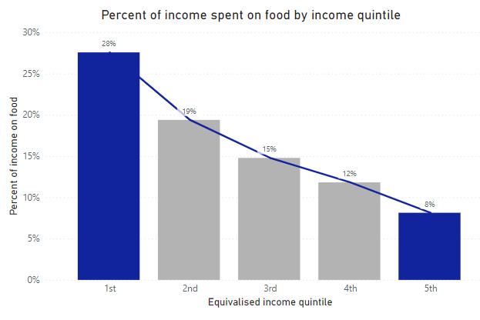
Lower-income households are more vulnerable to food costs
As a percentage of income, lower quintiles spend far more of their income on food. 28% of income for the bottom quintile compared to just 8% of income for the top quintile.
Spending a bigger portion of income on an expense makes you more vulnerable to any increases in it.
Example:
Household A spends 10% of income on food. Household B spends 30% of income on food.
If there is a 10% increase in food costs. One household spends 1% of total income more, the other 3% more.
Source: ABS Household Expenditure Survey (2015 -2016)

Slide 10
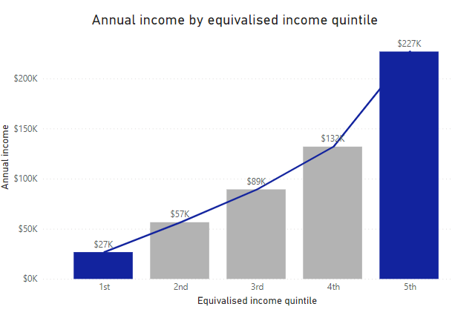
Income is most important factor
Income tends to increase exponentially. The 2nd lowest quintile earns more than twice the bottom quintile. The top quintile earns 9 times the bottom quintile and more than bottom 60% combined.
Often income is more important than location. Food prices may vary with location but will almost never cost multiple times as much relative to Sydney. On the other hand, the 2nd quintile has more than twice the income of the bottom quintile.
Source: ABS Household Expenditure Survey (2015 -2016)

Slide 11
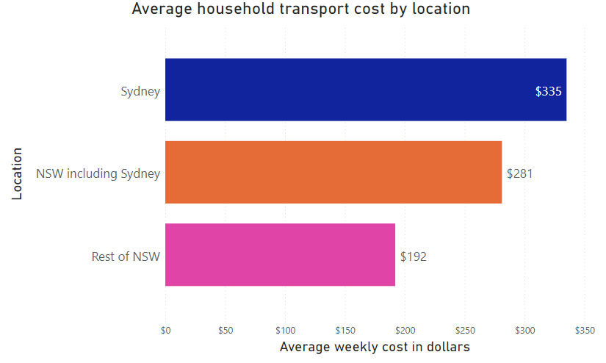
Sydney residents spend more on transport
Transport includes fuel, toll, servicing, registration, insurance, public transport and road fees but not car loans or parking.
According to the Australian Automobile Association, Sydney has the highest transport cost of any city in Australia.
The narrative that areas outside of Sydney drive more so spend more on transport isn't entirely true. There are other major costs, especially public transport and tolls.
Source: Australian Automobile Association transport affordability dashboard. (2022)

Slide 12
Toll and public transport costs make Sydney’s transport more expensive than rest of NSW
Location | Fuel | Tolls | Servicing | Insurance | Registration | Public Transport | Road Assist
Sydney | $96.59 | $94 | $33.06 | $35.34 | $24.17 | $50 | $2.33
Australia Regional City Average | $100.84 | $0 | $30.53 | $28.75 | $29.36 | $0 | $2.22
Australia Capital Cities Average | $96.10 | $26.08 | $32.31 | $34.22 | $30.88 | $39.65 | $2.23
Source: Australian Automobile Association transport affordability dashboard. (2022)
Although Sydney households may drive less distance than more regional areas, they experience more traffic jams. As a result, the amount spent on fuel by Sydney household is not significantly less.
Sydney is the most tolled city in Australia. Sydney households spend almost as much on toll as fuel.
Despite regional cities spending more on fuel, due to tolls and public transport costs, Sydney still spends more.

Slide 13
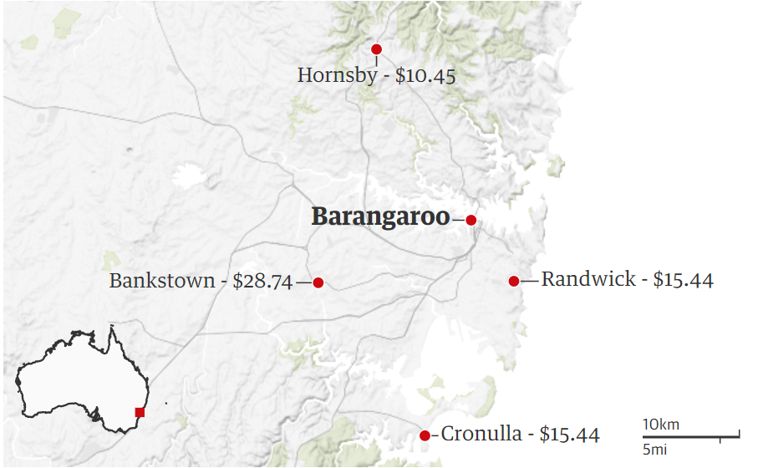
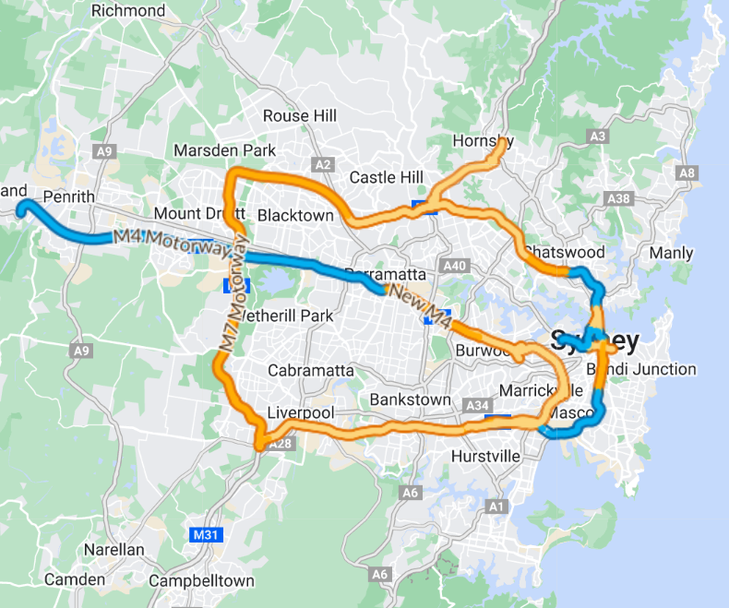
People disproportionately impacted by toll costs based on location
Toll cost to travel to Barangaroo
Sydney's toll roads
Two places can be similar distance from Barangaroo but have vastly different tolls. i.e., Bankstown costs twice as much as Cronulla. Therefore, toll isn't always distributed fairly based on distance.
The map shows western suburb households tend to pay more on tolls. This is because toll roads tend to branch out west instead of north or south.
Source: Sydney Motorways Toll Calculator | Transport for NSW

Slide 14
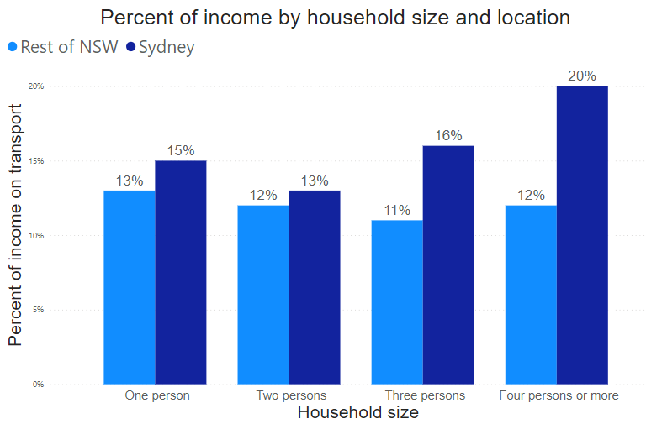
Sydney households spend more on transport even as a percent of income
Transport costs have increased in NSW by approximately 30% on average since 2016.
Despite Sydney households earning significantly more than the rest of NSW, they still spend a greater percentage of their income on transport.
A reduction in toll or public transport will help Sydney households but be of little benefit to more rural places.
Costs were calculated by scaling numbers in housing expenditure survey with increase in transport costs according to Australian Automobile Association transport affordability dashboard.
Source: ABS Household Expenditure Survey (2015-2016) adjusted with Australian Automobile Association transport affordability dashboard. (2022)

Slide 15
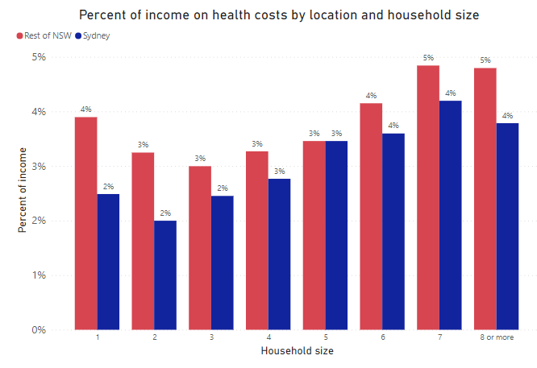
Lowering health costs are unlikely to significantly reduce financial pressure for most households
Average person in NSW spends $1169 a year on out-of-pocket medical costs.
Far smaller expenditure than rent, food or transport. This is because health bills tend to be largely subsidised by the government via Medicare.
Households with low per person income pay a greater proportion of household income.
Only costs where the individual pays are included. It covers most medical expenses such as pharmacies, hospitals ,dentistry , physiotherapy and more.

Slide 16
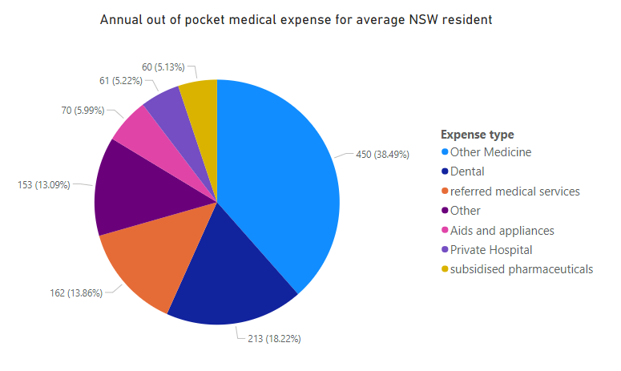
People with certain medical conditions disproportionately impacted
The medicine, dentistry and referred medical made up for about 60% of out-of-pocket expenses.
Majority of people might not pay $1169 a year on medical expenses but a minority pay significantly more. I.e., someone who needs to see the physio regularly due to a chronic issue or someone who regularly needs supplements for a deficiency.
Source: Australia institute of Health and Welfare Health Expenditure (2018-2019)

Slide 17
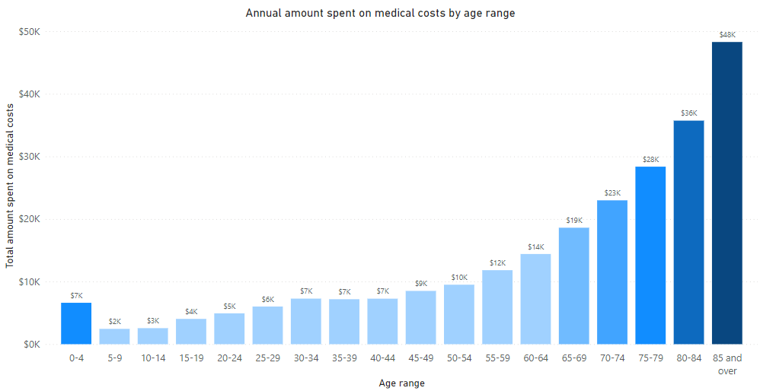
Elderly families more impacted by health costs
Medical expense in this instance refers to public and private hospitals, primary health care and referred services. It includes both government and out of pocket expenses.
Medical expenses tend to increase exponentially with age. Although typically medical expenses are a smaller expense compared to rent or food, they can be big in the case of elderly households..
0–4-year-old being an outlier is because babies also require significant medical attention.
Source: Australian Institute of Health and Welfare (Australian health expenditure demographics and diseases 2019 -2020) and Population | ABS

Slide 18
A reduction in different expenses benefits some households more than others
Food
Transport
Health
Households with low equivalised income benefit more such as one person and large households benefit more.
Households in more rural place also benefit more as they spend a greater proportion of income on food.
A reduction in toll or public transport will benefit Sydney households a lot but not the rest of NSW.
Toll reduction benefits people in western Sydney more due to toll roads branching west.
For most households, this expense is far smaller than rent, food or transport and is unlikely to change their financial situation on its own.
Households who have people with medical conditions or elderly people benefit significantly more.

Slide 19
Links to Sources:
ABS Table builder 2021 census of population and housing: Table Builder - TableBuilder - Table view (abs.gov.au)
ABS Income and Housing Survey: 6541.0.30.001 - Microdata: Income and Housing, Australia, 2013-14 (abs.gov.au)
ABS housing expenditure survey: Household Expenditure Survey, Australia: Summary of Results, 2015-16 financial year | Australian Bureau of Statistics (abs.gov.au)
Remote rural health research: RRH: Rural and Remote Health article: 1938 - Cost and affordability of healthy food in rural South Australia
Finder’s Research: Average cost of groceries per month - 2022 | Finder
Australian Automobile Association transport affordability dashboard. (2022): Transport Affordability - AAA - Data Dashboard
Health Expenditure 2018-2019 dashboard: https://www.aihw.gov.au/reports/health-welfare-expenditure/health-expenditure-australia-2018-19/contents/data-visualisation
Food bank Hunger report 2022: Foodbank Hunger Report 2022 - Foodbank Reports
ANU articles about financial stress: Australians under increasing financial stress – ANU
NSW government toll calculator: Sydney Motorways Toll Calculator | Transport for NSW

