Slide 1

by Just: A Capstone Project
Surrodash
Diego Alba, Julia King, Kaylyn Torkelson, Benedicte Diakubama, Yu-Chi Fang
Notes:
Kaylyn

Slide 2

Project Sponsor and Motivation
Overarching Goal: Build affordable manufacturing process for a viable biotherapeutic target.
What gives highest yield and purity?
Bench-top R&D and mechanistic models can be slow and expensive. How can we make that better?
Notes:
Kaylyn

Slide 3
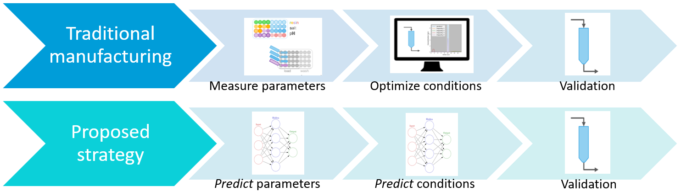
Process Design
Notes:
“Use mechanistic model to predict effects from features that would have been evaluated in HTP experiments. Use NN to predict the effects.”
“Use NN to predict optimized experimental conditions.”
“Still do same validation at bench-scale to ensure optimal conditions are achieved”

Slide 4
Surrogate Modeling in Biotech
Orders of magnitude speedup between MM and ML model allows you to ask more AND better questions.
Larger scale screening of molecules to find those that are easily purified; more quickly narrow the search space for the ideal candidates.
Sensitivity Analysis Capability: Which input parameters have the biggest impact on yield and purity?
Provide more information to wet lab processes for faster molecular/process design.
Notes:
Kaylyn

Slide 5

Use Cases
Generate data
Train surrogate model
Visualization and analysis
Use mechanistic model
Systematically vary parameters within physical limits
Define testing and training sets
Clean input data
Train 4 models
Predict yield and purity
Visualize input datasets
Load/train/test/ save models
Produce training curves
Notes:
Benedicte

Slide 6
Mechanistic Model Deliverables
Develop
“best practices” for modifying the provided MM
Provide
sample datasets within the repo
Explore
datasets in Dash visualization
Notes:
Benedicte
explain what we were given

Slide 7
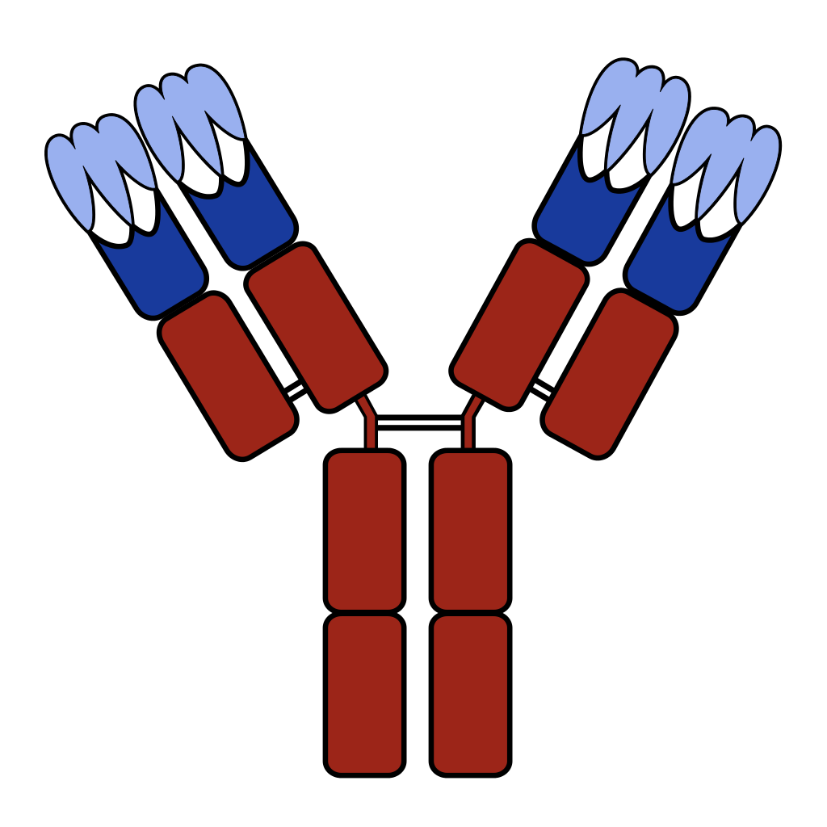
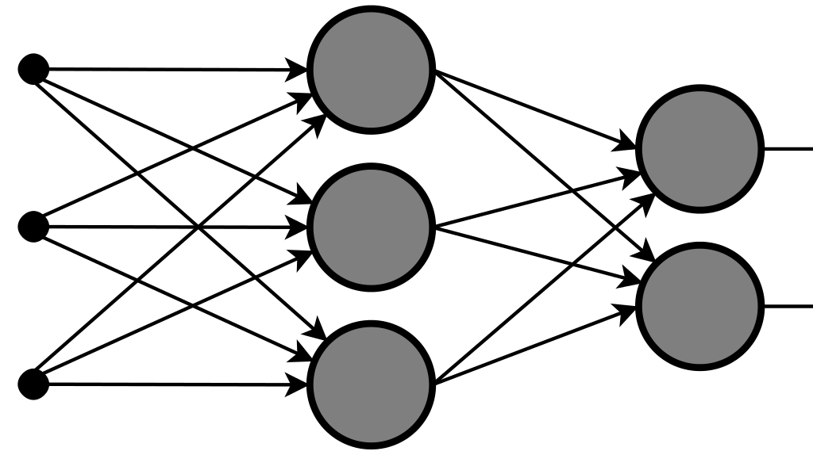
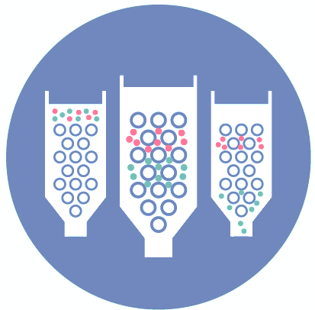
Pretrained Models
Different models:
Linear Regression
Neural Network
Predict:
Deterministic
Probabilistic
mean + std
yield
purity
Notes:
Diego

Slide 8

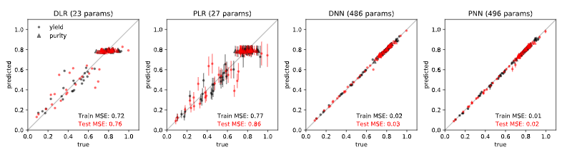
Results and Discussion
ML model is 1600 times faster than MM.
Prediction with the MM takes 1.6 seconds.
Prediction with ML model takes 0.001 seconds.
Can ask 1600 more questions in the same amount of time.
NNs are more accurate than linear regression models.
Low MSE; not sacrificing accuracy for speedup.
Notes:
Steven

Slide 9
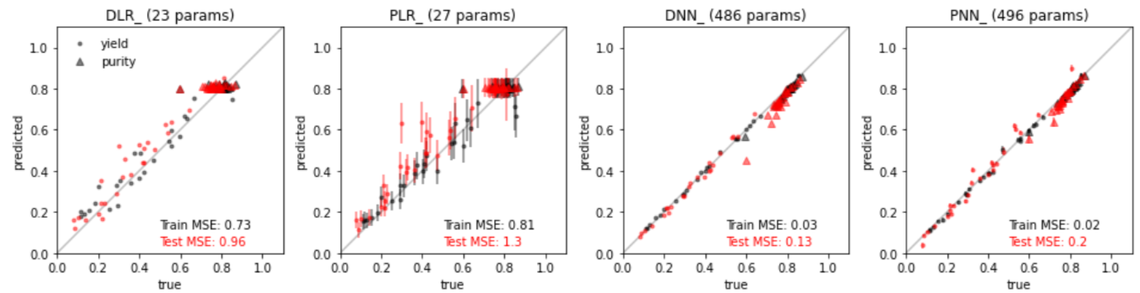
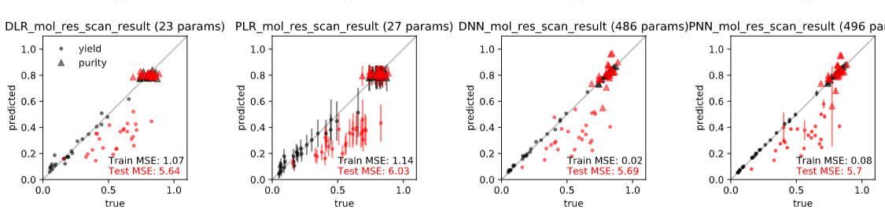
Predictive Power
Predict across variations in isotherm (Langmuir train, GIEX test).
Model struggles when predicting across resin.
Column characteristics (length/capacity/etc.) are different for each resin in real-life and thus hard-coded differently in MM.
Notes:
Steven

Slide 10

Dash Visualization
Notes:
Diego

Slide 11
Conclusions and Future Work
Our pre-trained models are 1600 times faster than the MM with small losses in accuracy.
The Python package and Dash app make it easy to use our pre-trained models or train your own.
Future Work: Mechanistic Model
Develop wrapping function to automate use of the MM.
Command line prompts that ask user for desired input parameters and outputs datasets.
Improve the accuracy of parameters in Langmuir isotherm model.
Produce datasets with multiple impurities.
Produce datasets for full factorial analysis (monitoring change over multiple parameters at once).
Notes:
Kaylyn

Slide 12
Future Work
Surrodash Improvements
Develop a Gaussian Process Regression model.
Works well on small datasets/provides uncertainty.
Develop further visualizations based on user requests.
Provide quantitative assessments within the data comparison tool.
If my predictions aren’t close to true values, is that because of error in the data? Is the “inaccurate” data statistically different?
Analysis of variance/further statistical analyses.
ML in Biotech Molecular Design
How do we use ML to go from sequence/structure of molecules to predicted yield and purity?
On-board experimentalists for validation.
Notes:
Kaylyn

