Slide 1
DIRECT Just Capstone Project 5/21/21

Slide 2
Outline
Modeling Framework
Datasets
Analysis
Final Product

Slide 3
Modeling Framework
Generate NNs with different structures
Deterministic
Probabilistic → predict mean and stdv (confidence)
Training routine
Hyperparameter tuning
Currently comparing extremes:
Multi-Linear Regression
DNN with 20x parameters
metric: MSE

Slide 4
Datasets: Sampling Strategies
Currently sampling from a random uniform distribution
Provides the widest range of available data
Don’t have enough information about the parameters to pinpoint a better or more accurate sampling strategy
Other sampling strategies: exploring how to best implement them with MM given time and resource constraints

Slide 5
Datasets
Parameter ranges were changed or narrowed based on literature search
Generated multiple datasets to be used in the analysis shown later (different isotherms, resins…)
Data generation is fairly slow and tedious
Can provide list of “best practices” and instructions for data generation

Slide 6
Datasets & Training
Preprocessing:
standardization of model parameters (mean zero, unit variance)
drop if yield or purity > 1
train-test split:
random, 80-20
ensure cuts from the same run are grouped
will implement k-fold
loss: MSE or log-likelihood:
minimizing weighted loss of yield and purity

Slide 7
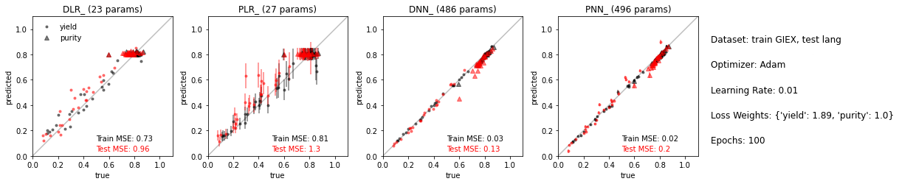
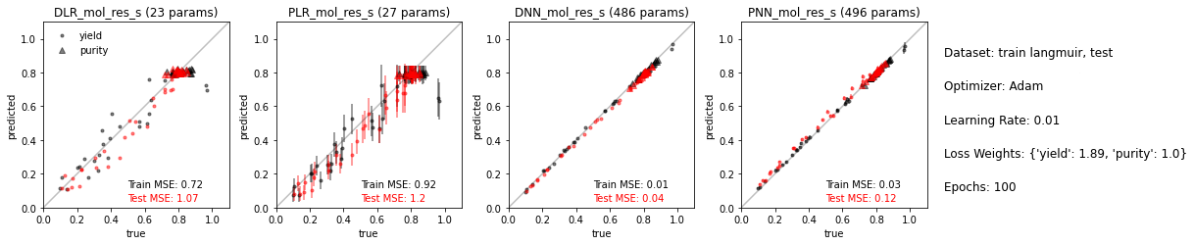
Analysis: Isotherms
Tests well on opposite training sets.
Models seem transferable between isotherm.

Slide 8
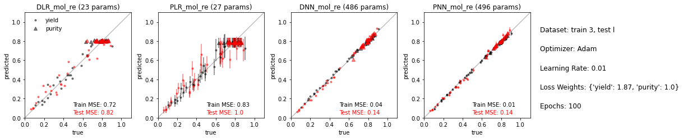
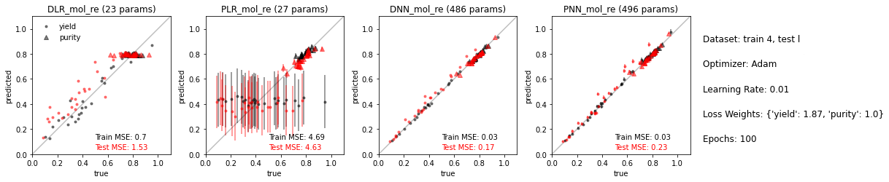
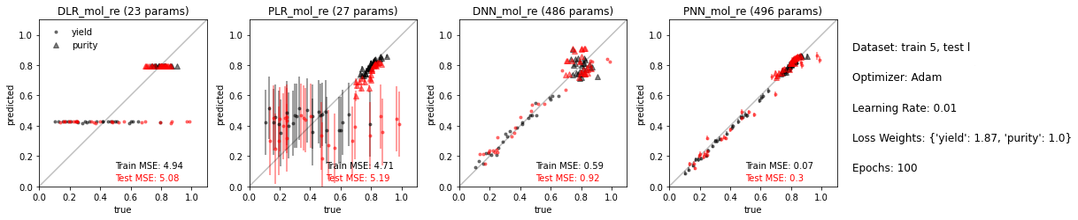
Analysis: Training Dataset Size

Slide 9
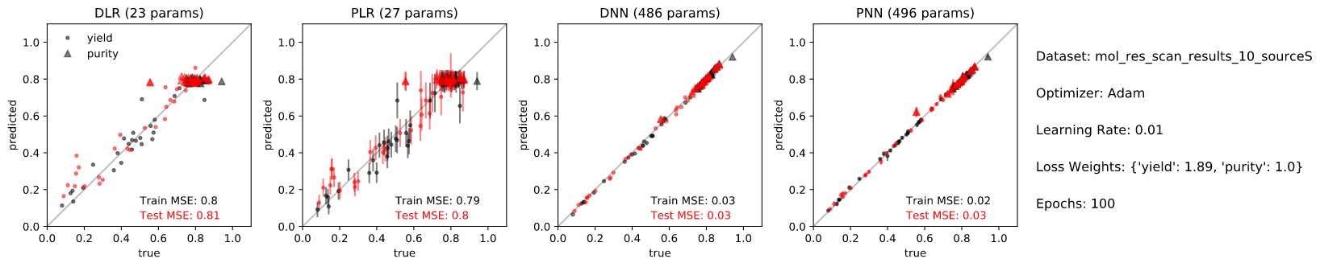
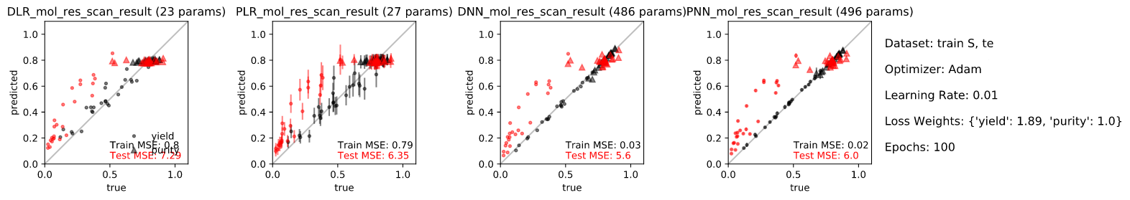
Analysis: Resin Type
Significant differences in yield across resins, harder to transfer model

Slide 10
Analysis: Next Steps
Hone NN structure and training?
Number of impurities?
Identify what areas of parameter space the model struggles with the most.
What happens if we combine all these data sets and train on that? How accurate is that model?

Slide 11
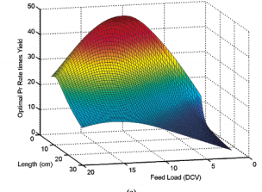
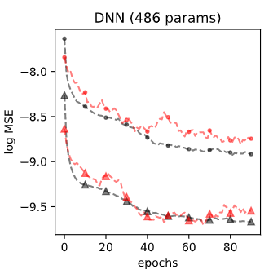
Final Product Idea: Integrated Dash App
Visualization of parameter space surfaces for yield and purity (slider bars included), feature exploration.
datasets produced by the MM and pretrained NNs
interactive (choose parameters to compare).
Load datasets, generate new datasets
Load pretrained NNs, define and train new NN
Visualization of NN performance
training curves
predictive accuracy
comparison across NNs

