Slide 1
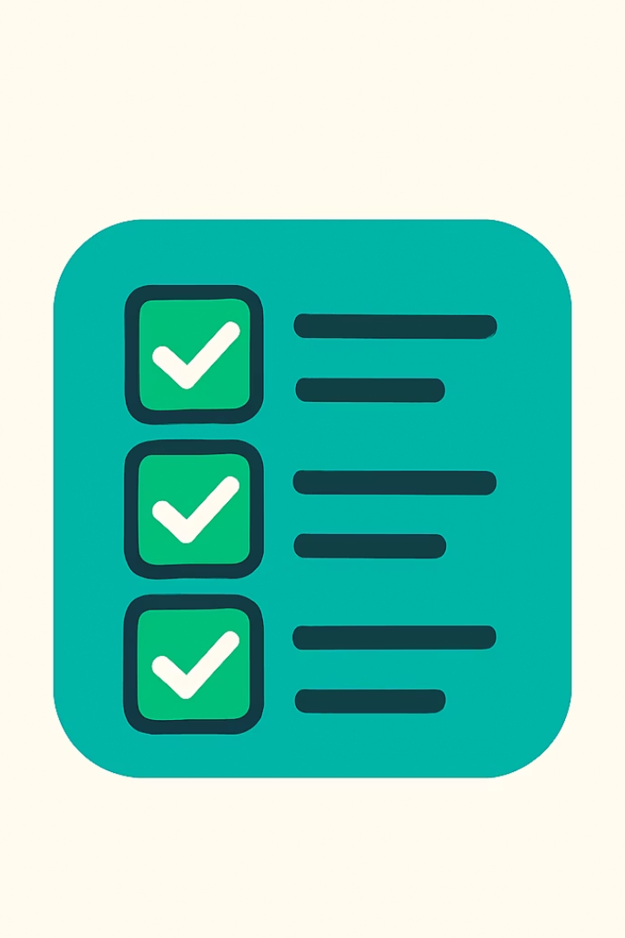
Task Flow: Modern Android App for Task Management
A powerful task tracking app with offline functionality and automated status updates. Built with Room Database for seamless local storage.

Slide 2
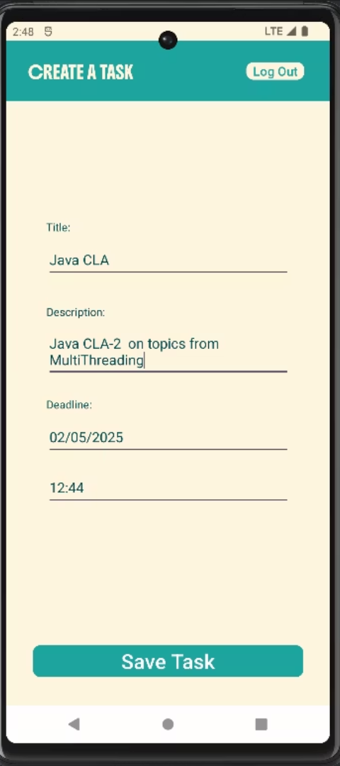




Key Features
User Authentication
Secure sign-up and login system for personal task management.
Task Management
Create and view tasks with titles, descriptions, and deadlines.
Auto Status Update
Tasks automatically marked as Completed when deadlines pass.
Offline Support
Access and manage tasks without internet connection.

Slide 3
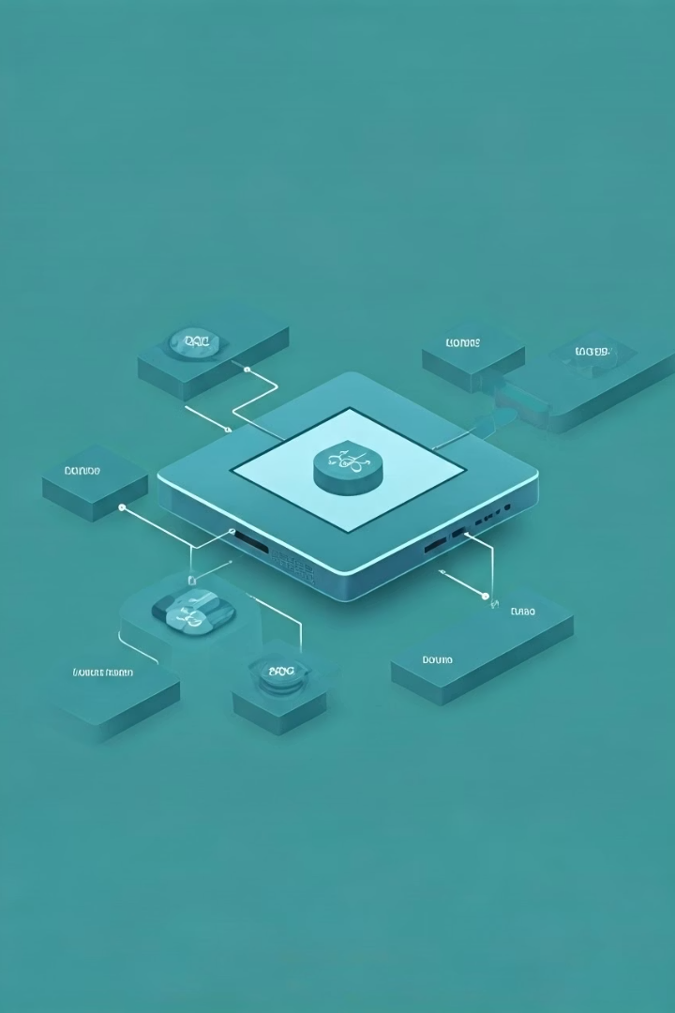
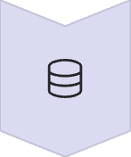



Task Flow Architecture
Room Database
Local SQLite database storage for all task information.
DAO Layer
Data Access Objects handle database operations efficiently.
Repository
Manages data operations between database and UI.
UI Layer
Activity and Fragment components display task information.

Slide 4
Room Database Implementation
Entity
DAO Interface
Defines Task table structure with required fields:
Contains methods for database operations:
Task ID (Primary Key)
Insert new tasks
Title and Description
Update existing tasks
Deadline (Date/Time)
Query tasks by status
Status (Pending/Completed)
Delete completed tasks

Slide 5
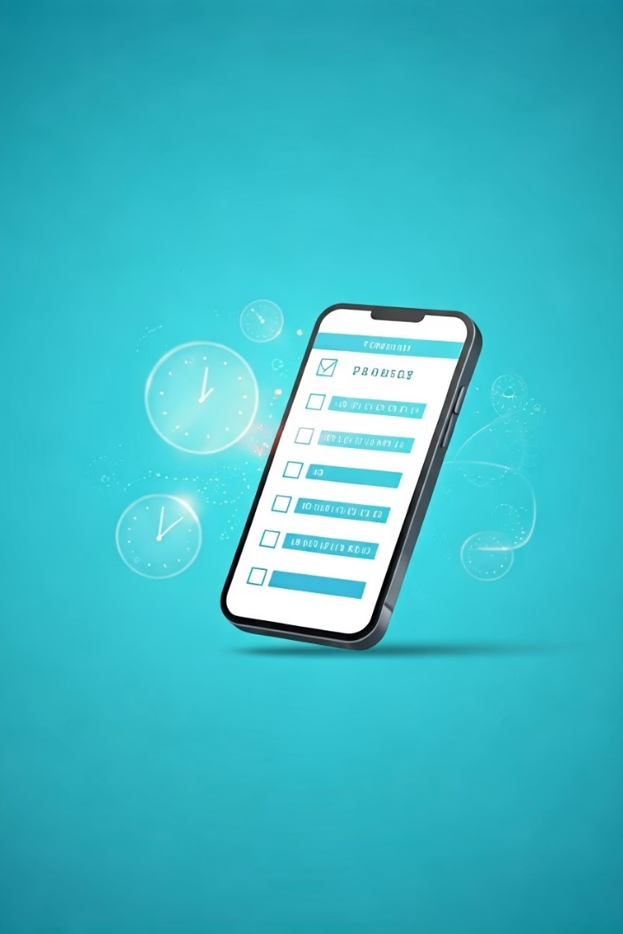
Auto Status Update Mechanism
Background Worker Setup
Implement WorkManager to schedule periodic task checks in the background.
Deadline Comparison Logic
Compare current time with task deadlines using Java Date utilities.
Status Update
Automatically update task status when current time exceeds deadline.
UI Refresh
Notify UI components to refresh when task statuses change.

Slide 6
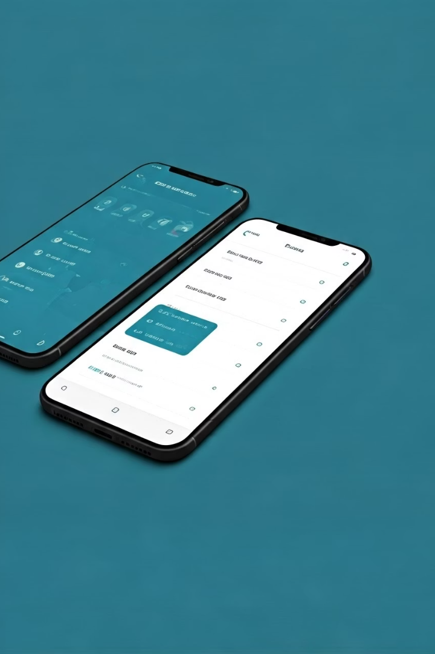
User Interface Components
Task List Fragment
Task Detail Fragment
RecyclerView displays all tasks
Form for viewing task details
SwipeToRefresh functionality
Edit/delete operations
Status indicator
Status filter chips
Task Creation Dialog
Input fields for task properties
Date/time picker for deadline
Validation logic

Slide 7








Technical Requirements
Android Studio
Latest stable version recommended
Java 8+
For lambda expressions and Stream API
Android SDK
Target API level 30+ (Android 11)
Dependencies
Room, LiveData, ViewModel, WorkManager

Slide 8








Implementation Timeline
Database Setup
Repository Layer
Create Room entities, DAOs, and database instance
Implement data operations and business logic
UI Components
Testing & Polish
Build activities, fragments, and adapters
Unit tests and UI refinements

