Slide 1
IOT BASED TOLL BOOTH MANAGEMENT SYSTEM
Team Members
S.no | Reg.No | Name of the Student | Section
1 | BL.EN.U4CSE17068 | K.Lalith Kumar | CSE-B
2 | BL.EN.U4CSE17131 | T.Vedha Sai | CSE-B
3 | BL.EN.U4CSE17054 | Kamma Rakesh | CSE-A
4 | BL.EN.U4CSE17118 | S.Dinesh Reddy | CSE-B

Slide 2
INDEX
Introduction
Toll Booth Management System
Requirements
Working
Components
Applications
Advantages
Conclusion

Slide 3
INTRODUCTION
Toll management systems play an important role in the growth of infrastructure all over the world. It is a kind of the money that a commuter has to pay to the road authorities while passing from one city to another. This in turn is a kind of tax that is used in the construction of roads, flyovers, and expressways.Tolling is a highly effective strategy for dealing with some of today’s most pressing transportation issues. Toll facilities help reduce congestion and improve mobility, and provide an additional source of funding for local construction and maintenance projects.

Slide 4
Toll Booth Management System
The IoT based Toll Booth Management System will be able to lift the barrier allowing the car to pass through and it will be done using Arduino Uno , Servo motor and ultrasonic sensor.

Slide 5
Requirements
Arduino Uno
Servo Motor
Mini Bread Board
2 Resistors
Tinkercad Simulator Software
2 Push buttons
Ultrasonic Sensor

Slide 6
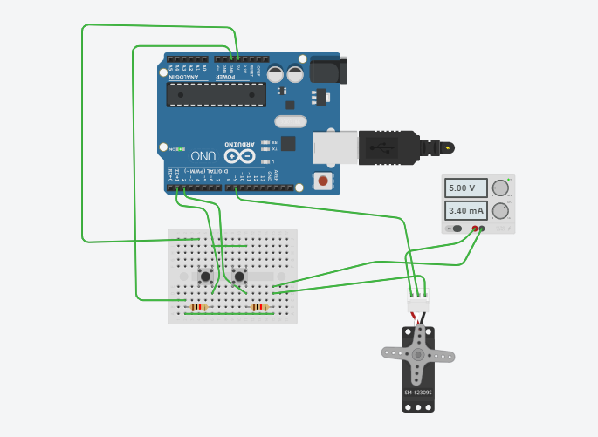
Working of the System-1

Slide 7
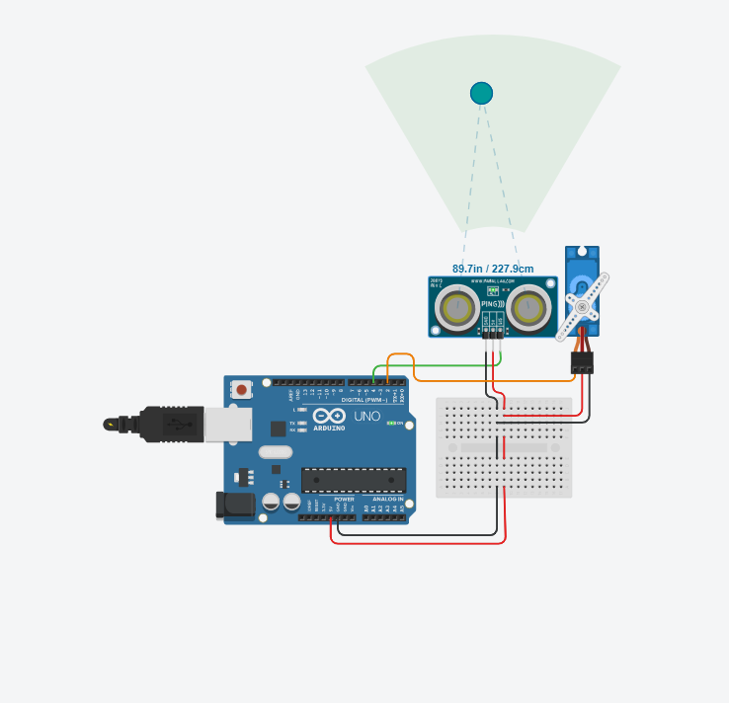
Working of the System-2

Slide 8
Components
Arduino UNO:- Arduino Uno is a microcontroller board based on the ATmega328P. It has 14 digital input/output pins 6 analog inputs, a 16 MHz quartz crystal, a USB Connection, power jack, an ICSP header and a reset button.
Servo motor It is a type of motor that can rotate with great precision. Normally this type of motor consists of a control circuit that provides feedback on the current position of the motor shaft, this feedback allows the servo motors to rotate with great precision.

Slide 9
A Breadboard is used to build and test circuits quickly before finalizing any circuit design. The breadboard has many holes into which circuit components like ICs and resistors can be inserted.
A Resistor is a passive two-terminal electrical component that implements electrical resistance as a circuit element. In electronic circuits, resistors are used to reduce current flow, adjust signal levels, to divide voltages, bias active elements, and terminate transmission lines, among other uses.

Slide 10
A small button or knob that when pushed operates something especially by closing an electric circuit
An Ultrasonic sensor is an electronic device that measures the distance of a target object by emitting ultrasonic sound waves, and converts the reflected sound into an electrical signal. Ultrasonic waves travel faster than the speed of audible sound (i.e. the sound that humans can hear).

Slide 11
Applications
Hi-tech smart devices for vehicle identification.
Intelligent software programs.
Multi Level security for daily operations as well as data handling.
Data warehousing and automated data backup programs.
Remote accessibility for Real Time Online Monitoring.

Slide 12
Advantages
User-friendly.
Convenient and Time Saving.
Decrease in fuel consumption.
Avoids traffic.

Slide 13
Conclusion
The current model is an base model of toll management system.
Future Scope:
The extended model can use rfid tags with combined web application in order to perform better.

Slide 14
THANK YOU...

