Slide 1
CSM 357 Human-Computer Interaction lecture 5: Evaluation Techniques
Rose-Mary Owusuaa Mensah Gyening

Slide 2
The main goals of this chapter are to accomplish the following:
••Explain the key concepts and terms used in evaluation.
•• Introduce a range of different types of evaluation methods.
•• Show how different evaluation methods are used for different purposes at different
stages of the design process and in different contexts of use.
•• Show how evaluation methods are mixed and modified to meet the demands of evaluating
novel systems.
••Discuss some of the practical challenges of doing evaluation.

Slide 3
Evaluation Techniques
In previous lecture, we have discussed a design process to support the design of usable interactive systems.
However, even if such a process is used, we still need to assess our designs and test our systems to ensure that they actually behave as we expect and meet user requirements. This is the role of evaluation.
Evaluation should not be thought of as a single phase in the design process
Ideally, evaluation should occur throughout the design life cycle, with the results of the evaluation feeding back into modifications to the design.

Slide 4
Goals of Evaluation
Evaluation has three main goals:
to assess the extent and accessibility of the system’s functionality,
to assess users’ experience of the interaction,
and to identify any specific problems with the system.

Slide 5
Evaluation Techniques
We will consider evaluation techniques under two broad headings: expert analysis and user participation.
Evaluation Techniques
Expert analysis
User Participation

Slide 6
Evaluation Techniques
Evaluation tests the usability, functionality and acceptability of an interactive system.
Evaluation may take place:
– in the laboratory
– in the field.
Some approaches are based on expert evaluation:
– analytic methods
– review methods
– model-based methods.
Some approaches involve users:
– experimental methods
– observational methods
– query methods.
An evaluation method must be chosen carefully and must be suitable for the job.

Slide 7
Evaluation through expert analysis
first evaluation of a system should ideally be performed before any implementation work has started.
If the design itself can be evaluated, expensive mistakes can be avoided, since the design can be altered prior to any major resource commitments.
Typically, the later in the design process that an error is discovered, the more costly it is to put right and, therefore, the less likely it is to be rectified.
It can be expensive to carry out user testing at regular intervals during the design process, and it can be difficult to get an accurate assessment of the experience of interaction from incomplete designs and prototypes.
Consequently, a number of methods have been proposed to evaluate interactive systems through expert analysis.

Slide 8
Evaluation through expert analysis
Let us consider four approaches to evaluation through expert analysis:
cognitive walkthrough,
heuristic evaluation,
the use of models and
use of previous work.

Slide 9
Evaluation through expert analysis: 1. cognitive walkthrough
The cognitive walkthrough is one way to test the usability of interactive software.
It focuses on
User’s task(s)
System’s Interface
The cognitive walkthrough may be used
without “real” uses, e.g. proposed vs. actual tasks
before a system is implemented

Slide 10
Evaluation through expert analysis: 1. cognitive walkthrough
In the cognitive walkthrough, the sequence of actions refers to the steps that an interface will require a user to perform in order to accomplish some known task.
The evaluators then ‘step through’ that action sequence to check it for potential usability problems.
Usually, the main focus of the cognitive walkthrough is to establish how easy a system is to learn.

Slide 11
Evaluation through expert analysis: 1. cognitive walkthrough
To do a cognitive walkthrough, you need four things:
1. A specification or prototype of the system.
2. A description of the task the user is to perform on the system.
3. A complete, written list of the actions needed to complete the task with the proposed system.
4. An indication of who the users are and what kind of experience and knowledge the evaluators can assume about them.
Given this information, the evaluators step through the action sequence (identified in item 3 above) to critique the system and tell a believable story about its usability.

Slide 12
Evaluation through expert analysis: 1. cognitive walkthrough
To do this, for each action, the evaluators try to answer the following four questions for each step in the action sequence
1. Is the effect of the action the same as the user’s goal at that point?
2. Will users see that the action is available? Will users see the button or menu item, for example, that is used to produce the action? This is not asking whether they will recognize that the button is the one they want. This is merely asking whether it is visible to them at the time when they will need to use it.

Slide 13
Evaluation through expert analysis: 1. cognitive walkthrough
3. Once users have found the correct action, will they know it is the one they need? This complements the previous question. It is one thing for a button or menu item to be visible, but will the user recognize that it is the one he is looking for to complete his task? Where the previous question was about the visibility of the action, this one is about whether its meaning and effect is clear.
4. After the action is taken, will users understand the feedback they get? If you now assume that the user did manage to achieve the correct action, will he know that he has done so? Will the feedback given be sufficient confirmation of what has actually happened?

Slide 14
Evaluation through expert analysis: 2. Heuristic evaluation
A heuristic is a guideline or general principle or rule of thumb that can guide a design decision or be used to critique a decision that has already been made.
Heuristic evaluation, developed by Jakob Nielsen and Rolf Molich, is a method for structuring the critique of a system using a set of relatively simple and general heuristics.
Heuristic evaluation can be performed on a design specification so it is useful for evaluating early design.
But it can also be used on prototypes, storyboards and fully functioning systems. It is therefore a flexible, relatively cheap approach.

Slide 15
How to perform a heuristic evaluation
Systematic inspection to see if interface complies to guidelines
Method
3-5 inspectors
usability engineers, end users, double experts…
inspect interface in isolation (~1–2 hours for simple interfaces)
compare notes afterwards
single evaluator only catches ~35% of usability problems
5 evaluators catch 75%
Works for paper, prototypes, and working systems

Slide 16
How to perform heuristic evaluation cont’d
Each evaluator assesses the system and notes violations of any of these heuristics(eg Nielson’s heuristics) that would indicate a potential usability problem.
The evaluator also assesses the severity of each usability problem using a severity rating on a scale of 0–4:
0 = I don’t agree that this is a usability problem at all
1 = Cosmetic problem only: need not be fixed unless extra time is available on project
2 = Minor usability problem: fixing this should be given low priority

Slide 17
How to perform heuristic evaluation cont’d
3 = Major usability problem: important to fix, so should be given high priority
4 = Usability catastrophe: imperative to fix this before product can be released

Slide 18
Nielson’s Heuristics
Avoid common design pitfalls by following principles of good design
Nielsen proposes 10 heuristics, others propose more or less.
When you are doing a usability evaluation for a software, you can inspect an interface for usability problems with these principles

Slide 19
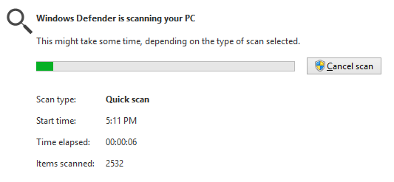
Ten Usability Heuristics (from Jakob Nielsen): Heuristic 1: Visibility of System status
Visibility of system status
The system should always keep users informed about what is going on, through appropriate feedback within reasonable time.

Slide 20
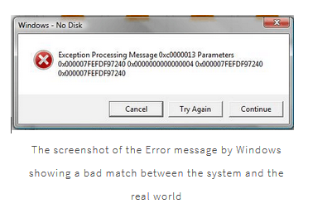
Ten Usability Heuristics (from Jakob Nielsen): Heuristic 2: Match between system and the real world
2. Match between system and the real world
The system should speak the users' language, with words, phrases and concepts familiar to the user, rather than system-oriented terms. Follow real-world conventions, making information appear in a natural and logical order.
error messages like these are not really very helpful for the end users (even for the developers at times).

Slide 21
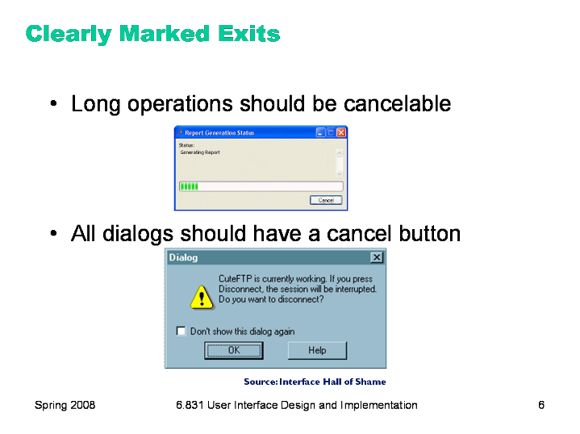
Ten Usability Heuristics (from Jakob Nielsen): Heuristic 3: User control and freedom
3. User control and freedom
Users often choose system functions by mistake and will need a clearly marked "emergency exit" to leave the unwanted state without having to go through an extended dialogue. Support undo and redo.

Slide 22
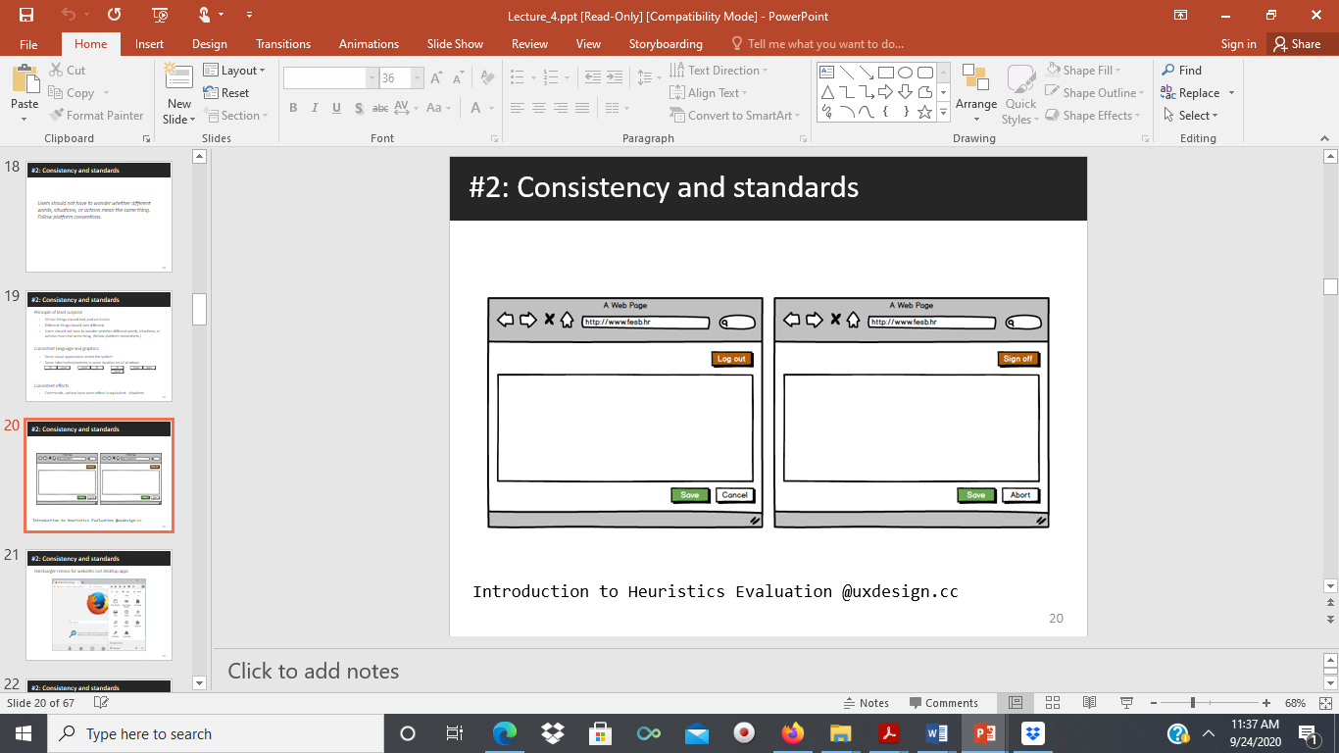
Ten Usability Heuristics (from Jakob Nielsen): Heuristic 4: Consistency and standards
4. Consistency and standards
Users should not have to wonder whether words, situations or actions mean the same thing in different contexts. Follow platform conventions and accepted standards.
Identify the inconsistencies in these two pages most likely for a website. One uses: logout, save, cancel. Another uses: sign off, save, abort

Slide 23
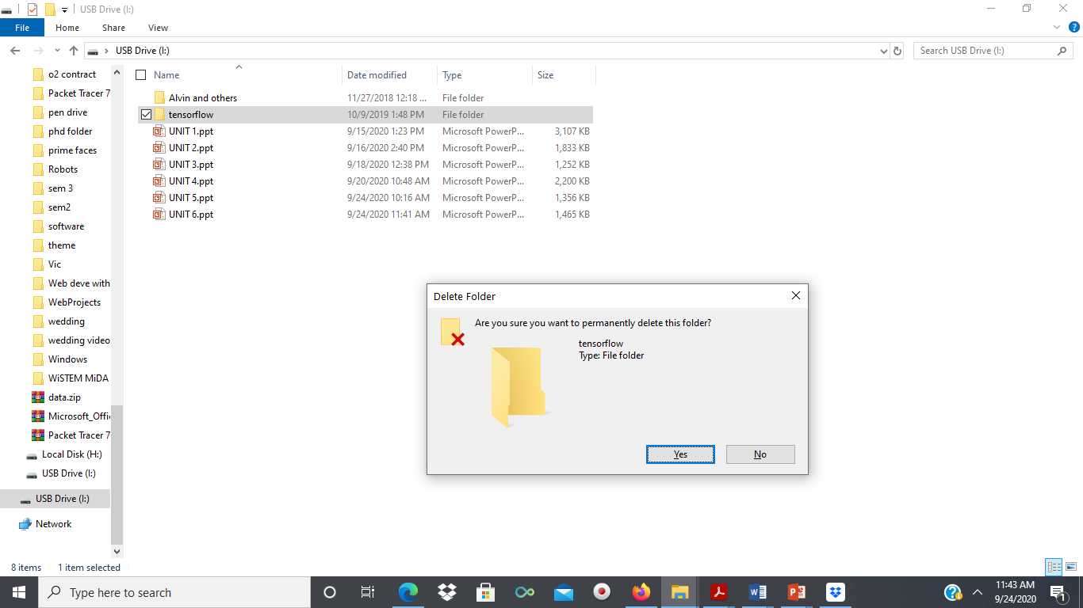
Ten Usability Heuristics (from Jakob Nielsen): Heuristic 5: Error prevention
5. Error prevention
Make it difficult to make errors. Even better than good error messages is a careful design that prevents a problem from occurring in the first place.

Slide 24
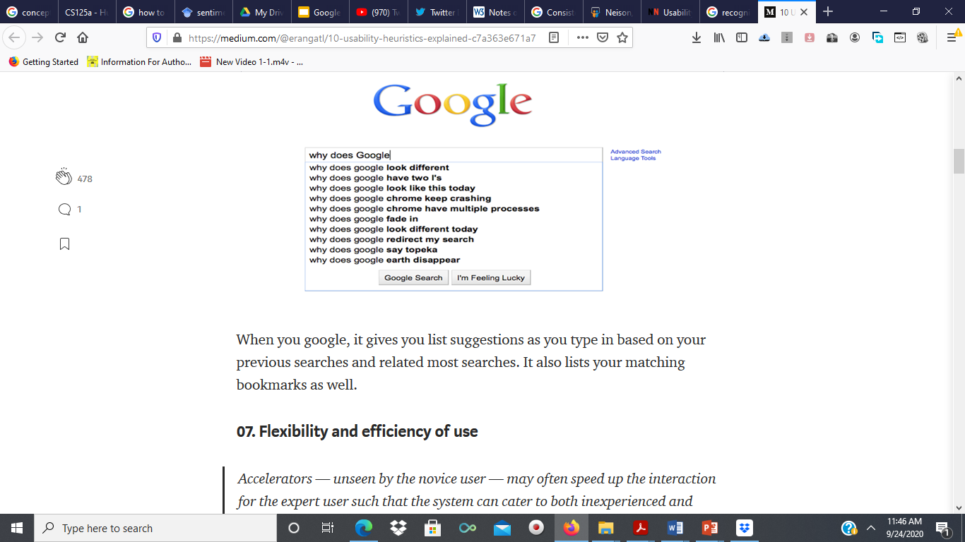
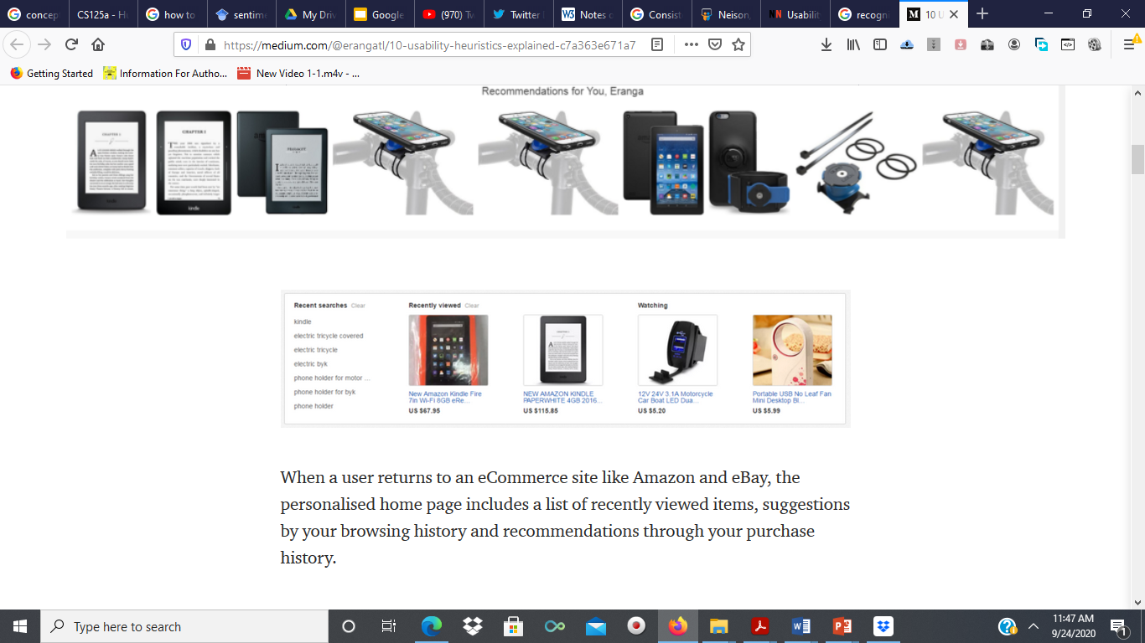
Ten Usability Heuristics (from Jakob Nielsen): Heuristic 6 Recognition rather than recall
6. Recognition rather than recall
Make objects, actions and options visible. The user should not have to remember information from one part of the dialog to another. Instructions for use of the system should be visible or easily retrievable whenever appropriate.

Slide 25
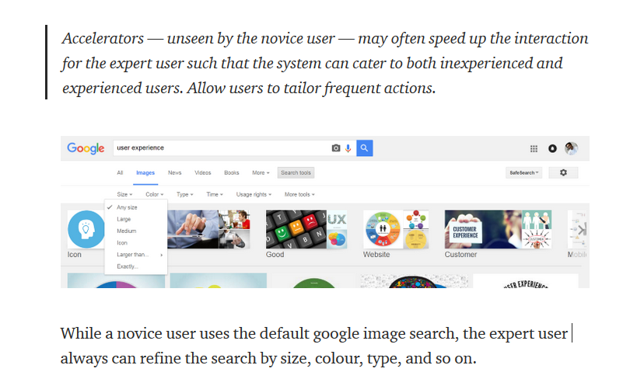
Ten Usability Heuristics (from Jakob Nielsen): Heuristic 7. Flexibility and efficiency of use
7. Flexibility and efficiency of use
Allow users to tailor frequent actions.
Accelerators – unseen by the novice user – may often speed up the interaction for the expert user to such an extent that the system can cater to both inexperienced and experienced users.

Slide 26
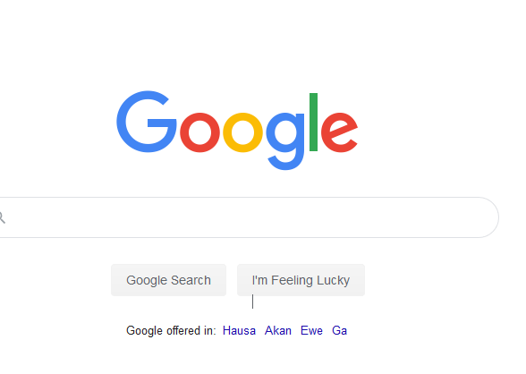
Ten Usability Heuristics (from Jakob Nielsen): Heuristic 8. Aesthetic and minimalist design
8. Aesthetic and minimalist design
Dialogs should not contain information that is irrelevant or rarely needed. Every extra unit of information in a dialog competes with the relevant units of information and diminishes their relative visibility.

Slide 27
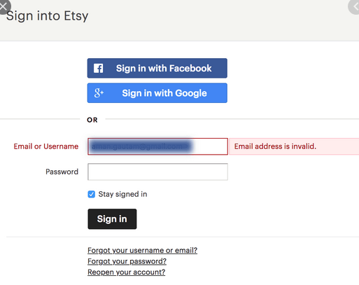
Ten Usability Heuristics (from Jakob Nielsen): Heuristic 9. Help users recognize, diagnose and recover from errors
9. Help users recognize, diagnose and recover from errors
Error messages should be expressed in plain language (no codes), precisely indicate the problem, and constructively suggest a solution.

Slide 28
Ten Usability Heuristics (from Jakob Nielsen): Heuristic 10. Help and documentation
10. Help and documentation
Few systems can be used with no instructions so it may be necessary to provide help and documentation. Any such information should be easy to search, focused on the user’s task, list concrete steps to be carried out, and not be too large.

Slide 29
Pros of Heuristic Evaluation
Heuristics can help the evaluators focus their attention on certain issues
Heuristic evaluation does not carry the ethical and practical issues/problems associated with inspection methods involving real users.
Evaluating designs using a set of heuristics can help identify usability problems with individual elements and how they impact the overall user experience.

Slide 30
Cons of Heuristic Evaluation
Choosing appropriate heuristics is extremely important; if the wrong set of heuristics is employed, certain usability problems may be overlooked.
Heuristic evaluation might be relatively time-consuming when compared to other 'quick and dirty' inspection methods, such as simple walkthroughs with a small sample of users. Training evaluators takes about a week on average, not including the time it takes to conduct the evaluations and debriefing sessions.
Unlike cognitive walkthroughs, heuristic evaluation is based on preconceived notions of what makes 'good' usability. However, this need not be seen as a negative point, as heuristics are often based on the experiences of real users with hundreds of designs

Slide 31
Heuristic Evaluation Reading assignment
Visit the website below and read on “How to Conduct a Heuristic Evaluation”
https://www.nngroup.com/articles/how-to-conduct-a-heuristic-evaluation/
Create and conduct a simple usability test for an existing software application (application)

Slide 32
Evaluation through expert analysis: 3. the use of models
A third expert-based approach is the use of models.
Certain cognitive and design models provide a means of combining design specification and evaluation into the same framework.
For example, the GOMS (goals, operators, methods and selection) model predicts user performance with a particular interface and can be used to filter particular design options.
Similarly, lower-level modeling techniques such as the keystroke-level model provide predictions of the time users will take to perform low-level physical tasks.

Slide 33
Evaluation through expert analysis: 4. Using previous studies in evaluation
A final approach to expert evaluation uses previous results as evidence to support (or refute) aspects of the design.
It is expensive to repeat experiments continually and an expert review of relevant literature can avoid the need to do so.
It should be noted that experimental results cannot be expected to hold arbitrarily across contexts.
The reviewer must therefore select evidence carefully, noting the experimental design chosen, the population of participants used, the analyses performed and the assumptions made.

Slide 34
Evaluation through user participation

Slide 35
Evaluation through user participation
The techniques we have considered so far concentrate on evaluating a design or system through analysis by the designer, or an expert evaluator, rather than testing with actual users.
However, useful as these techniques are for filtering and refining the design, they are not a replacement for actual usability testing with the people for whom the system is intended: the users.
User participation in evaluation tends to occur in the later stages of development when there is at least a working prototype of the system in place.

Slide 36
Evaluation Through User Participation
In this section we will look at a number of different approaches to evaluation through user participation.
These include
empirical or experimental methods,
observational methods,
query techniques, and
methods that use physiological monitoring, such as eye tracking and measures of heart rate and skin conductance.

Slide 37
Evaluation Through User Participation: experimental/empirical evaluation
One of the most powerful methods of evaluating a design or an aspect of a design is to use a controlled experiment.
This provides empirical evidence to support a particular claim or hypothesis.

Slide 38
Evaluation Through User Participation: experimental/empirical evaluation
Any experiment has the same basic form.
The evaluator chooses a hypothesis to test, which can be determined by measuring some attribute of participant behavior.
A number of experimental conditions are considered
Within this basic form, there are a number of factors that are important to the overall reliability of the experiment.
These include the participants chosen, the variables tested and manipulated, and the hypothesis tested.

Slide 39
Participants
The choice of participants is vital to the success of any experiment.
In evaluation experiments, participants should be chosen to match the expected user population as closely as possible
another issue relating to the participant set is the sample size chosen.
the sample size must be large enough to be considered to be representative of the population, taking into account the design of the experiment and the statistical methods chosen

Slide 40
Variables
Experiments manipulate and measure variables under controlled conditions, in order to test the hypothesis.
There are two main types of variables: those that are ‘manipulated’ or changed (known as the independent variables) and those that are measured (the dependent variables).
Example
An experiment wants to test whether search speed improves as the number of menu items decreases
Dependent variables: search speed
Independent variables: number of menu items (we may consider menus with five, seven, and ten items)

Slide 41
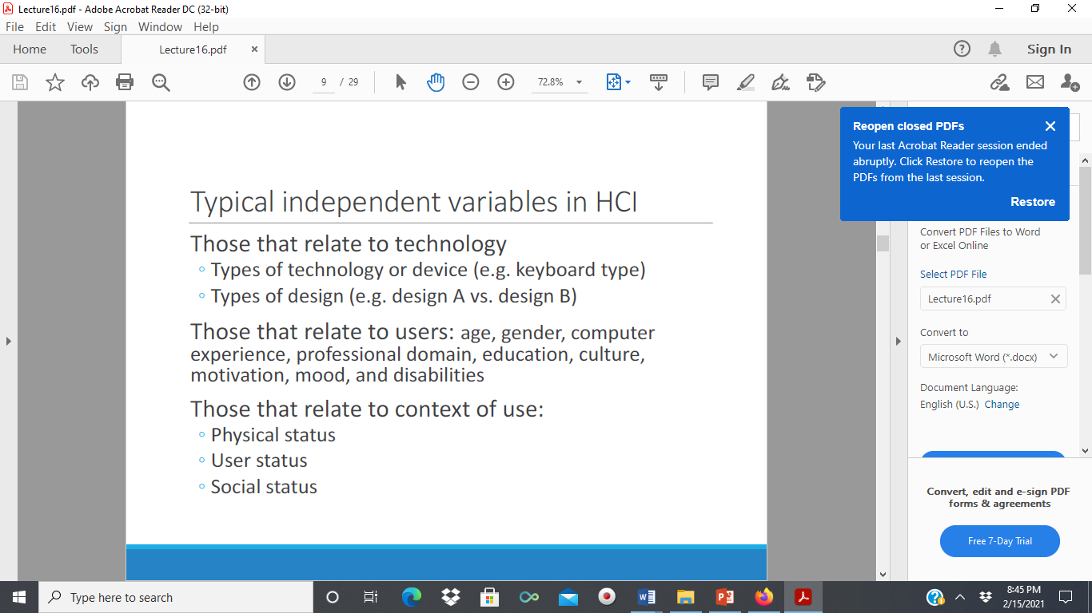

Slide 42
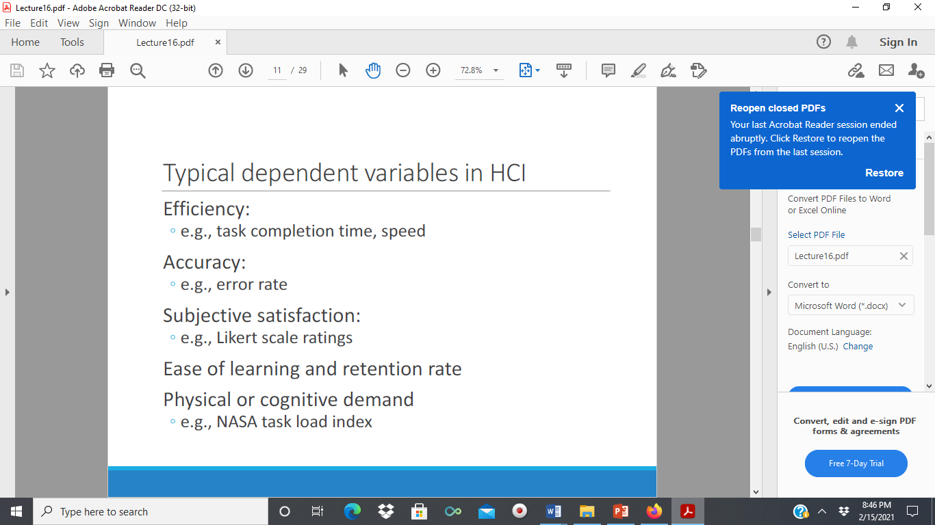

Slide 43
Hypotheses
A hypothesis is a prediction of the outcome of an experiment.
It is framed in terms of the independent and dependent variables, stating that a variation in the independent variable will cause a difference in the dependent variable.
The aim of the experiment is to show that this prediction is correct.

Slide 44
Experimental design
In order to produce reliable and generalizable results, an experiment must be carefully designed
You need to decide on the experimental method that you will use.
There are two main methods: between-subjects (between groups) and within-subjects.

Slide 45
Experimental design: Between-subjects
In a between-subjects (or randomized) design, each participant is assigned to a different condition.
There are at least two conditions: the experimental condition (in which the variable has been manipulated) and the control, which is identical to the experimental condition except for this manipulation.
This control serves to ensure that it is the manipulation that is responsible for any differences that are measured.

Slide 46
Between-subjects (or between-groups) study design: different people test each condition, so that each person is only exposed to a single user interface.
Within-subjects (or repeated-measures) study design: the same person tests all the conditions (i.e., all the user interfaces)

Slide 47
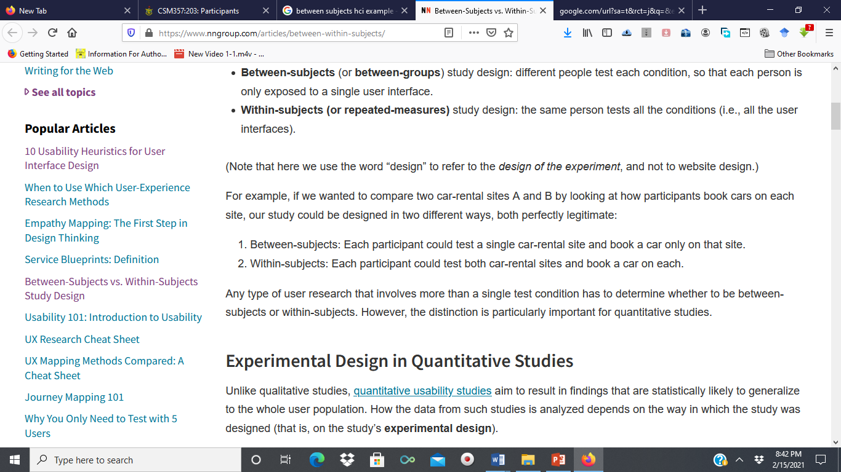
Case study: Within subjects and between subjects

Slide 48
Advantages and Disadvantages of Between-subjects experimental design
The advantage of a between-subjects design is that any learning effect resulting from the user performing in one condition and then the other is controlled: each user performs under only one condition.
The disadvantages are that a greater number of participants are required, and that significant variation between the groups can negate any results.
Also, individual differences between users can bias the results.
These problems can be handled by a careful selection of participants, ensuring that all are representative of the population and by matching participants between groups.

Slide 49
Experimental design: Within-subjects
The second experimental design is within-subjects (or repeated measures).
Here each user performs under each different condition.
This design can suffer from transfer of learning effects,
but this can be lessened if the order in which the conditions are tackled is varied between users, for example, group A do first condition followed by second and group B do second condition followed by first.
Within-subjects is less costly than between-subjects, since fewer users are required, and it can be particularly effective where learning is involved.
There is also less chance of effects from variation between participants.

Slide 50
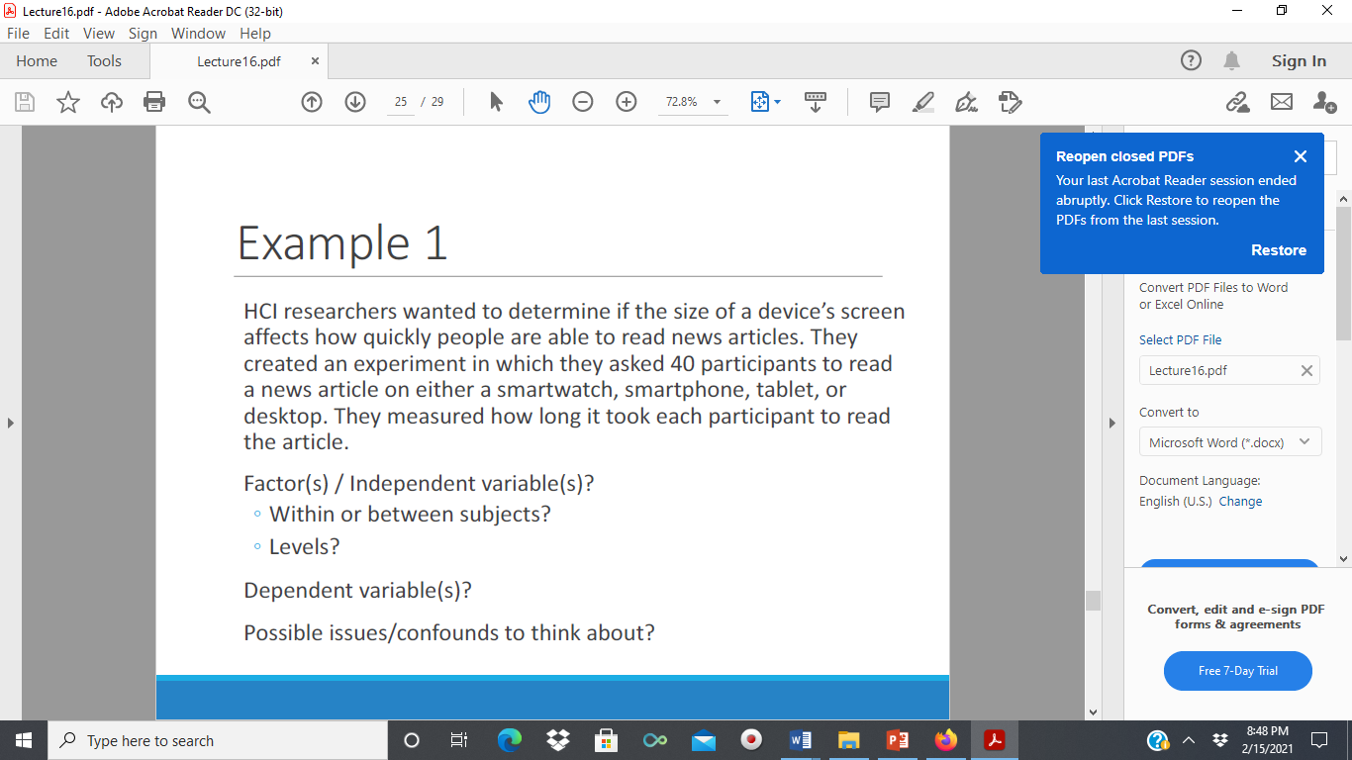
Empirical research: Example 1
www.nixdell.com>classes>lecture16

Slide 51
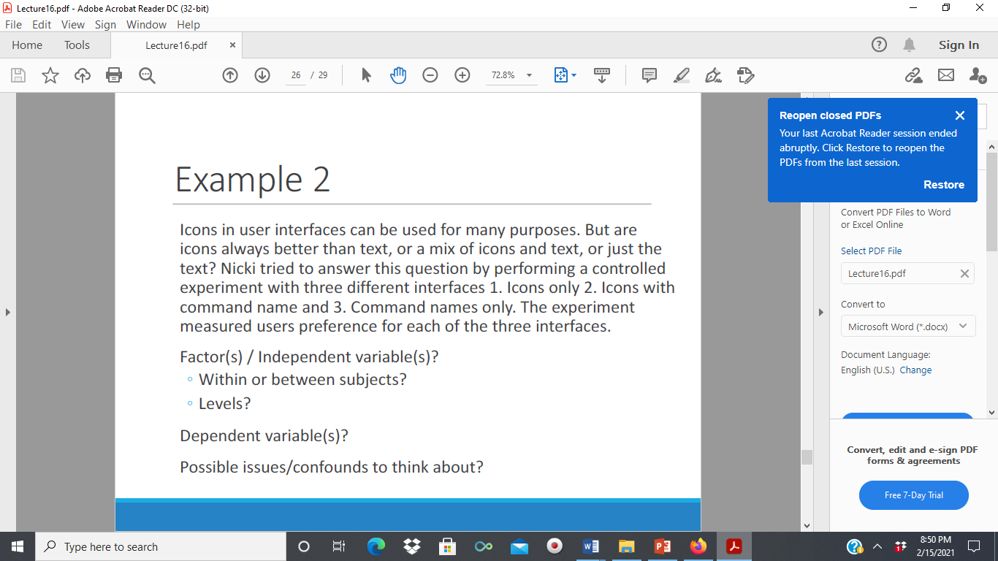
Empirical research: Example 2
www.nixdell.com>classes>lecture16

Slide 52
Evaluation Through User Participation: Observational techniques
A popular way to gather information about actual use of a system is to observe users interacting with it.
Usually they are asked to complete a set of predetermined tasks, although, if observation is being carried out in their place of work, they may be observed going about their normal duties.
Consequently users are asked to elaborate their actions by ‘thinking aloud

Slide 53
Evaluation Through User Participation: Observational techniques
The evaluator watches and records the users’ actions (using a variety of techniques such as Think aloud and cooperative evaluation)
Simple observation is seldom sufficient to determine how well the system meets the users’ requirements since it does not always give insight into the their decision processes or attitude.
Consequently users are asked to elaborate their actions by ‘thinking aloud

Slide 54
Some of the techniques used to evaluate systems by observing user behavior.
1. Think aloud: Think aloud is a form of observation where the user is asked to talk through what he is doing as he is being observed; for example, describing what he believes is happening, why he takes an action, what he is trying to do.
2. A variation on think aloud is known as cooperative evaluation in which the user is encouraged to see himself as a collaborator in the evaluation and not simply as an experimental participant. As well as asking the user to think aloud at the beginning of the session, the evaluator can ask the user questions (typically of the ‘why?’ or ‘what-if ?’ type) if his behavior is unclear, and the user can ask the evaluator for clarification if a problem arises. This more relaxed view of the think aloud process

Slide 55
Assignment
In not less than 200 words, explain why cooperative evaluation is better than think aloud approach to observation

Slide 56
Protocol analysis
The record of an evaluation session is known as a protocol, and
there are a number of methods from which to choose.
Paper and pencil
Audio recording
Video recording
Computer logging

Slide 57
Automatic protocol analysis tools
Analyzing protocols, whether video, audio or system logs, is time consuming and tedious by hand.
It is made harder if there is more than one stream of data to synchronize.
One solution to this problem is to provide automatic analysis tools to support the task. These offer a means of editing and annotating video, audio and system logs and synchronizing these for detailed analysis.
Examples of such automatic analysis tools are:
EVA (Experimental Video Annotator)
Workplace project at Xerox PARC
DRUM which also provides video annotation and tagging facilities.

Slide 58
Evaluation Through User Participation: Query Techniques
Another set of evaluation techniques relies on asking the user about the interface directly.
They embody the philosophy that states that the best way to find out how a system meets user requirements is to ‘ask the user’
There are two main types of query techniques: interviews and questionnaires.

Slide 59
Evaluation Through User Participation: Evaluation through monitoring physiological responses
One of the problems with most evaluation techniques is that we are reliant on observation and the users telling us what they are doing and how they are feeling.
What if we were able to measure these things directly?
Interest has grown recently in the use of what is sometimes called objective usability testing, ways of monitoring physiological aspects of computer use.
This will allow us to measure how they feel.
The two areas receiving the most attention to date are eye tracking and physiological measurement (Heart activity, Activity of the sweat glands, Electrical activity in muscle, Electrical activity in the brain).

Slide 60
Choose an appropriate evaluation method for each of the following situations.
(a)You are at an early stage in the design of a spreadsheet package and you wish to test what type of icons will be easiest to learn.
(b) You have a prototype for a theatre booking system to be used by potential theatre-goers to reduce queues at the box office.
(c) You have designed and implemented a new game system and want to evaluate it before release.
(d) You have developed a group decision support system for a solicitor’s office.
In each case, identify:
(i) the participants
(ii) the technique used
(iii) representative tasks to be examined
(iv) measurements that would be appropriate
(v) an outline plan for carrying out the evaluation.

Slide 61
Choose an appropriate evaluation method for each of the following situations.
(e) You have been asked to develop a system to store and manage student exam results and would like to test two different designs prior to implementation or prototyping.

Slide 62
Styles of evaluation
Evaluation styles
those performed under laboratory conditions
those performed ‘in the field’

Slide 63
Styles of Evaluation: Laboratory studies
In the first type of evaluation studies, users are taken out of their normal work environment to take part in controlled tests, often in a specialist usability laboratory
In addition, the participants operate in an interruption-free environment.
However, the lack of context – for example, filing cabinets, wall calendars, books or interruptions – and the unnatural situation may mean that one accurately records a situation that never arises in the real world. It is especially difficult to observe several people cooperating on a task in a laboratory situation
There are, however, some situations where laboratory observation is the only option, for example, if the system is to be located in a dangerous or remote location, such as a space station.

Slide 64
Laboratory studies
ACTIVITY A company is developing a new car seat to monitor whether a person is starting to fall asleep while driving and to provide a wake-up call using olfactory and haptic feedback. Where would you evaluate it?
Comment
It would be initially important to conduct lab-based experiments using a car simulator to see the effectiveness of the new type of feedback—in a safe setting, of course! You would also need to find a way to try to get the participants to fall asleep at the wheel. Once established as an effective mechanism, you would then need to test it in a more natural setting, such as a race track, airfield, or safe training circuit for new drivers, which can be controlled by the experimenter using a dual-control car.

Slide 65
Styles of Evaluation: Field studies
The second type of evaluation takes the designer or evaluator out into the user’s work environment in order to observe the system in action.
Again this approach has its pros and cons.
High levels of ambient noise, greater levels of movement and constant interruptions, such as phone calls, all make field observation difficult.
However, the very ‘open’ nature of the situation means that you will observe interactions between systems and between individuals that would have been missed in a laboratory study.

Slide 66
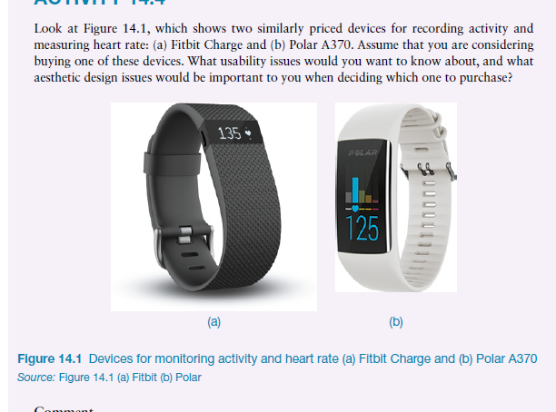

Slide 67
Comment
There are several usability issues to consider. Some that you might be particularly interested in finding out about include how comfortable the device is to wear, how clearly the information is presented, what other information is presented (for example, time), how long the battery lasts before it needs to be recharged, and so forth.
Most important of all might be how accurate the device is, particularly for recording heart rate if that is a concern for you.

Slide 68
Since these devices are worn on your wrist, they can be considered to be fashion items.
Therefore, you might want to know whether they are available in different colors, whether they are bulky and likely to rub on clothes and cause damage, and whether they are discrete or clearly noticeable.

Slide 69
Evaluation: Issues to consider
What do you have to tell participants, and what if they decide part way through the study that they don’t want to continue to the end? Can they stop, or do they have to continue?
Two central issues are:
•• Informing participants about their rights
••Making sure you take into account biases and other influences that impact how you
describe your evaluation findings
•• Ethical approval

Slide 70
Summary
Evaluation is an integral part of the design process and should take place throughout the design life cycle.
Its aim is to test the functionality and usability of the design and to identify and rectify any problems.
It can also try to determine the user’s attitude and response to the system.
It can take place in a specialist laboratory or in the user’s workplace, and may or may not involve active participation on the part of the user.

Slide 71
Summary
A design can be evaluated before any implementation work has started, to minimize the cost of early design errors.
Most techniques for evaluation at this stage are analytic and involve using an expert to assess the design against cognitive and usability principles.

Slide 72
THANK YOU

