Slide 1

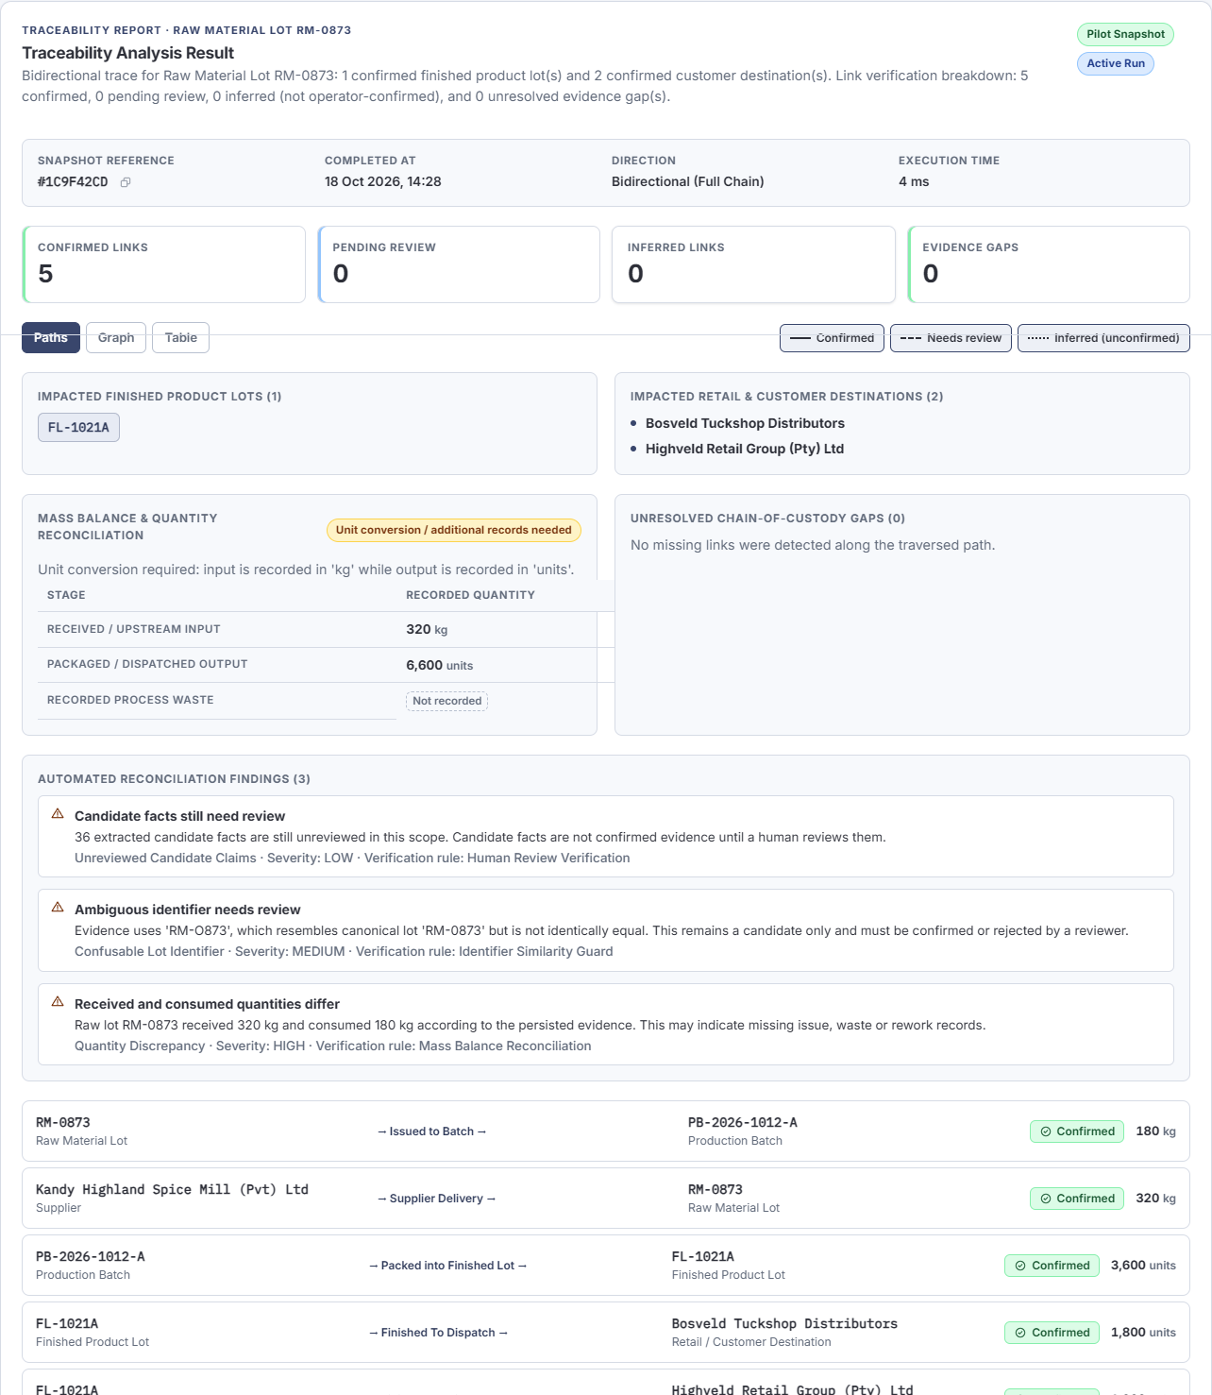
Klarrow
Evidence-reconciliation workbench
RUN 4 - CONTROLLED SYNTHETIC SCENARIO
Evidence reconciliation for
food-traceability investigations
Klarrow helps an operator assemble and challenge fragmented supplier, production and dispatch records - with source grounding, human decisions and explicit uncertainty.
15
35
4
8
AI rows
parser rows
value-in-quote
identifier-only
WHAT IT DOES
- Ingests supported text, CSV/TSV, Excel, EML, logs and text-selectable PDF.
- Uses local Meta Llama 3.2 3B to propose candidate facts; deterministic code handles structured parsing and traversal.
- Keeps value-in-quote, adjacent-line context, identifier-only and unlocated claims distinct; humans confirm relationships.
- Separates confirmed scope from possible exposure and records findings, caveats and audit history.
Trace snapshot - confirmed scope, unresolved gaps, insufficient mass balance
Not a recall decision system. Not certified. Not production-ready. One authored scenario; accuracy, time savings and customer demand remain unmeasured.
Klarrow - evidence-reconciliation workbench
18 Oct 2026

