Slide 1

Klarrow
Evidence-reconciliation workbench
AI ACADEMY SOUTH AFRICA · PITCHATHON
Evidence reconciliation
for food-traceability
investigations
Klarrow helps an operator assemble and challenge fragmented supplier, production and dispatch records - with source grounding, human decisions and explicit uncertainty.
Human review. Source grounding. Explicit uncertainty.
Prototype demonstration · 18 October 2026 · Run 4 controlled synthetic scenario
Notes:
Open with the investigation moment, not the technology. Klarrow is a human-in-the-loop workbench, not a recall decision engine.

Slide 2
THE INVESTIGATION MOMENT
A supplier alert starts a document hunt,
not a clean database query.
RECORDS ARRIVE IN DIFFERENT SHAPES
01
Which batches used the lot?
Production sheets, batch records and stock ledgers rarely share one identifier.
PDF
CSV
XLSX
Which customers received them?
LOG
EML
02
Dispatch notes and invoices sit across warehouses, carriers and spreadsheets.
same lot, different identifiers
kg vs units
03
Where does the evidence stop lining up?
missing pages · near-match codes
Quantities disagree; records are missing; typos look like real lot codes.
The operator must assemble, challenge and document the evidence trail. Klarrow is designed for that moment - not to decide food safety.
Klarrow · evidence-reconciliation workbench
02
Notes:
The problem is fragmented evidence, drifting identifiers and quantities that do not reconcile. Do not claim all factories behave this way; say this is the workflow we are testing.

Slide 3
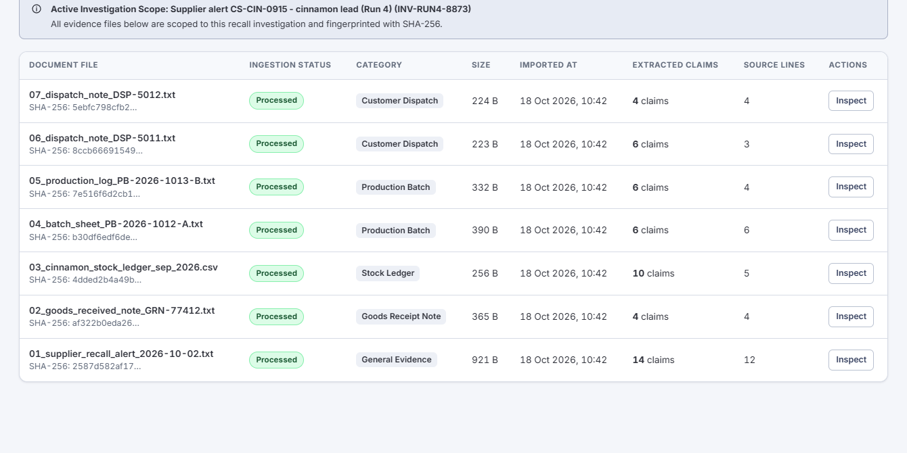
THE WORKBENCH
One workbench: ingest, ground, review, trace, export.
1
Ingest
›
2
Extract
›
3
Ground
›
4
Review
›
5
Trace & export
SUPPORTED INPUTS
Text · CSV/TSV · Excel · EML · logs · text-selectable PDF
HONEST BOUNDARY
Images and scanned PDFs are retained but not OCR'd. The prototype does not read handwriting or photographs.
Klarrow sits beside the system of record. It does not replace the ERP.
Klarrow · evidence-reconciliation workbench
03
Notes:
Walk the five-step workflow. State the no-OCR boundary. Klarrow sits beside the ERP.

Slide 4
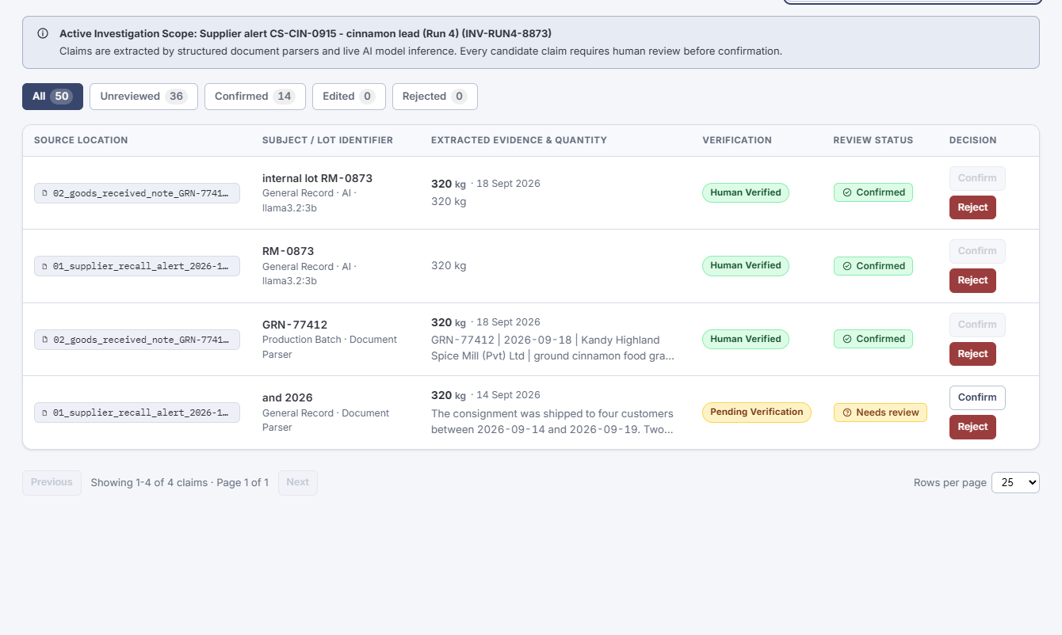
THE AI ROLE
Meta Llama proposes candidate facts.
Deterministic code and people decide.
LOCAL META LLAMA 3.2 3B
Candidate fact extraction from supported text. No cloud model call in this run.
DETERMINISTIC PARSERS
Structured rows, lots, quantities and trace-link proposals. Graph traversal is code, not the model.
HUMAN REVIEWER
Confirms, rejects or edits with a reason. Every decision is written to the audit trail.
15
35
4
3
8
AI rows
parser rows
value-in-quote
adjacent context
identifier-only
Run 4 · one authored seven-document scenario · 15 AI rows contain duplicate values; this is not 15 unique discoveries. No unique AI-only raw token was established.
Klarrow · evidence-reconciliation workbench
04
Notes:
Local Meta Llama 3.2 3B proposes candidate facts. Deterministic code handles structured parsing and graph traversal. Humans decide. Do not say the AI runs the trace.

Slide 5
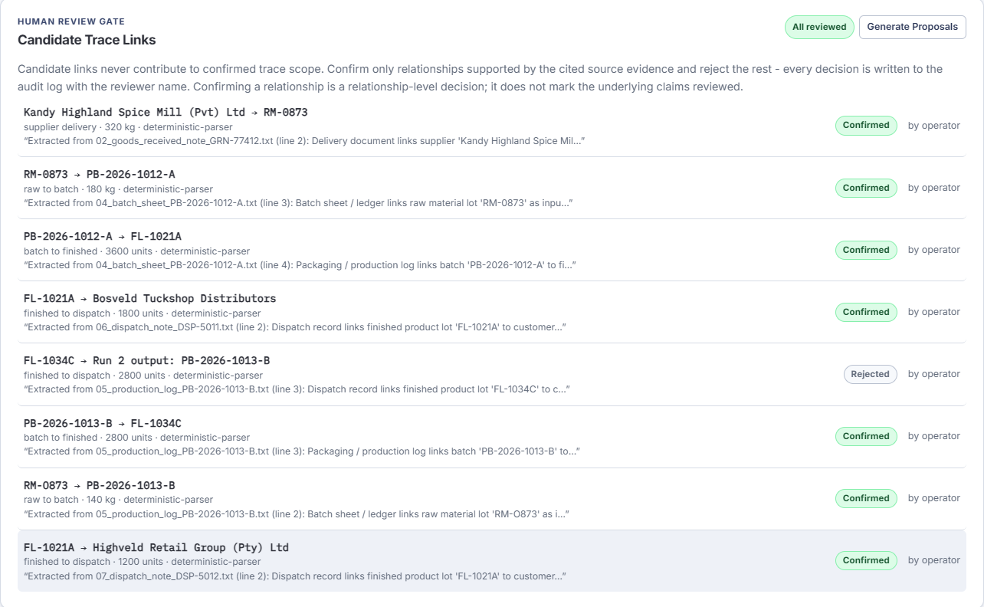
THE HUMAN GATE
A relationship is not confirmed just because
a model proposed it.
RUN 4 REVIEW OUTCOME
• 8 relationship proposals.
• 7 confirmed by the operator; 1 rejected.
• The rejected link is a false-positive dispatch phrase: "Run 2 output: PB-2026-1013-B".
• RM-O873 / RM-0873 alias deferred, not silently merged.
• Supporting facts reviewed for confirmed links; 36 facts remain unreviewed.
Confirmation records a human decision. It is not independent proof of truth.
The false positive is a feature of the demo, not a hidden failure: the gate caught it before it entered confirmed scope.
Klarrow · evidence-reconciliation workbench
05
Notes:
Show the false-positive rejection and deferred alias. The human gate is the product. Confirmation is a human decision, not independent truth.

Slide 6
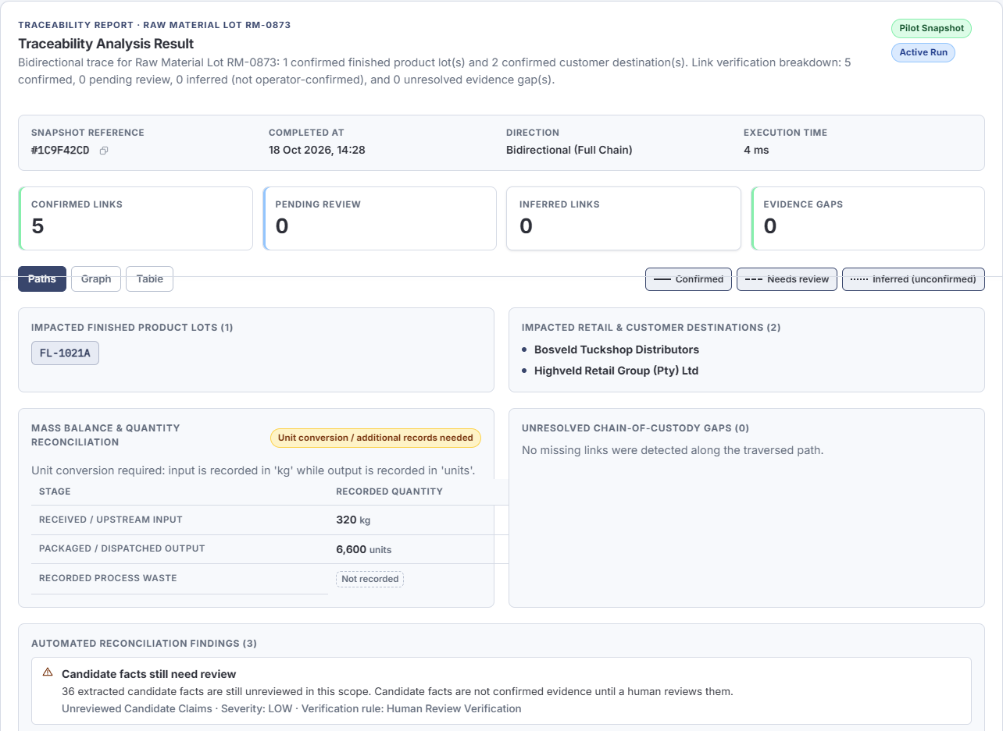
THE TRACE
The trace separates confirmed scope
from possible exposure.
RUN 4 SNAPSHOT
Confirmed
FL-1021A → Bosveld + Highveld
Outside this trace
FL-1034C stays outside the RM-0873 trace while the RM-O873 alias is deferred.
Possible scope
Empty in this snapshot.
Mass balance
Insufficient: 320 kg input vs 6,600 units output. No conversion invented.
3 open findings
Not a recall decision.
Klarrow · evidence-reconciliation workbench
06
Notes:
Confirmed scope: FL-1021A, Bosveld and Highveld. FL-1034C stays outside the RM-0873 trace while the alias is deferred. Mass balance is insufficient; no conversion is invented.

Slide 7
THE EVIDENCE BOUNDARY
What this run supports - and what it does not.
OBSERVED
NOT ESTABLISHED
• End-to-end workflow on one authored scenario.
• Local Llama candidate facts; deterministic parsing and traversal.
• Four grounding states, including adjacent-line context.
• Human rejection of one false-positive relationship.
• Deferred alias; confirmed vs possible scope; export.
• General accuracy, precision or recall.
• Time saved vs manual work.
• Unique AI-only raw facts.
• Real customer data, demand or pilots.
• Production readiness, OCR or certification.
One authored scenario · one local model · one operator · n=1
We are deliberately showing the boundary, not hiding it.
Klarrow · evidence-reconciliation workbench
07
Notes:
This is the honesty slide. One authored scenario, one model, one operator, n=1. No accuracy, time-saving, customer or production claims.

Slide 8
SOUTH AFRICAN CONTEXT
Why this matters in South Africa.
Producer responsibility
Export traceability
Regulator can require action
Food safety and accurate labelling rest with the producer. Enforcement is delegated to municipal health services.
PPECB food-safety audits explicitly cover traceability for regulated agricultural products intended for export.
The NCC may require a producer to conduct an investigation or carry out a recall programme on its terms.
National Department of Health, Food Control
PPECB, Food Safety Services
Consumer Protection Act 68 of 2008, s60
The implication: one event may need an evidence pack for several audiences. We are testing whether an evidence-reconciliation overlay helps - not claiming that demand is proven.
Sources: health.gov.za/food-control-home · ppecb.com/services/food-safety-services · gov.za Consumer Protection Act 68 of 2008
Klarrow · evidence-reconciliation workbench
08
Notes:
South African context: producer responsibility, export traceability audits, NCC investigation/recall powers. Do not claim FSMA 204 applies in South Africa.

Slide 9
THE ASK
Next: a practitioner-led, authorised
mock-recall evaluation.
WEEK 1
WEEK 2
WEEK 3
WEEK 4
Practitioner review
Records
Timed tabletop
Validation memo
15-minute walkthrough of the synthetic scenario.
Authorised or redacted records that resemble the real workflow.
Manual baseline vs Klarrow-assisted pass on equivalent evidence.
What helped, what failed, what must change before a pilot.
MEASURE
Time to assemble the evidence pack · missed or ambiguous links · human review load · unresolved gaps · auditability
Draft plan, not a committed pilot. No customer has been contacted or committed.
We are asking for: a 15-minute review, authorised/redacted records, and one supervised tabletop.
Klarrow · evidence-reconciliation workbench
09
Notes:
Ask for a practitioner review and authorised/redacted records. This is a draft 30-day validation plan, not a committed pilot.

Slide 10
Klarrow
Evidence-reconciliation workbench
Evidence before assertion.
Klarrow helps an operator assemble, challenge and document the evidence trail for a food-traceability investigation - with human decisions, source grounding and explicit uncertainty.
Seeking practitioner review and authorised or redacted records.
Not a recall decision system. Not certified. Not production-ready.
Run 4 · one authored synthetic scenario · 18 October 2026
Notes:
Close on evidence discipline. Invite a supervised evaluation. Do not imply customers, pilots or regulatory approval.

