Slide 1

LEDs
kleben
löten
programmieren

Slide 2
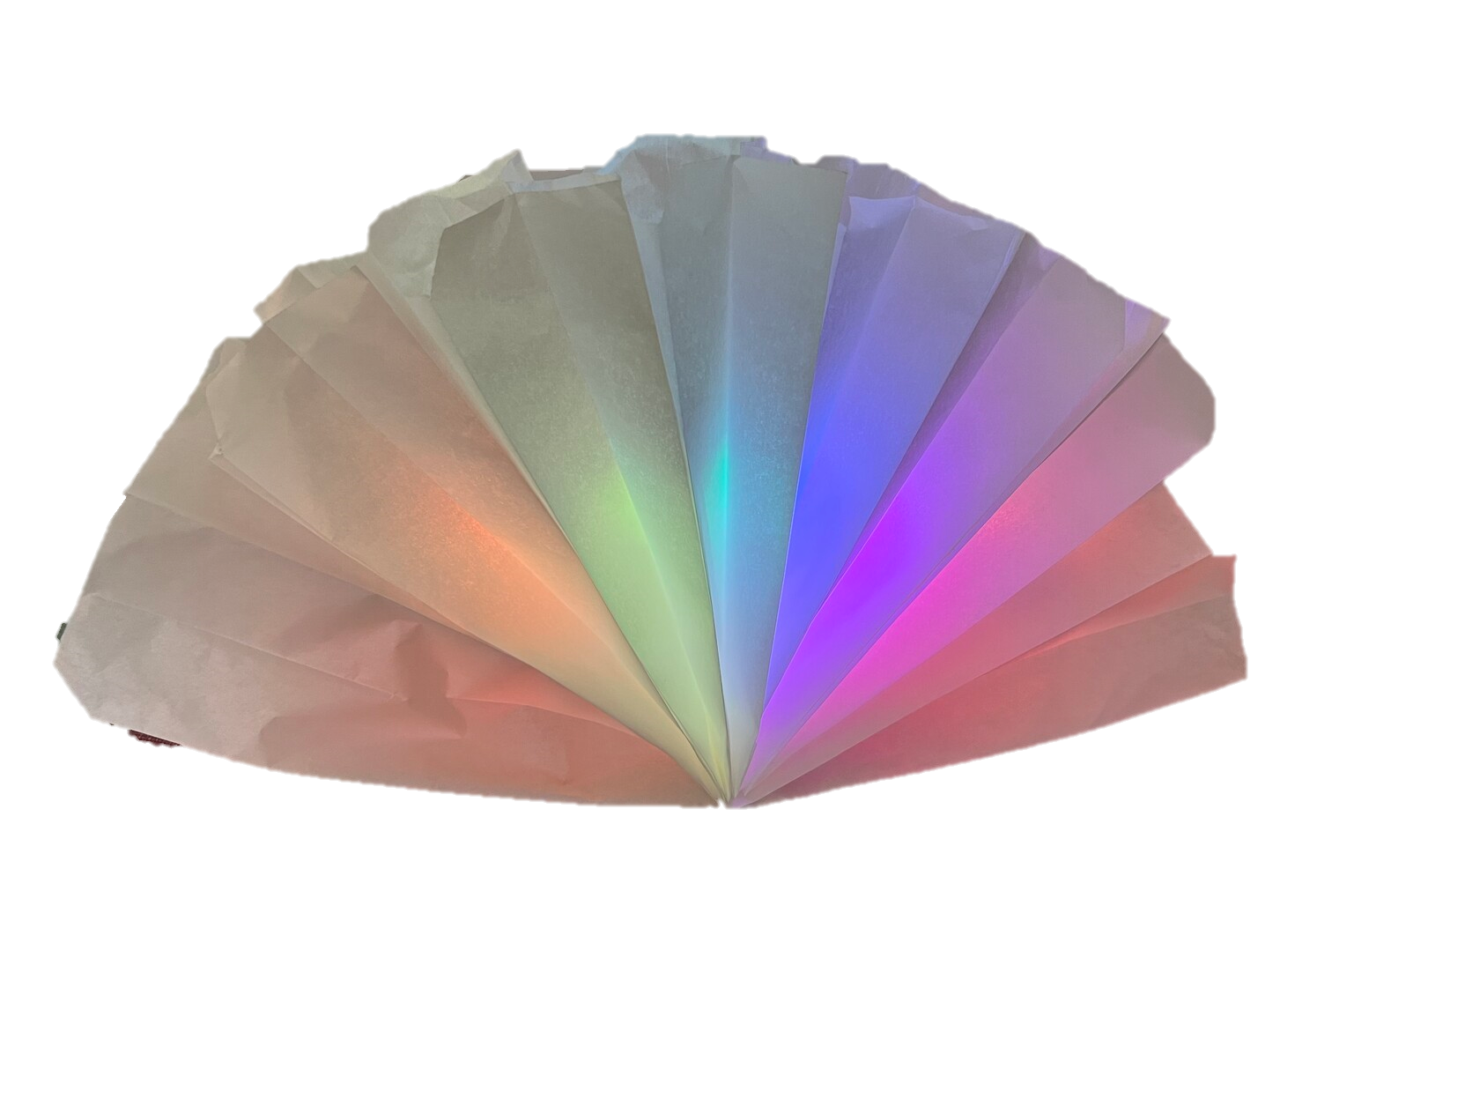
Hardware 1 - Papier

Slide 3
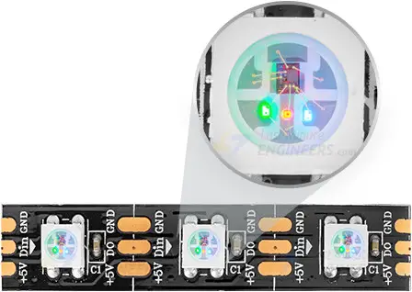
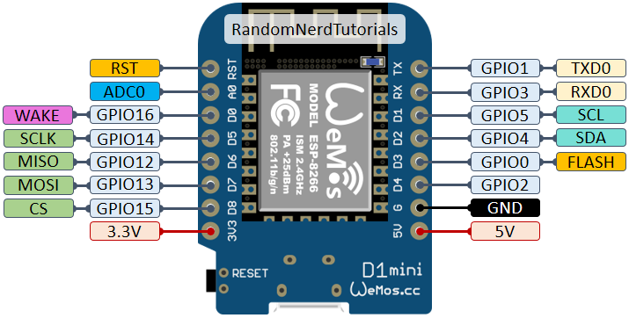

Hardware 2 - Strom

Slide 4



Software choose your enemy
Arduino IDE
MicroPython
WLED
C https://www.arduino.cc/
Python https://micropython.org/
Ready to use https://kno.wled.ge/

Slide 5
Software Arduino
int i = 0;
bool b = false;
CRGB color = CRGB::Red;
void loop() {
leds[i] = color;
FastLED.show();
i++;
if (i == NUM_LEDS) {
if (b) {
color = CRGB::Black;
} else {
color = CRGB::Green;
}
i=0;
b=!b;
}
delay(200);
}
Arduino IDE kann auch für ESPs genutzt warden
https://arduino-esp8266.readthedocs.io/en /latest/installing.html
Libraries:
FastLED http://fastled.io/
#include <FastLED.h>
#define LED_PIN 4
#define NUM_LEDS 16
#define BRIGHTNESS 5 // 0-255
#define LED_TYPE WS2812B
#define COLOR_ORDER GRB
CRGB leds[NUM_LEDS];
void setup() {
FastLED.addLeds <LED_TYPE, LED_PIN,
COLOR_ORDER>
(leds, NUM_LEDS)
.setCorrection( TypicalLEDStrip );
FastLED.setBrightness(BRIGHTNESS);
}

Slide 6
Software MicroPython
MicroPython Image auf den ESP flashen
https://micropython.org /download /ESP8266_GENERIC/
Code live bearbeiten
main.py
z.B. Visual Studio Code mit Pymakr (Preview)
direkt ausführen
from machine import Pin, freq
from neopixel import NeoPixel
from sys import platform
import time
import math
import gc
numberOfLeds = 16
# pin 4 is also called D2
ledPin = Pin(4, Pin.OUT)
leds = NeoPixel(ledPin,
numberOfLeds)
def setAllTo(rgb):
for i in range(numberOfLeds):
leds[i] = (rgb)
leds.write()
setAllTo(255,0,0)
setAllTo(toRgb(h, s, v))

Slide 7

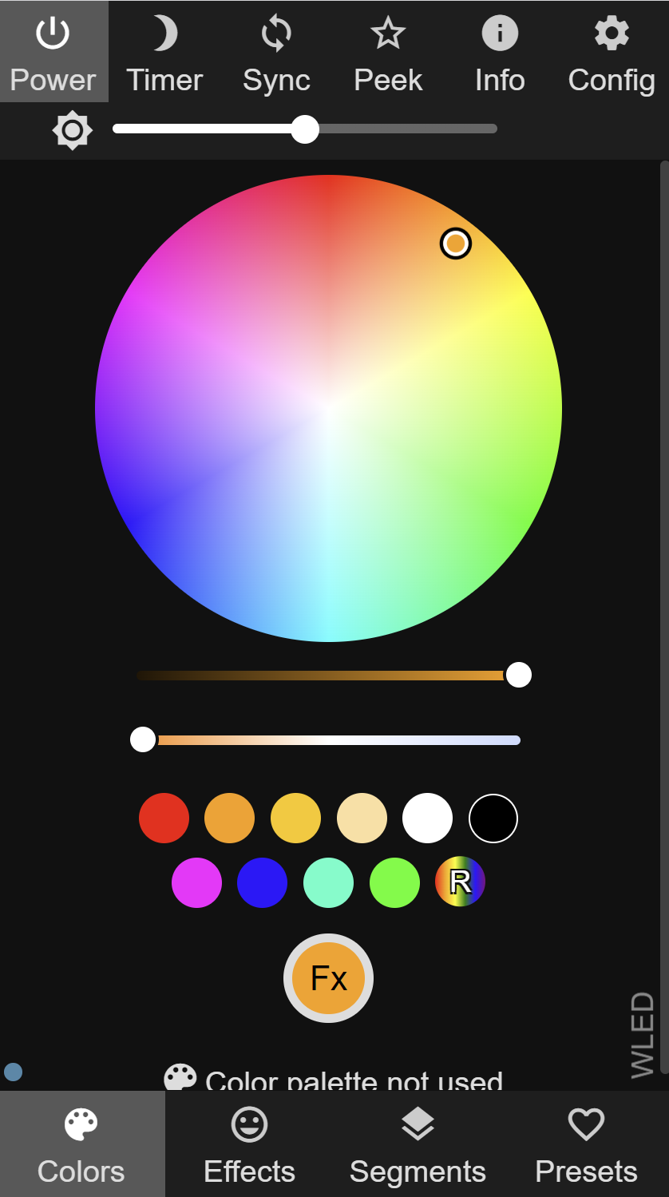
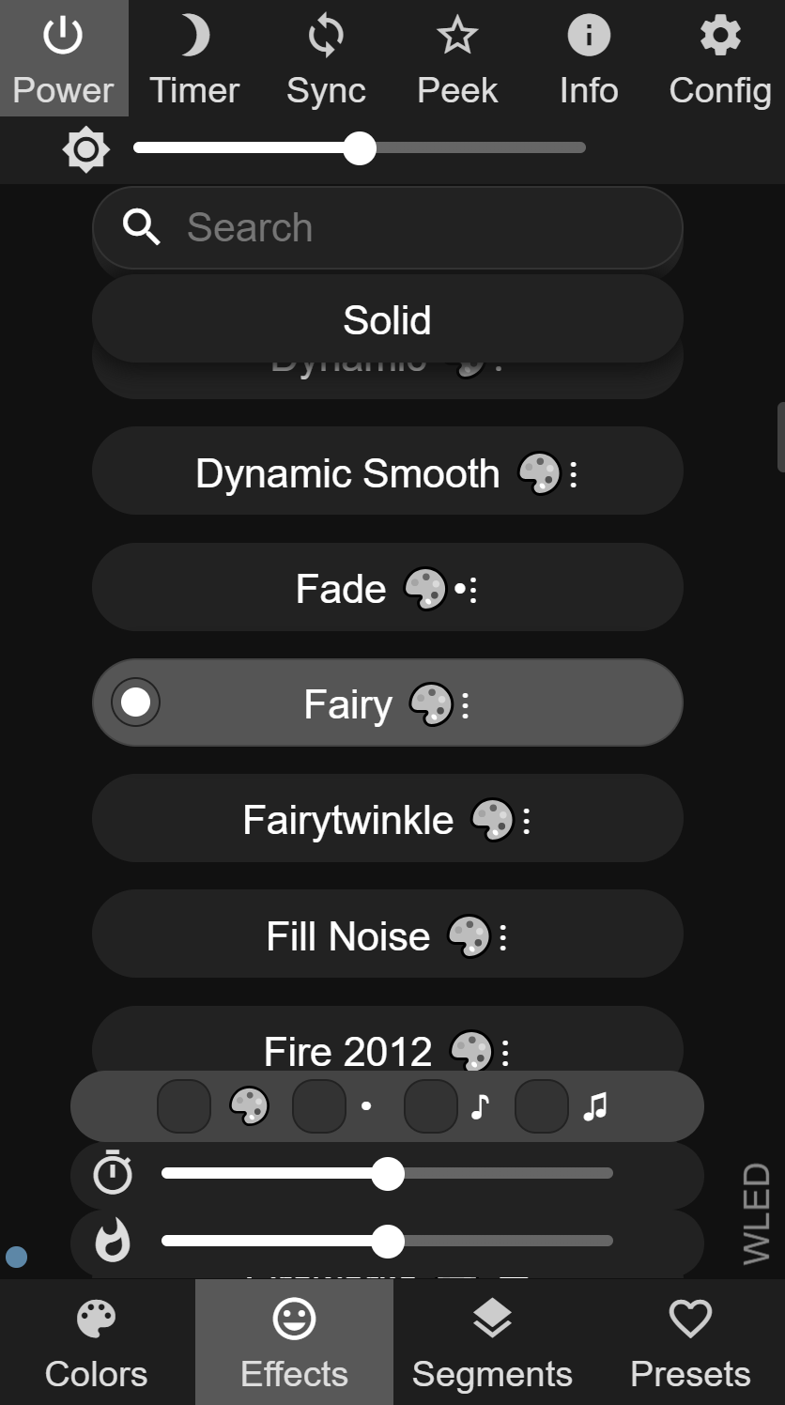
Software WLED
WLED Image auf den ESP flashen
Web Installer https://install.wled.me/ (z.B. Chromium)
mit WiFi “WLED-AP” verbinden
pw = wled1234
http://4.3.2.1

Slide 8
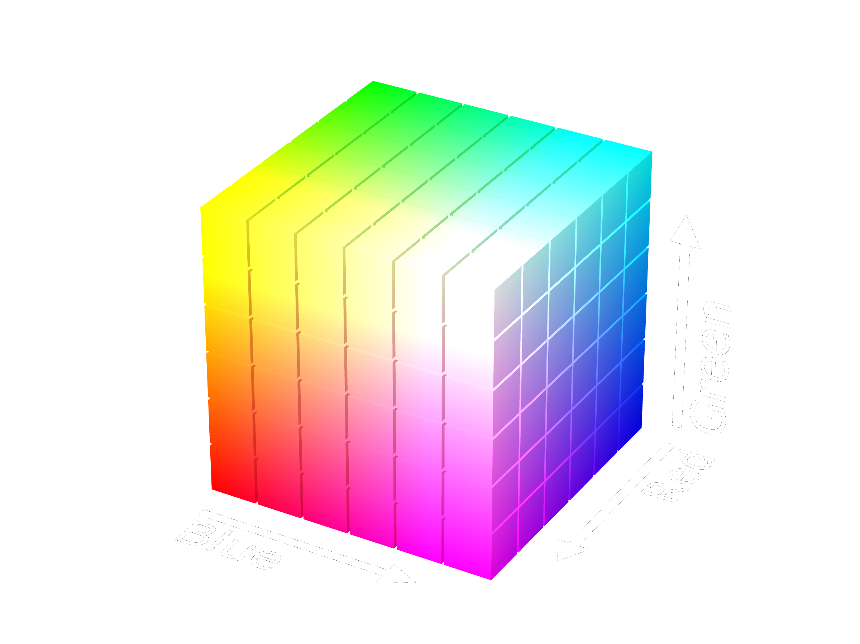
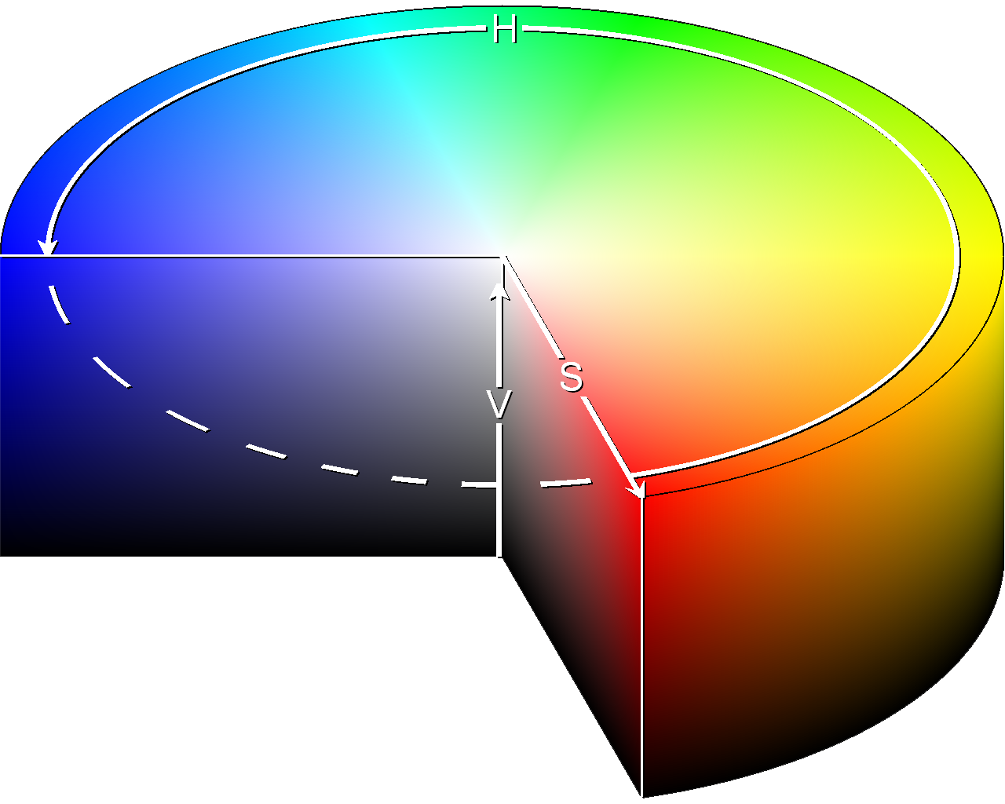
Farbräume
RGB (rot, grün, blau)
HSV (hue, saturation, value)

Slide 9

Code / Stuff
https://github.com/irgendwienet/37c3-kidspace-leds

