Slide 1
Comparing Flavors of TCP on Different Network Topologies
By: Louie DiBernardo

Slide 2
How is everything setup?
Mininet running natively on an ubuntu installation on Linux 5.13.0-39-generic and on MPTCP version as well.
As a controller, I have a second ubuntu installation running OpenDayLight.
Currently both run directly on hardware, not VMs

Slide 3
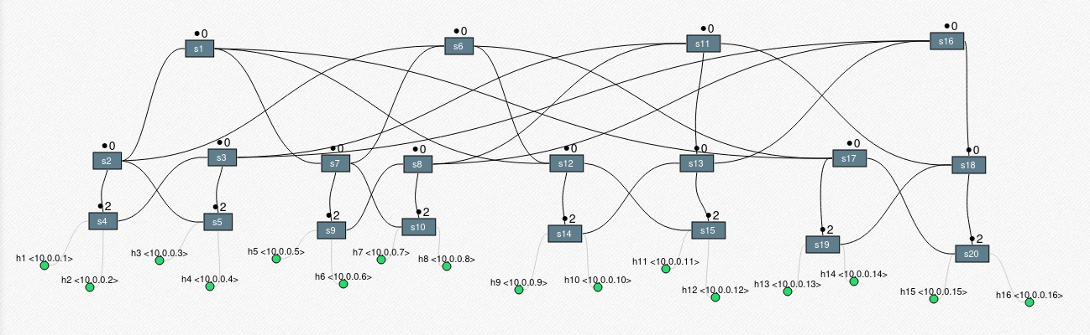
Fat Tree Topology - Visualizer
Using Spear Narmox visualizer:

Slide 4
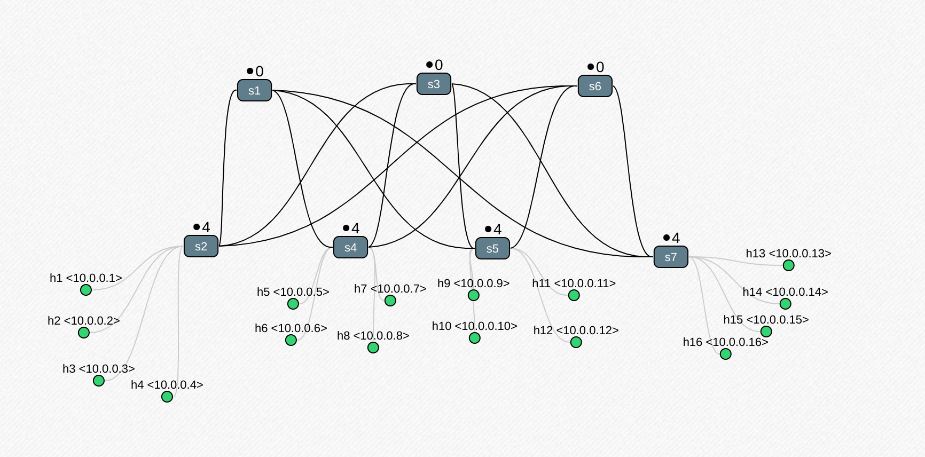
Leafspine Topology
Using Spear Narmox visualizer:

Slide 5
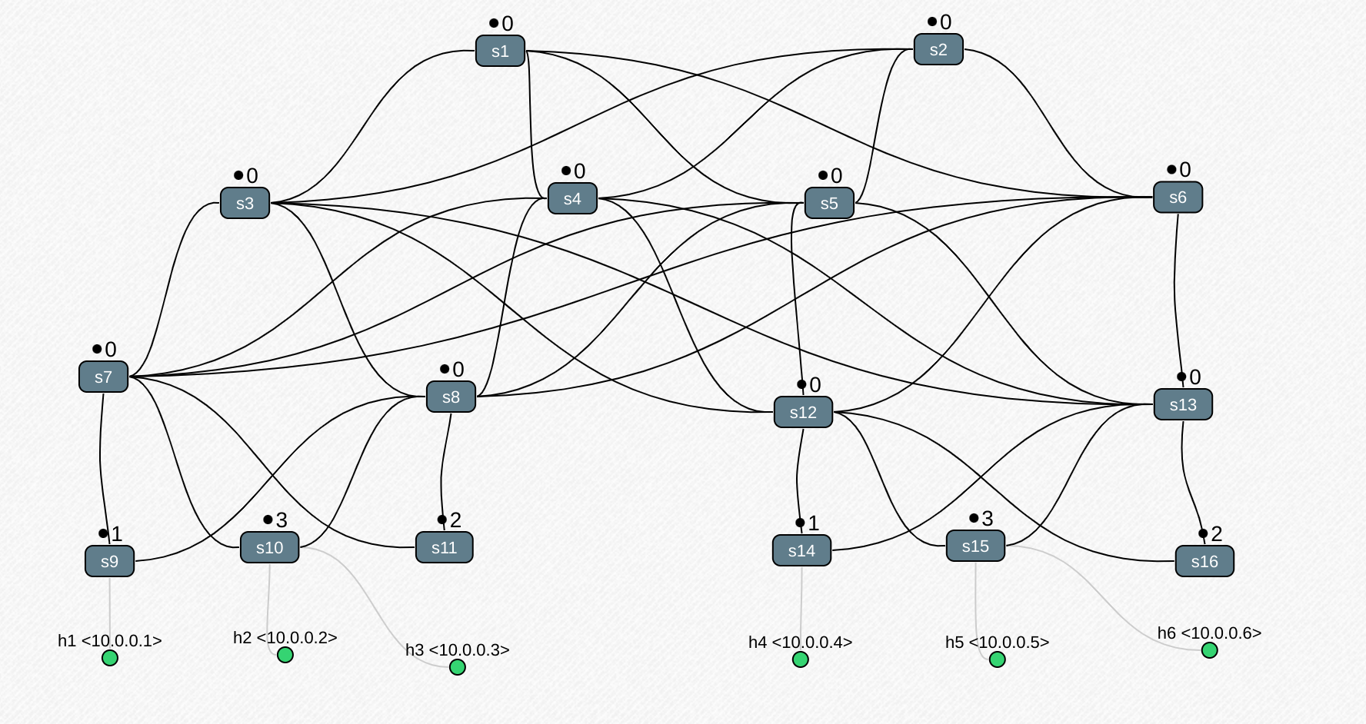
Superspine Topology
Using Spear Narmox visualizer:

Slide 6
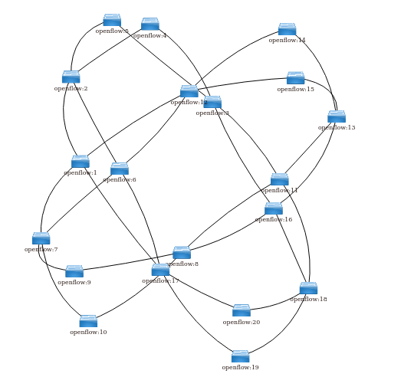
Fat Tree Topology – Visualizer: ODL
Interestingly, ODL has some limits to its DLUX package visualizer.

Slide 7
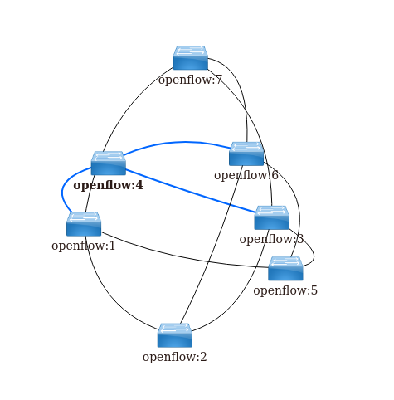
Leaf spine Topology – Visualizer: ODL
Interestingly, ODL has some limits to its DLUX package visualizer.

Slide 8
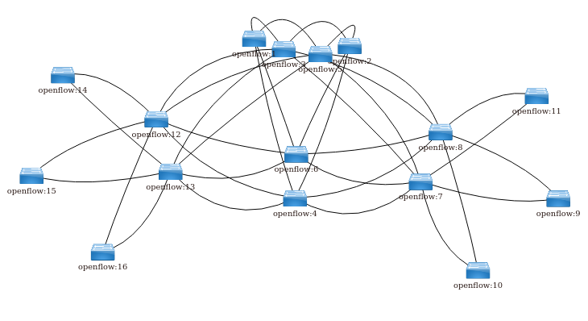
Super spine Topology – Visualizer: ODL
Interestingly, ODL has some limits to its DLUX package visualizer.

Slide 9
MPTCP Graphs

Slide 10
Current Problems
A lot of issues trying to get the dctcp linux kernel installed, not much documentation seems to exist for installing it (at least that I can find)
TCP and STCP implementations were incorrect! I found this out when merging the graphs together with MPTCP. Currently in the process of testing TCP, will need to figure out path for STCP moving forward.

Slide 11
Reproducability
Currently, everything is running hardware, not vm’s. To reporoduce my work (as I currently have it setup) two different computers will need to be running, one with ODL, and one with mininet.

Slide 12
Questions?

