Slide 1
JOB-A-THON May 2021
-The most exciting data science hiring event.
Name:- Abhishek Kumar Prasad
Final-Year Grad Student.
College: Ramrao Adik Institute of Technology, Navi-Mumbai.
Contact no: +91 8286250976
Gmail:- justabhishek1999@gmail.com
LinkedIn:- https://www.linkedin.com/in/abhishek-kumar-prasad-aa065310a/

Slide 2
OUTLINE.
Introduction.
Data-Cleaning.
Feature Engineering.
Model.
Conclusion

Slide 3
Introduction
Problem Statement:
Credit Card Lead Prediction
Happy Customer Bank is a mid-sized private bank that deals in all kinds of banking products, like Savings accounts, Current accounts, investment products, credit products, among other offerings.
The bank also cross-sells products to its existing customers and to do so they use different kinds of communication like tele-calling, e-mails, recommendations on net banking, mobile banking, etc.
In this case, the Happy Customer Bank wants to cross sell its credit cards to its existing customers. The bank has identified a set of customers that are eligible for taking these credit cards.
Now, the bank is looking for your help in identifying customers that could show higher intent towards a recommended credit card, given:
Customer details (gender, age, region etc.)
Details of his/her relationship with the bank (Channel_Code,Vintage, 'Avg_Asset_Value etc.)

Slide 4
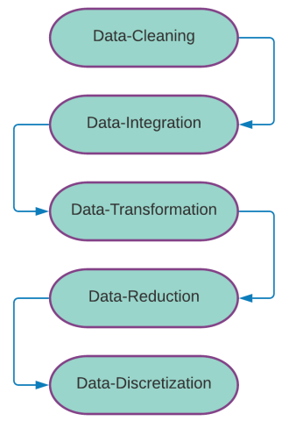
Data pre-processing.
Data pre-processing is the process of simply transforming raw data into an understandable format. Real-world data is sometimes incomplete, inconsistent, redundant, and noisy. Data pre-processing involves various stages that help to convert raw data into a processed and realistic format. The below diagram depicts the various stages involved in the pre-processing.

Slide 5
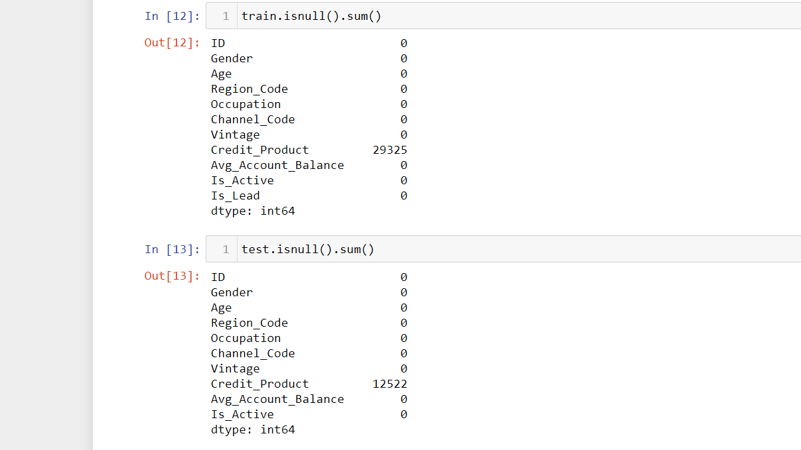
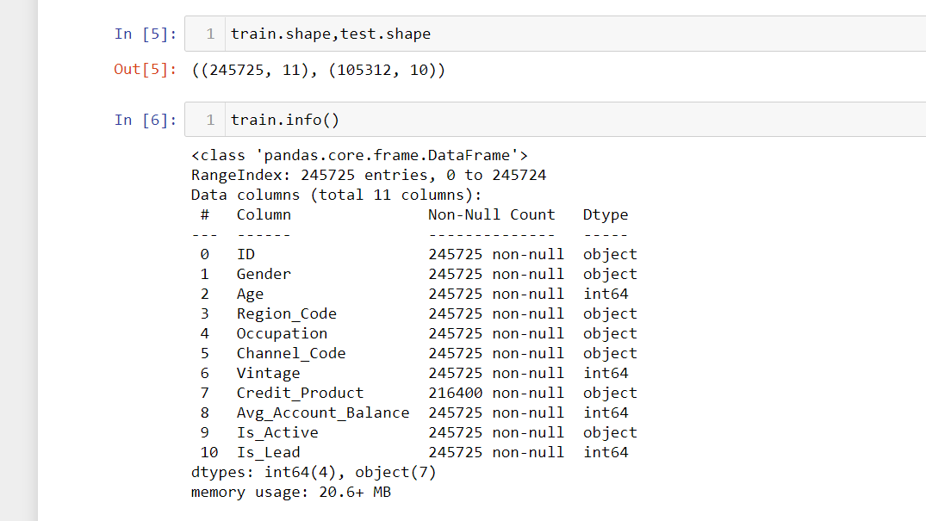
The training and test set contains 7 object Dtype values which has to be converted into integer format.
The below snapshot indicates the train shape, test shape and the number of null values.

Slide 6
Dealing with the Null values.
Handling missing Data
There are basically 3 Basic Methods to deal with this problem:
1) To delete the Data rows containing NaN Values.
Con:- This will also delete the data which may be important for the prediction and it is not recommended when the dataset is small also for this competition we cannot drop null values as it will give dimension error while submission.
2) To use Mode value
con:- I have used mode value but it is giving low accuracy and also results in biasing.
3) To fill the missing data with some temporary variable.
Here, I have used the “Missing” Variable in null values.
Conclusion: Here, I have tested all the 3 methods but got high ROC_AUC score by using the 3rd Method.

Slide 7
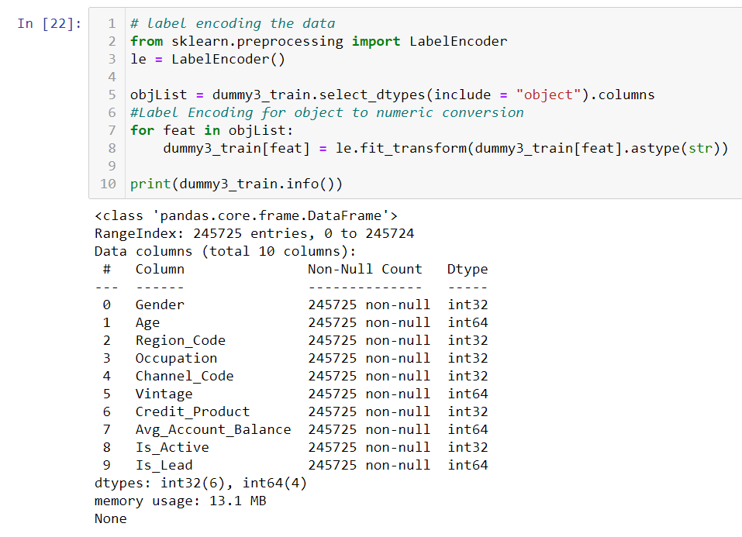
Feature-Engineering
Here, first all the object Dtype is converted using Sklearn
LabelEncoder.
This helps to remove all the noise from the dataset and make it uniform, before pushing it into the Model.
Feature Engineering is the most important. The pre-processed data is then fed to the feature selection phase. In this phase, the crucial and befitting features are drawn out. This enables us to diminish the dimensionality of the data without degrading the quality.

Slide 8
Comparison of ML Model
Here, Comparison based approach is used, by comparing 11 Machine Learning Classifier Algorithms.
That are:
Logistic Regression
Naive_Bayes
SGD Classifier
Decision TreeClassifier
LGBM Classifier
XGB Classifier
AdaBoost Classifier
MLP Classifier
RandomForest Classifier
Gradient Boosting Classifier
CatBoost Classifier

Slide 9
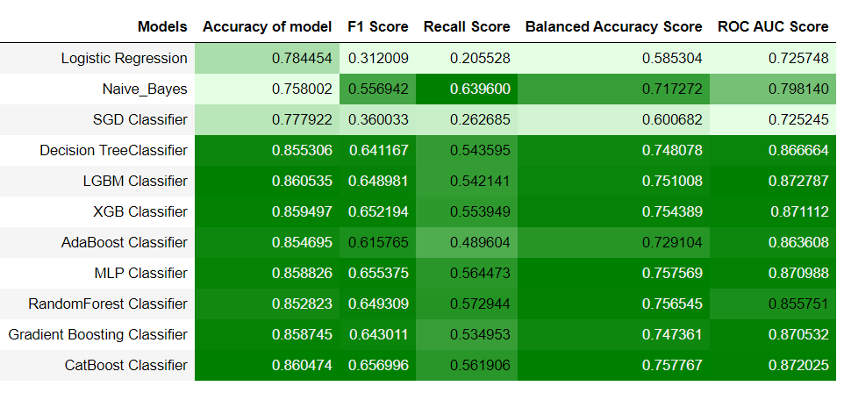
The Results of the 11 Machine Learning Classifiers are shown below in the figure.
Here, LGBM, XGB, MLP and, CATBoost is performing better with high ROC_AUC SCORE.

Slide 10
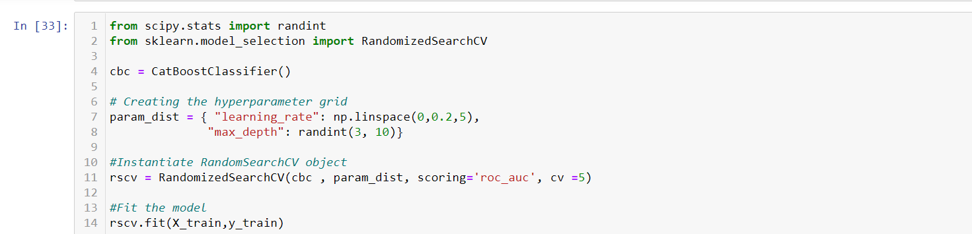
Hyper Parameter Tuning.
GridSearchCV and RandomizedSearchCV is used to Hyper Paramater tuning.
These are the open source libraries which helps to get the best parameter possible for our model.

Slide 11
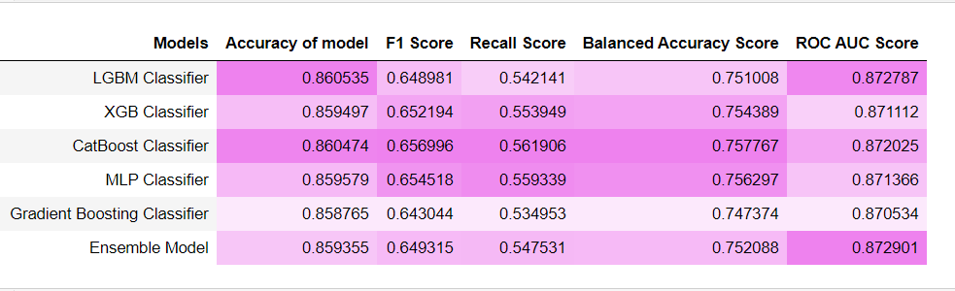
Stacking based Ensemble Model.
Here, only the best classifiers are used for Ensemble Model which are:
CatBoost Classifier and LGBM Classifier. The base classifier used here is LogisticRegression.
Below figure represents the comparison between High Scoring Algorithm and Ensemble Model.
It can be stated that Ensemble Model is giving a little better Results.

Slide 12
Conclusion:
The Approaches used in this problem statement are:
Comparing different classifier Algorithms.
Choosing the best Algorithm.
Hyper-tuning it using GridSearchCV and RandomSearchCV.
Then using Stacking based Ensemble Model.
The Code is being attached with this ppt.
Future-Work:
Applying Deep Learning Model.
Thank-You
Sincerely,
ABHISHEK KUMAR PRASAD

