Slide 1
Tsitsiklis-Van Roy vs Tilley comparison
Stanisław Cabaj
Bartosz Justkowski
Wojciech Szyszka

Slide 2
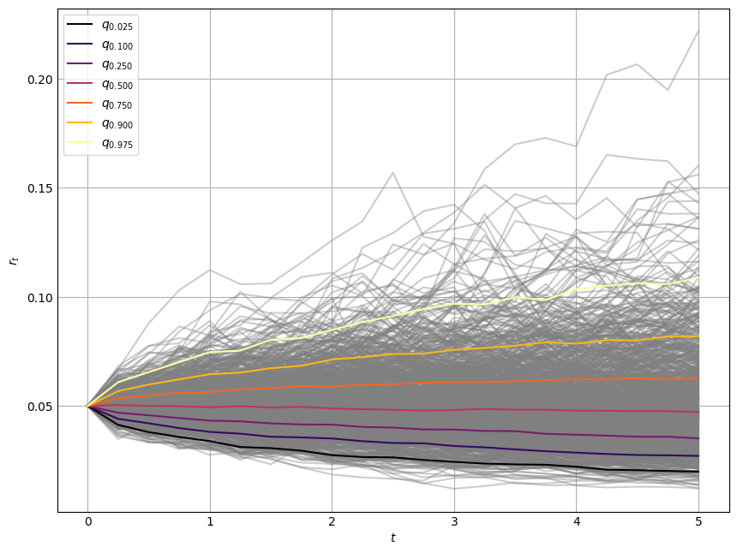
Black Scholes dynamic + quantiles
We use the Black Scholes dynamic in order to generate interest rates. (generally speaking we shouldn’t use this model because it is not mean-reverting)

Slide 3
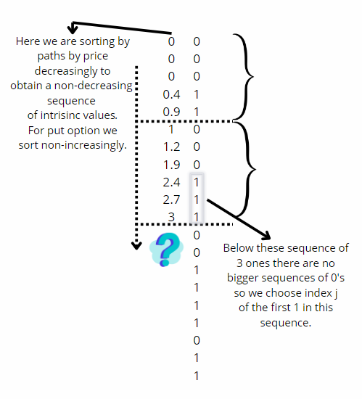
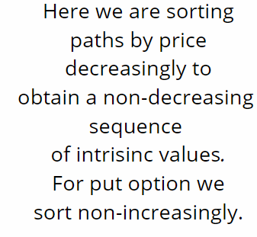
Tilley algorithm

Slide 4
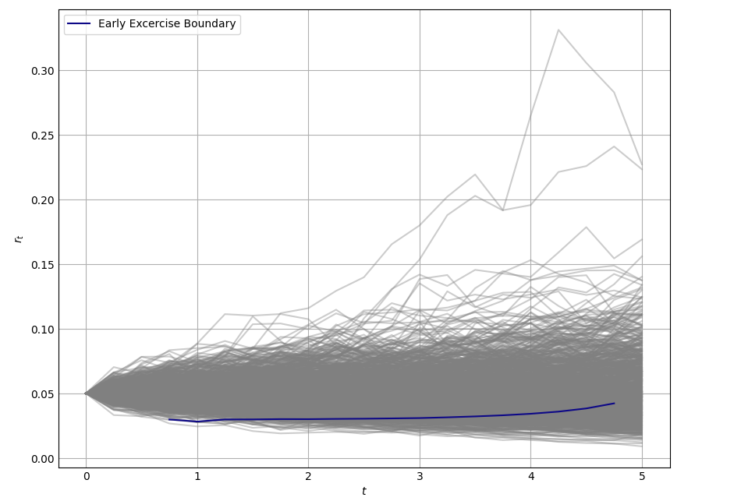
Early excercise boundary for American Put

Slide 5


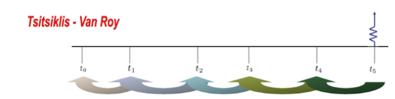
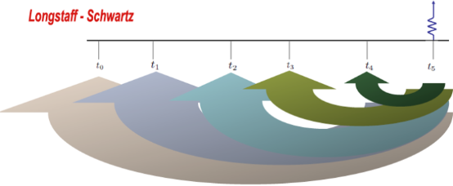
Tsitsiklis-Van Roy algorithm
We use the regression (deg 3) technique to approximate the conditional expectation function at each excercising date:
We calculate value of an asset by using:
Difference between Tsitsiklis-Van Roy and Longstaff-Schwartz:

Slide 6
Setup
Floating interest rates
Volatility: 20%
Time steps: 21
Risk-free rate: 2%
Paths: it depends ☺
Maturity: 5 years
Starting value: 0.05
American put option
Notional: 1000
Maturity: 5 years
Strike: 5%
Swap
Notional: 1000
Payment frequency: 4 (a year)
Maturity: 5 years
Swap rate: 5%

Slide 7
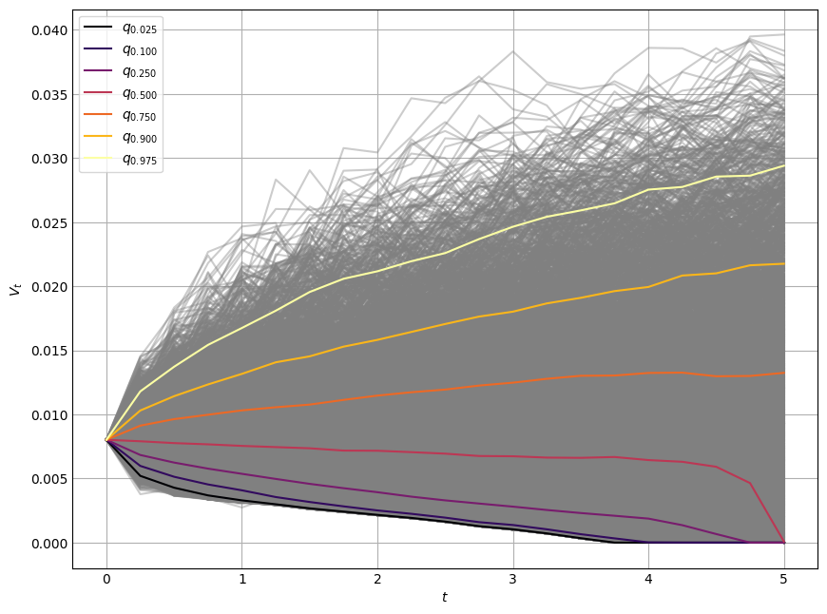
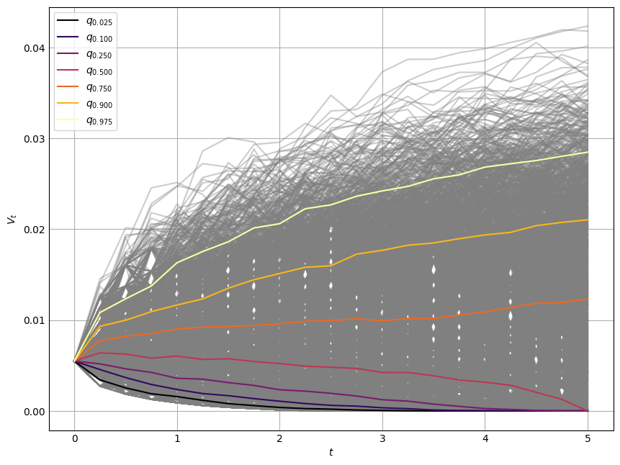
Tsitsiklis-Van Roy
Tilley
American Put Option

Slide 8
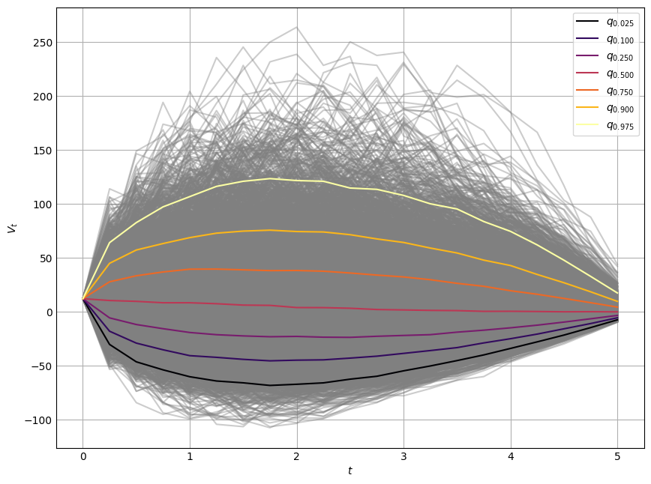
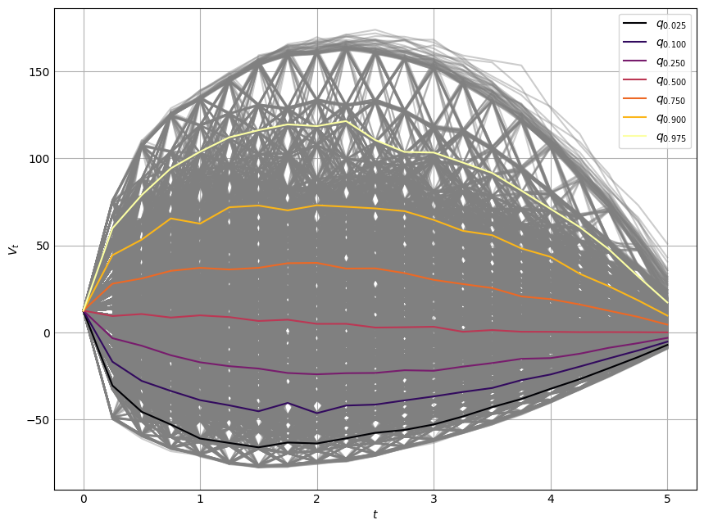
Tsitsiklis-Van Roy
Tilley
Swap

Slide 9
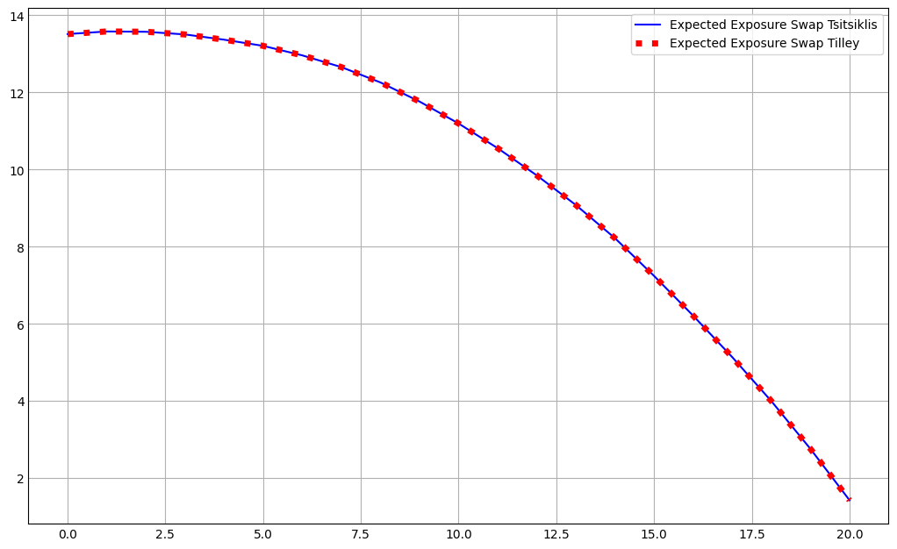

Comparison of Expected Exposures for swap

Slide 10
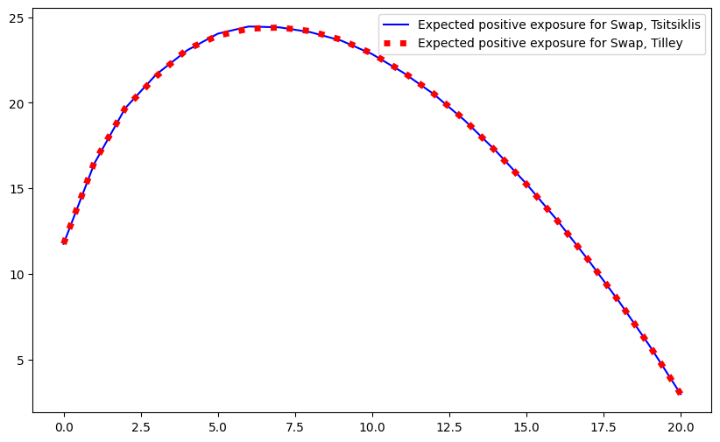
Comparison of Expected Positive Exposures for swap

Slide 11
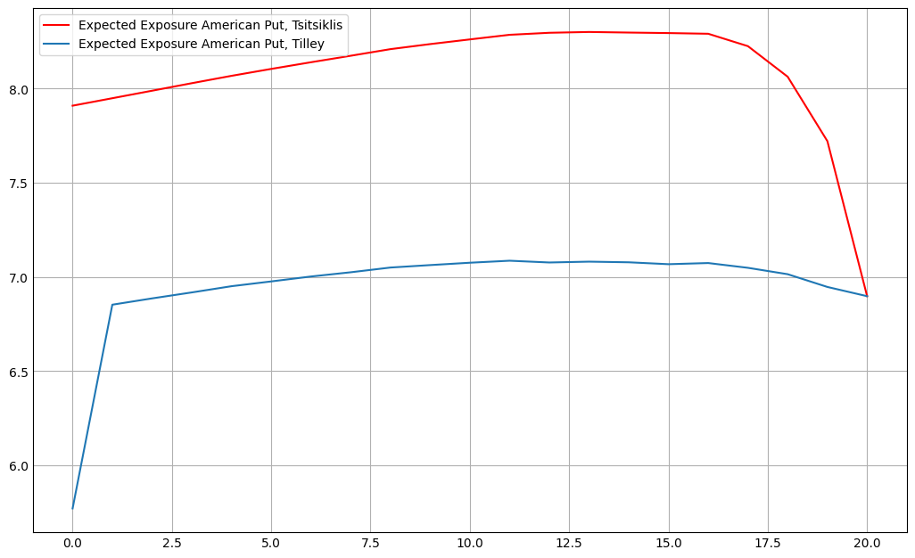
Comparison of Expected Exposures for american put option

Slide 12
Lets check what happens when we will move parameters

Slide 13
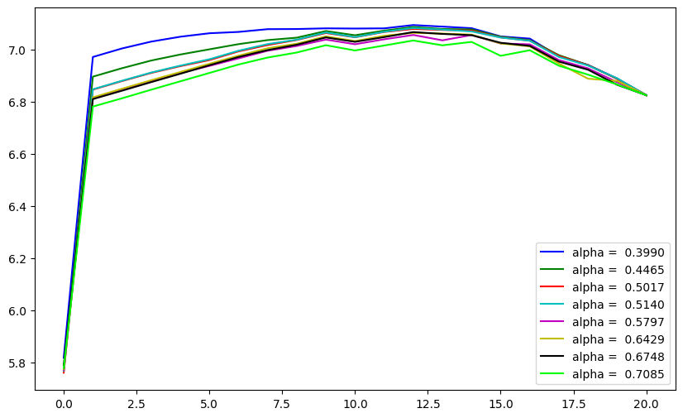


Tilley and alpha comparison
Q – number of boundles
M – number of paths

Slide 14
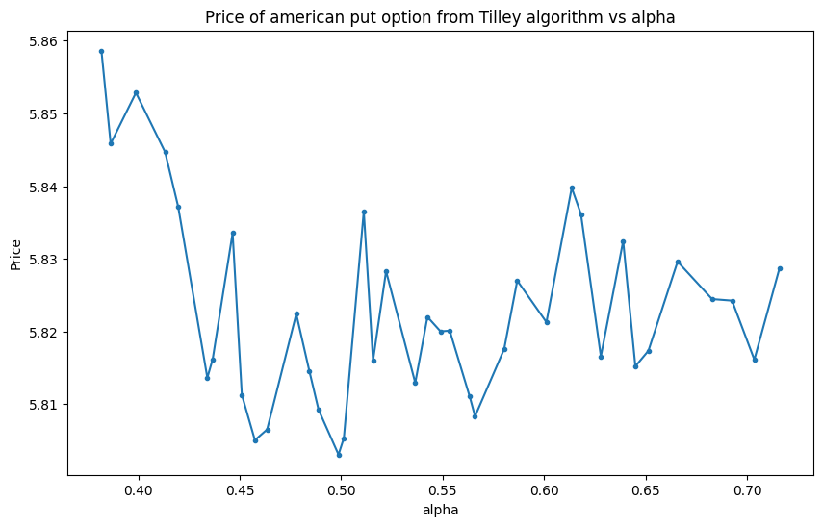

Slide 15
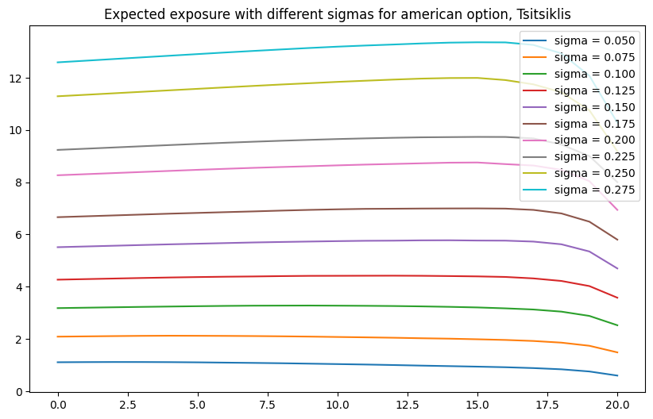

Slide 16
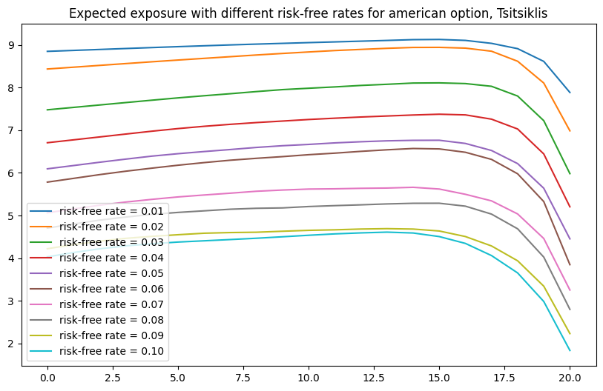

Slide 17
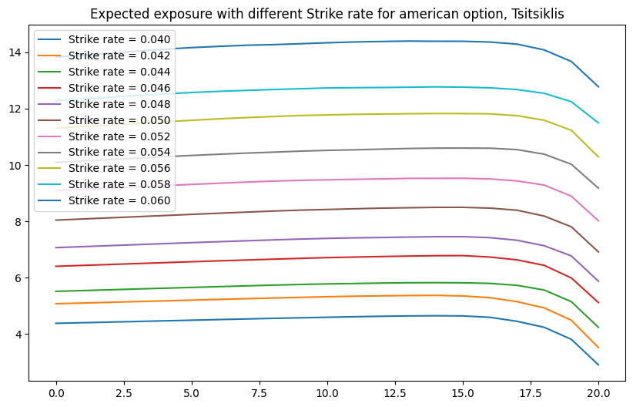

Slide 18
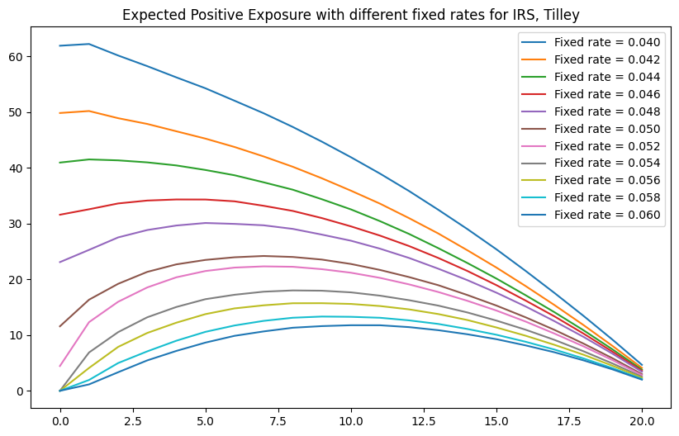

Slide 19
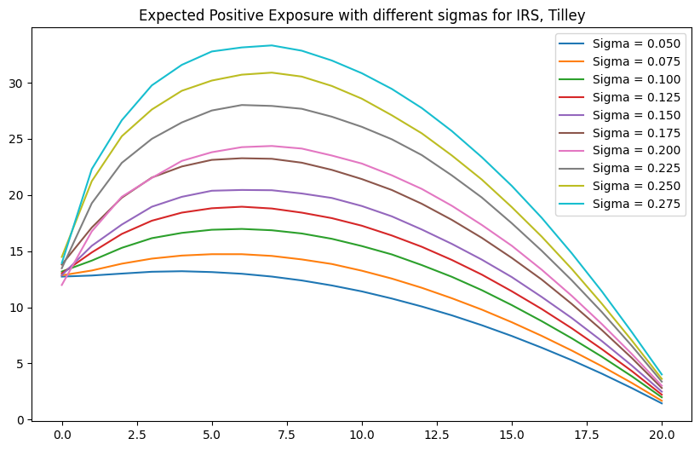

Slide 20
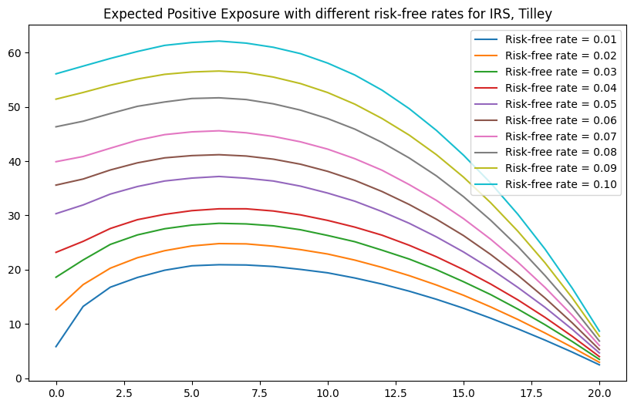

Slide 21

Thank you for your attention!

