Slide 1

OBJECTIVE-C
A PRESENTATION FROM GROUP 3
Members:
Trần Quốc Bảo
Nguyễn Đức Duy
Nguyễn Công Hoàng

Slide 2
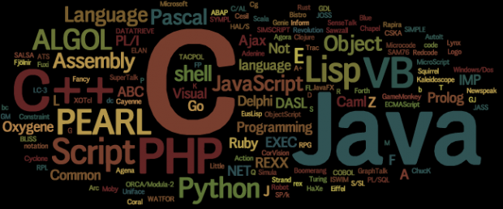
HISTORY

Slide 3
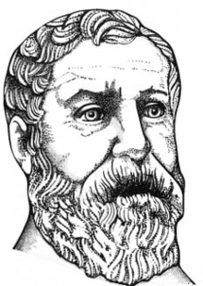
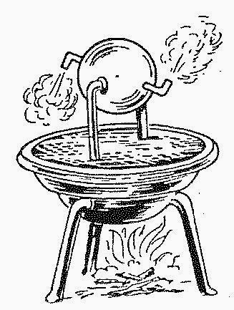
AD 60
Heron of Alexandria
Configurable puppet machine

Slide 4
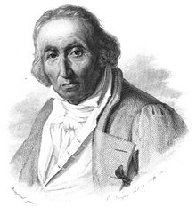
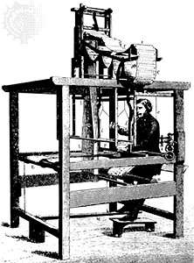
Joseph Marie Jacquard
First prototype of punch card

Slide 5
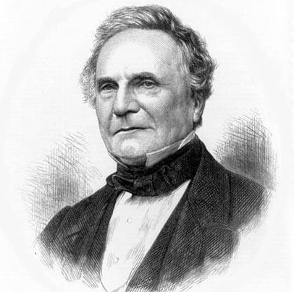
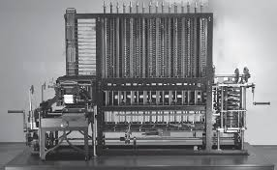
Charles Babbage
Created a machine to calculate
blueprint for the engine
London Science Museum replicated his design and created it and they ran a test and it showed the correct answer.

Slide 6
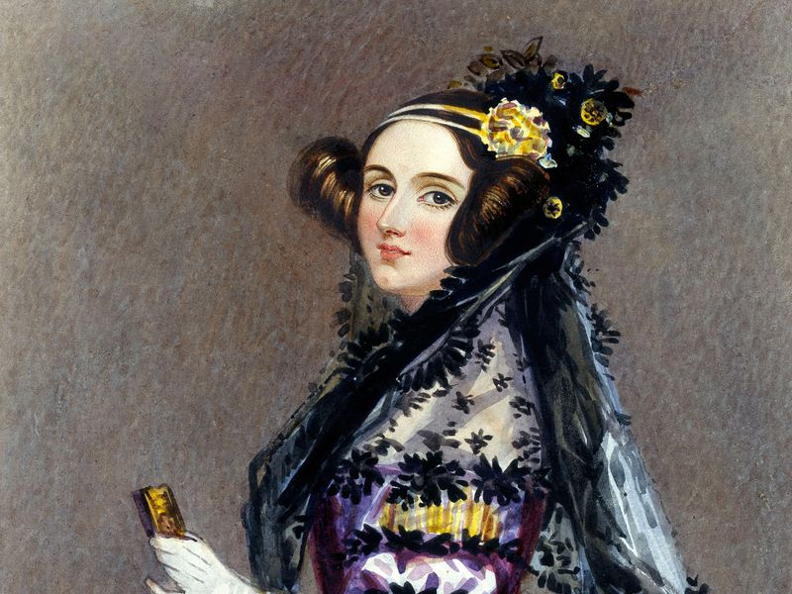
Ada Lovelace
- World first
programmer

Slide 7
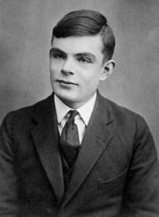
Alan Turing

Slide 8
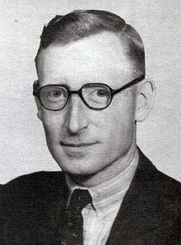
Tommy Flowers

Slide 9
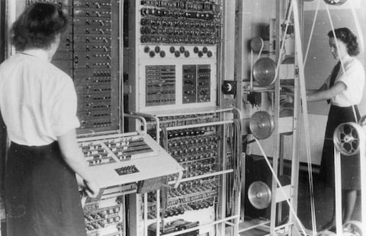
Colossus

Slide 10
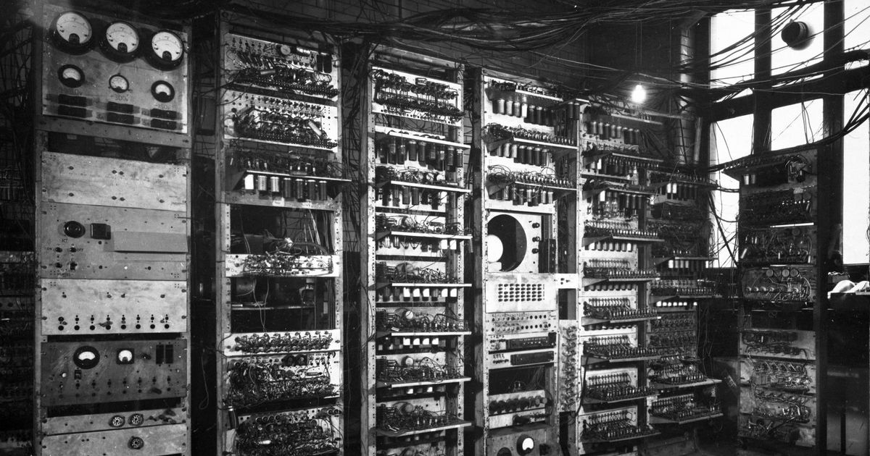
Manchester BABY

Slide 11
ENIAC

Slide 12
Short Code
IBM

Slide 13
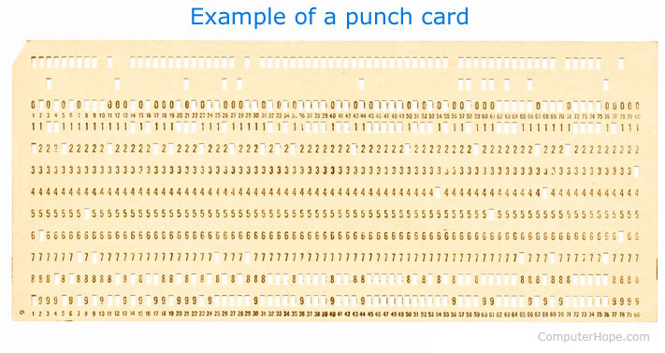

Slide 14
Speedcoding
John Backus –IBM - 1952

Slide 15
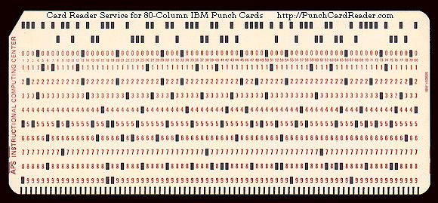

Slide 16
First Compiler
A-0

Slide 17
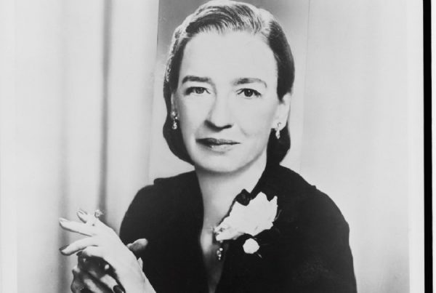
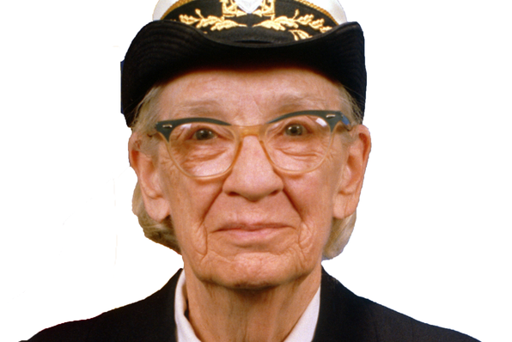
Grace Hopper

Slide 18
Autocode
Alec Glennie

Slide 19
Fortran
John Backus

Slide 20
PRINT *, "Hello World!"
END

Slide 21
Algo - 58
John Backus

Slide 22
Algo-60
DISPLAY()

Slide 23
LISP
John McCarthy - MIT

Slide 24
Cobol
Grace Hopper

Slide 25
IDENTIFICATION DIVISION.
PROGRAM-ID. HELLO-WORLD.
* simple hello world program
PROCEDURE DIVISION.
DISPLAY 'Hello world!'.
STOP RUN.

Slide 26
BASIC
Thomas Eugene Kurts

Slide 27
APL
Lenneth Iverson

Slide 28
'Hello World'

Slide 29
life←{⍝↑1 ⍵∨.∧3 4=+/,¯1 0 1∘.⊖¯1 0 1∘.⌽⊂⍵ ⍝}

Slide 30
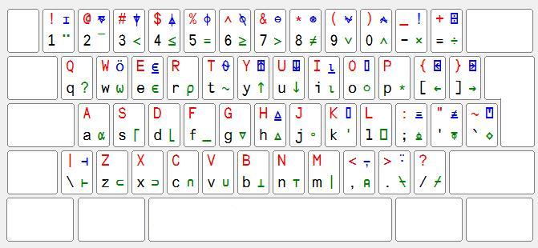
APL Keyboard

Slide 31
Simula
OOP - 1967

Slide 32
LOGO
Wally Feurzeig, Seymour Papert and Cynthia Solomon

Slide 33
Pascal
Niklaus Wirth

Slide 34
program Hello;
begin
writeln ('Hello, world.');
end.

Slide 35
Smalltalk
1972

Slide 36
C
Dennis Ritchie

Slide 37
#include <stdio.h>
int main()
{
// printf() displays the string inside quotation
printf("Hello, World!");
return 0;
}

Slide 38
Prolog
Alan Colmerauers

Slide 39
SQL
IBM

Slide 40
Compiler Language With No Pronounceable Acronym (INTERCAL)
IBM

Slide 41
DO ,1 <- #13
PLEASE DO ,1 SUB #1 <- #238
DO ,1 SUB #2 <- #108
DO ,1 SUB #3 <- #112
DO ,1 SUB #4 <- #0
DO ,1 SUB #5 <- #64
DO ,1 SUB #6 <- #194
DO ,1 SUB #7 <- #48
PLEASE DO ,1 SUB #8 <- #22
DO ,1 SUB #9 <- #248
DO ,1 SUB #10 <- #168
DO ,1 SUB #11 <- #24
DO ,1 SUB #12 <- #16
DO ,1 SUB #13 <- #162
PLEASE READ OUT ,1
PLEASE GIVE UP

Slide 42
ML
Robin Milner

Slide 43
CLU
Barbara Liskov

Slide 44
Scheme
Abel & Sussman

Slide 45
MATLAB
Mathworks

Slide 46
C++
1983

Slide 47
Objective C
Apple

Slide 48
Object Pascal
Niklaus

Slide 49
HyperTalk
Dam Winkler

Slide 50
Erlang
Joe Amstrong

Slide 51
Perl
Larry Wall

Slide 52
Haskell
Simon Peyton Jones el al

Slide 53
Python
Guido van Rossum 1991

Slide 54
print("This line will be printed.")
Print "This line will be printed."

Slide 55
Visual Basic
Alan Cooper & Microsoft 1991

Slide 56
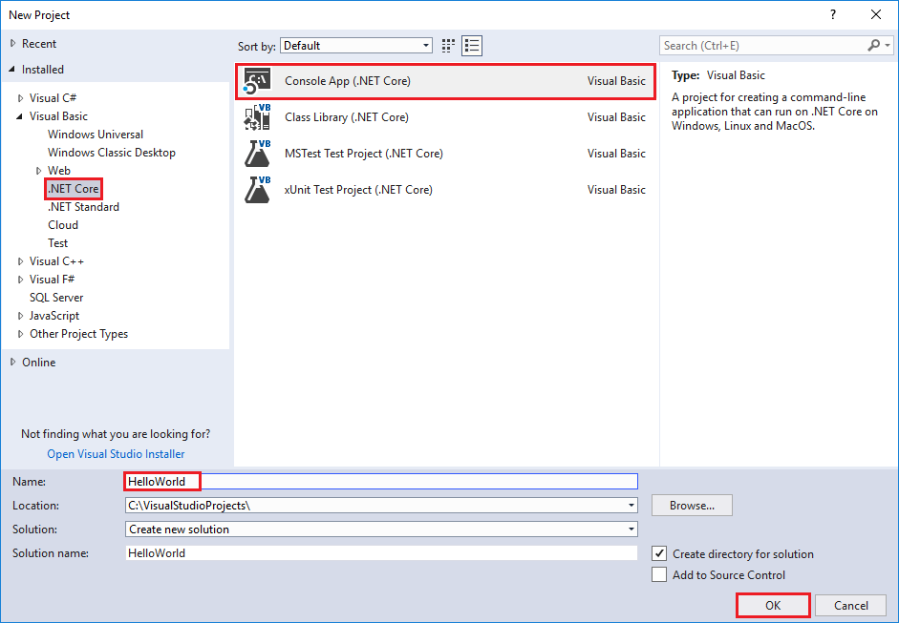
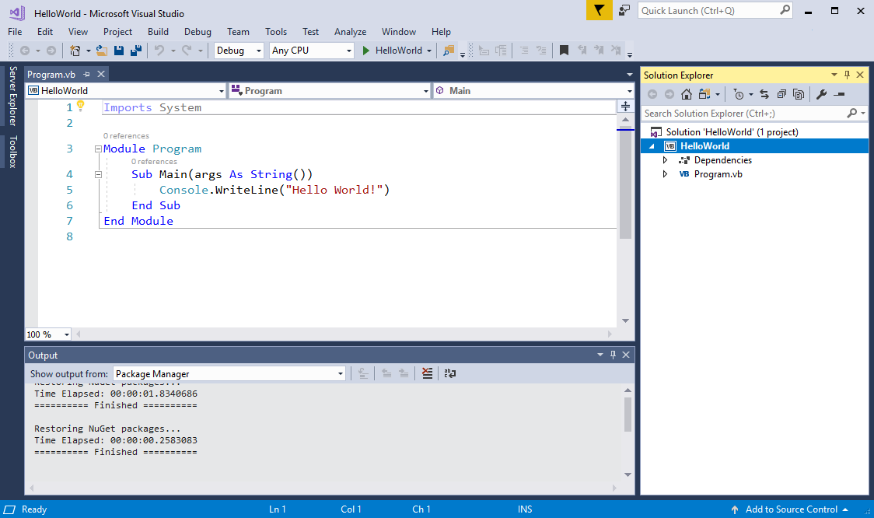
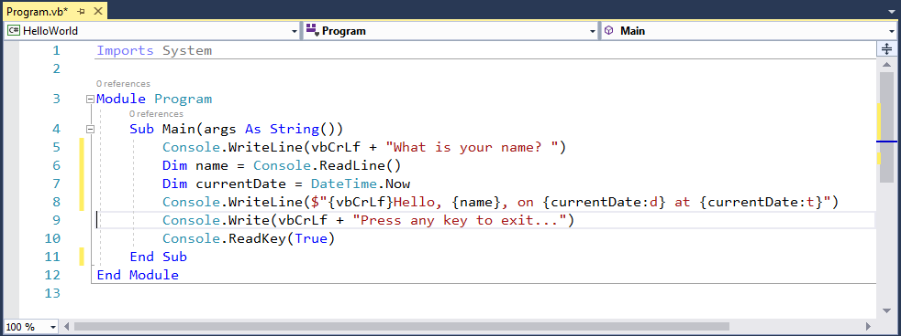

Slide 57
brainfuck
Urban Muller

Slide 58
+[-[<<[+[--->]-[<<<]]]>>>-]>-.---.>..>.<<<<-.<+.>>>>>.>.<<.<-.

Slide 59
Oak
James Gossling

Slide 60
Java
James Gossling & Sun Microsystems

Slide 61
package usingj2ee.hello; import java.rmi.*; import java.util.*; import javax.ejb.*; /** The implementation class for the HelloWorldSession bean */ public class HelloWorldSessionImpl implements SessionBean { /** Holds the session's greeting */ protected String greeting; /** The session context provided by the EJB container. A session bean must hold on to the context it is given. */ private SessionContext context; /** An EJB must have a public, parameterless constructor */ public HelloWorldSessionImpl() { } /** Called by the EJB container to set this session's context */ public void setSessionContext(SessionContext aContext) { context = aContext; } /** Called by the EJB container when a client calls the create() method in the Home interface */ public void ejbCreate() throws CreateException { greeting = "Hello World!"; } /** Called by the EJB container when a client calls the create(String) method in the Home interface */ public void ejbCreate(String aGreeting) throws CreateException { greeting = aGreeting; } /** Called by the EJB container to wake this session bean up after it has been put to sleep with the ejbPassivate method. */ public void ejbActivate() { } /** Called by the EJB container to tell this session bean that it is being suspended from use (it's being put to sleep). */ public void ejbPassivate() { } /** Called by the EJB container to tell this session bean that it has been removed, either because the client invoked the remove() method or the container has timed the session out. */ public void ejbRemove() { } /** Returns the session's greeting */ public String getGreeting() { return greeting; } /** Changes the session's greeting */ public void setGreeting(String aGreeting) { greeting = aGreeting; } }

Slide 62
public class HelloWorld { public static void main(String[] args) { // Prints "Hello, World" to the terminal window. System.out.println("Hello, World"); } }

Slide 63
PHP
Rasmus Lerdorf

Slide 64
<?php echo "Hello World"; ?>

Slide 65
Ruby
Yukihiro Matsumoto

Slide 66
LiveScript
Brendan Eich

Slide 67
Javascript
Brendan Eich

Slide 68
C#
Anders Heijsberg

Slide 69
ECMAScript

Slide 70
JVM Language
Scala, Groovy, Clojure, Jruby, Fantom, Jython,…

Slide 71
F#
Don Syme & Microsoft Research

Slide 72
Go
Google

Slide 73
Rust
Mozilla

Slide 74
JavaScript like language
CoffeeScript, Dart, TypeScript, …..

Slide 75
Category

Slide 76
Programming languages category (based on most common paradigms)
Imperative: describes step-by-step instructions to computer to perform.
+ Procedural
+ Object - oriented
Declarative: declares properties of the desired result, but not how to compute it.
+ Functional
+ Logic

Slide 77
Imperative
Procedural : groups instructions into procedures which might be called during a program's execution
- Fortran (Formular Translating system)
+ developed by IBM in 1950’s, first commercial version was released in 1957.
+ the first high-level language
+ solve problems with a heavy mathematics or computational flavor.
- Cobol (COmon Bussiness-Oriented Language)
+ developed by a group headed by Amiral Grace Murray Hopper of U.S Navy in
1959 and 1960
+ serve bussiness .
- C:
+ developed in early 1970s by Dennis Ritchie at AT&T lab.
+ originally designed system programming (UNIX).
+ was a popular for its close relationship with UNIX and its efficiency.

Slide 78
Imperative
Object-oriented : groups instructions into objects with attributes that can be inherited.
- Smalltalk (purely):
+ developed at the Learning Research Group of Xerox PARC by during the 1970s.
+ first for educational use, later for constructionist learning.
- Ruby:
+ developed in 1993 by Matsumiko Yukihiro in Japan.
+ influenced by Perl, Smalltalk, Eiffel, Ada, and Lisp.
- Effiel (purely):
+ developed in 1985 by Bertrand Meyer.
+ many important programming concepts.

Slide 79
Imperative
Object-oriented :
- Java :
+ developed by James Gosling at Sun Microsystems and released in 1995.
+ features from SmallTalk, with a syntax similar to C and C++. + fewer low-level facilities than C and C++, provide garbage collection.
- C#:
+ developed by Microsoft in 2000.
+ make some improvements over C++ in safe usage.
+ share many features with Java, an object-oriented syntax based on C++. - C++:
+ developed at Bell Labs by Bjarne Stroustrup in early 1980s.
+ extending the C programming language.
+ provide the ability to do object – oriented programming

Slide 80
Declarative
Functional : the desired result is declared as the value of a series of function applications - Haskell (purely):
+ a open standard for functional languages in late 1980s.
+ first version The first version of Haskell (Haskell 1.0) was defined in 1990.
+ teaching, research and industry.
- Elm (purely):
+ designed by Evan Czaplicki in 2012
+ creating web browser-based graphical user interfaces.
+ share many features with Java, object-oriented syntax based on C++.
- Others: Scala, Elixir, …

Slide 81
Declarative
Logic: the desired result is declared as the answer to a question about a system of facts and rules.
- Prolog:
+ artificial intelligence and computational linguistics.
+ specific tasks: searching databases, voice control systems.

Slide 82
OBJECTIVE-C

Slide 83
Why Objective-C ?
Inspired by “old” C- programming language, Objective-C is defined as set of extensions to the C language. It’s designed to give C full object-oriented programming capabilities.
And if you want to work at Apple (or you want to make iOS or macOS software), you definitely want to learn Objective-C.

Slide 84

What is Cocoa?
Cocoa is a (it's actually an umbrella framework which combines three othdevelopment framework er frameworks, Foundation, AppKit and CoreData).
This framework is packed with functionalities ranging from low-level computing to high-level video and audio processing to integrate with iOS app.

Slide 85
A quick word through Objective C.
Objective C shares the same basic logic and syntax in naming variable, data types, iteration and conditional statement like many other programming languages, especially languages in C-family:C, C++, ...
Things go differently when it touches the Object-oriented Programming (OOP) part.

Slide 86
BASIC ELEMENT
Feature | Objective C
Comment | /* */
Include object code from code libraries | #import <>
Statement terminator | ;
Block delimiter | { }
Free format | Yes
Case sensitive | Yes
Reserved words | Yes
Identifiers | Letter, digit, underscore; cannot be a reserved word
Named constants | Yes
Declarations | Before use

Slide 87
BASIC ELEMENT
Feature | Objective C
Type casting | Yes, integer promotion
Object string | @” “
Output to screen | NSLog();
Output formatting | Yes, NSLog(“@d”), NSLog(“@f”),..
Assignment operator | =
Arithmetic operator | +, -, *, /, %. ++, --
Boolean operator | ==, >= , <= , !=
Modularity | Via functions
Local Scope | A variable declared inside a function is known only at there
Argument/Parameter | Must match in number, order and type

Slide 88
BASIC ELEMENT
Feature | Objective C
Math-like module | Give returned data type in function header, return value with same type of value
Procedure-like module | Use “void“ keyword in function header
Object-oriented Programming | Almost everything is Object , OOP plays a crucial role in Objective-C
Inheritence | Yes
Module invocation | [object-identifier object-method]

Slide 89
DATA TYPE
Primitive type:
- Integer type: short, int, long.
- Floating point type: float, double.
- Pointer type:
- Character type: char.
- Void type: void.
- Struct type: Made by programmers to serve their specific purpose and it comprise of one or many primitive type listed above.
Objective C data type:
NSObject is the root class.
- NSString: The main way to hold string in Obj_C
- NSNumber.
- Id data type:
- NSArray: Only works with object, not primitive data type, end with “nil”
- NSDictionary: Value-key pairs, works with objects, end with “nil”

Slide 90
DECISION MAKING
If condition
if(boolean_expression) {
/* statement(s) will execute if the boolean expression is true */
}
If... else...
if(boolean_expression) {
/* statement(s) will execute if the boolean expression is true */
} else {
/* statement(s) will execute if the boolean expression is false */
}

Slide 91
DECISION MAKING
Switch
switch(expression){
case constant-expression :
statement(s);
break; /* optional */
case constant-expression :
statement(s);
break; /* optional */
/* you can have any number of case statements */
default : /* Optional */
statement(s);
}
Nested if, nested switch

Slide 92
ITERATION
For loop:
for( init; condition; increment ) {
statement(s);
}
while loop:
while(condition) {
statement(s);
}
Do while loop:
do {
statement(s);
}
while( condition );
Nested loop:

Slide 93
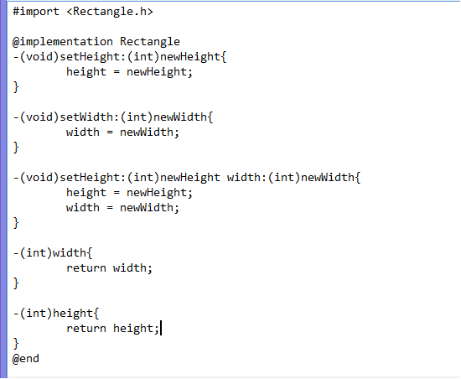
FUNCTION
- (return_type) method_name:( argumentType1 )argumentName1
joiningArgument2:( argumentType2 )argumentName2 ...
joiningArgumentn:( argumentTypen )argumentNamen {
body of the function
}

Slide 94
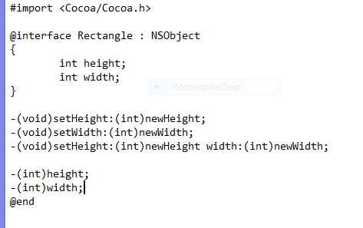
There are two file of every Objective-C class The .m file and the .h file
You want to declare all the class, object, method in .h file. .h file is kind of a report sheet that lists all the name of methods and variables about the class we will use in our program.
The Rectangle class.

Slide 95
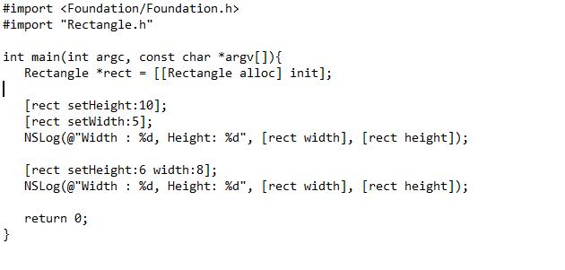
In the main function.

Slide 96
SAMPLE : linear search. binary search. Quadratic funcion.

Slide 97
References:
Mark Render. 2016, May 16. Keynote session: The History of Programming. Retrieved from: https://www.youtube.com/watch?v=Tr9E_vzKRVo
Objective-c Tutorial tutorialspoint.com - https://www.tutorialspoint.com/objective_c/index.html

Slide 98
THANK YOU FOR LISTENING
SPONSORED BY GROUP3

