Slide 1

OBJECTIVE-C
A PRESENTATION FROM GROUP 3
Members:
Trần Quốc Bảo
Nguyễn Đức Duy
Nguyễn Công Hoàng

Slide 2
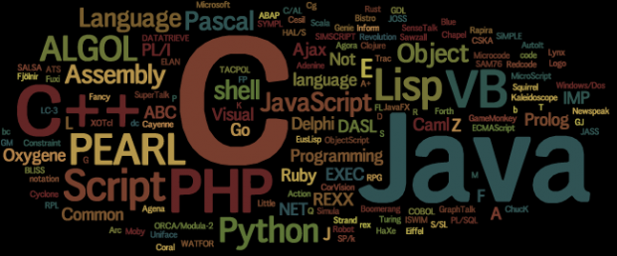
HISTORY

Slide 3
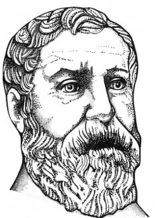
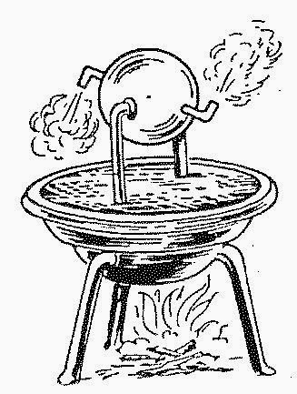
AD 60
Heron of Alexandria
Configurable puppet machine

Slide 4
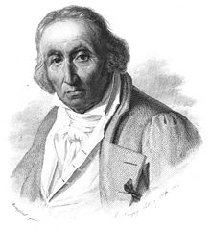
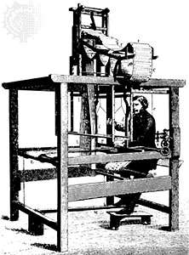
Joseph Marie Jacquard
First prototype of punch card

Slide 5
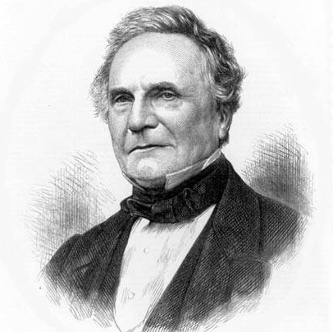
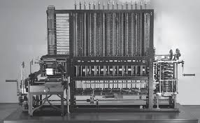
Charles Babbage
Created a machine to calculate
blueprint for the engine
London Science Museum replicated his design and created it and they ran a test and it showed the correct answer.

Slide 6
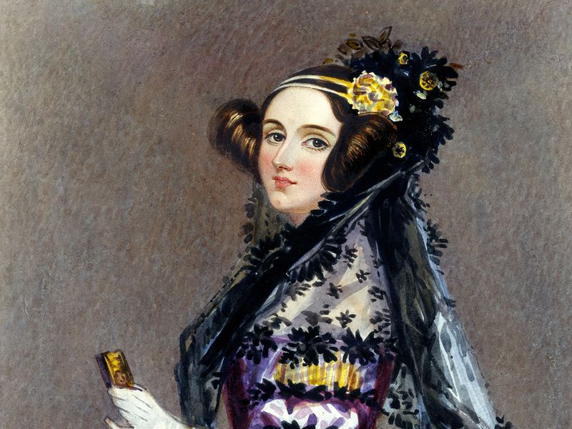
Ada Lovelace
- World first
programmer

Slide 7
Alan Turing

Slide 8
Tommy Flowers

Slide 9
Colossus

Slide 10
Manchester BABY

Slide 11
ENIAC

Slide 12
Short Code
IBM

Slide 13
Speedcoding
John Backus –IBM - 1952

Slide 14
First Compiler
A-0

Slide 15
Grace Hopper

Slide 16
Autocode
Alec Glennie

Slide 17
Fortran
John Backus

Slide 18
Algo - 58
John Backus

Slide 19
Algo-60
DISPLAY()

Slide 20
LISP
John McCarthy - MIT

Slide 21
Cobol
Grace Hopper

Slide 22
BASIC
Thomas Eugene Kurts

Slide 23
APL
Lenneth Iverson

Slide 24
Simula
OOP - 1967

Slide 25
LOGO
Wally Feurzeig, Seymour Papert and Cynthia Solomon

Slide 26
Pascal
Niklaus Wirth

Slide 27
Smalltalk
1972

Slide 28
C
Dennis Ritchie

Slide 29
Prolog
Alan Colmerauers

Slide 30
SQL
IBM

Slide 31
Compiler Language With No Pronounceable Acronym (INTERCAL)
IBM

Slide 32
ML
Robin Milner

Slide 33
CLU
Barbara Liskov

Slide 34
Scheme
Abel & Sussman

Slide 35
MATLAB
Mathworks

Slide 36
C++
1983

Slide 37
Objective C
Apple

Slide 38
Object Pascal
Niklaus

Slide 39
HyperTalk
Dam Winkler

Slide 40
Erlang
Joe Amstrong

Slide 41
Perl
Larry Wall

Slide 42
Haskell
Simon Peyton Jones el al

Slide 43
Python
Guido van Rossum 1991

Slide 44
Visual Basic
Alan Cooper & Microsoft 1991

Slide 45
Oak
James Gossling

Slide 46
Java
James Gossling & Sun Microsystems

Slide 47
PHP
Rasmus Lerdorf

Slide 48
Ruby
Yukihiro Matsumoto

Slide 49
LiveScript
Brendan Eich

Slide 50
Javascript
Brendan Eich

Slide 51
C#
Anders Heijsberg

Slide 52
ECMAScript

Slide 53
JVM Language
Scala, Groovy, Clojure, Jruby, Fantom, Jython,…

Slide 54
F#
Don Syme & Microsoft Research

Slide 55
Go
Google

Slide 56
Rust
Mozilla

Slide 57
JavaScript like language
CoffeeScript, Dart, TypeScript, …..

Slide 58
Category

Slide 59
Programming languages category (based on most common paradigms)
Imperative: describes step-by-step instructions to computer to perform.
+ Procedural
+ Object - oriented
Declarative: declares properties of the desired result, but not how to compute it.
+ Functional
+ Logic

Slide 60
Imperative
Procedural : groups instructions into procedures which might be called during a program's execution
- Fortran (Formular Translating system)
+ developed by IBM in 1950’s, first commercial version was released in 1957.
+ the first high-level language
+ solve problems with a heavy mathematics or computational flavor.
- Cobol (COmon Bussiness-Oriented Language)
+ developed by a group headed by Amiral Grace Murray Hopper of U.S Navy in
1959 and 1960
+ serve bussiness .
- C:
+ developed in early 1970s by Dennis Ritchie at AT&T lab.
+ originally designed system programming (UNIX).
+ was a popular for its close relationship with UNIX and its efficiency.

Slide 61
Imperative
Object-oriented : groups instructions together with the part of the state they operate on
- Smalltalk (purely):
+ developed at the Learning Research Group of Xerox PARC by during the 1970s.
+ first for educational use, later for constructionist learning.
- Ruby:
+ developed in 1993 by Matsumiko Yukihiro in Japan.
+ influenced by Perl, Smalltalk, Eiffel, Ada, and Lisp.
- Effiel (purely):
+ developed in 1985 by Bertrand Meyer.
+ many important programming concepts.

Slide 62
Imperative
Object-oriented :
- Java :
+ developed by James Gosling at Sun Microsystems and released in 1995.
+ features from SmallTalk, with a syntax similar to C and C++. + fewer low-level facilities than C and C++, provide garbage collection.
- C#:
+ developed by Microsoft in 2000.
+ make some improvements over C++ in safe usage.
+ share many features with Java, an object-oriented syntax based on C++. - C++:
+ developed at Bell Labs by Bjarne Stroustrup in early 1980s.
+ extending the C programming language.
+ provide the ability to do object – oriented programming

Slide 63
Declarative
Functional : the desired result is declared as the value of a series of function applications - Haskell (purely):
+ a open standard for functional languages in late 1980s.
+ first version The first version of Haskell (Haskell 1.0) was defined in 1990.
+ teaching, research and industry.
- Elm (purely):
+ designed by Evan Czaplicki in 2012
+ creating web browser-based graphical user interfaces.
+ share many features with Java, object-oriented syntax based on C++.
- Others: Scala, Elixir, …

Slide 64
Declarative
Logic: the desired result is declared as the answer to a question about a system of facts and rules.
- Prolog:
+ artificial intelligence and computational linguistics.
+ specific tasks: searching databases, voice control systems.

Slide 65
OBJECTIVE-C

Slide 66
Why Objective-C ?
Inspired by “old” C- programming language, Objective-C is defined as set of extensions to the C language. It’s designed to give C full object-oriented programming capabilities.
And if you want to work at Apple (or you want to make iOS or macOS software), you definitely want to learn Objective-C.

Slide 67

What is Cocoa?
Cocoa is a (it's actually an umbrella framework which combines three othdevelopment framework er frameworks, Foundation, AppKit and CoreData).
This framework is packed with functionalities ranging from low-level computing to high-level video and audio processing to integrate with iOS app.

Slide 68
A quick word through Objective C.
Objective C shares the same basic logic and syntax in naming variable, data types, iteration and conditional statement like many other programming languages, especially languages in C-family:C, C++, ...
Things go differently when it touches the Object-oriented Programming (OOP) part.

Slide 69
BASIC ELEMENT
Feature | Objective C
Comment | /* */
Include object code from code libraries | #import <>
Statement terminator | ;
Block delimiter | { }
Free format | Yes
Case sensitive | Yes
Reserved words | Yes
Identifiers | Letter, digit, underscore; cannot be a reserved word
Named constants | Yes
Declarations | Before use

Slide 70
BASIC ELEMENT
Feature | Objective C
Type casting | Yes, integer promotion
Object string | @” “
Output to screen | NSLog();
Output formatting | Yes, NSLog(“@d”), NSLog(“@f”),..
Assignment operator | =
Arithmetic operator | +, -, *, /, %. ++, --
Boolean operator | ==, >= , <= , !=
Modularity | Via functions
Local Scope | A variable declared inside a function is known only at there
Argument/Parameter | Must match in number, order and type

Slide 71
BASIC ELEMENT
Feature | Objective C
Math-like module | Give returned data type in function header, return value with same type of value
Procedure-like module | Use “void“ keyword in function header
Object-oriented Programming | Almost everything is Object , OOP plays a crucial role in Objective-C
Inheritence | Yes
Module invocation | [object-identifier object-method]

Slide 72
DATA TYPE
Primitive type:
- Integer type: short, int, long.
- Floating point type: float, double.
- Pointer type:
- Character type: char.
- Void type: void.
- Struct type: Made by programmers to serve their specific purpose and it comprise of one or many primitive type listed above.
Objective C data type:
NSObject is the root class.
- NSString: The main way to hold string in Obj_C
- NSNumber.
- Id data type:
- NSArray: Only works with object, not primitive data type, end with “nil”
- NSDictionary: Value-key pairs, works with objects, end with “nil”

Slide 73
DECISION MAKING
If condition
if(boolean_expression) {
/* statement(s) will execute if the boolean expression is true */
}
If... else...
if(boolean_expression) {
/* statement(s) will execute if the boolean expression is true */
} else {
/* statement(s) will execute if the boolean expression is false */
}

Slide 74
DECISION MAKING
Switch
switch(expression){
case constant-expression :
statement(s);
break; /* optional */
case constant-expression :
statement(s);
break; /* optional */
/* you can have any number of case statements */
default : /* Optional */
statement(s);
}
Nested if, nested switch

Slide 75
ITERATION
For loop:
for( init; condition; increment ) {
statement(s);
}
while loop:
while(condition) {
statement(s);
}
Do while loop:
do {
statement(s);
}
while( condition );
Nested loop:

Slide 76
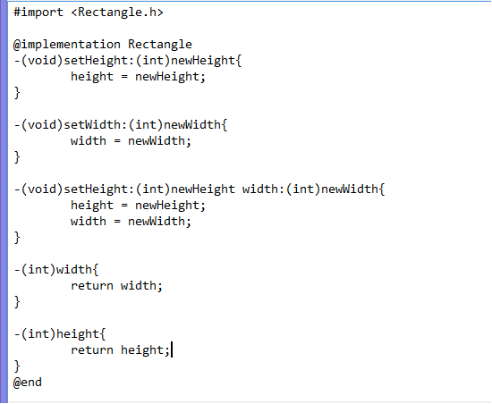
FUNCTION
- (return_type) method_name:( argumentType1 )argumentName1
joiningArgument2:( argumentType2 )argumentName2 ...
joiningArgumentn:( argumentTypen )argumentNamen {
body of the function
}

Slide 77
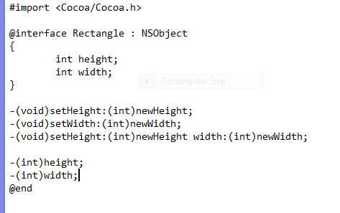
There are two file of every Objective-C class The .m file and the .h file
You want to declare all the class, object, method in .h file. .h file is kind of a report sheet that lists all the name of methods and variables about the class we will use in our program.
The Rectangle class.

Slide 78
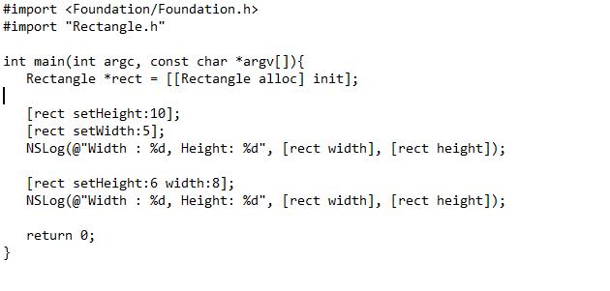
In the main function.

Slide 79
SAMPLE : linear search. binary search. Quadratic funcion.

Slide 80
THANK YOU FOR LISTENING
SPONSORED BY GROUP3

