Slide 1

OBJECTIVE-C
A PRESENTATION FROM GROUP 3
Members:
Trần Quốc Bảo
Nguyễn Đức Duy
Nguyễn Công Hoàng

Slide 2
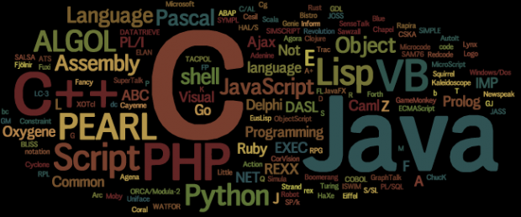
HISTORY

Slide 3
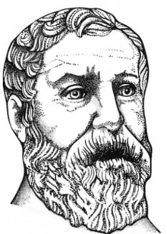
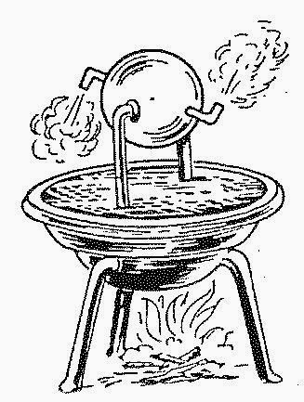
AD 60
Heron of Alexandria
Configurable puppet machine

Slide 4
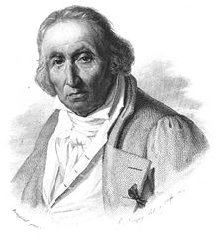
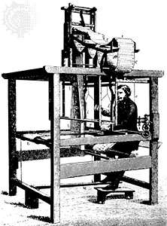
Joseph Marie Jacquard
First prototype of punch card

Slide 5
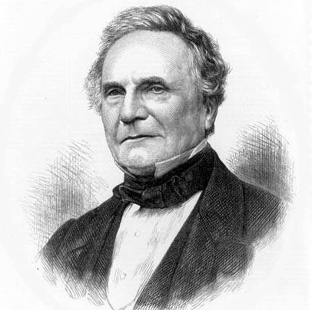
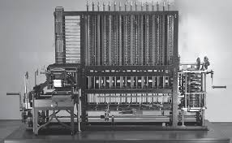
Charles Babbage
Created a machine to calculate
blueprint for the engine
London Science Museum replicated his design and created it and they ran a test and it showed the correct answer.

Slide 6
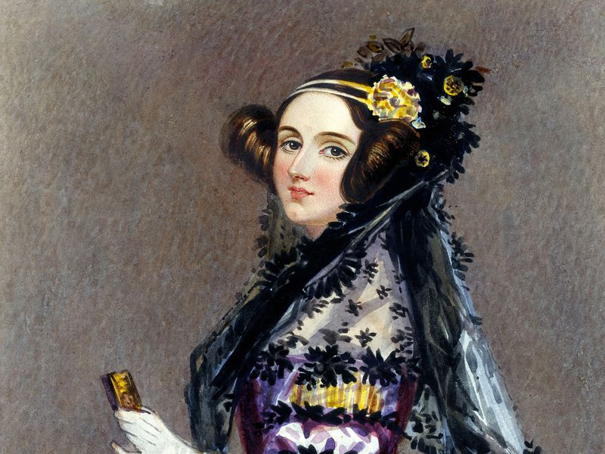
Ada Lovelace
- World first
programmer

Slide 7
Alan Turing

Slide 8
Tommy Flowers

Slide 9
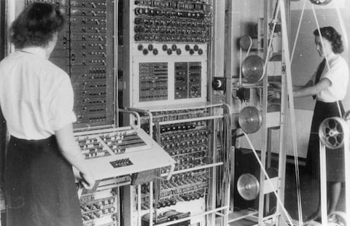
Colossus

Slide 10
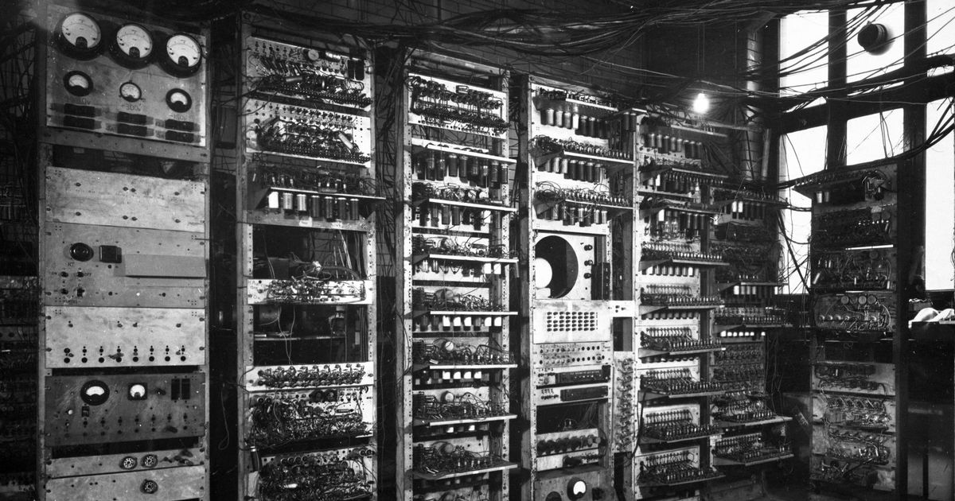
Manchester BABY

Slide 11
ENIAC

Slide 12
Short Code
IBM

Slide 13
Speedcoding
John Backus –IBM - 1952

Slide 14
First Compiler
A-0

Slide 15
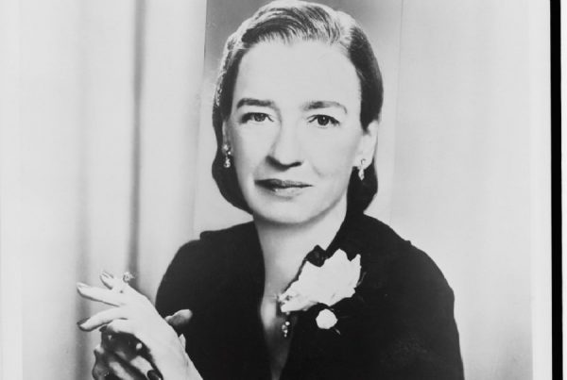
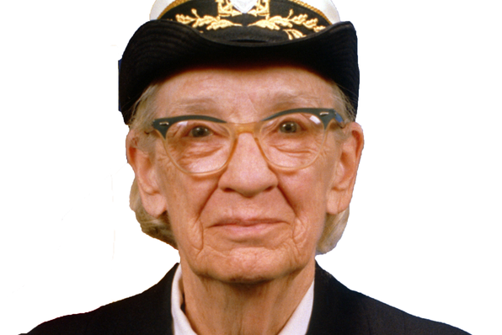
Grace Hopper

Slide 16
Autocode
Alec Glennie

Slide 17
Fortran
John Backus

Slide 18
PRINT *, "Hello World!"
END

Slide 19
Algo - 58
John Backus

Slide 20
Algo-60
DISPLAY()

Slide 21
LISP
John McCarthy - MIT

Slide 22
Cobol
Grace Hopper

Slide 23
IDENTIFICATION DIVISION.
PROGRAM-ID. HELLO-WORLD.
* simple hello world program
PROCEDURE DIVISION.
DISPLAY 'Hello world!'.
STOP RUN.

Slide 24
BASIC
Thomas Eugene Kurts

Slide 25
APL
Lenneth Iverson

Slide 26
'Hello World'

Slide 27
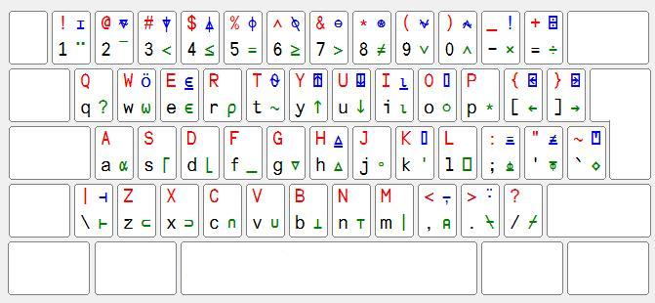
APL Keyboard

Slide 28
life←{⍝↑1 ⍵∨.∧3 4=+/,¯1 0 1∘.⊖¯1 0 1∘.⌽⊂⍵ ⍝}

Slide 29
Simula
OOP - 1967

Slide 30
LOGO
Wally Feurzeig, Seymour Papert and Cynthia Solomon

Slide 31
Pascal
Niklaus Wirth

Slide 32
program Hello;
begin
writeln ('Hello, world.');
end.

Slide 33
Smalltalk
1972

Slide 34
C
Dennis Ritchie

Slide 35
#include <stdio.h>
int main()
{
// printf() displays the string inside quotation
printf("Hello, World!");
return 0;
}

Slide 36
Prolog
Alan Colmerauers

Slide 37
SQL
IBM

Slide 38
Compiler Language With No Pronounceable Acronym (INTERCAL)
IBM

Slide 39
DO ,1 <- #13
PLEASE DO ,1 SUB #1 <- #238
DO ,1 SUB #2 <- #108
DO ,1 SUB #3 <- #112
DO ,1 SUB #4 <- #0
DO ,1 SUB #5 <- #64
DO ,1 SUB #6 <- #194
DO ,1 SUB #7 <- #48
PLEASE DO ,1 SUB #8 <- #22
DO ,1 SUB #9 <- #248
DO ,1 SUB #10 <- #168
DO ,1 SUB #11 <- #24
DO ,1 SUB #12 <- #16
DO ,1 SUB #13 <- #162
PLEASE READ OUT ,1
PLEASE GIVE UP

Slide 40
ML
Robin Milner

Slide 41
CLU
Barbara Liskov

Slide 42
Scheme
Abel & Sussman

Slide 43
MATLAB
Mathworks

Slide 44
C++
1983

Slide 45
Objective C
Apple

Slide 46
Object Pascal
Niklaus

Slide 47
HyperTalk
Dam Winkler

Slide 48
Erlang
Joe Amstrong

Slide 49
Perl
Larry Wall

Slide 50
Haskell
Simon Peyton Jones el al

Slide 51
Python
Guido van Rossum 1991

Slide 52
print("This line will be printed.")
Print "This line will be printed."

Slide 53
Visual Basic
Alan Cooper & Microsoft 1991

Slide 54
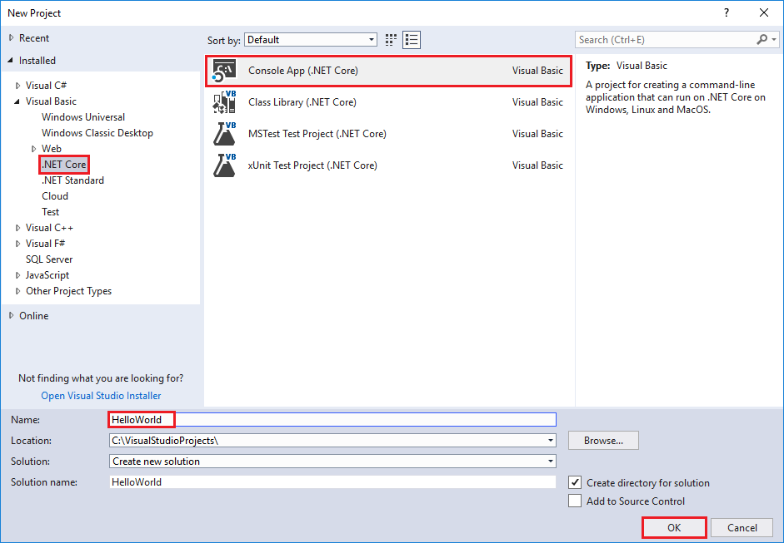
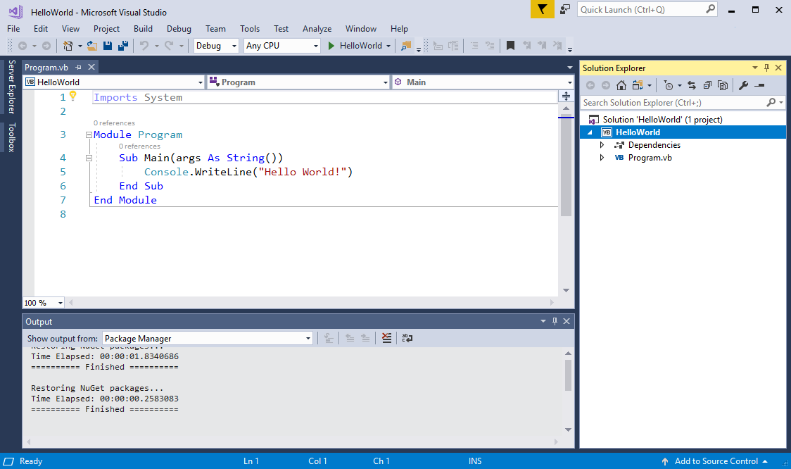
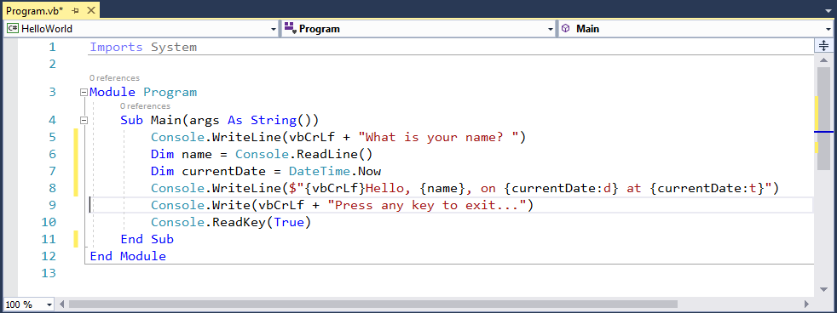

Slide 55
brainfuck
Urban Muller

Slide 56
+[-[<<[+[--->]-[<<<]]]>>>-]>-.---.>..>.<<<<-.<+.>>>>>.>.<<.<-.

Slide 57
Oak
James Gossling

Slide 58
Java
James Gossling & Sun Microsystems

Slide 59
package usingj2ee.hello; import java.rmi.*; import java.util.*; import javax.ejb.*; /** The implementation class for the HelloWorldSession bean */ public class HelloWorldSessionImpl implements SessionBean { /** Holds the session's greeting */ protected String greeting; /** The session context provided by the EJB container. A session bean must hold on to the context it is given. */ private SessionContext context; /** An EJB must have a public, parameterless constructor */ public HelloWorldSessionImpl() { } /** Called by the EJB container to set this session's context */ public void setSessionContext(SessionContext aContext) { context = aContext; } /** Called by the EJB container when a client calls the create() method in the Home interface */ public void ejbCreate() throws CreateException { greeting = "Hello World!"; } /** Called by the EJB container when a client calls the create(String) method in the Home interface */ public void ejbCreate(String aGreeting) throws CreateException { greeting = aGreeting; } /** Called by the EJB container to wake this session bean up after it has been put to sleep with the ejbPassivate method. */ public void ejbActivate() { } /** Called by the EJB container to tell this session bean that it is being suspended from use (it's being put to sleep). */ public void ejbPassivate() { } /** Called by the EJB container to tell this session bean that it has been removed, either because the client invoked the remove() method or the container has timed the session out. */ public void ejbRemove() { } /** Returns the session's greeting */ public String getGreeting() { return greeting; } /** Changes the session's greeting */ public void setGreeting(String aGreeting) { greeting = aGreeting; } }

Slide 60
public class HelloWorld { public static void main(String[] args) { // Prints "Hello, World" to the terminal window. System.out.println("Hello, World"); } }

Slide 61
PHP
Rasmus Lerdorf

Slide 62
<?php echo "Hello World"; ?>

Slide 63
Ruby
Yukihiro Matsumoto

Slide 64
LiveScript
Brendan Eich

Slide 65
Javascript
Brendan Eich

Slide 66
C#
Anders Heijsberg

Slide 67
ECMAScript

Slide 68
JVM Language
Scala, Groovy, Clojure, Jruby, Fantom, Jython,…

Slide 69
F#
Don Syme & Microsoft Research

Slide 70
Go
Google

Slide 71
Rust
Mozilla

Slide 72
JavaScript like language
CoffeeScript, Dart, TypeScript, …..

Slide 73
Category

Slide 74
Programming languages category (based on most common paradigms)
Imperative: describes step-by-step instructions to computer to perform.
+ Procedural
+ Object - oriented
Declarative: declares properties of the desired result, but not how to compute it.
+ Functional
+ Logic

Slide 75
Imperative
Procedural : groups instructions into procedures which might be called during a program's execution
- Fortran (Formular Translating system)
+ developed by IBM in 1950’s, first commercial version was released in 1957.
+ the first high-level language
+ solve problems with a heavy mathematics or computational flavor.
- Cobol (COmon Bussiness-Oriented Language)
+ developed by a group headed by Amiral Grace Murray Hopper of U.S Navy in
1959 and 1960
+ serve bussiness .
- C:
+ developed in early 1970s by Dennis Ritchie at AT&T lab.
+ originally designed system programming (UNIX).
+ was a popular for its close relationship with UNIX and its efficiency.

Slide 76
Imperative
Object-oriented : groups instructions together with the part of the state they operate on
- Smalltalk (purely):
+ developed at the Learning Research Group of Xerox PARC by during the 1970s.
+ first for educational use, later for constructionist learning.
- Ruby:
+ developed in 1993 by Matsumiko Yukihiro in Japan.
+ influenced by Perl, Smalltalk, Eiffel, Ada, and Lisp.
- Effiel (purely):
+ developed in 1985 by Bertrand Meyer.
+ many important programming concepts.

Slide 77
Imperative
Object-oriented :
- Java :
+ developed by James Gosling at Sun Microsystems and released in 1995.
+ features from SmallTalk, with a syntax similar to C and C++. + fewer low-level facilities than C and C++, provide garbage collection.
- C#:
+ developed by Microsoft in 2000.
+ make some improvements over C++ in safe usage.
+ share many features with Java, an object-oriented syntax based on C++. - C++:
+ developed at Bell Labs by Bjarne Stroustrup in early 1980s.
+ extending the C programming language.
+ provide the ability to do object – oriented programming

Slide 78
Declarative
Functional : the desired result is declared as the value of a series of function applications - Haskell (purely):
+ a open standard for functional languages in late 1980s.
+ first version The first version of Haskell (Haskell 1.0) was defined in 1990.
+ teaching, research and industry.
- Elm (purely):
+ designed by Evan Czaplicki in 2012
+ creating web browser-based graphical user interfaces.
+ share many features with Java, object-oriented syntax based on C++.
- Others: Scala, Elixir, …

Slide 79
Declarative
Logic: the desired result is declared as the answer to a question about a system of facts and rules.
- Prolog:
+ artificial intelligence and computational linguistics.
+ specific tasks: searching databases, voice control systems.

Slide 80
OBJECTIVE-C

Slide 81
Why Objective-C ?
Inspired by “old” C- programming language, Objective-C is defined as set of extensions to the C language. It’s designed to give C full object-oriented programming capabilities.
And if you want to work at Apple (or you want to make iOS or macOS software), you definitely want to learn Objective-C.

Slide 82

What is Cocoa?
Cocoa is a (it's actually an umbrella framework which combines three othdevelopment framework er frameworks, Foundation, AppKit and CoreData).
This framework is packed with functionalities ranging from low-level computing to high-level video and audio processing to integrate with iOS app.

Slide 83
A quick word through Objective C.
Objective C shares the same basic logic and syntax in naming variable, data types, iteration and conditional statement like many other programming languages, especially languages in C-family:C, C++, ...
Things go differently when it touches the Object-oriented Programming (OOP) part.

Slide 84
BASIC ELEMENT
Feature | Objective C
Comment | /* */
Include object code from code libraries | #import <>
Statement terminator | ;
Block delimiter | { }
Free format | Yes
Case sensitive | Yes
Reserved words | Yes
Identifiers | Letter, digit, underscore; cannot be a reserved word
Named constants | Yes
Declarations | Before use

Slide 85
BASIC ELEMENT
Feature | Objective C
Type casting | Yes, integer promotion
Object string | @” “
Output to screen | NSLog();
Output formatting | Yes, NSLog(“@d”), NSLog(“@f”),..
Assignment operator | =
Arithmetic operator | +, -, *, /, %. ++, --
Boolean operator | ==, >= , <= , !=
Modularity | Via functions
Local Scope | A variable declared inside a function is known only at there
Argument/Parameter | Must match in number, order and type

Slide 86
BASIC ELEMENT
Feature | Objective C
Math-like module | Give returned data type in function header, return value with same type of value
Procedure-like module | Use “void“ keyword in function header
Object-oriented Programming | Almost everything is Object , OOP plays a crucial role in Objective-C
Inheritence | Yes
Module invocation | [object-identifier object-method]

Slide 87
DATA TYPE
Primitive type:
- Integer type: short, int, long.
- Floating point type: float, double.
- Pointer type:
- Character type: char.
- Void type: void.
- Struct type: Made by programmers to serve their specific purpose and it comprise of one or many primitive type listed above.
Objective C data type:
NSObject is the root class.
- NSString: The main way to hold string in Obj_C
- NSNumber.
- Id data type:
- NSArray: Only works with object, not primitive data type, end with “nil”
- NSDictionary: Value-key pairs, works with objects, end with “nil”

Slide 88
DECISION MAKING
If condition
if(boolean_expression) {
/* statement(s) will execute if the boolean expression is true */
}
If... else...
if(boolean_expression) {
/* statement(s) will execute if the boolean expression is true */
} else {
/* statement(s) will execute if the boolean expression is false */
}

Slide 89
DECISION MAKING
Switch
switch(expression){
case constant-expression :
statement(s);
break; /* optional */
case constant-expression :
statement(s);
break; /* optional */
/* you can have any number of case statements */
default : /* Optional */
statement(s);
}
Nested if, nested switch

Slide 90
ITERATION
For loop:
for( init; condition; increment ) {
statement(s);
}
while loop:
while(condition) {
statement(s);
}
Do while loop:
do {
statement(s);
}
while( condition );
Nested loop:

Slide 91
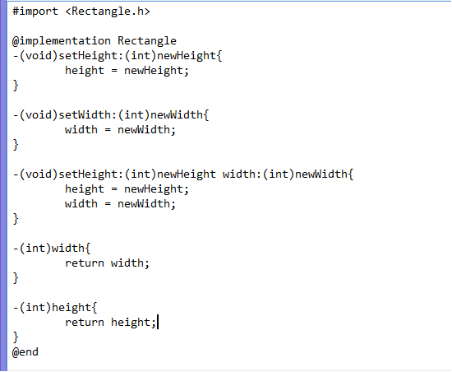
FUNCTION
- (return_type) method_name:( argumentType1 )argumentName1
joiningArgument2:( argumentType2 )argumentName2 ...
joiningArgumentn:( argumentTypen )argumentNamen {
body of the function
}

Slide 92
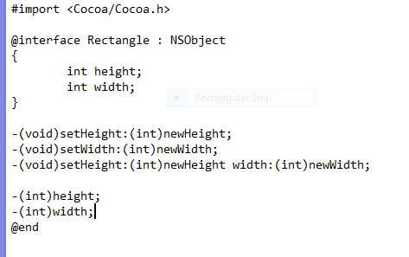
There are two file of every Objective-C class The .m file and the .h file
You want to declare all the class, object, method in .h file. .h file is kind of a report sheet that lists all the name of methods and variables about the class we will use in our program.
The Rectangle class.

Slide 93
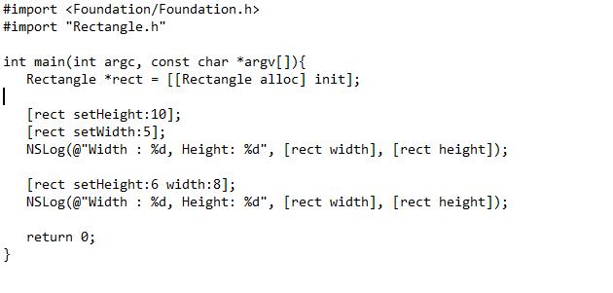
In the main function.

Slide 94
SAMPLE : linear search. binary search. Quadratic funcion.

Slide 95
References:
Mark Render. 2016, May 16. Keynote session: The History of Programming. Retrieved from: https://www.youtube.com/watch?v=Tr9E_vzKRVo
Objective-c Tutorial tutorialspoint.com - https://www.tutorialspoint.com/objective_c/index.html

Slide 96
THANK YOU FOR LISTENING
SPONSORED BY GROUP3

