Slide 1

OBJECTIVE-C
A PRESENTATION FROM GROUP 3
Members:
Trần Quốc Bảo
Nguyễn Đức Duy
Nguyễn Công Hoàng

Slide 2
Why Objective-C ?
Inspired by “old” C- programming language, Objective-C is defined as set of extensions to the C language. It’s designed to give C full object-oriented programming capabilities.
And if you want to work at Apple (or you want to make iOS or macOS software), you definitely want to learn Objective-C.

Slide 3

What is Cocoa?
Cocoa is a (it's actually an umbrella framework which combines three othdevelopment framework er frameworks, Foundation, AppKit and CoreData).
This framework is packed with functionalities ranging from low-level computing to high-level video and audio processing to integrate with iOS app.

Slide 4
A quick word through Objective C.
Objective C shares the same basic logic and syntax in naming variable, data types, iteration and conditional statement like many other programming languages, especially languages in C-family:C, C++, ...
Things go differently when it touches the Object-oriented Programming (OOP) part.

Slide 5
BASIC ELEMENT
Feature | Objective C
Comment | /* */
Include object code from code libraries | #import <>
Statement terminator | ;
Block delimiter | { }
Free format | Yes
Case sensitive | Yes
Reserved words | Yes
Identifiers | Letter, digit, underscore; cannot be a reserved word
Named constants | Yes
Declarations | Before use

Slide 6
BASIC ELEMENT
Feature | Objective C
Type casting | Yes, integer promotion
Object string | @” “
Output to screen | NSLog();
Output formatting | Yes, NSLog(“@d”), NSLog(“@f”),..
Assignment operator | =
Arithmetic operator | +, -, *, /, %. ++, --
Boolean operator | ==, >= , <= , !=
Modularity | Via functions
Local Scope | A variable declared inside a function is known only at there
Argument/Parameter | Must match in number, order and type

Slide 7
BASIC ELEMENT
Feature | Objective C
Math-like module | Give returned data type in function header, return value with same type of value
Procedure-like module | Use “void“ keyword in function header
Object-oriented Programming | Almost everything is Object , OOP plays a crucial role in Objective-C
Inheritence | Yes
Module invocation | [object-identifier object-method]

Slide 8
DATA TYPE
Primitive type:
- Integer type: short, int, long.
- Floating point type: float, double.
- Pointer type:
- Character type: char.
- Void type: void.
- Struct type: Made by programmers to serve their specific purpose and it comprise of one or many primitive type listed above.
Objective C data type:
NSObject is the root class.
- NSString: The main way to hold string in Obj_C
- NSNumber.
- Id data type:
- NSArray: Only works with object, not primitive data type, end with “nil”
- NSDictionary: Value-key pairs, works with objects, end with “nil”

Slide 9
DECISION MAKING
If condition
if(boolean_expression) {
/* statement(s) will execute if the boolean expression is true */
}
If... else...
if(boolean_expression) {
/* statement(s) will execute if the boolean expression is true */
} else {
/* statement(s) will execute if the boolean expression is false */
}

Slide 10
DECISION MAKING
Switch
switch(expression){
case constant-expression :
statement(s);
break; /* optional */
case constant-expression :
statement(s);
break; /* optional */
/* you can have any number of case statements */
default : /* Optional */
statement(s);
}
Nested if, nested switch

Slide 11
ITERATION
For loop:
for( init; condition; increment ) {
statement(s);
}
while loop:
while(condition) {
statement(s);
}
Do while loop:
do {
statement(s);
}
while( condition );
Nested loop:

Slide 12
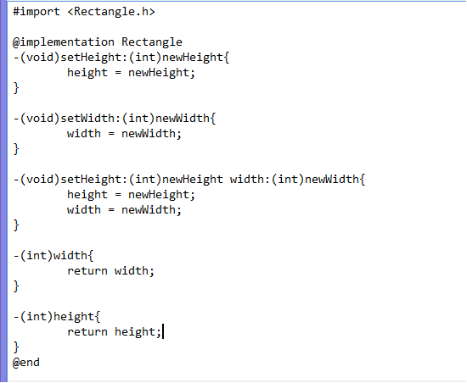
FUNCTION
- (return_type) method_name:( argumentType1 )argumentName1
joiningArgument2:( argumentType2 )argumentName2 ...
joiningArgumentn:( argumentTypen )argumentNamen {
body of the function
}

Slide 13
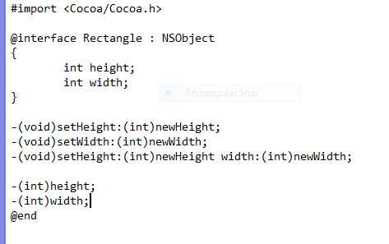
There are two file of every Objective-C class The .m file and the .h file
You want to declare all the class, object, method in .h file. .h file is kind of a report sheet that lists all the name of methods and variables about the class we will use in our program.
The Rectangle class.

Slide 14
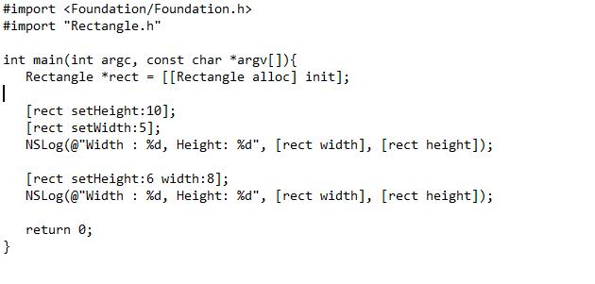
In the main function.

Slide 15
SAMPLE : linear, binary search, pt bac 2

Slide 16
THANK YOU FOR LISTENING

