Slide 1
GAN
Xuyin Qi
A1873008
The University of Adelaide
Notes:
We designed this template so that each member of the project team has a set of slides with its own theme. Members, here’s how you add a new slide to just your set:
Mark where you want to add the slide: Select an existing one in the Thumbnails pane, click the New Slide button, then choose a layout. The new slide gets the same theme as the other slides in your set.
Careful! Don’t annoy your fellow presenters by accidentally changing their themes. That can happen if you choose a different theme from the Design tab, which changes all of the slides in the presentation to that look.

Slide 2
Agenda
Introduction
Body
Conclusion

Slide 3
Introduction
Definition
Why interesting
A generative model using adversarial nets framework
Recently NovelAI is really pupular to generate a picture
We learn some discriminative models in class, but know little about generative model

Slide 4
Body
Timeline
Key points of the model
Details
Experiment & examples

Slide 5
Timeline
Deep Boltzmann Machines→Generative Stochastic Networks→VAE
→GAN→???
Salakhutdinov, R. and Hinton, G. E. (2009). Deep Boltzmann machines. In AISTATS’2009, pages 448–455.
Bengio, Y., Thibodeau-Laufer, E., and Yosinski, J. (2014a). Deep generative stochastic networks trainable by backprop. In ICML’14.
Kingma, D. P. and Welling, M. (2014). Auto-encoding variational bayes. In Proceedings of the Interna_x0002_tional Conference on Learning Representations (ICLR).
Ian Goodfellow, Jean Pouget-Abadie, Mehdi Mirza, Bing Xu, David Warde-Farley, Sherjil Ozair, Aaron Courville, Yoshua Bengio (2014) Generative Adversarial Nets Advances in Neural Information Processing Systems 27 (NeurIPS 2014)

Slide 6
Key points
The generative model is pitted against an adversary: a discriminative model that learns to determine whether a sample is from the model distribution or the data distribution
Competition in this game drives both teams to improve their methods

Slide 7
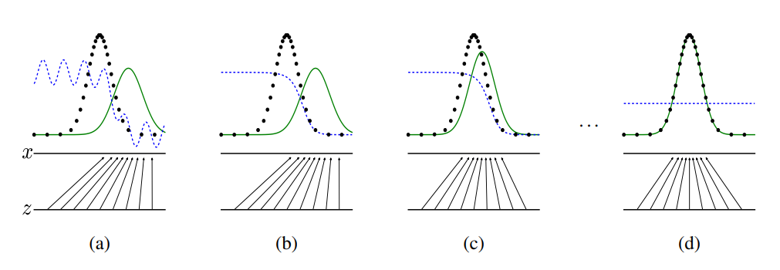
Details

Slide 8
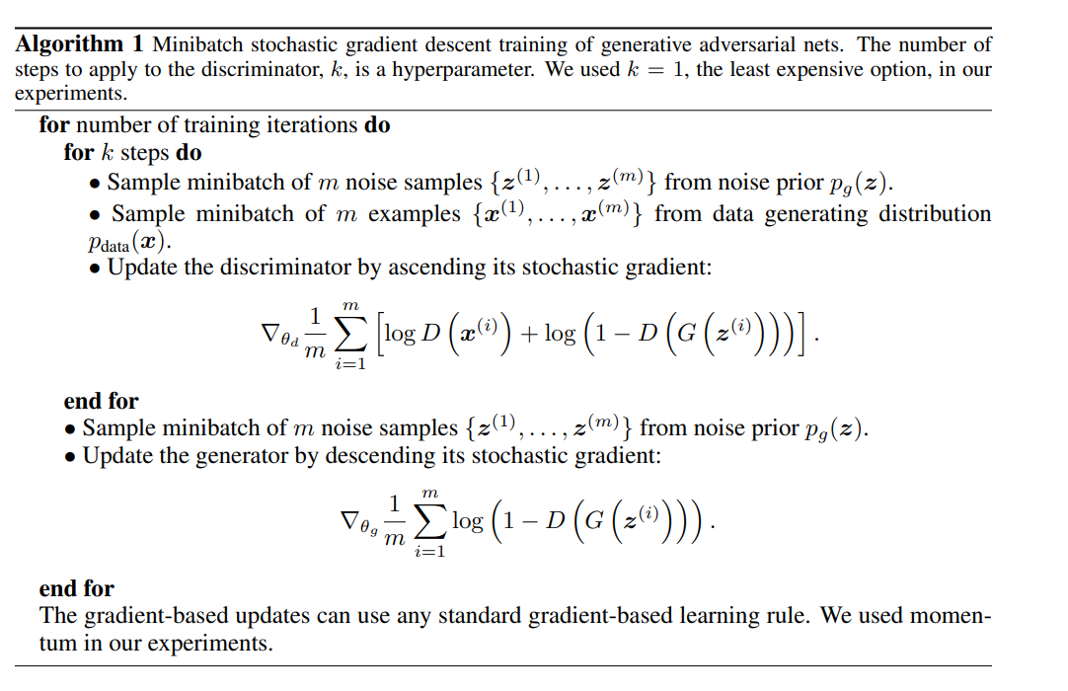
Details

Slide 9
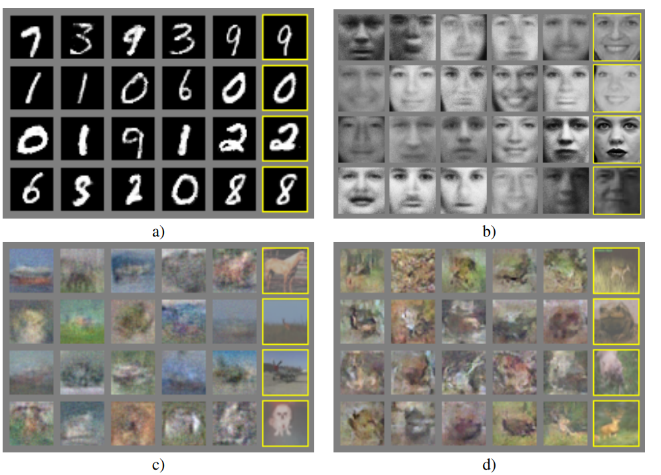
Experiments&Examples
My implementation
Examples from the GAN paper:

Slide 10
Conclusion
Generative models becomes quite popular nowadays
There are still some improvements about GAN(WGAN)
Recently, stable diffision becomes the most powerful model
What we can learn from the development of these models?
[1]Martin Arjovsky, Soumith Chintala, Léon Bottou Wasserstein Generative Adversarial Networks In ICML 2017
[2]Jonathan Ho, Ajay Jain, Pieter Abbeel Denoising Diffusion Probabilistic Models
(NeurIPS 2020)

Slide 11
Thank you!

