Slide 1
SOLID (Principles)
By Abhi

Slide 2
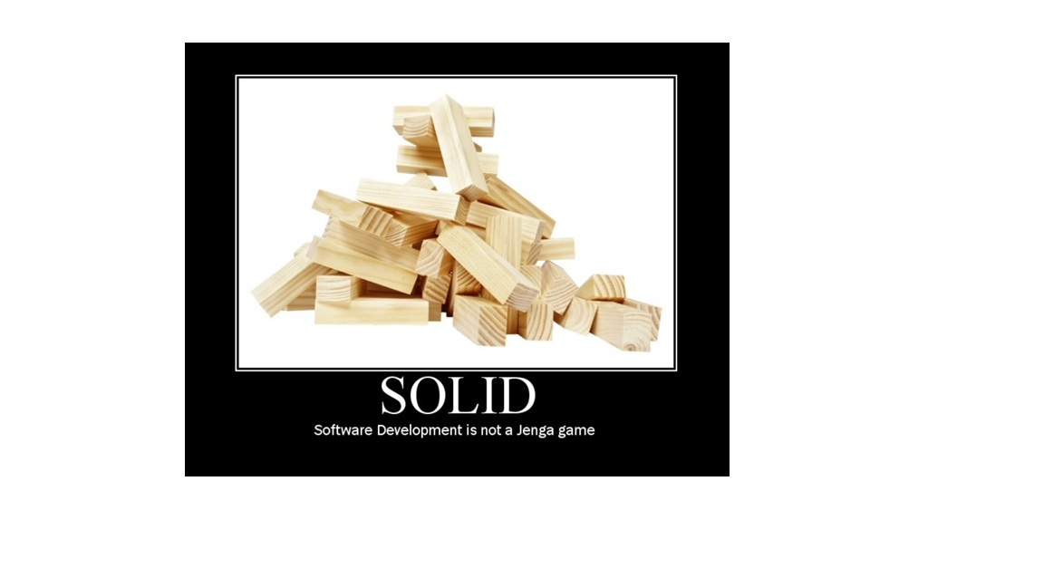

Slide 3
WHAT ARE PRINCIPLES
MEANING -: IS IT A RULE , NOOOO ITS NOT BUT IT’S A GUIDLINE TO FOLLOW ,
FOR EXAMPLE IF AM LIVIN GIN HOSTEL , I MUST FOLLOW RULE TO SLEEP AT 10 PM
WHERE IF I AM LIVING IN HOME I MUST SLEEP SO THAT I CAN WAKE UP IN MORNING
SO RULES ARE IN HOSTEL BUT PRINCIPLE IS TO WAKE UP IN MORNING EARLY

Slide 4
SOLID
S — Single Responsibility Principle (SRP) do not put feet into two boats
O — Open/Closed Principle (OCP) we should always learn new things but never forget your values and cutltures
L — Liskov Substitution Principle (LSP) you should be easily able to fit into something
I — Interface Segregation Principle (ISP)
D — Dependency Inversion Principle (DIP)

Slide 5
SO SOLID IS A GUIDLINE
OUR AIM IS TO FOLLOW THEM AS MUCH AS POSSIBLE
THERE WILL BE SENARIOS WHERE MUST CANNOT USE PRINCIPLES BUT IT DOESN’T MEAN WE
SHOULDN’T USE PRINCIPLES ,

Slide 6
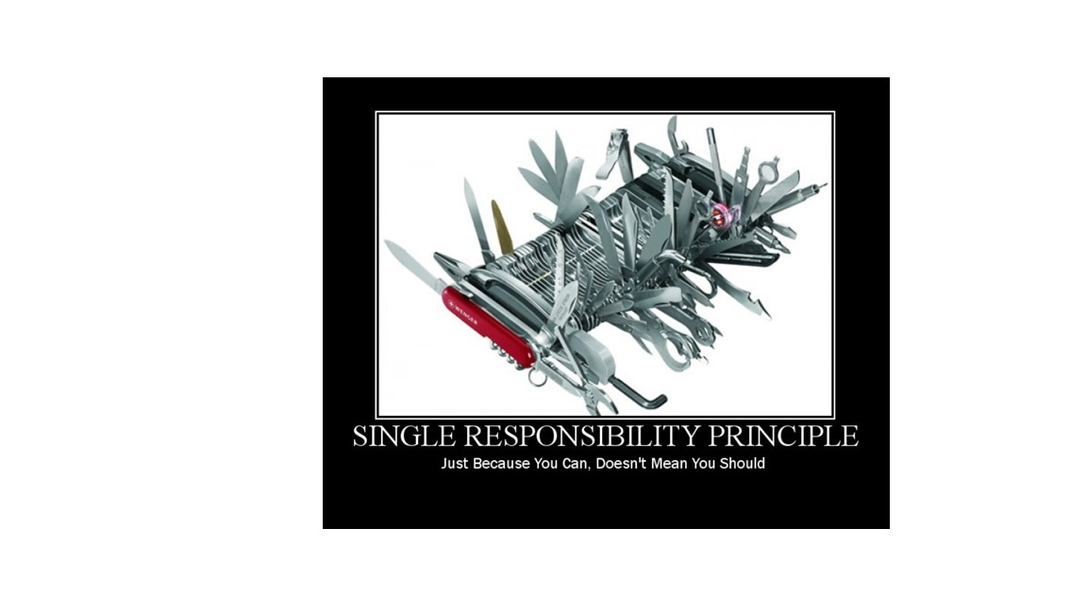

Slide 7
SRP – Example with Birds
Imagine you are building a software system about Birds.
When you build software, you must check edge cases.
Because once your project grows, it will be hard to change and will waste time
if you rewrite things again and again.

Slide 8
Understanding Birds
When we talk about Birds, what comes to mind first?
It can be a Sparrow, Crow, Parrot, etc.
All birds have different roles and behaviors.
So while building software, you must handle the diversity of birds.

Slide 9
Storing Birds
If we can create objects of a Bird class, then we can store them in a database.
So what should a Bird class contain?
      Attributes (Fields)
      A basic Bird must have:
      name
      type
      numberOfWings
      color
      Weight
      ______________
      Methods
      A Bird may have:
      fly()
      makeSound()
      dance()

Slide 10
Example
Bird B1 = new Bird(); B1.name = "Sparrow";
B1.type = "Small";
B1.makeSound(); // chi chi chi
Bird B2 = new Bird();
B2.name = "Crow";
B2.type = "Medium";
B2.makeSound(); // ka ka ka

Slide 11
if (type == "sparrow") … else if (type == "crow") …
This becomes a big SRP violation.
Where the Problem Begins
If I call:
B1.makeSound();
B2.makeSound();
Are both supposed to make the same sound?
No.
Each bird has a different sound.
So if one method
(makeSound())
tries to give different outputs for different birds using conditions like

Slide 12
Conclusion
For any object, its method should only do one job.
makeSound();
should only make the sound of that specific bird, not decide which bird it is.
This leads to better:
maintainability
readability
Testing
understandability
separation of responsibilities

Slide 13
Understanding the Problem (If–Else Issue)
Let’s say we have a method like this:
makeSound() {
if (type == "crow") {
sound("caw caw");
}
else if (type == "sparrow") {
sound("chi chi");
}
}

Slide 14
Problems with this approach
Hard to understand — Too many if-else conditions make the code confusing.
Difficult to test — Testing becomes harder as conditions increase.
Code duplication — Repeated logic appears for every new bird type.
Less reusable code — The method is tightly coupled to specific bird types.
Violation of SRP (Single Responsibility Principle).

Slide 15
Why does this code violate SRP?
The method makeSound() should only make a sound.
But in your example, the method is:
making sound
deciding which bird is calling
mixing behavior logic with type checking
This means the method is trying to do the same job that the
makesound() method problem had — deciding behavior for multiple bird types.
This is a strong violation of SRP.

Slide 16
What should the Bird class represent?
The agenda of the Bird class is to:
act as a structure,
define common behavior,
allow each subclass (Crow, Sparrow, Pigeon, etc.) to implement its own methods.
Classes should be responsible only for what belongs to them.

Slide 17
How to identify SRP violations
Methods with multiple if–else blocks
If you have many conditions, it means you're trying to do:
  "If this → do that"
  "If that → do something else"
This is a clear sign the method is doing more than one job.

Slide 18
BUT
In some cases if else might be needed for example if you are creating an account in fix deposite then bank should ask you
If(10 year == 10% interest)}{
Else (20 year == 20 % intrest ){

Slide 19
ANOTHER WAY HERE SRP VIOILATION CAN HAPPEN
MONSTER METHODS
FOR EXAMPLE IN ONE METHOD YOU ADD
DB.CONNECTION (String querry “;;;;;;;”)
Db.save(save database)
Transfer to dto (
From entiry)
In above example you are violating SRP , it says you must have one funcationality in one method

Slide 20
ANOTHER WAY HERE SRP VIOILATION CAN HAPPEN
Is
Package structure
You should put only package to its classes or services , or repo etc as per its functionality

Slide 21
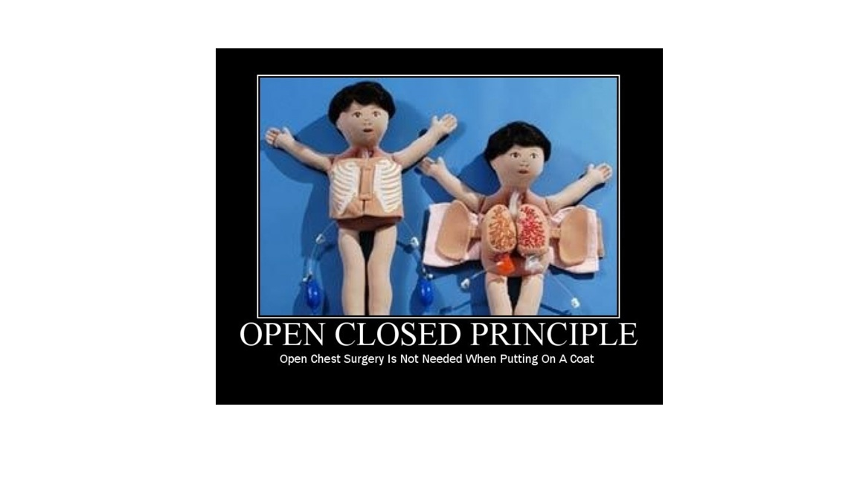

Slide 22
OPEN CLOSE PRINCIPLE
Open for Extension, Closed for Modification

Slide 23
What is OCP?
Open/Closed Principle means your code should be:
OPEN for extension (easy to add new features)
CLOSED for modification (never change existing working code)

Slide 24
In Simple Terms:
Modification = Changing what already exists in your code
Extension = Adding new things without touching existing code
✅ Allowed: Adding new classes, new methods, new code
❌ Not Allowed: Modifying existing methods, changing working logic

Slide 25
Why OCP?
Reduces bugs
Improves maintainability
Makes code scalable
Makes future changes safer
Allows adding new features without fear

Slide 26
EASY TESTING
Lets say you already build the code and run all test cases , and it works fine , now client ask you to add a new bird in it , don’t you think
Now you need to run all tests again and chech if code works fine , and do you gurrenty that your code will work fine again and smooth?
Of course NO….

Slide 27
The Problem: OCP Violation Example
Initial Bird Class (Bad Design)
class Bird {
String name;
String type;
String color;
double weight;
void makeSound() {
if(name == "crow") {
Sout("ka ka ka");
} else if(name == "sparrow") {
Sout("chi chi chi");
} else if(name == "pigeon") {
Sout("gur gur gur");

Slide 28
Problem
Every time a new bird comes:
You must modify existing code
More chances of bugs
Code becomes lengthy
Hard to maintain
Hard to preform test cases

Slide 29
The Crisis: Client Wants Peacock!
Now the client says: "We need to support a new bird - PEACOCK!"

Slide 30
What happens with our current code?
void makeSound() {
if(name == "crow") {
Sout("ka ka ka");
} else if(name == "sparrow") {
Sout("chi chi chi");
} else if(name == "pigeon") {
Sout("gur gur gur");
} else if(name == "peacock") { // ❌ MODIFICATION!
Sout("meow meow");
}
}
Why This is Bad:
We MODIFIED existing code instead of extending
Risk of breaking existing functionality for Crow, Sparrow, Pigeon
Violates OCP - code is NOT closed for modification
This pattern repeats for every new bird type

Slide 31
The Solution: OCP Compliant Design so what do you think will be the solution of this
Lets jump to Version 2: Proper Architecture which supports OCP

Slide 32
// Abstract base class with common attributes abstract class Bird { String name; String type; String color; double weight; }
// Segregated interfaces for different behaviors interface IDance { void dance(); }
interface IFly { void fly(); }
interface IMakeSound { void makeSound(); }
class Sparrow extends Bird implements IFly, IMakeSound, IDance
public void fly() { Sout("Sparrow darting"); } public void makeSound() { Sout("Chi Chi Chi!"); } public void dance() { Sout("Sparrow twirling"); }
class Crow extends Bird implements IFly, IMakeSound, IDance
public void fly() { Sout("Crow flying high"); } public void makeSound() { Sout("Ka Ka Ka!"); } public void dance() { Sout("Crow hopping dance"); }
Adding Peacock –
The OCP Way!
↓
class Peacock extends Bird implements IFly, IMakeSound, IDance
public void fly() { Sout("Peacock short flight"); } public void makeSound() { Sout("Meow Meow!"); } public void dance() { Sout("Peacock feather display!"); }

Slide 33
Key Benefits of OCP Approach
Safe Evolution
Existing Crow, Sparrow, Pigeon code remains untouched
Zero risk of breaking working functionality
Easy Maintenance
New features = New code only
No need to understand complex if-else logic
Clean Architecture
Each bird is responsible for its own behavior
No giant methods with endless conditionals
Team-Friendly
Multiple developers can work on different birds

Slide 34
Visual Comparison
Bird Class
├── makeSound() [MODIFIED for each new bird]
├── fly() [MODIFIED for each new bird]
└── dance() [MODIFIED for each new bird]
After OCP (Good)
Bird (Abstract)
├── Crow [EXTENDS Bird]
├── Sparrow [EXTENDS Bird]
├── Pigeon [EXTENDS Bird]
└── Peacock [EXTENDS Bird] ← NEW! No changes to others

Slide 35
Summary
OCP is NOT bad - it's essential for building maintainable, scalable software!
Remember:
Add new classes for new features
Never change working existing code
Design for extension from the beginning
If-else/switch chains = Red flag for OCP violation
This principle ensures your codebase grows safely without becoming a fragile house of cards! 🏗️

Slide 36
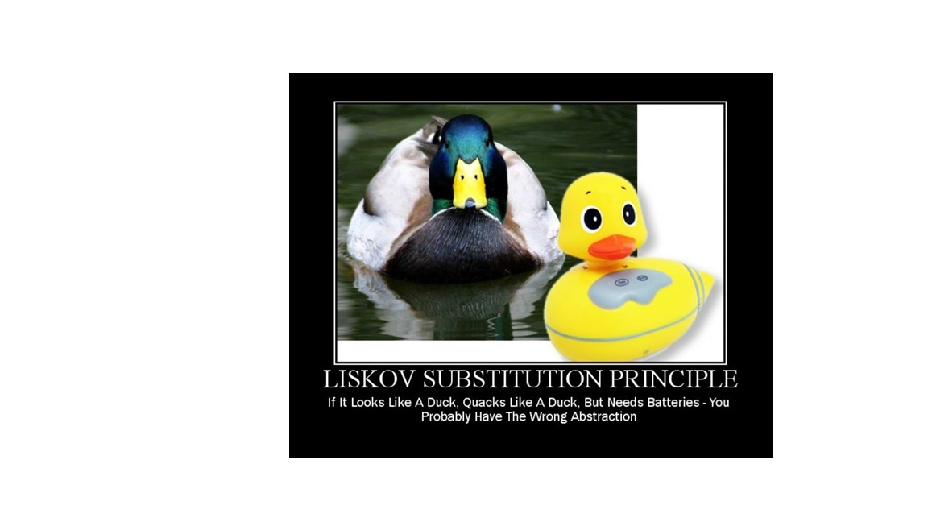

Slide 37
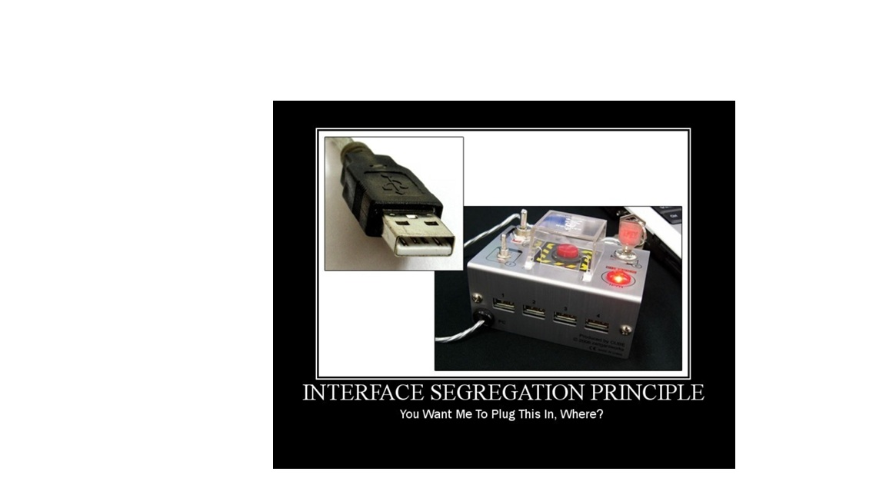

Slide 38
