Slide 1
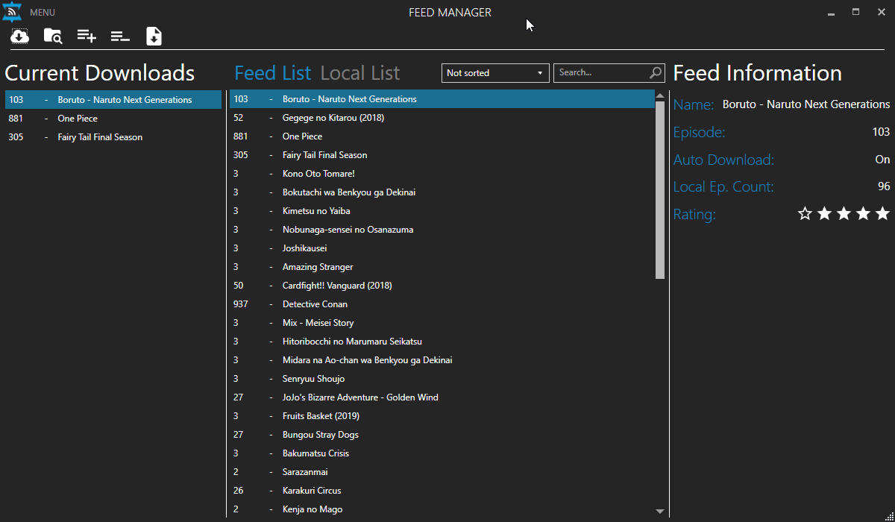
List View
Tab Control
Search Bar
Info Panel

Slide 2
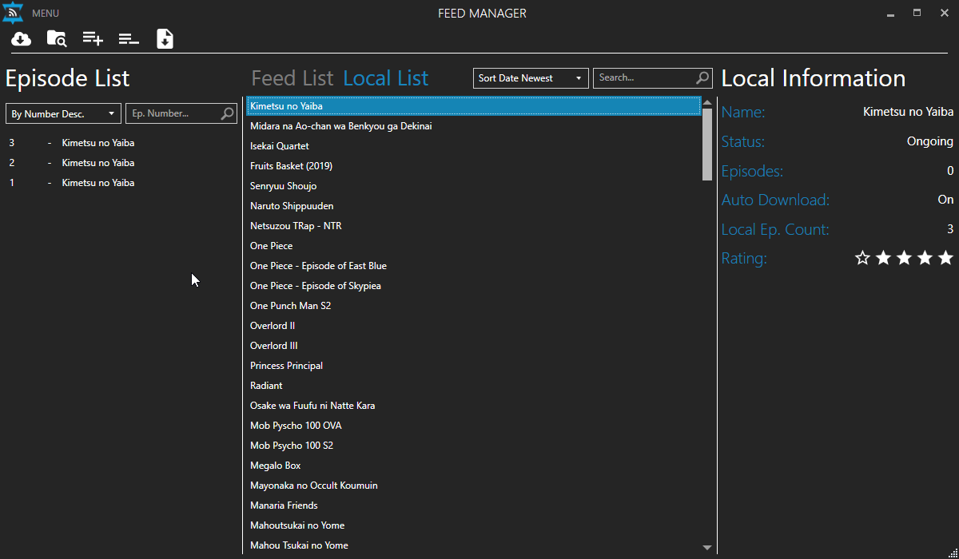
Icon bar
Episode List

