Slide 1

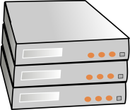
1
…
Miner
victim.com
2
New Proof-of-DDoS block
4
Proof-of-Stake block
Prev block hash: 2f7c63…
Tx Merkle root: 9c8f15…
Nonce: 63a108…
Proof-of-DDoS: 8b2761…
Transactions:
…
Prev block hash: cc2b1a…
Tx Merkle root: 839f2c…
Diff: + vicX.com
Transactions:
* -> Miner
Alice -> Bob
Dave -> [DDoS vic2.com]
(PAY_TO_DDOS)
Bob -> Bob (coinstake)
[DDoS vic2.com] -> Eve
(PAY_TO_DDOS) {proof}
5
3

