Slide 1
DDoSCoin Cryptocurrency with a Malicious Proof-of-Work
Eric Wustrow
University of Colorado Boulder
ewust@colorado.edu
Benjamin VanderSloot
University of Michigan
benvds@umich.edu

Slide 2
Outline
Background
DDoSCoin Design
Discussion

Slide 3
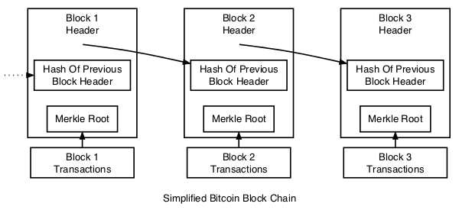
Cryptocurrencies
Digital, decentralized cash
Double spending problem
Public ledger of transactions
Mining rewards
Source: bitcoin.org

Slide 4
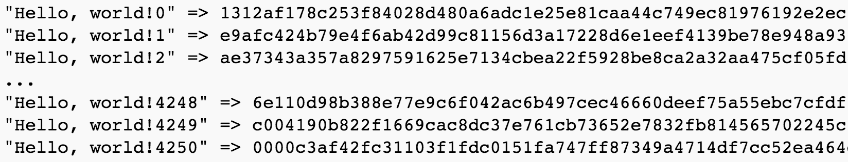
Proof-of-Work
Bitcoin
Peercoin
Permacoin
TorPath
DDoSCoin
Source: bitcoin.org
Notes:
Talk about each proof of work
Discuss difficulty setting first here

Slide 5
Proof-of-Stake
Peercoin
Coin-days are proof
Rate-limiting prevents proof-of-work
Coins can only age 90 days

Slide 6
Outline
Background
DDoSCoin Design
Discussion

Slide 7
DDoSCoin Proof-of-Work
Notes:
Make clear this is in normal a TLS Handshake!!!!
Discuss EVERY LINE
Drag out what is in the client_random
Commitment to features
We can prove that the server saw this nonce!

Slide 8
DDoSCoin Proof-of-Work
Components of client random
Previous block hash
Transaction Merkle tree root
Nonce

Slide 9
Block Validation
Previous block hash
Merkle tree hash
Client random
Signature
Target difficulty
SHA256(DH Parameters || signature || N)
Notes:
Say how we are able to provide all of this as the miner, and what it proves to the other miners
server key exchange parameters, signature, and the block’s nonce (N)

Slide 10
Victim Selection
Any server?
Fixed set of servers?
Proof-of-Stake blocks
PAY_TO_DDOS transactions
Notes:
First two: explain why it does not work at all
We learn we need a small number, but resiliency dictates dynamism
Say the people who can cause a victim site based on the other two

Slide 11
Victim Selection
PAY_TO_DDOS
Proof-of-Stake Block
Notes:
No reward for proof of stake

Slide 12

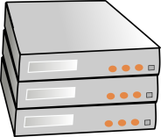
Victim Selection
PAY_TO_DDOS
Proof-of-Stake Block
…
Miner
victim.com
New Proof-of-DDoS block
Proof-of-Stake block
Prev block hash: 2f7c63…
Tx Merkle root: 9c8f15…
Nonce: 63a108…
Proof-of-DDoS: 8b2761…
Transactions:
…
Prev block hash: cc2b1a…
Tx Merkle root: 839f2c…
Diff: + vicX.com
Transactions:
* -> Miner
Alice -> Bob
Dave -> [DDoS vic2.com]
(PAY_TO_DDOS)
Bob -> Bob (coinstake)
[DDoS vic2.com] -> Eve
(PAY_TO_DDOS) {proof}
Notes:
No reward for proof of stake

Slide 13
Proof-of-Work Implementation
Notes:
Miner attacking our server
Quad-core server running nginx
Gigabit Ethernet
3000 TLS Connections per second
6x response time increase

Slide 14
Outline
Background
DDoSCoin Design
Discussion

Slide 15
Discussion
Malicious “useful” proof-of-work
Challenges regarding bandwidth
Forking to deny a target designation
TLS 1.2, 1.3
Ethereum smart contract PAY_TO_DDOS
Adoption

Slide 16
Defenses
Version or cipher suite changes
Claiming rewards
Legal action
Stakeholding

Slide 17
Ethics
Do not publish the full coin
Do not attack real servers
Full disclosure

Slide 18
DDoSCoin Cryptocurrency with a Malicious Proof-of-Work
Eric Wustrow
University of Colorado Boulder
ewust@colorado.edu
Benjamin VanderSloot
University of Michigan
benvds@umich.edu

Slide 19
Target Difficulty
Global difficulty parameter
Adjust the rate at which transactions are processed
Per-domain difficulty parameter
Allow all targets to be viable
Constant time intervals
Initial difficulty set by user

