Slide 1
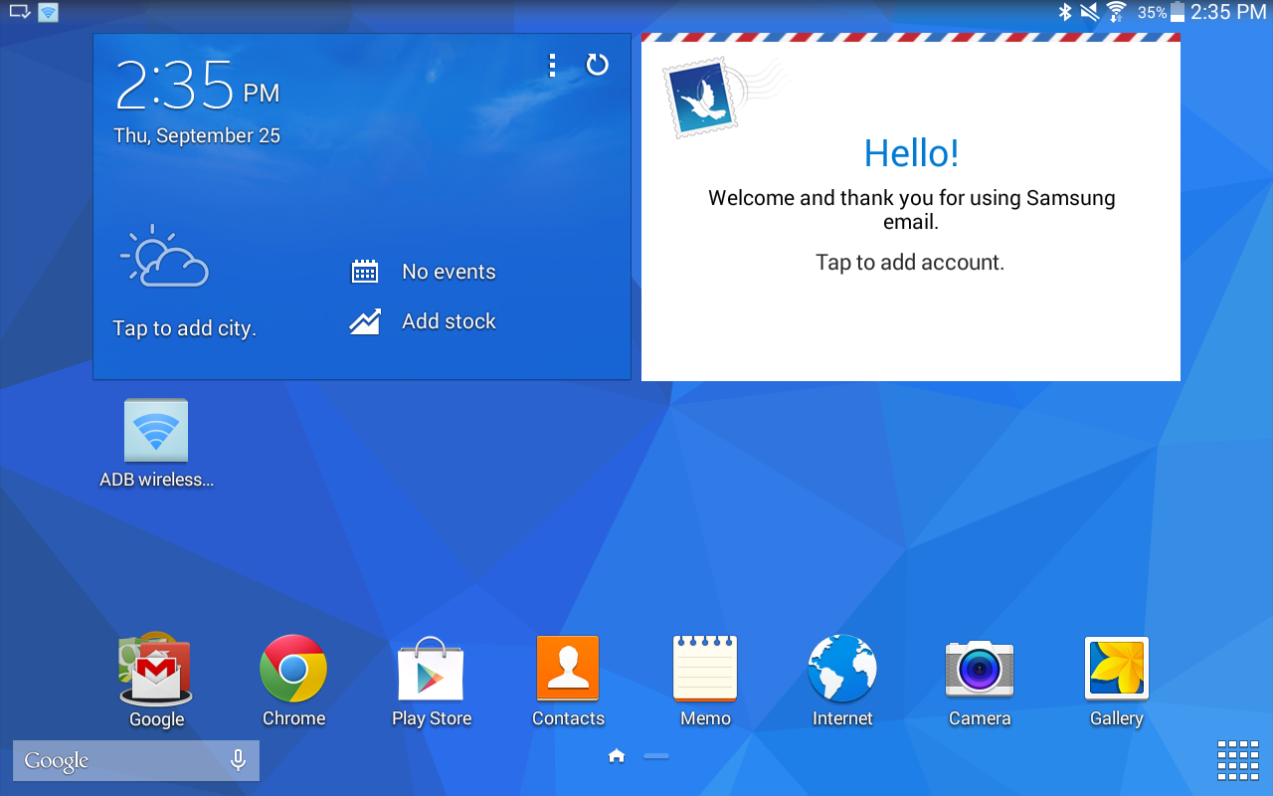
CLICK

Slide 2

CLICK

Slide 3
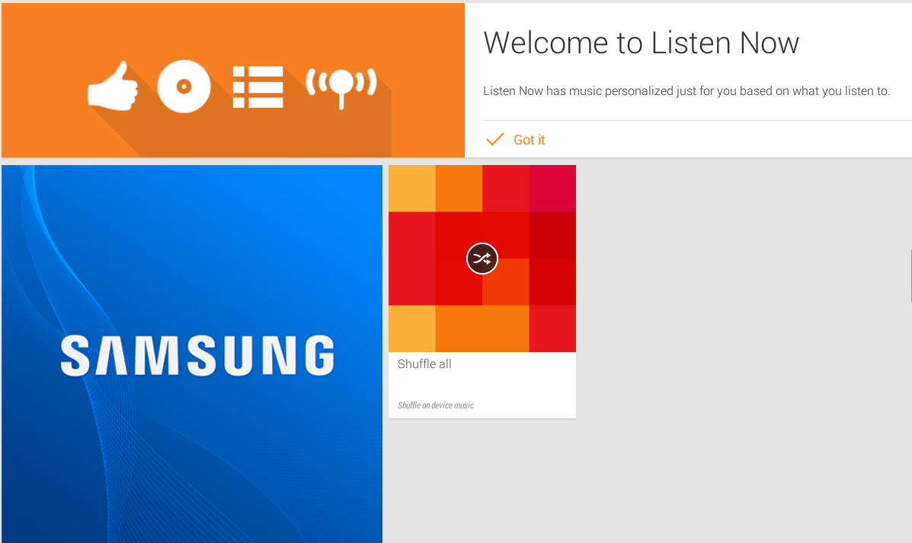
CLICK

