Slide 1
Gaming with CNCF Infrastructure
Aldin Setiawan
Yogyakarta | October, 2026

Slide 2
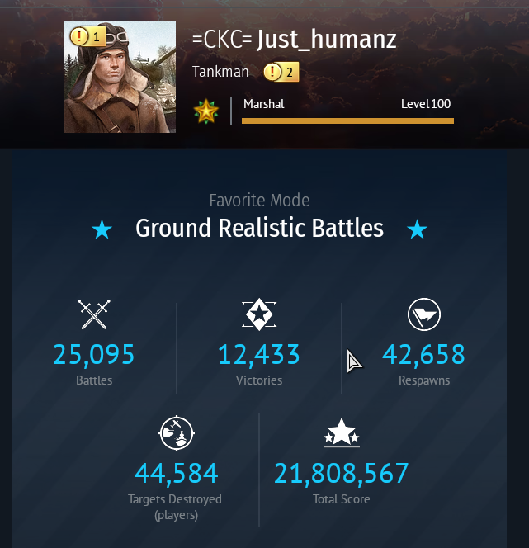
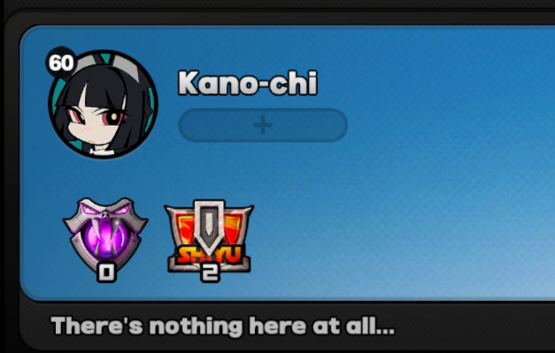
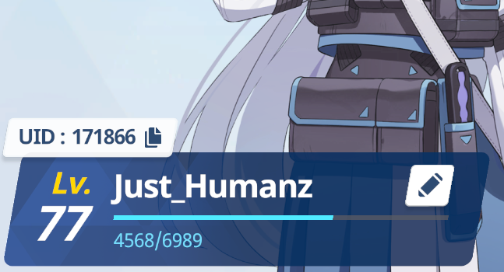
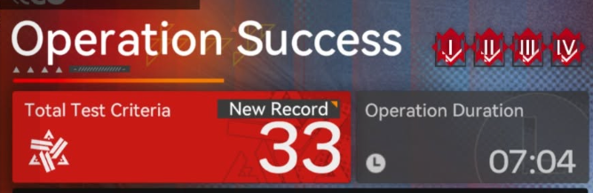

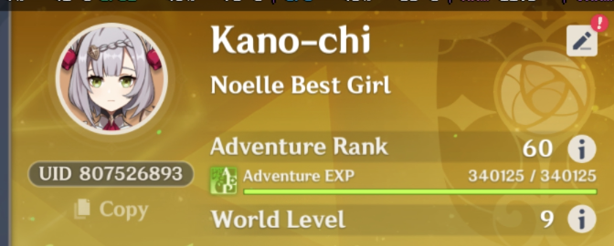
Quick Intro About me
A linux gacha addiction gamer since 2016 and currently working as linux infrastructure stuff.

Slide 3

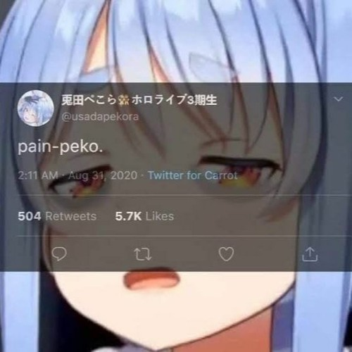
Throwback: Gaming on linux?
Painful
Unplayable
Wasting time
Can It run crysis?

Slide 4
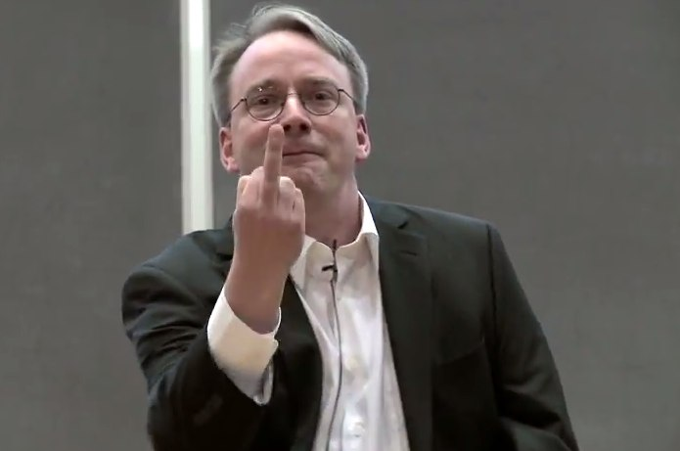
Throwback: How hard it’s is?
Only a few of game are native running on linux(Dota2&CS:GO)
Garbage desktop driver(Nvidia)
Poor performance of OpenGL
Tuning the kernel for low latency support
Random crash

Slide 5
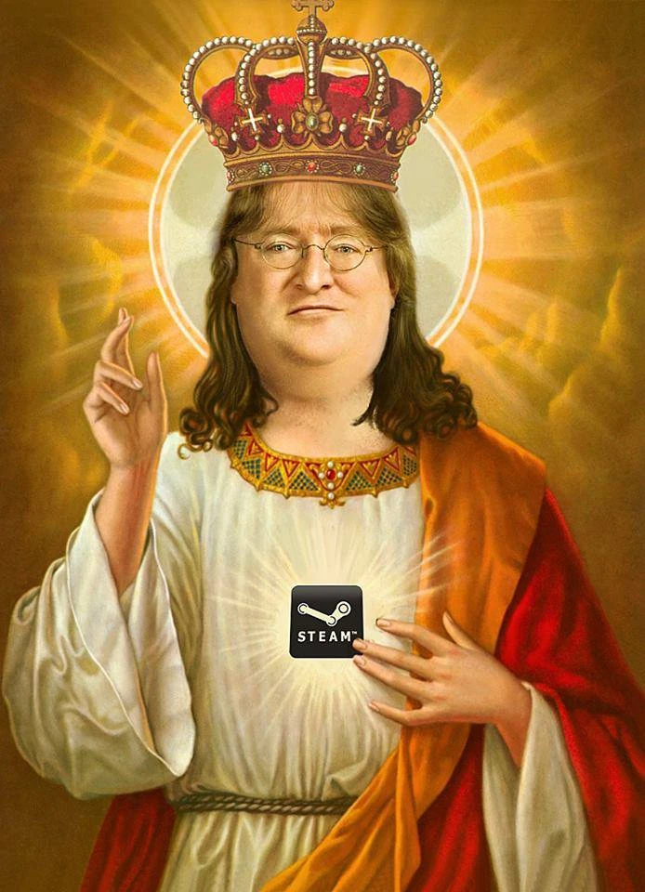
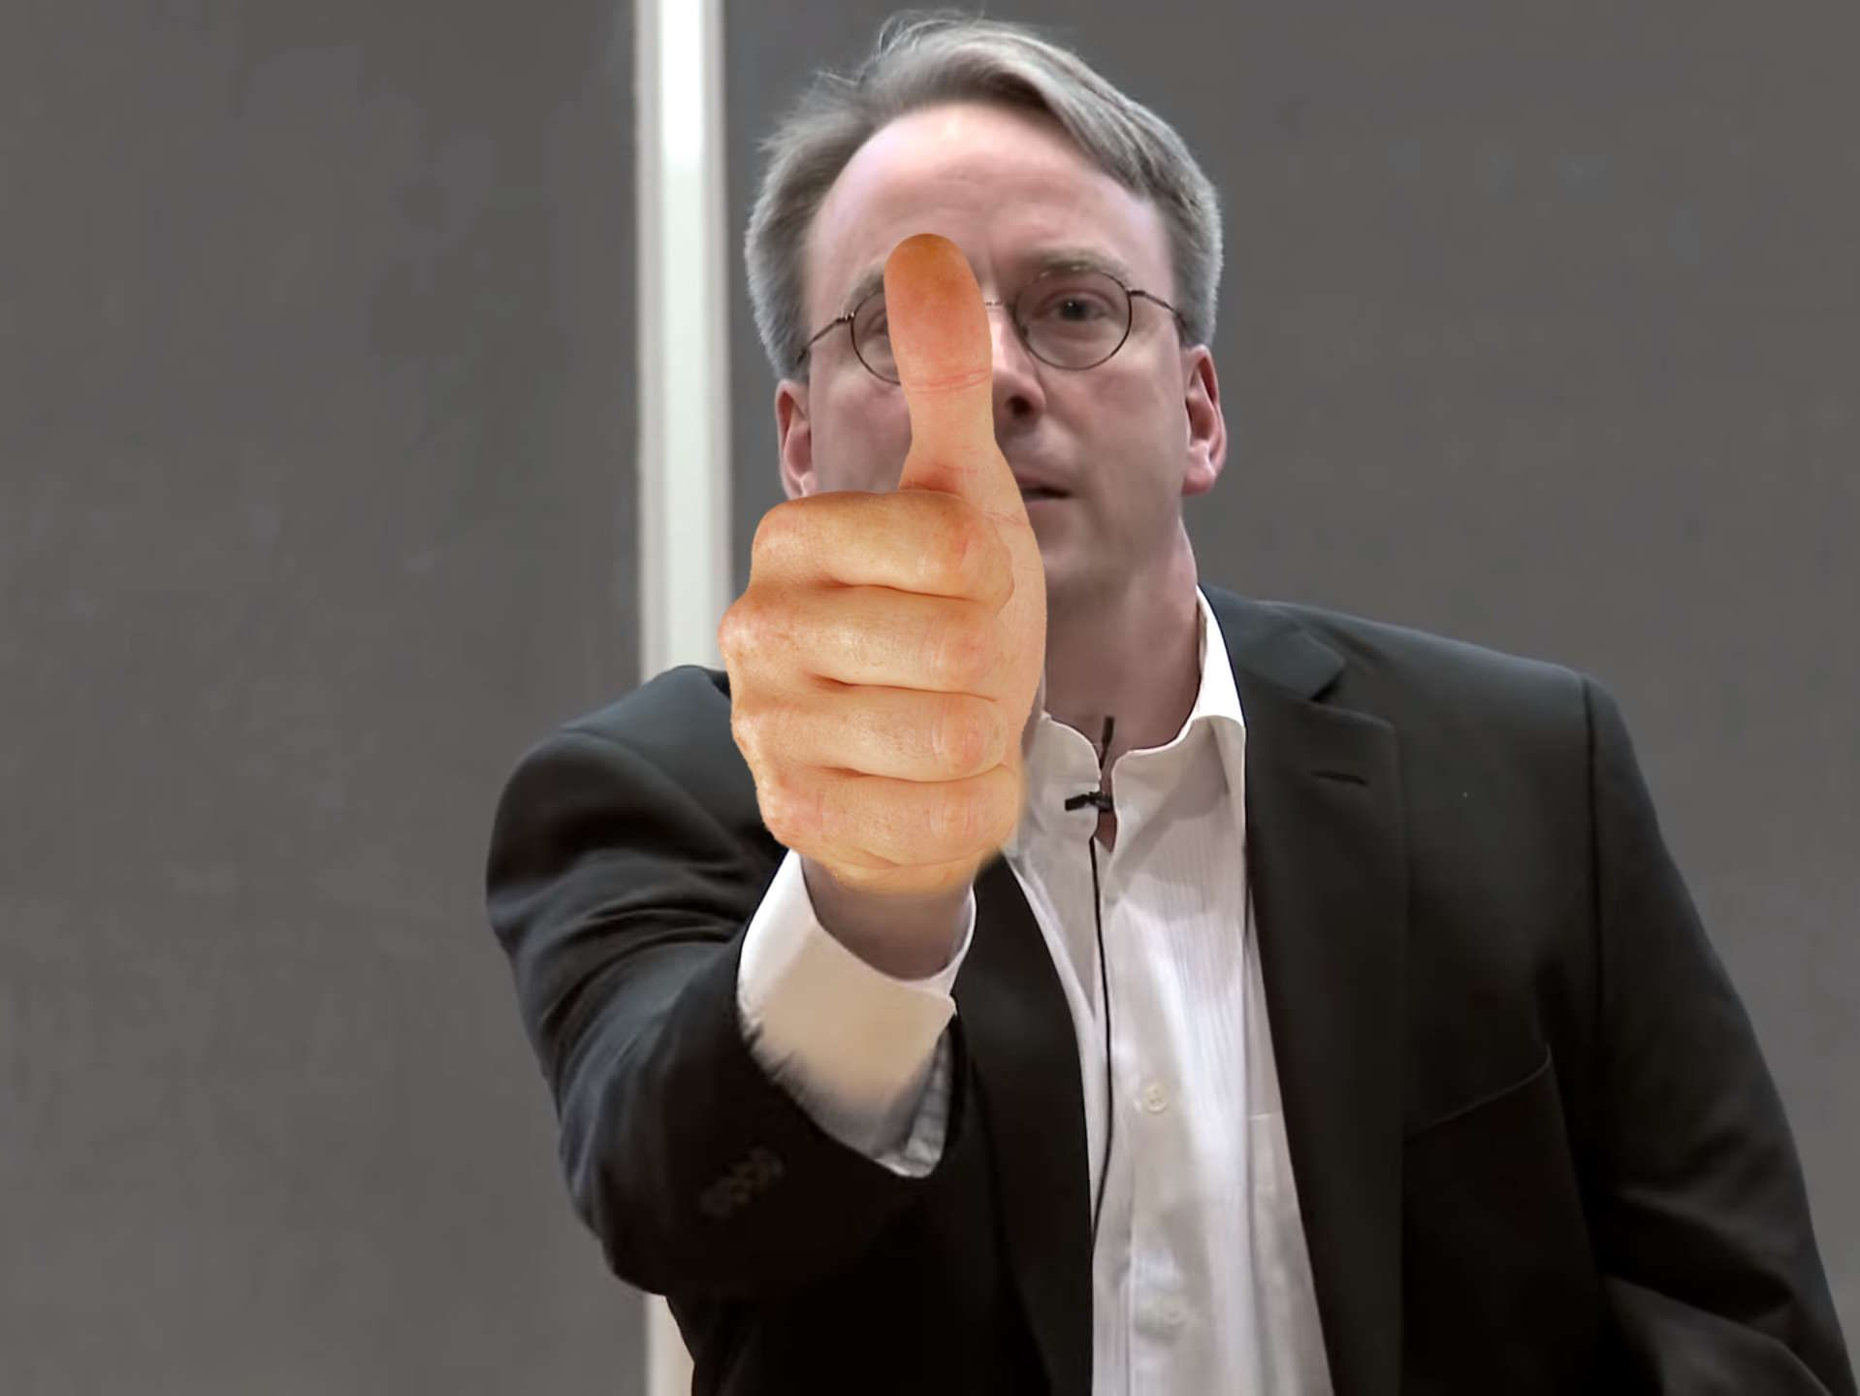
Nowadays: How hard it is?
GGEZ
Optimum Driver support
‘Just work’
Most of dependency solved
by containerized(flatpak)

Slide 6
Timeline of Gaming on Linux
2013 – SteamOS alchemist Release
2016 – Vulkan Project are Started
2017 – Wine Dxvk Introduce
2018 – Steam Proton Release
2021 – Steam Deck Booming

Slide 7

Gaming with CNCF Infrastructure?
Gaming on Linux now days are pretty easy(just work). Can we bring it into little bit further?
Like. Gaming on the Cloud?

Slide 8
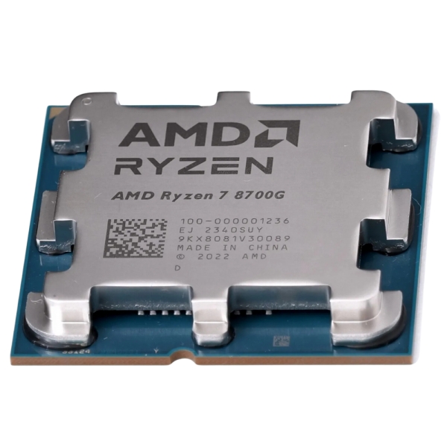
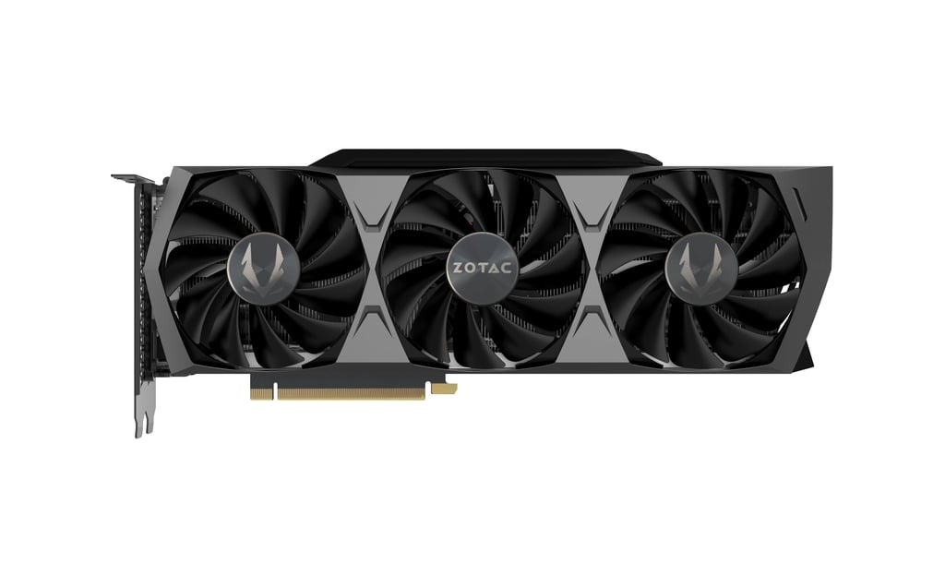
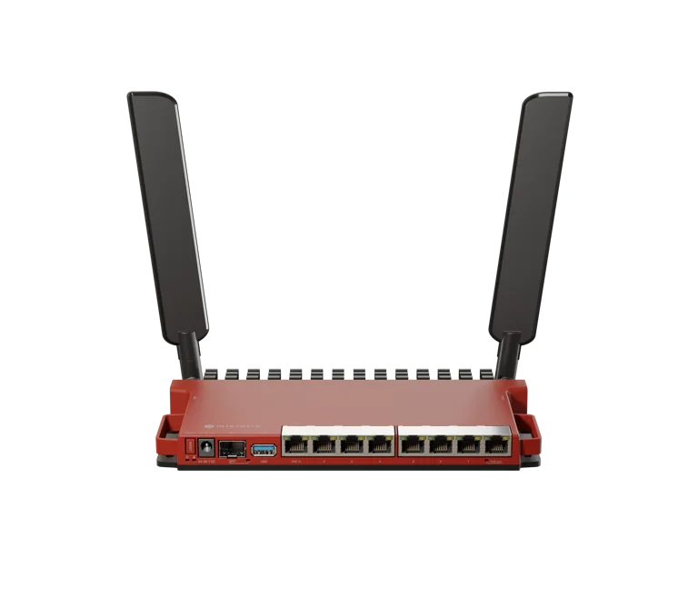
The Infrastructure
MiniPC as Server:
  AMD Ryzen 5 2400GE
  AMD ATI Radeon Vega Series
  32GiB of Ram DDR4
  2 NIC for 802.3ad Bond
PC as the Game Host:
  AMD Ryzen 7 8700G
  NVIDIA GeForce RTX 3090
  16GiB of Ram DDR5
  2 NIC for 802.3ad Bond
Mikrotik Router:
  L009UiGS-2HaxD
  512MiB of Ram
  4 NIC for 802.3ad Bond

Slide 9
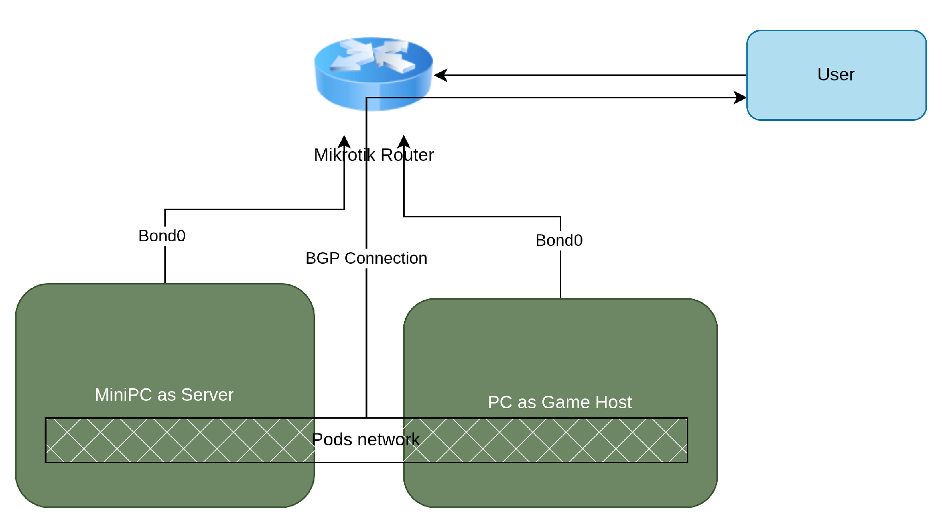
High Level design

Slide 10
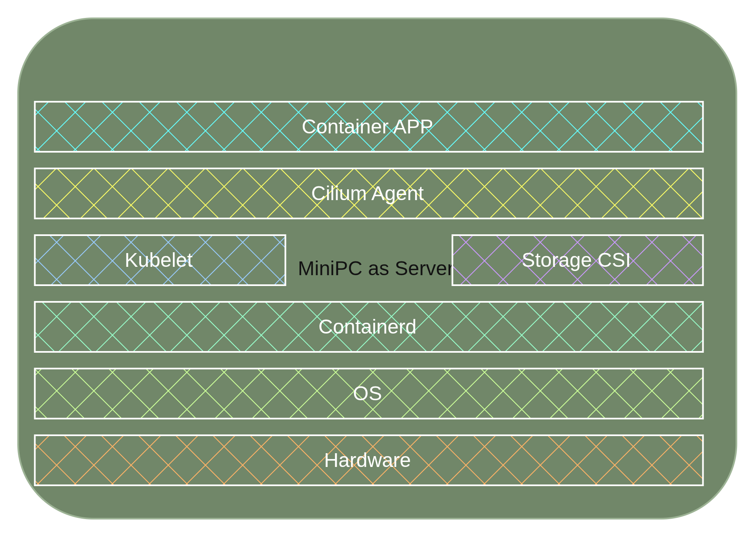
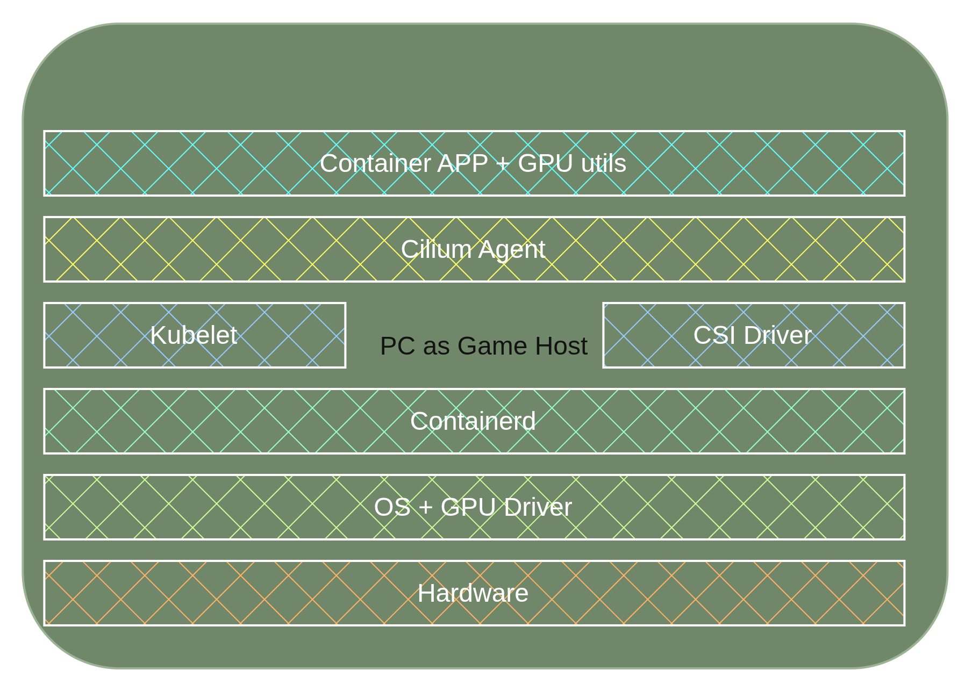
High Level design

Slide 11
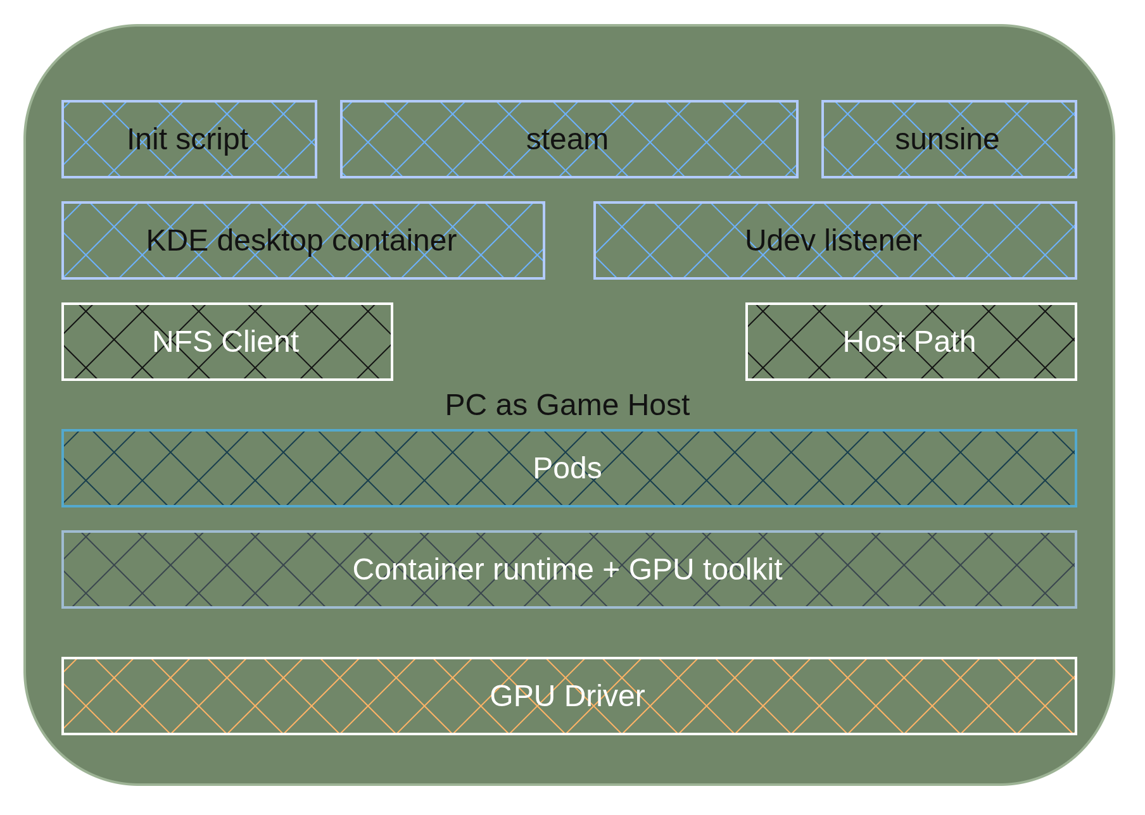
High Level design

Slide 12
Tools
Rook
  Ceph-rbd from rook
Cilium
  Pods Network
  Pods BGP
CoreDNS
  Resolver for the stateless pods
Helm
Grafana+Prometheus
  Monitoring Host&CSI

Slide 13
Quick Code Peek
Helm charts:
  Github

Slide 14


Quick Demo
PC Desktop
Smartphone

Slide 15

Is it done, Yuri?

Slide 16

PoC or Prototype
Huge blocker
Not all game support proton
Competitive game not very recommended
Anti Cheat Spyware Program
End-User License Agreement
Point Plus
Centralized Storage
Immutable user-spaces
Play anytime&anywhere
Huge blocker
Not all game support proton
Competitive game not very recommended
Anti Cheat Spyware Program
End-User License Agreement

Slide 17
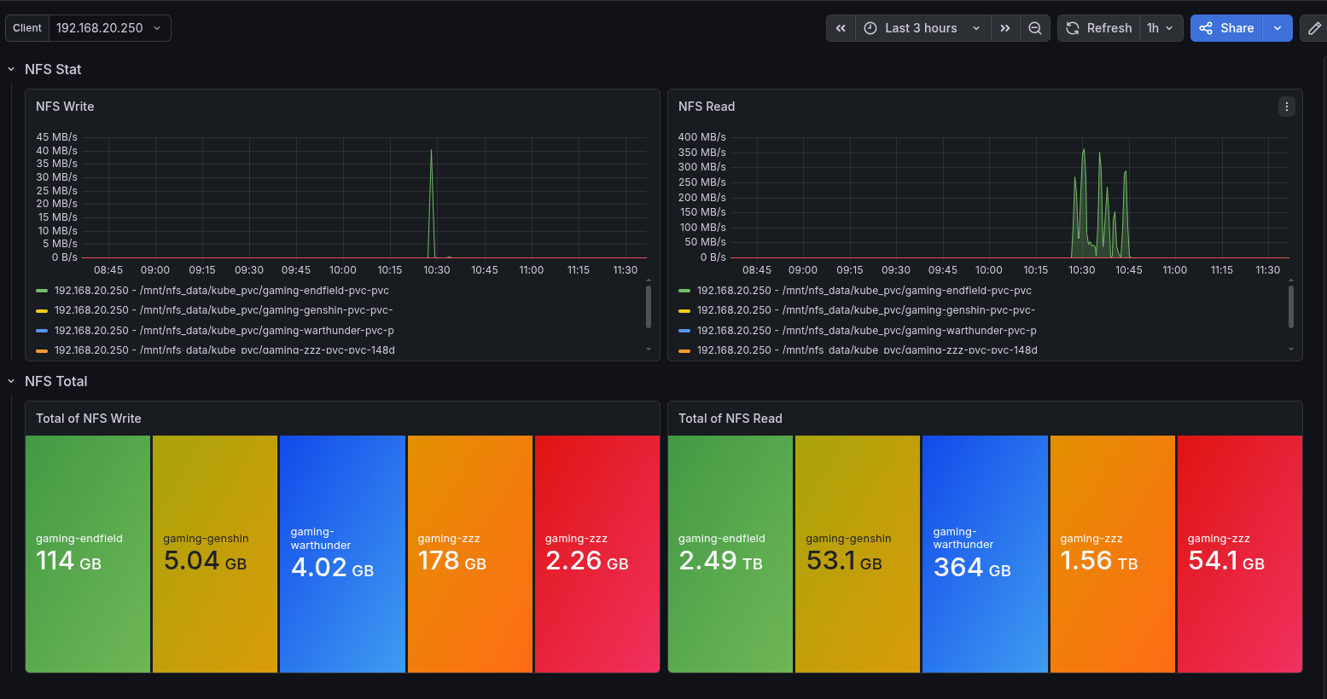
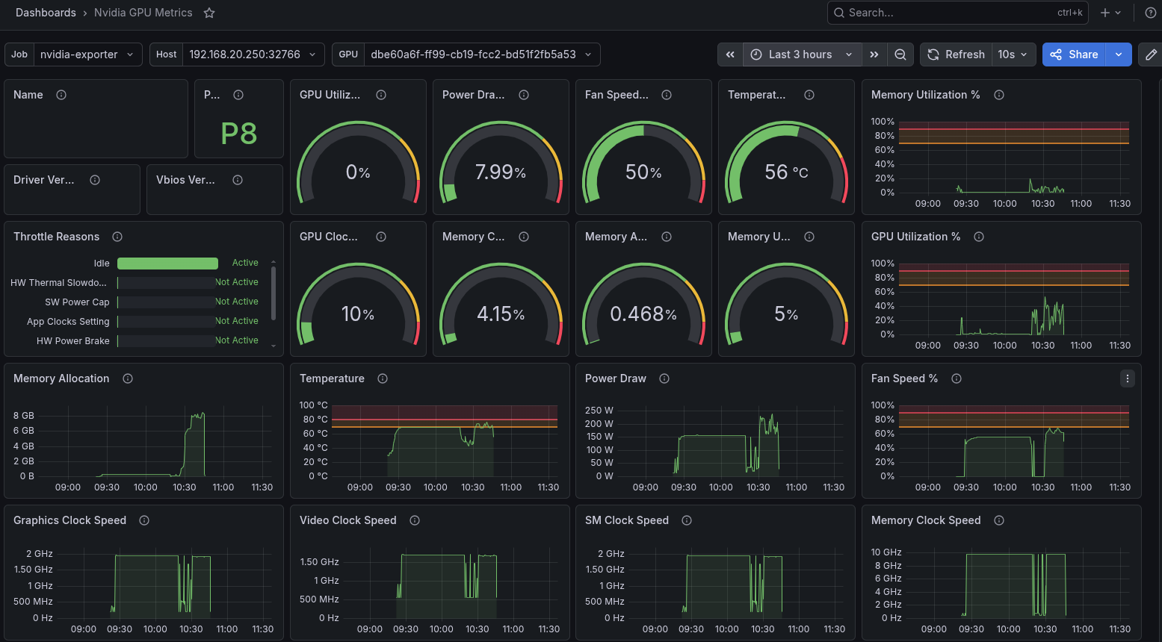
Monitoring (Optional)

Slide 18

Thank You

