Slide 1
INSY 674 · Enterprise Data Science · McGill · Fall 2026
Predicting late deliveries
Flagging risky Olist orders at approval, so ops can act before the customer notices
Group 9
Fidan Shiraliyeva · Hasan Malik · Jay Malhotra · Jingyu Wu · Mia Scalabrin · Peace Isaac · Tasnim Hassan
GitHub repository: olist-late-delivery (github.com/JustJay7/olist-late-delivery)
Notes:
[0:10] Introduce the team and the project in one line: we predict which Olist orders will arrive late, at the moment the order is approved.
Speaker: ________

Slide 2
OBJECTIVE · THE PROBLEM
Late orders come with far worse reviews
1 in 14
Share of orders with a 1 or 2-star review
delivered orders arrived late
(5,986 of 85,371, Jan 2017 – Jul 2018)
2.21★
6.7× more likely to get a 1–2★ review when late
average review when late,
vs 4.28★ when on time
Reviews only size the problem. They are never used as model inputs.
Notes:
[0:45] About 1 in 14 delivered orders arrived late. Late orders average 2.21 stars against 4.28, and 62.5% get a 1 or 2-star review, against 9.3% of on-time orders. That's an association, but a strong one. Our goal is to flag likely-late orders early enough to act, instead of finding out from a bad review. Reviews never feed the model. (README 1.1)
Speaker: ________

Slide 3
OBJECTIVE · WHO IT SERVES
Ops needs a daily shortlist of risky orders
1. Order approved
2. Nightly risk score
3. Top 10% flagged
4. Ops acts
Every order gets scored using only what is known at approval
Yesterday's approved orders are ranked by risk of arriving late
About 18 orders a day go to the ops team
Push the seller to ship, chase the carrier, or warn the customer with a new date
The model ranks orders for people to review. It never changes delivery dates on its own.
Notes:
[0:40] The user is Olist's operations team. Every morning, the orders approved the day before get a risk score, and the riskiest 10%, about 18 orders a day, are flagged. For those, ops can push the seller to ship sooner, chase the carrier, or warn the customer and give a new date. The model only ranks orders so people know where to look. (README 1.3, 5.4)
Speaker: ________

Slide 4
OBJECTIVE · WHAT OLIST DOES TODAY
Padding the promise isn't enough: lateness comes in waves
24 vs 10
Late rate by month of purchase
days promised vs days actually taken (medians). A one-size safeguard, with no order-level risk score.
33% → 62%
Nov 2017, Feb and Mar 2018 hold 33% of training orders but 62% of the late ones
Feb–Mar 2018 was network-wide: even São Paulo's late rate nearly tripled (3.4% → 9.4%).
Notes:
[0:45] Olist's safeguard today is a generous promise: the median promise is 24 days, but the median delivery takes 10. That works for the average order, but there's no order-level risk score. Lateness comes in waves: 12.4% in November 2017, 14.1% in February and 19.0% in March 2018. Those three months hold a third of the training orders but 62% of the late ones, and in Feb–Mar even São Paulo's late rate nearly tripled. (README 1.4, 2.2)
Speaker: ________

Slide 5
OBJECTIVE · HOW THE DATA FITS
Olist's public data lets us predict at the moment ops can act
From raw orders to a clean, labelled population
The frame
Supervised binary classification: late or not
Scored offline in a daily batch
Predict at order approval, using only what is known then
All orders, Sep 2016 – Oct 2018
99,441
Status is delivered
96,478
The metrics
Has approval and delivery dates
96,456
PR-AUC: ranks the rare late orders
Recall in the top 10%: of all late orders, how many does ops catch?
Bought from Jan 2017 onward
96,189
Promised by 1 Aug 2018 (censoring rule)
Why not accuracy?
85,371
"Always on time" is 95.9% accurate on the test set and catches zero late orders
Notes:
[0:45] We used the public Olist Kaggle dataset, nine tables joined into one row per order. After the filters, including dropping orders promised after 1 August 2018 whose late deliveries wouldn't be recorded yet, we have 85,371 orders. It's binary classification, scored daily at approval with only what's known then. We measure PR-AUC and recall in the top 10%; accuracy is useless, since 'always on time' is 95.9% accurate and catches nothing. (README 1.5–1.8)
Speaker: ________

Slide 6
PROCESS
Our process, end to end, with no peeking at the future
1. Frame
2. Explore
3. Prepare
4. Compare 7 models
5. Tune + ensembles
6. Test once
The time split: train on the past, test on the future
Train Jan 2017 – Mar 2018 · 64,038 orders · 8.0% late
Test Apr – Jul 2018 · 21,333 · 4.1% late
2,000-order gap ▲
One leak-free pipeline refitted inside every fold (103 inputs)
5-fold time-series CV with the same 2,000-order gap
A random split would have flattered us: 27.7% recall vs the honest 23.7%
Notes:
[0:35] We followed the checklist end to end. The key design choice is the time split: train on January 2017 to March 2018, test on April to July 2018, touched once at the end. A 2,000-order gap, about two weeks, separates training from validation and test, because those orders hadn't been delivered yet, so their outcomes wouldn't have been known. All preprocessing lives in one pipeline refitted inside every fold. A random split would have flattered us: 27.7% recall instead of the honest 23.7%. (README 3, 4.4, DECISIONS D6–D7)
Speaker: ________

Slide 7
PROCESS · INSIGHT FROM EXPLORING THE DATA
Late deliveries happen when the promise is too short for the distance
Late rate by distance and promised window (training period)
1 in 5
Distance ↓ / promise → | 0–18 d | 18–22 d | 22–25 d | 25–30 d | 30+ d
0–137 km | 4.5% | 3.2% | 3.5% | 4.1% | 1.7%
137–357 km | 11.3% | 8.3% | 5.5% | 5.1% | 6.0%
357–547 km | 13.1% | 9.9% | 7.6% | 6.8% | 4.2%
547–889 km | 14.8% | 14.9% | 9.4% | 6.9% | 5.4%
889+ km | 20.7% | 20.1% | 16.8% | 13.4% | 7.5%
late when the route is over 889 km and the promise is 22 days or less
1.7%
late when under 137 km with a 30+ day promise
Where it goes > what's in it. Rio is late 15.6% of the time, 2.9× Minas Gerais (5.3%), despite shorter routes. Product categories only span 5.9–10.2%.
Notes:
[0:50] This is the headline insight from exploring the data. Down each column, risk rises with distance; across each row, it falls as the promise gets longer. Orders travelling over 889 km with a promise of 22 days or less were late about 1 in 5 times; short routes with long promises, 1.7%. Olist already gives far customers longer promises, just not long enough. And where the parcel goes matters more than what's in it: Rio is late 2.9 times as often as Minas Gerais. (README 2.3, 2.7)
Speaker: ________

Slide 8
PROCESS · COMPARING MODELS
Simple beats complex: logistic regression led from the start
Cross-validated lift, mean ± std over 5 folds (1.0 = random)
Why lift? Lift = PR-AUC ÷ the fold's late rate. Fold late rates swing from 2.8% to 18.8%, so raw PR-AUC would mostly measure the period.
Trees overfit (training lift 6–12× validation). Shortlist: LR, random forest, gradient boosting, one per family so their errors differ.
Surprise
The EDA pointed to trees (curves, interactions). They didn't win.
Linear
Tree-based
Probabilistic
Baselines
Notes:
[0:45] Fidan compared seven models from five families plus two baselines, all on the same pipeline and time-series folds. We compare on lift, PR-AUC divided by the fold's late rate, because fold late rates swing from 2.8% to 18.8%. Linear models led, only a little ahead of the two-feature baseline. Tree models started below it: they overfit, with training lift 6 to 12 times their validation lift. The surprise: the EDA pointed to tree models, and they didn't win. We shortlisted logistic regression, random forest and gradient boosting, one per family. (README 4.1, 4.5, 2.7)
Speaker: ________

Slide 9
PROCESS · FINE-TUNING
Dropping one misleading column helped more than all the tuning
Cross-validated lift, mean ± std over 5 folds
Why? With only 15 months of data, purchase_month remembered which months had been bad, not real seasonality. February was 3.0% late in 2017 and 14.1% in 2018.
No gain: 4 voting ensembles (the best only tied LR) and 8 extra features such as seller history and route slack.
Final model
Randomized search, 90 trials (5–7 hyperparameters, several continuous). Gains sit within the fold noise, but dropping the month helped all three models.
Tuned logistic regression (L1): best, fastest, easiest to explain
Notes:
[0:45] Tasnim tuned the three shortlisted models with randomized search, 90 trials, chosen over grid search because each model has 5 to 7 hyperparameters, several continuous. Tuning helped a little. Dropping purchase_month helped more than all the tuning, and it helped all three models, though every gain here is within the fold-to-fold noise. With only 15 months of data, the month column remembered which months had been bad, not seasonality. February was 3% late in 2017 and 14% in 2018. Four voting ensembles and eight extra features didn't beat it. The final model is a tuned logistic regression: the best, the fastest and the easiest to explain. (README 4.4, 5.1, 5.2)
Speaker: ________

Slide 10
RESULT · TEST SET, TOUCHED ONCE
Checking the riskiest 10% of orders catches 36% of late deliveries
316 of 876
Share of all late orders caught, by share of orders reviewed (test set)
late orders caught in Apr–Jul 2018 (36.1%), vs 294 with the 2-feature baseline and about 88 with random checks
3.6×
flagged orders were late 3.6× as often as a random order
Honest caveat: the PR-AUC gain over B1 is real (0.126 vs 0.109; 95% CI +0.006 to +0.027). At the 10% budget the gain is within the noise (+2.5 points, CI −0.4 to +4.8).
Notes:
[0:50] On the four test months, touched once, checking the riskiest 10% of orders each day would have caught 316 of 876 late orders, 36%. Random checks catch about 88, and the two-feature baseline 294. Flagged orders were late 3.6 times as often as a random order. To be honest about it: the PR-AUC gain over the baseline is real, but at the 10% budget the gain over the baseline is within the noise, because promised days and customer state already carry most of the signal. (README 5.3, 5.4, 6)
Speaker: ________

Slide 11
INSIGHTS · WHAT DRIVES RISK, WHAT THE MODEL MISSES
Promise and distance drive the risk; "ordinary" late orders stay invisible
Drop in test PR-AUC when the feature is shuffled
Direction: a promise 1 SD longer roughly halves the odds of being late (×0.52); 1 SD more distance raises them ×1.55. Associations, not causes.
What it misses (last CV fold, Feb–Mar 2018): late orders that look ordinary, shorter than the ones it catches (727 vs 1,011 km) and more often in-state. All 3 shortlisted models miss the same 66%.
A person would have needed: the seller's hand-off to the carrier, carrier backlogs, strikes and holidays, and the current network-wide delay.
Price, weight, category and purchase time: close to zero.
Notes:
[0:50] On the test set, the strongest drivers are the promised window, distance, customer state, freight and whether the order ships within one state. A promise one standard deviation longer roughly halves the odds of being late. Price, weight, category and purchase time barely matter. Jingyu's error analysis on the last validation fold, before tuning, shows what the model misses: late orders that look ordinary, shorter and more often within one state. All three shortlisted models miss the same two-thirds, so the limit is the data, not the algorithm. A person would have needed the seller's hand-off to the carrier, carrier backlogs, strikes or holidays. (README 4.3, 5.4)
Speaker: ________

Slide 12
ASSUMPTIONS AND LIMITATIONS
Assumptions and limitations, and how we'd fix them
Assumption · The promised date is the one the customer saw at checkout
Assumption · Ops can review about 10% of orders a day (we also report 5% and 20%)
Assumption · Patterns from 2017 to Mar 2018 still hold in Apr–Jul 2018
Limitation | Likely impact | How to address it
Every model levels off at about 2.0 CV lift | 64% of late orders still missed | Add dispatch scans, carrier, holiday and strike data
Scores run about 2× too high on the test period (8.1% vs 4.1%) | A probability cut-off flags the wrong number | Flag the top 10% daily; recalibrate on recent data
Gain over B1 at the 10% budget is within the noise | Extra features may not change what ops catch | Re-check on a fresh period; keep B1 as a fallback
Short test window with the May 2018 truckers' strike; 2,963 orders never delivered | Real uncertainty; true late rate likely above 7% | Retrain quarterly and monitor monthly
Notes:
[0:50] Three assumptions: the promised date is the one the customer saw, ops can review about 10% a day, and the training period's patterns still hold in the test months. The limitations: every model levels off at about 2.0 lift, so 64% of late orders are still missed; the fix is new data such as dispatch scans, carrier data and strike calendars. Scores run about twice too high on the calmer test period, so flag the top 10% rather than using a probability cut-off. At the 10% budget the gain over the baseline is within the noise. And the test window is short and includes the May 2018 truckers' strike. (README 7)
Speaker: ________

Slide 13
CONCLUSION · RECOMMENDATION
Score daily, review the top 10%, invest in new data
How accurately? Moderately: checking 10% of orders catches 36% of late ones, 3.6× random.
What drives the risk? A promise too short for the distance, and the destination, not the product.
What worked
What didn't
Time-based split and folds (a random split overstates)
Comparing models on lift, not raw PR-AUC
Dropping purchase_month
A regularised logistic regression
Tree models and ensembles: more capacity, more memorisation
Extra features: recent late rates, seller history, route slack
Native categorical splits for gradient boosting
1
Score nightly
2
Monitor and retrain
3
Invest in data
Review the top 10%; rank, don't use as a probability
Track top-10% recall monthly; retrain quarterly
Dispatch scans, carrier data, a disruption calendar
Notes:
[0:40] Our answer: moderately well. Checking 10% of orders catches 36% of late ones, 3.6 times random, and the risk comes from promises too short for the distance and from the destination, not the product. What worked: the time-based split, comparing on lift, dropping purchase_month, and a simple regularised logistic regression. What didn't: trees, ensembles and extra features. Our recommendation: score nightly and review the top 10%, track recall and retrain, and invest in new data rather than more modelling. (README 6)
Speaker: ________

Slide 14
Thank you ·
github.com/JustJay7/olist-late-delivery
Contributors
Jay Malhotra | @JustJay7 | Project lead, framing, integration
Hasan Malik | @Hasan8036 | Exploring the data
Fidan Shiraliyeva | @shiraliyeva | Model comparison and shortlist
Jingyu Wu | @Jing-yu-Wu | Interpretation and error analysis
Peace Isaac | @LoluPH | Presentation and slides
Tasnim Hassan | @tasnimrh | Tuning, ensembles, final test
Mia Scalabrin | @MiaMakarov | Preparing the data
Notes:
Open the floor for questions. Backup slides follow for Q&A.

Slide 15
Appendix
Backup slides for Q&A: full benchmark, leakage controls, validation choices, late rate by state, and test results by month
Notes:
Backup slides. Not presented; use for Q&A.

Slide 16
BACKUP · README 4.1
Full model comparison, 5-fold time-series CV
Model | Lift | PR-AUC | Recall top 10% | ROC-AUC | Fit time / fold
Logistic regression | 1.81 ± 0.21 | 0.158 ± 0.122 | 21.5% ± 2.7 | 0.667 ± 0.032 | 0.8 s
Logistic regression, balanced | 1.81 ± 0.19 | 0.157 ± 0.118 | 21.5% ± 2.4 | 0.664 ± 0.031 | 1.9 s
B1: promised days + customer state | 1.76 ± 0.35 | 0.150 ± 0.107 | 20.1% ± 5.1 | 0.646 ± 0.035 | 0.2 s
Linear SVM | 1.76 ± 0.26 | 0.155 ± 0.121 | 20.8% ± 3.1 | 0.663 ± 0.033 | 0.7 s
Random forest | 1.61 ± 0.16 | 0.141 ± 0.107 | 18.6% ± 2.2 | 0.638 ± 0.029 | 18.1 s
Gradient boosting (HistGB) | 1.54 ± 0.24 | 0.139 ± 0.109 | 17.1% ± 3.6 | 0.620 ± 0.049 | 7.1 s
Gaussian naive Bayes | 1.37 ± 0.11 | 0.119 ± 0.089 | 14.8% ± 1.0 | 0.603 ± 0.025 | 0.3 s
Decision tree | 1.25 ± 0.16 | 0.110 ± 0.084 | 15.4% ± 2.1 | 0.569 ± 0.034 | 0.5 s
B0: random | 1.00 ± 0.03 | 0.088 ± 0.067 | 9.9% ± 0.9 | 0.501 ± 0.007 | 0 s
Notes:
Backup: full benchmark from README 4.1. Std across the 5 folds.

Slide 17
BACKUP · README 3.4, DECISIONS D3–D10
How we kept the future out of the model
Only approval-time features | Timing, location, distance, order size and cost, product. Delivery dates, status and reviews are banned (config.BANNED_FEATURE_COLUMNS).
Time split | Train on purchases before 1 Apr 2018, test on Apr–Jul 2018. A random split lets the model learn from the future.
2,000-order gap | Before every validation fold and the test set: those orders' outcomes weren't known yet.
Pipeline inside the folds | Imputation, log transform, scaling and encoding are refitted on each fold's training part only.
History features | Seller and route history may only use orders delivered before the current purchase (D10).
Censoring rule | Orders promised after 1 Aug 2018 are dropped: their late deliveries would not yet show up.
Calendar-day target | Late = delivered on a later day than promised. Timestamps would inflate the rate from 6.8% to 8.1%.
Notes:
Backup: every leakage control. Random-split comparison: shuffled CV would give PR-AUC 0.189 and 27.7% recall vs the honest 0.168 and 23.7% (README 4.4).

Slide 18
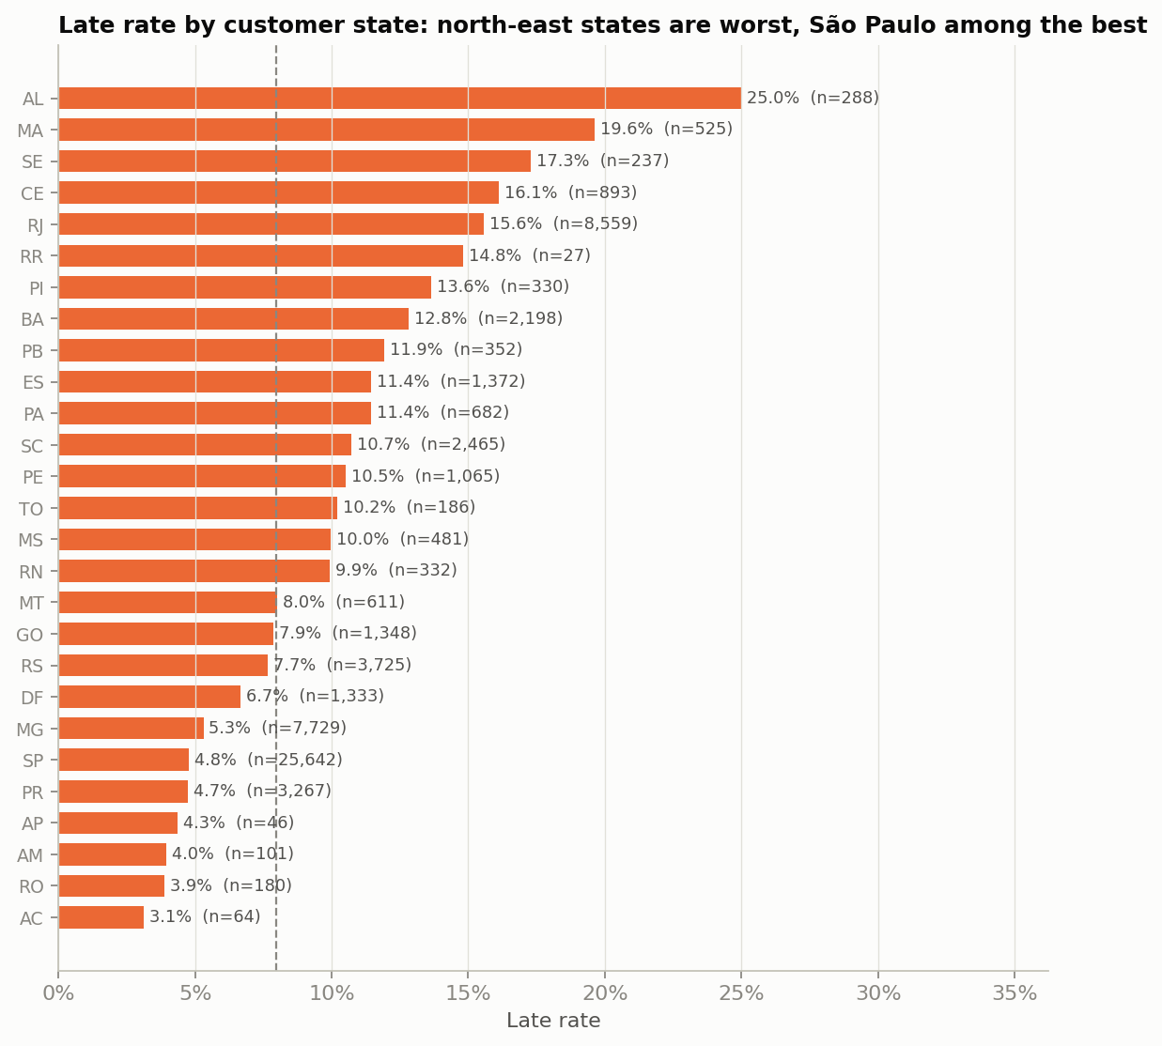
BACKUP · README 2.3
Where the order goes: late rate by customer state
North-eastern states are worst: Alagoas 25.0%, Maranhão 19.6%, Sergipe 17.3%, Ceará 16.1%, vs São Paulo 4.8% (40% of orders).
Rio vs Minas Gerais: 15.6% vs 5.3% late, even though Rio's customers are closer to their sellers and get the same promise.
Customer state is the strongest single feature (AUC 0.633 on its own).
Notes:
Backup: Hasan's state chart, training period only. Regional delivery conditions matter beyond distance.

Slide 19
BACKUP · README 5.1–5.2
Tuning and ensembles: what we tried
Model (cross-validated) | Selected settings | PR-AUC | Lift | Recall top 10%
LR, untuned | C = 1 | 0.158 | 1.81 | 21.5%
LR, tuned | L1, C = 0.157, rare categories < 20 grouped | 0.161 | 1.87 | 22.5%
LR, tuned, no purchase_month (final) | as above | 0.168 | 1.98 | 23.7%
Random forest, tuned, no month | depth 12, ≥ 18 orders per leaf | 0.161 | 1.80 | 20.7%
HistGB, tuned, no month | learning rate 0.014, 395 trees, L2 4.9 | 0.157 | 1.79 | 21.5%
Best ensemble (weighted vote) | 2×LR + RF + HistGB | 0.168 | 1.94 | 23.1%
Rule fixed in advance: a more complex model replaces LR only if it is better on at least 4 of 5 folds and its average gain exceeds one standard error. No ensemble passed. Stacking was not used: time-series folds don't partition the data, so its meta-model would learn from future orders.
Notes:
Backup: tuning and ensemble comparison (README 5.1, 5.2; ensemble numbers from reports/figures/outputs/tasnim_5_2_ensemble_comparison.csv).

Slide 20
BACKUP · README 5.3–5.4
Test results by month, and why scores are a ranking
Test set by month: final model vs B1
8.1% vs 4.1%
Month | Orders | Late rate | Lift: final | Lift: B1
Apr 2018 | 6,798 | 4.5% | 3.85 | 3.31
May 2018 (strike) | 6,743 | 6.6% | 2.32 | 1.88
Jun 2018 | 5,901 | 1.2% | 5.10 | 4.19
Jul 2018 | 1,891 | 3.0% | 2.18 | 2.86
mean predicted risk vs observed late rate on the test set
Use it as a ranking. The model learned from a period with twice the late rate. A cut-off chosen on training data would flag 10.9% of test orders instead of 10%, so flag the top 10% each day and recalibrate if real probabilities are needed.
The final model beats B1 in April and May. June and July each have fewer than 75 late orders, so those comparisons are noisy. May coincides with Brazil's truck drivers' strike, a shock no feature can see.
Notes:
Backup: monthly test results (reports/figures/outputs/tasnim_5_3_monthly.csv) and calibration (README 5.4).

