Slide 1
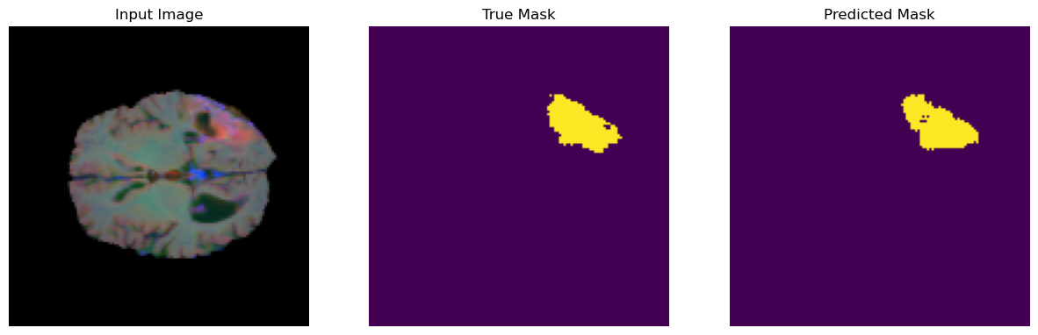
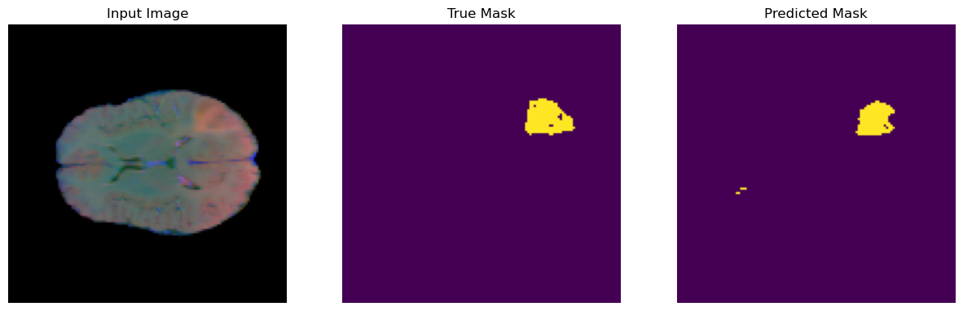
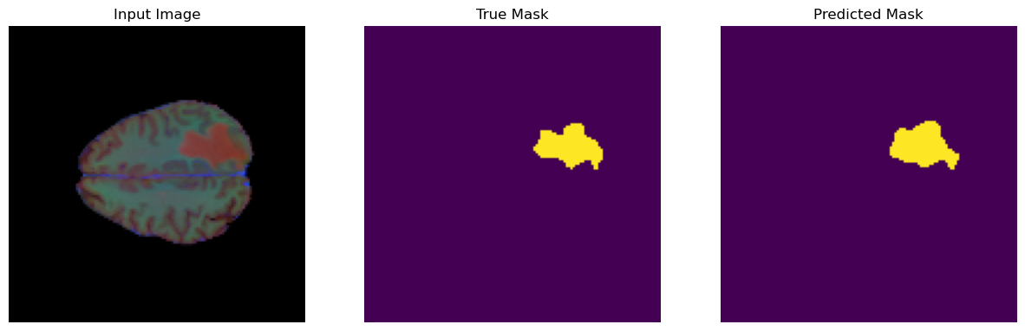
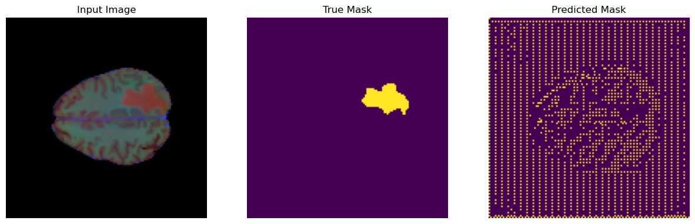
Cross-Modality Consistency Regularisation for Semi-Supervised Learning
Jay Johnston
Notes:
Mention that it is fine to interrupt and ask questions!
Describe what is on the slide!

Slide 2
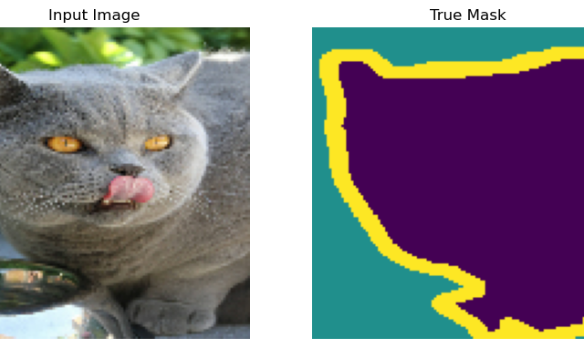
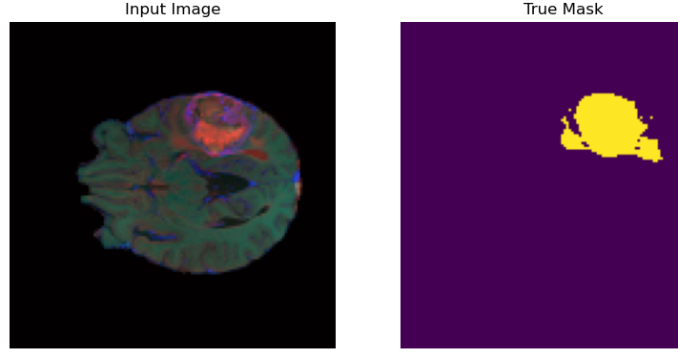
Problem: Image Segmentation
Image segmentation is difficult to program explicitly – often requires manual labour
Important for medical imaging – segmenting tissue scans
A perfect use-case for machine learning
Notes:
Briefly introduce self
Working on image segmentation
Image segmentation refers to the task of assigning regions of pixels in an image to different classes
This could be for things like as computer vision, or in this case, medical imaging, where we want to break a medical scan into pieces with some sort of meaning such as healthy tissue vs tumour tissue

Slide 3
Our Focus – BratS Dataset
Brain Tumour Segmentation (BraTS) dataset – 369 MRI brain scans of patients with glioblastomas
Segmented by specialists into multiple types of tumour tissue
In this work we simplify the segmentation to a binary ‘tumour’ / ‘not tumour’ segmentation, and only use 3 of the 4 available modalities (displayed here as RGB channels)
Notes:
We’ll be looking at a public dataset called the BraTS dataset, which consists of 369 MRI scans of glioblastoma patients
Each scan, or volume, has hundreds of 2D slices, each in 4 modalities that accentuate different features in the brain by using different imaging techniques
All slices have corresponding labels, or ground truth segmentations, made manually
Original dataset distinguishes different parts of the tumour – we convert the dataset to a binary segmentation task to simplify
Will refer to the two classes as ‘foreground’ and ‘background’ or tumour and not tumour
We also only use 3 of the 4 modalities, which are shown in these images as red, green and blue channels

Slide 4
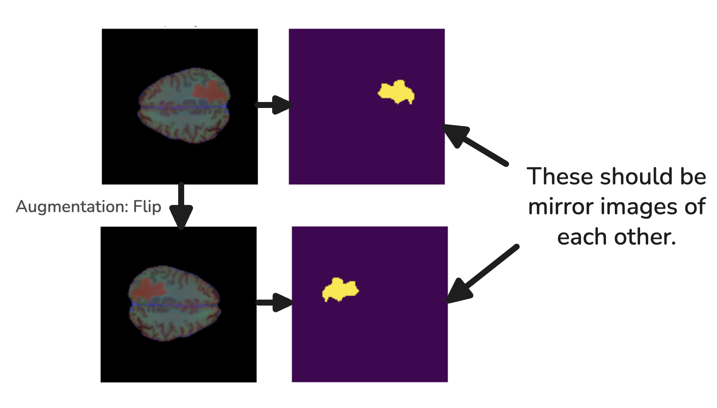
Why Semi-Supervised Learning (SSL)?
Obtaining labelled datasets is difficult, especially in medical image segmentation
Goal – Train a machine learning model on both labelled and unlabelled data
Common methods are:
Pseudo-labelling – use the model to create labels on unlabelled data when the model is confident
Consistency regularisation – encourage the model to give the same output under augmentations to the unlabelled input image
Example of
Consistency Regularisation
Notes:
To apply machine learning, we need training data
Gold standard is labelled data
Unfortunately we cannot always rely on having a large labelled dataset:
Labelling data is time intensive and in the case of medical image segmentation, requires specialists to manually label scans
Unlabelled data is much easier to obtain in very large volumes
We would like a way to use a very large unlabelled dataset in conjunction with a small labelled dataset to train a model
The most common ways of doing this are pseudo-labelling and consistency regularisation
In pseudo-labelling we create artificial labels for unlabelled data using the model
In consistency regularisation we try to encourage the model to give the same output under different augmentations to the input through a consistency loss
A nice analogy is if you are given a problem set in your maths class but they don’t release solutions, you and your friend can try doing the problem in different ways, and if you get the same solution, you can be more confident that it is correct.

Slide 5
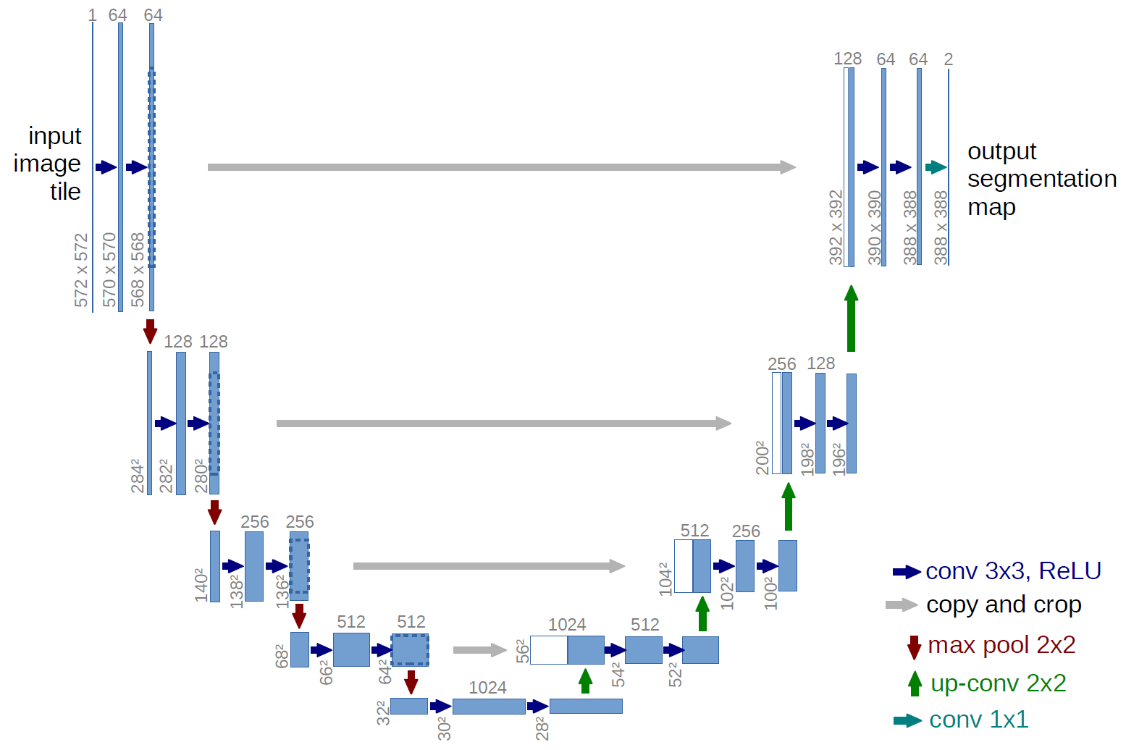
U-Net Architecture & Pretrained networks
Pretrained Weights
Very lightweight without greatly sacrificing performance
Contracting path:
Reduces dimensionality and extracts features
Expanding path:
Reintroduces fine details to produce a detailed segmentation
This work uses pretrained weights in the contracting path from MobileNetV2
Image credit: Olaf Ronneberger, Philipp Fischer & Thomas Brox. (2015)
Notes:
The way that we’ll be doing image segmentation is using a neural network architecture called the U-net.
The U-net is a very popular and lightweight way to apply CNNs to image segmentation problems
We apply convolutions to begin extracting features in a ‘contracting path’
The reduction in the dimension of information as it passes through forces the network to learn high level features rather than overfitting to the training set
An expanding path then upsamples this, and concatenates the earlier layers through skip connections to reintroduce finer details to give a high quality segmentation
In this work, we initialise the weights in the contracting path with weights from an existing image classification network, MobileNetV2
Takes less time to train the network
Mention existence of appendix!

Slide 6
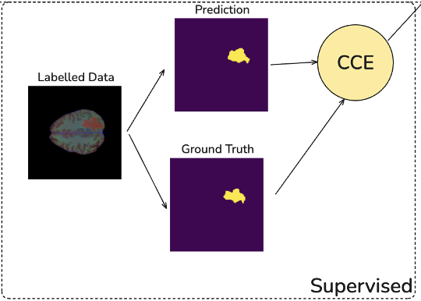
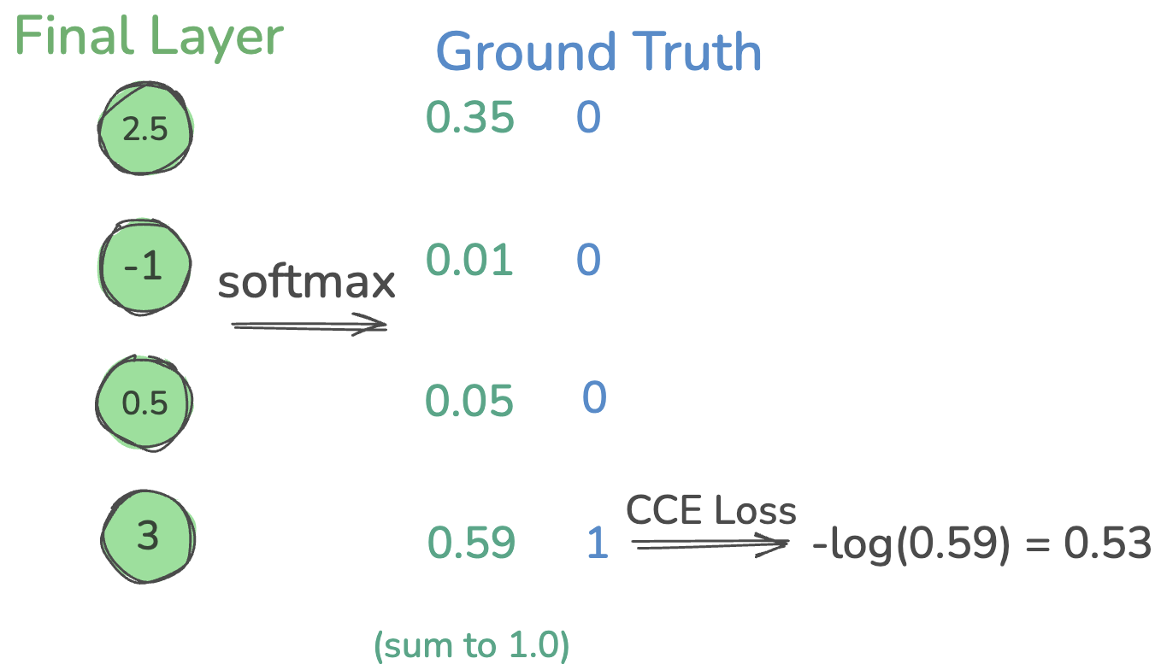
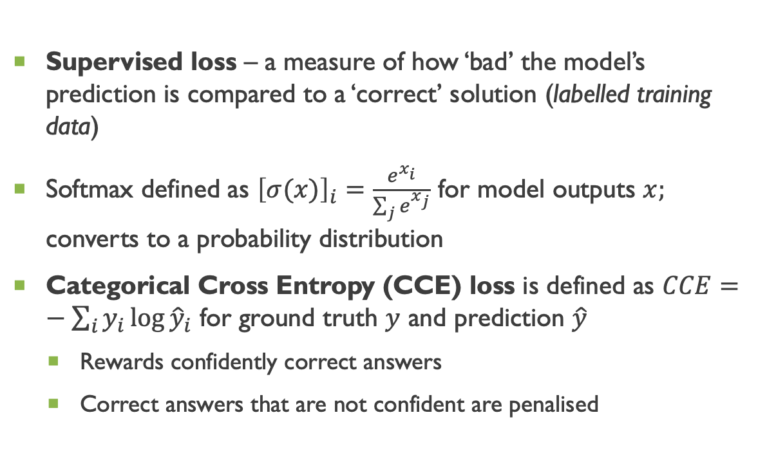
Training U-Nets - Supervised Learning
Supervised loss – a measure of how ‘bad’ the model’s prediction is compared to a ‘correct’ solution (labelled training data)
Softmax defined as ${\left[σ(x)\right]}_{i}=\frac{e^{x_{i}}}{\sum_{j}{e^{x_{j}}}}$ for model outputs $x;$ converts to a probability distribution
Categorical Cross Entropy (CCE) loss is defined as $CCE=−\sum_{i}{y_{i}\log{{\hat{y}}_{i}}}$ for ground truth $y$ and prediction $\hat{y}$
Rewards confidently correct answers
Correct answers that are not confident are penalised
Notes:
The standard way to train this network is by defining a supervised loss, where we measure how bad the model’s prediction is on some labelled training data
For each pixel, the U-net gives values for each class, with higher value indicating higher confidence in that class
We convert these values to a probability distribution via softmax, defined as shown
Softmax outputs are then compared to a ground truth distribution by the categorical cross-entropy loss
This loss function is very popular for classification problems as it penalises unconfident answers, even if it turns out to be correct
The goal of training is to minimise this loss

Slide 7
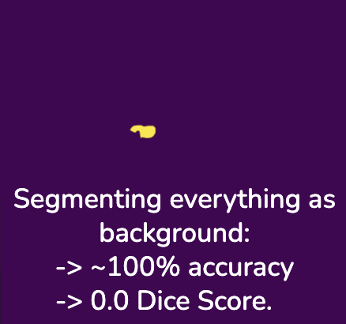
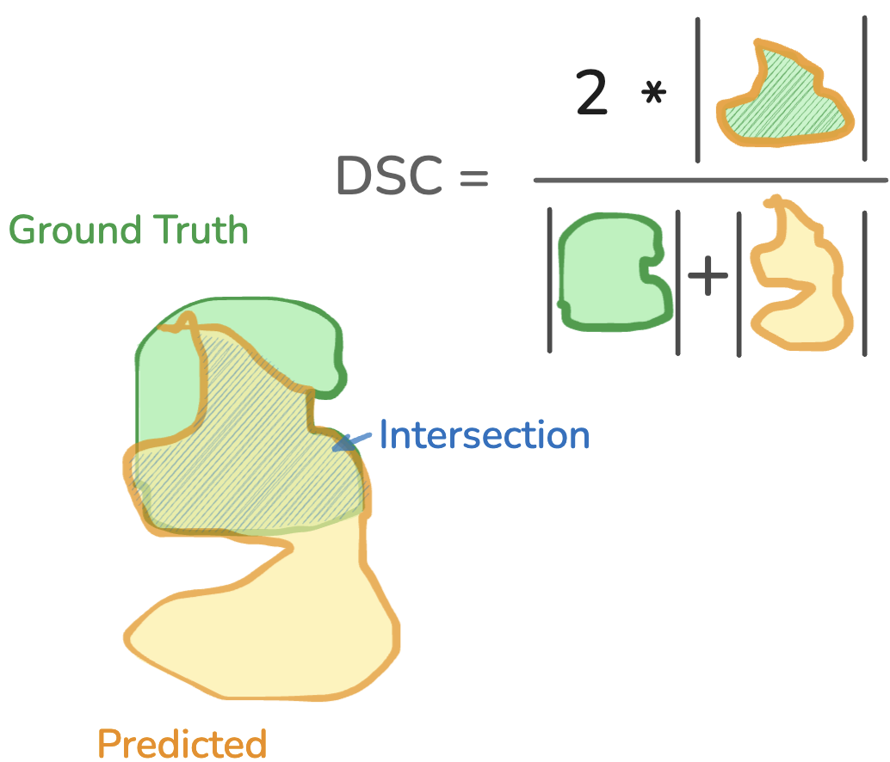

Evaluating Segmentations: The Dice Metric & Dice Loss
An easy metric for the quality of a segmentation is accuracy; what proportion of the pixels are segmented correctly
This means that small segmented regions don’t contribute significantly to our metric
The Dice metric is a widely popular metric for image segmentation
Small foreground regions now contribute highly to the metric
The (Soft) Dice loss is a generalisation of this to work on probability distributions on classes, and is (roughly) $1−$ Dice score
Notes:
- We need a way to evaluate how good a segmentation is given the ground truth segmentation
A simple way would be to calculate the proportion of correctly segmented pixels, but this runs into problems
If the foreground is small compared to the background, then the model can get very high accuracy by simply segmenting everything as background
This is addressed by the Dice metric
Ratio of correctly segmented foreground pixels to total foreground pixels in both prediction and ground truth
Ranges from 0 to 1 – segmenting all background will now give the worst score of zero, and a perfect seg only will give 1
On a related note, we can also define the soft dice loss, which is essentially one minus the dice score, but is also generalised to work on probability distributions on segmentation classes

Slide 8
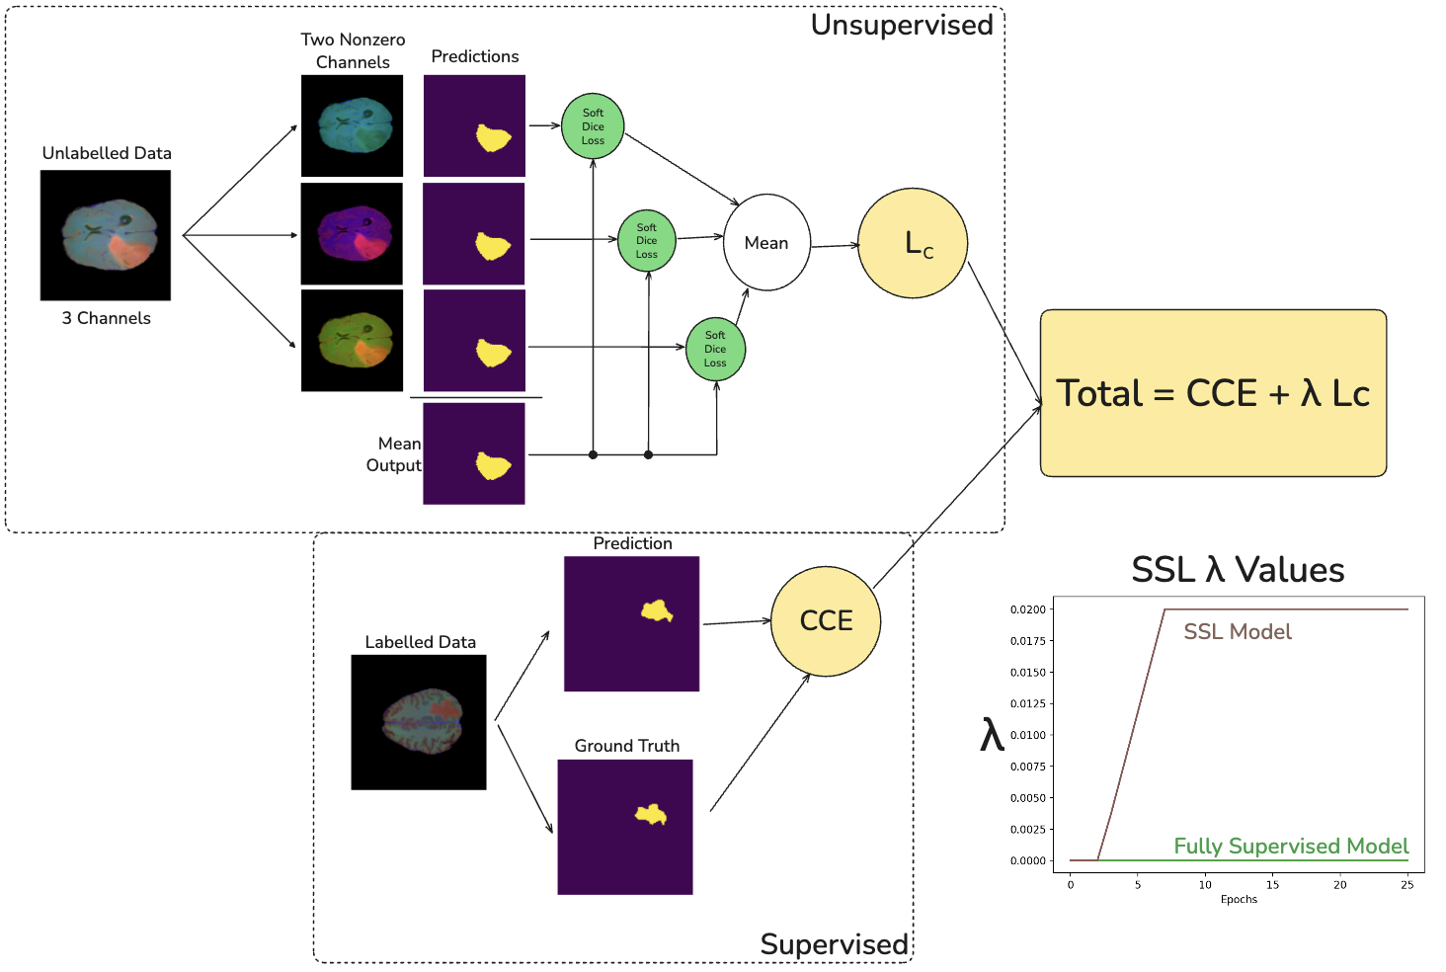

The Focus of this Work - Custom Consistency Loss
(To our knowledge) a novel approach to consistency regularisation in multimodal data
Enforce consistency between model predictions when different modalities are zeroed out
Soft Dice Loss: $SDL(\hat{p},p)=1−\frac{2\sum_{i}{p_{i}⋅{\hat{p}}_{i}}}{\sum_{i}{p_{i}}+\sum_{i}{{\hat{p}}_{i}}},$ where $p,\hat{p}$ are softmax outputs.
Encourage the model to use information from all modalities
Requires a weight schedule $L_{total}=CCE+λL_{c}$
Notes:
The focus of my project has been to implement an unsupervised consistency loss leveraging the multimodal information available in the BraTS dataset
The core observation leading to this approach is that a perfect algorithm should be able to produce the correct segmentation even if some of the modalities are missing.
Then for an unlabelled slice with 3 modalities, we produce 3 predictions, each with one modality missing.
Connect to colours
Then we take the mean softmax output, and for each of the predictions compute the soft dice loss with the mean output
These three losses are averaged to give a final consistency loss, which represents how similar these predictions are
To minimise this loss is to tell the network to try really hard to use all three modalities rather than becoming dependent on just one of them
Importantly, we do this with lots of unlabelled data, so the model is able to ‘see’ a better representation of what brain tumours look like
This loss is meaningless at first – the model must first be able to produce slightly reasonable predictions
We introduce a weight schedule
We begin by training the model in a fully supervised fashion, then ramp up the contribution of the unsupervised loss to the total loss as training progresses

Slide 9
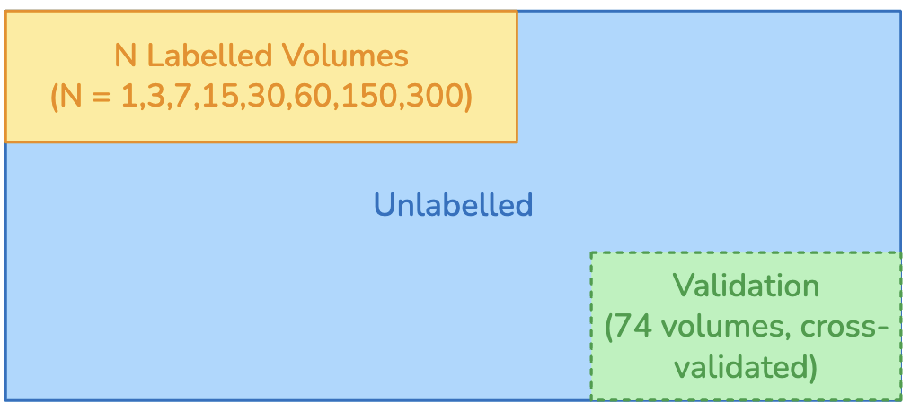
Comparing Supervised and Semi-Supervised Learning
Trained the model with 1, 3, 7, 15, 30, 60, 150 and 300 labelled volumes, each multiple times, with and without SSL
Use validation datasets – the model never uses data from these volumes to train
Notes:
We need a way to see if SSL is worth doing.
We select a small number of training volumes to be our labelled dataset
I ran this test with 1, 3, 7, 15, 30, 60, 150 and 300 labelled volumes to cover a few orders of magnitude
We also select some validation volumes, which the model will never use to train itself
These are used to gauge the model’s performance throughout training
The rest is unlabelled data – which is only used by the SSL model
Then, if we have, say, 15 labelled volumes, we train a fully-supervised model on those 15 labelled volumes a bunch of times
Then, train a model with SSL on those 15 labelled volumes with the rest of the dataset unlabelled a bunch of times

Slide 10
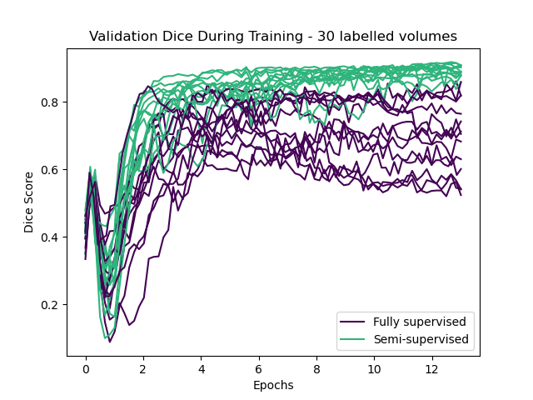
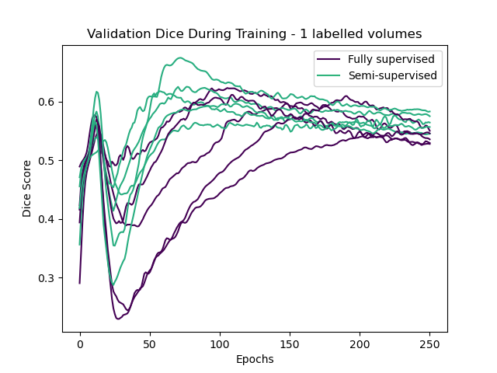
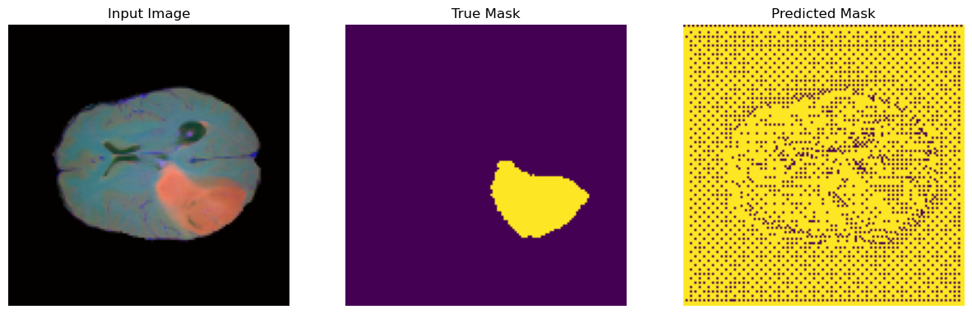
features seen During Training
In some cases, the model was run multiple times to collect more data – not done for all tests due to time limitations
Overfitting visible as Dice score dropping in later epochs
Fully supervised model begins overfitting more quickly (except when labelled set is extremely small)
Dice score initially drops rapidly
A result of using pretrained weights – the model initially gets worse as it ‘unlearns’ certain features
SSL stability
The performance of the model over multiple runs is much more consistent with SSL – likely because the total dataset is larger
Notes:
Onto results –
First thing to note: due to limitations in time and computation, I collected more data in some cases, but this is reflected in the statistical analysis of the results
The plots at the top are the dice score on validation data as the model trains, so we can see that the lines trend upwards and remain between 0 and 1, so the model is in fact learning something!
Elaborate what the plots are showing first!
We can see, especially in the purple line here, which is the fully supervised model, and all the training runs on the right, that the dice score begins to drop off after reaching an optimum
This is because the model begins to overfit, where it essentially starts to just memorise the training data to reduce the loss instead of learning general patterns – and this is a common limitation we encounter when working with small datasets
We can also see a really steep drop initially – this is because the model starts with some pretrained weights that lead to the initial segmentation picking up some features and on average giving a 50-50 segmentation. The model then has to unlearn some features in the contracting path and oftentimes will segment everything as background momentarily, which leads to this dip
We also see that the models with SSL converge to each other, and appear to be more stable during training, as well as being more resistant to overfitting. Fully supervised models sometimes do poorly and cannot recover

Slide 11
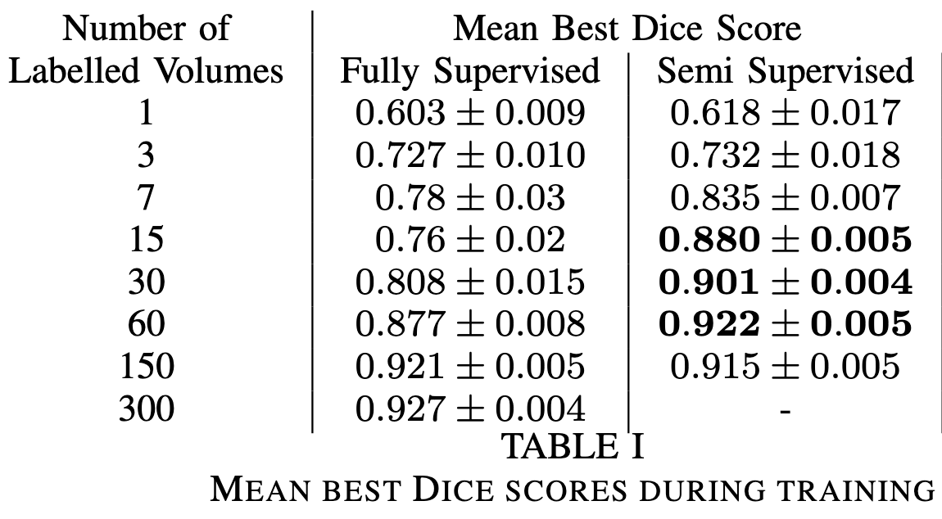
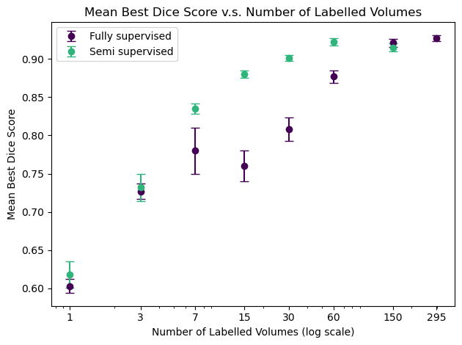
Results – Performance Improvements
When the labelled proportion is very small or very large, SSL has no significant benefit
For labelled proportions of 5%-20%, SSL showed an improvement in Dice score (p < 0.0003)
SSL with 20% of dataset labelled achieves similar performance to fully-supervised on 100% of dataset.
Notes:
The main results:
The general metric I used for comparing the SSL model to the fully supervised model was the mean best dice score
Go to previous slide
When we have extremely small labelled datasets – less than 1% - SSL and fully supervised perform about the same
Going back to a point I made earlier, this is because the labelled dataset is too small to give reasonable predictions – the consistency loss becomes meaningless
We also see that when more than half of the dataset is labelled, the improvement from SSL again disappears
This is because fully supervised learning actually works quite well when we have this many labelled volumes, and in the limiting case of 100% of the dataset, SSL and fully supervised end up being the same algorithm so we certainly expect the same performance
But this regime is not really relevant to our problem because we are interested in training networks on very small amounts of labelled data
This is fairly typical to see in semi-supervised learning
We have a very statistically significant improvement in performance when 5-20% of the dataset is labelled, accompanied by some fairly large increases in dice score
For 15 labelled volumes, we have an improvement of 0.12 in dice score
fully-supervised model with all data labelled reaches 0.927 mean best Dice score, and we can achieve 0.922 with the SSL algorithm with only 20% of the dataset labelled

Slide 12
Conclusion & Further Work
Consistency regularisation between modalities is a viable way to include unlabelled data during training!
SSL with moderately small (~20%) proportions of the labelled dataset can rival fully supervised learning on the entire dataset
Yet to be seen:
Whether this improvement holds up for more complicated tasks
Whether this will still improve performance when combined with existing methods
Notes:
To conclude:
We find that consistency regularisation between modalities is a viable way to include unlabelled data during training
As a caveat here, this requires the modalities to correlated, which is to say that the scans need to be aligned so that we can reasonably expect the same segmentation to be produced by each of them individually
We also find that applying the SSL method described here to datasets with as little as 20% of the data labelled can rival fully supervised learning with the entire dataset labelled
Its important to note that the fully supervised model that we compared against here was very bare bones – there are many improvements that could be made to the model to improve its performance
We would hope that these improvements can be applied to both the SSL model and fully supervised model, and that the improvement described here remains after making these modifications – this is further work
We also made many simplifications to the task for the sake of providing a proof of concept – further work should study the viability of applying this method to more complicated image segmentation tasks.
Questions?

Slide 13
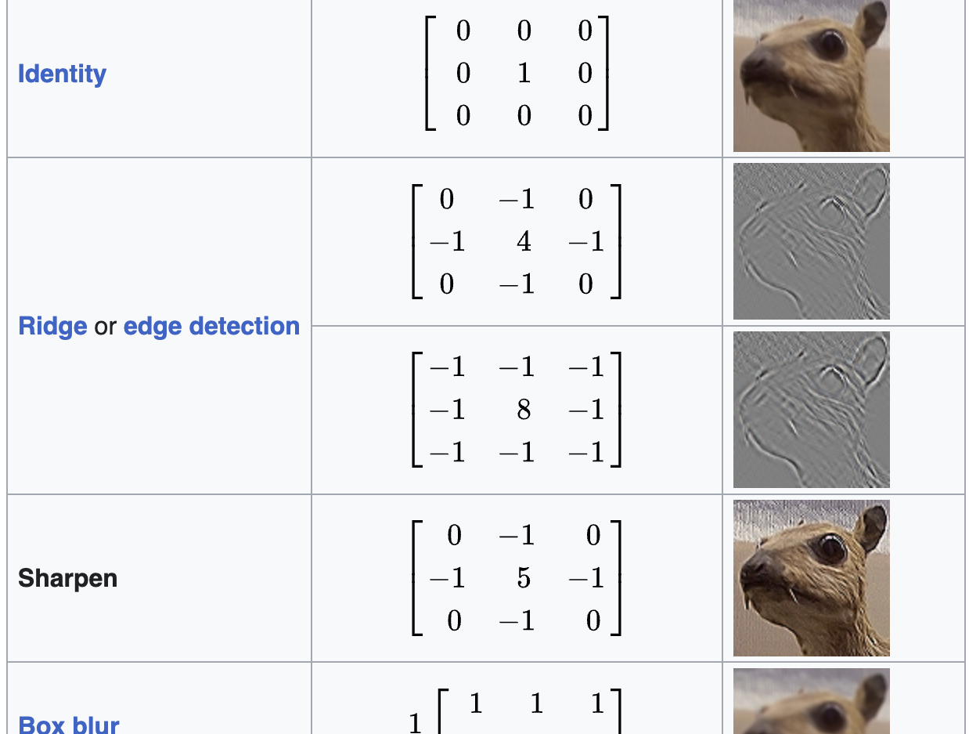
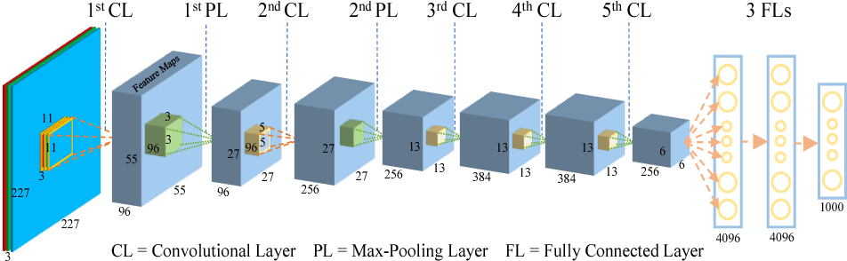
APPENDIX: Convolutional Neural Networks (CNNs)
Image credit: Wikipedia. (2025)
Image credit: Zhuwei Qin, Fuxun Yu, Chenchen Liu, & Xiang Chen. (2018)
Used for tasks involving images
Model optimizes the convolution kernels
Dimension of image information usually progressively reduced throughout the network to extract high-level features
CNNs have less weights than other methods
Notes:
typical way of applying machine learning to image tasks is via convolutions
We assume that the image exhibits local continuity in pixels
You can’t just encode any problem as a random looking image and expect CNNs to work
Convolutions are an operation between a kernel, which our machine learning model will learn, and an image
These are applied to different parts of the image in the same way – assumes that the task is applied similarly across the image
Uses much less weights than other methods – less worried about overfitting
CNNs use successive convolutions to extract the high-level features of an image
Between successive convolutions, we reduce the dimension of the image (pooling layer)
Later convolutions are acting on information from a larger window of the original image to obtain higher level features

Slide 14
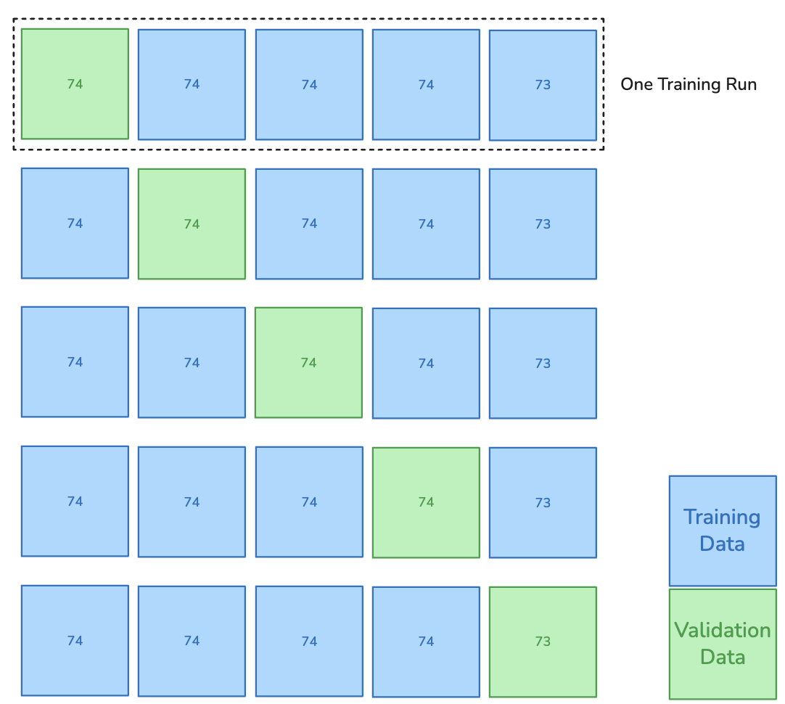
Appendix: k-Fold Cross-Validation
The 369 volumes are shuffled and split into 4 groups of 74 and one remaining group of 73
The model was trained 5 times – once with each as the validation dataset, and the remaining as the training datasets
Within the training dataset, a small number of volumes are kept as labelled data, and the labels are removed the remaining volumes.
Notes:
To collect data, we first split the 369 volumes into 5 groups, and trained the model 5 times with eac of these groups designated the validation dataset exactly once
Validation data is never used to train the model, so the model wont overfit to it and we can use it gauge performance during training via the Dice metric
Training loop
This whole process is done with and without SSL, and for varying numbers of labelled volumes

Slide 15
Appendix: Training
Training loop:
Instantiate the model with pretrained weights in the contracting path and random weights in the expanding path
Take a batch of labelled data and produce predictions, and take a batch of unlabelled data (each batch taken from the training dataset)
Compute the total loss (supervised + unsupervised with weight schedule)
Update model parameters by computing the gradient of the total loss
At regular intervals, compute the mean Dice score on the validation dataset; stop training once this stops increasing

