Slide 1

Group 9: Simple guys
P-Hack

Slide 2
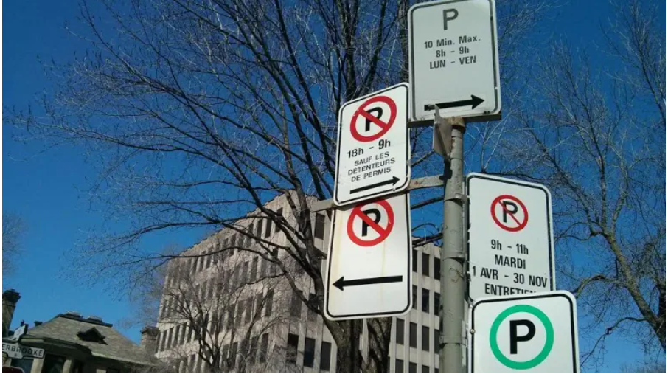

Slide 3
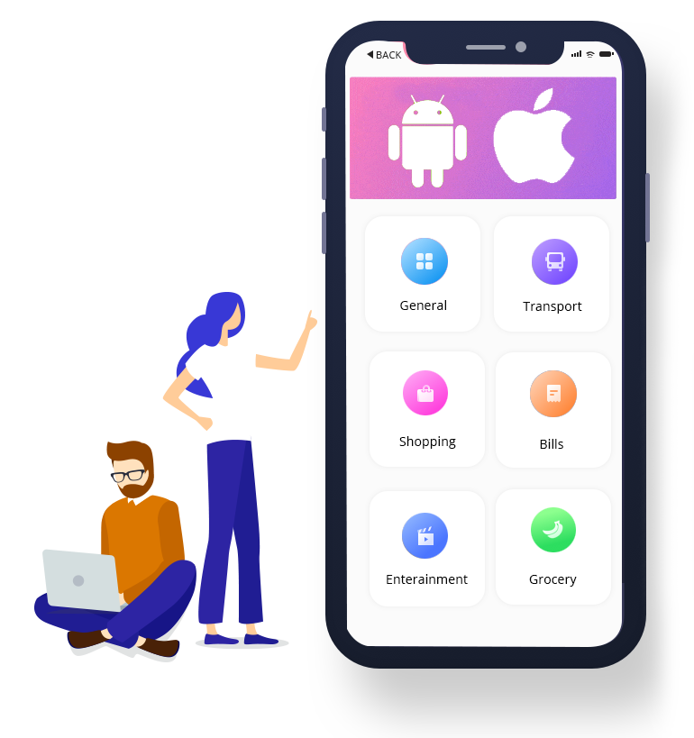
PARKmeHere!
Make the simple be the different

Slide 4
Introduction
- Problem
-Target user
-Solution
-Future add-up feature
-Showing the code

Slide 5
Problem
Interms of business owners: Not enough parking lot ( or even don’t have)
-> would like to have more spaces
-> would like to attract more customers
Interms of customers: Afraid of finding a parking lot
-> finding the easiest way to park
-> avoiding the parking ticket
-> would like to save time

Slide 6


Target user

Slide 7
Solution
Providing the application can solve the parking issue:
- Giving recommendations for where to park ( based on 2 criterias: distance, price)
- Giving the parking information (duration parking available)
- Having the notification be for the parking time expire

Slide 8
Future add-up features
- Giving the recommendation about the priority Route in winter.
- Giving the recommendation avoiding the construction.
- Recommend the accessible Pedestrian Traffic Signals.
Creating communication bridge between business owners and the customers
-

Slide 9

Stop talking!
Show me HOW DOES IT WORK?

Slide 10
How could we do it?
Source of data:
- On-Street Parking Rates
( https://data.calgary.ca/dataset/On-Street-Parking-Rates/pda2-cfwb/data)
- On-Street Parking Zones
(https://data.calgary.ca/Transportation-Transit/On-Street-Parking-Zones/g33j-xi2h )
- Snow and Ice Clearing Priority Routes Map
(https://data.calgary.ca/Health-and-Safety/Snow-and-Ice-Clearing-Priority-Routes-Map/fuea-eg5z )
-Accessible Pedestrian Traffic Signals
(https://data.calgary.ca/Health-and-Safety/Accessible-Pedestrian-Traffic-Signals/cqiv-q7en )
-Calgary Business Licences:
( https://data.calgary.ca/Business-and-Economic-Activity/Calgary-Business-Licences/vdjc-pybd)

Slide 11

THANK YOU FOR LISTENING

