Slide 1
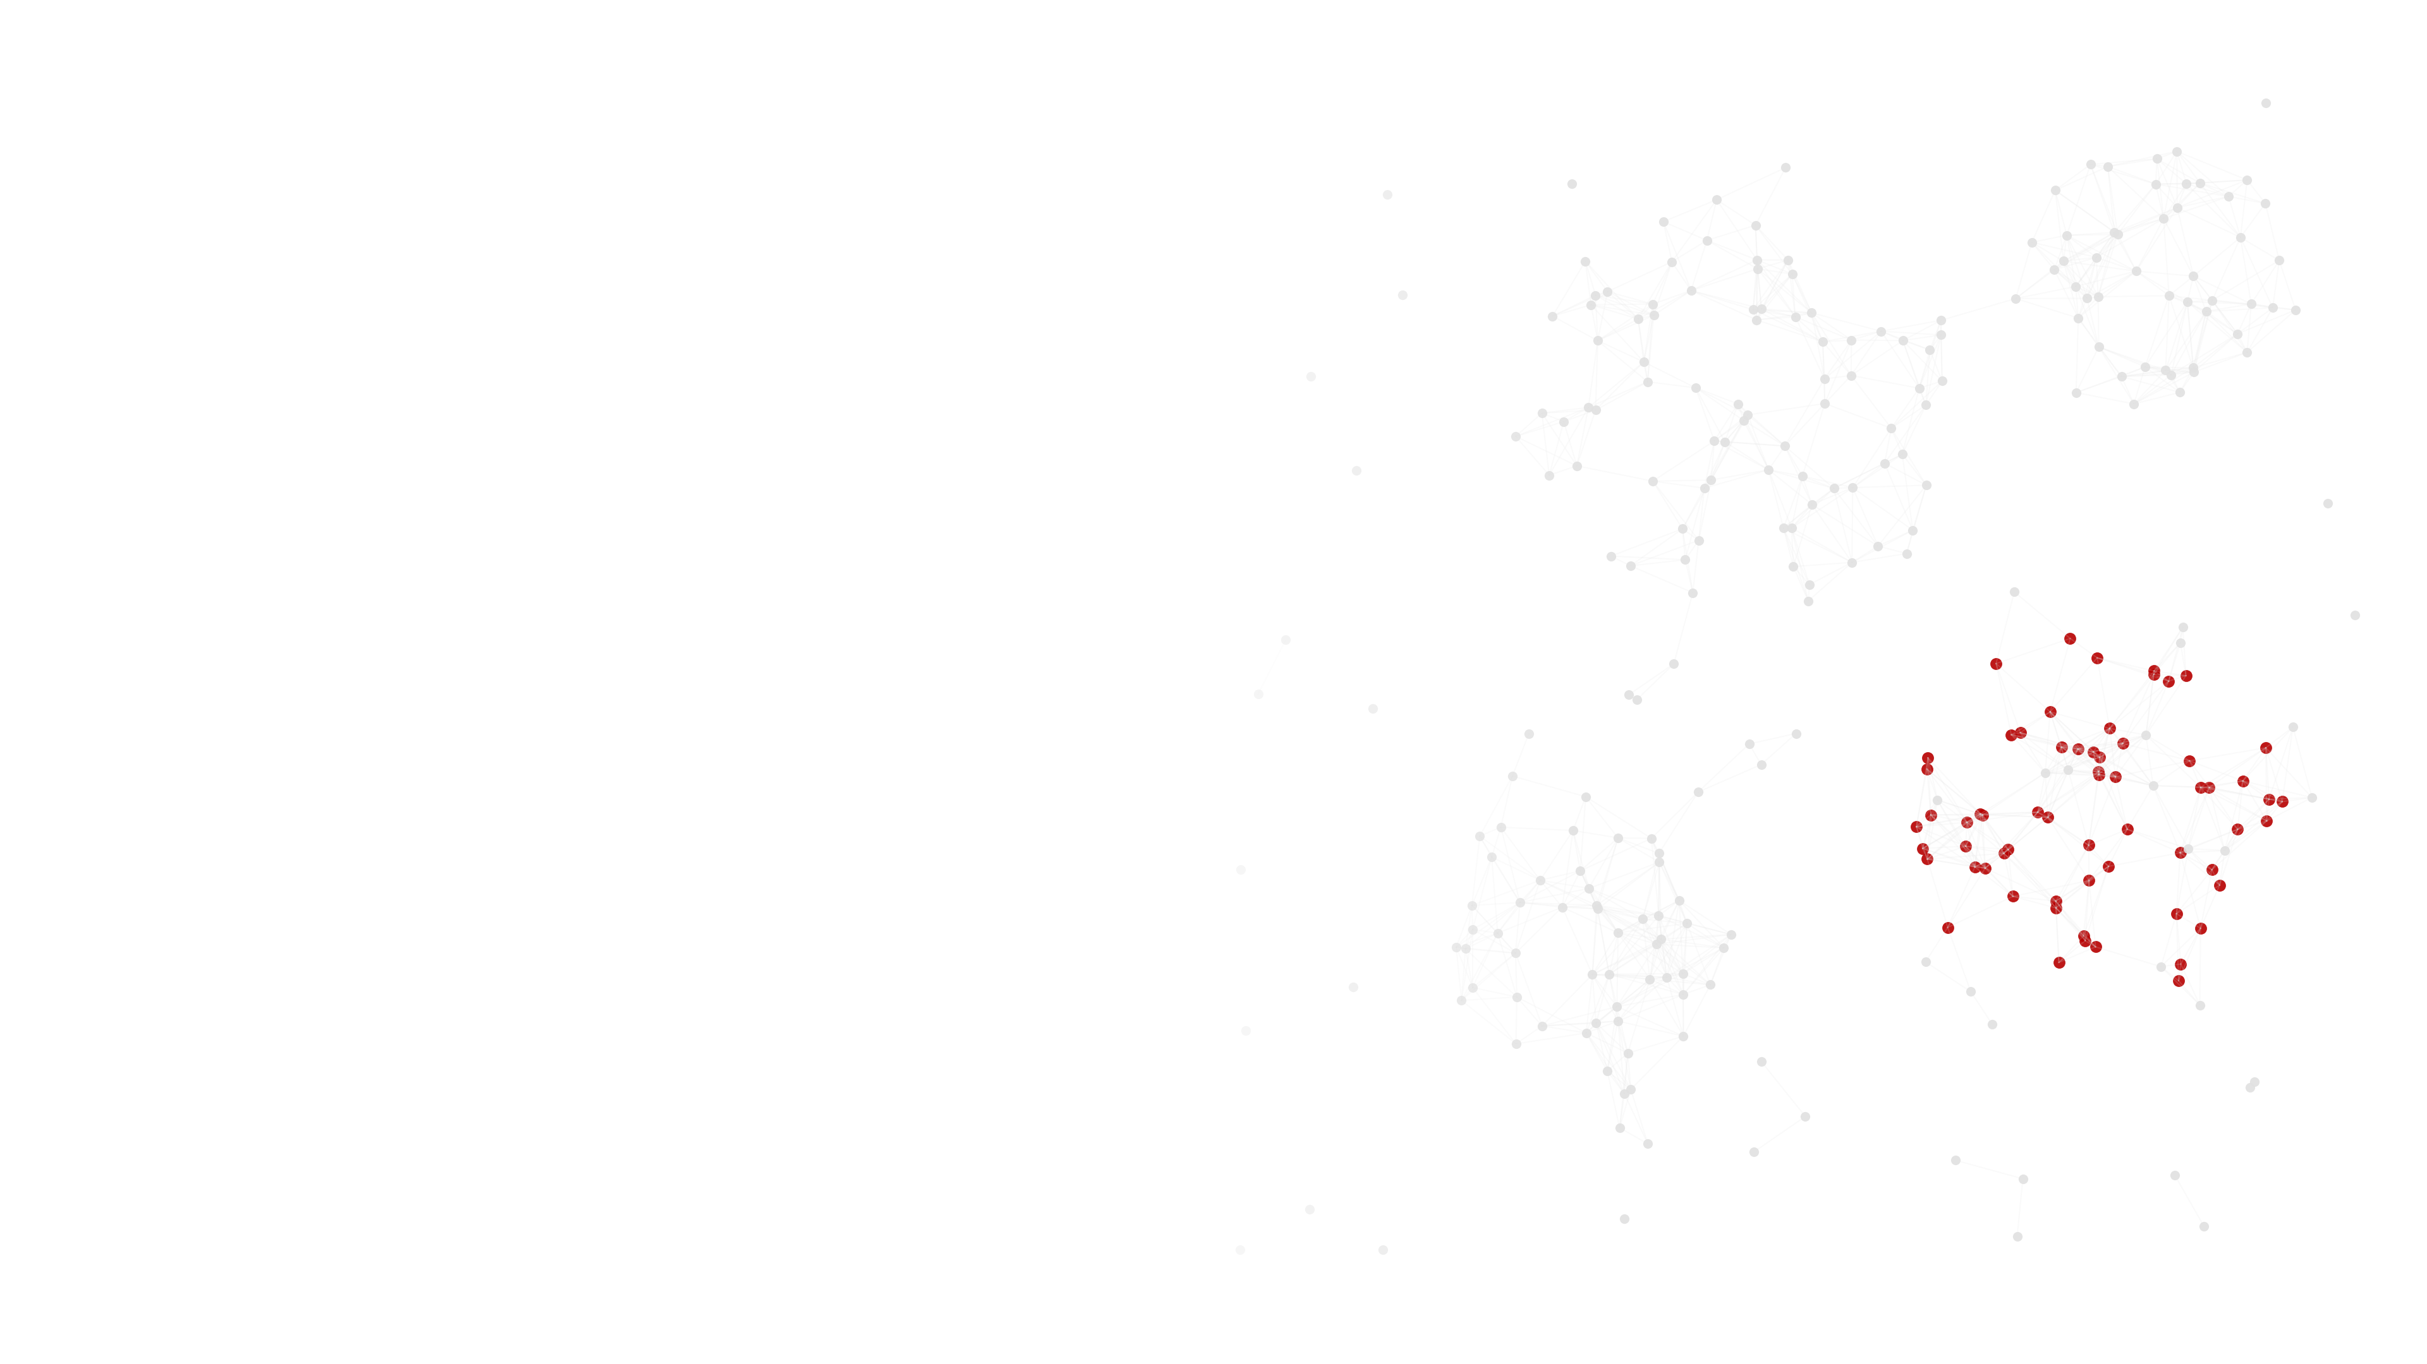

INGROUP METHOD SEMINAR · OCTOBER 2026
Agent-Based Modeling for
Group and Team Research
Justin M. Jones, Ph.D.
National Counterterrorism Innovation, Technology, and Education Center (NCITE)
University of Nebraska at Omaha
Notes:
[Target: 20s] Welcome attendees as they join. State the title and affiliation once the room has settled, and note that slides will be shared afterward along with the code repository, so no one needs to transcribe anything during the live demonstrations.

Slide 2

ROADMAP
Ninety minutes, four moves, one model
9:00
9:12
9:20
10:00
10:12
Reframe
Anatomy
Build & sweep
Standards & limits
Discussion
ABM as a data generating process; the theory-method mismatch it addresses
Agents, rules, environment, time, and stochasticity as formalized verbal theory
One model, four stages, live; a parameter sweep as a factorial design
Verification, validation, ODD, and the honest critique of simulation
Eighteen minutes on your own designs, seeded by three questions sent in advance
INGroup Method Seminar ● tick 02
Notes:
[Target: 30s] Walk through the five blocks at a glance without reading every word on screen. Flag up front that the same model gets built incrementally across the build-and-sweep block, so attendees are not tracking four unrelated demos.

Slide 3
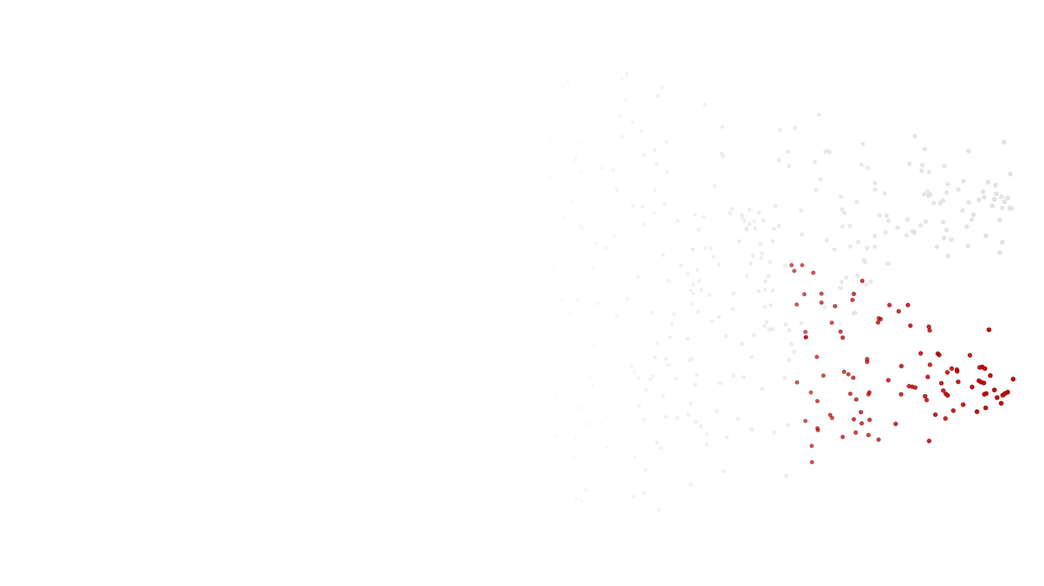
01
PART 01 · REFRAME
ABM as a data generating process
Why group and team theories describe processes that single-shot designs cannot observe.
INGroup Method Seminar ● tick 03
Notes:
[Target: 5s] Section break. One sentence: we start with the mismatch between the theories this room writes and the designs it runs.

Slide 4
REFRAME · 1 OF 5
Your theories describe emergence.
Your designs can't observe it happening.
Group and team theory: bottom-up, path-dependent, order-sensitive constructs that arise from interaction over time.
Cross-sectional survey, single-shot experiment: static, order-blind snapshots that can only observe emergence's residue.
INGroup Method Seminar ● tick 04
Notes:
[Target: 90s] Name this tension directly, using language attendees already use in their own papers: emergence, bottom-up processes, path dependence. Point out that almost none of that language survives contact with a cross-sectional design, and that this gap, not a general enthusiasm for computation, is the reason to spend ninety minutes on ABM.

Slide 5
REFRAME · 2 OF 5
What you already know, applied downstream
A parameter sweep
is a factorial design
A bank of replications
is a set of Monte Carlo draws
Simulated output
is analyzed like survey or experimental data
An agent-based model
is a data generating process
INGroup Method Seminar ● tick 05
Notes:
[Target: 60s] Move through the mapping quickly, letting the last row land as the session's organizing claim stated plainly for the first time on screen. Everything for the next seventy minutes elaborates this one idea.

Slide 6
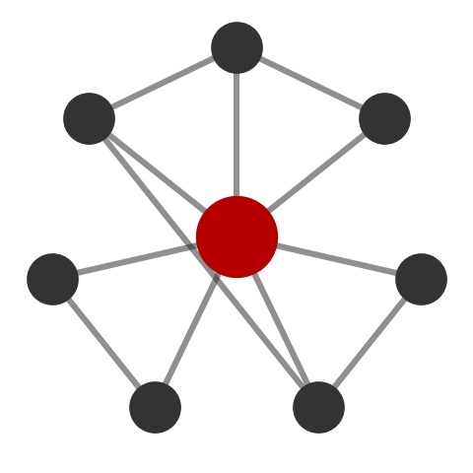
REFRAME · 3 OF 5 · EXEMPLAR
Epstein (1999)
Epstein, J. M. (1999). Agent-based computational models and generative social science. Complexity, 4(5), 41-60.
WHAT THIS STUDY SHOWED
Demonstrated that macro-level social regularities can be generated from simple, stated micro-rules, which neither pure induction from data nor pure deduction from axioms can show in the same way: the model has to actually produce the pattern, not just be consistent with it.
INGroup Method Seminar ● tick 06
Notes:
[Target: 45s] This is the foundational citation for the whole session's logic and was on the pre-reading, so treat it as a callback rather than new material.

Slide 7
REFRAME · 4 OF 5 · EXEMPLAR
Kozlowski et al. (2013)
Kozlowski, S. W. J., Chao, G. T., Grand, J. A., Braun, M. T., & Kuljanin, G. (2013). Advancing multilevel research design: Capturing the dynamics of emergence. Organizational Research Methods, 16(4), 581-615. (ORM Best Paper, 2013.)
WHAT THIS STUDY SHOWED
Proposed a research paradigm connecting theory, computational modeling, and data analysis so that emergence is examined directly as it unfolds, rather than inferred after the fact from the construct validity of a higher-level measure.
INGroup Method Seminar ● tick 07
Notes:
[Target: 60s] This paper is written by people this audience already reads, in the audience's own journal, making the same argument the session has just made. Let that land as corroboration rather than repetition.

Slide 8
REFRAME · 5 OF 5 · EXEMPLAR
Kozlowski et al. (2016)
Kozlowski, S. W. J., Chao, G. T., Grand, J. A., Braun, M. T., & Kuljanin, G. (2016). Capturing the multilevel dynamics of emergence: Computational modeling, simulation, and virtual experimentation. Organizational Psychology Review, 6(1), 3-33.
WHAT THIS STUDY SHOWED
Laid out computational modeling, agent-based simulation, and virtual experimentation as a working strategy for studying emergence in teams, treating the simulation as a laboratory in which an emergent process can be manipulated and watched directly.
INGroup Method Seminar ● tick 08
Notes:
[Target: 45s] This is the same group's applied follow-through on the 2013 paradigm paper, and it sets up Grand et al. (2016) in the anatomy block, which is the model this program produced. Verify the one-sentence summary against the abstract before presenting.

Slide 9
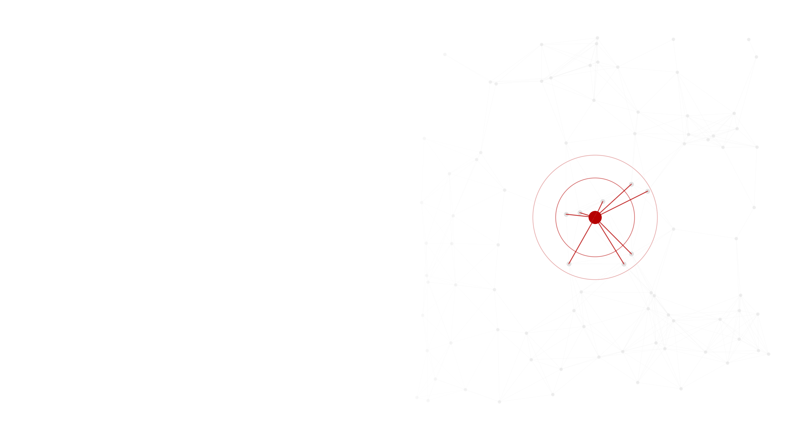
02
PART 02 · ANATOMY
What a model has to say out loud
Agents, attributes, rules, environment, time, and stochasticity as formalized verbal theory.
INGroup Method Seminar ● tick 09
Notes:
[Target: 5s] Section break. The red agent is the unit of analysis; everything else on the slide is what a model has to specify about it.

Slide 10
ANATOMY · 1 OF 5
Six things every model has
1
2
3
Agents
Attributes
Rules
who is acting
what varies across them
how they interact
4
5
6
Environment
Time
Stochasticity
what they act within
how the process unfolds
what is left to chance
INGroup Method Seminar ● tick 10
Notes:
[Target: 60s] State plainly that none of these six is exotic. Every one of them is a decision attendees make, at least implicitly, whenever they write a specific theoretical claim rather than a vague one.

Slide 11
ANATOMY · 2 OF 5
You have been half-specifying models all along
“Members with higher status exert more influence during disagreement.”
Agent attribute
status
Interaction rule
influence weighted by relative status during disagreement
Environment (implied)
a group in which disagreement occurs
INGroup Method Seminar ● tick 11
Notes:
[Target: 75s] Walk the sentence apart live. This example is drawn loosely from process-oriented theories of team knowledge emergence such as Grand and colleagues' work, cited on the next slide, where the theoretical claim already implies most of a model's components before anyone writes a line of code.

Slide 12
ANATOMY · 3 OF 5 · EXEMPLAR
Grand et al. (2016)
Grand, J. A., Braun, M. T., Kuljanin, G., Kozlowski, S. W. J., & Chao, G. T. (2016). The dynamics of team cognition: A process-oriented theory of knowledge emergence in teams. Journal of Applied Psychology, 101(10), 1353-1385.
WHAT THIS STUDY SHOWED
Advanced and computationally tested a process-oriented theory of how collectively held team knowledge emerges over time from individual-level cognition, directly addressing team cognition theory's tendency to remain static despite describing an inherently dynamic process.
INGroup Method Seminar ● tick 12
Notes:
[Target: 45s] Point back to the previous slide's worked example; this is the kind of theory that example was standing in for, made concrete and computational.

Slide 13
ANATOMY · 4 OF 5 · EXEMPLAR
Dionne et al. (2010)
Dionne, S. D., Sayama, H., Hao, C., & Bush, B. J. (2010). The role of leadership in shared mental model convergence and team performance improvement: An agent-based computational model. The Leadership Quarterly, 21(6), 1035-1049.
WHAT THIS STUDY SHOWED
Modeled leadership structure as the team's communication network: participative leadership connected everyone, while leader-member exchange connected an in-group and tied the out-group only to the leader. Participative structures converged mental models more, but improved performance only when expertise was diverse and mutual interest was strong.
INGroup Method Seminar ● tick 13
Notes:
[Target: 50s] Read this as the six-part anatomy in a published teams model: members are the agents, expertise and interest are attributes, opinion sharing and evaluation are the rules, and the leadership network is the environment. It also previews Stage 4, where network structure becomes a parameter.

Slide 14
ANATOMY · 5 OF 5 · EXEMPLAR
Vancouver & Weinhardt (2012)
Vancouver, J. B., & Weinhardt, J. M. (2012). Modeling the mind and the milieu: Computational modeling for micro-level organizational researchers. Organizational Research Methods, 15(4), 602-623.
WHAT THIS STUDY SHOWED
Showed that translating an existing verbal micro-level theory into a computational model routinely exposes internal contradictions and unstated assumptions that verbal reasoning alone does not surface, even for well-established theories.
INGroup Method Seminar ● tick 14
Notes:
[Target: 60s] Bridge line into the live build: the fastest way to find out whether a favorite theory actually holds together is to try to write it down precisely enough for a machine to run it, which is exactly what happens for the next forty minutes.

Slide 15
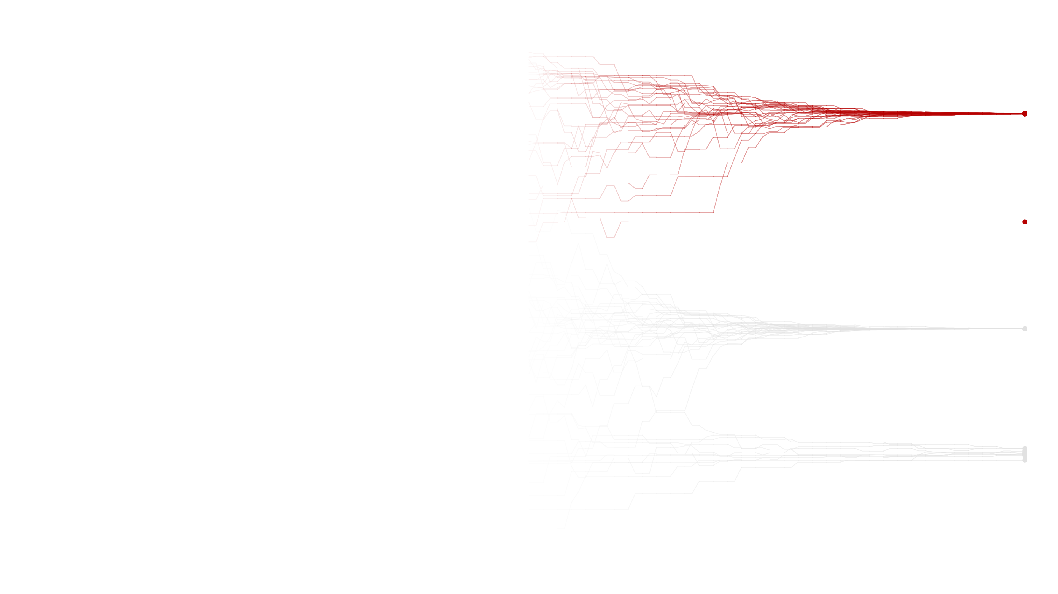
03
PART 03 · BUILD & SWEEP
One model, four stages
A bounded-confidence model built live, then swept like a factorial design.
INGroup Method Seminar ● tick 15
Notes:
[Target: 5s] Section break before the live build. Switch screens to NetLogo after the next slide.

Slide 16
LIVE BUILD · STAGE 1
Full mixing, unconditional convergence
Baseline: every pair that meets moves toward each other. No threshold yet.
stage1.nlogo Interface Info Code
EXPECTED
to go
ask turtles [
let partner one-of other turtles
let m (opinion + [opinion] of partner) / 2
set opinion m
ask partner [ set opinion m ]
]
tick
end
A near-uniform spread of two hundred agents collapses to a single spike within about fifty ticks, every time, regardless of the starting configuration.
INGroup Method Seminar ● tick 16
Notes:
[Target: 30s] Switch to the pre-built stage1.nlogo file. Do not type this live; reveal it already open and press setup, then go. Narrate the rule once in one sentence before pressing go.

Slide 17
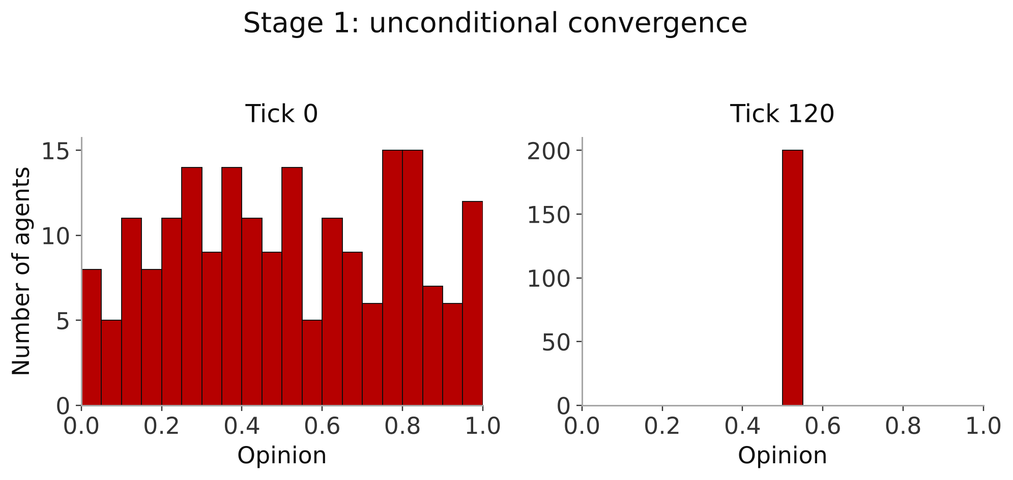
LIVE BUILD · STAGE 1 RESULT
Boring on purpose
INGroup Method Seminar ● tick 17
Notes:
[Target: 45s] This outcome is the same every run, which is the point: it establishes the baseline before Stage 2 introduces the threshold that makes the outcome genuinely uncertain and history-dependent.

Slide 18
LIVE BUILD · STAGE 2
Add the confidence threshold
One new slider, one new condition (Deffuant et al., 2000). Only agents close enough in opinion update at all.
stage2.nlogo Interface Info Code
EXPECTED
to go
ask turtles [
let partner one-of other turtles
let d abs (opinion - [opinion] of partner)
if d < confidence-threshold [
let m (opinion + [opinion] of partner) / 2
set opinion m
ask partner [ set opinion m ]
]
]
tick
end
Run at threshold 0.5: consensus, as before. Run again at threshold 0.15, same seed: two or three permanent, isolated clusters.
INGroup Method Seminar ● tick 18
Notes:
[Target: 40s] Run the high-threshold version first as a callback to Stage 1, then the low-threshold version from the same seed. The side-by-side contrast is the entire teaching point of this stage.

Slide 19
LIVE BUILD · STAGE 2 SETUP
Same seed, one slider moved
confidence-threshold = 0.5
behaves like Stage 1 — full consensus
confidence-threshold = 0.15
fragments into stable, permanent clusters
INGroup Method Seminar ● tick 19
Notes:
[Target: 30s] Keep this slide up while the second run plays out on the shared NetLogo window, so attendees can hold both conditions in mind at once.

Slide 20
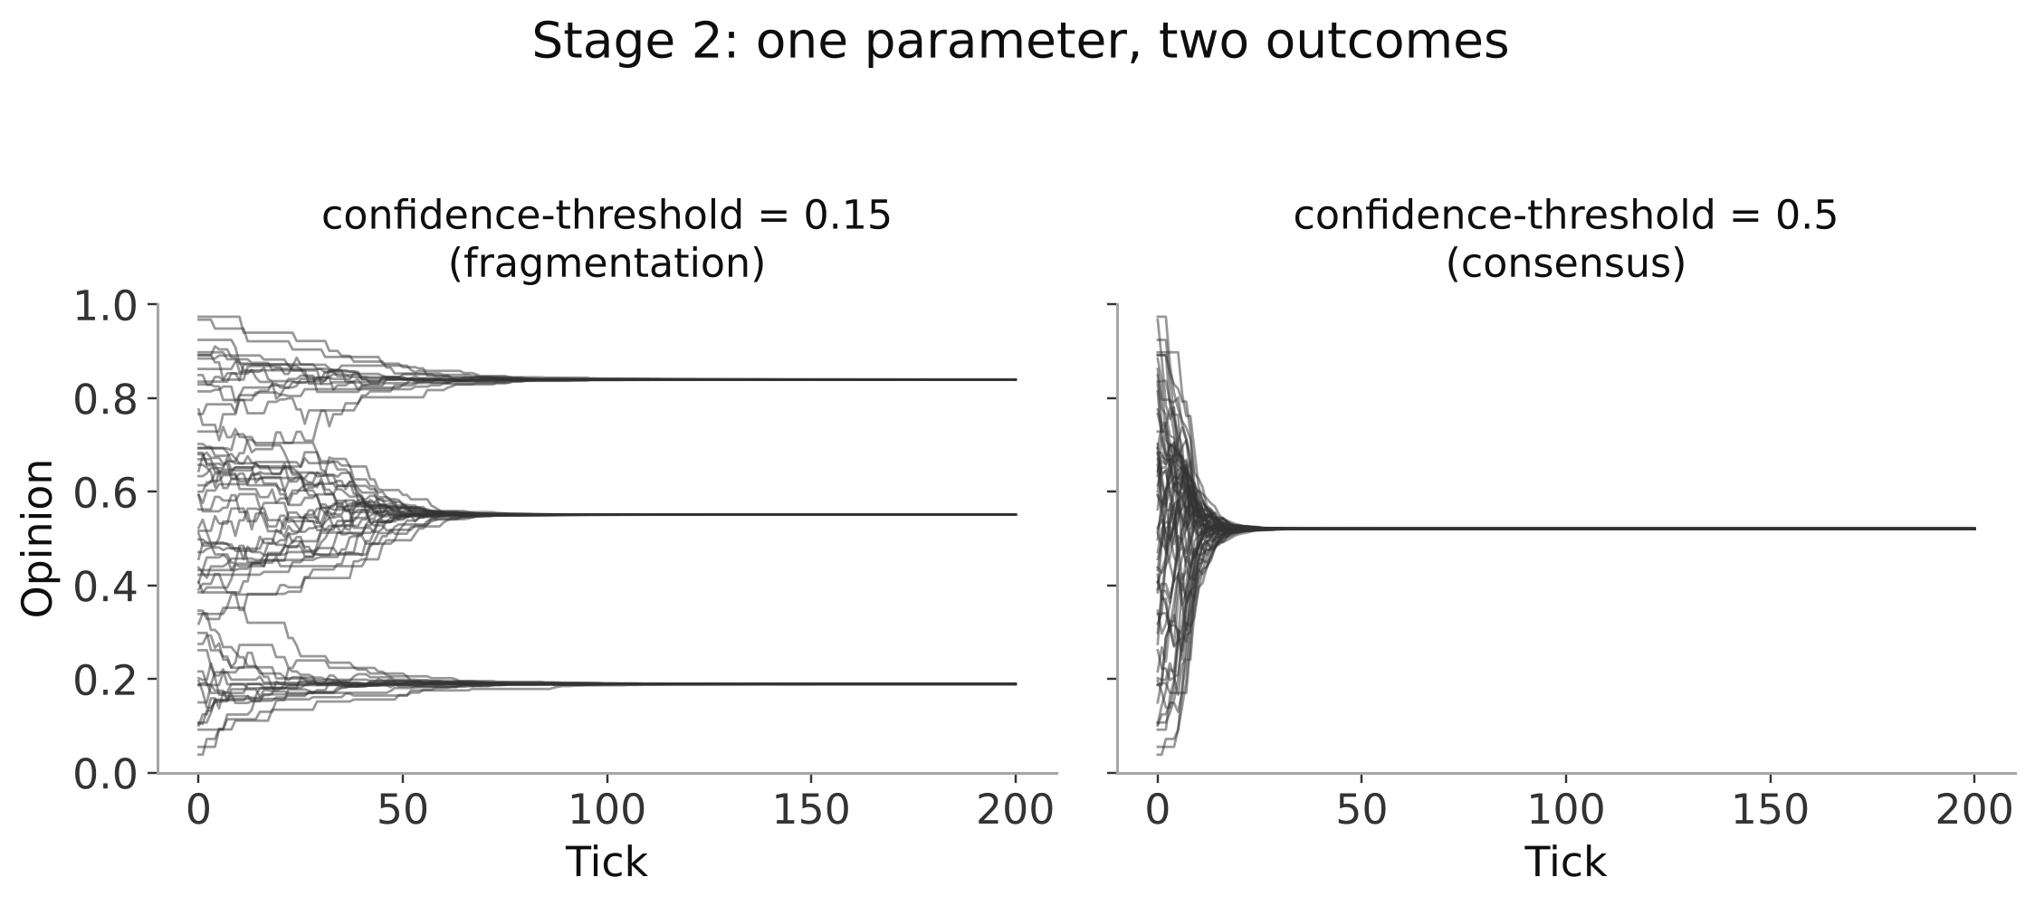
LIVE BUILD · STAGE 2 RESULT
One parameter, two outcomes
INGroup Method Seminar ● tick 20
Notes:
[Target: 60s] Every line is one agent's opinion over time. Point out the flat, permanent lines on the left once fragmentation happens; there is no mechanism in this model for a cluster to later re-merge, which is itself a modeling assumption worth naming.

Slide 21
PARAMETER SWEEP · 1 OF 5
Where exactly does it flip?
A parameter sweep is a factorial design in which the levels are values of a model parameter and the observations are simulated runs instead of participants.
Factor
confidence-threshold, 10 levels from 0.05 to 0.50
Replication
30 fresh random seeds per level
DV
number of stable opinion clusters at the end of the run
INGroup Method Seminar ● tick 21
Notes:
[Target: 50s] This slide is the pivot of the whole session: everything before it built the model, everything after it treats the model's output the way attendees already treat any other dataset.

Slide 22
PARAMETER SWEEP · 2 OF 5
The BehaviorSpace configuration
experiment name: threshold-sweep
vary: confidence-threshold [0.05 : 0.05 : 0.50]
fixed: num-agents = 200, mu = 0.25
repetitions: 30 per level (300 runs total)
setup / go: setup / go
stop condition: ticks >= 500 OR opinion-std < 0.001
measure (each tick): opinion-std
measure (at end): count-clusters
INGroup Method Seminar ● tick 22
Notes:
[Target: 40s] Show this configuration dialog live for a few seconds on the actual BehaviorSpace window, but do not run it: 300 runs is too slow for a video call, and the output is already on the next slide as a pre-generated figure.

Slide 23
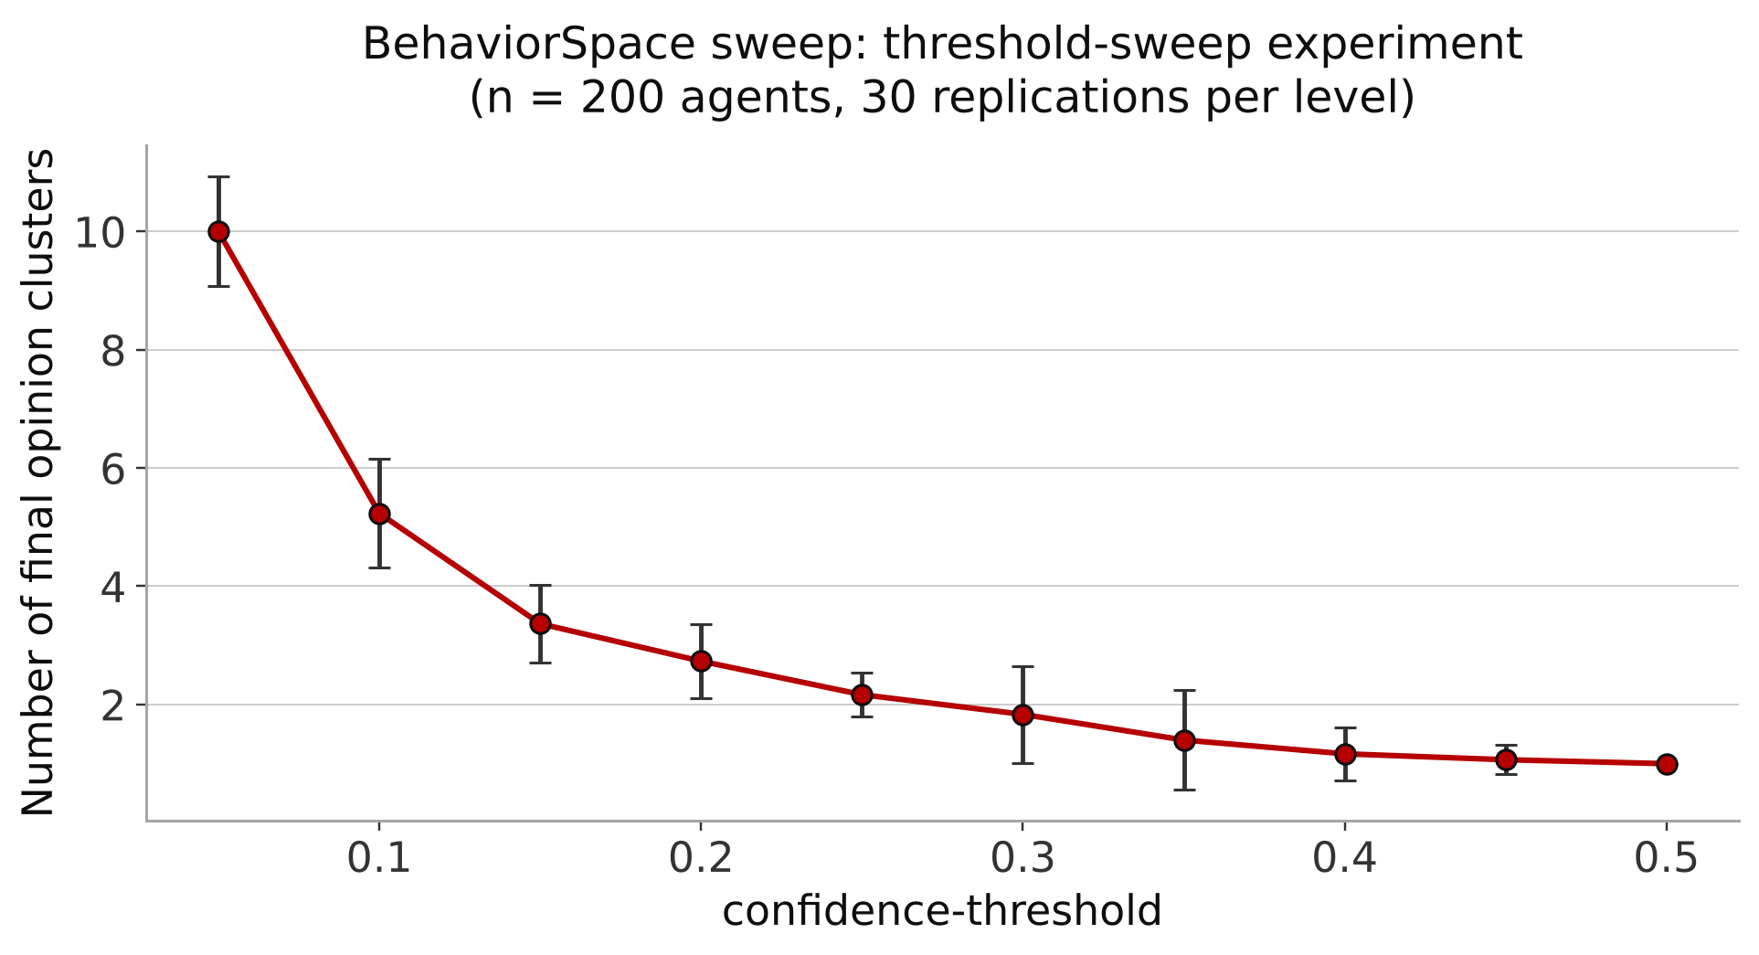
PARAMETER SWEEP · 3 OF 5
The sweep, run in advance
INGroup Method Seminar ● tick 23
Notes:
[Target: 50s] This is a real run of the threshold-sweep experiment above, not an illustration. Note where the curve is steepest, around threshold 0.05 to 0.15, and connect that back to the two demonstration values just shown live.

Slide 24
PARAMETER SWEEP · 4 OF 5
Why thirty replications, not one
Each replication is one Monte Carlo draw from the same data generating process. The standard error of a simulated mean shrinks with the square root of the number of runs, exactly the way it does for any other sample mean.
SE(mean) ∝ 1 / √ n
The error bars on the previous slide are that logic, not a decoration: they widen wherever the model is genuinely more variable across seeds, most visibly at low thresholds where a small change in initial draw changes which agents end up in which cluster.
INGroup Method Seminar ● tick 24
Notes:
[Target: 55s] State the square-root relationship once in plain language, then immediately point back at the previous slide's error bars as the concrete referent, so the equation is not left floating in the abstract.

Slide 25
PARAMETER SWEEP · 5 OF 5 · EXEMPLAR
Vancouver et al. (2010)
Vancouver, J. B., Weinhardt, J. M., & Schmidt, A. M. (2010). A formal, computational theory of multiple-goal pursuit: Integrating goal-choice and goal-striving processes. Journal of Applied Psychology, 95(6), 985-1008.
WHAT THIS STUDY SHOWED
Built a computational model integrating goal-choice and goal-striving that reproduced established empirical patterns in multiple-goal pursuit that piecemeal verbal theories had described separately but never jointly accounted for in one formal system.
INGroup Method Seminar ● tick 25
Notes:
[Target: 45s] This is the sweep-and-replicate logic applied to a different, individual-level substantive area, useful for any attendee whose interest is motivation rather than teams specifically.

Slide 26
LIVE BUILD · STAGE 3
Demographic faultlines and negative influence
Members carry two demographic attributes. Similar teammates attract; dissimilar teammates repel (after Flache & Mäs, 2008).
stage3.nlogo Interface Info Code
EXPECTED
to go
ask one-of turtles [
let me self
let pulls [ weight-to me *
(opinion - [opinion] of me) ]
of other turtles
;; weight = 1 - 2 * (opinion gap / 2
;; + demographic gap) / K
;; weight < 0: pushed away
set opinion clamp
(opinion + rate * mean pulls)
]
tick
end
Crisscrossed attributes: the team usually converges. Aligned attributes: it splits along demographic lines. Same aligned team, but subteams converge before they meet: the split mostly disappears.
INGroup Method Seminar ● tick 26
Notes:
[Target: 40s] Two changes from Stage 2, both straight from the teams literature: influence now depends on demographic similarity as well as opinion similarity, and sufficiently dissimilar teammates push each other apart instead of being ignored. Opinions here are three issues, not one. The negative-influence step is the same move Smaldino's Unit 3 uses to get from clustering to polarization.

Slide 27
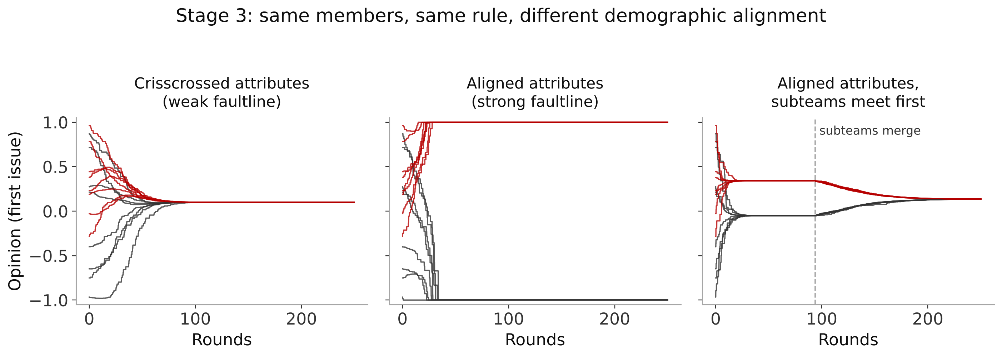
LIVE BUILD · STAGE 3 RESULT
Faultlines split teams, unless timing intervenes
Runs ending split along subgroup lines, 100 seeds each: crisscrossed 13 · aligned 84 · aligned, subteams first 16
INGroup Method Seminar ● tick 27
Notes:
[Target: 60s] Same sixteen members and the same rule in all three panels; only the alignment of demographics and the timing of contact change. Red and gray are the two subgroups. Point at the middle panel as the faultline prediction made mechanical, then at the right panel as the counterintuitive timing result from Flache and Mäs: let subteams settle internally first and the later merger no longer polarizes.

Slide 28
LIVE BUILD · STAGE 3 EXEMPLAR
Flache & Mäs (2008)
Flache, A., & Mäs, M. (2008). How to get the timing right: A computational model of the effects of the timing of contacts on team cohesion in demographically diverse teams. Computational and Mathematical Organization Theory, 14(1), 23-51.
WHAT THIS STUDY SHOWED
Formalized faultline theory with homophily, heterophobia, social influence, and rejection, reproduced the claim that strong faultlines undermine cohesion, and showed the timing of contact matters: subteams that reach consensus before merging suffer far less. Mäs et al. (2013) extended the model to crisscrossing demographics.
INGroup Method Seminar ● tick 28
Notes:
[Target: 45s] This is the model Stage 3 simplifies. For anyone studying diversity or faultlines, it is the clearest example in the teams literature of an ABM generating a design recommendation, about sequencing contact, that a cross-sectional study could not have produced.

Slide 29
LIVE BUILD · STAGE 4
Network topology replaces random pairing
Who can influence whom is now structural, not random. This is the SNA seminar's variable, used as a model input.
stage4.nlogo Interface Info Code
EXPECTED
extensions [ nw ]
to setup
...
nw:generate-watts-strogatz turtles links
num-agents neighborhood-size rewire-prob
[ fd 10 ]
end
to go
ask turtles [
let b one-of link-neighbors
...
]
end
At rewire-prob 0, a ring lattice: clusters track spatial position. Raise rewire-prob and long-range shortcuts pull distant clusters into contact, changing the outcome with the threshold unchanged.
INGroup Method Seminar ● tick 29
Notes:
[Target: 35s] This is the riskiest live segment. Have the two pre-recorded clips ready and cut to them if the layout algorithm or the shared screen lags; narrate over the recording rather than waiting on a live render.

Slide 30
LIVE BUILD · STAGE 4 SETUP
The variable your last seminar measured
is now a dial you set
In an observed network, structure is something you estimate from data. In this model, structure is a parameter: fix the threshold, change only rewire-prob, and watch the same rule produce a different outcome.
INGroup Method Seminar ● tick 30
Notes:
[Target: 40s] Keep this general rather than citing specifics of the prior SNA seminar, which this session was not present for; the point stands regardless of exactly what that seminar covered.

Slide 31
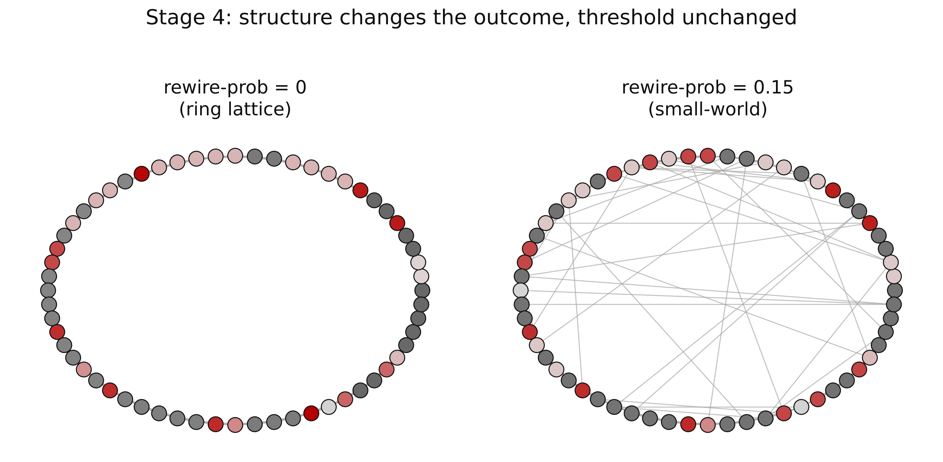
LIVE BUILD · STAGE 4 RESULT
Structure changes the outcome
INGroup Method Seminar ● tick 31
Notes:
[Target: 55s] Color encodes final opinion on a continuous scale from gray to red; darker islands in the ring lattice are visible local consensus, and the shortcuts on the right are what pull otherwise-separate regions of the ring into eventual agreement.

Slide 32
LIVE BUILD · STAGE 4 EXEMPLAR
Lazer & Friedman (2007)
Lazer, D., & Friedman, A. (2007). The network structure of exploration and exploitation. Administrative Science Quarterly, 52(4), 667-694.
WHAT THIS STUDY SHOWED
Simulated problem-solving groups in which agents imitate better-performing contacts and found that efficient, densely connected networks win in the short run but lose in the long run on complex problems, because less efficient networks preserve the diversity that exploration needs.
INGroup Method Seminar ● tick 32
Notes:
[Target: 45s] This is Stage 4's lesson at the scale of organizations: structure is not neutral plumbing. It also connects forward to the NK-landscape application in a few minutes.

Slide 33
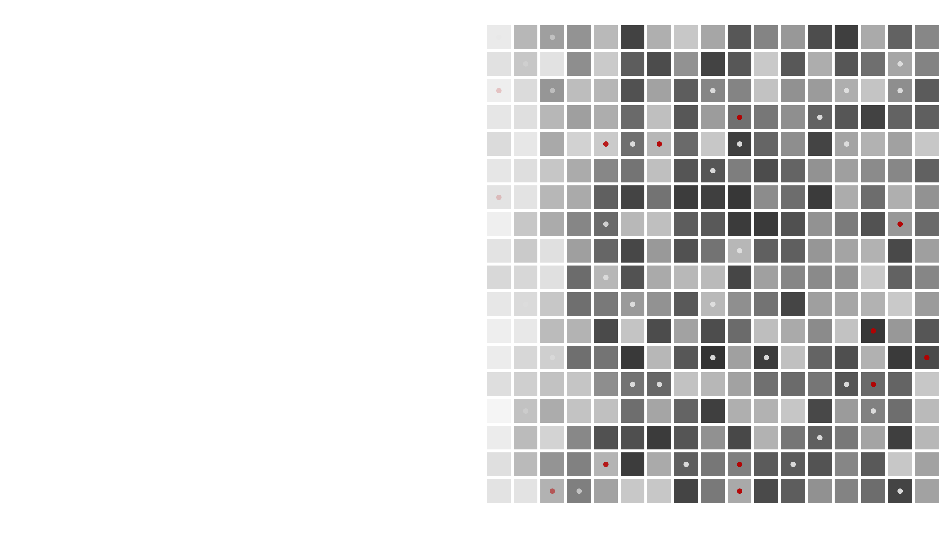
04
PART 04 · STANDARDS & LIMITS
When should anyone believe a simulation?
Verification, validation, sensitivity, reporting, and the honest critique.
INGroup Method Seminar ● tick 33
Notes:
[Target: 5s] Section break. The demos are over; this block is about what reviewers will ask.

Slide 34
STANDARDS & LIMITS · 1 OF 5
Verification and validation are different questions
Verification
Validation
Does the code correctly implement the model you specified?
Does the model's behavior correspond to something real?
Unit tests, code review, checking edge cases against hand calculation.
Comparison to empirical data, expert judgment, or established theoretical benchmarks.
INGroup Method Seminar ● tick 34
Notes:
[Target: 45s] A model can be perfectly verified and still invalid, and the reverse is rarer but possible too. Keep the two questions visibly separate rather than letting them blur into one general notion of a model being good.

Slide 35
STANDARDS & LIMITS · 2 OF 5
Validation means something different for each
Abstract theoretical model
internal consistency, comparison to established qualitative patterns, plausibility of assumptions
Empirically calibrated model
quantitative fit to real data, out-of-sample prediction, parameter recovery
INGroup Method Seminar ● tick 35
Notes:
[Target: 45s] The bounded-confidence model built today is the abstract case throughout: it was never calibrated to a specific dataset, and that is a legitimate, common choice, not a shortcut, as long as it is stated plainly in the write-up.

Slide 36
STANDARDS & LIMITS · 3 OF 5
Sensitivity analysis is due diligence, not decoration
Before trusting a result, vary every parameter you did not sweep, one at a time, and confirm the qualitative conclusion survives.
Does the result hold at num-agents = 50 and 500, not only 200?
Does it hold at mu = 0.1 and mu = 0.4, not only 0.25?
Does it hold across different random seeds at the same parameter values?
INGroup Method Seminar ● tick 36
Notes:
[Target: 40s] Name today's model's own unchecked assumption honestly: the fixed convergence rate mu was never swept in the demonstrations, which is exactly the kind of thing sensitivity analysis exists to catch before publication.

Slide 37
STANDARDS & LIMITS · 4 OF 5 · REPORTING STANDARD
Grimm et al. (2020)
Grimm, V., Railsback, S. F., Vincenot, C. E., Berger, U., Gallagher, C., DeAngelis, D. L., ... Ayllon, D. (2020). The ODD protocol for describing agent-based and other simulation models: A second update to improve clarity, replication, and structural realism. Journal of Artificial Societies and Social Simulation, 23(2), 7.
WHAT THIS STUDY SHOWED
Established a standardized reporting structure, Overview, Design concepts, Details, that lets an independent team read a model description and actually rebuild it, addressing a replication gap that unstructured methods sections routinely left open.
INGroup Method Seminar ● tick 37
Notes:
[Target: 45s] When reviewing an ABM manuscript as a referee, this protocol is a legitimate checklist to ask for explicitly if a submission's methods section is vague about any of its three sections.

Slide 38
STANDARDS & LIMITS · 5 OF 5 · THE HONEST CRITIQUE
Smith & Conrey (2007)
Smith, E. R., & Conrey, F. R. (2007). Agent-based modeling: A new approach for theory building in social psychology. Personality and Social Psychology Review, 11(1), 87-104.
WHAT THIS STUDY SHOWED
Argued that ABM's core advantage over variable-based causal modeling is representing dynamic, interactive processes structurally, while acknowledging directly that the same representational flexibility is what invites the standard overfitting objection.
INGroup Method Seminar ● tick 38
Notes:
[Target: 55s] State the objection in one sentence before opening it to the room as the third discussion prompt later: a sufficiently flexible model can reproduce nearly any pattern, so fit to a target pattern alone is not evidence the mechanism is right.

Slide 39
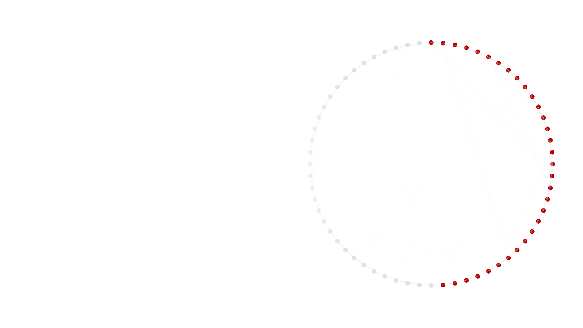
INTERLUDE · APPLICATIONS
Four places these tools are already working
A brief survey of current applied work, not a findings talk.
INGroup Method Seminar ● tick 39
Notes:
[Target: 20s] Signal the register shift here: the methods content is finished, and this block is a brief survey of current applied work, not a research talk. Move quickly through the next four slides.

Slide 40
APPLICATIONS · 1 OF 4
An NK-landscape model of aspiration architecture in AI-augmented team learning
Extends the classic exploration-exploitation and rugged-landscape traditions to ask how a team's aspiration level, not just its search strategy, shapes learning when an AI tool changes what exploration costs.
Closest published lineage: March (1991); Levinthal (1997).
INGroup Method Seminar ● tick 40
Notes:
[Target: 30s] Keep this to the one sentence on screen; do not present results, since this is a survey block, not a findings talk.

Slide 41
APPLICATIONS · 2 OF 4
A Kalman-filter model of shared mental model convergence in multiteam systems
Treats shared mental model convergence as a filtering problem across interdependent teams, extending organizational-learning simulation traditions from the single-team case to a multiteam system.
Closest published lineage: Carley (1992); Dionne et al. (2010).
INGroup Method Seminar ● tick 41
Notes:
[Target: 30s] One sentence, then move on; this project is the most methodologically distinct from today's running example and is worth naming as evidence that the anatomy taught today generalizes beyond opinion dynamics.

Slide 42
APPLICATIONS · 3 OF 4
A particle swarm optimization extension on power disparity in teams
Borrows a search-based optimization algorithm to model how unequal influence among team members changes the team's ability to find good solutions on an interdependent task landscape.
Closest published lineage: Tarakci et al. (2016); Rivkin & Siggelkow (2003).
INGroup Method Seminar ● tick 42
Notes:
[Target: 30s] This is the project furthest from a standard NetLogo demo, useful for signaling that the field's toolkit extends well past the bounded-confidence family shown live today.

Slide 43
APPLICATIONS · 4 OF 4
A network model of strategic consensus formation
Extends the dissertation's processual theory of strategic consensus into a network-structured agent-based model, directly continuing today's Stage 4 move from random pairing to network topology.
Closest published lineage: Cao et al. (2020).
INGroup Method Seminar ● tick 43
Notes:
[Target: 30s] Close the loop explicitly back to the Stage 4 demo from earlier in the session; this project is the most direct continuation of what the room just watched built live.

Slide 44
GOING FURTHER
Where to keep building
Models of Social Dynamics
Models of social influence
Models are stupid
Smaldino, Cultural Evolution Society
Flache et al. (2017)
Smaldino (2017)
Seven free units with NetLogo models, slides, and exercises. Unit 3, Opinions and Polarization, covers today's Stages 1 to 3. CC BY-NC-SA 4.0.
A map of the assimilation, similarity-bias, and repulsion families of influence models and the open problems in each.
The short case for simple, deliberately incomplete models as tools for thinking, written for social psychologists.
learn.culturalevolutionsociety.org
JASSS, 20(4), 2
Computational Social Psychology
INGroup Method Seminar ● tick 44
Notes:
[Target: 30s] Point attendees who want to keep going without a methods course to Smaldino's free module first; its Unit 3 rebuilds today's Stages 1 to 3 in more depth, with exercises. For the teams-specific line, Kozlowski et al. (2016) and Grand et al. (2016) are the next reads.

Slide 45
PART 05 · DISCUSSION · 18 MINUTES
Back to your own designs
1
For a theory you study with a cross-sectional or single-timepoint design, what would an agent-based model of it need to specify explicitly?
2
When is empirical calibration necessary to persuade reviewers in your field, and when is an uncalibrated model sufficient?
3
What would convince you a model's fit to a pattern reflects a real mechanism, not just enough free parameters?
INGroup Method Seminar ● tick 45
Notes:
[Target: 1080s] These were circulated with the pre-reading a week out, so open by asking whether anyone has come with a specific theory in mind for prompt one rather than reading the prompts cold. Protect this block's full eighteen minutes; if time is short, it was trimmed upstream, not here.

Slide 46
THANK YOU
Code, slides, and figures
github.com/justmj/[repository-placeholder]
Includes the four staged .nlogo files, an R port, a Python port, and a README for each.
Justin M. Jones, Ph.D.
Research Specialist, NCITE, University of Nebraska at Omaha
jjones188@unomaha.edu · justmj.github.io
INGroup Method Seminar ● tick 46
Notes:
[Target: 15s] Confirm the repository link will be live and emailed to the INGroup list within a day or two, since attendees install nothing during the session itself.

Slide 47
REFERENCES (APA 7) · 1 OF 2
Cao, S., MacLaren, N. G., Cao, Y., Dong, Y., Sayama, H., Yammarino, F. J., Dionne, S. D., Mumford, M. D., Connelly, S., Martin, R., Standish, C. J., & Newbo, T. R. (2020). An agent-based model of leader emergence and leadership perception within a collective. Complexity, 2020, Article 6857891.
Carley, K. M. (1992). Organizational learning and personnel turnover. Organization Science, 3(1), 20-46.
Deffuant, G., Neau, D., Amblard, F., & Weisbuch, G. (2000). Mixing beliefs among interacting agents. Advances in Complex Systems, 3, 87-98.
Dionne, S. D., Sayama, H., Hao, C., & Bush, B. J. (2010). The role of leadership in shared mental model convergence and team performance improvement: An agent-based computational model. The Leadership Quarterly, 21(6), 1035-1049.
Epstein, J. M. (1999). Agent-based computational models and generative social science. Complexity, 4(5), 41-60.
Flache, A., & Mäs, M. (2008). How to get the timing right: A computational model of the effects of the timing of contacts on team cohesion in demographically diverse teams. Computational and Mathematical Organization Theory, 14(1), 23-51.
Flache, A., Mäs, M., Feliciani, T., Chattoe-Brown, E., Deffuant, G., Huet, S., & Lorenz, J. (2017). Models of social influence: Towards the next frontiers. Journal of Artificial Societies and Social Simulation, 20(4), 2.
Grand, J. A., Braun, M. T., Kuljanin, G., Kozlowski, S. W. J., & Chao, G. T. (2016). The dynamics of team cognition: A process-oriented theory of knowledge emergence in teams. Journal of Applied Psychology, 101(10), 1353-1385.
Grimm, V., Railsback, S. F., Vincenot, C. E., Berger, U., Gallagher, C., DeAngelis, D. L., ... Ayllon, D. (2020). The ODD protocol for describing agent-based and other simulation models: A second update to improve clarity, replication, and structural realism. Journal of Artificial Societies and Social Simulation, 23(2), 7.
Kozlowski, S. W. J., Chao, G. T., Grand, J. A., Braun, M. T., & Kuljanin, G. (2013). Advancing multilevel research design: Capturing the dynamics of emergence. Organizational Research Methods, 16(4), 581-615.
Kozlowski, S. W. J., Chao, G. T., Grand, J. A., Braun, M. T., & Kuljanin, G. (2016). Capturing the multilevel dynamics of emergence: Computational modeling, simulation, and virtual experimentation. Organizational Psychology Review, 6(1), 3-33.
INGroup Method Seminar ● tick 47
Notes:
[Target: 0s] Leave the references on screen briefly at the very end and note they will also be in the emailed slide deck, since no one should be transcribing a reference list in real time.

Slide 48
REFERENCES (APA 7) · 2 OF 2
Lazer, D., & Friedman, A. (2007). The network structure of exploration and exploitation. Administrative Science Quarterly, 52(4), 667-694.
Levinthal, D. A. (1997). Adaptation on rugged landscapes. Management Science, 43(7), 934-950.
March, J. G. (1991). Exploration and exploitation in organizational learning. Organization Science, 2(1), 71-87.
Mäs, M., Flache, A., Takács, K., & Jehn, K. A. (2013). In the short term we divide, in the long term we unite: Demographic crisscrossing and the effects of faultlines on subgroup polarization. Organization Science, 24(3), 716-736.
Rivkin, J. W., & Siggelkow, N. (2003). Balancing search and stability: Interdependencies among elements of organizational design. Management Science, 49(3), 290-311.
Smaldino, P. E. (2017). Models are stupid, and we need more of them. In R. R. Vallacher, S. J. Read, & A. Nowak (Eds.), Computational social psychology (pp. 311-331). Psychology Press.
Smaldino, P. E. (n.d.). Models of social dynamics: An introductory module [Online tutorial]. Cultural Evolution Society. https://learn.culturalevolutionsociety.org/social_dynamics_module/
Smith, E. R., & Conrey, F. R. (2007). Agent-based modeling: A new approach for theory building in social psychology. Personality and Social Psychology Review, 11(1), 87-104.
Tarakci, M., Greer, L. L., & Groenen, P. J. F. (2016). When does power disparity help or hurt group performance? Journal of Applied Psychology, 101(3), 415-429.
Vancouver, J. B., & Weinhardt, J. M. (2012). Modeling the mind and the milieu: Computational modeling for micro-level organizational researchers. Organizational Research Methods, 15(4), 602-623.
Vancouver, J. B., Weinhardt, J. M., & Schmidt, A. M. (2010). A formal, computational theory of multiple-goal pursuit: Integrating goal-choice and goal-striving processes. Journal of Applied Psychology, 95(6), 985-1008.
INGroup Method Seminar ● tick 48
Notes:
[Target: 0s] Second half of the reference list.

