Slide 1



A Closed-loop Basil Plant
Digital Twin Framework
Rayan CONTULIANO BRAVO
Co-authors: Pr. Gianluca Bontempi - Pascal Tribel
AI4DT 2026 - Maastricht - October 2026
Notes:
Greetings
Present DT framework for a single plant
Began as my master thesis at ULB with Pr. Bontempi & Pascal Tribel as promotors
Combines multiple sensors & cameras to builld a virtual representation of the plant => able to infer decisions of for exemple when to trigger to water pump to irrigate the plant
I’ll explain how all the components work together, how we manage to build this prototype and how it behaved when deployed for a short period of test

Slide 2

About me
Computer science
Master’s thesis at ULB
Cybersecurity
Interests
Software, embedded systems, AI
Current master’s at ULB
2
Notes:
I’ll start by introducing myself
RCB, I studied computer sciences at the ULB where I did this master thesis
Like working on practicals projects on which I can get a feedback of what it does IRL
Enjoy working on areas that brings togethers software engineering, embedded systems and AI
Current MA-SECU also at ULB

Slide 3
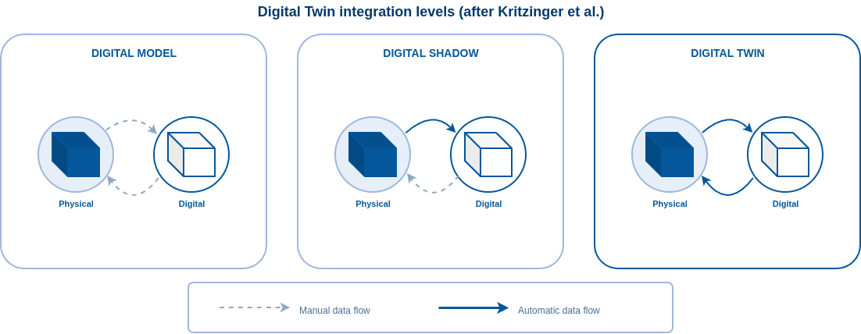
What is a Digital Twin?
Notes:
For this work, following the definition of DT:
System that is composed of a Physical object and its V counterpart
Observations from P are captured by any type of sensors to track relevant features
Automatically updates the Digital object
The Digital representation itsfelf based on those observations, can infer a state, make decisions and prediction to control & act on the physical object
Particular compared to its predecessor the DM & DS is the auto bidirectional flow that allows the DT to manage itself in a way
In agriculture existing systems => monitoring, modelling, recommendations and in some cases control AT != scales
Our goal = practical implementation of the complete DT loop at plant level
Note: complete loop doesn’t mean sophisticated models but rather that the complete loop is implemented.
WE DO NOT CLAIM THAT the DT IS BIOLOGICALLY ACCURATE

Slide 4
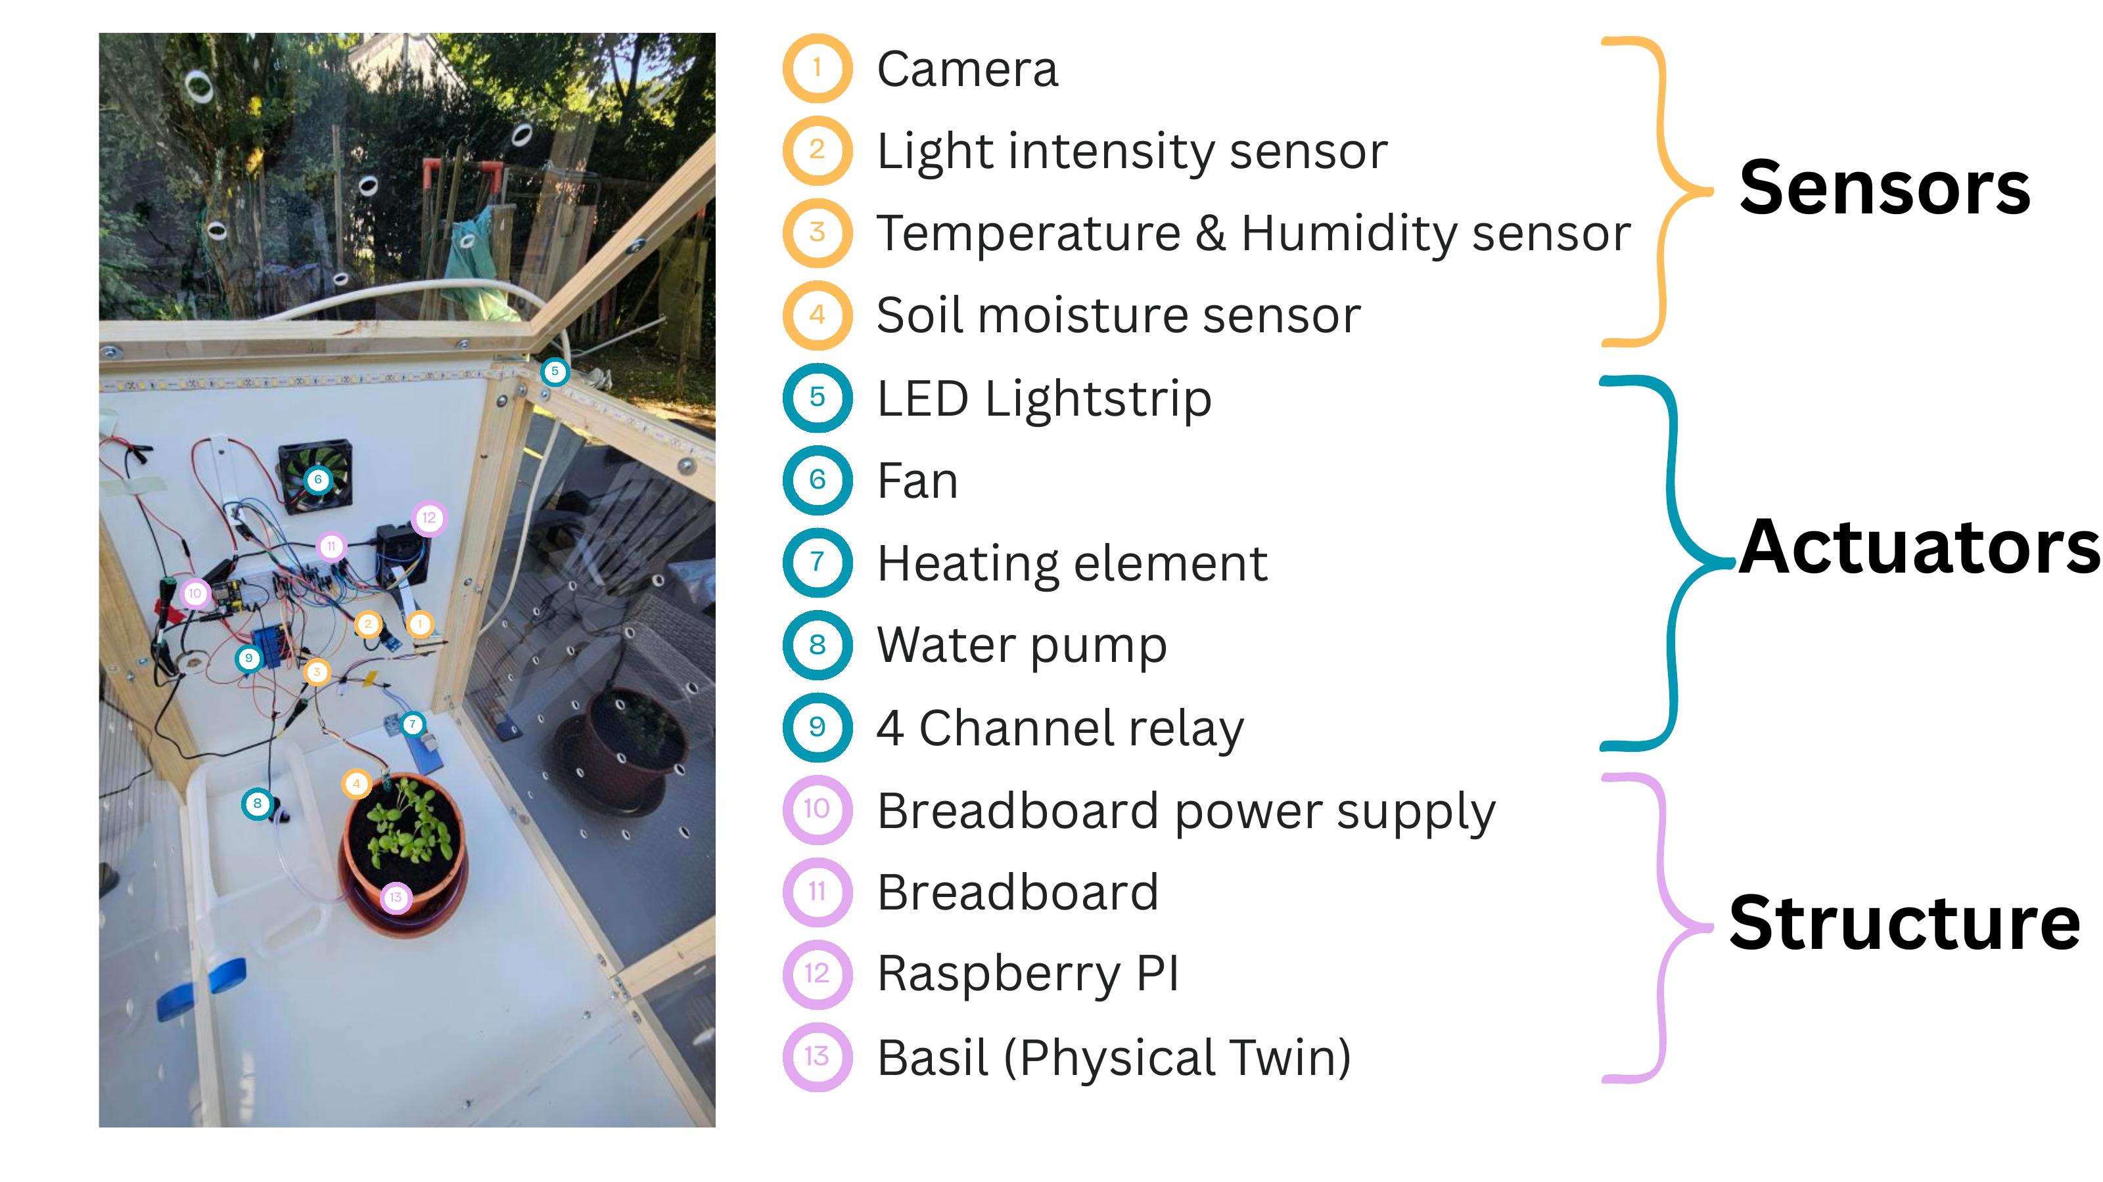
The prototype
The physical twin
A basil plant in a controlled box.
Why basil ?
Indoor-friendly and shows measurable responses to light and temperature within weeks.
Notes:
This is the physical setup
We know that a plant lives in a constantly changing environemnt with many interacting variable such as light, t°, h%, soil moisture and the plant can respond relatively slowly or fast depending on the condition
It becomes necessary to track those environmental and physiological variable to create a representation of that physical object
In this setup with have a light, t°, h% and soil moisture sensors as well as 2 cameras that look from different angles and are used to extract the leaf count, height and how much the plant is green
Everything on a RPI4
Actuator side we have a fan, heating element, led light and a water pump but at this stage only the water pump is handled, the other are there for future improvement
Basil : experiment subject because it grows indoor and shows measurable changes over a relatively short period of time when its environment changes

Slide 5
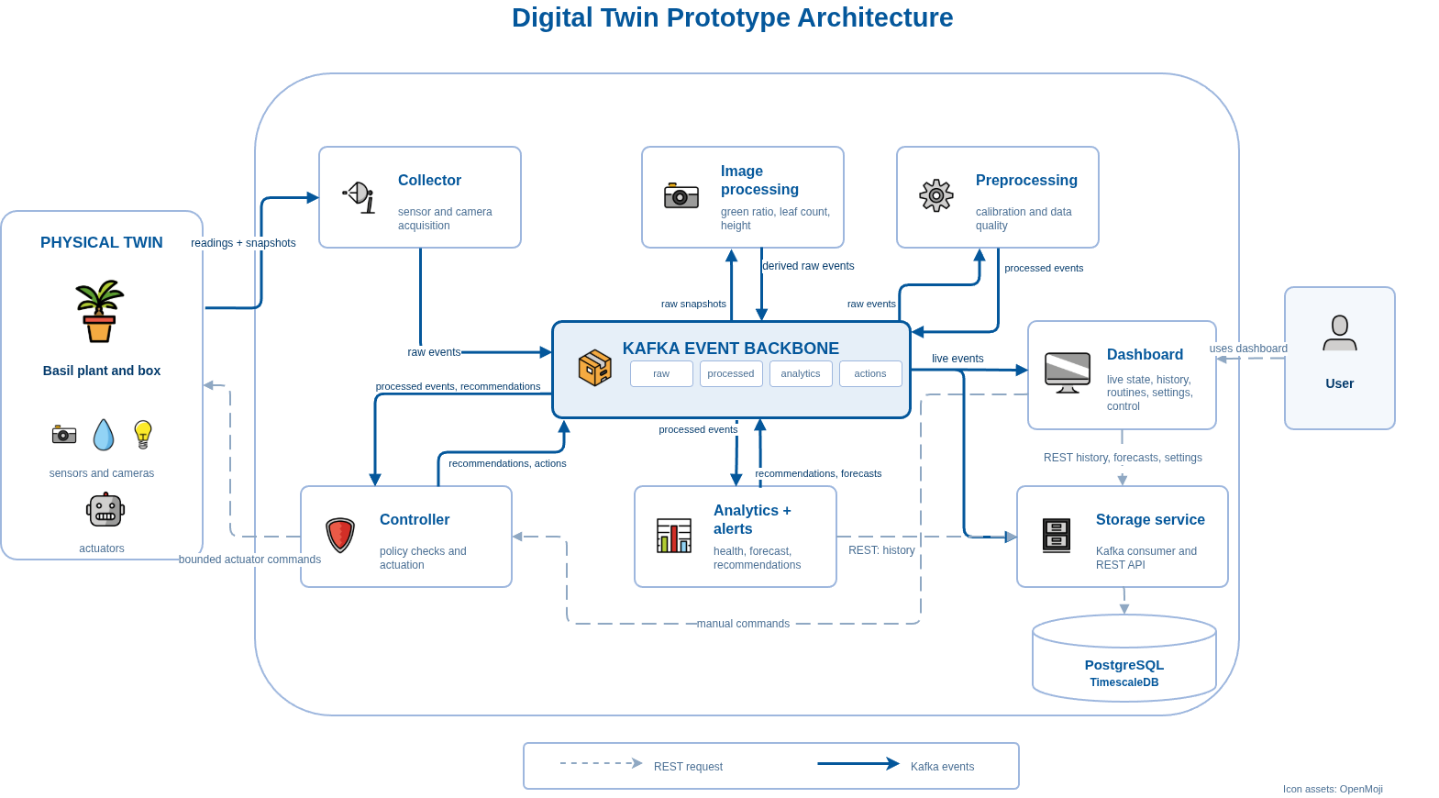
System Architecture
800
21°C
[img]
15cm
75%
21°C
15cm
75%
21°C
15cm
75%
21°C
800
21°C
75%
21°C
15cm
21°C
[img]
15cm
[img]
15cm
75%
21°C
15cm
800
21°C
[img]
75%
21°C
15cm
75%
21°C
15cm
Notes:
Broad overview of the system
- Micro-service architecture, each component has its own responsibility, (independent, can scale)
- Communicating through a Kafka event for live data (broadcast when multiple services needs information) and a REST API inter-module communication (history, commands, configuration)
Follow one observation :
- the collector reads sensors and cameras and publishes raw events
- image processing turns snapshots into numeric plant variables;
- preprocessing built on Spark Structured Streaming - calibrates, validates and scores every reading
- storage persists processed data in TimescaleDB, which handles both time-series and relational data, so readings stay linked to actions and recommendations
- analytics builds features and produces health estimates, forecasts and recommendations
- the controller is the only component allowed to touch the actuators
- the dashboard exposes everything to the user.

Slide 6
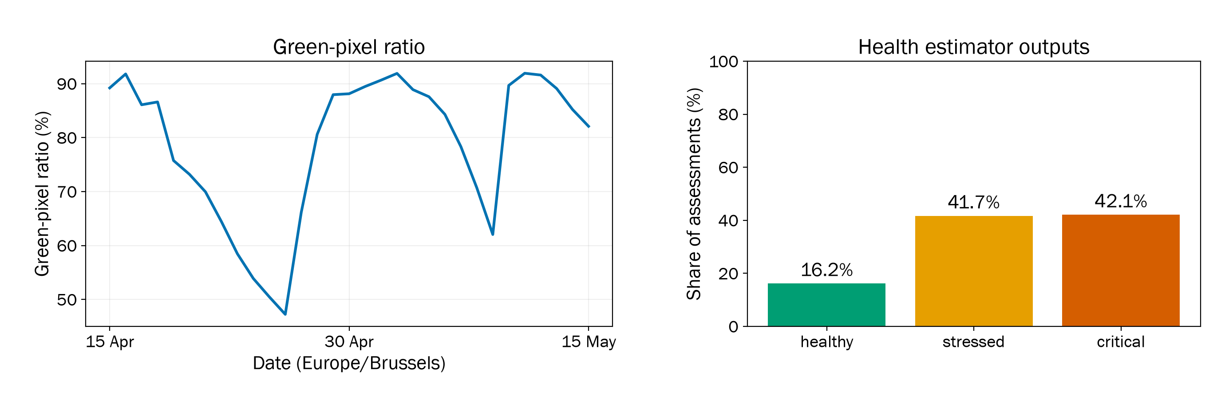
Observations and health estimates
15 April–15 May 2026 152,552 observations
Notes:
We ran the prototype from the 15 April - 15 May and collected just over a hundred and fifty-two thousand observations.
Dev interruption and connection issues and hardware failures during that month => not uninterrupted operation
Dry experiment to verify that the prototype could estiimates state and track features and it estimated most states as stressed and critical. Again not biologically accurate, it just proved the prototype managed to infer those states based on the received observations
The curve on the left => Green ratio we can see during the period without watering the green ration really changed from 90% to below 50%

Slide 7
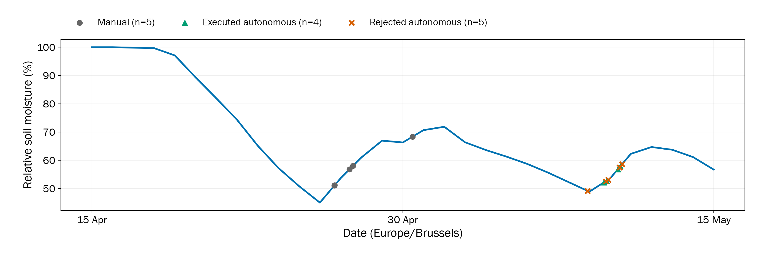
Recommendations and actions
9 autonomous requests 4 executed - 5 rejected
Notes:
Here is the soil moisture history with the pump requests.
The line shows daily median soil moisture : Grey circles => manual activations, green triangles =>completed autonomous irrigations, crosses => rejected autonomous requests.
9 autonomous actions : 4 executed and 5 rejected (1 because of an exceeding duration, 4 because of the cooldown)
The prototype managed to trigger actions based on the analytics it made and that it had an impact on the soil moisture
However because the deployment period was limited and that only this much of actions has been taken its does not give enough evidence to claim how good that the watering startegy was

Slide 8
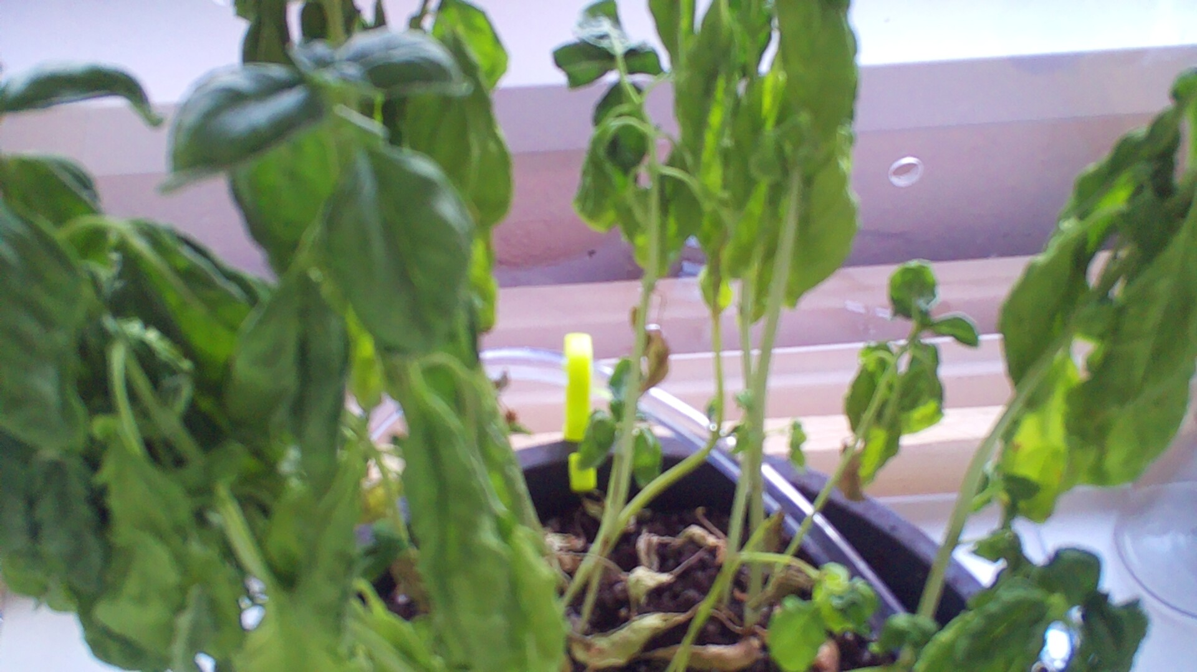
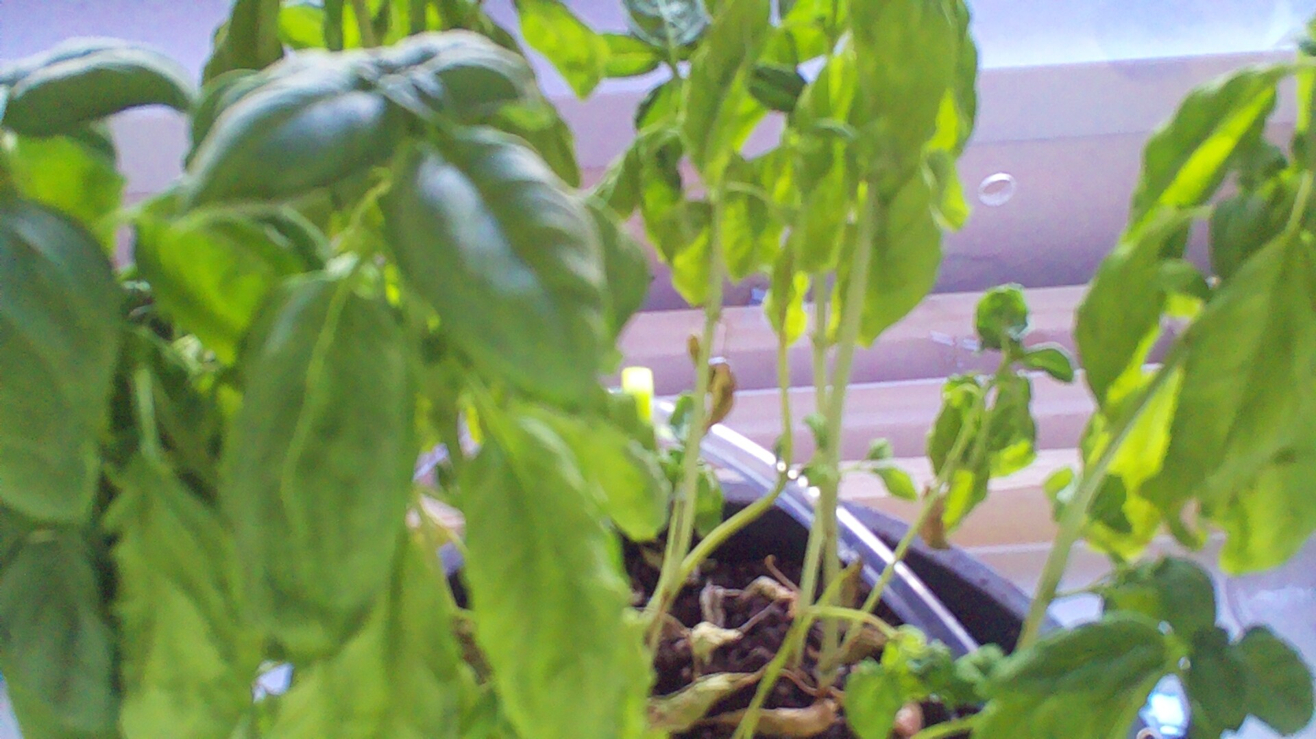
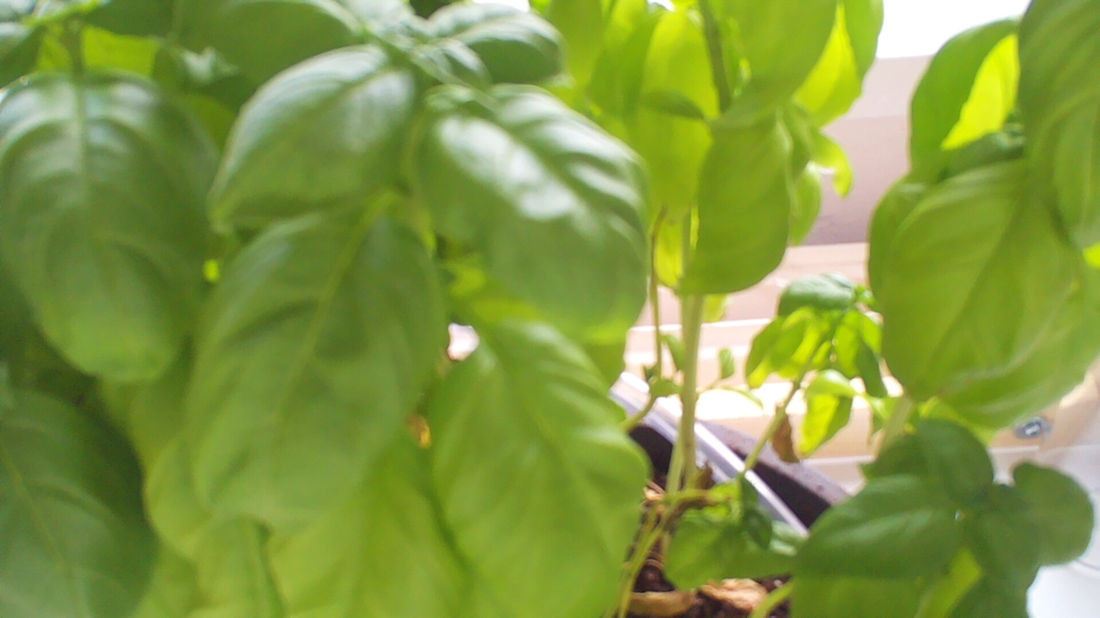
Visual observations
9 May · 12:55
9 May · 20:25
10 May · 12:25
Notes:
These images illustrate the visual effect of the actions on the plant.
You can see a change in the plant's appearance. The measurements also change over the surrounding days. That actually support the green ratio plot I showed you earlier

Slide 9
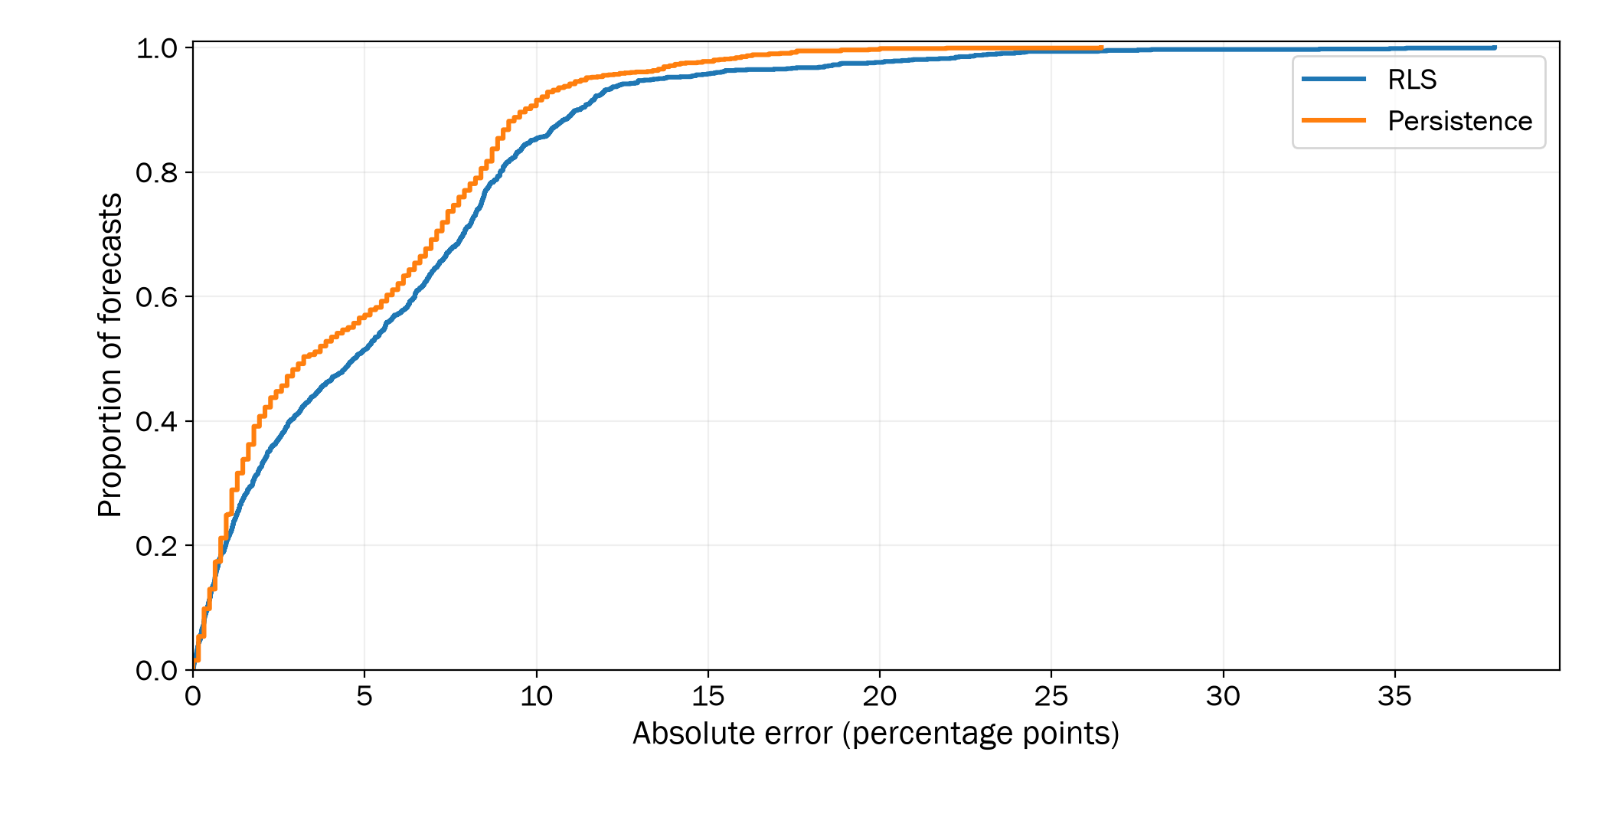
Forecast evaluation
MAE RLS: 5.54 pp Persistence: 4.65 pp
Notes:
We also evaluated the three-hour forecast against a simple baseline. Persistence predicts that moisture three hours from now will equal the current reading.
The RLS performed worse than I expected maybe because it ignores temperature, light and humidity, and it lags sudden changes around watering.
During the evaluation period the Persistencec baseline surprisingly performed a bit better.
This is a clearly a point for later improvement

Slide 10
Limitations
One plant, no control group
Sensor and hardware failures
Unvalidated health estimates
Transfer and scaling untested
Notes:
Althought the prototype was able to retrive observation quasi-continuously, infer health state, make predictions and trigger actions, the prototype is still at an early stage and there are limitation to the current state and some more work to do
First : the prototype was evalutation over a short period of time with no control group and only the pump was tested. We can examine the operation of the system, but we can't establish a long-term health benefit.
Operational fragility, low-cost sensors disconnected, one camera failed, and image quality limited the derived plant features. At the same time, the Raspberry Pi reached its four-gigabyte memory limit, and some crashes required a manual reboot.
Additionally, the health thresholds remain specific to the prototype. and we also although the system was designed to be extendable and scalable, we did not test it on multiple plants or diverse environment conditions.
OTHER LIMITATIONS THAT ARE NOT SPECIFIC TO OUR PROTOTYPE BUT RATHER THE CONCEPT:
Hardware failures, sensors only partly observe the plant, its state is difficult to model, and slow responses make action effects difficult to isolate without longer, controlled experiments.

Slide 11

Thank you.
I look forward to your questions.
Notes:
To conclude, we built a complete plant-level digital twin pipeline and ran it for thirty days.
It combined sensor and image observations with data qualification, health estimates, forecasts, and even irrigation actions.
Those results demonstrate the operation of the system. However, it does not establish a benefit for the plant and that will require a controlled experiment with biological assessment.
Future work should consist of using the current prototype (on firstly improve maybe add more relevent sensors, handle all actuators, better analytics models and finish suspended tasks)
Using the prototype as an experimental platform with longer more controlled experiments with control groups, different plant types and environments etc...
Thank to Gianluca Bontempi and Pascal Tribel for their guidance and collaboration. And thank you for listening. I'm happy to take your questions.

Slide 12
Formalization of the Digital Twin
S(t) = { E(t) , O(t) , Q(t) }
E(t) - Environment
L light (lx)
M soil moisture (%)
T air temperature (°C)
H relative humidity (%)
O(t) - Visible plant
G green-pixel ratio (%)
N leaf count
P plant height (cm)
Q(t) - Data quality
a score in [0, 1] per reading
computed from validation checks
Notes:
The represented state combines environmental readings, image-derived observations and data quality. The configured quality score uses passed range, rate-of-change and stuck-value checks with weights of 0.4, 0.4 and 0.2. A passing score reflects these checks and does not establish physical accuracy.

Slide 13
Health Estimation
healthy
Hydration
Atmosphere
Vitality
Observability
2h context
stressed
Combine severity & confidence
24h context
critical
unknown
Notes:
So what happens inside analytics?
The first part of the analytics module estimates the health of the plant using fix thresholds
Reads observations from a 2h window (focus on short and recent fluctuation) and a 24H window (longer trends not visible on short)
Then analyse those features into 4 groups
Hydratation will focus on the soil moisture trends and dryness of the plant
Atmosphere is the environment with t° and h% and vapor pressure deficit wich represent the environement of the plant
Vitality represent visual features trends of the plant
Observality focus on the data quality and if we have enough data to evaluation, if it recent enough etc... Because we do not want low-quality data to have an impact on the future decisions
Estimator combines them into 4 groups to have an estimation of the health. Note that we haven’t validated the results again expert biological assessments => I wouldn’t present them as an accurate diagnostic but it is a first step

Slide 14
Forecasting and recommendations
Soil moisture forecast
3 h forecast ≤ 55%
Irrigate 8 s
Recommendation
confidence ≥ 0.55
Stressed / critical
Inspect plant
Notes:
The second part forecasts soil moisture three hours ahead.
Use RLS online linear model that updates its coefficients as new readings arrive.
In this implementation it learns a trend from the moisture readings over time.
The infer a recommendation, it combines the health estimation with the soil forecasting
Requests 8s of pumping when health is stressed or critical, forecast moisture <= 55%, and both confidence values reach 0.55.
If there is not enough confidence or the soil moisture forecast isn’t dry the action will be to inspect the plant

Slide 15
Closing the loop
Recommendation
from analytics
Actuator policy
allowed commands
max duration: 15 s
cooldown: 3 h
overlap handling
execute + auto-OFF
Operating mode
AI autopilot on: routines skipped. Off: AI advice only.
Routine
e.g. daily 08:00
reject + record why
Manual
from the dashboard
Notes:
Before that any actions is executed, they need to go throught the Controller gate wich purpose is to protect the physical object from action that could harm it.
Controller checks whether the command is allowed, duration, enough time has passed since the previous action, overlapping.
IMPORTANT THAT THE CONTROLLER DOESN’T BLINDLY ACCEPTS ACTION
Analytics may suggest, but only the controller touches hardware

Slide 16
System architecture

Slide 17
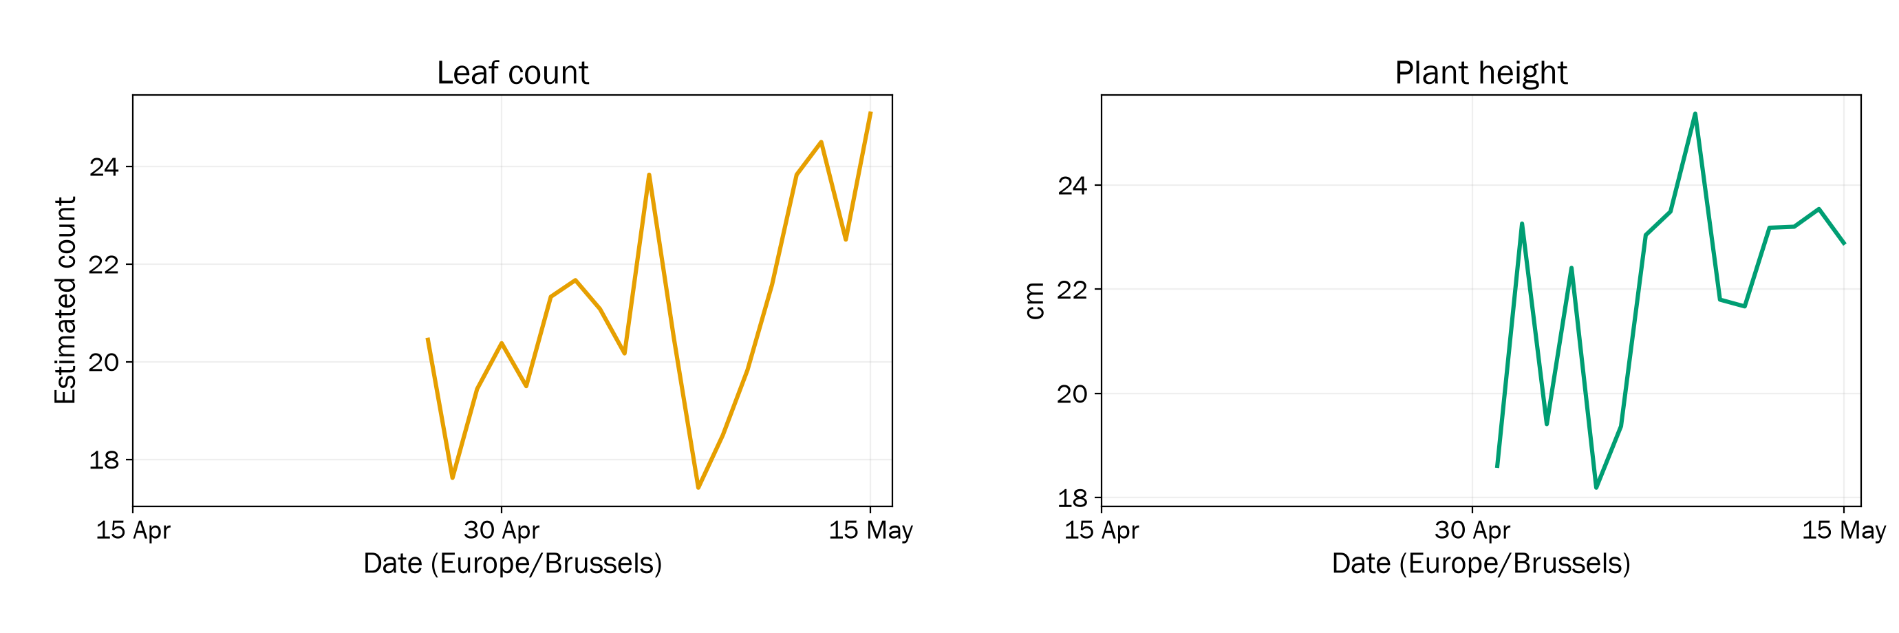
Image-derived measurements
Notes:
These are the leaf-count and height panels produced by the public summary script using the same daily aggregation as the paper. The series begin later because their image pipelines became available later. Lighting, overlapping leaves and segmentation affect these measurements. A short-term fall in estimated height should not be read as proof that the plant physically shrank.

Slide 18
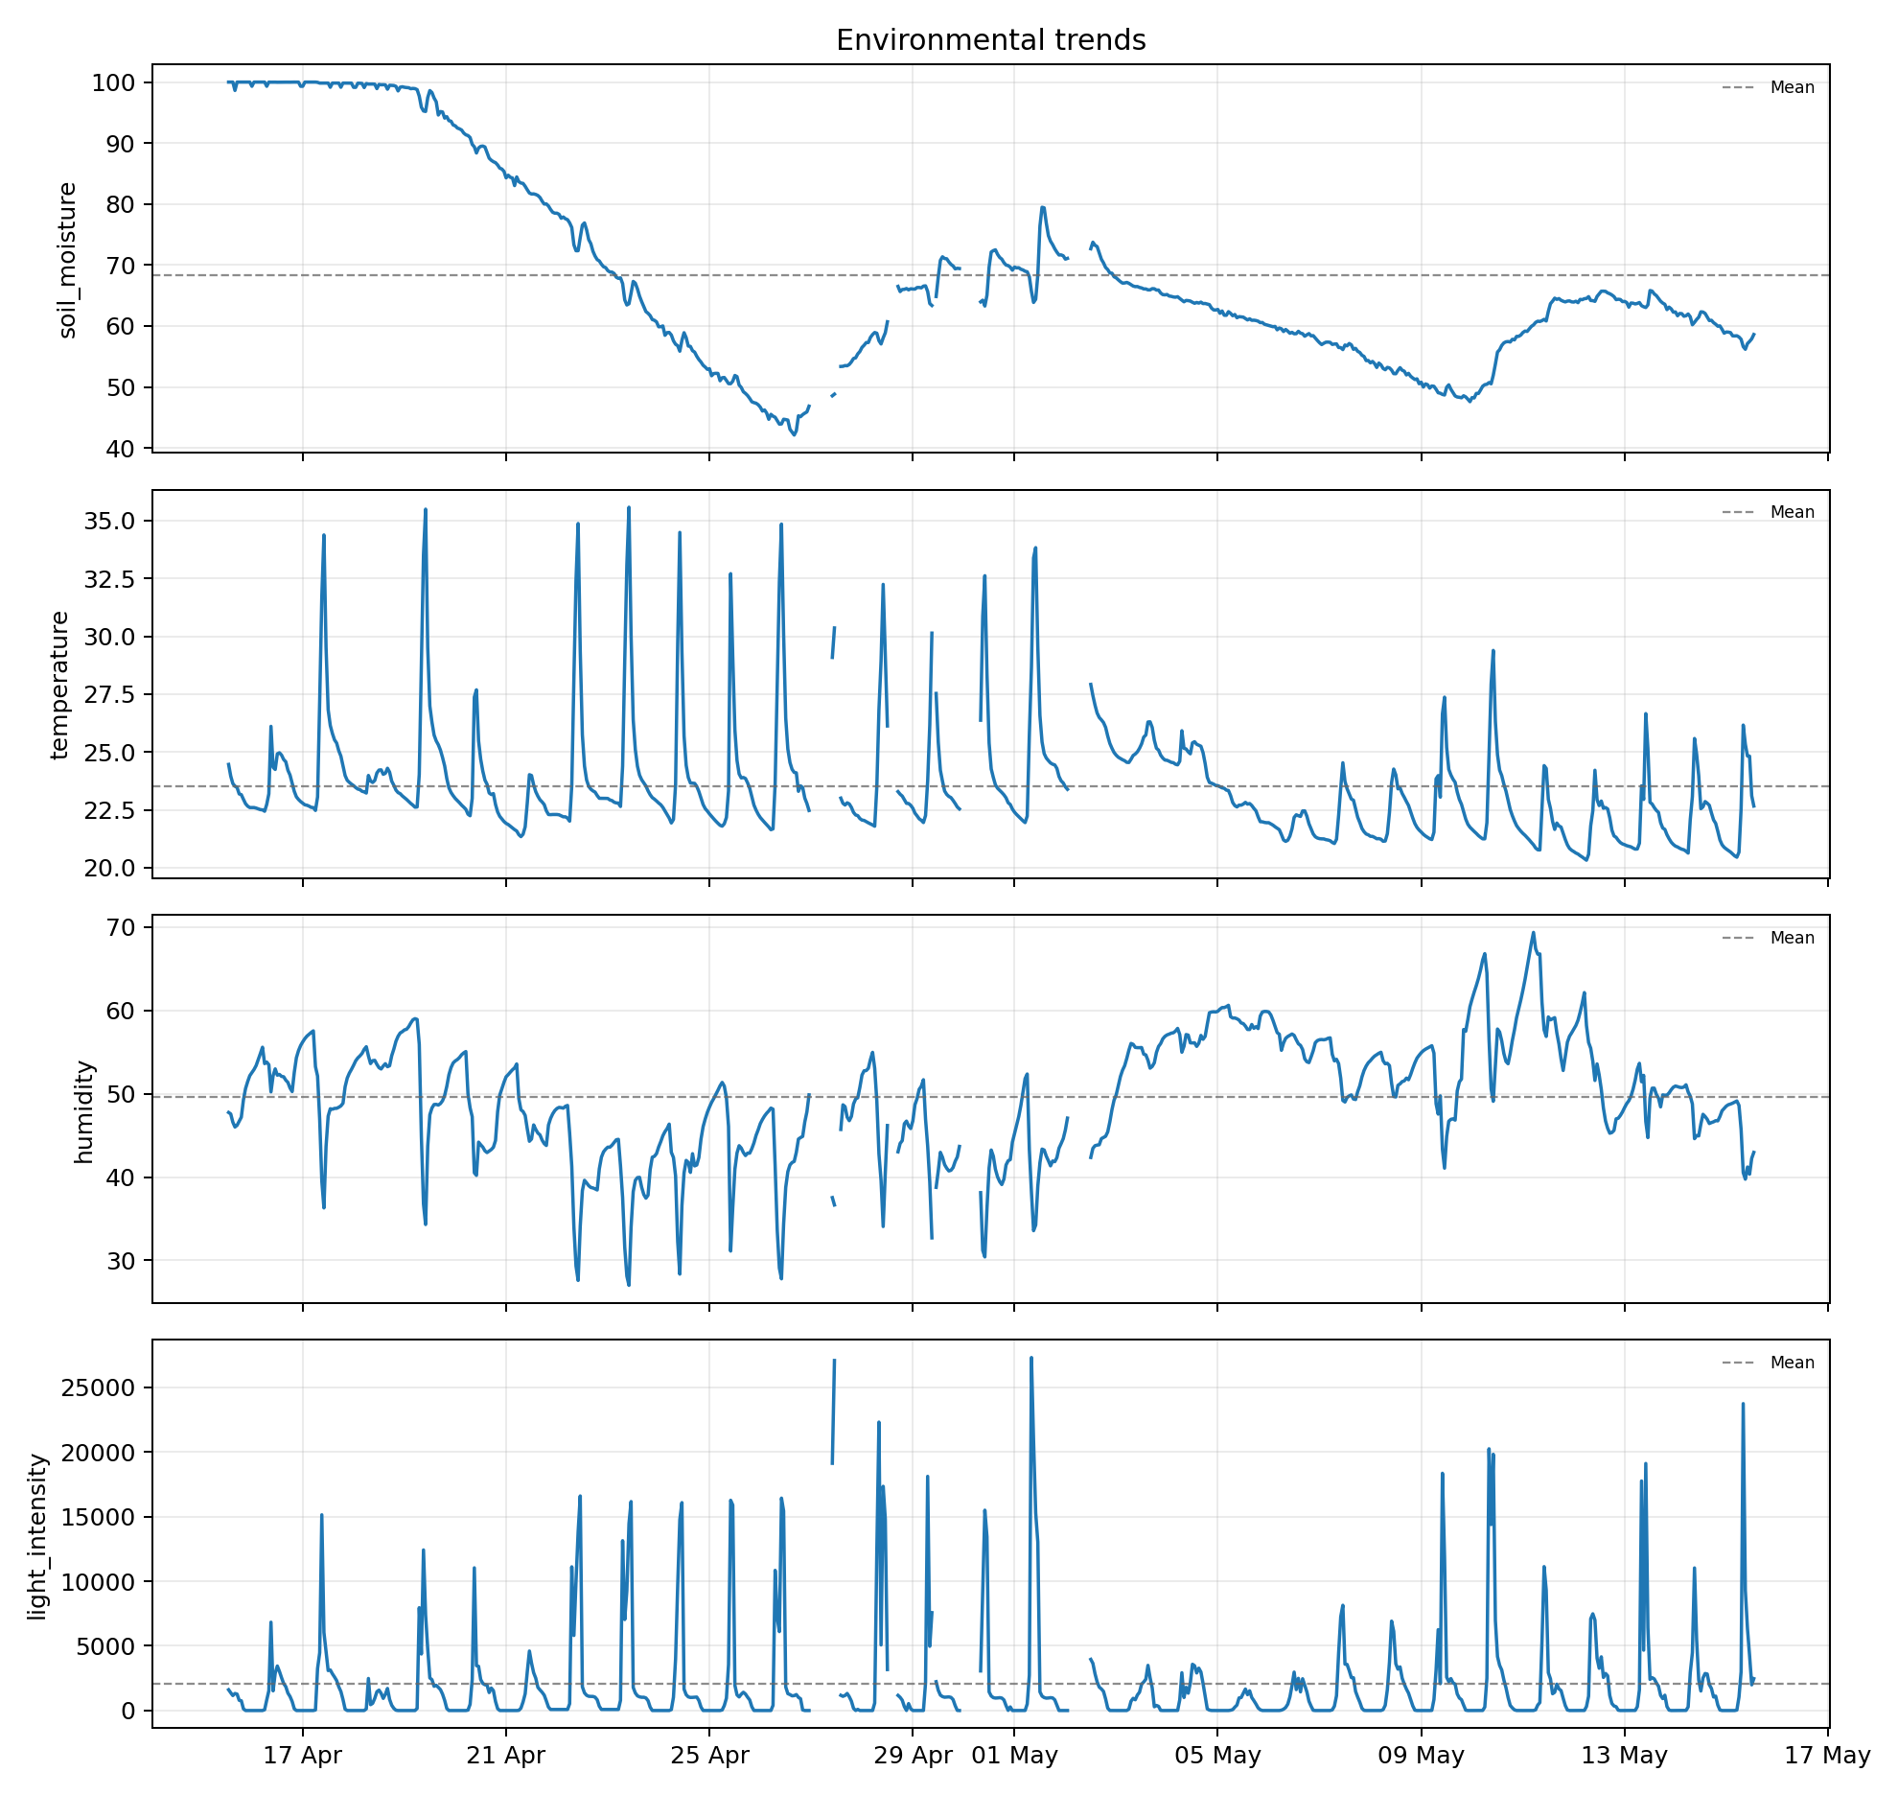
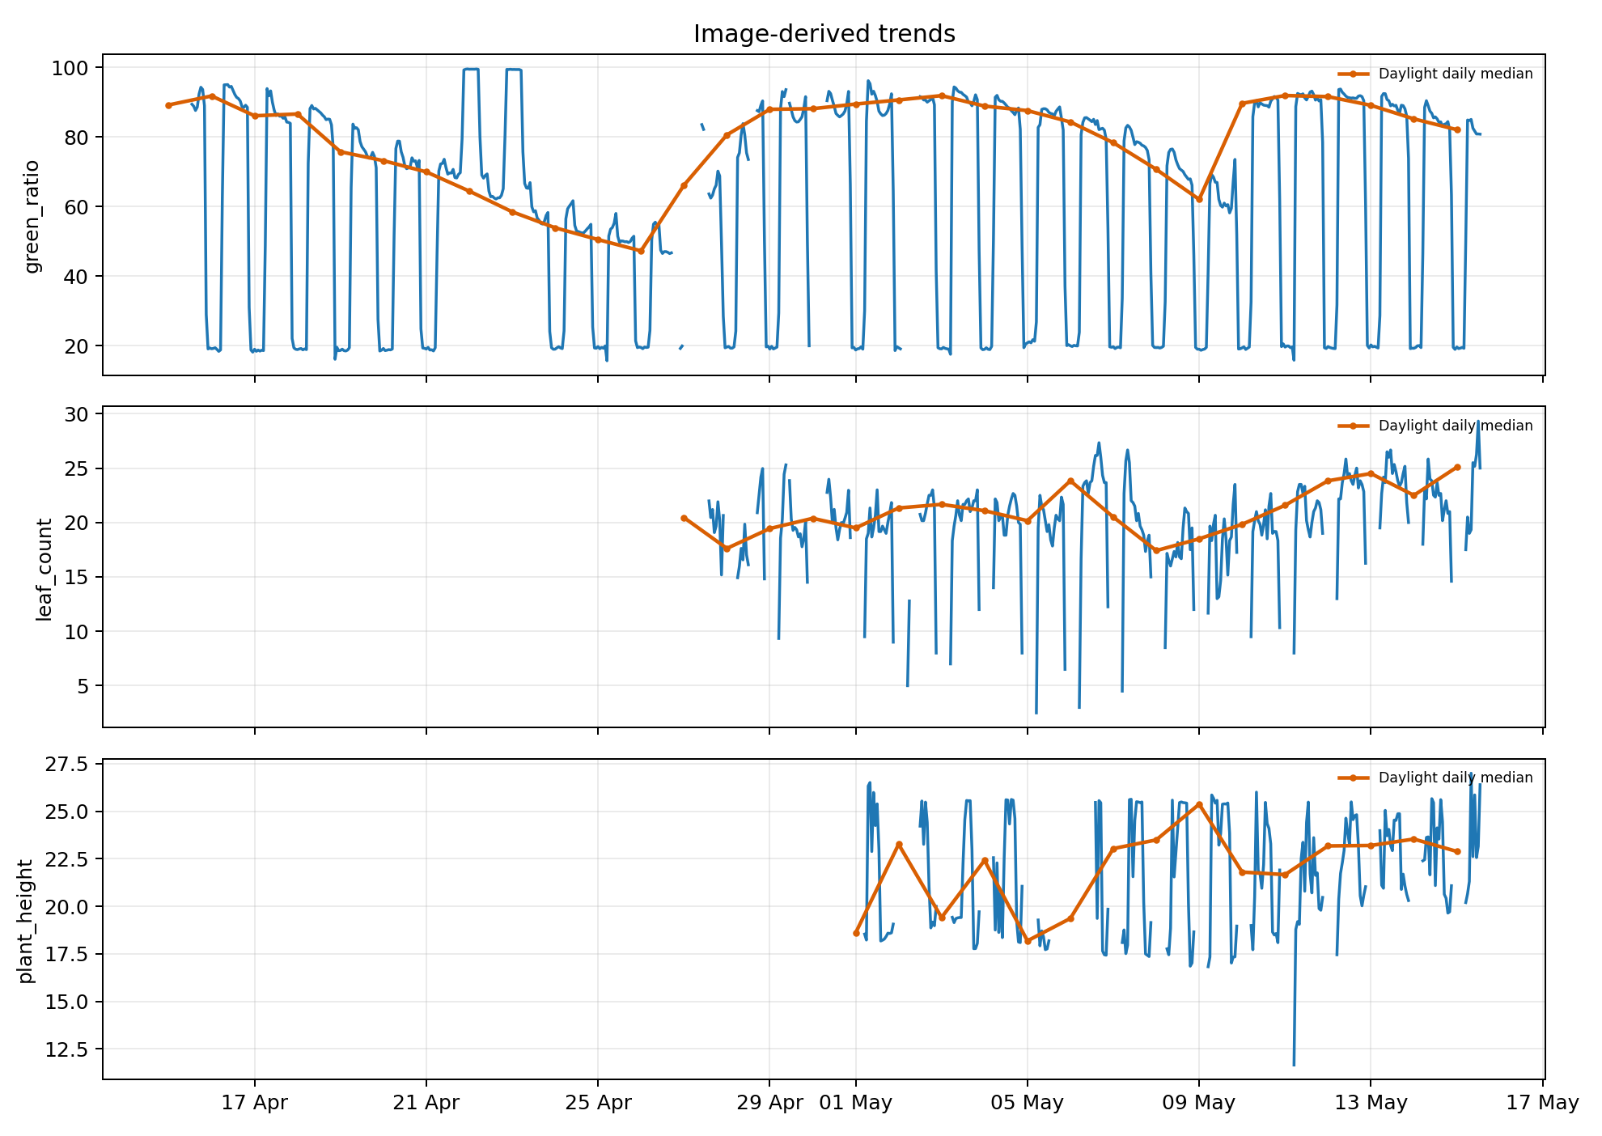
Observations
Notes:
What did thirty days of data actually show ?
First, clear daily rhythms in light, temperature, humidity.
Second, we can observe a dry-down trend.
I withheld watering for weeks to force the system to detect hydration stress.
Soil moisture fell from full saturation to forty-two percent, the visual indicators degraded along with it, and both recovered after watering resumed - the plant's visible state tracked its water status.
Third, the plant kept growing: the daylight median leaf count climbed from about twenty to twenty-five.

Slide 19
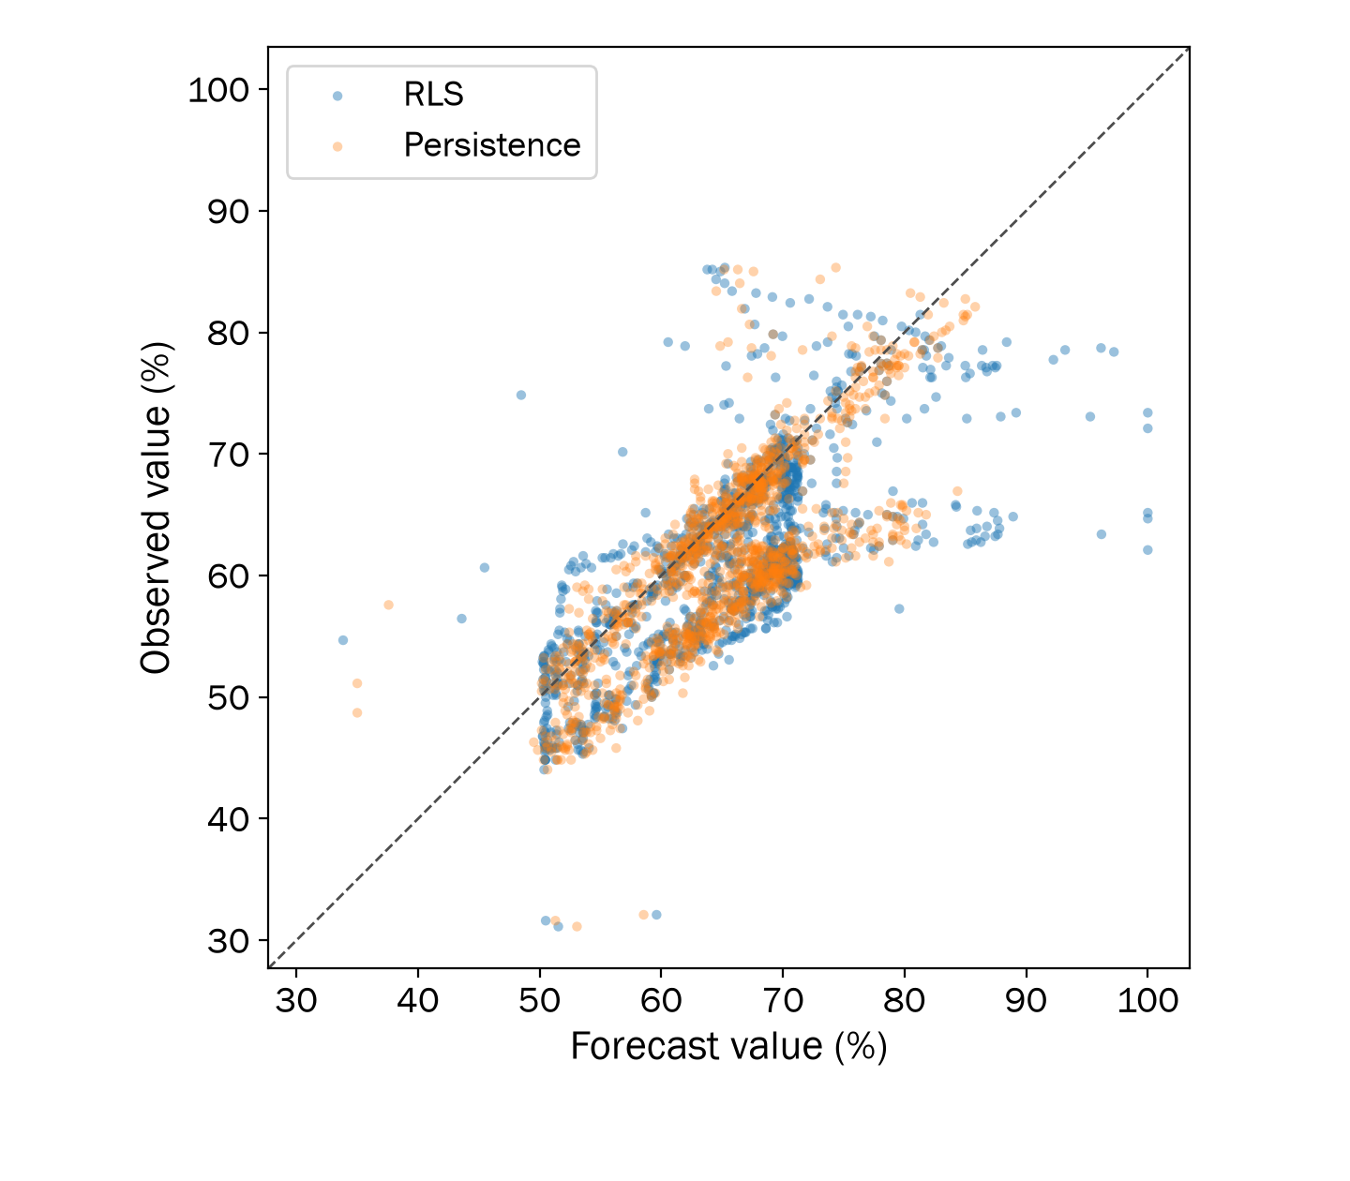
Forecast diagnostics
Notes:
The diagonal represents perfect agreement between forecast and observed moisture. Both models use the same 1,303 matches. RLS has MAE 5.54 and RMSE 7.53 percentage points. Persistence has MAE 4.65 and RMSE 6.21.

Slide 20
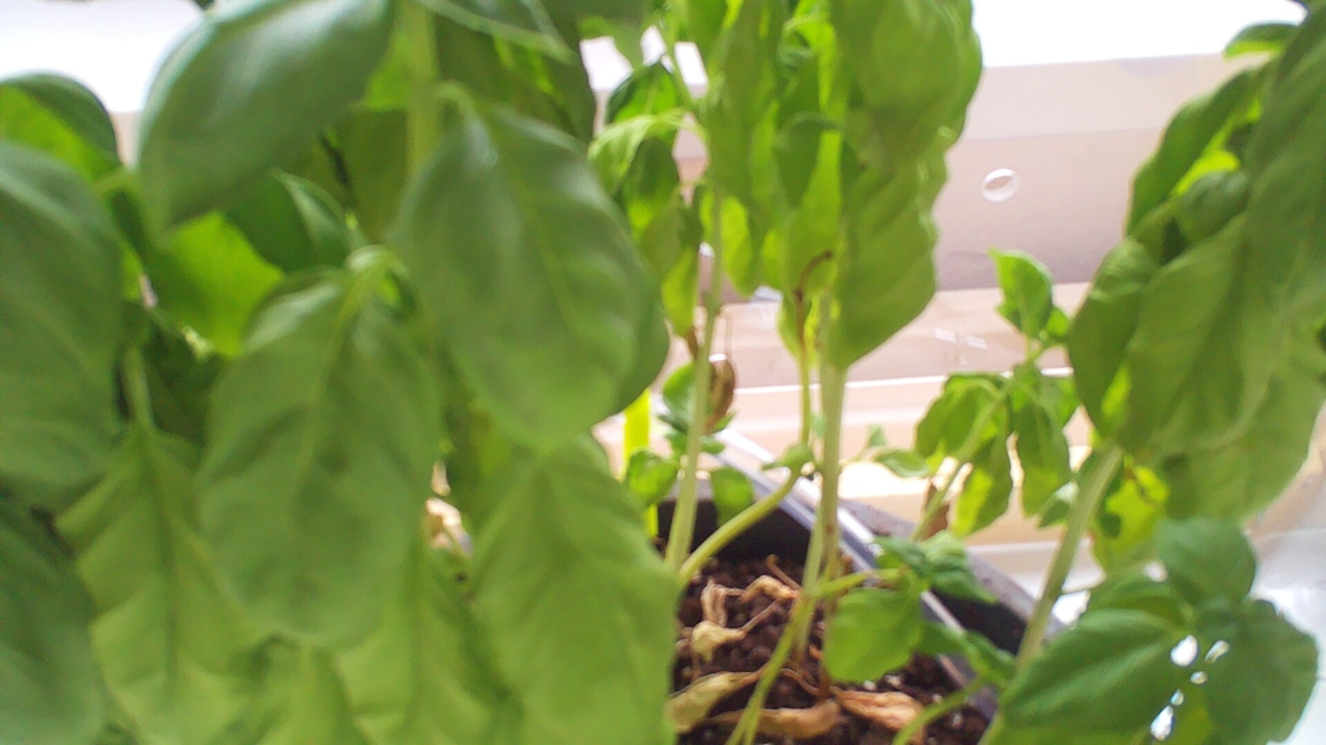
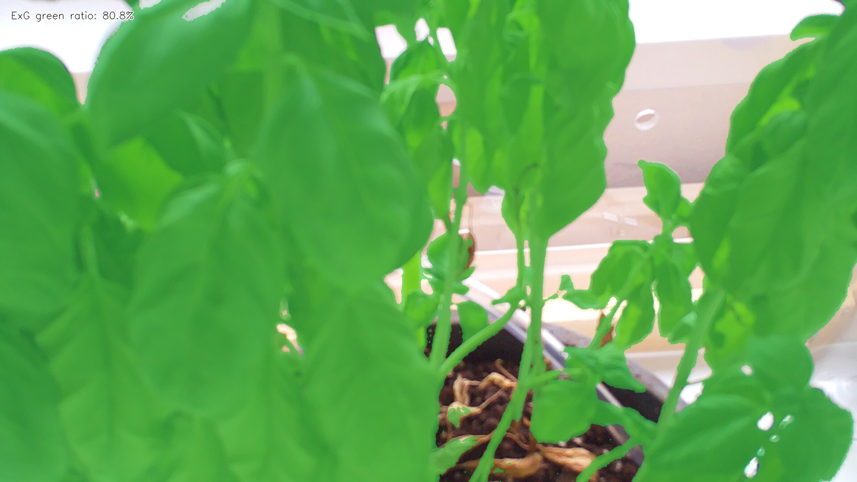
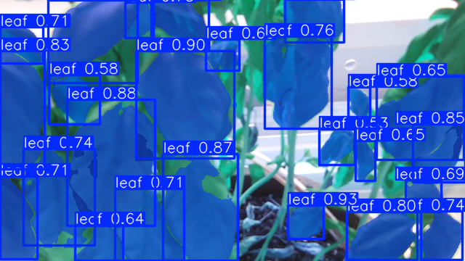
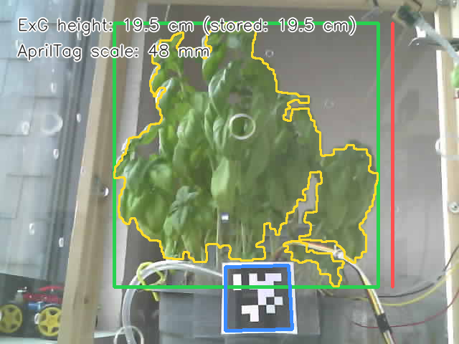
Image processing
Top view - raw snapshot
ExG segmentation → G(t) green ratio
YOLO leaf detection → N(t) leaf count
Side view + AprilTag scale → P(t) height
Notes:
The top-view green-pixel ratio comes from Excess Green segmentation. YOLO estimates leaf count. Side-view segmentation with an AprilTag scale provides an estimated height. These observations pass through the same preprocessing and quality checks as sensor readings. Camera conditions limit all three.

Slide 21
Future Work
What does each actuator do ?
Can it keep a plant healthy for a full cycle ?
Does it transfer to other environments ?
Where does it stop scaling ?
The prototype as an experimental platform.
Notes:
The prototype can now serve as an experimental platform for four follow-up questions.
Controlled tests to measure the onset, magnitude and duration of each actuator’s effect, so that we can get a clear view of each of those effects, how much to put in to gain a specific amount ...
Test the performance of the prototype to see if it can keep a plant healthy and make it grow and compare it against other methods
Identify if the prototype could easily transfer to other species or if some parts (sensors, thresholds and models) need recalibrations
Add plants, sensors and sampling rates until latency, memory or reliability becomes a limiting factor to understand how much does it scale. What to fix, what to change before making the prototype more complex.

Slide 22
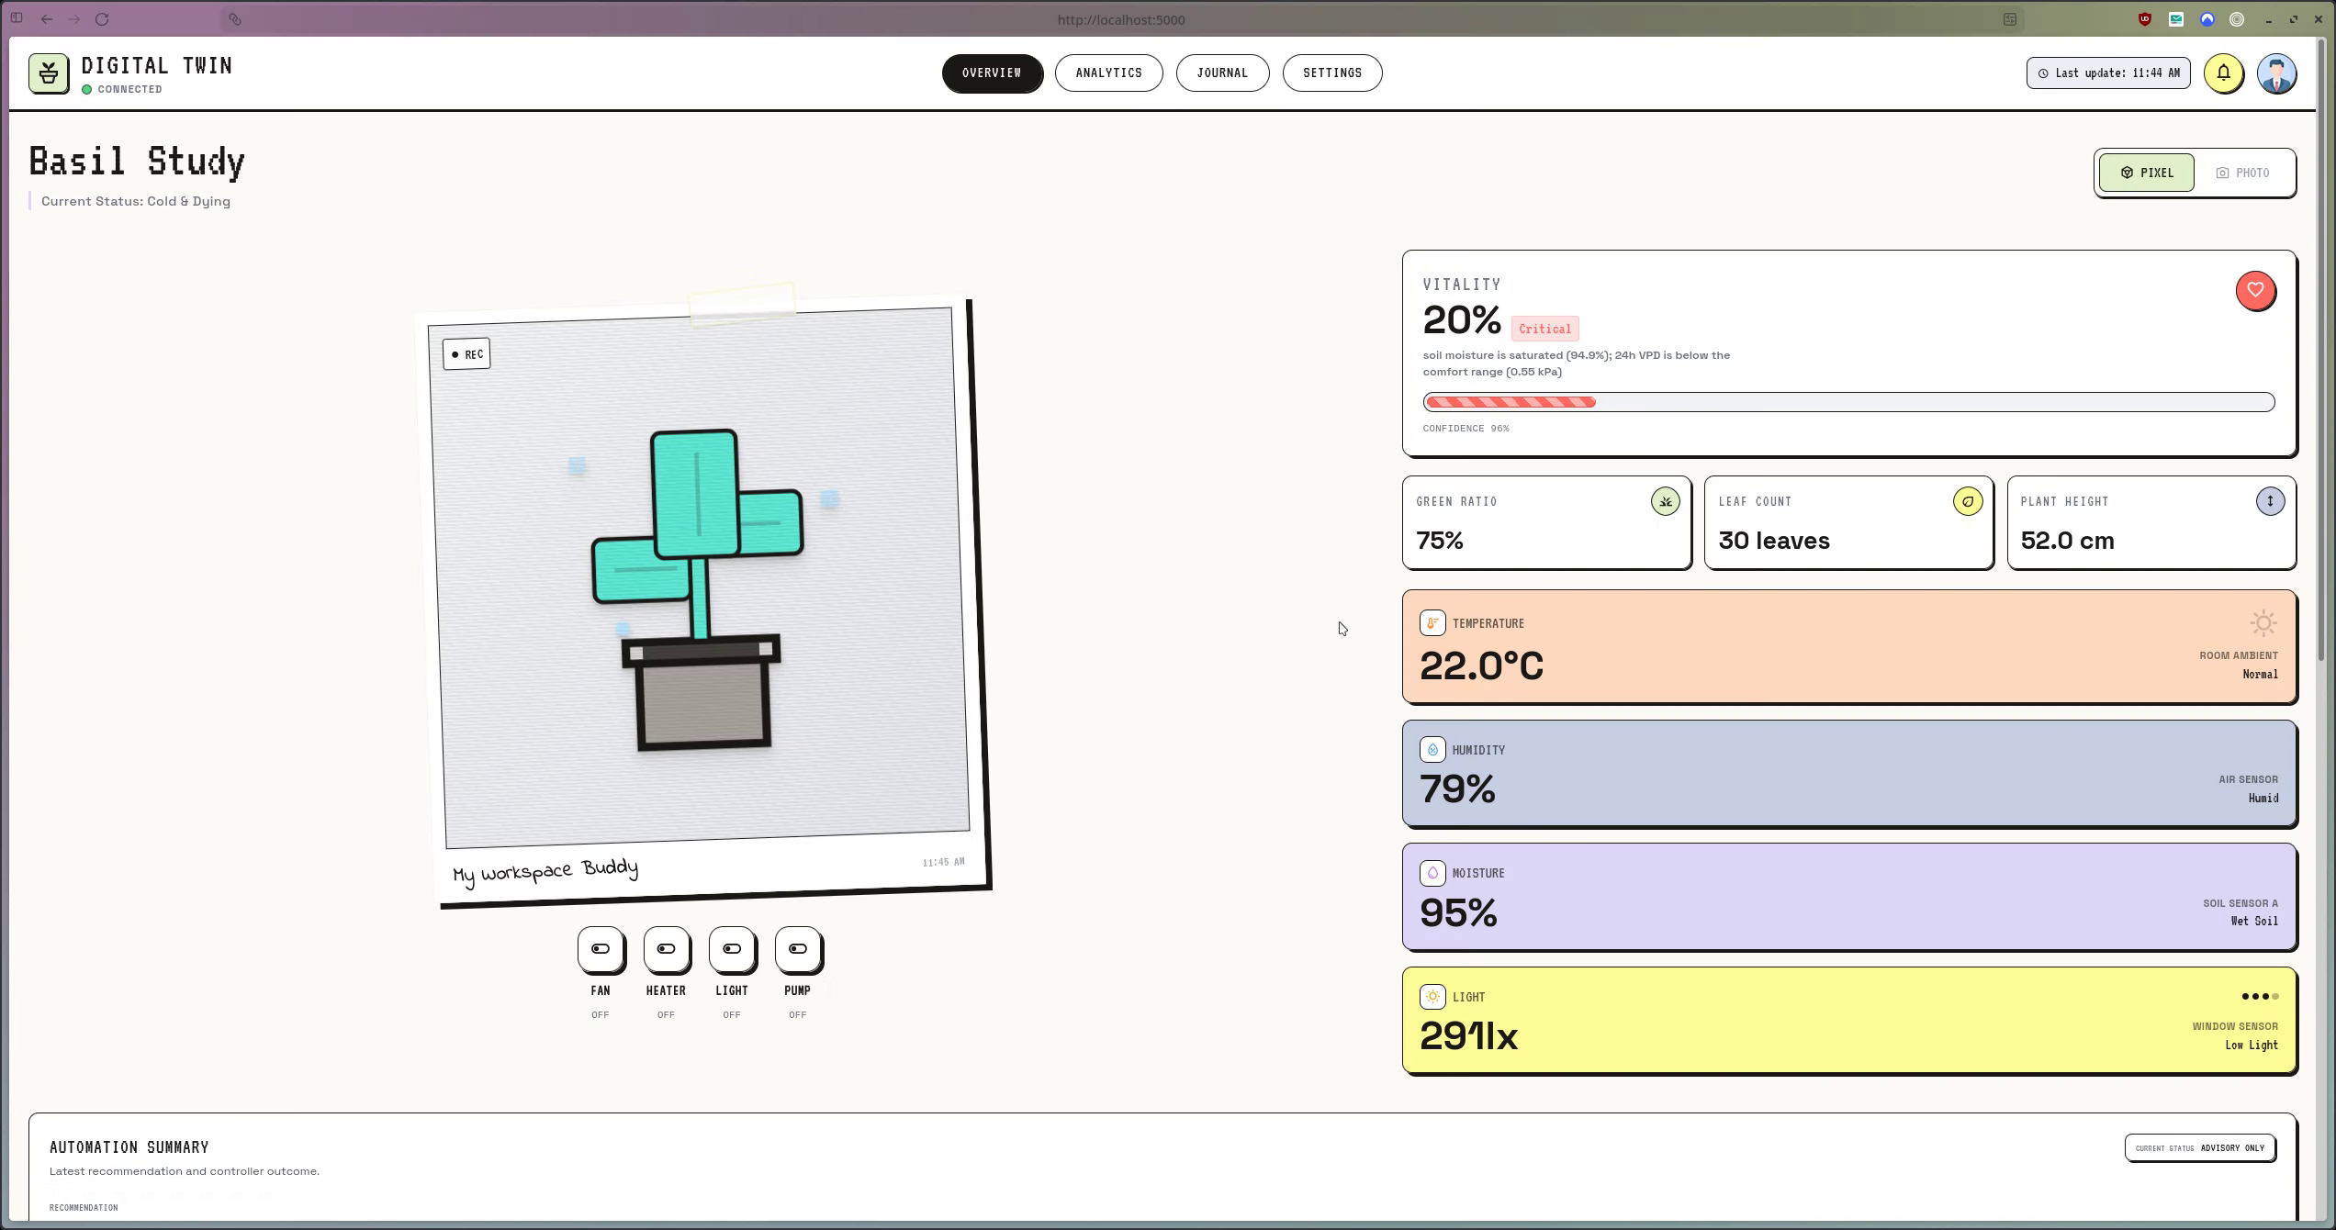
Demo
Notes:
Dashboard demonstration
Backup material outside the timed talk
This recording shows the dashboard interface and its supporting views. The video lasts about two and a half minutes and is embedded in the PowerPoint. It is outside the timed talk. Use it when discussing how the user inspects observations, forecasts and action history. Interface values shown in a demonstration should not be treated as additional case-study results.
Sources
docs/ai4dt-2026/main.typ
User-edited workshop deck saved on 18 October 2026
Rayan supplied /home/cbr/Videos/Screencasts/dt-demo.webm on 18 October 2026

