Slide 1
CS478 Assignment4 ONNX Research
Dec 15th, 2020

Slide 2
Research and Practical Test
Research into the ONNX framework
It’s use cases
Impact on machine learning
Companies implementation and support
Practical Experiment Using ONNX
Created two separate ONNX models using different frameworks
Pytorch
Tensorflow

Slide 3
Team Hard as ONNX
Chet Gurevitch
Alexandre Renaud
Rodolfo Rodriguez
Collaborative effort on research into the ONNX model

Slide 4
Deliverables
Code Repo (if any) (URL):
https://github.com/JustRudyRodriguez/DeepLearningOnnx

Slide 5
Project Summary
We performed a broad approach to research, looking at the many use cases of ONNX. As well as attempting to create two different ONNX models using different frameworks, Pytorch & Tensorflow
The Conclusion in brevity is that ONNX is a very versatile platform, and likely going to be significant stepping stone in the future of Machine learning.
Research is Contained in our supporting word.doc, we will now show our process in practical testing of ONNX.

Slide 6
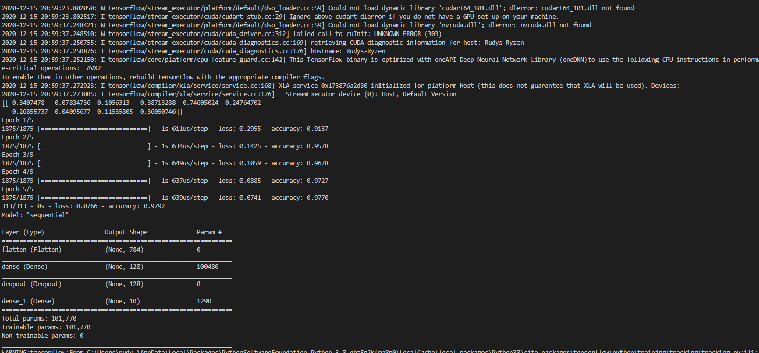
Tests/Demo
import tensorflow as tf
mnist = tf.keras.datasets.mnist#loading mnist dataset.
(x_train, y_train), (x_test,y_test) = mnist.load_data()#loading MNist Data Set into tuples
x_train, x_test = x_train/255.0, x_test /255.0 # converting data to float
model = tf.keras.models.Sequential([ #creating Sequential keras model.
tf.keras.layers.Flatten(input_shape=(28, 28)),
tf.keras.layers.Dense(128, activation='relu'),
tf.keras.layers.Dropout(0.2),
tf.keras.layers.Dense(10)
])
predictions = model(x_train[:1]).numpy() #or each example the model returns a vector of "logits" or "log-odds" scores, one for each class.
predictions
print(predictions)
#convert logitcs into probablities.
tf.nn.softmax(predictions).numpy() # not sure how to get this value right now.
#The losses.SparseCategoricalCrossentropy loss takes a vector of logits and a True index and returns a scalar loss for each example.
loss_fn = tf.keras.losses.SparseCategoricalCrossentropy(from_logits=True)
#This loss is equal to the negative log probability of the true class: It is zero if the model is sure of the correct class.
#This untrained model gives probabilities close to random (1/10 for each class), so the initial loss should be close to -tf.log(1/10) ~= 2.3.
loss_fn(y_train[:1], predictions).numpy()
#compiles model.
model.compile(optimizer='adam',
loss=loss_fn,
metrics=['accuracy'])
#The Model.fit method adjusts the model parameters to minimize the loss:
model.fit(x_train, y_train, epochs=5)
#evaluates model performance.
model.evaluate(x_test, y_test, verbose=2)
model.summary()
model.save('saved_model')
# The above code is from the into to tensorflow, as an example DL model.
#This following line is run from command line, and converts this tensorflow model into a ONNX model. saving it as model.onnx
#python -m tf2onnx.convert --saved-model saved_model --output model.onnx
TensorFlow Model
We created a sequential keras model.
It was using the mnist dataset, similar to the assignment we performed earlier in the semester.
We saved this model in tensorflow/keras format.

Slide 7
Pytorch
Pytorch model
We created a pytorch model as well.
We used a pre-built model in this case, because how the model was built did not matter.
Pytorch ONNX support allowed us to export the model in ONNX natively!
import torch
import torchvision
dummy_in = torch.randn(10, 3, 224, 224)
model = torchvision.models.resnet18(pretrained=True)
in_names = [ "actual_input_1" ] + [ "learned_%d" % i for i in range(16) ]
out_names = [ "output1" ]
torch.onnx.export(model, dummy_in, "pytorch.onnx", input_names=in_names, output_names=out_names, opset_version=7, verbose=True)
#pytorch offers native support for onnx, and makes the process of converting simple with one line of code.

Slide 8
Validation
We first converted the TensorFlow model using tf2onnx library.
Then using the ONNX runtime library, we ran Check_model() to validate both models were correctly saved in the ONNX format.
import onnx
# Preprocessing: load the ONNX model
model_path = 'pytorch.onnx'
onnx_model = onnx.load(model_path) #loading in the pytorch Model.
model_path = 'model.onnx'
onnx_model2 = onnx.load(model_path)# loading in the tensor flow model.
# Check the model, if an onnx model is not found function will result in error, if one is found will return none.
onnx.checker.check_model(onnx_model)
onnx.checker.check_model(onnx_model2)
print('The models are in onnx format!')

Slide 9
Conclusion
The ONNX model is a versatile framework aimed at helping the development of machine learning through supporting developers in these key ways.
Creating a standard for interoperability amongst key machine learning platforms.
Offering a runtime that can help enable application development using machine learning
Giving access to cloud infrastructure for faster training of complex models
Increasing Cooperation amongst different frameworks, to assist the machine learning ecosystem as a whole.

