Slide 1
DD Discussion
Pietro MeLzi, Alessandro Pina, Matteo Salvadore

Slide 2
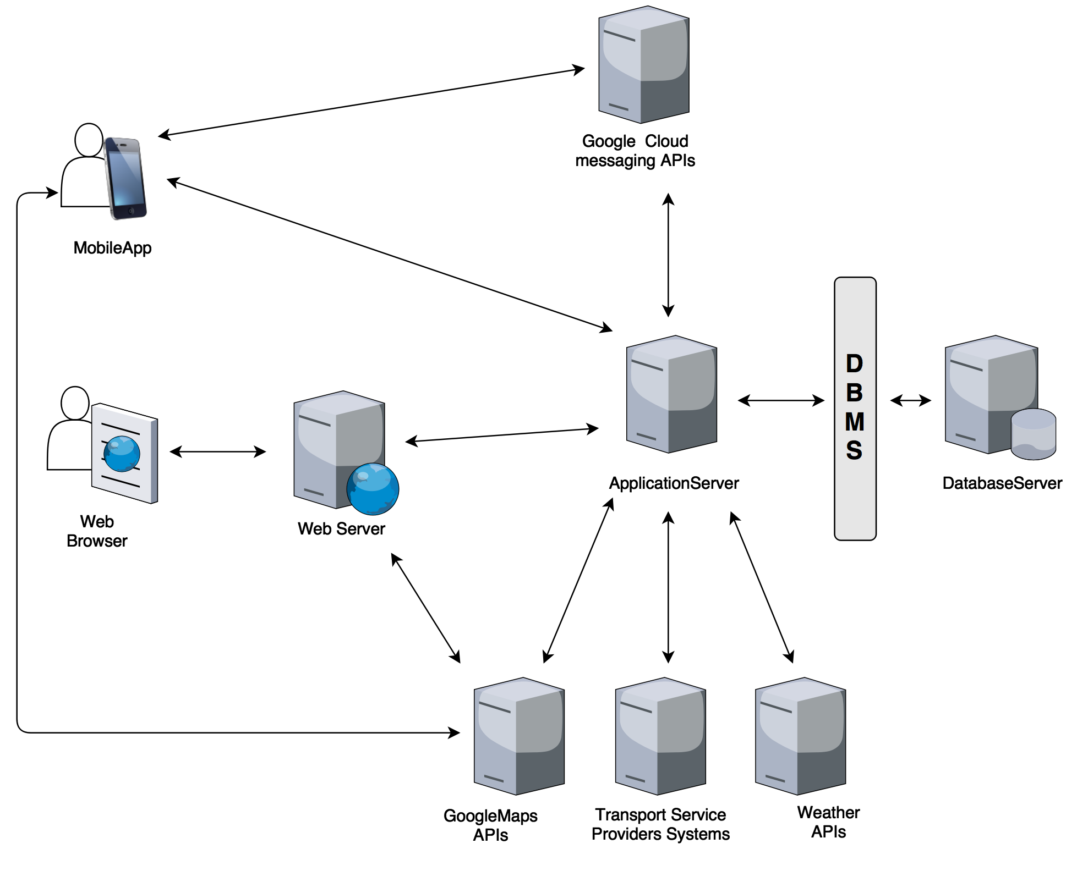
Architecture overview

Slide 3
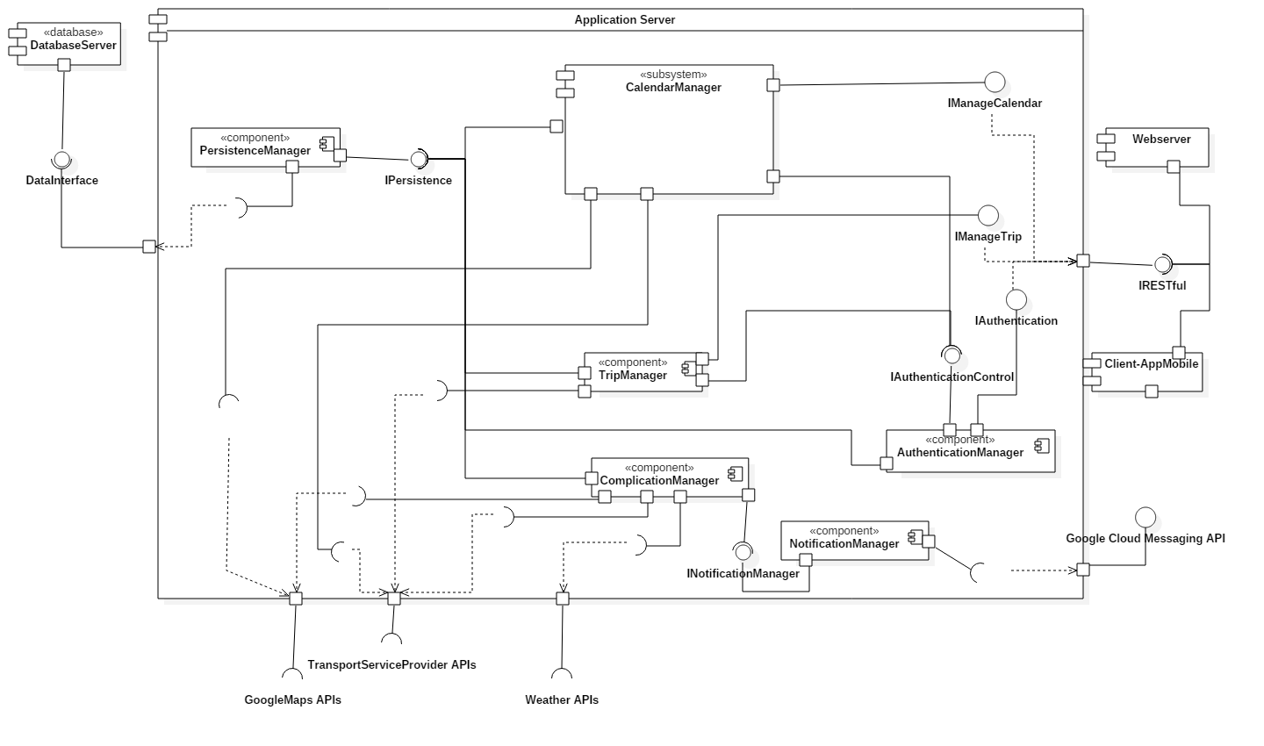
Main components: (1) application server

Slide 4
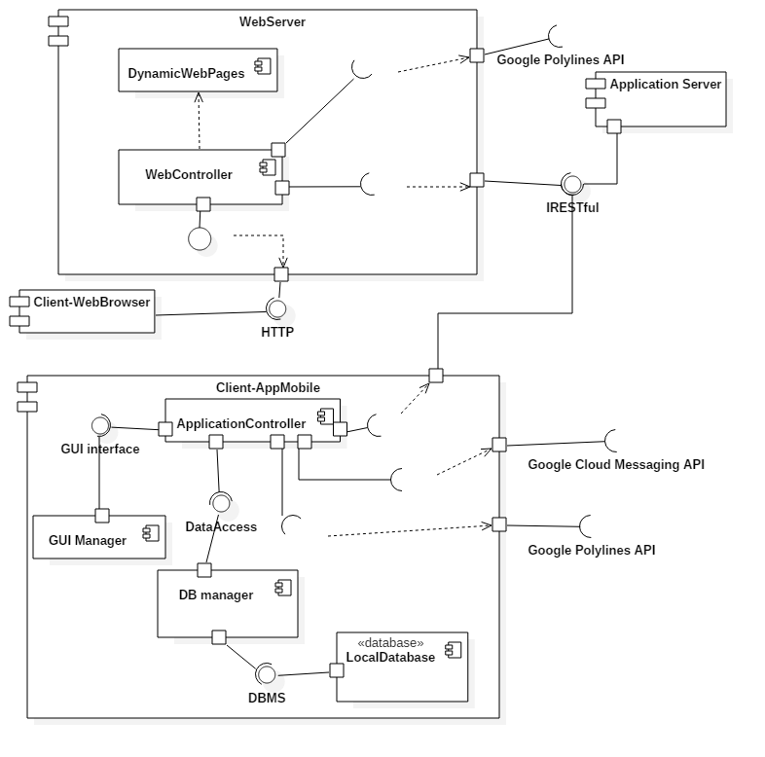
Main components: (2) web server and mobile app

Slide 5
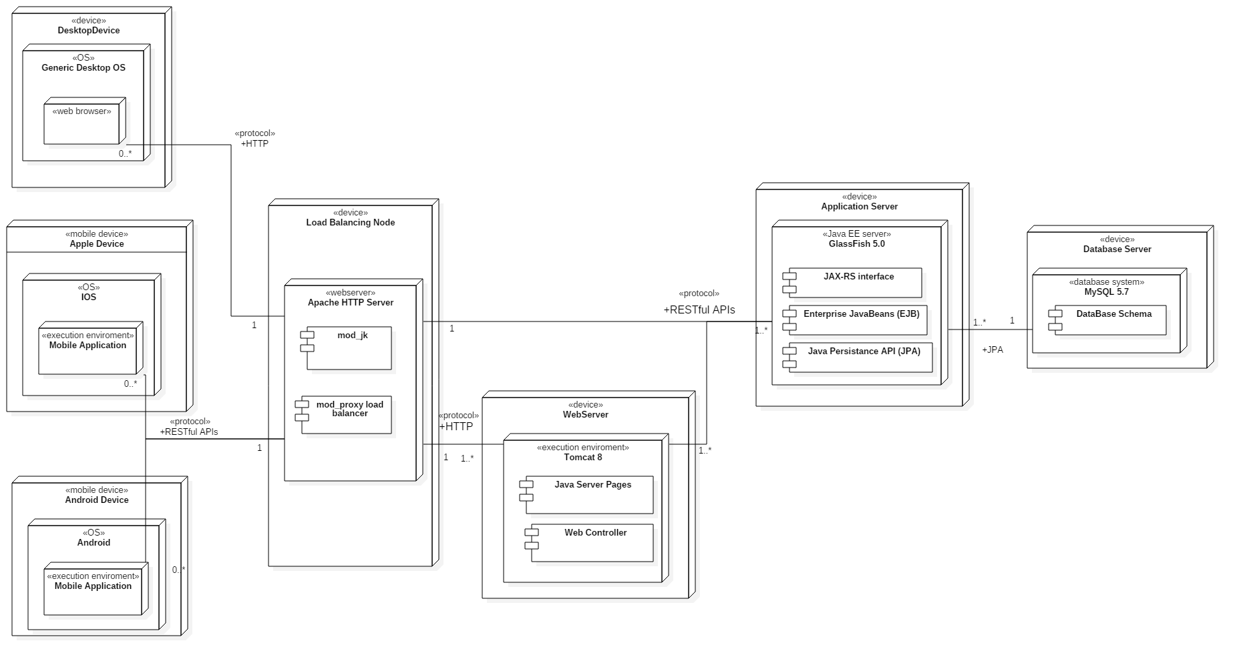
Deployment diagram

Slide 6
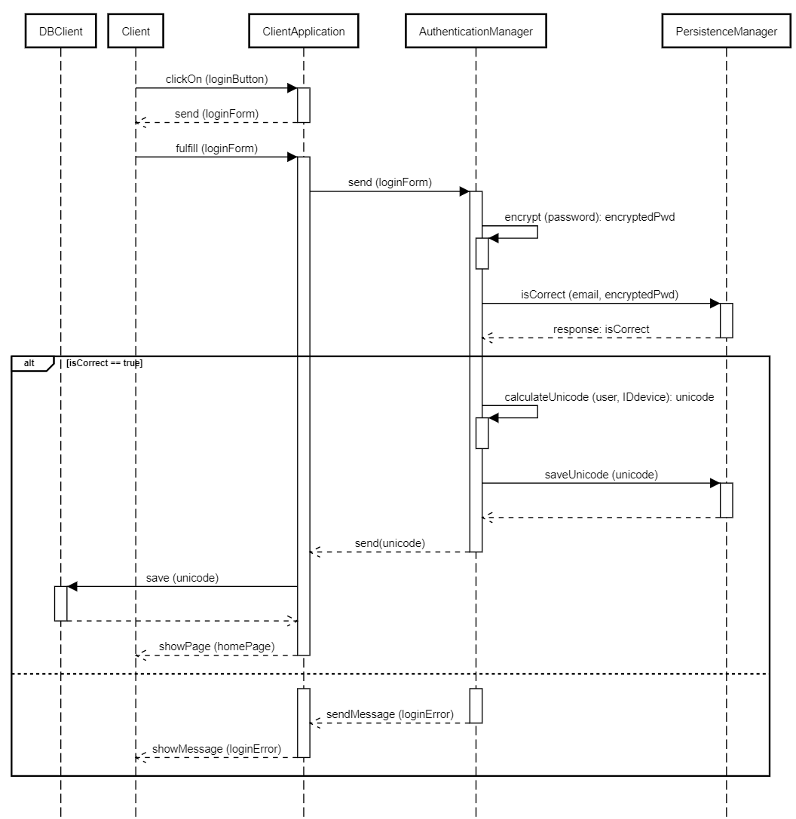
Runtime view: (1) login

Slide 7
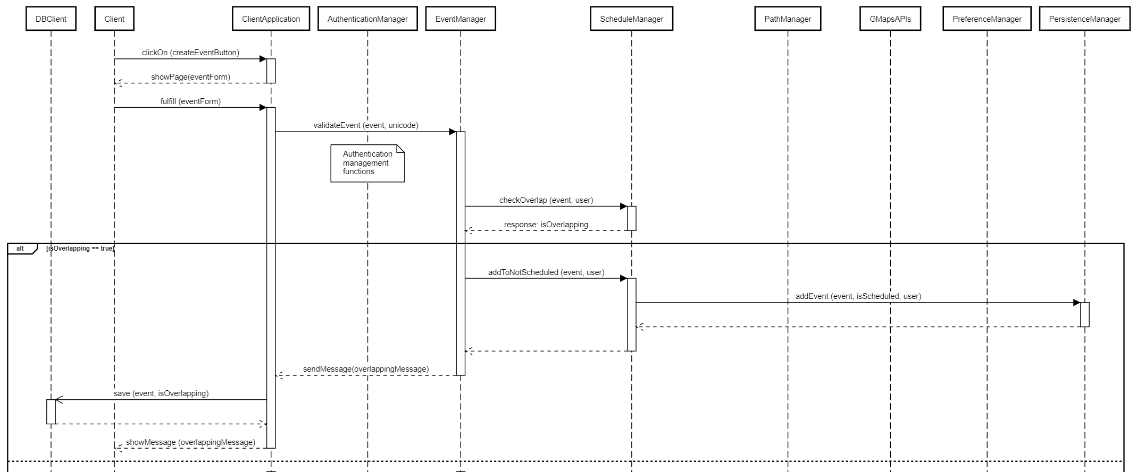
Runtime view: (2) create event

Slide 8
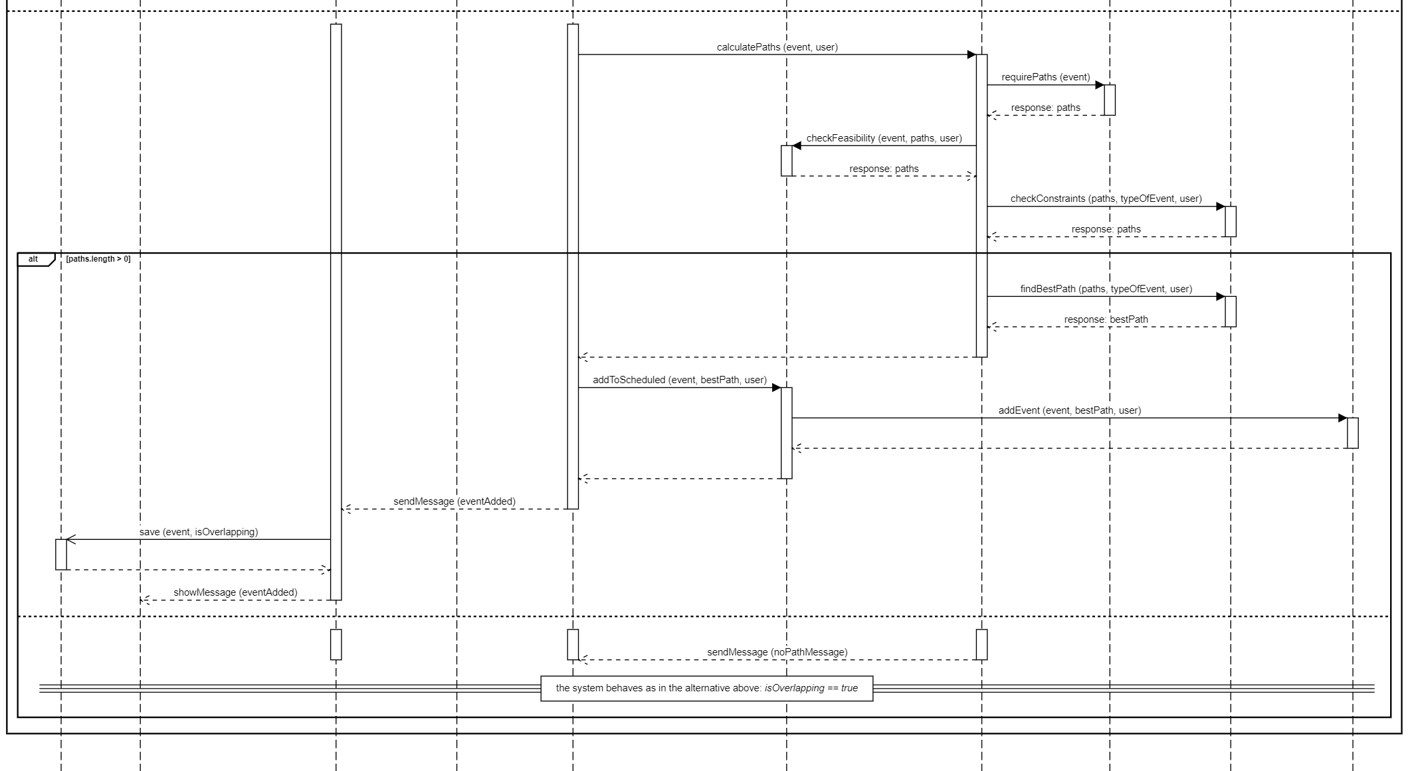

Slide 9
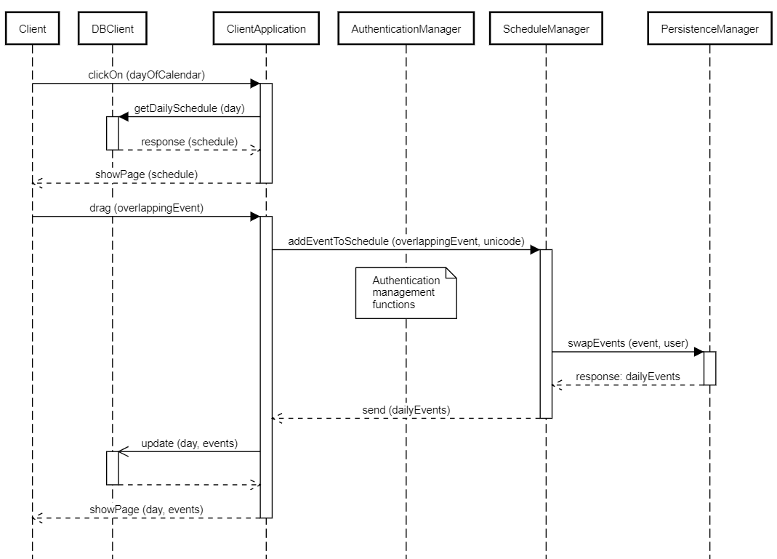
Runtime view: (3) choose between overlapping events

Slide 10
Other decisions
Notifications:
rely on GCM (Google Cloud Messaging);
sent when a travel is no more feasible due to traffic, adverse weather conditions or possible strikes;
sent when local DB must be updated.
Local DB update:
an user can access the system from different devices;
redundancy between server and local DBs must be handled;
timestamps are used to select data to be updated.

Slide 11
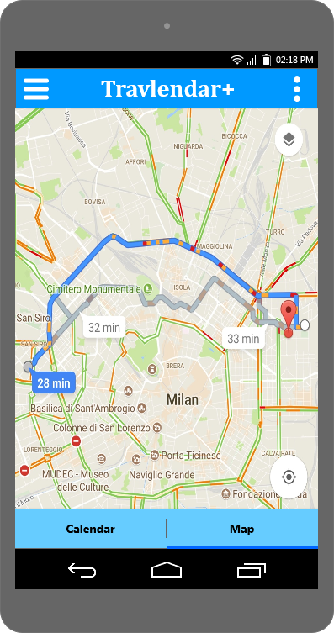
Algorithms: (1) path calculation
we rely on Google Maps APIs to calculate paths;
sharing vehicles are not included into results;
an internal algorithm will consider this option;
if a path with car or bike is possible and sharing vehicles are available on that path, a sharing path option is considered;
if in a subpath a sharing vehicle is available we’ll consider this option.

Slide 12
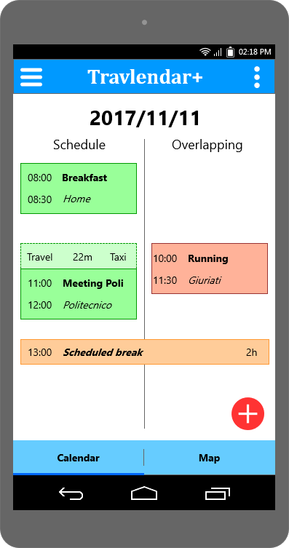
Algorithms: (2) overlapping event
schedule must contain only feasible events (with also feasible travels);
overlapping events are memorized into a different array;
the user can drag an overlapping event into the schedule;
the system will remove the scheduled events no more feasible.

Slide 13
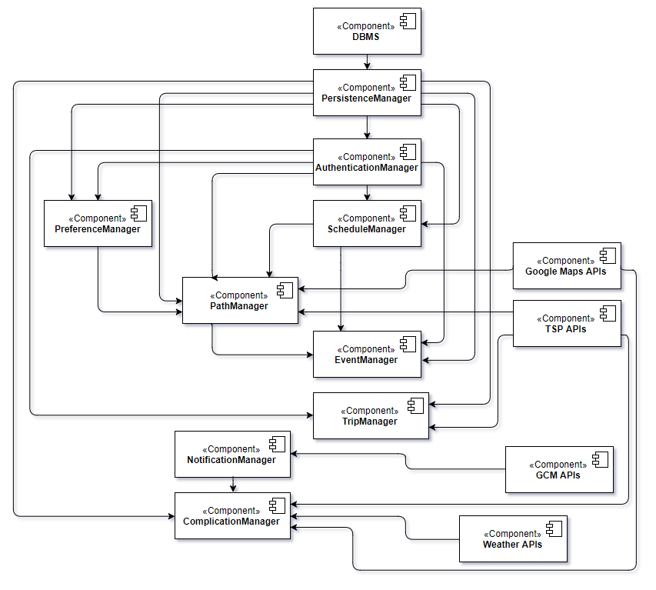

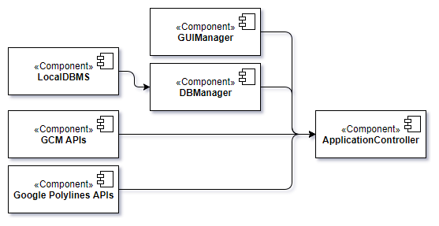
Implementation, integration and test plan
Application server
Web server
Mobile application

Slide 14
Thanks for your attention

