Slide 1
Autonomous Drone Obstacle Avoidance
Using Monocular Depth Estimation
Fixed Wing VTOL · Robotics and Computer Vision
Siddharth Lama Manit Aravind Sahil Asopa Riyaan Sheth
BTECH CAP 501 Project Life Cycle Management · Unit 1 and 2
1

Slide 2
DOMAIN · ROBOTICS AND COMPUTER VISION
Project Introduction
—> Small drones now inspect towers, survey sites, monitor crops and carry parcels. Almost all of that work happens close to structures and close to people.
—> To avoid obstacles you must know distance. Laser scanners measure it well but are heavy, costly and power hungry. Stereo pairs need calibration that survives vibration.
—> On a small airframe the binding currency is mass. Every gram of sensor is a gram not spent on battery, and battery is flight time.
—> One ordinary camera weighs a few grams and costs very little. It simply cannot measure distance, because projection destroys depth.
The problem area
A single photograph has no distance in it. A small object near the lens and a large one far away project to identical pixels.
No amount of geometry recovers the difference from one image.
What changed
Photographs of the real world are highly structured. Distant surfaces look smaller, lose contrast and are hidden by nearer ones.
MiDaS learned those cues from a mixture of public datasets and generalises to scenes it has never seen.
2

Slide 3
WHY IT MATTERS · WHAT IS IN AND OUT
Problem Statement and Scope
The problem, stated precisely
A small aircraft carrying only one forward facing colour camera must reach a sequence of positions in a cluttered space without striking anything, using no distance sensor, no prior map and no external positioning.
In scope
Simulation as the graded deliverable, with perfect depth available for comparison.
Pretrained MiDaS used as published. No training.
A transparent reactive policy with a non learned safety stop underneath.
Seeded courses so every depth source is judged on identical layouts.
—> Depth is predicted, not measured. A prediction can be confidently wrong and nothing in the output says when.
—> The prediction has no units. It says which things are nearer, not that the wall is three metres away.
—> The camera sees a wedge. A one metre wingspan sweeps a full circle. Anything that leaves the frame is invisible while the wingtip is still moving.
Out of scope
Mapping and global path planning. The planner only ever reacts to the current frame.
Training a depth network from scratch.
Moving obstacles.
Outdoor flight, until the regulatory position is confirmed in writing.
3

Slide 4
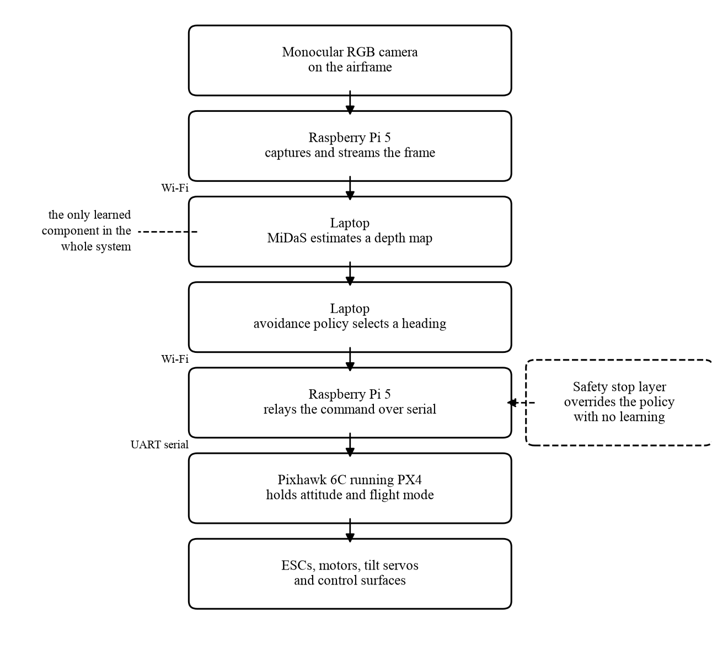
ONE LEARNED STAGE, EVERYTHING ELSE READABLE
Proposed AI and ML Solution
Uncertainty and experimentation
The network returns a plausible estimate, not a guaranteed value. Two similar scenes can give different depth.
So the loop is built to tolerate it. The chosen heading is smoothed over time rather than taken from the newest frame.
Monitoring after deployment
Scene statistics such as brightness and near field pixel fraction are tracked against a reference distribution.
Drift lowers the speed and raises the stop distance. Less confidence must always produce more caution.
Model evaluation
Depth quality on real photographs, using NYU and KITTI, after aligning both scale and offset by least squares.
Flight outcomes across many held out seeded courses, reported as distributions with a confidence interval.
Retraining when conditions change
Deliberately a second line response, never the first.
Light adaptation to new scenes must pass the simulation quality gate before it is promoted. Slowing down is safer than a fresh model nobody has tested.
4

Slide 5
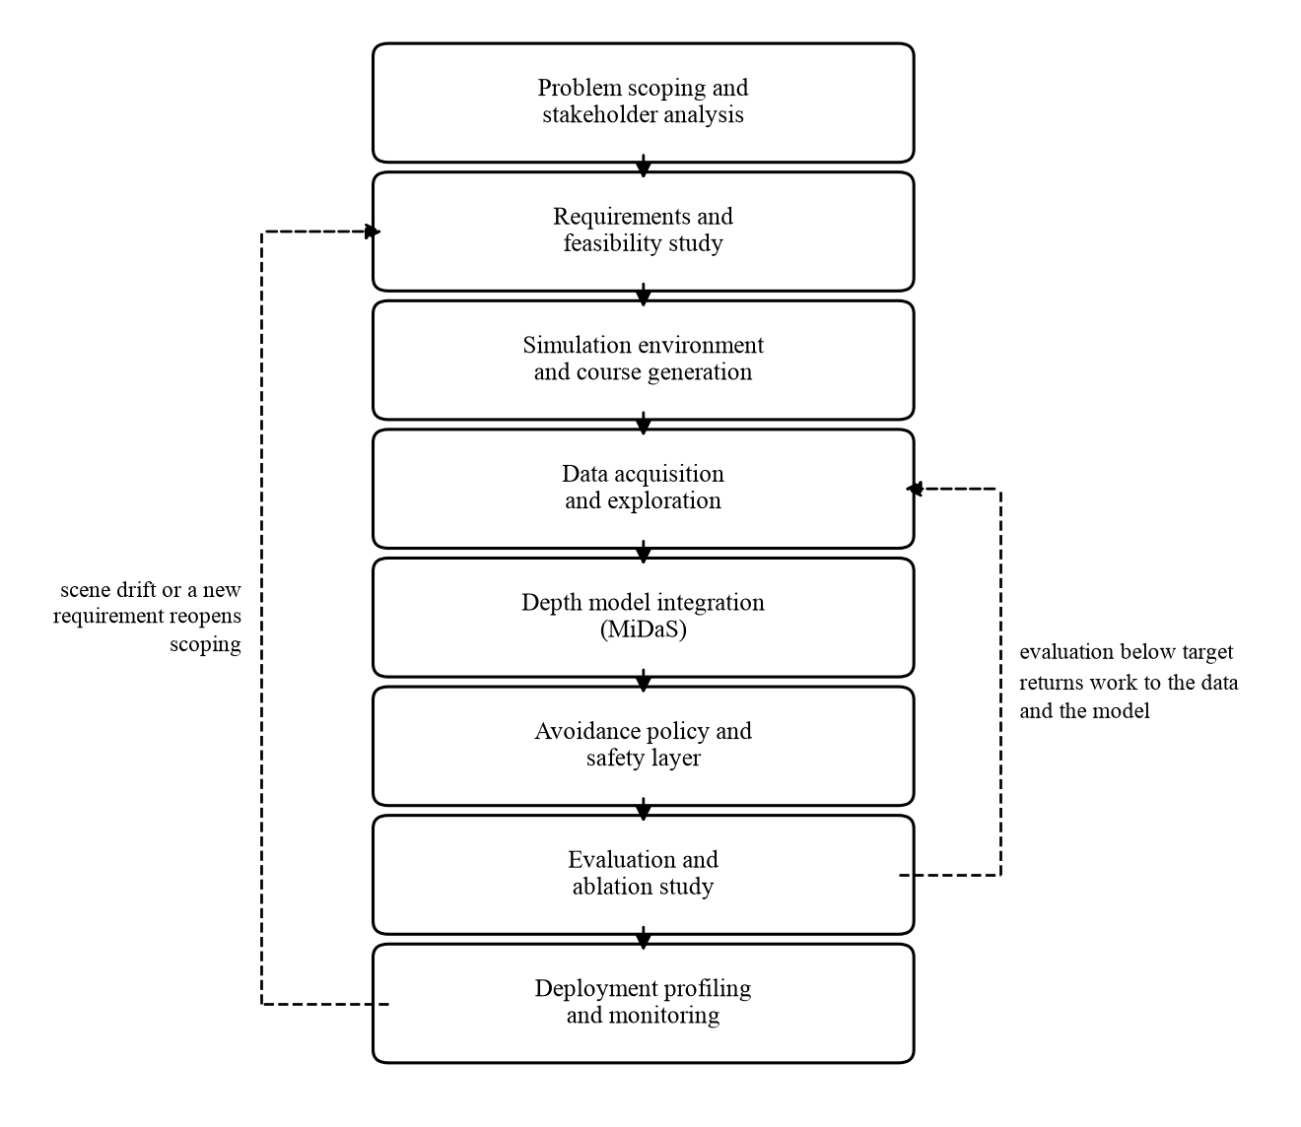
PROBLEM TO MONITORING, WITH THE LOOPS THAT MATTER
Life Cycle and ML Pipeline
The two feedback loops
Evaluation back to data and model. Poor ablation results send work to perception, not to the steering logic.
Monitoring back to scoping. If scenes stop resembling development, the problem has moved even though nothing broke.
Automated pipeline stages
Course generation from seeds, and frame export.
Depth benchmarking and per seed flight scoring.
Policy parameter search and drift comparison.
The quality gate before a change is accepted.
We have already used loop one
An early evaluation had the aircraft barely moving.
The lineage record traced it to feature creation. Per column distance included the floor, so every direction read the same and the policy could not tell open space from an obstacle.
Human judgement and accountability
What density is a fair test, not a flattering one.
Which seeds are held back, fixed before results.
What accuracy justifies flying at all.
That it is fit to fly near people.
5

Slide 6
CRISP-DM · TDSP · GOOGLE ML
Comparing Life Cycle Frameworks
Aspect | CRISP-DM | Microsoft TDSP | Google ML Life Cycle
Primary emphasis | Understanding the problem through iteration | Roles, deliverables and repeatable team process | Production serving and continuous operation
Data work | Central, with its own phase and explicit rework | Structured acquisition with a documented manifest | Automated validation and transformation
Operation | Ends at deployment | Ends at customer acceptance | Assumes a running system with retraining
Automation and pipeline | Little. The cycle is human driven | Moderate, through templates and reports | Strong. The pipeline is the unit of work
Team collaboration | Light, no prescribed roles | Explicit named owner per deliverable | Assumes a platform team already exists
Best fit for this project
CRISP-DM. Our work is investigative. We do not know in advance how much performance is lost when measured depth is replaced by predicted depth.
It expects evaluation to send work back, which is exactly what happened to us.
Framework selection
CRISP-DM sets the shape of the work. Google pipeline discipline applies to anything that runs more than once.
TDSP contributes only its named owner per deliverable. Its customer acceptance stage assumes a client we do not have.
6

Slide 7
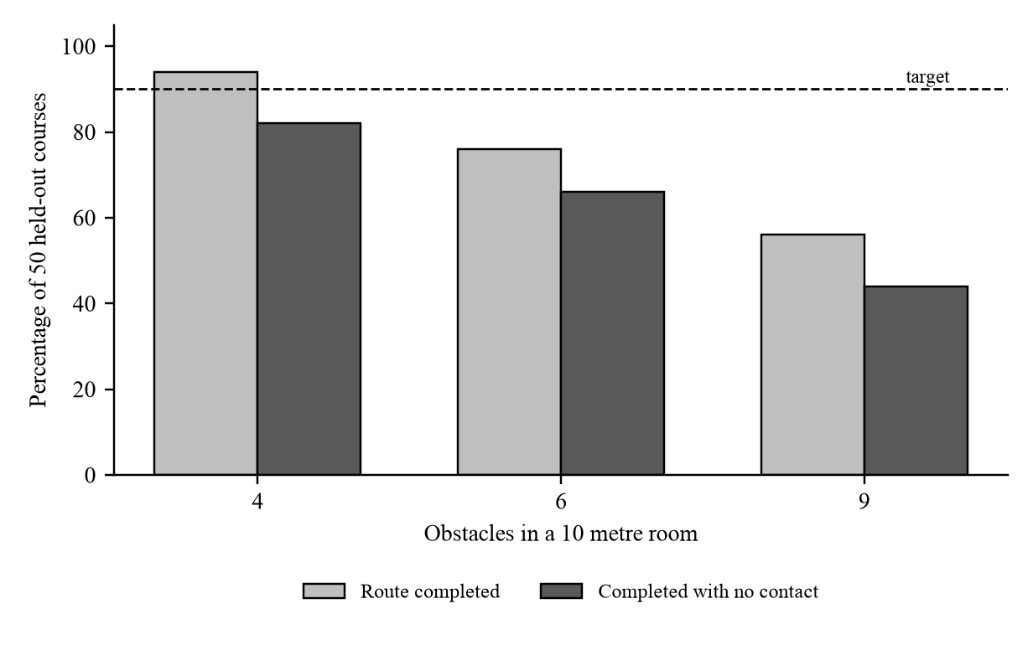
TESTED, NOT ASSERTED
Technical Feasibility
Aspect | Project analysis | Risk | Mitigation
Data sufficiency | No training data needed. The simulator gives exact depth free | Simulator imagery is cleaner than photographs | Report benchmark accuracy on real images alongside
Model capability | MiDaS-small, 21 M parameters, built for CPU | Output has no units, unknown scale and offset | Fit both by least squares. Median scaling alone is wrong
Latency and hardware | Our loop sustains over 200 cycles per second on a laptop | Streaming video over Wi-Fi can eat the whole 100 ms budget | Measure the round trip. Benchmark the model on the Pi first
Sensor coverage | Camera sees a wedge. The wing is 1.00 m across | Obstacles leaving the frame are hit by the wingtip | Wide lens plus a short term decaying memory. Both tested
Airframe control | Four motors with two tilt servos, so a tilting rotor | Tilt mechanisms and transition are the hardest VTOL case | Keep all avoidance testing in hover. Transition is separate
What the measurement says
Every figure uses perfect depth, so it is the ceiling. Estimated depth cannot beat it.
Tuning on 12 courses gave 92 per cent. The same settings gave 66 per cent on 50 held out courses. Quote the second number.
7

Slide 8
COST, OPERATION AND HARM
Economic, Operational and Ethical Feasibility
Aspect | Project analysis | Risk | Mitigation
Economic | Simulation costs nothing. Airframe 55,000 to 90,000 rupees | Buying motors before the mass budget exists | Two stage purchase. Propulsion last
Economic | No labelling needed. The simulator supplies exact depth | Development effort is the real cost, paid in time | Four owners, one per workstream
Operational | Team operates it. A named pilot holds a manual override | An alert nobody reads is not monitoring | Named owner for drift review
Operational | Model never retrained, so no retraining pipeline | Work becomes unusable once the team disperses | Seeded courses, pinned versions, one hour to reproduce
Economic conclusion
The graded deliverable is unambiguously feasible. It costs nothing beyond hardware the team owns and time the semester already allocates.
The airframe is the only real expenditure, and propulsion is deferred until all up mass and thrust to weight are known.
Ethical issue | Affected group | Potential harm | Mitigation
Privacy | Anyone within view who never agreed | A camera above head height records private ground | No frame written to disk in flight. Nothing leaves the operator
Bias and fairness | People near textureless or thin structures | The model is worse there, moving risk onto them | Failure modes published, stop distance set for the worst case
Misuse | Bystanders and observed individuals | Autonomy lowers the barrier to persistent observation | No person detection, tracking or recording exists. Deliberate
Oversight | Bystanders and the operator | Nobody accountable if the system is treated as responsible | Named pilot in command. The stop layer cannot be overridden
Ethical conclusion. It may proceed, with conditions
Graded work stays in simulation. Flight begins indoors, enclosed, over soft flooring, guards fitted, override held.
No transition until hover is stable and repeatable.
Published results always quote estimated depth on held out courses. Overstating reliability for a system that can strike a person is a safety failure, not a presentational one.
8

Slide 9
WRITTEN SO EACH ONE CAN PASS OR FAIL
Requirements Engineering
Functional
FR3 A safety layer refuses forward motion whenever the nearest surface at flying height is inside 1.2 m, overriding the policy.
FR4 The aircraft flies an ordered sequence of operator specified stations with no further human input.
FR6 A given integer seed always produces the identical obstacle layout.
Data
At least 5,000 colour and true depth pairs from seeded courses, plus the NYU and KITTI evaluation splits.
Camera intrinsics recorded for every source so comparisons between sources are valid.
Courses are regenerated from committed seeds rather than stored. The seed list is the dataset.
Non functional
NFR3 Camera to command latency at most 100 ms at 2 m/s. Derived below, not chosen.
NFR4 Zero contacts across 20 runs with the steering policy disabled and only the stop rule active.
NFR5 At least 0.80 of pixels within a factor of 1.25 of true depth on NYU, after aligning scale and offset.
Ethical
No camera frame is written to disk during flight, and no imagery leaves the operator's own equipment.
Known failure modes are published in the model documentation rather than hidden.
The headline figure is always estimated depth on held out courses. The perfect depth result is reported beside it as a stated ceiling.
The latency budget is derived. At 2 m/s the aircraft travels 0.20 m during a 100 ms delay and needs 0.67 m more to slow at 3 m/s squared, so stopping takes 0.87 m before any margin. That is why FR3 sits above one metre.
9

Slide 10
THE LEAST INFLUENCE, THE MOST AT STAKE
Stakeholder Management
Stakeholder | Role or interest | Influence | Main concern
Bystanders on the ground | Present beneath the aircraft. Agreed to nothing, gain nothing | Very low | Injury from a collision. Being recorded without consent
Property owners | Own the buildings and vehicles flown near | Low in flight, high after | Damage. Overflight without permission
Operator and pilot | Flies it and carries legal responsibility | High | Held responsible for software they did not write
Regulators | Set registration, certification and airspace rules | Very high | Unregistered operation. No demonstrated failsafe
Institution | Provides premises, carries liability | High | Injury on its premises. Reputational exposure
Project team | Design, build, evaluate, document | High | Delivering in a semester while reporting honestly
Dataset providers | Released the model and benchmarks under stated terms | Low but binding | Attribution. KITTI is non commercial
Future maintainers | Continue the work after we disperse | Low now, high later | Reproducing results without asking us
Data subjects are not the affected community
Data subjects are the people in the benchmark photographs. Licence compliance protects them.
The affected community is whoever stands beneath the aircraft. They gave nothing and face physical harm.
Conflicts we had to resolve
Team against bystanders. We gain from flying early, they carry the risk. So testing is staged.
Team against assessors. A high number is rewarded, the honest one is lower. The reporting rule was fixed first.
10

Slide 11
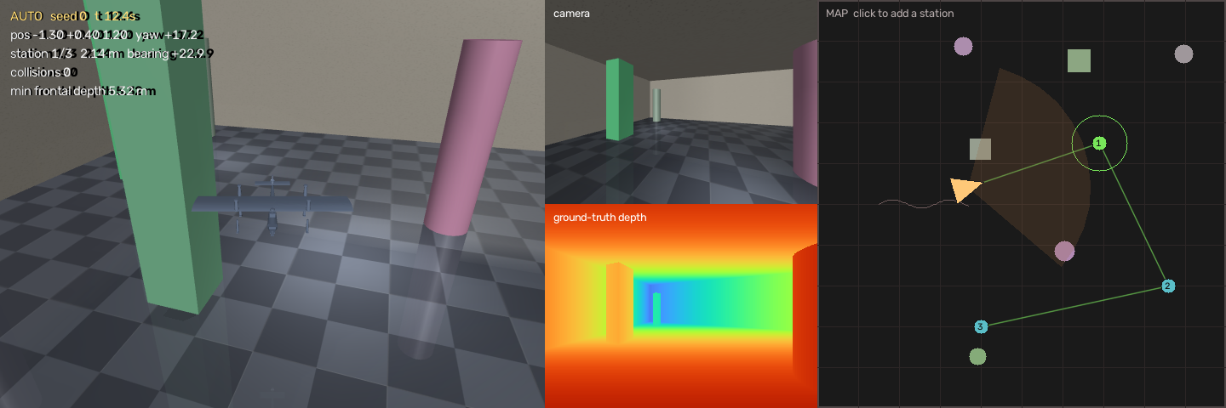
THE GAP, THE RISK, THE NEXT MOVES
Future Work and Next Steps
Immediate next steps
1. Put MiDaS into the loop and run the ablation. The policy already takes the depth map as an argument, so the planner needs no change.
2. Verify the scale and offset alignment before trusting any depth figure. Median scaling alone would make the model look broken when the alignment is at fault.
3. Measure whether the model runs on the Raspberry Pi. The architecture assumes it cannot, and that assumption has never been tested. If it can, the wireless link leaves the control loop entirely.
4. Resolve the 90 per cent target in writing. We prefer reporting a curve against obstacle density, which describes the method better than any single number.
5. Complete the mass and thrust budget before buying propulsion.
6. Confirm the regulatory position with the institution. This is a gate on outdoor flight, not paperwork to finish afterwards.
Main justification and gap identified
Nobody has measured what avoidance performance costs when a distance sensor is replaced by a prediction, with everything else held constant. Our ablation does exactly that.
Most important risk to address first
A reactive policy has no way out of a concave trap. With perfect depth we complete 66 per cent of held out courses without contact, and most failures are timeouts, not crashes. That is the ceiling, so the 90 per cent target cannot be met as things stand.
11

Slide 12
Thank you
Questions welcome
Siddharth Lama Manit Aravind Sahil Asopa Riyaan Sheth
Autonomous Drone Obstacle Avoidance Using Monocular Depth Estimation
12

