Slide 1
MISSING TRANSVERSE ENERGY performance of the CMS Detector
European Organisation of Nuclear Research(CERN)
The CMS Collaboration

Slide 2
Abstract
pp collisions with COM 7 TeV
Anomalous measurements of missing transverse energy are studied, and algorithms for their identification are described.
The performances of several reconstruction algorithms for calculating missing transverse energy are compared.
An algorithm, called missing-transverse-energy significance, which estimates the compatibility of the reconstructed missing transverse energy with zero, is described, and its performance is demonstrated.

Slide 3
What is “MET” ?
MET=Missing Transverse Energy(Not MTE?)
MET measures the energy/momentum imbalance in the plane transverse to the colliding proton beams.
Longitudinal momentum uncertain.
Imbalance due to undetected particles,noise,dead/hot cell,unknown particles/physics processes.
Usually neutrinos,non-SM particles(SUSY LSP),very forward particles escapes.

Slide 4
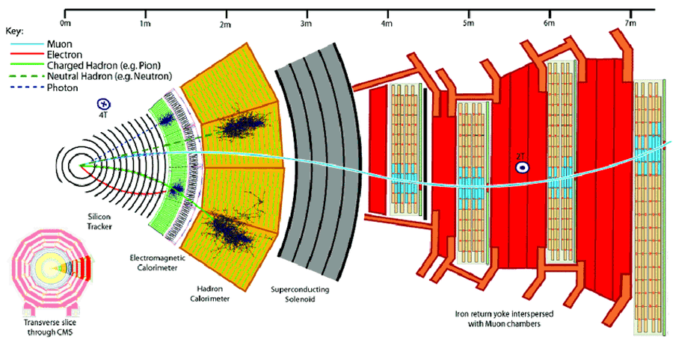
CMS Detector

Slide 5
Data selection And Reconstruction
Intergrated luminsotiy 36pb^-1=Amount of data collected
Events with identified primary vertex.
Jets Reconstruction using anti Kt logarithm technique(designed to group particles into jets based on their momenta and spatial proximity. This algorithm is known for producing well-defined, circular jets with a cone-like shape)
3 Jets- Calo jets ,JPT jets,PF jets
Photons Identification(Ecal E=4.2 + 0.006p^{λ}t) Ecal/Hcal<0.5,(Shape of Cluster Energy)
Electrons Identification(+match charge track)(|η | < 1.4442,1.5660 < |η |<2.5)
Muon Identification(less E/Hcal Deposit),(Sum of Pt around less),(less interactive)
B jets Identification(SimpleSecondaryVertex(longLived)flight dist.),(SoftMuonbypt)(Transverse momen. ,Jet axis,discriminant,higher prob. From b jet)

Slide 6
Reconstruction of MET
MET=-ve sum of all final state particle’s Pt
3 Recon. Algo -PF,Calo,Tcalo jets
Calo calculated using the energies contained in calorimeter towers.
Tc information of tracks is also added(No correc for high Pt’s-already well measured by calorimtr).
Jet energy correction upto particle level
Type1 correc.=Energy-scale correc forPt>20&<0.9E inEcal
Type 2=Correction for soft jet,from Z boson events
Both type1,2 for calo jets,type1 for PF,none for TCalo

Slide 7
Large Met due to misreconstruction
Due to uninstrumental effects,random readout discharge,particles hitting the transducers(Direct ionisa. Si).
Small no of affected channel still useful(after removing anamoly MET using “Cleaning”) others tagged not suitable.
In EB(Sing.evnt)particle striking the sensor,direct Ionisation.
Noise in HF-Scintillation light(Sing.event),Cherenkov light(Sing. evnt),Punch through particles
information about charge sharing, timing, pulse shapes, and expected behaviors used to detect anomalies.
Scintillators->tyvek, HF PMT->multi anode PMT(For cherenkov &punch through),HPD->SiPM(For noise)

Slide 8
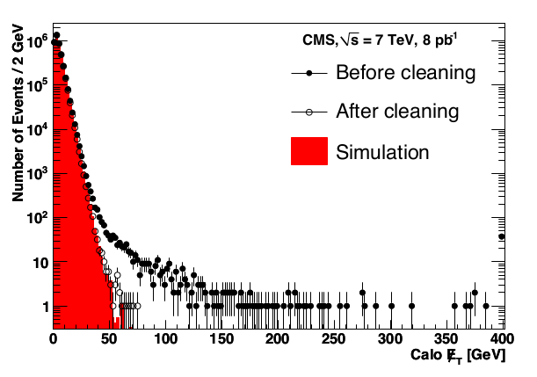

Slide 9
Contributions of non-instrumented or non-functioning detector regions
Unistrumental areas,areas(cracks) between barrel and endcap section.
About 1% crystal not functional/have high level of noise.
Masked in reconstruction
Triggers used for masking/tagging useful/unuseful events

Slide 10
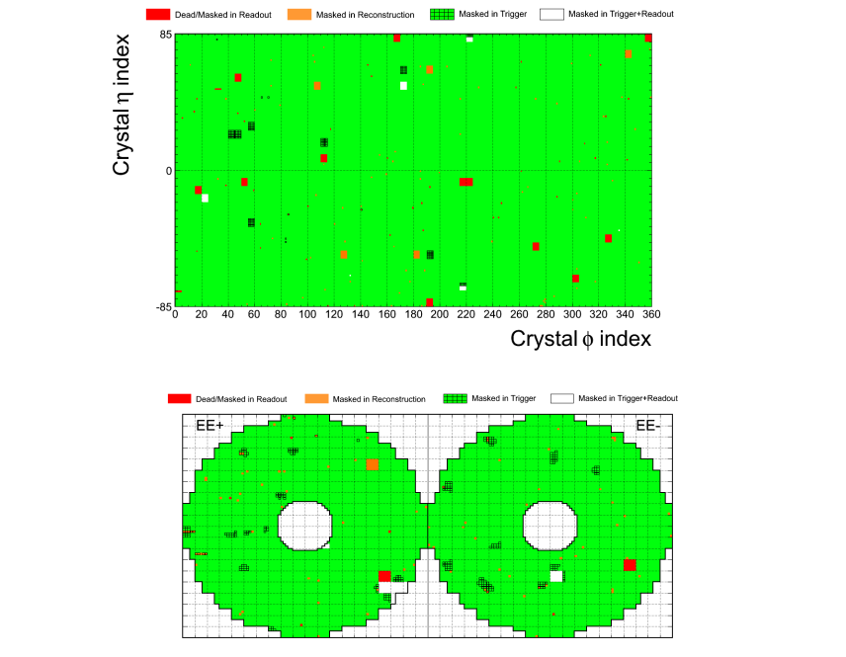
Barrel-->
EndCaps-->

