Slide 1



The European Organization for Nuclear Research (CERN)
The ATLAS COLLABORATION
Search for Higgs Decay via H→γZ(ℓ+ℓ-)
in pp collision at COM energy 13 TeV at
ATLAS
TUSHAR (V22124)
Supervisor- Dr. Amal Sarkar
School of Physical Sciences
IIT Mandi

Slide 2
Outline:
Introduction
ATLAS Detector
Event selection & categorization
Simulation samples and signal modeling
Results
Conclusion

Slide 3
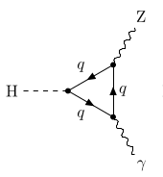
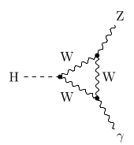
Introduction
Channel [ H→γ Z (ℓ+ℓ-) ] selected. ℓ+ℓ- are leptons pair (e⁺e⁻ or μ⁺μ⁻) , Z → Z⁰ boson & H -> Higgs Boson, γ -> photon
Proton-Proton collisions , COM Energy= 13TeV, Integrated luminosity = 139 fb⁻¹
Higgs - mass 125.09 GeV, Spin 0, Electric & Color charge =0, Parity = +1
Branching ratio : 1.54x10⁻³ (125.09 GeV)
Prior Signal Strength: 6.6 (5.2) at CL = 95% at 125.09 GeV, Intg. Luminosity = 36.1 fb⁻¹
Improved event selection, optimized particle identification, improved event categorisation.
Feynman Diagram of Higgs decaying to Z & Ɣ via 2 modes

Slide 4
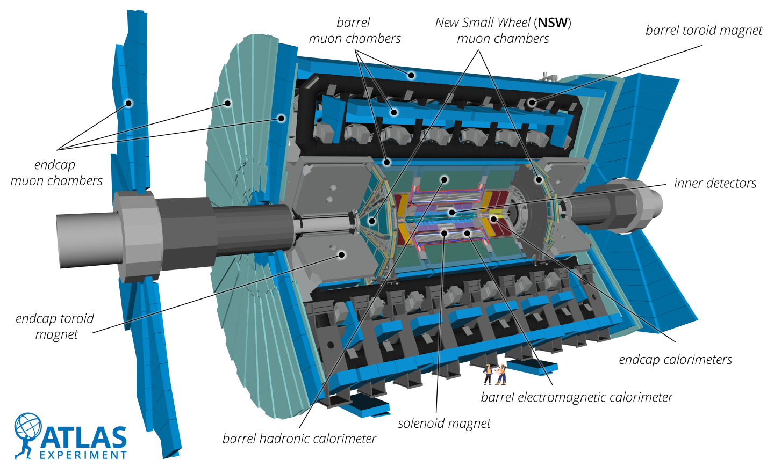
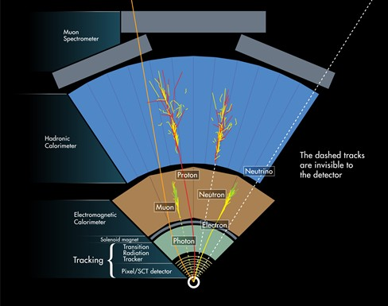
ATLAS Detector
Images from cern.ch

Slide 5
Event Selection and Categorization
Events Requirements: At least one photon & same flavour opposite charge associated with primary vertex.
Muons: |η|<2.7 , pt> 10 GeV | Electrons: |η|<2.47, pt> 10 GeV | Photons: |η|<2.37, pt> 10 GeV , Z boson invariant mass: 50 GeV to 101 GeV, pT^{Ɣ}/mzƔ>0.12
Topo-clustering used, Jets recon. by Anti-Kt algorithm (AK4)--|η|<2.47, pt> 10 GeV,
Events classified in : (2 or more jets & Δηjj>2) VBF enriched, (pT^{Ɣ}/mzƔ> 0.4) High relative pt category, high pTt (>40 GeV) μ⁺μ⁻, low pTt (<40 GeV) μ⁺μ⁻, high pTt (>40 GeV) e⁺e⁻, low pTt (<40 GeV) e⁺e⁻

Slide 6
Simulation Samples & Signal modeling
Simulated events used to optimize signal and reduce background.
Signal/Background yield extracted from fit to mzɣ distribution by assuming parametric models for both the signal and backgrounds.
Background model constructed from ZƔ, Zɣjj & Z+jets simulated data.
Signal+Background fitting done in each category to remove spurious signal contributions with mh varied between 123 GeV and 127 GeV.

Slide 7
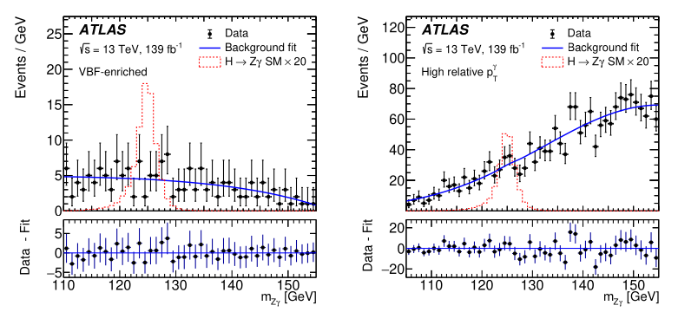
Results
(a) The ZƔ invariant mass distribution for VBF events
(b) The ZƔ invariant mass distribution for High relative pT^{Ɣ} events
(a) (b)

Slide 8
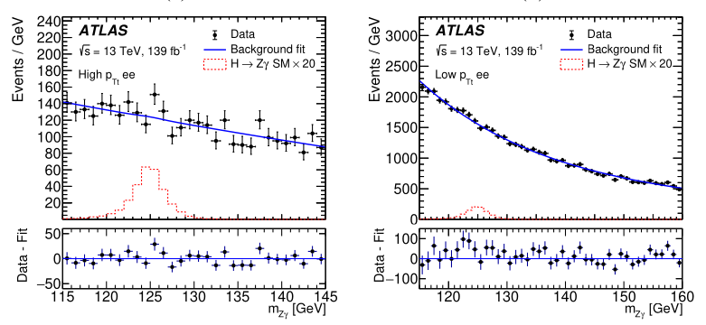
Results (continued)
(a) The ZƔ invariant mass distribution for High pTt e⁺e⁻ events
(b) The ZƔ invariant mass distribution for Low pTt e⁺e⁻ events
(a) (b)

Slide 9
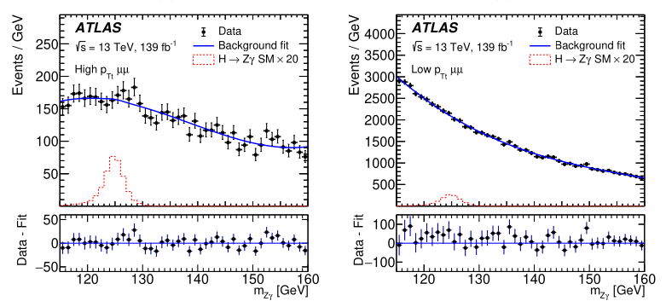
Results (continued)
(a) The ZƔ invariant mass distribution for High pTt e⁺e⁻ events
(b) The ZƔ invariant mass distribution for Low pTt e⁺e⁻ events
(a) (b)

Slide 10
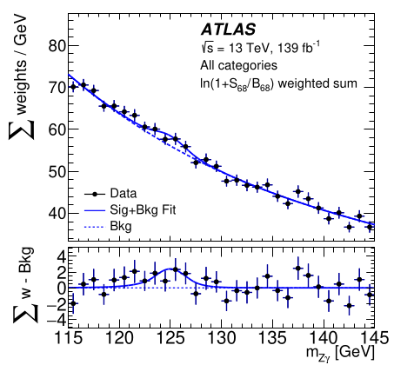
Results (Continued)
Weighted ZƔ invariant mass distribution of events satisfying H⟶ZƔ selection in data. Events categories weighted by ln(1+S68/B68).
S68 is expected no of higgs signal events in an interval around the peak position for signal of 125.09 GeV containing 68% of SM signal, B68 is background events in this interval.

Slide 11
Conclusion
The observed confidence level upper limit is 3.6 times the SM prediction at mh 125.09 GeV.
Best fit value for the signal yield is 2.0+0.9 (stat.)+0.4 (syst.) .
The statistical component of uncertainty is dominant.
Did not take into account missing transverse energy .
References : arXiv:2005.05382v2 End of presentation

