Slide 1
Studying the channel H->W+W->2l+2v
TUSHAR (V22124)
School of Physical Sciences (IIT Mandi)
Supervisor- Dr. Amal Sarkar

Slide 2
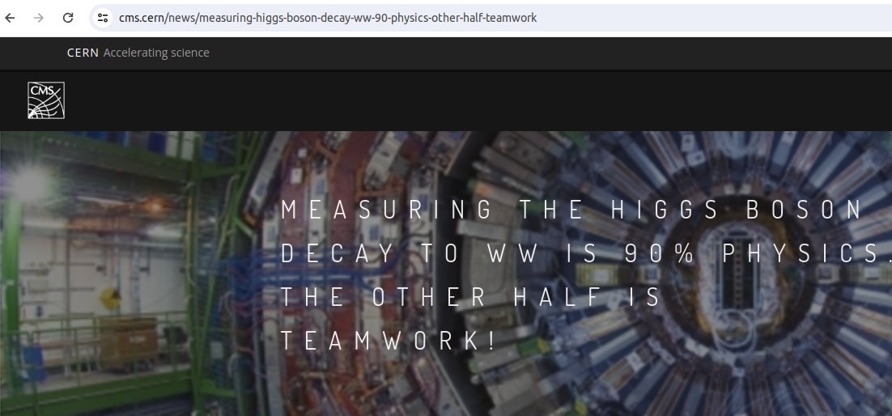
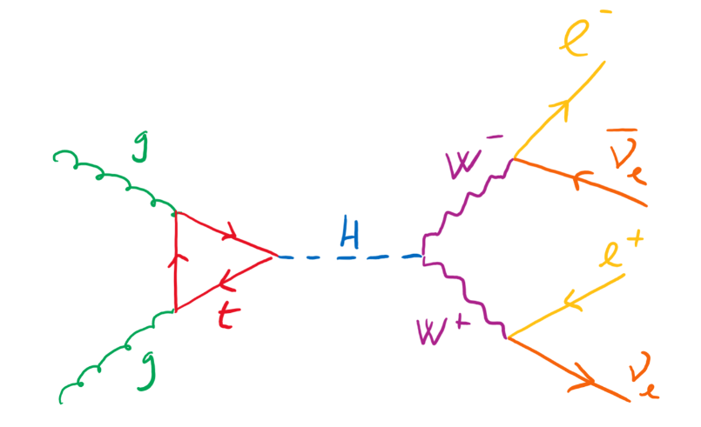
Motivation
◆ Coupling between Higgs and W bosons
◆ W carrier of Weak force
◆ Can understand spontaneous breaking of electroweak symmetry
◆ At High Energy Electroweak unification
◆ Higgs field responsible for Electroweak symmetry breaking and providing mass
to W bosons
Image taken from cms.cern
Feynman diagram of Higgs decaying to pair of W bosons

Slide 3
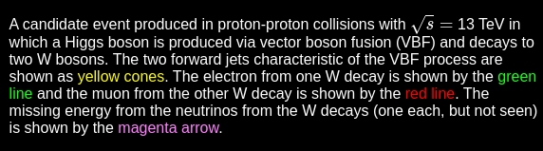

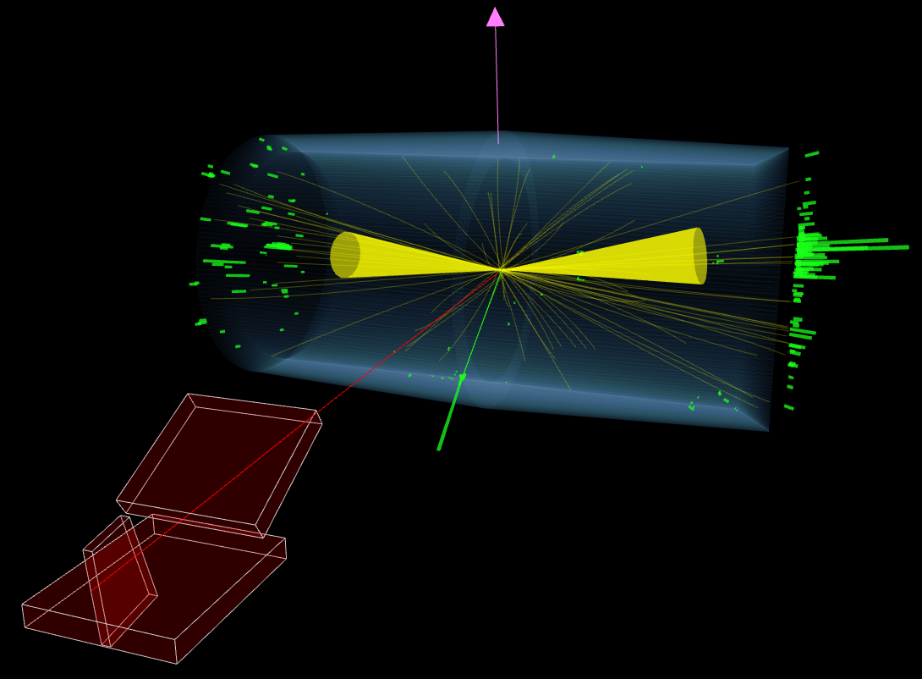
Challenges in the proposed work
◆ W further decays into lepton and neutrino
◆ Neutrino – Hard to measure
◆ MET comes into play
◆ Events selection depends on
Higgs production mechanism
◆ VBF, Associated production, GG fusion ,..
◆ In GG fusion , Need to select events
with pair of leptons and a large MET

Slide 4
What is pythia
Monte carlo generator
Can simulate the collision between particles such as e-, e+, proton and antiproton in various combination.
Energy range: 10 GeV to 100 TeV
Uses perturbative QCD for both low-pTand high-pT regions.
pT > 2 GeV the parton scatterings is correctly described by perturbative QCD.
Physics Processes
QCD processes
Resonance decays
ISR (Initial state parton showers) , FSR
Beam remnants
Hadroniztion
Ordinary decays

Slide 5
How Pythia does
Main physics aspect
◆Initially 2 beam particles coming
◆One shower initiator parton from each beam starts off a sequence of branchings, such as q → qg, which build up an initial-state shower
◆One incoming parton from each of the two showers enters the hard process, where then a number of outgoing partons are produced, usually two. It is the nature of this process that determines the main characteristics of the event.
◆The hard process may produce a set of short-lived resonances, like the Z/W± gauge bosons, whose decay to normal partons has to be considered in close association with the hard process itself
◆The outgoing partons may branch, just like the incoming did, to build up final-state showers.
◆When a shower initiator is taken out of a beam particle, a beam remnant is left behind. This remnant may have an internal structure, and a net colour charge that relates it to the rest of the final state.
◆The QCD confinement mechanism ensures that the outgoing quarks and gluons are not observable, but instead fragment to colour neutral hadrons.

Slide 6
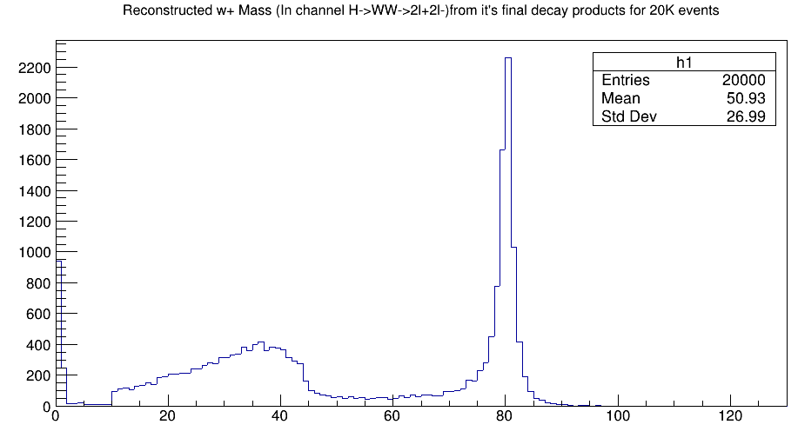
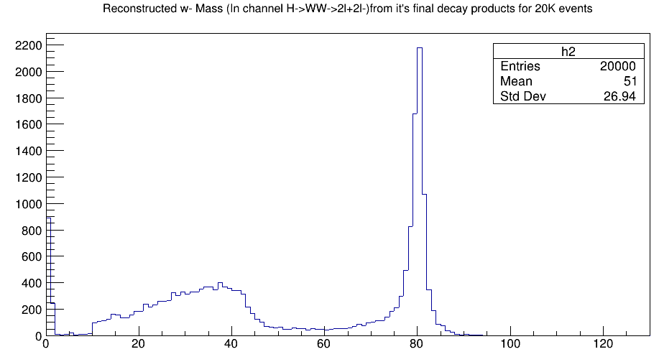
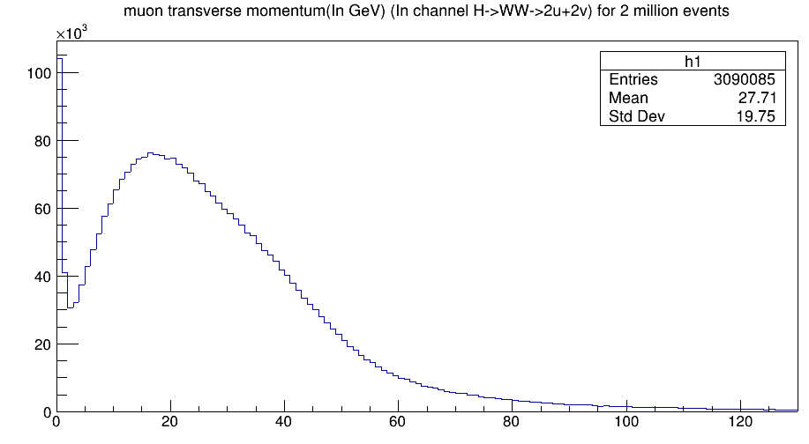
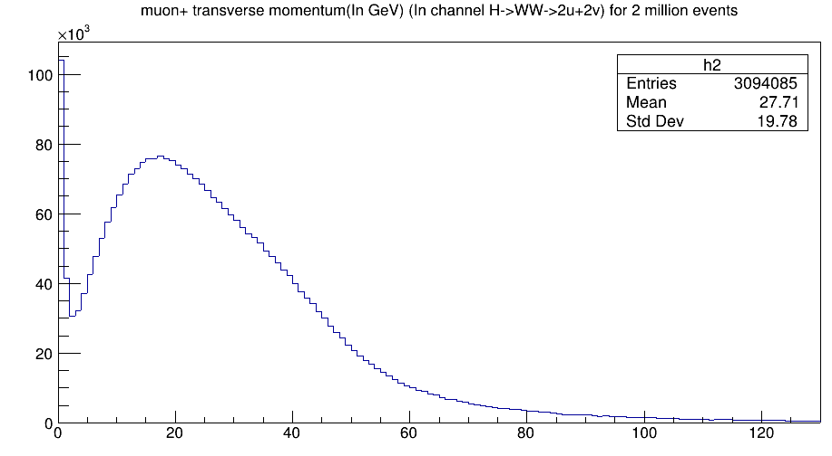
Work done
Reconstructed w+ mass
Reconstructed w- mass
Muon transverse momentum muon+ transverse momentum

Slide 7
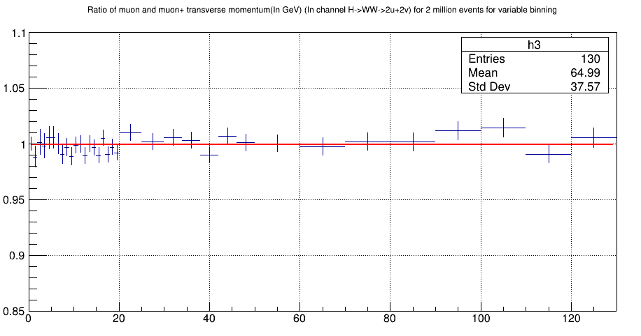
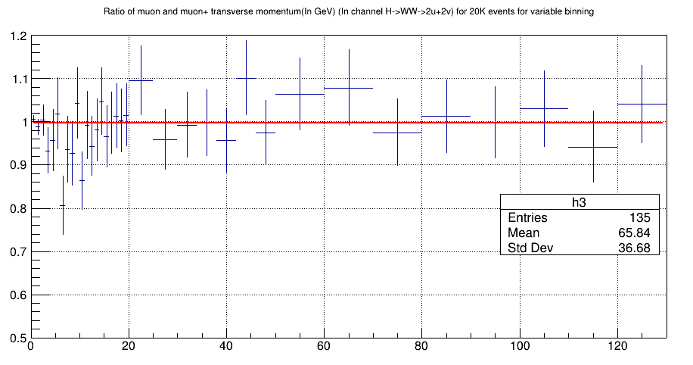
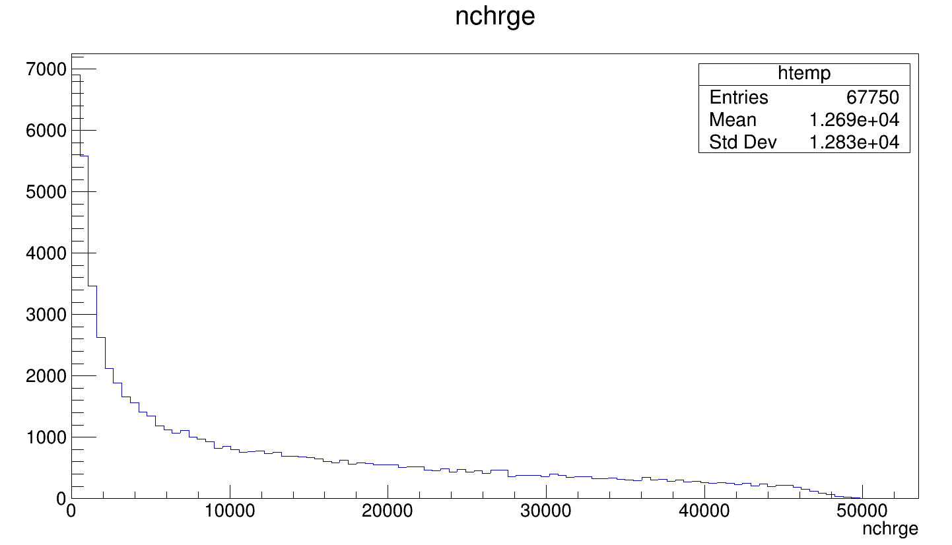
Work done
For p p collisions at 13Tev For pb pb collisions at 13Tev
No of charge particles produced in events

