Slide 1

Kinematics study of Higgs production
in H→W⁺W⁻ → 2l + 2ν channel
TUSHAR (v22124)
Supervisor Dr. Amal Sarkar
School of Physical Sciences
IIT Mandi
August 9, 2024

Slide 2

Outline of the presantation
☆ Motivation
☆ Challenges in the proposed work
☆ Pythia: The event generator
☆ Work done
☆ Results
☆ Summary

Slide 3
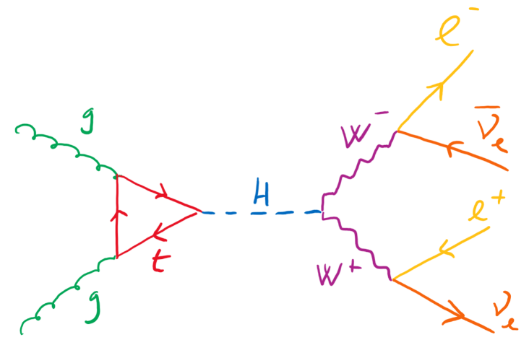
Motivation
☆ Coupling between Higgs & W bosons
☆ Probing spontaneous breaking of electroweak symmetry
☆ W bosons carriers of weak force
☆ Interact weakly with QGP
Feynman diagram of channel of interest

Slide 4
Challenges in proposed work
☆ W further decays into lepton and neutrino
☆ Neutrino’s – Hard to measure
☆ MET needs to be taken into account
☆ Large MET associated in this channel

Slide 5
Pythia: The event generator
☆ Monte carlo generator
☆ Can simulate collisions between e⁻,e⁺, p⁺, p⁻ and heavy ions
☆ Energy range 10 GeV to 100 TeV
☆ Uses perturbative QCD for both low and high pT
☆ Physics processes
⬨ QCD processes
⬨ Resonance Decays
⬨ ISR (Initial State parton shower), FSR
⬨ Beam remnants
⬨ Hadronization
⬨ Ordinary decays

Slide 6
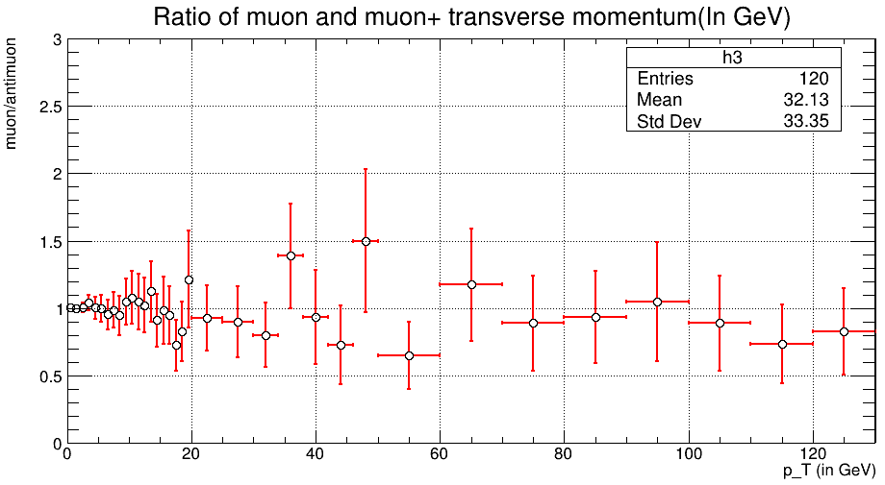
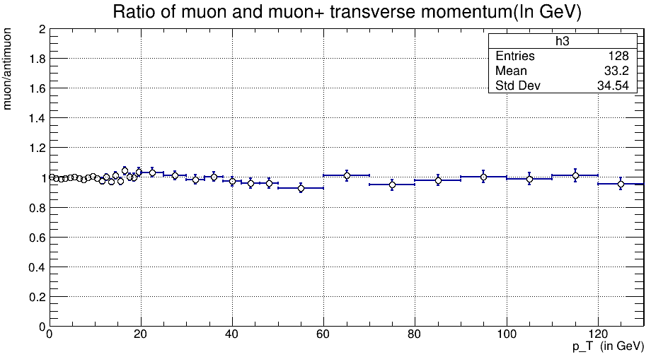
Event verification
☆ Asymmetry in W boson production
☆ Pb-pb collisions →
less μ⁺ than μ⁻
☆ p-p collisons →
less μ⁻ than μ⁺

Slide 7
Kinematics selection of muon and neutrinos
☆ Final decay product of channel under study muons and neutrinos
☆ Need to select potential muons to reduce background as much as possible
☆ Muons and neutrino’s should have pT near MW/2
☆ In analysis, Selection cut on μ and ν & pT [30 GeV,50 GeV]

Slide 8
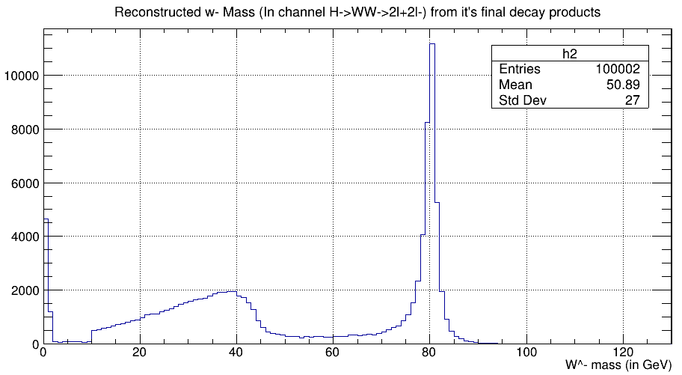
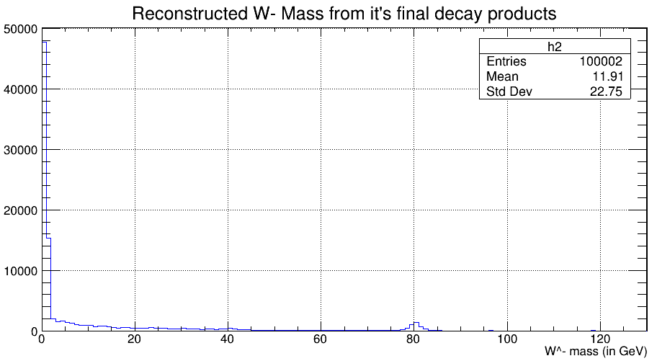
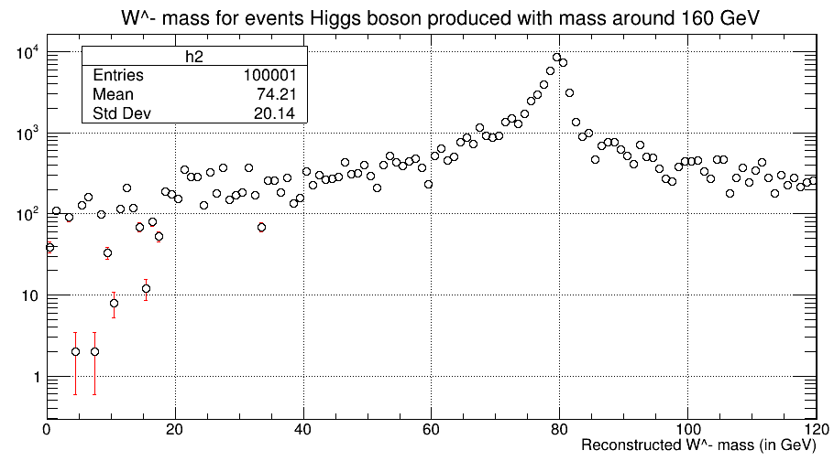
Reconstruction of W⁻ bosons
1
2
1
1 Reconstructed mass of W⁻ for signal events
2 Reconstructed mass of W⁻ for background events
3 Reconstructed mass of W⁻ for events with Higgs mass 160 GeV
3

Slide 9
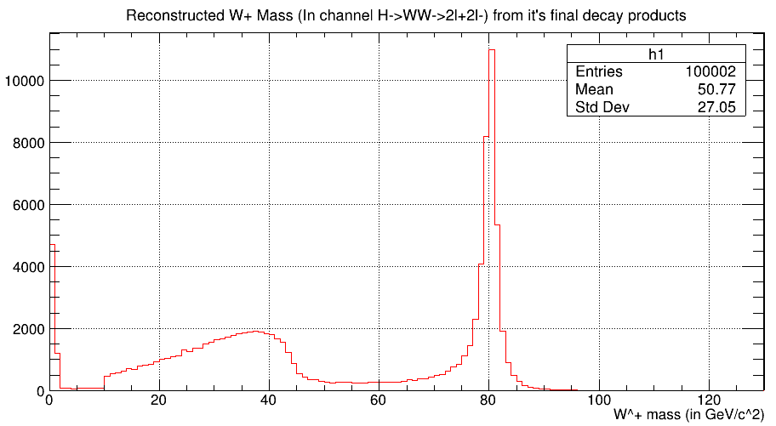
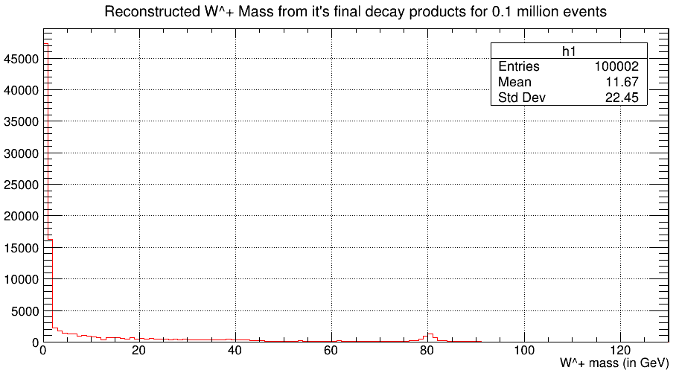
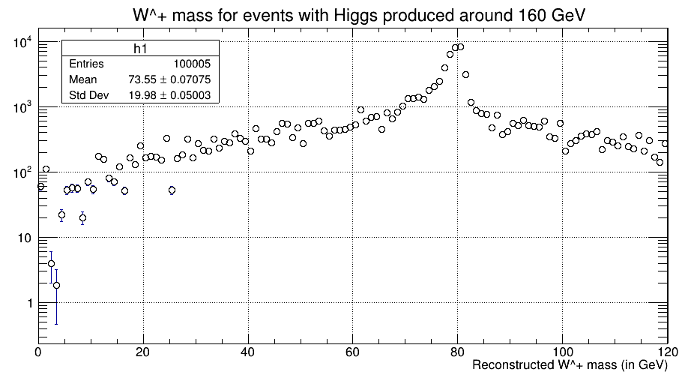
Reconstruction of W⁺ bosons
1
2
1 Reconstructed mass of W⁺ for signal events
2 Reconstructed mass of W⁺ for background events
3 Reconstructed mass of W⁺ for events with Higgs mass 160 GeV
3

Slide 10
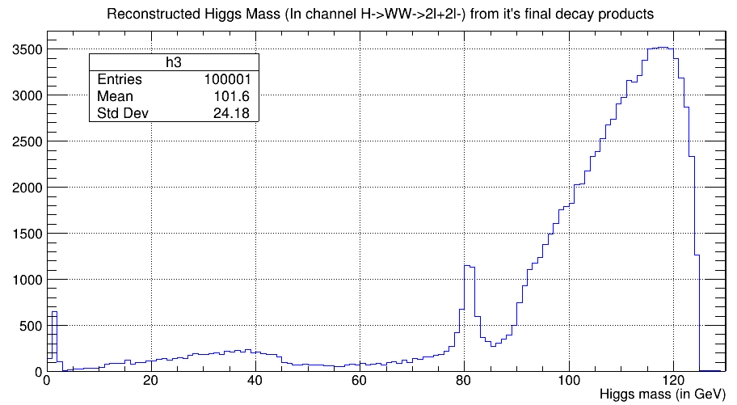
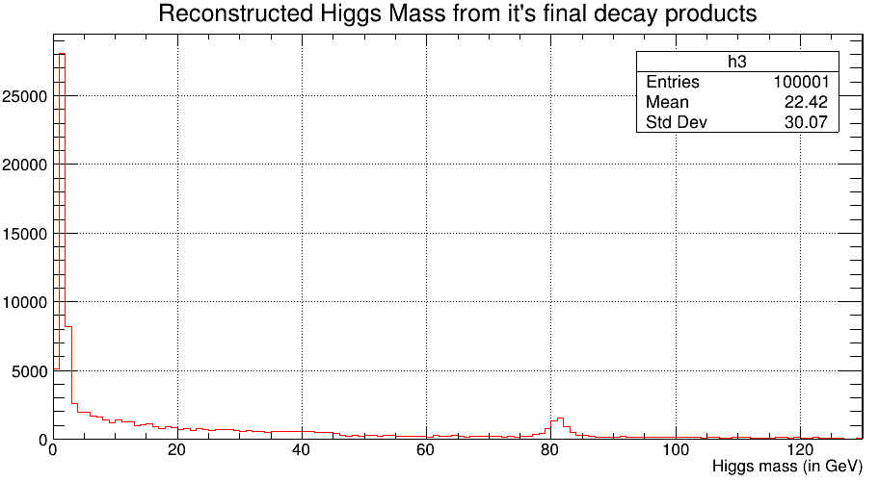
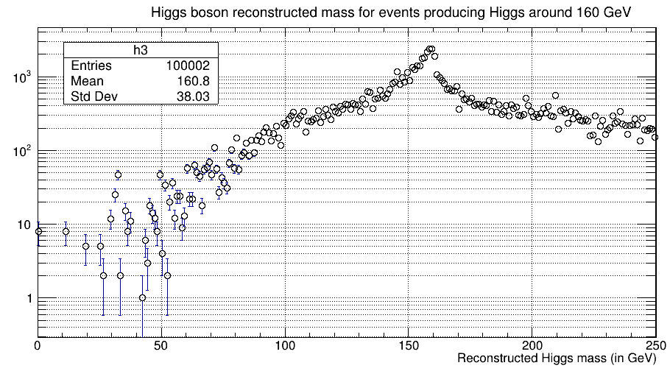
Reconstruction of Higgs bosons
1
2
1 Reconstructed mass of Higgs boson for signal events
2 Reconstructed mass of Higgs boson for background events
3 Reconstructed mass of Higgs boson for events with Higgs mass 160 GeV
3

Slide 11
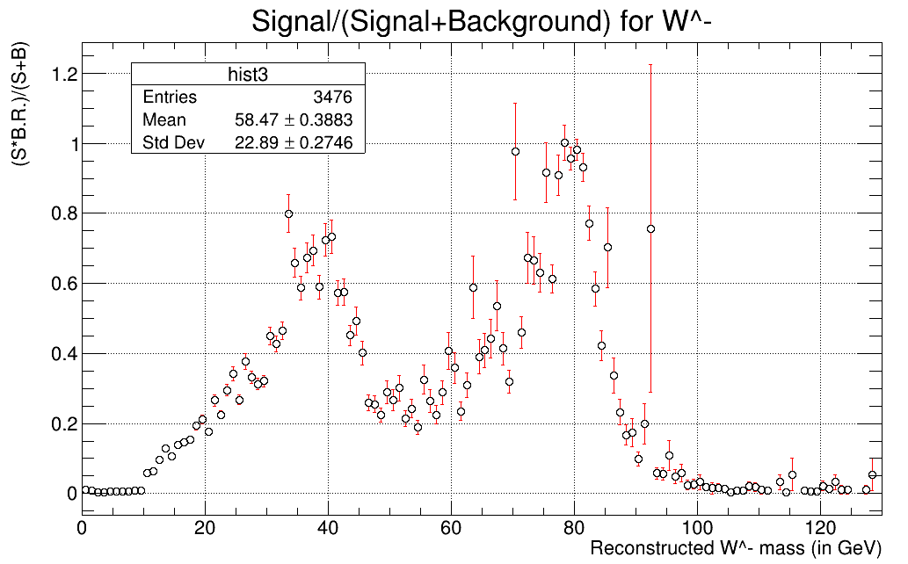
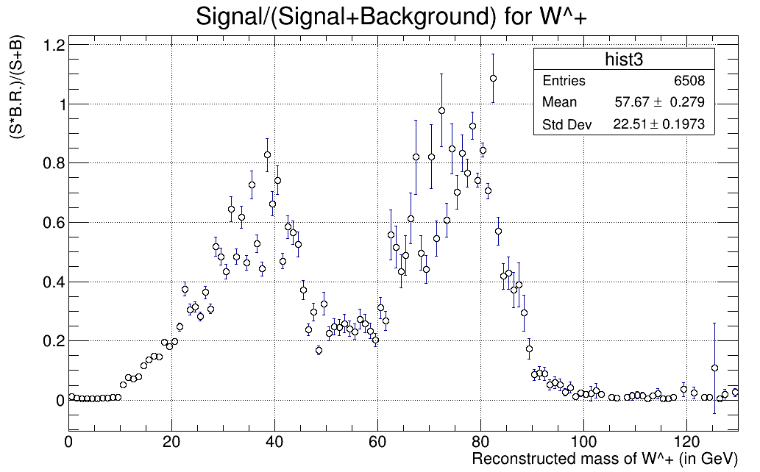
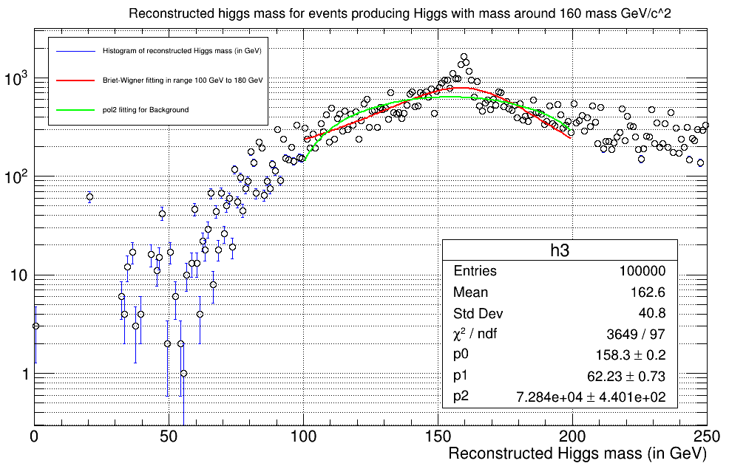
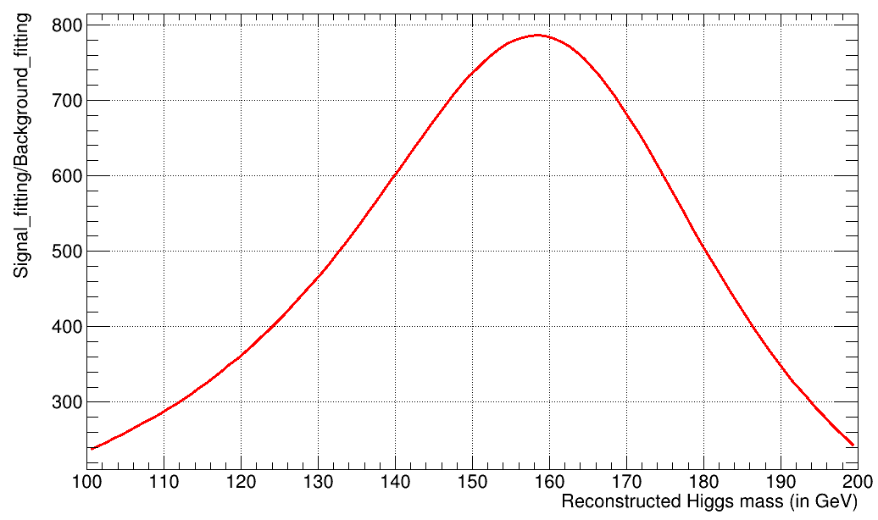
Signal Extraction

Slide 12
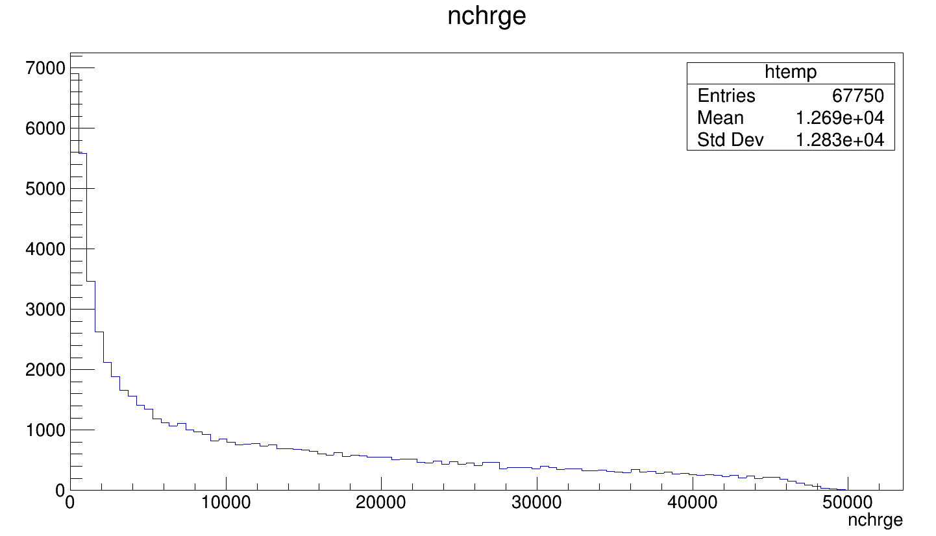
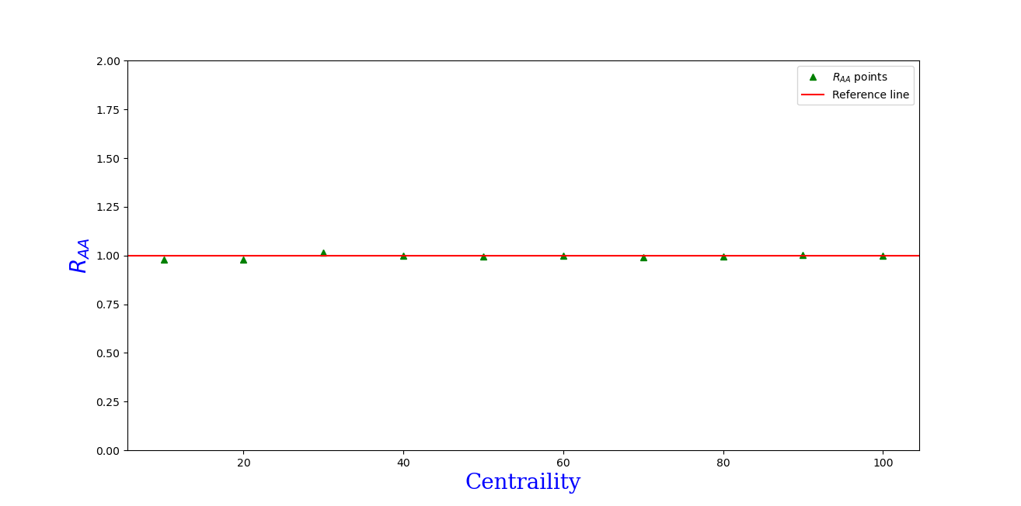
Nuclear modification factor
☆ Measures the change in observables due to modification in nuclei
☆ Depends on η, pT, production of particle
☆ RAA for W bosons is supressed for mid and High centrality events

Slide 13
Summary
☆ Production of W bosons were asymmetric in pp and pb-pb collisions.
☆ Reconstructed mass of W⁻ boson was peaked around 78.50 GeV/c² & W⁺ was peaked around 78.05 GeV/c². The mass of Higgs was peaked around 118.035 GeV/c².
☆ Error in W⁻ (80.36) mass 2.32 % , W⁺ (80.36) mass 6.04 % and in Higgs mass (125.35) is 5.83% .
☆ For events with Higgs mass with a bandwidth around 160 Gev/c² was having Briet Wigner distribution and recon. mass was peaked around 158.03 GeV/c².
☆ Raa for charged particles was around 1.

Slide 14
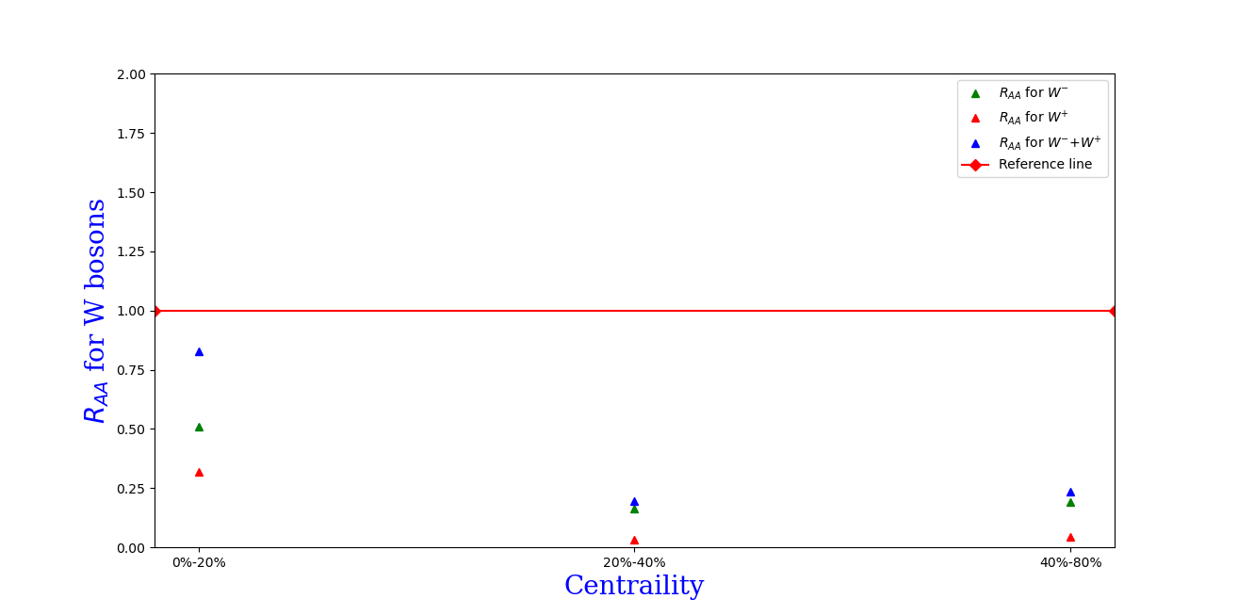
Bonus slide
☆ Only production of W bosons in different centrality classes

