Slide 1
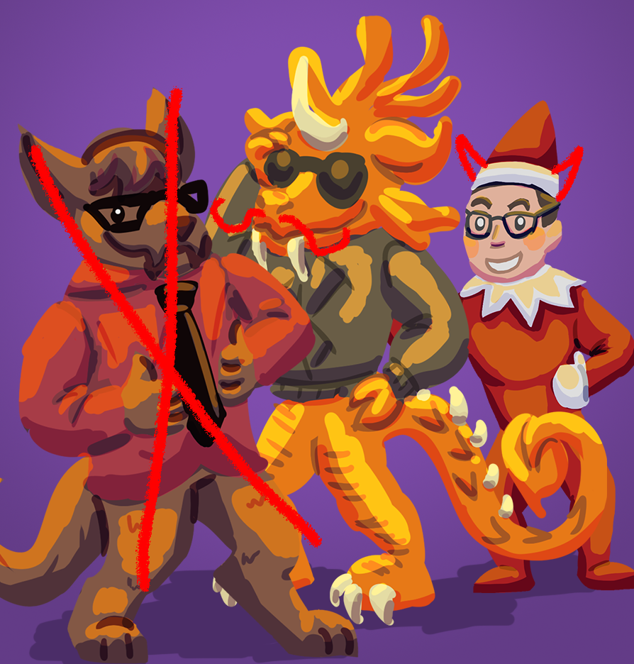
Just Wungus & Jimmy
Present an analysis of...

Slide 2
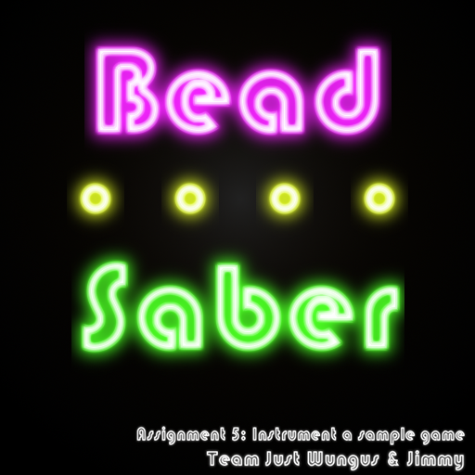

Slide 3
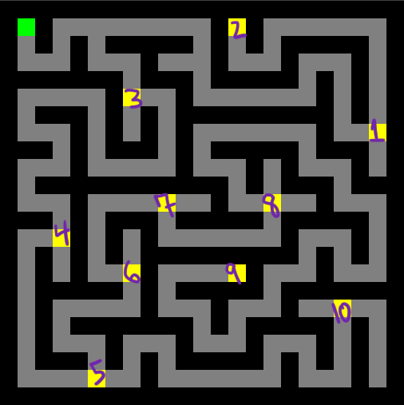


Experience goals
Click to the beat of a 120bpm looping measure
Collect beads in a predetermined order without moving their position
Make playtime last longer than 50 seconds

Slide 4
Strategy
Click on the downbeat
Music track
Movement reward and screen pulse
Off beat penalty
Collect in order
Shrinking beads
Bead color change
Finish in over 60
Movement punishments slow the player down
Staggered beat shrinking

Slide 5
Instrumentation
Click on the downbeat
With a counter increasing every frame, take the counter at the moment of a click
Take counter modulo thirty (the length of one beat)
Collect in order
Records the grid coordinate of each collected bead in real time
Finish in over 60
Event sent at the end of the game
Timestamped

Slide 6
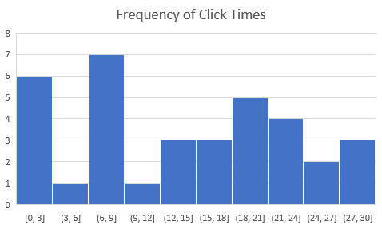
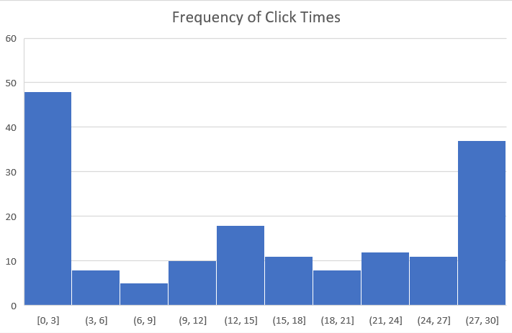
Baseline vs Post-mod Player Behavior

Slide 7
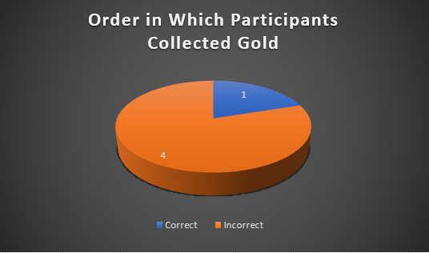
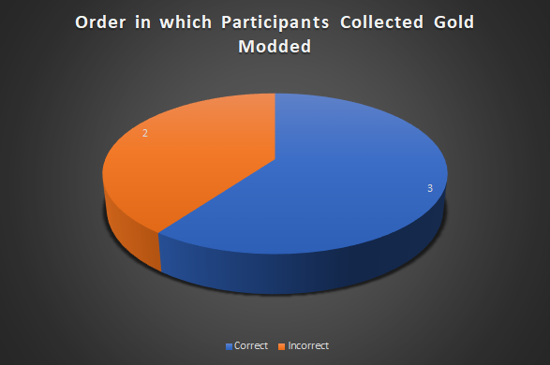
Baseline vs Post-mod Player Behavior

Slide 8
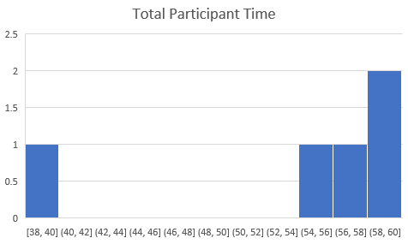
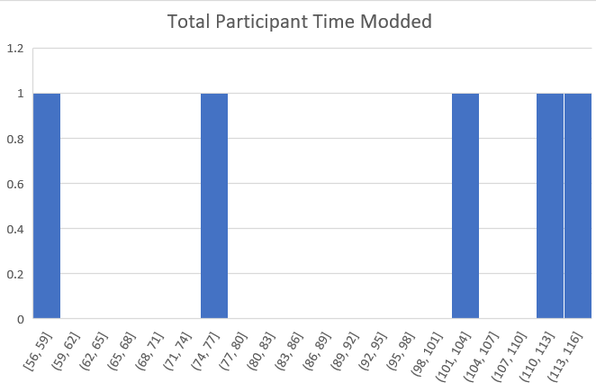
Baseline vs Post-mod Player Behavior

Slide 9
Any questions?

