Slide 1
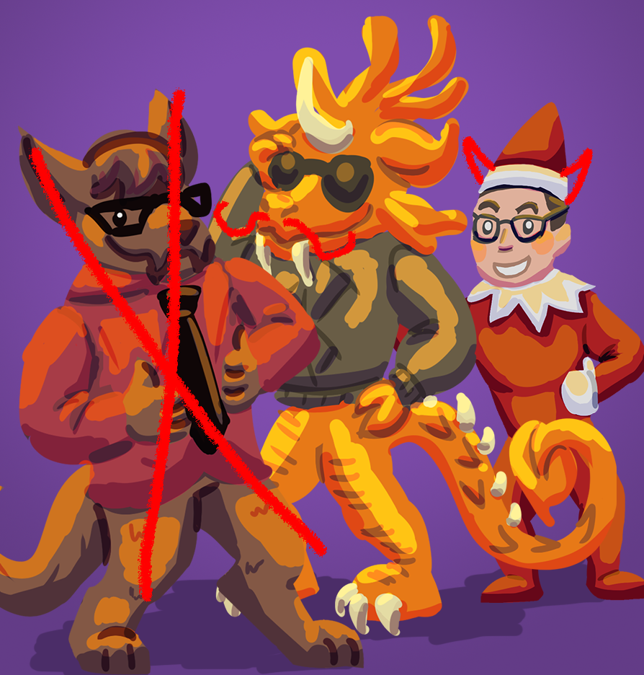
Just Wungus & Jimmy
Jordan Cattelona
Leo Bunyea
Final Story Game Treatment

Slide 2

Notes:
leo

Slide 3
Key Features
Showcases the comedy in wanting what you can’t have
Two sets of three vignette style microgames about how much it sucks to be kid or a young adult
Each microgame has a simple mechanic that can be learned in seconds
Two color palettes, one for child experiences and one for young adult experiences
Can play experiences in any order
Notes:
Jordan

Slide 4


Target Audience
8-12 year old kids
20-28 year old adults
Notes:
leo

Slide 5
Play Description
Child Problems
Eat Vegetables
Continually click to peck away at the gross dinner that your parents have prepared for you
Height Requirements
Click on specific beads to navigate an amusement park line only to find you’re not tall enough for the ride
Enforced Bedtime
Play their gameboy after bedtime without their parents catching them
Adult Problems
Stolen Food
Hunt through the refrigerator moving aside old and expired food to get to your food, only to find that your roommate has eaten it already
Amusement Park Sickness
Try to hold in your vomit while riding a rollercoaster
Distracting Notifications
Be kept awake by your pesky smartphone continually going off
Notes:
Jordan: Child Problems
Leo: Adult Problems

Slide 6
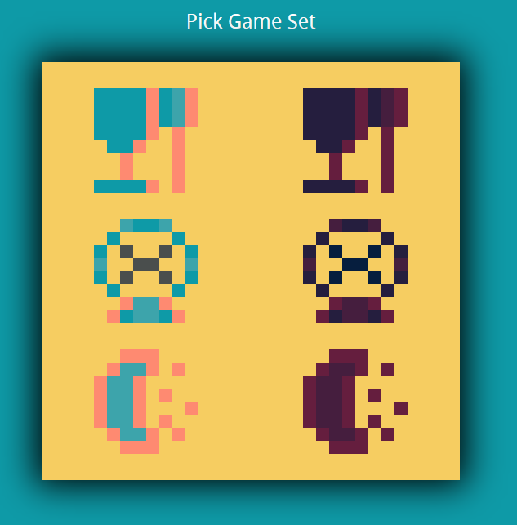
Notes:
leo

Slide 7

Notes:
leo

Slide 8

Notes:
Jordan

Slide 9


Slide 10

General Experience Goals
For players to find comedy in the content
For player to relate to the experiences depicted in the microgames
Notes:
Leo

Slide 11
Measurable Experience Goals
Each micro-game completed in less than 30 seconds
Event sent upon start and completion of each microgame
85% of players complete every micro-game
Event sent upon completion of final game
Players pick their microgame set within 10 seconds
Event sent upon starting up the game and picking the first set
Notes:
Jordan

Slide 12
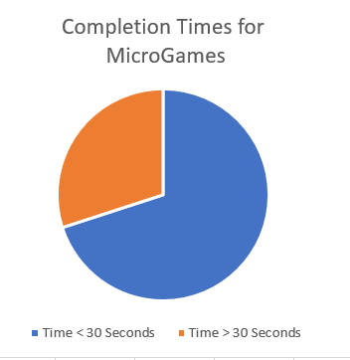
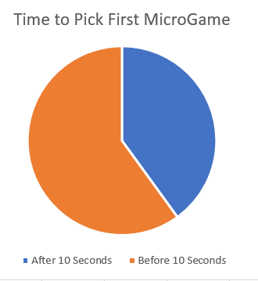
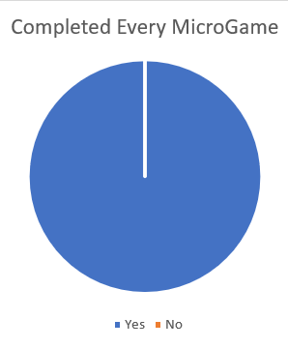
Playtesting and Analytics Results
Notes:
Leo

Slide 13
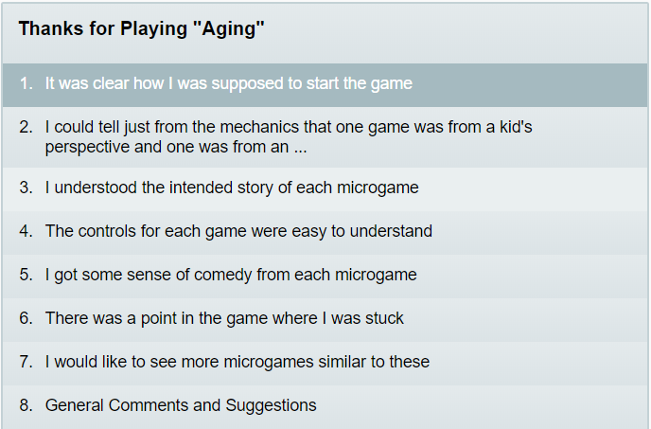
Survey Results
Notes:
Jordan

Slide 14
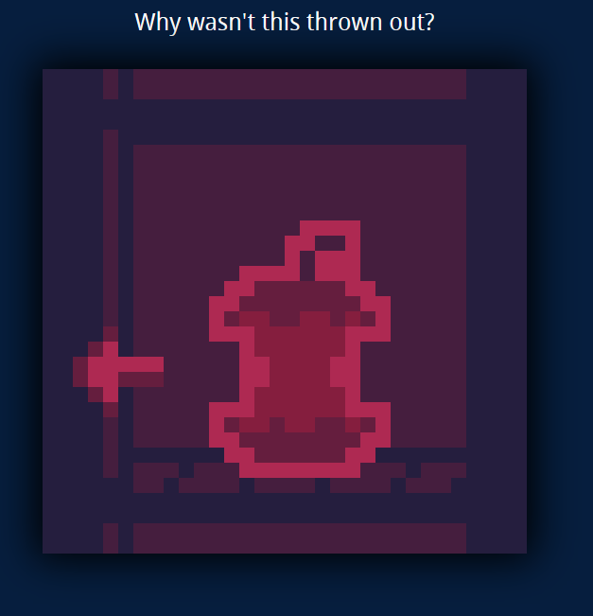
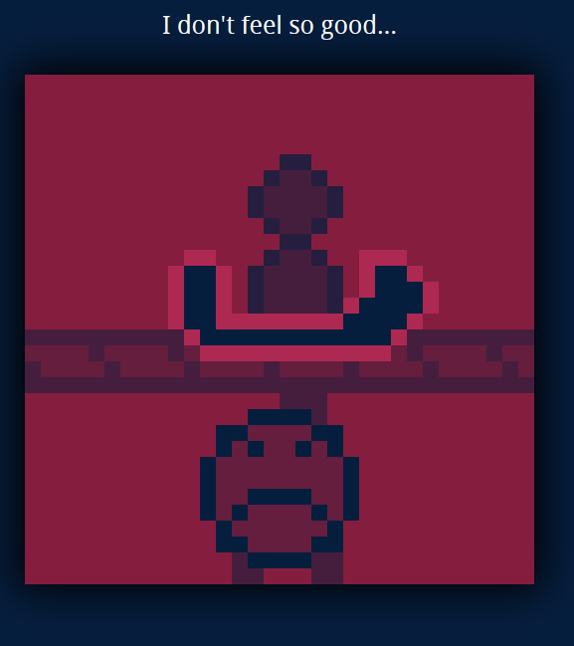
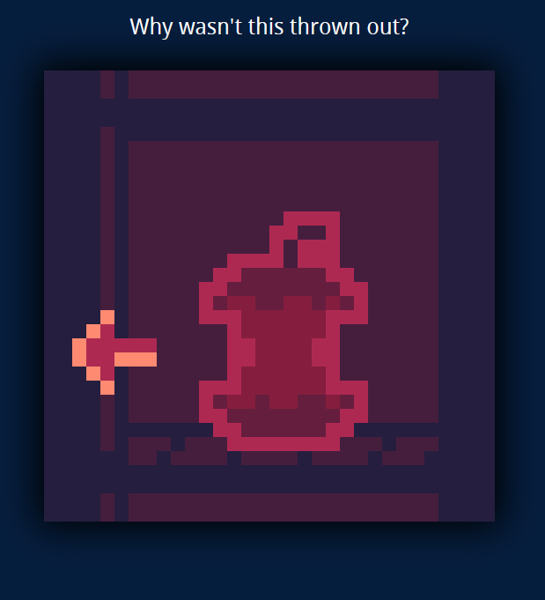
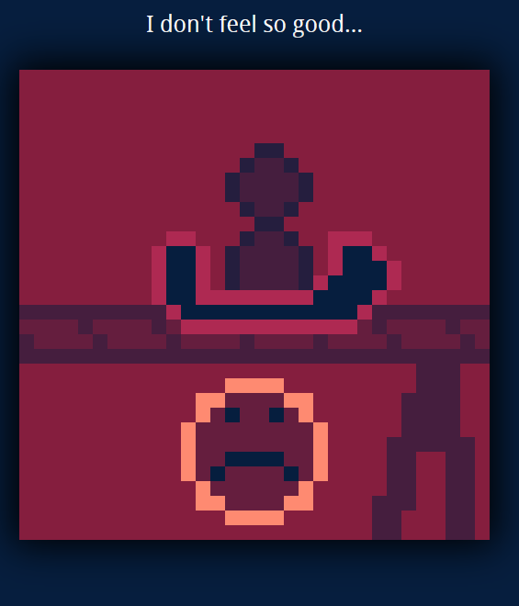
Critique
Microigames lacking in signifiers
Exaggerate events
Vomit
Gross veggies
Notes:
Leo

Slide 15
Demo time.

